Slide 1
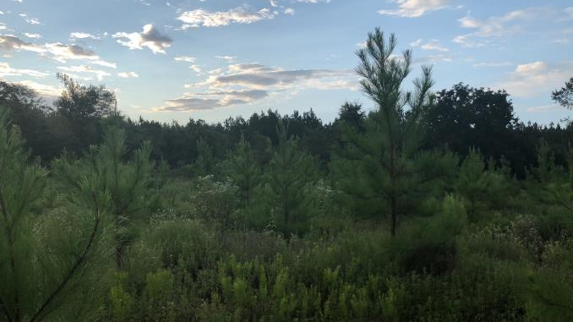
Using The Forestry Reclamation Approach On Reclaimed Mines In The Western Gulf: Effects on Pinus taeda Seedling Growth And Survival
Cassie Phillips,
Jeremy Stovall, Hans Williams,
Ken Farrish, James Van Kley
Notes:
Make text bigger on all graphs
Add dr to everyone's name

Slide 2
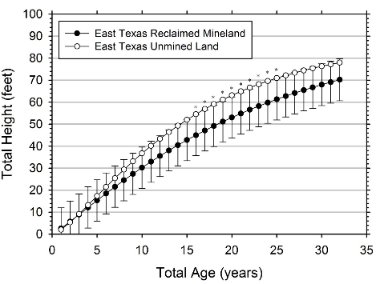
Surface Mining on the Gulf Coastal Plain
Texas is the leading producer of lignite coal
Surface mines are then reclaimed to forest or grasslands
Surface Mining and Reclamation Control Act (1977)
Promoted land stability but created high soil compaction
Inadvertently created a preference for areas to be reclaimed to nonnative grassland in much of the U.S.
Priest et al. 2016 – Forest Science
Notes:
Luminent reclaimed mines at Oak Hill – restoring productivity already can we restore it to better than beofre

Slide 3
Surface Mining on the Gulf Coastal Plain
Texas is the leading producer of lignite coal
Surface mines are then reclaimed to forest or grasslands
Surface Mining and Reclamation Control Act (1977)
Promoted land stability but created high soil compaction
Inadvertently created a preference for areas to be reclaimed to nonnative grassland in much of the U.S.
Priest et al. 2016 – Forest Science
Can we do better?
Notes:
Luminent reclaimed mines at Oak Hill – restoring productivity already can we restore it to better than beofre

Slide 4
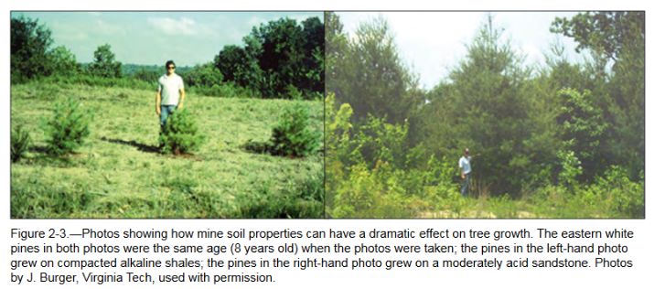
Reclamation in the Gulf Coastal Plain
East Texas has maintained forestry as the preferred post mining land use
Increasing properties that promote faster tree growth, and in turn a timelier bond release, is of interest to land owners and coal companies
Notes:
Talk about picture first and then stuff in writing about east texas

Slide 5
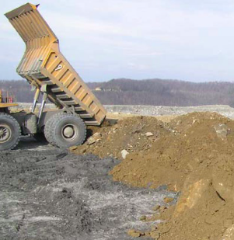
The Forestry Reclamation Approach
Suitable rooting medium
No less than 4ft deep
Loosely graded topsoil
End dumping technique
Use tree compatible cover
Plant two types of trees
Early and late successional species
Use proper tree planting technique
Appalachian End Dumping
Photo from Forest Reclamation Advisory No. 3
GOAL: Adapt the FRA to Western Gulf
Notes:
Animate goal to float in after and bigger
Steps of FRA
Developed in appalachia in response to prblems with reclamation after SMCRA
4. Helps speed up sucession
GOAL 1 – to adapt the FRA to gulf coastal region – we have different climates and soils and trees so adapation this from applachain area
Tree planting tech – during the late winter season while plants are still dormant is best, hand planting to the correct rooting depth (at least 4 ft)

Slide 6
Objectives
Determine the effects of the Forestry Reclamation Approach on the physical and chemical properties of the soil
Determine loblolly pine seedling performance based on tree physiology and competing vegetative cover
Notes:
Goal and objectives and have goals before it - make sure edits are ok with Stovall
Goal to adapt FRA to western GULF

Slide 7
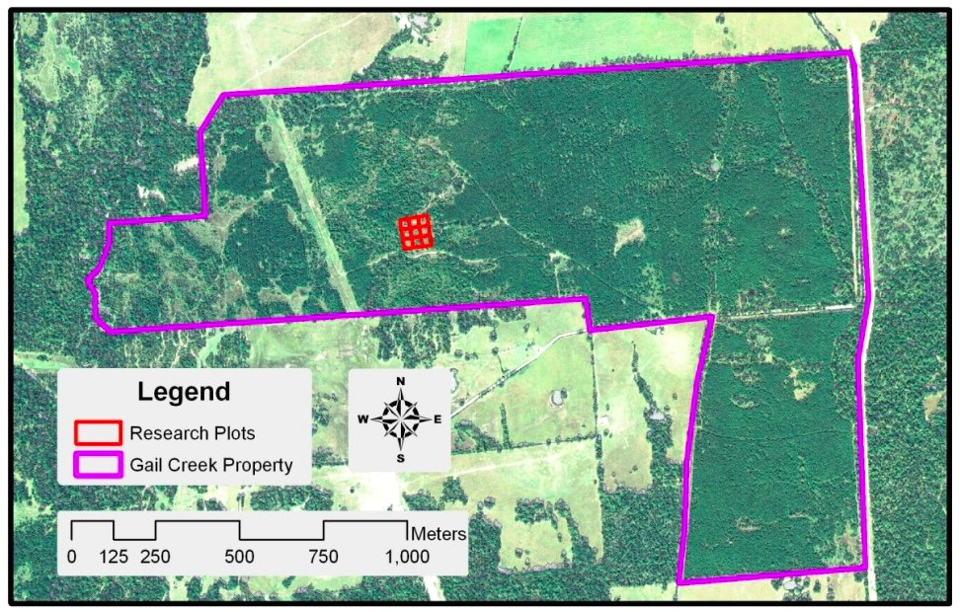
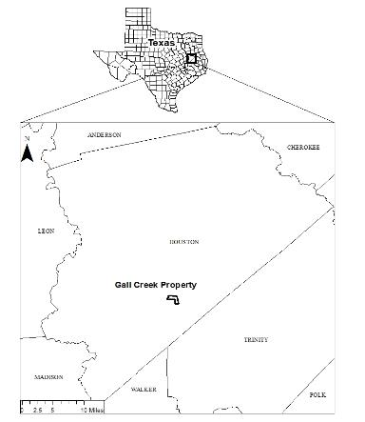
Study Site
Gail Creek
Mine demonstration site
C/o Jeremy Stovall
Houston Co.
2 hectare site
Nine experimental plots
Notes:
Houston County
31.204719, -95.387349
2 acre site – 9 plots on the site
Lighten picture on bottom!!
We didn’t have to worry about worker safety - MSHA
That’s why we didn’t do it on a mine itself
This was topsoil haulback method -

Slide 8
Soil Information
Very fine, smectic, thermic, Vertic Hapludalf

Slide 9
Randomized complete block design
Three replicates
Two buffer rows
48 loblolly pine seedlings per plot
FRA
Control
Scraper
Scraper
Control
FRA
Control
Scraper
FRA
UAS footage of the site taken on May 6, 2018
Notes:
Remind them that FRA is the forestry reclamation approach DJI Phatom 4 Pro
Ask Stovall about going full screen for each treatment

Slide 10
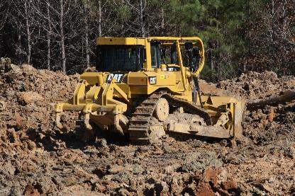
‘Pan Scraper’ Method
1.3 m (4ft) deep pits
Traditional pan scraper method could not be used
Topsoil haul-back method was used
Soil was replaced in 15 cm (6 in) layers
Frequent trafficking simulated pan scraper method
January 2016
Notes:
4ft pits were dug
The clay was too wet and thick for a traditionally pan scraper so a CAT D6T dozer pushed the soil back into the dug pits and replaced it in thin (6cm) layers – resulting in frequent trafficking “simulated pan scraper”

Slide 11
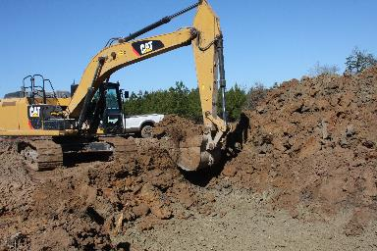
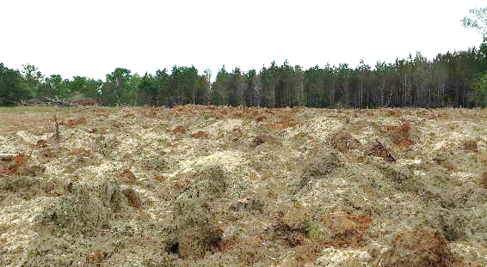
FRA Method
1.3 m (4ft) deep pits
End dumping simulated by dumping buckets of soil into the pits
Soil is left in loose piles
Notes:
Simulated small scale end dumping
Push up method was tried 1st- but the this left large clay blocks and seemed to be causing too much compaction
Excavator dropped full buckets of soil from 1.5m above the groundline into the approx. 1.3m deep pits. Next bucket was dropped adjectent to but overlapping the last pile
Lighten up the second picture

Slide 12
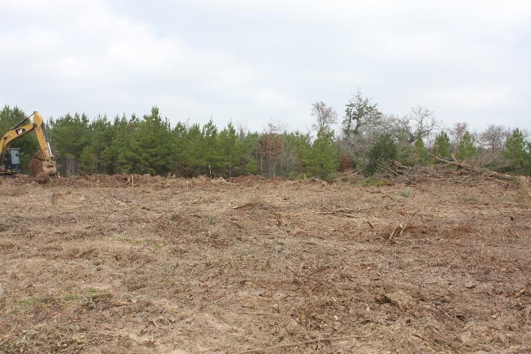
Control Plot
Plots cleared of all vegetation
Notes:
Not trafficked on after they were cleared Cleared by dozer
Hand planted8 x 9 foot spacing
48 International Forest Company (IFCO) per plot = 432 seedlings total

Slide 13
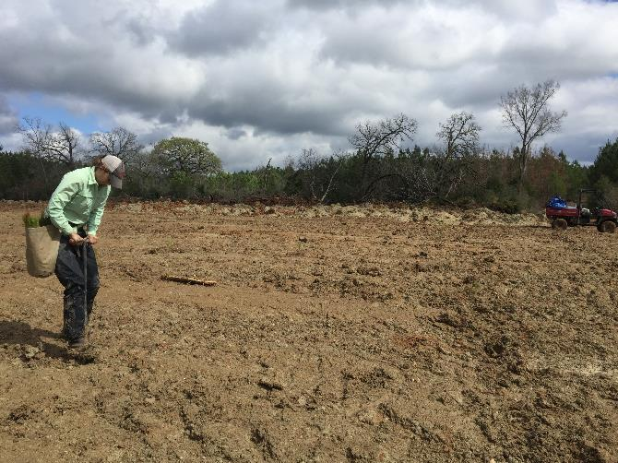
Treatment Implementation
IFCO containerized loblolly seedlings were hand planted on February 23, 2016
No cover crop was used
No erosion control was used
Notes:
Put type of seedlings

Slide 14
Soil Texture
a
b
b
α = 0.05
a
a
a
a
ab
b
Notes:
And explain that tukey are for each texture
Darker text
Using the Baucus Method – 15 cm
Clay soil for FRA
Control was clay loam
Scraper was clay to clay loam
FRA was clay

Slide 15
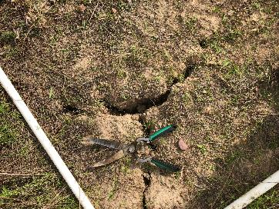
Bulk Density
Notes:
Write when I took it check in thesis – and how that might differ the measurement
Bulk density taken at top 10cm
Using a slide hammer
Pad that data with pictures of seedlings

Slide 16
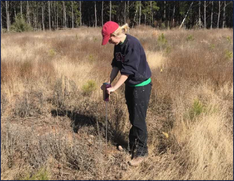
Cone Penetrometer
Notes:
Write date when I took it and that I tried it other seasons but was unable to get a reading due to hard soil or wet soil
Include cone penetrometer model
To a depth of 6 inches
TBD : find depth at which force applied is 300 psi (no roots can penetrate @ this level)

Slide 17
Soil Chemical Properties
Treatment | pH | P | K | Ca | Mg | S | Na
 |  | ----------------------------mg kg⁻¹ ---------------------------
Control | 5.93 | 7 | 125 | 2826 | 557 | 10 | 214
Scraper | 7.05 | 3 | 120 | 4516 | 691 | 10 | 273
FRA | 7.43 | 3 | 106 | 4453 | 740 | 13 | 445
Soil pH, Ca, and Mg were significantly higher in the two treatments versus the control
Nitrates were undetectable in most treatment plots
Soil mixing is likely the cause of the increased soil nutrients and higher pH values
Notes:
Discussion – about pH how levels did not seem to decrease tree volumes and growth in FRA despite the less ideal higher pH

Slide 18
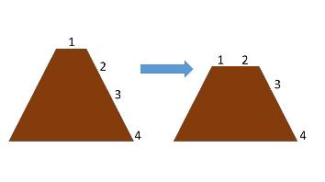
FRA Slope Location
Year | Slope Location | Volume (cm³) | Number of Trees
 | 1 | 65.64 | 13
2016 | 2 | 46.51 | 25
 | 3 | 63.01 | 35
 | 4 | 61.56 | 51
 | 1 | 1292.37 | 13
2017 | 2 | 967.44 | 24
 | 3 | 961.33 | 35
 | 4 | 1037.05 | 51
 | 1 | 5660.95 | 31
2018 | 2 | 5256.46 | 18
 | 3 | 5448.56 | 26
 | 4 | 5916.9 | 48
Slope location did not affect tree volumes
Notes:
Add p value 0.05 on diagram

Slide 19
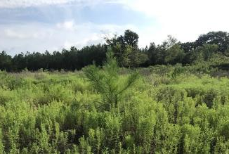
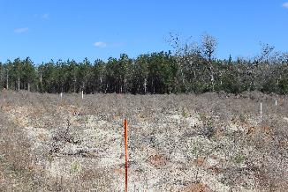
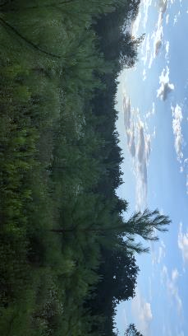
FRA Sites Over Time
January 2017
July 2017
July 2018
Soil settling occurred on FRA plots indicating the “bumps” that are not aesthetically pleasing flatten out over time
Notes:
Mounds were smaller than they would be operationally – east texas mines are also more likely to level out due to soil textures
Also talk about gully erosion and how this site didn’t have that but others might here in the western gulf coastal plain

Slide 20
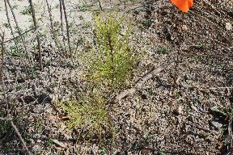
Survival Rates
Notes:
Add year 1
Split up the two graphs onto
Say when I got them : First Year survival and growth and summer b/w 1
Talk about how you did survival
Have pictures after comparing sizes
All was a one time measuremnts
DO YEAR 2 not year 1 (basically the same)

Slide 21
Tree Volumes
Notes:
Double check error bars on 2018
Between year 1 and 2 all treatments also changed significantly (a = 0.05) except for scraper

Slide 22
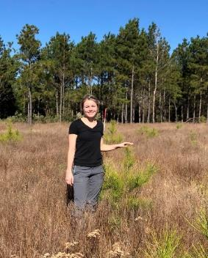
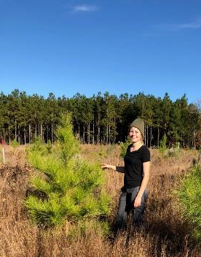
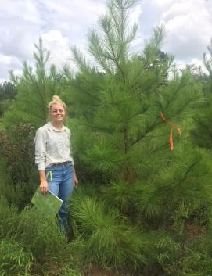
Tree Seedling Comparison
Control
Pan Scraper
FRA
Notes:
Put 2018 pics in here

Slide 23
2018 Leaf Level Water Potential
Notes:
P value too, one for time one for treatment - major point we did not find significant differences in treatments this did not explain vols or suviv
Also add 2018 on there
How it works
Reference pic – a tiny bead of water in the end of the needle fascicle
More neg more stressed

Slide 24
LiCOR 6400-XT
E= leaf transpiration
g_{s}= stomatal conductance
Notes:
Same message – no differences with treatment or correlations with vol and survival
Include licor picture
Ci inter cellular Co2 concentration
Photo is photosynthetic carbon assimilation

Slide 25
LiCOR 6400-XT
A_{sat}= light saturated photosynthetic rate
C_{i}= intercellular C0₂ concentration
Notes:
Add p values – same thing no treatment differences variation with time though – don’t go to
Include licor picture
Ci inter cellular Co2 concentration
Photo is photosynthetic carbon assimilation

Slide 26
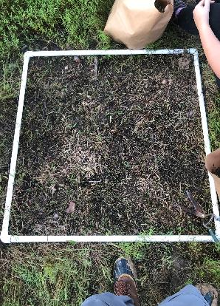
Competing Vegetation Density
Notes:
Yr 1 label
1m plots vegetation was clipped and weighed – inlucding any herbaceous or woody debris all above ground biomass went.
Take decimals off the Y axis

Slide 27
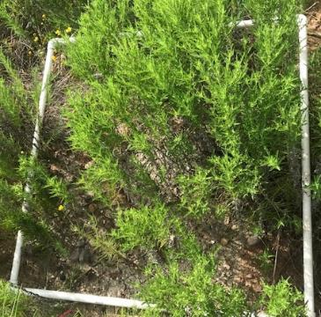
Percent Cover
Notes:
Percent cover
Talk about picture – FRA plot had less percent cover but the vegetation was taller and thicker
Control plot – had lowest sruvival and tree volumes could be related to the high volume of competing ground cover

Slide 28
Ground Cover
FRA
Pan Scraper
Control
Cover data were collected in July of 2017 and 2018
Notes:
Write out month
Percent cover
Talk about picture – FRA plot had less percent cover but the vegetation was taller and thicker
Control plot – had lowest sruvival and tree volumes could be related to the high volume of competing ground cover

Slide 29
Conclusions
Priest et al. 2016 showed that after 6 years trees on mined sites catch up to unmined areas
Surface and subsurface tillage have been shown to result in increased seedling survival and percent cover (Angel et al., 2018)
Tillage is very costly and long term effects may not justify the costs
Notes:
Needs to be buffed up somehow
Link to Jeremy priest stuff – biomass early lag in growth on reclaimed sites and how FRA seems to address that early lag, the bigger trees are earlier the more likely they would have more potiental later – may another slide. Link to Hannah stuff.

Slide 30
Future Research
The FRA method should be tested on current coal mined reclamation sites
Cost comparison studies between the conventional reclamation methods and FRA are underway
Possible below ground biomass differences between treatments are being researched
Notes:
All pics are FRA plots

Slide 31
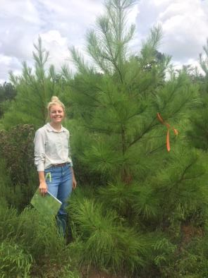
Acknowledgements
Field Techs
Thomas Briggs
Megan McCombs
Casity King
William Kruckeberg
Thomas Dimmit
Nick Peckham
Isabella Reyes
Devin Theisen
Alix Matthews
Dr. Dennis Gravatt (SFASU Biology Department)
Fellow grad students
This project was funded by the Office of Surface Mining Reclamation and Enforcement
Notes:
McIntire Stennis funding Stovall
Put GA ENV dept too
Add mcentire Stennis

