Slide 1
Case Study: Early Outcomes and Lessons Learnt from a Recently Translocated Woodland Ecosystem
By
Neil Humphries (Blakemere Consultants Ltd)
and
Aude Delmer and Geraint Hopkins (Tarmac Ltd)

Slide 2
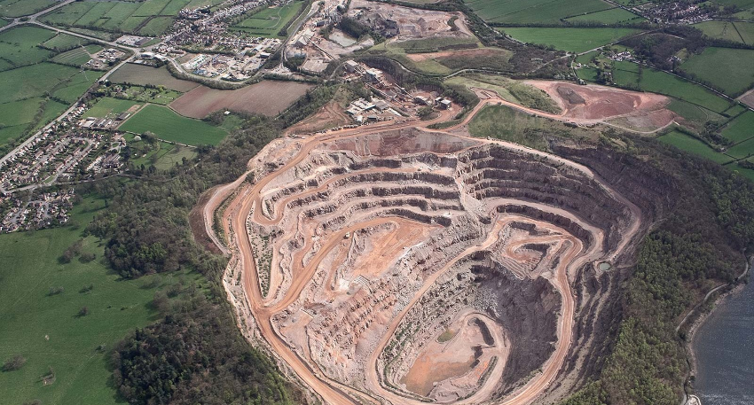
Mountsorrel Quarry, Leicestershire UK

Slide 3
Context
Nationally important aggregate reserve
Resource exploited by increasing the diameter of the cone-shaped quarry
Quarry outer rim covered by UK statutory designated and development policy protected ‘ancient’ semi-natural woodland –
in existence for over 400 years – site of Saxon lineage
occurrence of lowland and upland oak woodland types together (W10 & W16)
occurrence of rare saprolyxic (dead wood habitat) invertebrate species
Planning consent granted conditional with translocation of woodland soils, flora and dead wood even though little now left due to historic extraction
Such translocations are extremely controversial and hence few documented

Slide 4
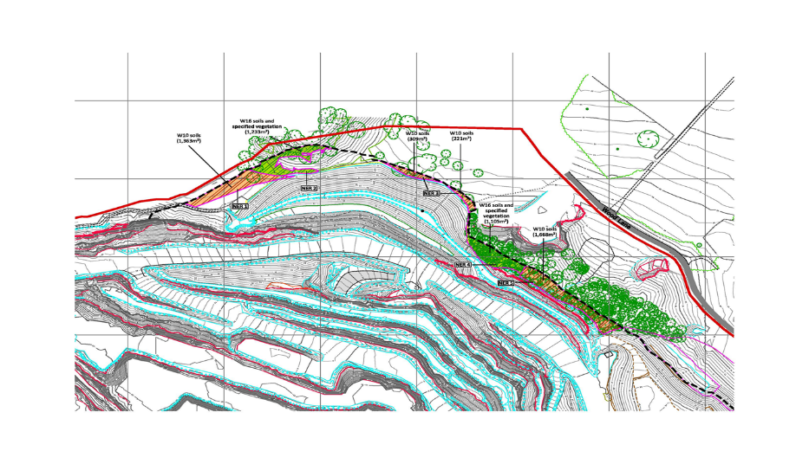
NER - W10 & W16 Compartments

Slide 5
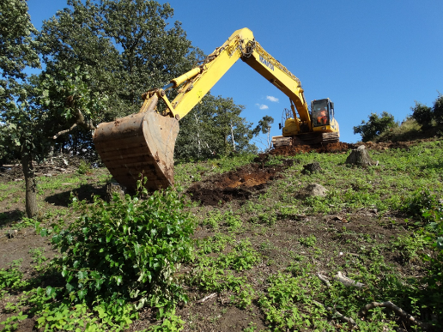
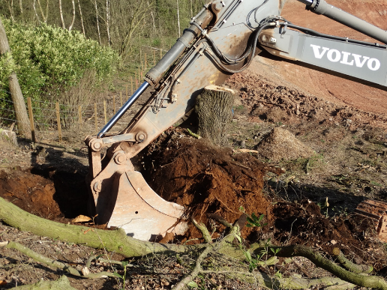
Donor Site - Recovery of Soils & Vegetation (April & September 2017)
Soil & Ground Flora
Pollarded/Coppiced Trees

Slide 6
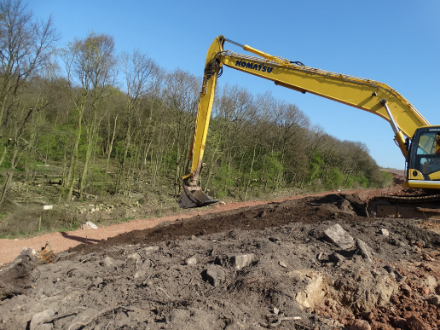
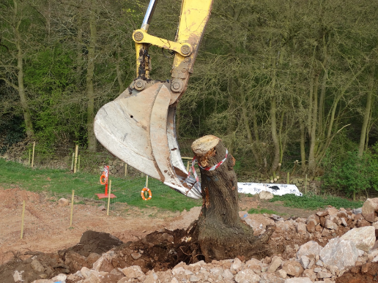
Receptor Site - Placement of Soils & Vegetation (April & September 2017)
Soil & Ground Flora Placement
Tree Placement

Slide 7
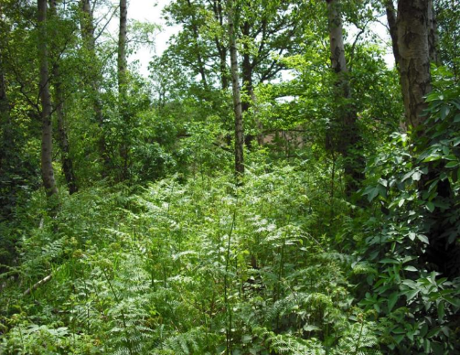
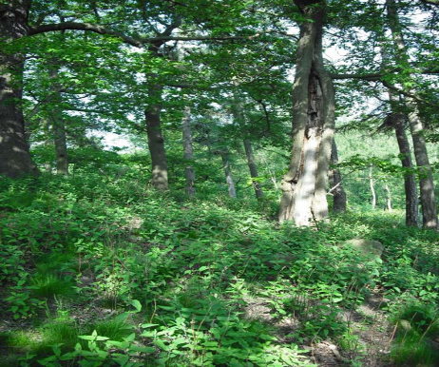
Donors – Pre-Pollarding & Translocation
W10 Quercus robur-Pteridium aquilinum-Rubus fruticosus woodland
W16 Quercus spp.-Betula spp.-Deschampsia flexuosa woodland

Slide 8
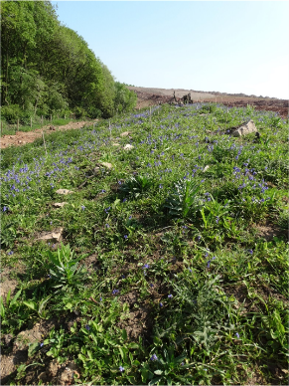
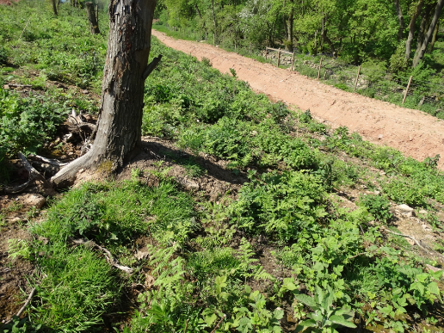
Receptor – Recovering W10 & W16 Oak Woodland
W10 Plot May 2018
W16 Plot May 2018

Slide 9
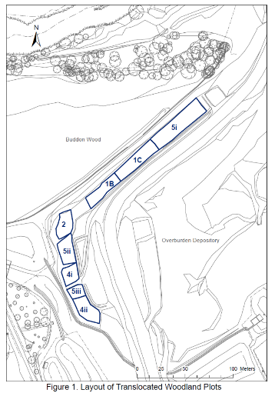
Monitoring 2018
Woodland Types - Donor Areas/Receptor Plots -
W10 – 5i-5iii
W16 – 1B, 1C, 2, 4i-4ii
Donor Areas - May 2014
botanical species lists & abundance, woodland structure
Receptor Areas – July 2018
Botanical – species lists & abundance per plot
Invertebrates – sweep netting – species lists

Slide 10
Literature
Few accessible & informative accounts -
Outcome in 70 years time and with canopy development in 20 years
Year 1 monitoring of value because:
initial floristic composition (IFC concept, Egler, 1954) an accepted indicative metric of longer term outcomes
intervention may be needed where dominance by some species - herbaceous weed/invasive species of particular concern

Slide 11
‘Tree Layer’- vegetation
Presence of representative species typical of W10 & W16 types
Recovery of tree transplants & regenerating seedlings indicating future canopy development
‘TREE LAYER’
Translocated Area Type | W10 | W16
Pollarded Trees - live/number | 11/20 | 15/22
Tree Seedlings - number | 24 | 75
NVC Tree/Shrub Species - after/before | 4/6 | 7/2

Slide 12
Ground Layer - vegetation
 | ‘GROUND LAYER’
Translocated Area Type | W10 | W16
Number of Species | 64 | 84
NVC herbaceous species Kept/Lost/Gained | 14/4/5 | 9/0/2
Non-NVC Type - Disturbed land species Kept/Lost/Gained | 2/5/22 | 0/0/28
Alien Woody Species Kept/Lost/Gained | 0/2/1 | 1/0/2
Presence of representative species of W10 & W16 types
Presence of non-woodland disturbed ground species from seed-bank, but also non-native invasive woody species present
Sources - surrounding land & disturbed areas exacerbated by opening-woodland core

Slide 13
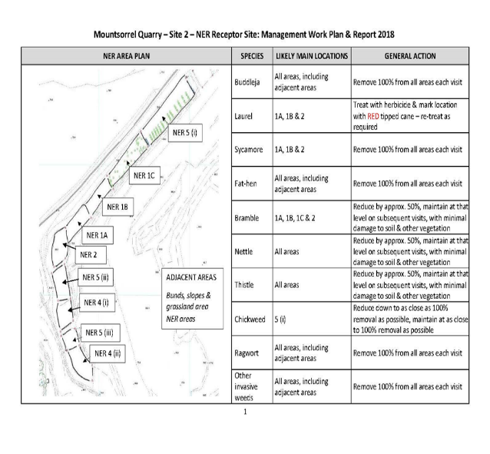
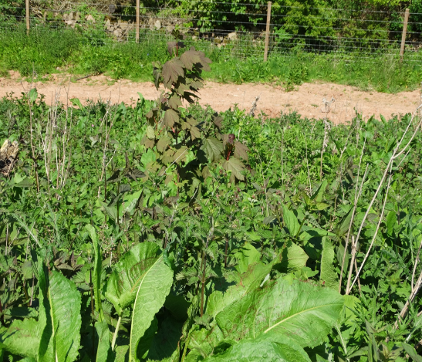
Pro-active Management Tailored to Woodland Types

Slide 14
Habitat Affinities of Invertebrates
Habitat Type | Number of Species | Invertebrate Groups
Total Number | 110
Dead Wood | 4 | bee, fly, wasp
Tree Layer | 7 | butterfly, lacewing, soldier beetle, fly, spider
Ground Layer | 33 | butterfly, plant bug, fly, hoverfly, bee, spider
Disturbed Ground | 21 | butterfly, plant bug, ladybird beetle, bee
Other Habitats | 43 | butterfly, soldier fly, dragonfly, damselfly, moth, predatory bug, plant bug, ladybird beetle, hoverfly, bee, wasp
Dead wood species translocated
Most other species represented grassland/scrub mosaic stage of vegetation recovery and expect to change with canopy development
Most other species were immigrants from surrounding woodland and grassland/disturbed ground

Slide 15
Conclusions
Year 1 monitoring important as confirmed component NVC W10 & W16 species were present
Confirmed the need to pro-actively control invasive species around the locality of the translocation
Outcome similar to clear felled/coppiced woodland
The arguement against woodland translocations may be less sustainable than argued by opponents and relevant to other developments, eg HS2 rail

Slide 16
Acknowledgements
We thank Tarmac Ltd for their encouragement to present and publish our paper. The translocation involved several of Tarmac’s staff in planning and operational roles, the engaged professional consultants and contractors.
Particular thanks are due to Trevor Warren, Shane Tompkin, Tim Deal, Andy McIntosh, Gareth Burdell and David Park of Tarmac, Jim Meadowcroft of DJA, Andy Hawkes of Chepstow Plant, and Ian and Tom Johnson of Planterior.
The species recording was carried out by specialists, Paul Benyon (LLQS) botany in 2014, and in 2018, Mark Woods (Baker Consultants) botany and Andy Godfrey (AGA) invertebrates.

