Slide 1
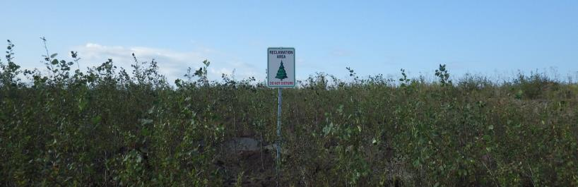
Tree regeneration and growth on reclaimed oil sands mine sites
Brad Pinno
bpinno@ualberta.ca

Slide 2
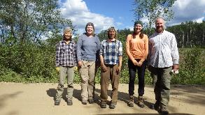

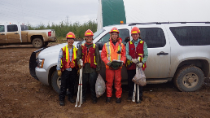
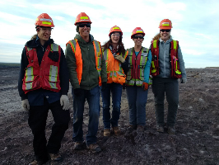

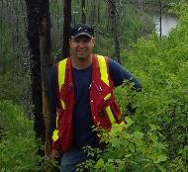
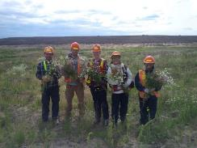
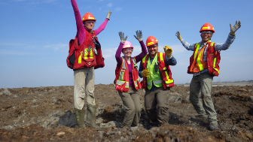



Slide 3
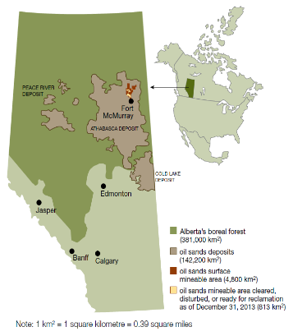
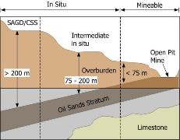
Oil Sands in Alberta
Mining occurs where the oil sands deposit is thick and close to the surface, i.e. near the Athabasca River north of Fort McMurray, thermal extraction used everywhere else
Most of the rest of Alberta is underlain by conventional oil and gas deposits
7 active mines
Oil sands mining has directly disturbed over 80,000 ha of boreal forest so far; 8,200 ha are under active reclamation
Mines are where overburden is shallow and oil sand is close to the surface.

Slide 4
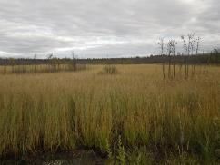
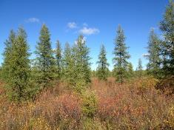
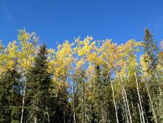
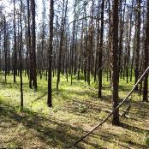
Natural landscape
Boreal forest on the interior plains
Half uplands, half wetland bogs and fens
Upland soils mainly Alfisols on mesic sites, wetland Histosols
These are the basis of reclamation soils
  Peat-mineral mix (PMM)
  Forest floor-mineral mix (FFMM)
Borderline sub-arctic climate
Moisture limited environment (455 mm)
Sedge dominated fen
Tamarack and black spruce wetland
Aspen-spruce mixedwood on mesic sites
Jack pine on xeric sites

Slide 5
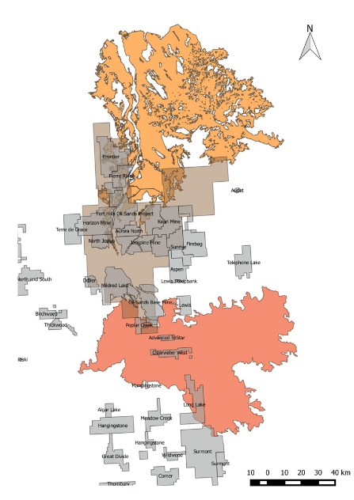
Disturbances
Richardson Fire
  Spring 2011
  575,000 ha
Mineable Oil Sands
  Mines + other industrial developments
  Total area 480,000 ha
Fort McMurray Fire
  Spring 2016
  530,000 ha
  Over 80,000 people evacuated
Other disturbances
  Insects and diseases
  Timber harvesting

Slide 6

Oil sands mine reclamation in Alberta
Public land
The goal is to create functioning forest ecosystems but what present at a particular location before disturbance is not necessarily similar to what will be there afterwards
Equivalent land capability
Important part of that is getting trees and forests back on the landscape, i.e. tree establishment and growth

Slide 7
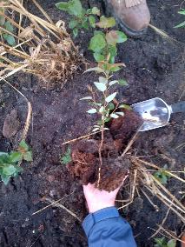
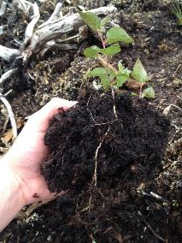
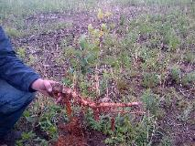
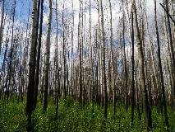
Trembling aspen seedling regeneration
Naturally regenerates from root suckers after disturbance
Seedlings typically uncommon BUT lots of seedlings after disturbances including reclamation
Tiny seed but widely dispersed, exacting microsite requirements
Planting aspen can be challenging and expensive
What reclamation treatments and environmental conditions maximize potential seedling establishment?
Aspen seedlings
Aspen suckers

Slide 8
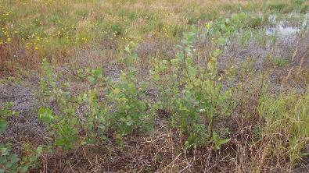
Aspen regeneration
Trembling aspen seedlings
3-year old site with both PMM and FFMM
Most seedlings on unfertilized PMM
  High water holding capacity
  Rough surface
  Little competition
Fertilizer reduced regeneration due to increased competition
In unfertilized areas, 82% of PMM plots > 2,000 sph compared to 43% for FFMM
Can start to put probabilities of regeneration success on reclamation prescriptions
Pinno & Errington 2015 Ecol Rest

Slide 9
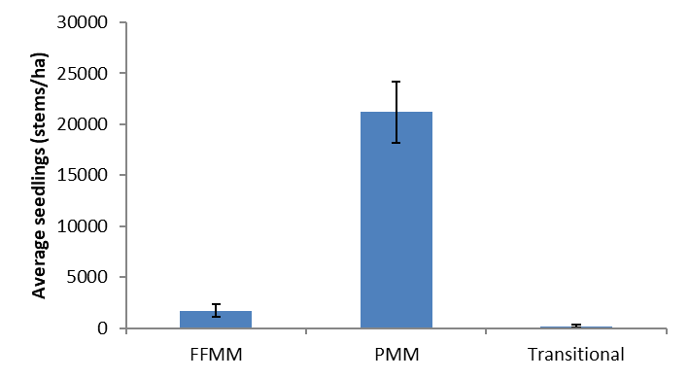
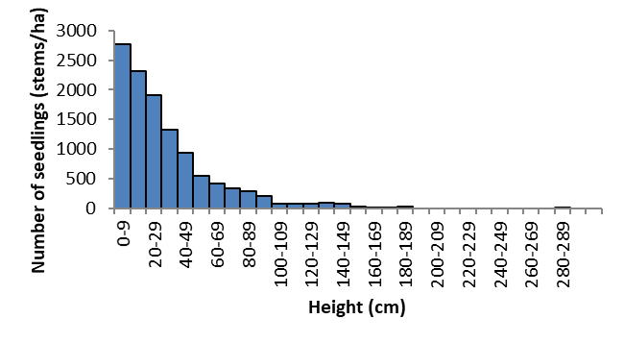
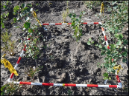
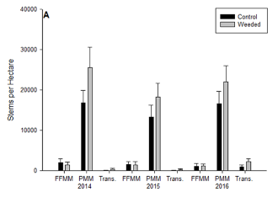
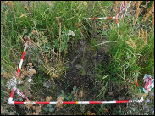
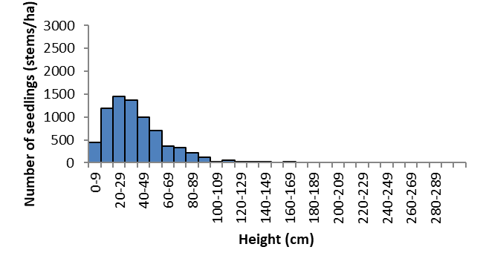
Competition control and ingress
20,000
PMM continuous recruitment
2,000
Peat Mineral Mix
FFMM recruitment complete
Forest floor mineral mix
deBortoli et al. 2019. CJFR.
Greater deciduous tree seedling establishment on PMM than FFMM
Competition control resulted in increased tree seedling establishment
Continued recruitment of seedlings in PMM but not FFMM

Slide 10
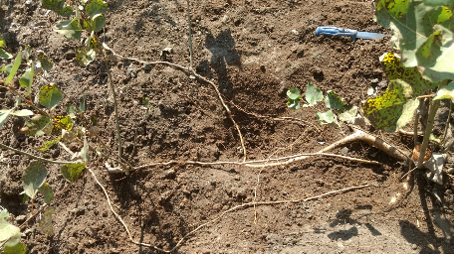
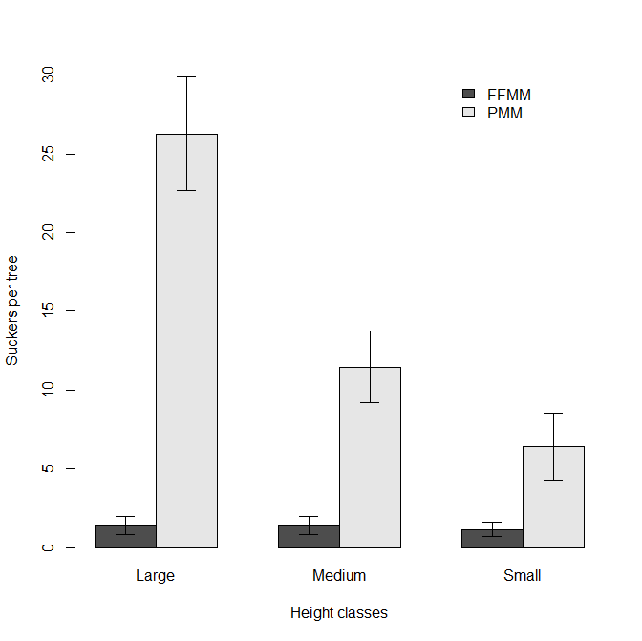
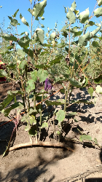
Aspen resiliency to disturbance
Cut individual aspen seedlings (6-years old) of different sizes and recorded suckering
More suckers on PMM
Larger trees produced more suckers on PMM
Competition reduced suckering
Aspen seedlings are resilient
Jean et al. 2019. New Forests.

Slide 11
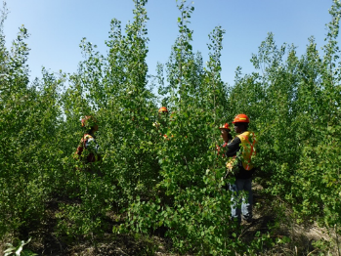
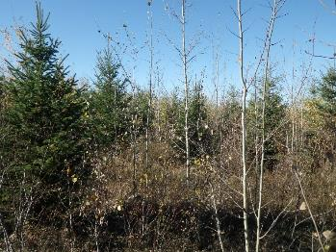
Tree growth
Link tree growth to soil properties and reclamation practices
Aspen and white spruce
Greenhouse study
Field study
Stem analysis

Slide 12
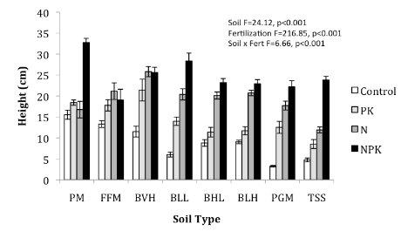
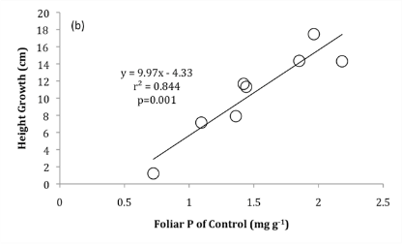
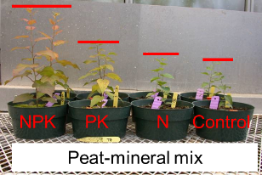
Greenhouse study
8 soil types, aspen seedlings
Big difference in aspen growth among soils
Response to fertilizer varied by soil characteristics
Specific soil characteristics are more important than general soil type
Pinno et al. 2012. CJFR

Slide 13
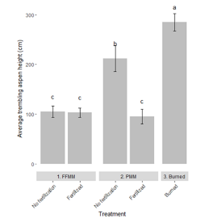
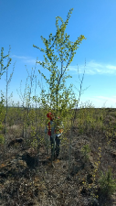
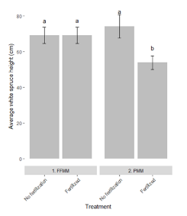
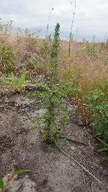
Field study
Aspen
6-year old aspen and spruce
Aspen seedling top height greatest on PMM, reduced by fertilization
Aspen growth related to foliar nutrients, soil pH and competition
No site variables to explain natural sucker growth
Very little difference in spruce height
Spruce
Tremblay et al. 2019. New Forests.

Slide 14
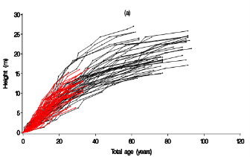
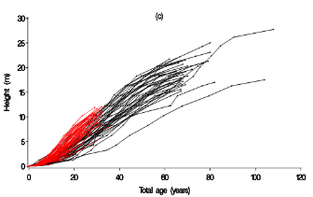
Stem analysis
Aspen
Growth of trees on reclaimed sites compared to natural stands in the region
Aspen growth similar between reclaimed and natural
White spruce growth slightly higher on reclaimed sites
Spruce
Yang et al. In review.

Slide 15
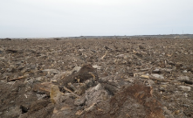
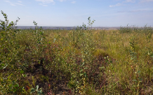
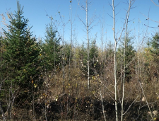
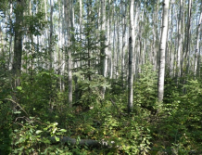
Future of reclamation forests
Trees and forests are growing on reclaimed sites
Stand and site dynamics of reclaimed forests are unknown
Atmospheric deposition and climate change impacts
Reclamation practices can be applied to encourage tree regeneration and increase tree growth but there are still many unknowns
Year 0
Year 4
Year 15
Natural mixedwood

Slide 16
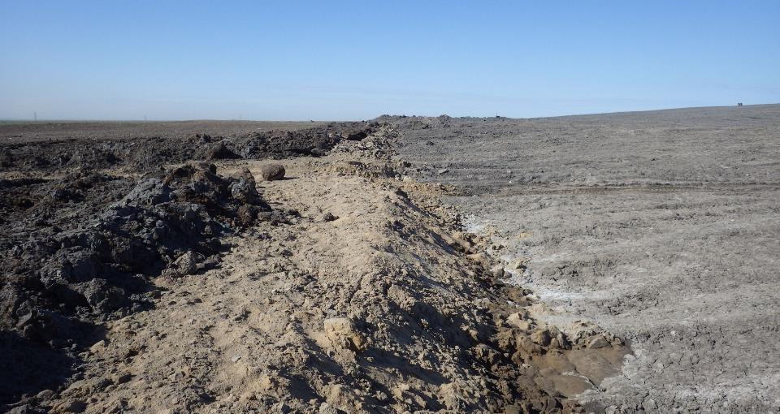
Thanks!

