Slide 1
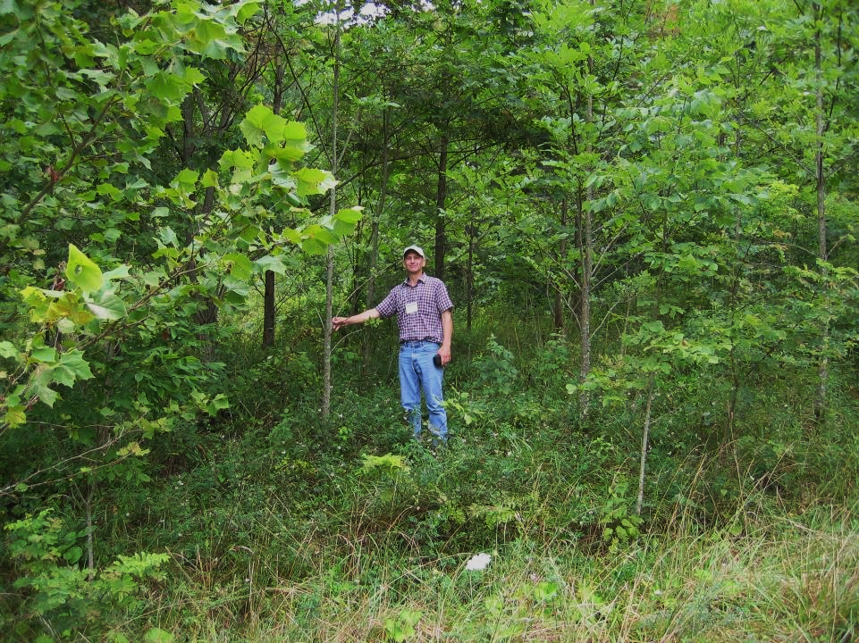
Early Growth Rates of
Hardwood Trees in West Virginia
K. Dallaire, L. Wilson-Kokes, P. Emerson, C. DeLong,
C. Thomas, J. Skousen
West Virginia University
Division of Plant and Soil Sciences

Slide 2
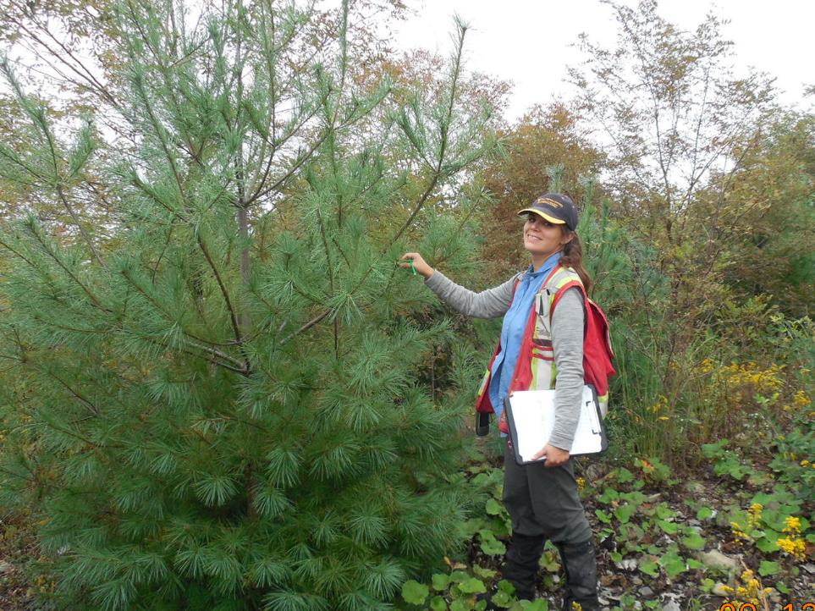
Kara Dallaire

Slide 3
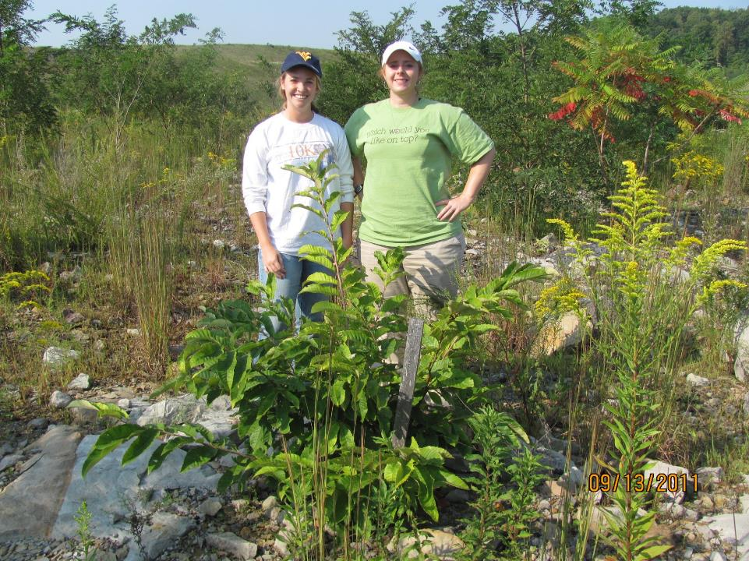
Lindsay Wilson-Kokes

Slide 4
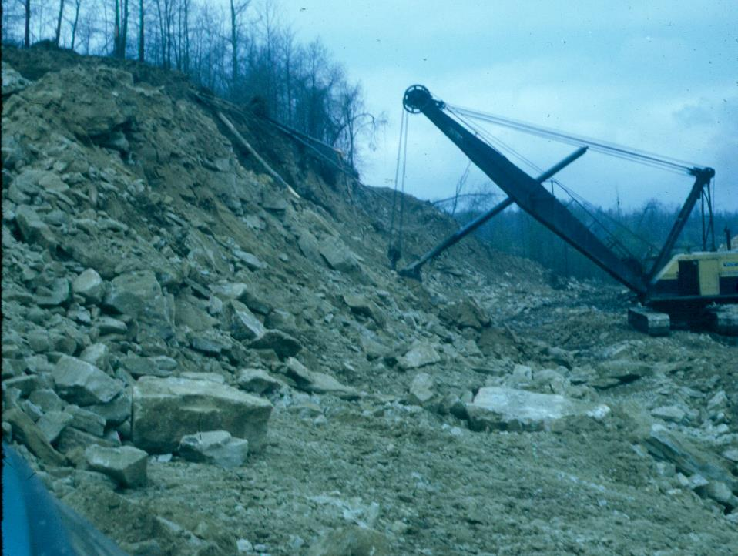
Coal Mining in Appalachia for decades
1950s dragline

Slide 5
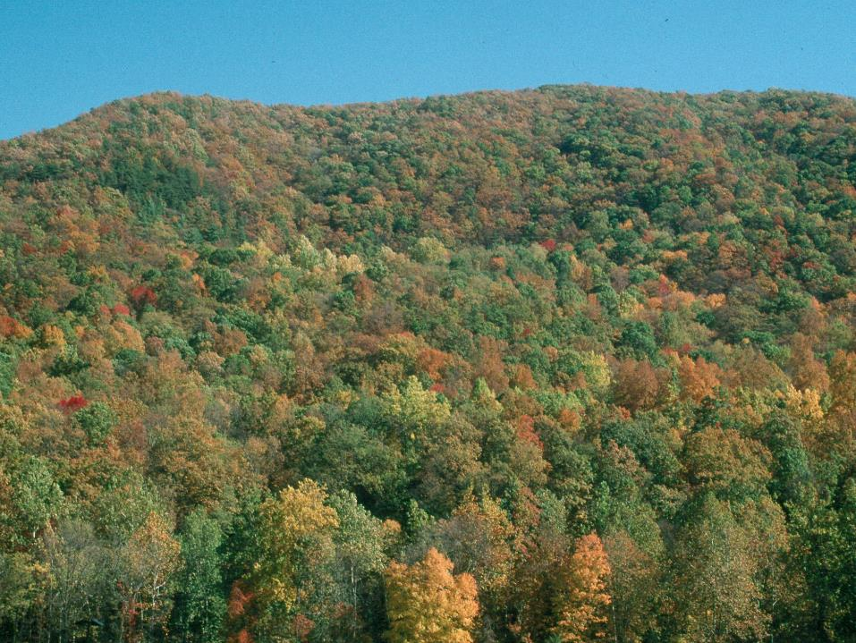
About 75% of pre-mined land in
Appalachia is forest

Slide 6
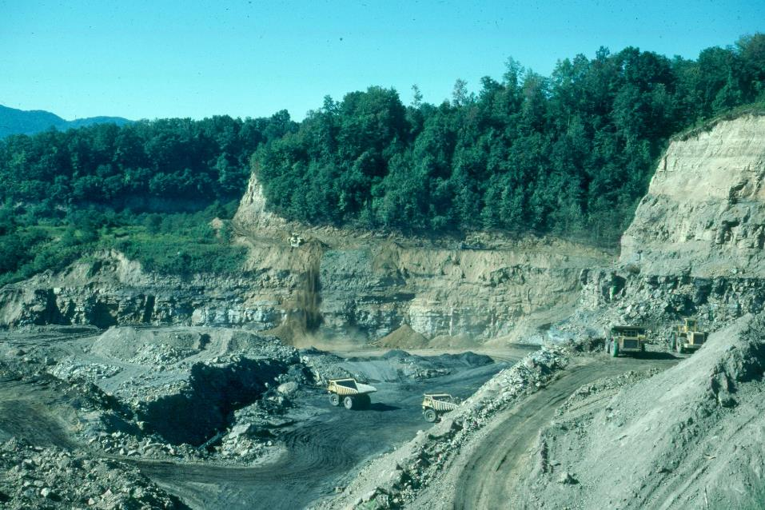
Mining disrupts forest ecosystem

Slide 7
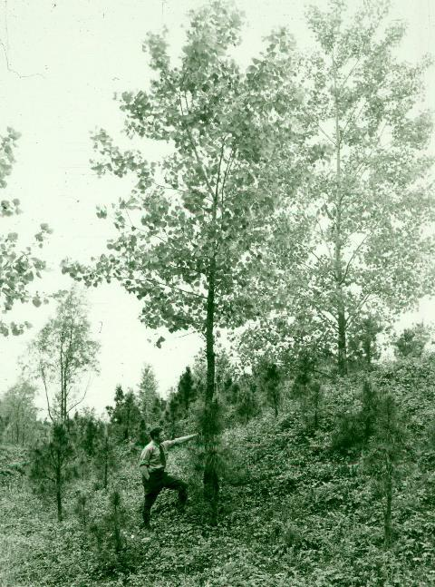
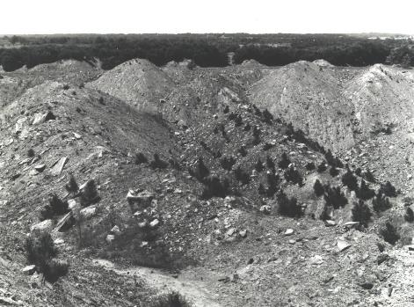
Early mining methods were suitable for tree re-colonization
Good Substrate
No Grading
No Competing Vegetation

Slide 8
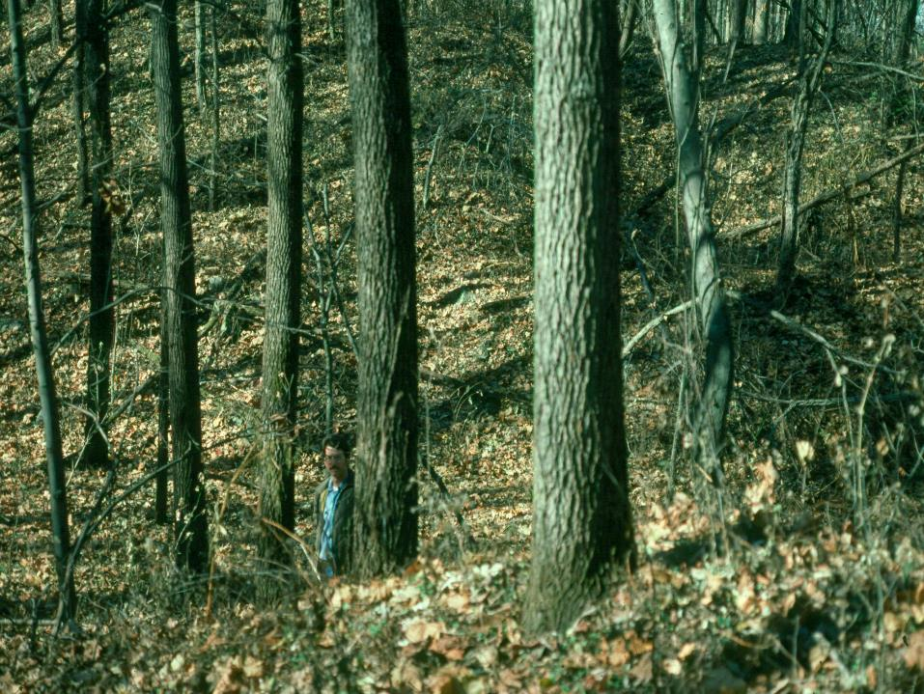
Some of these old mined sites have the best tree growth!

Slide 9
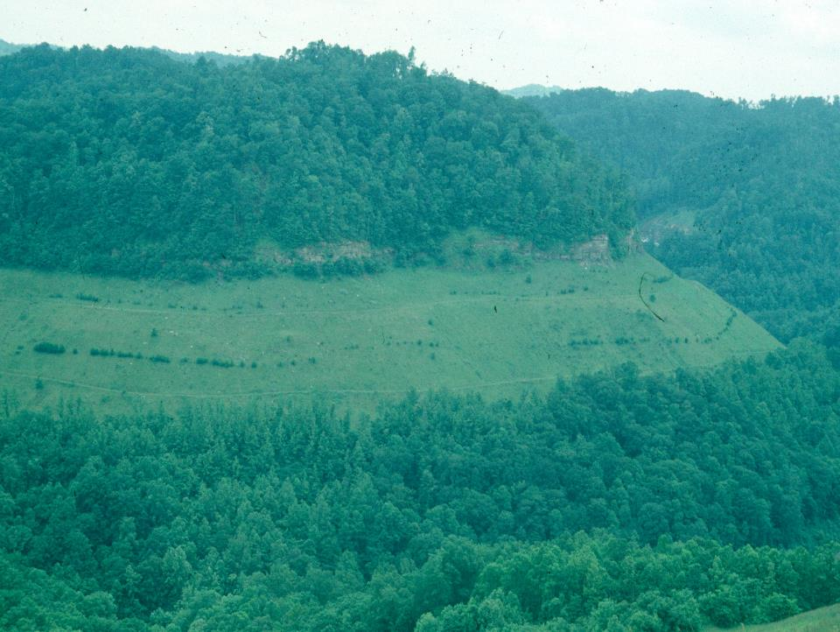
Old un-compacted contour jobs…

Slide 10
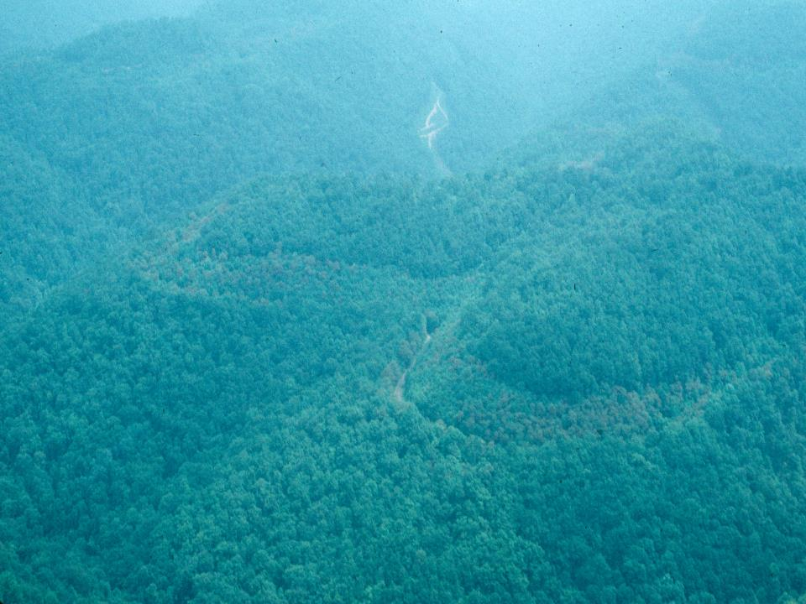
…readily reverted back to trees!

Slide 11
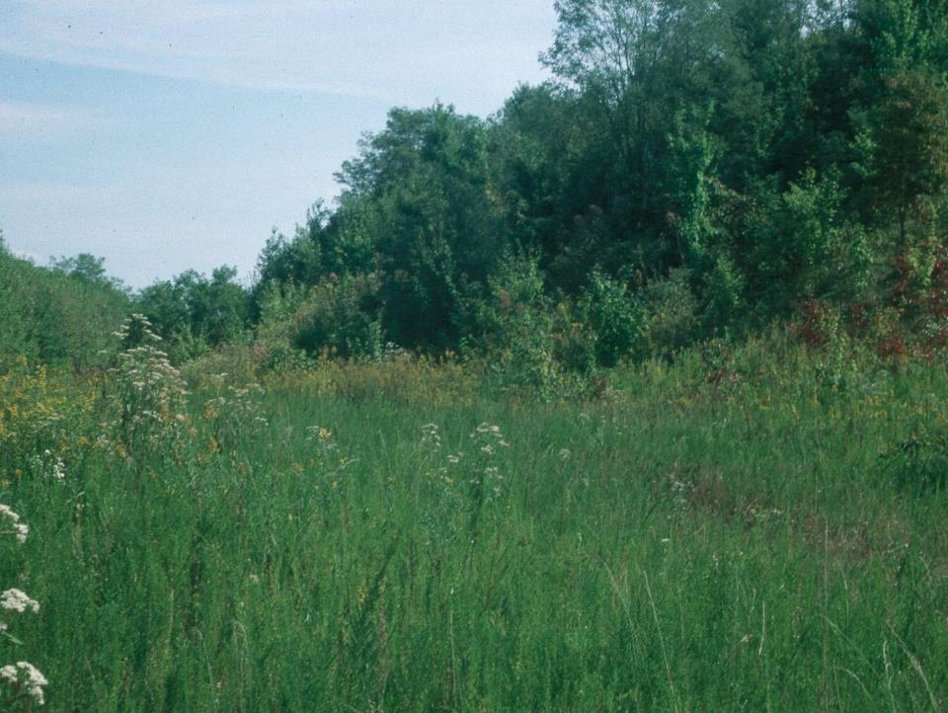
1977 - Surface Mining Control
and Reclamation Act (SMCRA)
Act was intended to:
  Enhance human safety
  Control erosion
  Improve water quality
  Return the land to AOC
Land was largely put back to pasture and hay land with soil compaction and heavy seeding rates to meet regulations

Slide 12
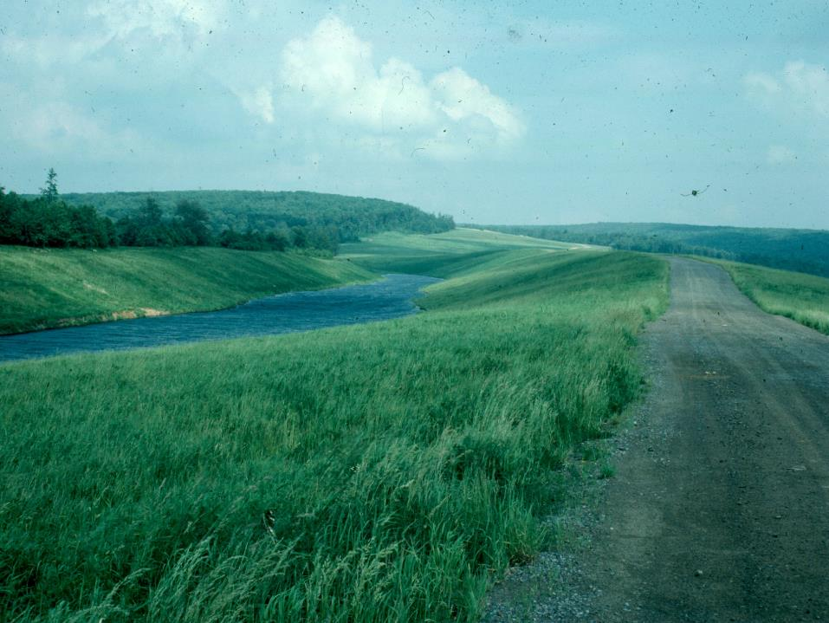
SMCRA interpretation led to most post mined land being reclaimed to pasture and hayland
Economic benefit from grazing and hay production

Slide 13
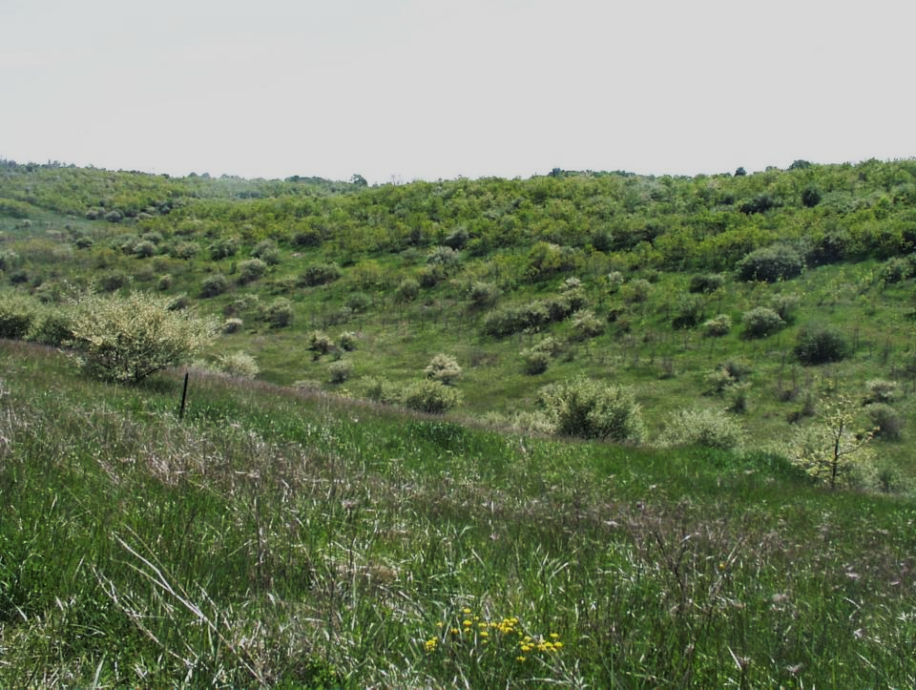
But if the land is not managed
in a pasture or hayland use …
Heavy groundcover and Compaction
resulted in
Grass and Invasive Shrub Wasteland

Slide 14
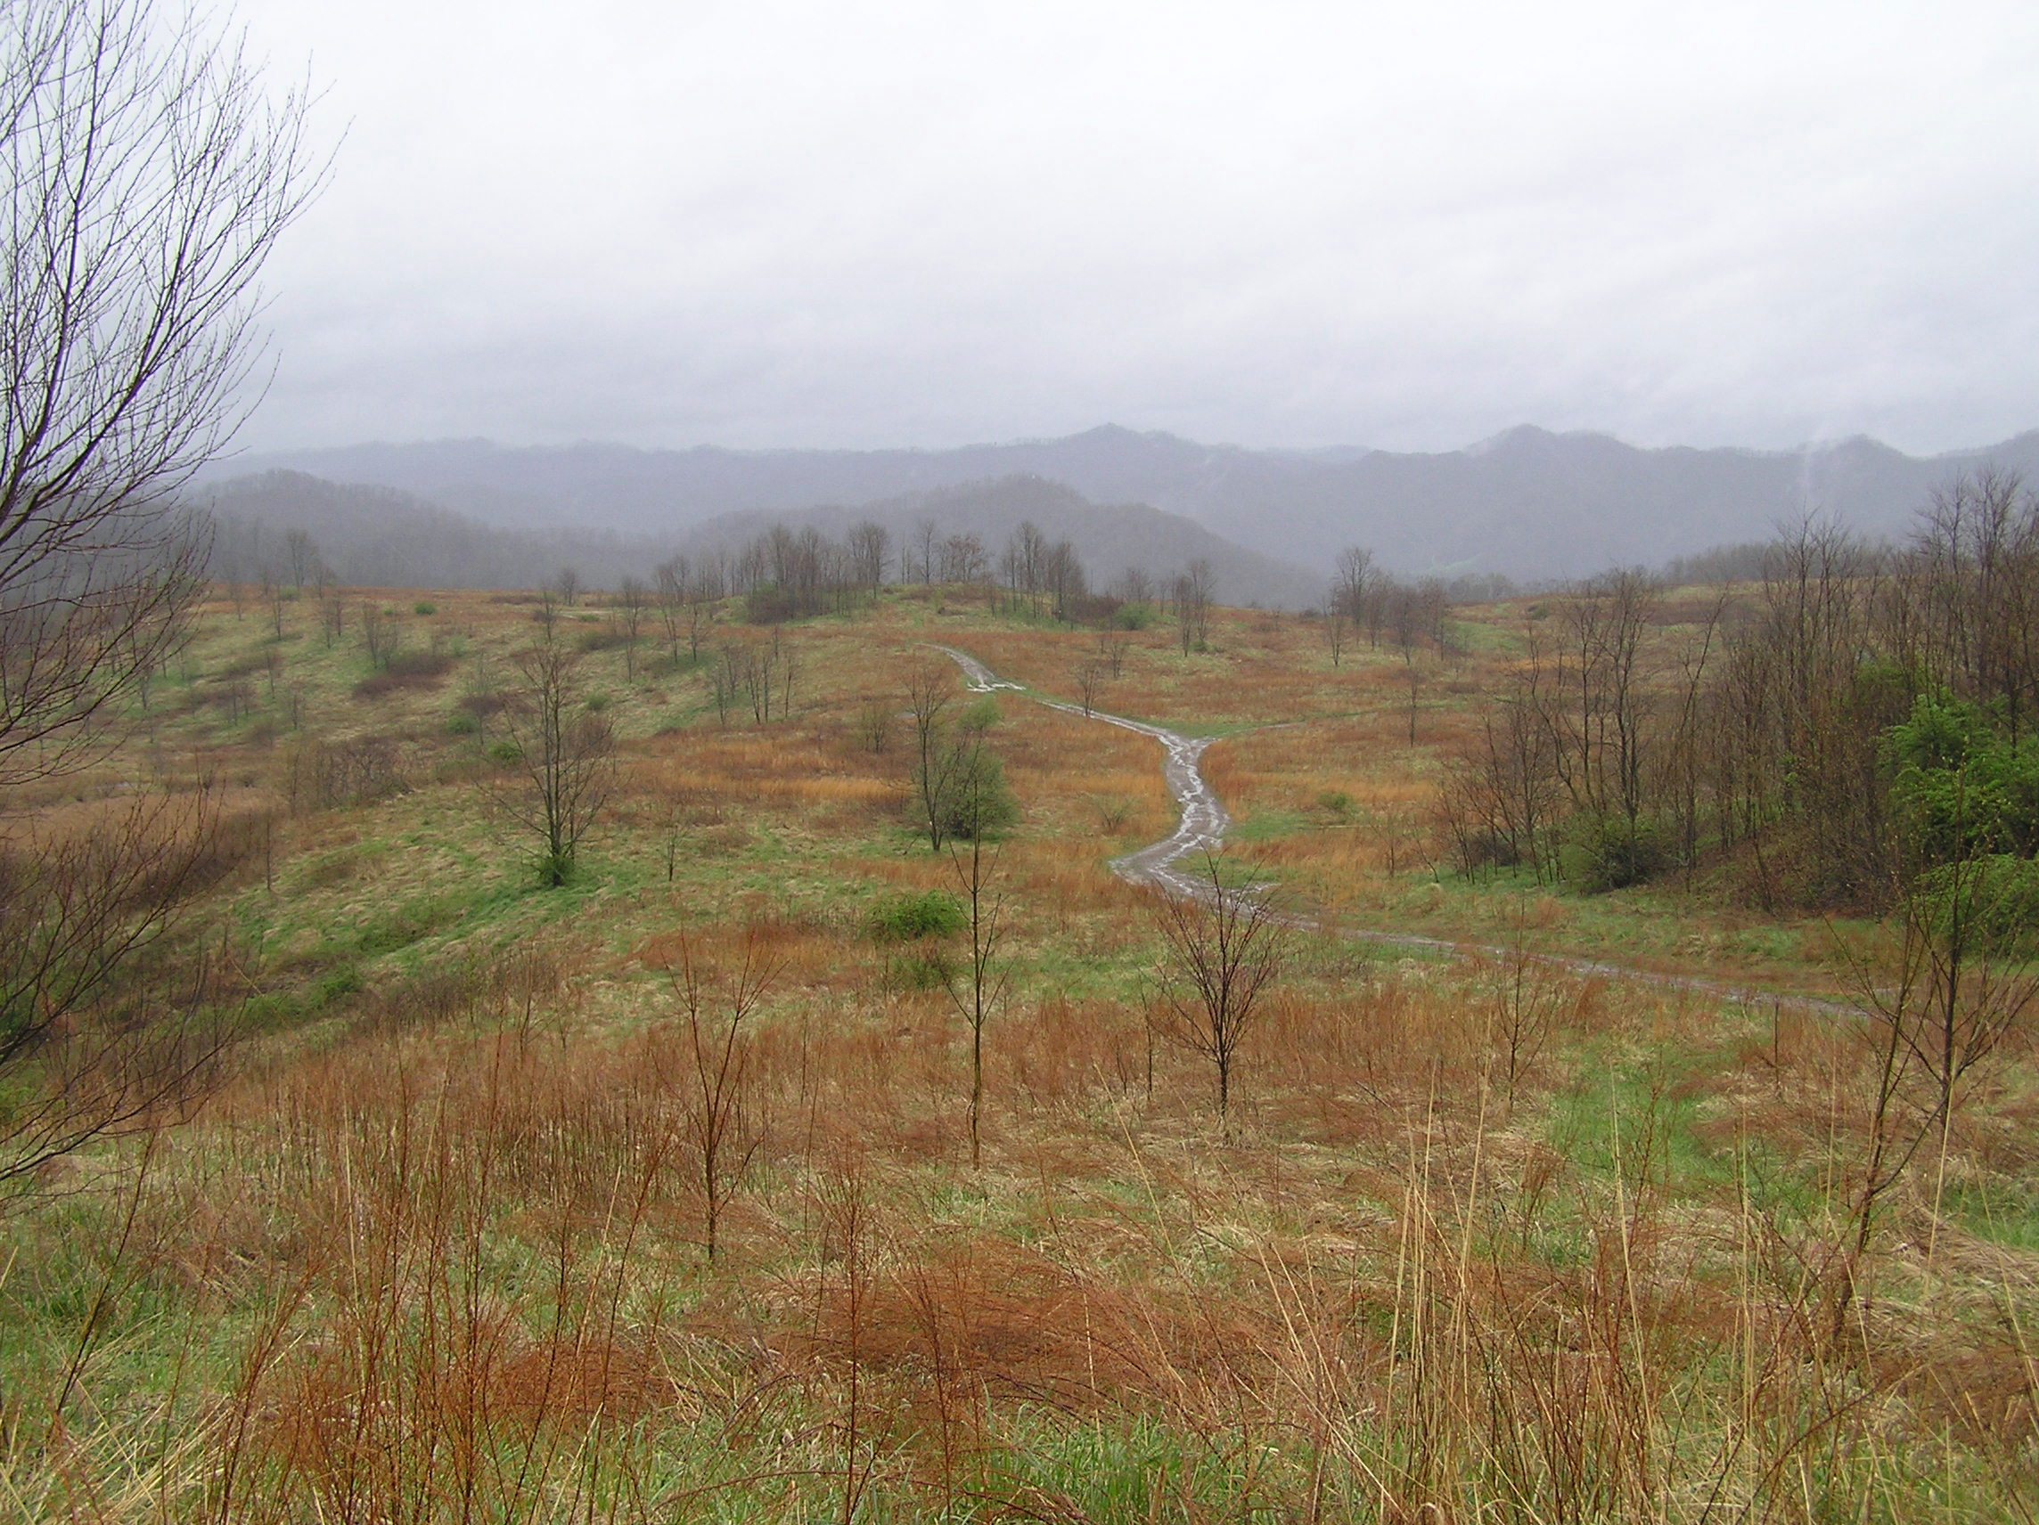
Unmanaged Hay Land or Pasture
Good for What?
How long to go back to Forest?
Notes:
1977 AOC variant permit with a hayland/pastureland post mine land use.

Slide 15
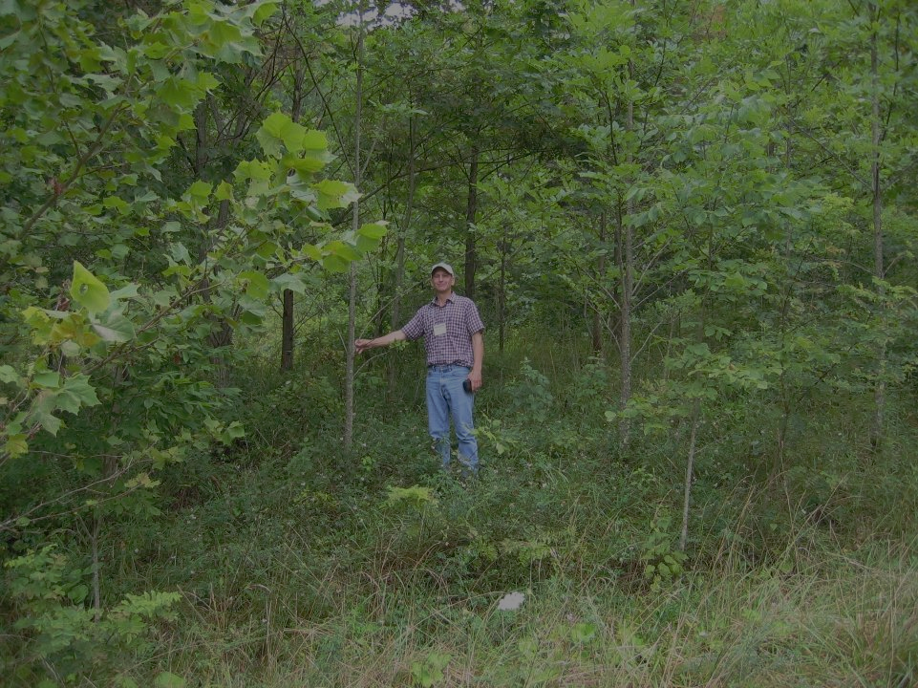
Develop Forests on Mined Lands
Benefits of reforestation include:
wildlife habitat
commercial wood production
improve ecosystem diversity
ecosystem services

Slide 16
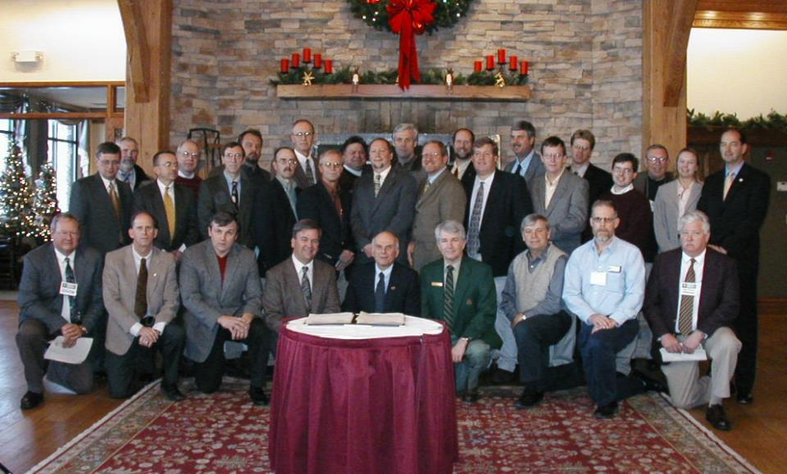
ARRI
Reforestation Initiative

Slide 17
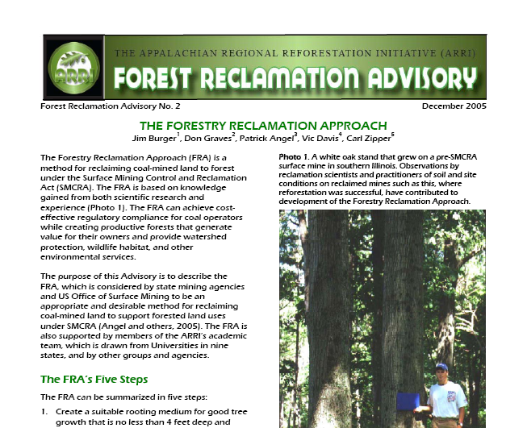
Science Team
Develop Advisories

Slide 18
The 5 Steps of FRA
1. Create a suitable rooting medium...
2. Loosely grade the rooting medium...
3. Use compatible ground covers...
4. Plant two types of trees…
5. Use proper tree planting techniques.

Slide 19
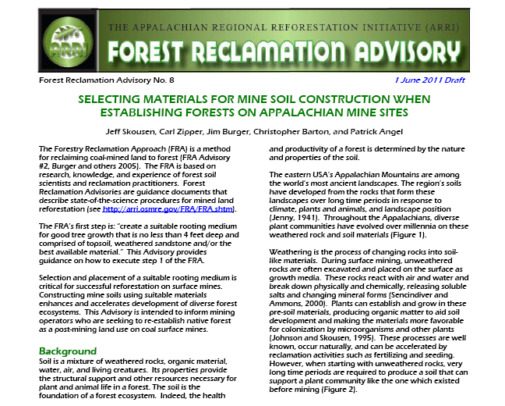
Selecting Best Materials
for Mine Soil

Slide 20
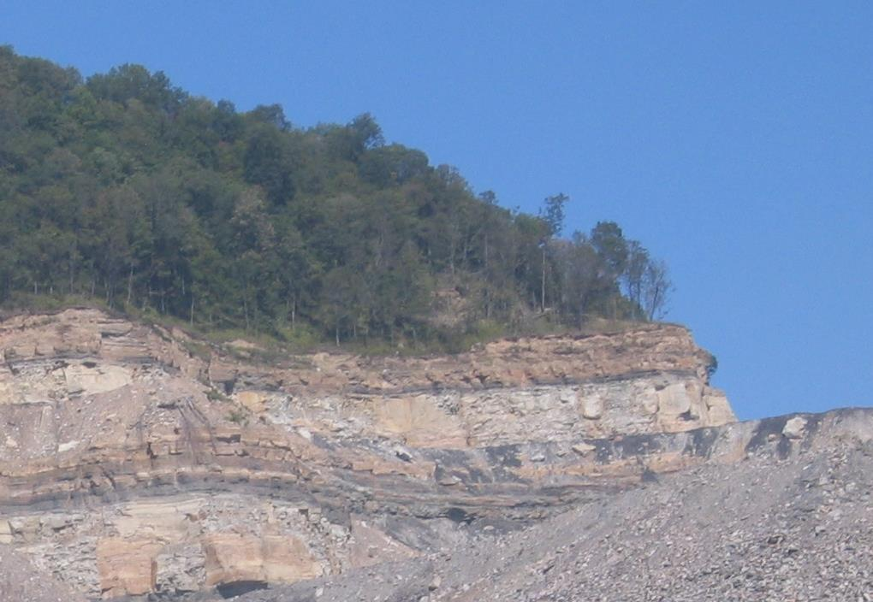
Topsoil BEST
Substitute material may be used in lieu of topsoil
Use weathered sandstones, to
supplement topsoil

Slide 21
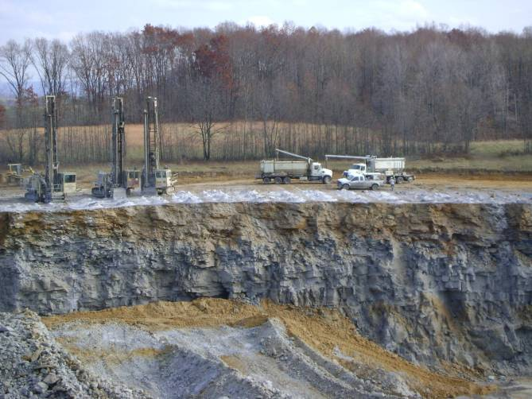
Native Soil in background
Brown subsoil/rock at top
Gray material lower down

Slide 22
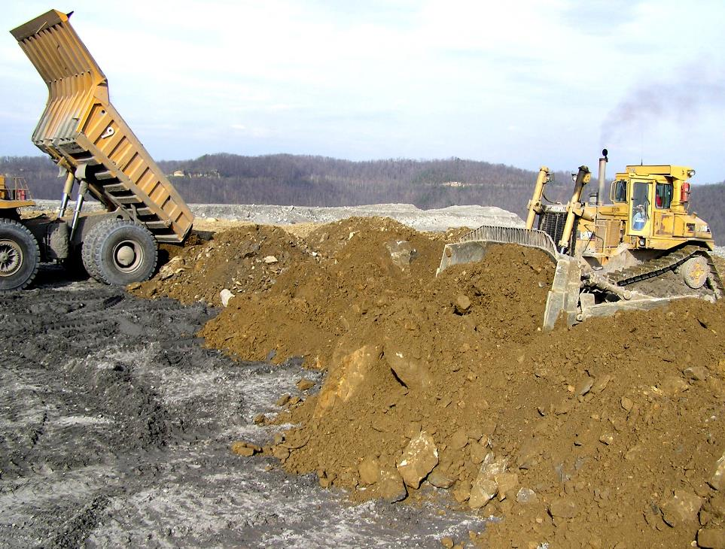
Brown Sandstone

Slide 23
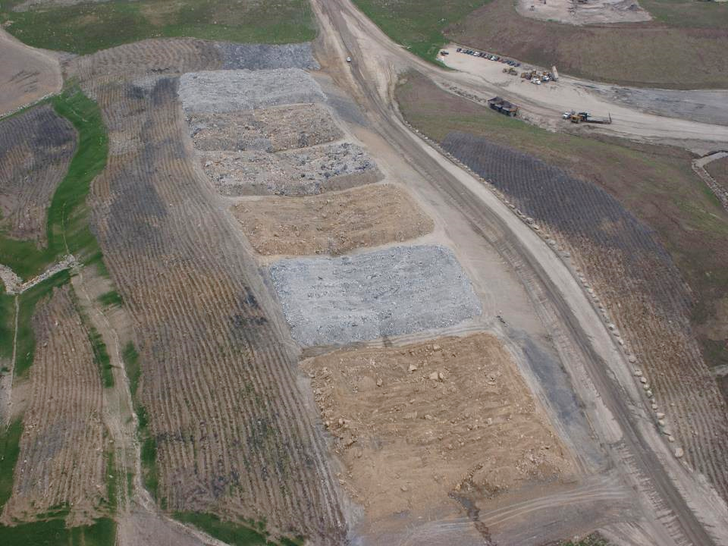
Methods
Numerous studies have documented…
Brown better than Gray
University of Kentucky
Bent Mountain Research Complex
Notes:
This is UK’s Bent Mountain project in Pike County, Kentucky
It’s BROWN vs GRAY vs MIXED
2 plots of each…
6 total…
These are the 2 brown plots… here and here…
These are the 2 gray…
These are the 2 mixed…

Slide 24
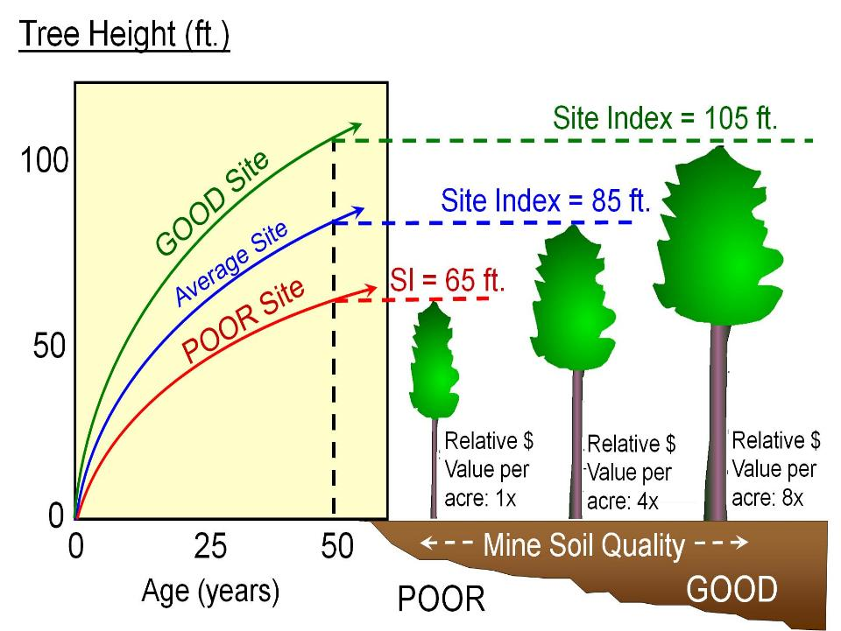
Burger et al. 2000

Slide 25
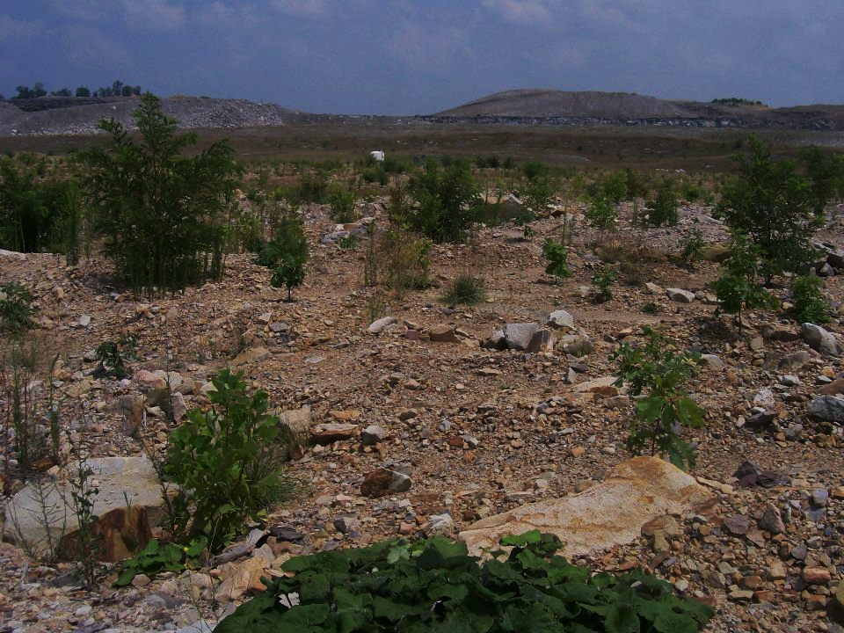
Objective:
How does tree growth compare…?
Evaluate tree growth on:
1) native soils
2) brown sandstone
3) gray sandstone

Slide 26
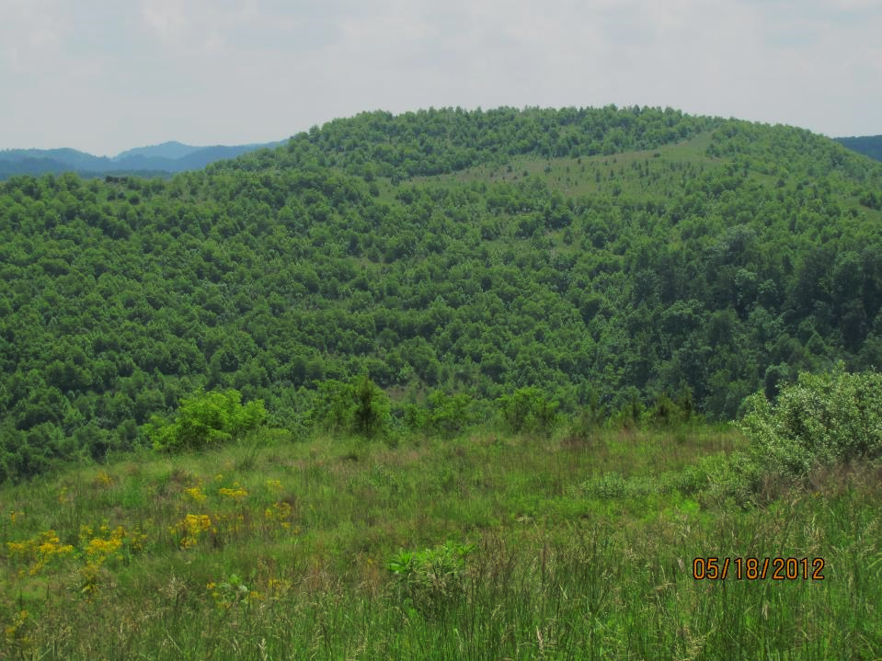
Compare the height of red oak, white oak, and tulip poplar from mined sites to trees growing in unmined conditions
Looked at tree height data from:
  Predicted heights from Web Soil Survey with Site Index information
  Fernow Forest
  Catenary and Birch River Mines

Slide 27
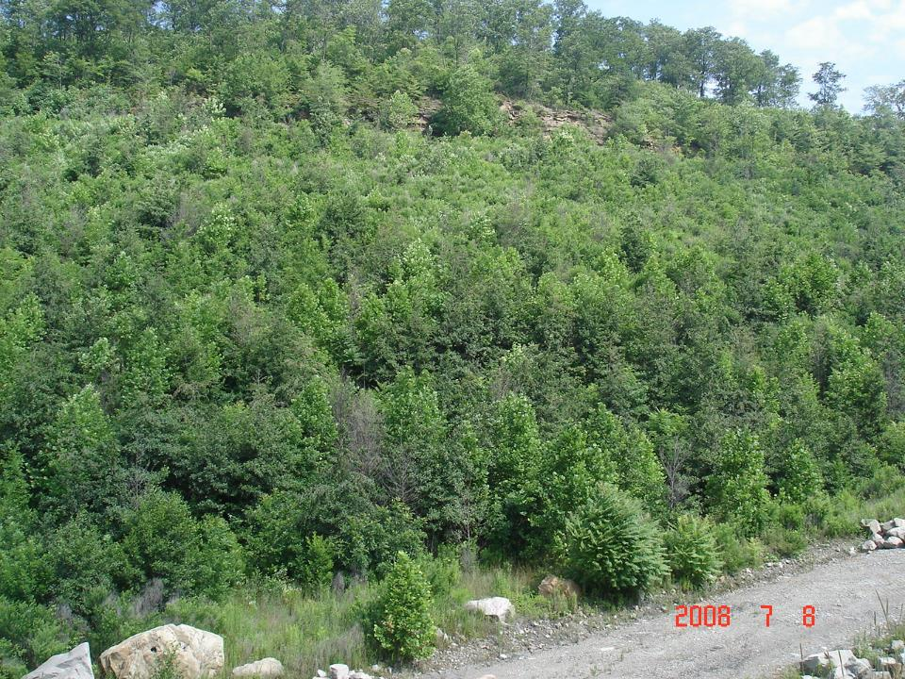
Early growth in native forests:
1) Pre-mining Site Index

Slide 28
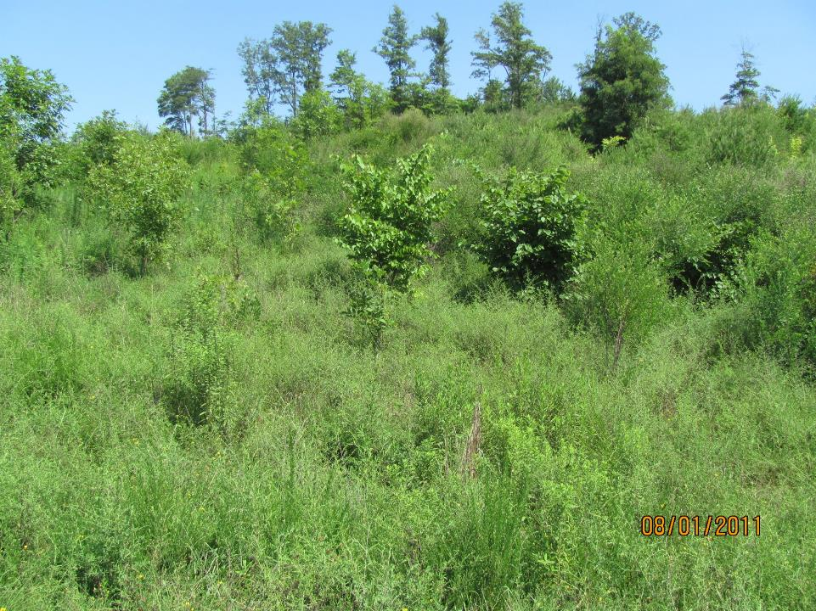
Early growth in native forests:
2) Fernow after canopy removal

Slide 29
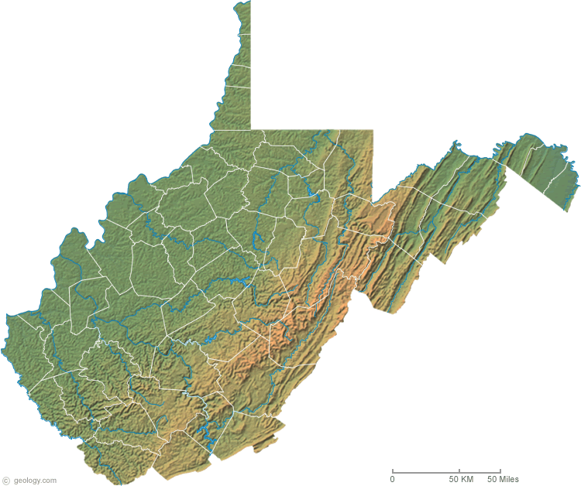
Mine Soils Study Sites:
1. Samples Mine
Morgantown
Charleston
Samples Mine

Slide 30
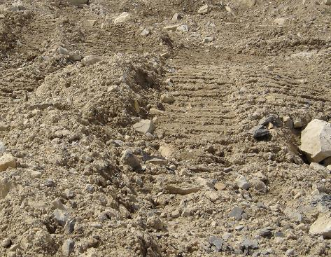
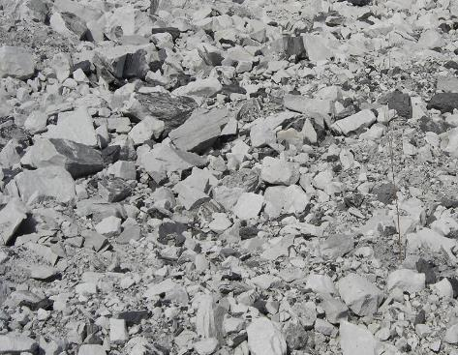
Brown Sandstone
Gray Sandstone

Slide 31
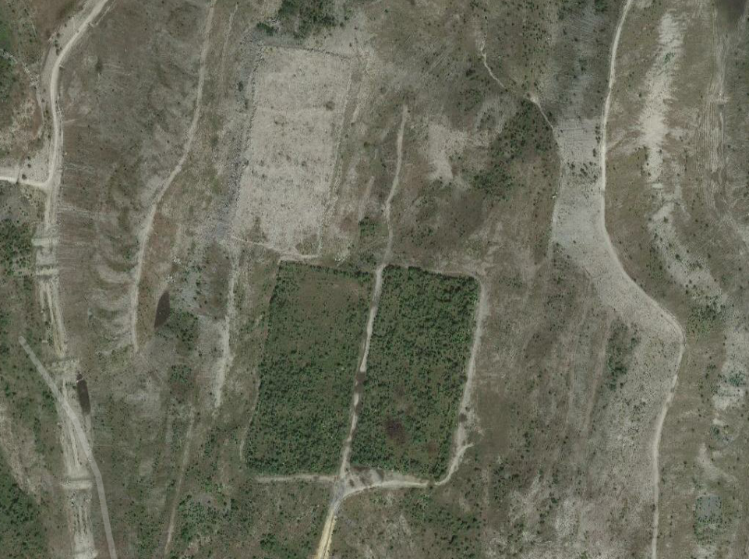
Gray Plot
7 acres each
Brown Plot

Slide 32
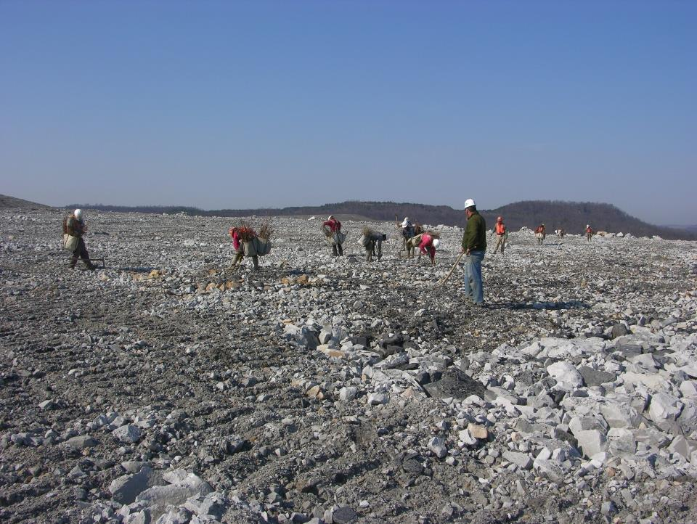
Growth and Survival of Hardwood Trees on West Virginia Surface Mines
11 Tree Species planted
Commercial Planting Company
2.5 x 2.5 m spacing
By Paul Emerson West Virginia University

Slide 33
Trees Planted
Species | Total # Planted | % of total planted
Red Oak | 3,400 | 22
White Oak | 2,500 | 16
White Ash | 2,500 | 16
Sugar Maple | 1,500 | 10
Chestnut Oak | 1,250 | 8
Tulip-Poplar | 1,250 | 8
White Pine | 1,250 | 8
Black Locust | 465 | 3
Black Cherry | 465 | 3
Redbud | 465 | 3
Dogwood | 465 | 3
Total | 15,510 | 100 %

Slide 34
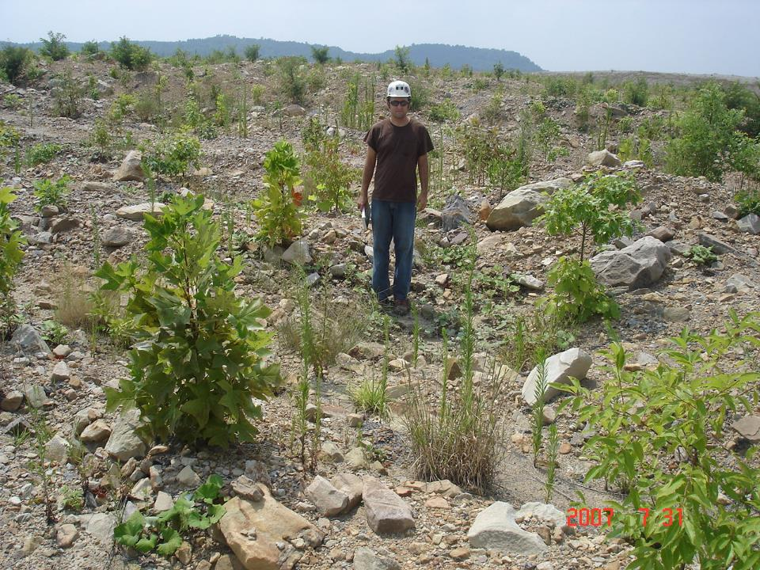
Growth after 2 years – Brown

Slide 35
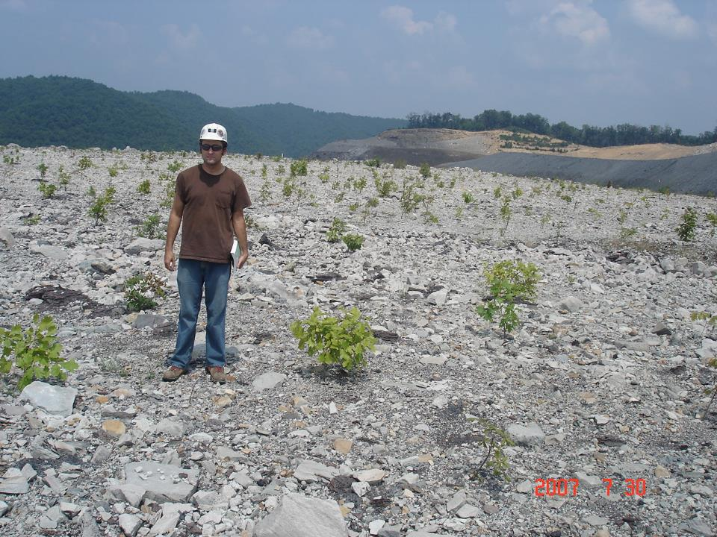
Growth after 2 years - Gray

Slide 36
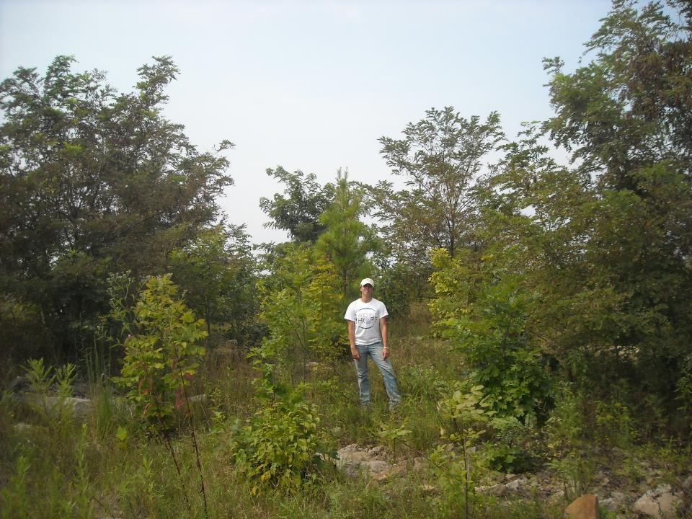
Growth after 6 years - Brown

Slide 37
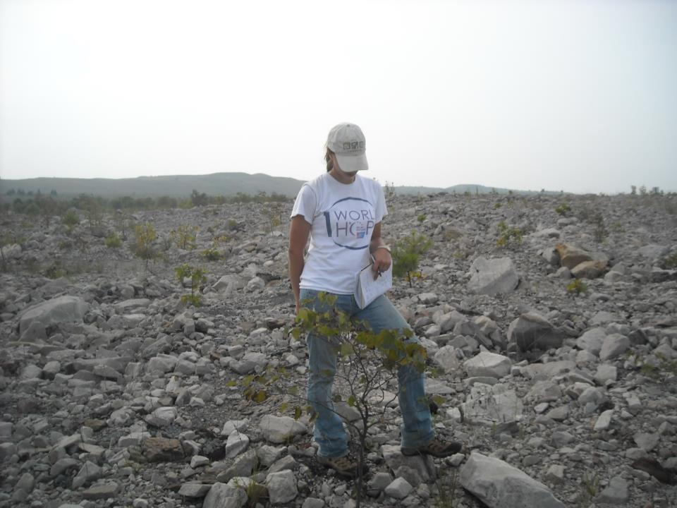
Growth after 6 years - Gray

Slide 38
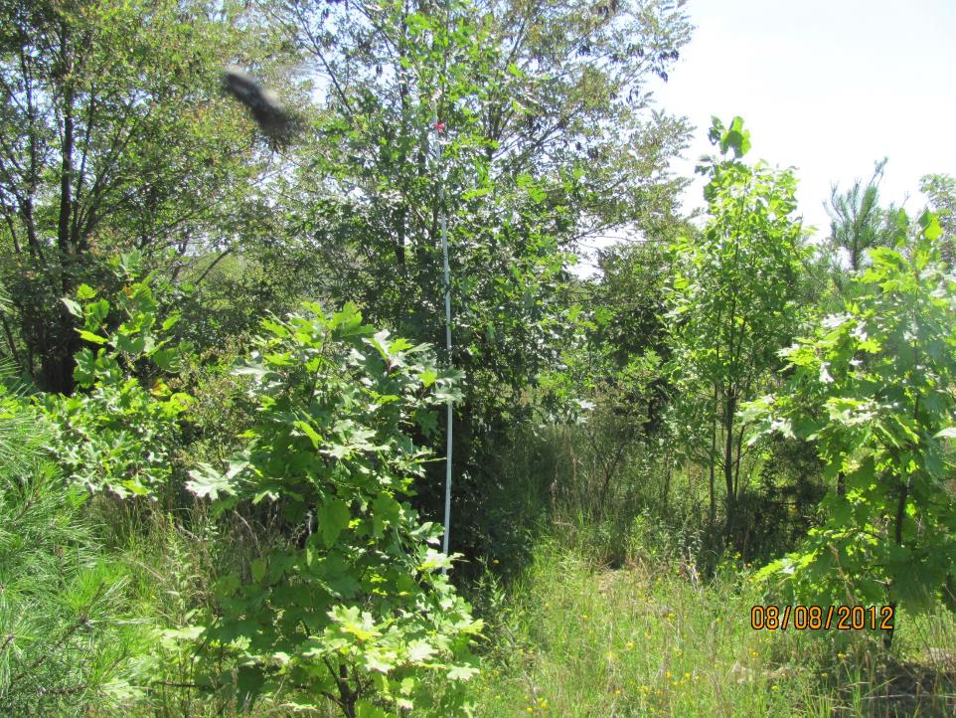
Growth after 8 years - Brown

Slide 39
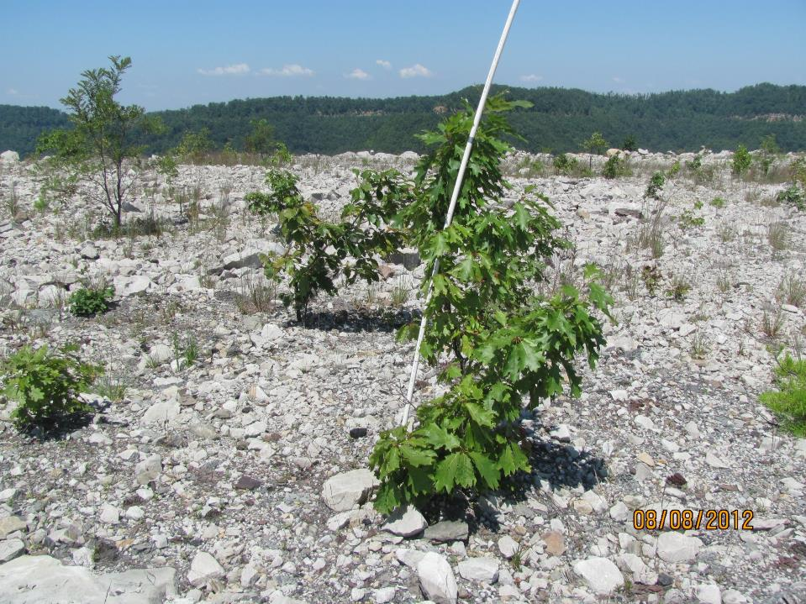
Growth after 8 years - Gray

Slide 40
Mine Soil Study Sites:
2. Birch River Mine
Morgantown
Charleston
Arch-Birch River

Slide 41
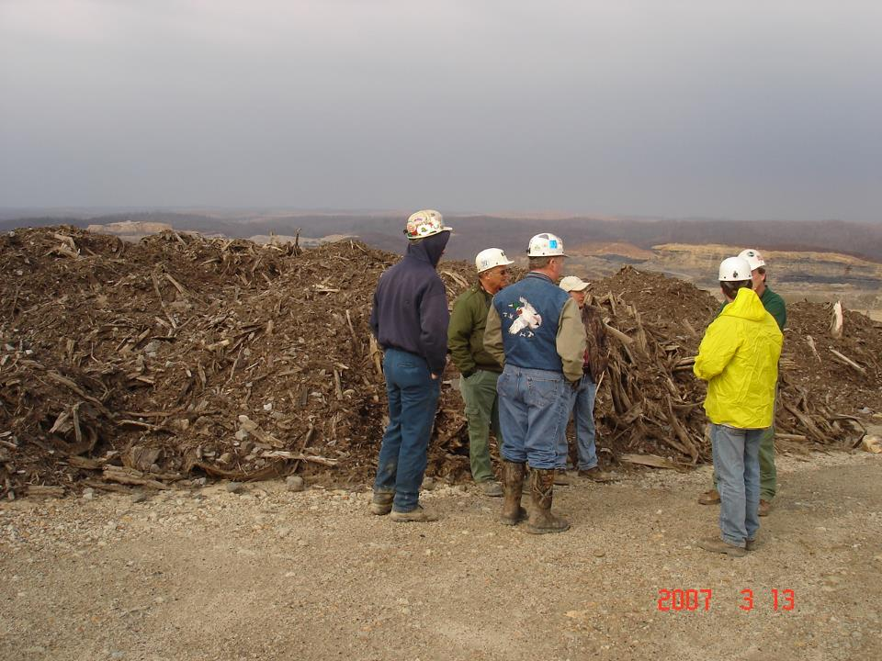
Bark & Sawmill Waste

Slide 42
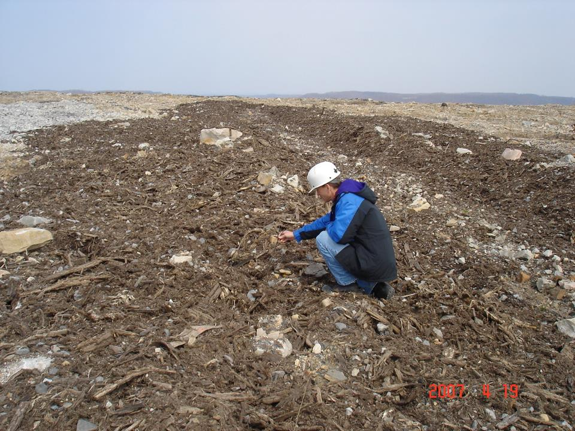
Bark Mulch spread down the middle
Gray
Mulch
Brown

Slide 43
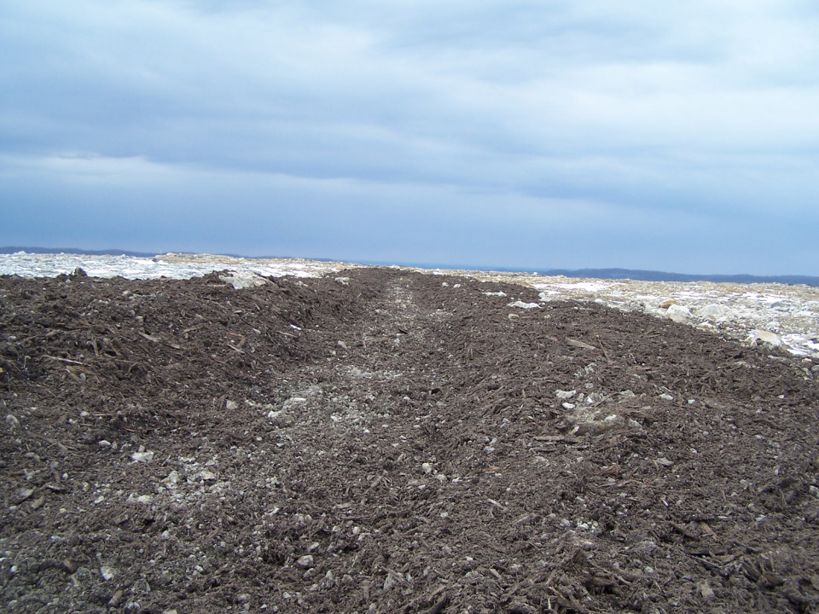
BARK MULCH
Addition of Organic Matter…
  Reduce bulk density
  Increase water infiltration/holding capacity
  Reservoir of nutrients
  Prevent extremes in temperature and moisture

Slide 44
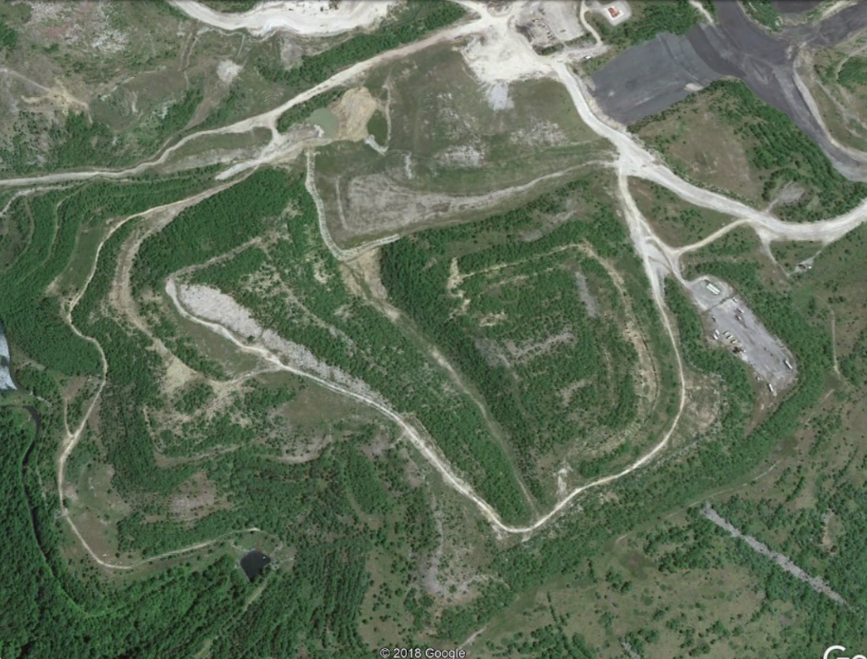
Mulch Plot
Brown Plot
Gray Plot

Slide 45
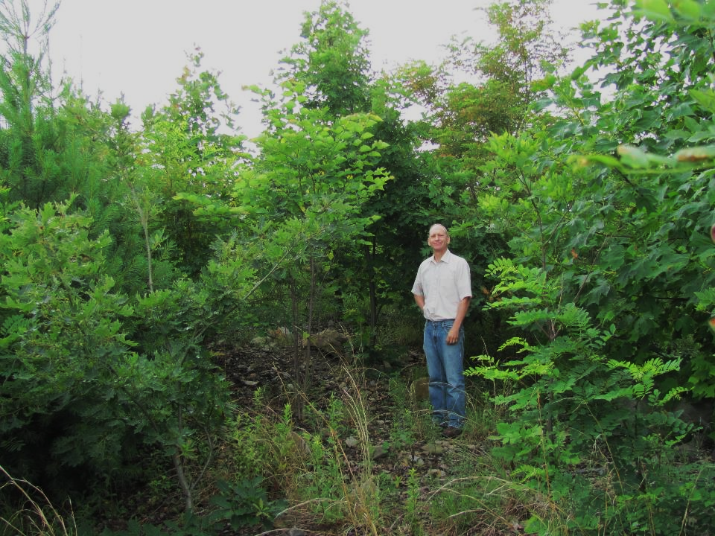
Brown after 8 years

Slide 46
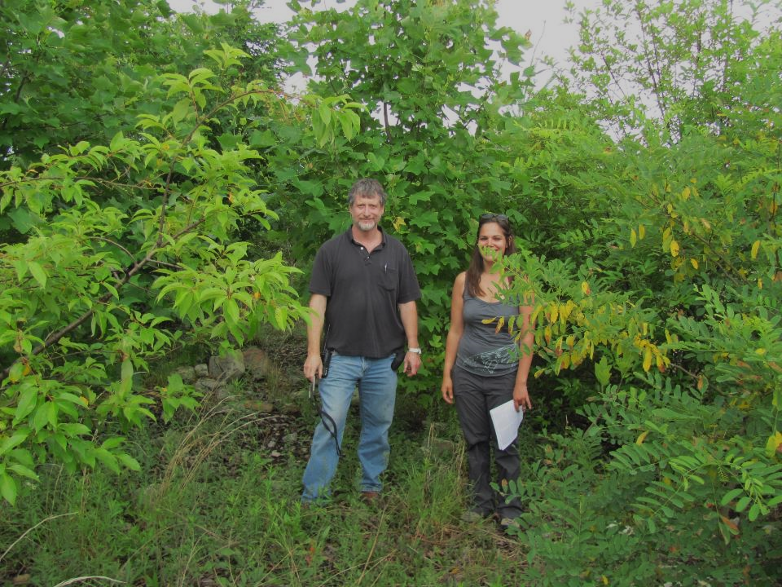
Mulch after 8 years

Slide 47
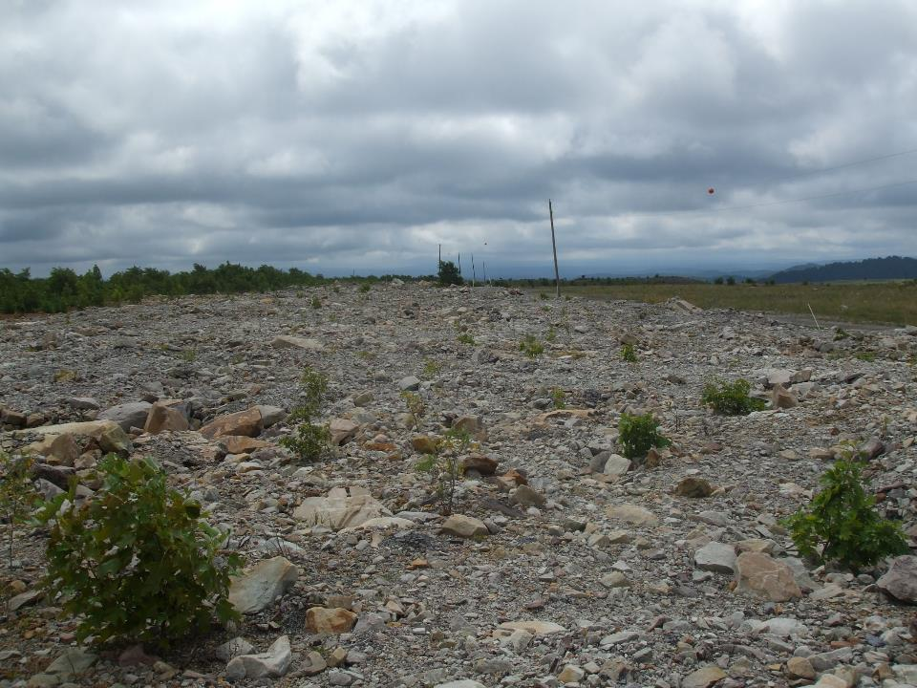
Gray after 8 years

Slide 48
Soil Properties
Property | pH | EC (ds/m) | Fines (%)
Native | 4.6 | <0.01 | 60
Brown | 5.7 | 0.03 | 68
Mulch | 7.0 | 0.04 | 50
Gray | 8.0 | 0.06 | 36
Hardwood trees like pH from 4.5-6
More fines means better water and nutrient relations

Slide 49
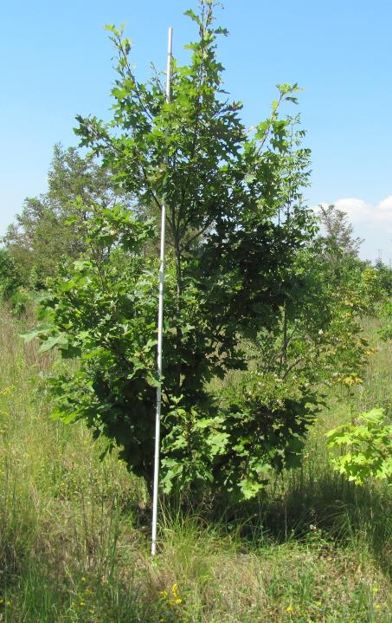
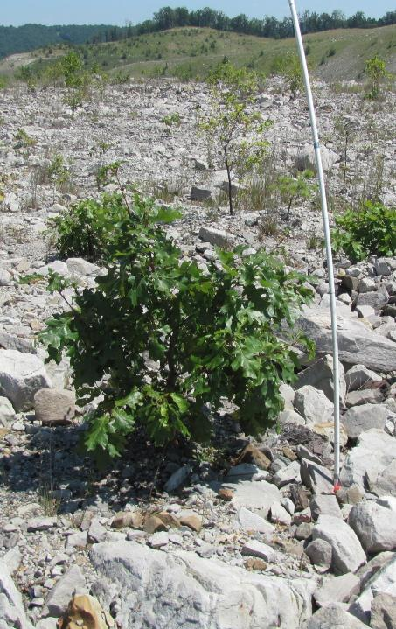
Brown Red Oak Gray

Slide 50
Pre-mine Soils
Site Index
6 m

Slide 51
Site Index
Gray vs Index
92% lower
Gray – CY
Gray – BR
Birch River Catenary

Slide 52
Site Index
Brown vs Index
50% lower
Brown – CY
Brown – BR

Slide 53
Site Index
Mulch vs Index
50% lower
Mulch - BR

Slide 54
Site Index
Fernow vs Index
25% lower
Fernow

Slide 55
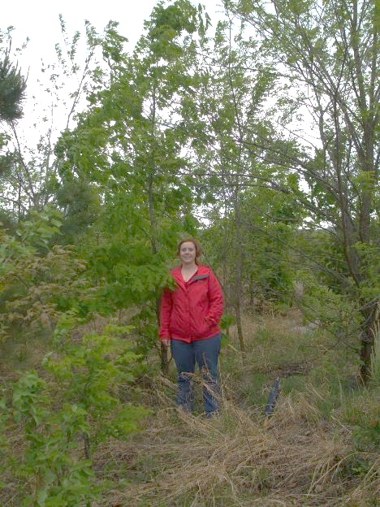
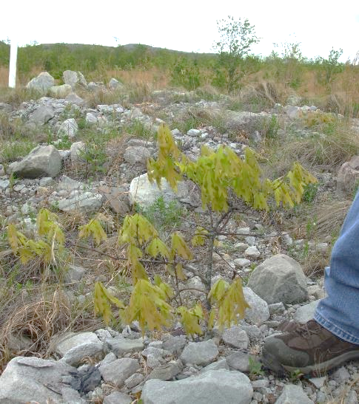
Brown White Oak Gray

Slide 56
6 m

Slide 57
Gray vs Index
90% lower
Gray – CY
Gray – BR

Slide 58
Brown vs Index
50% lower
Brown – CY
Brown – BR

Slide 59
Mulch vs Index
40% lower
Mulch – BR

Slide 60
No Fernow Comparison

Slide 61


Brown Yellow Poplar Gray

Slide 62
Site Index
12 m

Slide 63
Site Index
Gray – CY
Gray – BR

Slide 64
Brown vs Index
75% lower
Brown – CY
Brown – BR

Slide 65
Mulch vs Index
75% lower
Mulch – BR

Slide 66
Fernow vs Index
25% lower
Fernow

Slide 67

Study 3 - Summary
Conclusions
Tree Growth on Gray Sandstone – Poor
  90 to 95% lower growth
Tree Growth on Brown Sandstone – Moderate
50% lower growth
Tree Growth on mine sites is lower than growth on undisturbed areas

Slide 68

Transplanted Seedlings
1st Year – Sleep
2nd Year – Creep
3rd Year – Leap

Slide 69

On Mine Soils
Transplanted Seedlings
1st and 2nd Year – Sleep
3rd to 5th Year – Creep
5th + Year – Leap

Slide 70
Site Index
Brown vs Index
50% lower
Brown – CY
Brown – BR

Slide 71

Will tree growth always be lower?

Slide 72

As mine soils age and weather,
release fresh nutrients and develop
properties similar to pre-mine soils,
tree growth may be higher in later stages
and during the 2nd and 3rd tree rotations.

Slide 73

Notes:
If graded to a smooth surface…
and especially if lacking rocks and organic debris…
salvaged topsoil may be more prone to erosion initially…
than the rocky spoils used in some reclamation practices today.
Thus, when a slow-growing tree-compatible ground cover is used…
Some erosion of the topsoil may occur during the first year or two…
as the seeded and volunteer vegetation becomes established

Slide 74

Comments

