Slide 1
Source Control or How to Eliminate Acidophiles and Influence Water Quality
Paul Eger
Global Minerals Engineering / Linkan Engineering
Jim Gusek, Lee Josselyn
Linkan Engineering
Tom Clark
Solfatara Laboratories
Global Minerals Engineering
Notes:
Thanks for including us in your program. My co-author, Jim Gusek and I have been involved with passively treating acid rock drainage for about 30 years and we came to the realization that source control of ARD might be more sustainable. I’d like to introduce you to some general concepts of source control and how these might be applied at

Slide 2
Outline
What is source control?
Why is it important?
Study Site
Approach
Results
Conclusions
Next steps

Slide 3
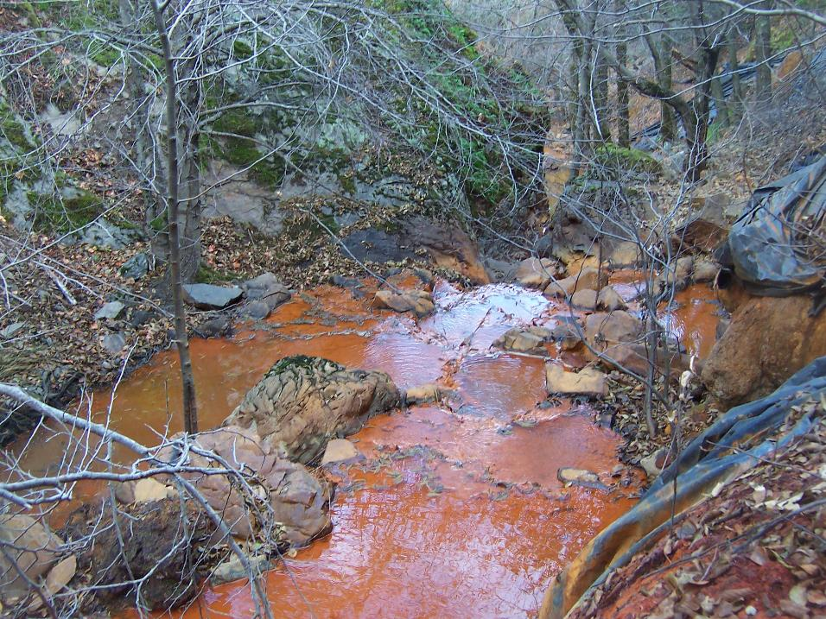
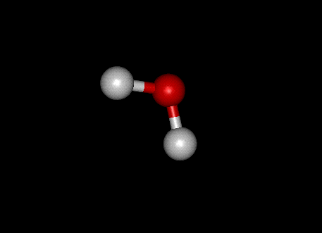
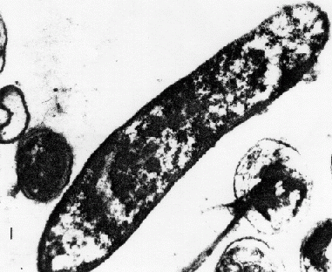
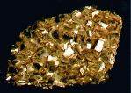
Acid Rock Drainage Tetrahedron
Fuel
Water
FIRE
Air
Heat
ARD
Oxidizer
(Air, Fe⁺³)
Bacteria
Pyrite
Notes:
Before we get started, we need to understand that ARD formation is analogous to the combustion triangle we all learned in elementary school. Cut off the air, fuel or heat supplies and you won’t have a fire. (CLICK)
ARD formation is similar, you need pyrite (of course), air, water and not fully appreciated, bacteria: acidithiobacillus ferro-oxidans . Cut off one or more corners of the ARD tetrahedron, and ARD kinetics is greatly suppressed. But if you cut off the bacteria corner, you can slow the kinetics of ARD formation by 3 orders of magnitude (that’s a thousand times slower).

Slide 4
Why is it Important?
IN PERPETUITY
Unless we can find practical
source control remedies
Notes:
The mining industry suffers from a huge bacterial infection and acidithiobacillus ferro-oxidans is the main cause of this geological disease. Unless we figure out a remedy for the patient, we’re looking at PERPETUAL TREATMENT; in perpetuity is a long time. This is NOT a sustainable outcome.

Slide 5
Acid Rock Drainage Tetrahedron
Water
Oxidizer
(Air, Fe⁺³)
Bacteria
Pyrite
DO NOTHING = PERPETUAL TREATMENT
DO SOMETHING (anything) = SUSTAINABLE REMEDIES
Notes:
It’s not enough to kill the bad bacteria, just killing the bacteria leads to short term control

Slide 6
Source Control Options
Pyrite
Avoidance
Processing
Water
Covers
Impermeable
Evaporative
Oxidizer
Subaqueous disposal
Organic covers
Bacteria
Bactericides
Organic materials

Slide 7
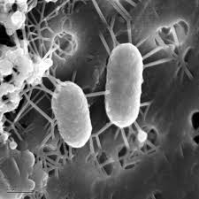
Why Bacteria?
They are everywhere!
Shown to greatly accelerate rate of pyrite oxidation
Rate increases by orders of magnitude
Been found in circumneutral mine drainage
Major influence on the ultimate water quality
Acidithiobacillus Ferrooxidans

Slide 8
Changing the Microbial Community
Eliminate with bactericide
Surfactants – Sodium Lauryl Sulfate
US Bureau of Mines 1980’s
Create conditions for other bacteria
Change environment and replace by competition
Organics – milk
Western Research Institute ( 2008)
Create biofilms

Slide 9
THE SITE

Slide 10
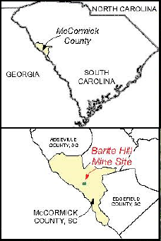
Barite Hill Gold Mine
McCormick, South Carolina
Historic mining 1850’s
Open pit mining 1991-1994
Reclamation from 1995 to 1999
Bankruptcy July 1999
Emergency action 2007
Superfund designation 2009
Notes:
Produced 59,000 oz Au and 109,000 oz silver
Remaining bond $700,000

Slide 11
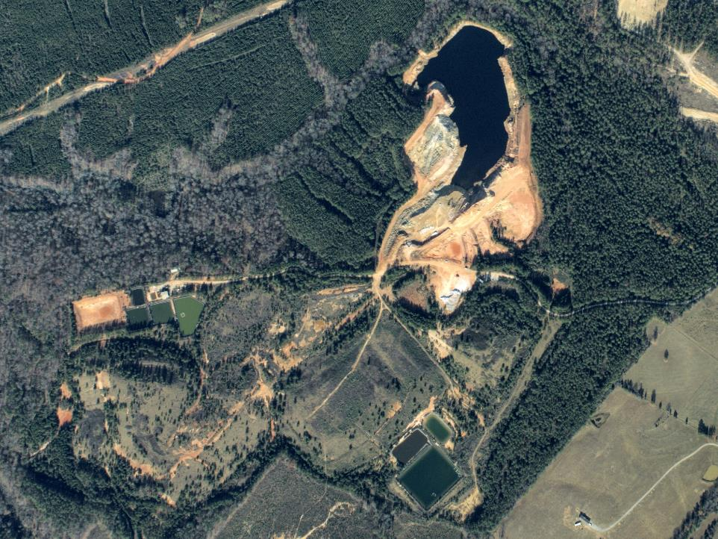
Inventory Results 2007
10-acre acid pit lake pH 1.5 – 2.2
No outlet
Water level rising
Acid seeps from Leach Pad
Acid seeps from Spent Ore Landfill
Acid seeps from Waste Rock Pile
Ditches severely eroding

Slide 12
Remedial Action

Slide 13
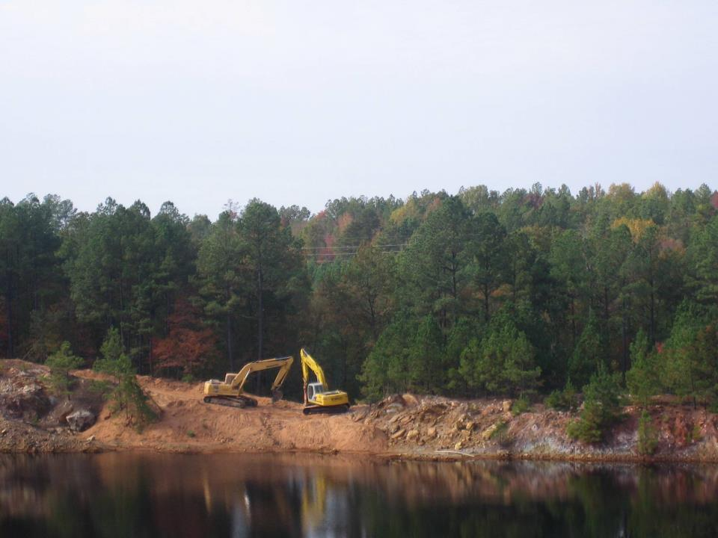
Spillway Construction

Slide 14
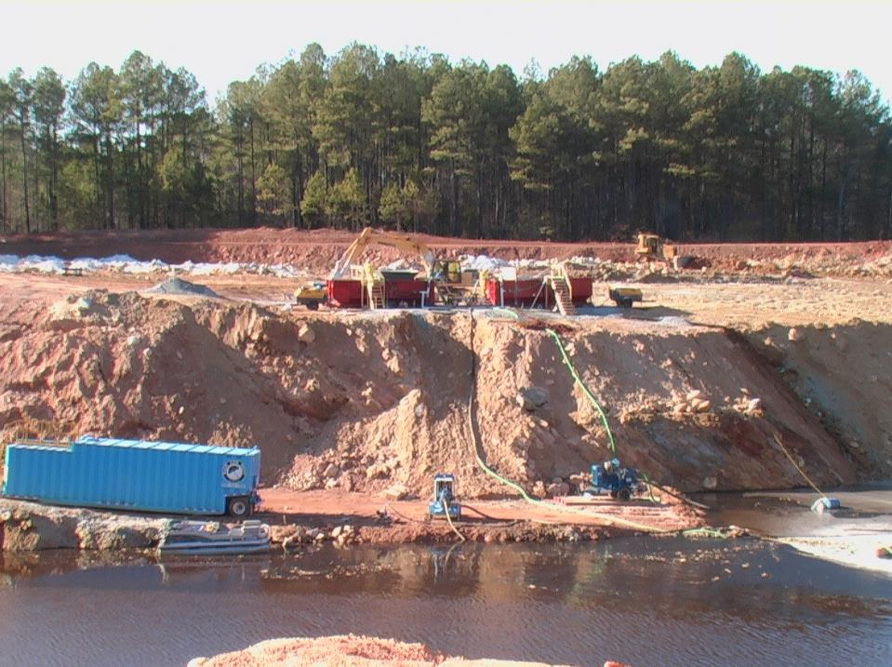
Lake Neutralization and Carbon Addition

Slide 15
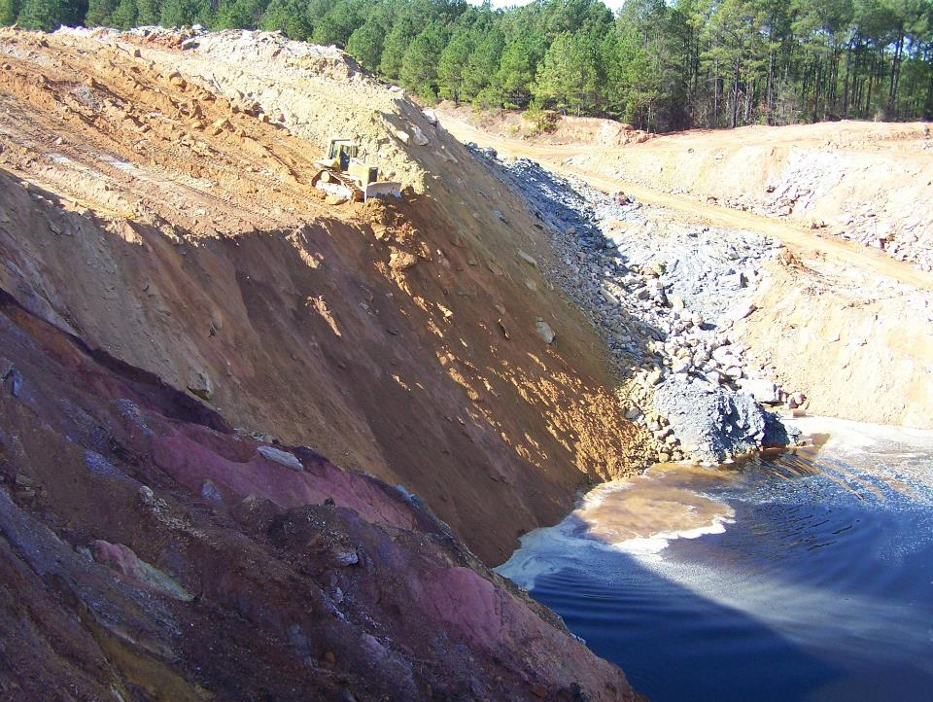
Stockpile reclamation

Slide 16
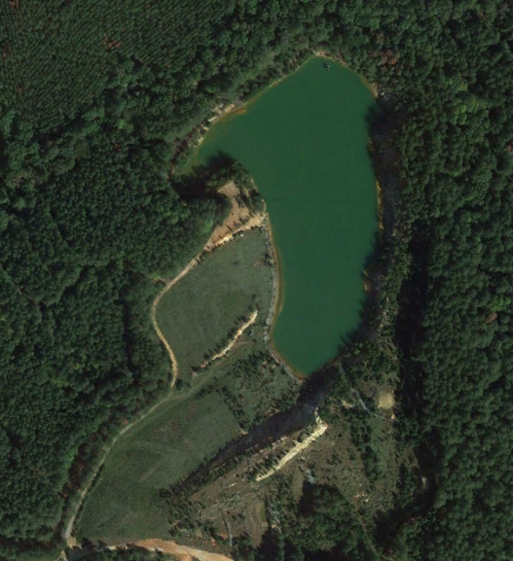
2016
pH 2.5
Waste rock

Slide 17
Problem
Pit water continued to be acidic with high levels of trace metals
Periodically retreated pit with sodium hydroxide
Immediate pH increase but slow decline
Continued input of acid from waste rock appears to be major source
Need a more permanent and sustainable solution

Slide 18
Project Goal
Develop and conduct proof of principle tests to develop innovative remedial actions for the site

Slide 19
Project Objectives
Collect and characterize representative samples from the site
Conduct initial screening tests to refine proof of principle testing
Conduct proof of principle testing for various site components
Waste rock stockpiles
Pit water
Groundwater
Pit bottom
Notes:
Focus on waste rock stockpile since it appears to be major source of loads to the pit

Slide 20
Proof of Principle
Objective was to determine only if the technique could work
Developed screening protocols to facilitate testing
Based on standard testing techniques when possible
Eliminate dead ends early
Amendments based on screening tests
No optimization
To Go or NoT TO Go;
that is the question

Slide 21
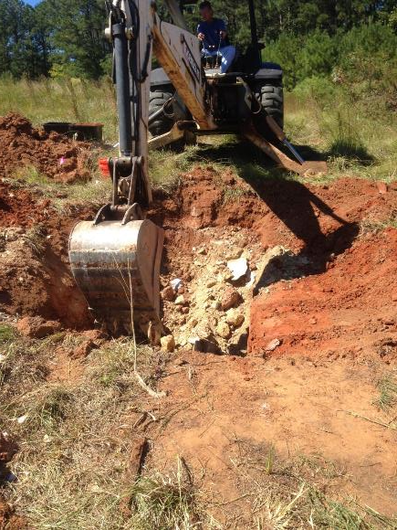
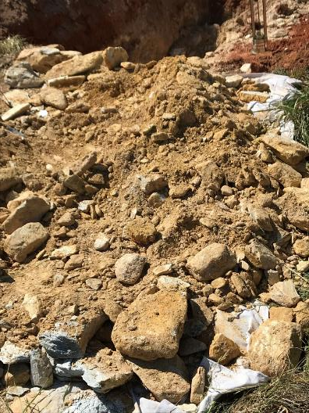
Sample Collection
Fine particles

Slide 22
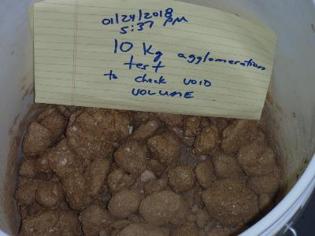
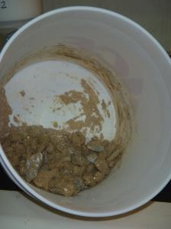
Sample Preparation
Sample contained large percentage of fines
Poor flow properties
Agglomerated sample to improve hydraulic conductivity
Agglomeration process only required distilled water
Use this sample in all reactors
Notes:
Discuss advantages and disadvantages

Slide 23
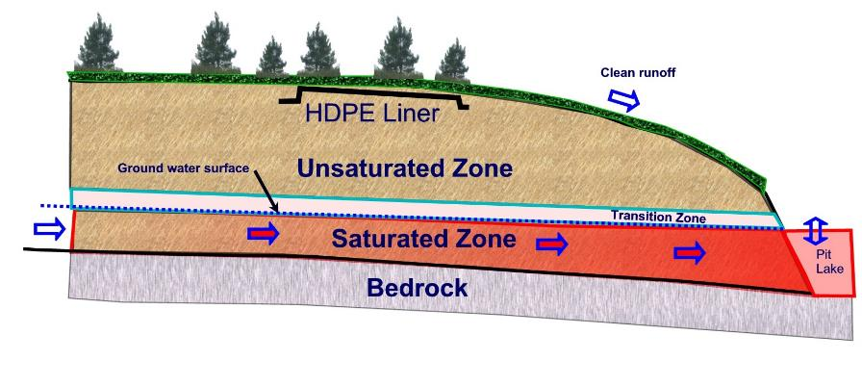
Stockpile conceptual model

Slide 24
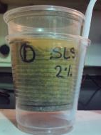
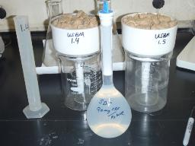
Approach
Develop specific test condition to simulate each zone in the stockpile
Unsaturated
Transition
Saturated
Screening Tests
Beaker Tests (milk & surfactants)
Modified US Bureau of Mines (surfactants)

Slide 25
Unsaturated Zone
Portion of the stockpile
permanently above water
Aerobic environment
Reaction products moved by water infiltration
Contains both residual and sulfide acidity
Residual or stored acidity = reaction products that have not been rinsed out of stockpile
Sulfide or potential acidity = unreacted sulfide minerals which can react in the future

Slide 26
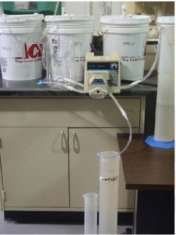
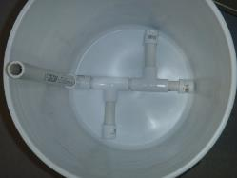
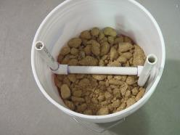
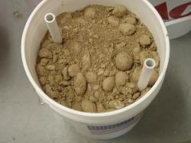
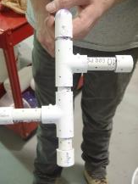
Unsaturated Tests- Methods
Modified humidity cell test
20 kg sample
One week drying cycle
Similar to standard humidity cells
Peristaltic pump - flooded from bottom with distilled deionized water
Water pumped out
20 kg charge
10 kg charge
Gravel layer not shown

Slide 27
Unsaturated Tests- Treatments
Control
Sodium Lauryl Sulfate (SLS)/Alkalinity
Sodium Lauryl Sulfate (SLS)/Alkalinity/Milk
Sequential application
Milk
Milk /Alkalinity
Bacterial inoculum added to milk reactors

Slide 28
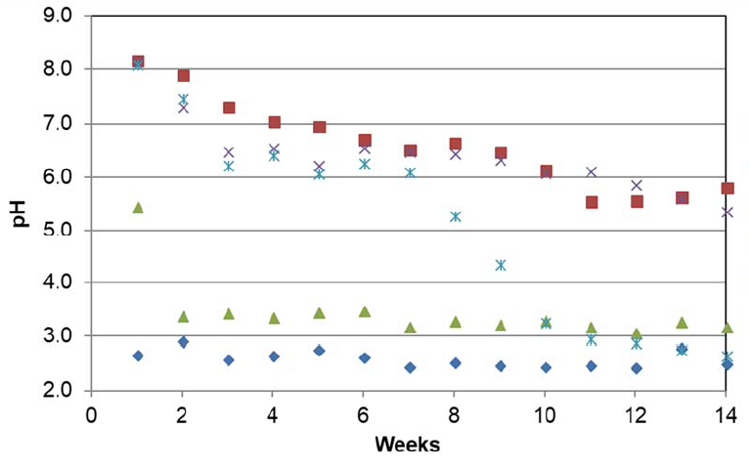
Unsaturated Zone 20-kg Test pH Results
SLS/Alkalinity
Milk/Alkalinity
SLS/Alkalinity/Milk
Milk
Control

Slide 29
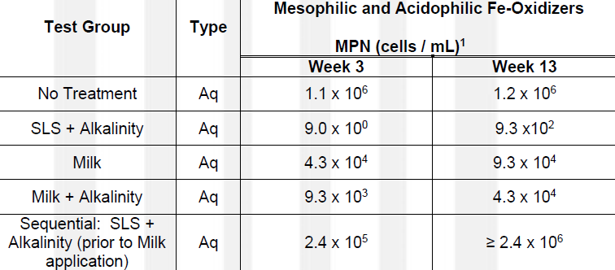
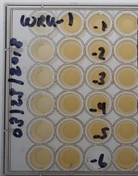
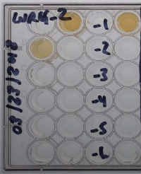
Unsaturated Zone 20-kg Test Microbial Suppression

Slide 30
Transition Zone
Portion of the stockpile between high and low water level
Alternating wet and dry cycle
Ideal conditions for oxidation and transport

Slide 31
Transition Zone Tests- Treatments
Control
Sodium Lauryl Sulfate (SLS)/Alkalinity
Milk
Milk /Alkalinity

Slide 32
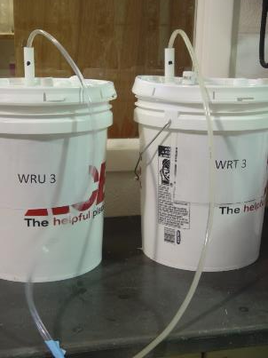
Transition Tests- Methods
20 kg sample
Alternate one week cycles flood and dry
Reactors flooded from bottom with peristaltic pump
Simulated natural groundwater was used as rinse
Water pumped out

Slide 33
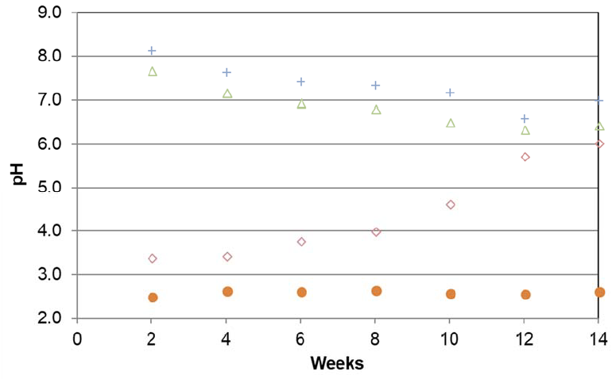
Transition Zone 20-kg Test pH Results
SLS/Alkalinity
Milk/Alkalinity
Milk
Control

Slide 34
Transition Zone – Microbial Results

Slide 35
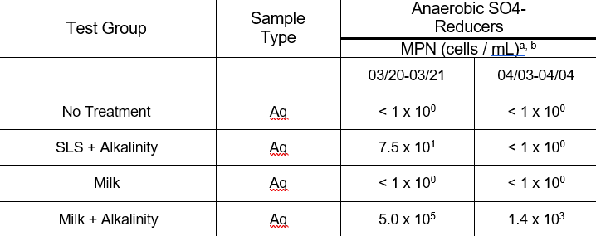
Transition Zone – Microbial Results
Week 9
Week11
Notes:
Commercial heap leaches10 6 to 10 8
Sampled ½ way through draw down to minimize contamination

Slide 36
Saturated Zone
Portion of the stockpile below low water level
Permanently flooded
Low pH
High ferric iron
Sulfide oxidation occurs due to ferric iron

Slide 37
Saturated Zone Tests- Treatments
Alkalinity
Milk /Alkalinity
Since primary oxidation is by ferric iron
SLS would not be expected to be effective

Slide 38
Saturated Zone Tests - Methods
20 kg sample
Permanently flooded
Sample volume withdrawn weekly
Water replaced
Amendments added over time
Initial portion of study
Simulate groundwater flow

Slide 39
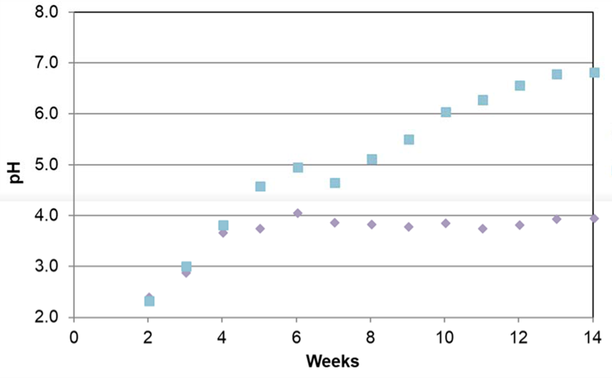
Saturated Zone-pH results
Milk/Alkalinity
Alkalinity

Slide 40
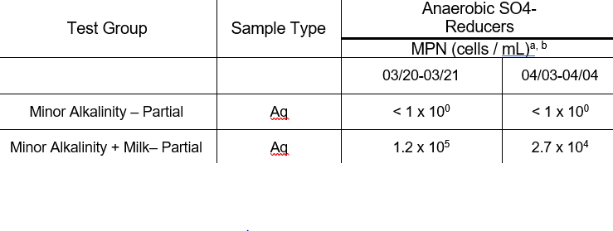
Saturated Zone-Microbial results
Week 9
Week 11
Alkalinity
Milk/Alkalinity

Slide 41
Conclusions
Source Control Works!

Slide 42
Conclusions
Microbial community successfully modified
SLS/ Alkalinity effective at suppressing acidophilic bacteria in the unsaturated and transition zone conditions
Milk/Alkalinity
Effective in transition and saturated zone
Neutralized acidity
Replaced acidophiles with sulfate reducers

Slide 43
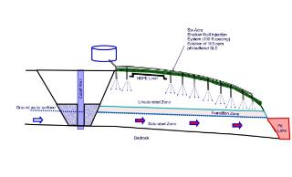
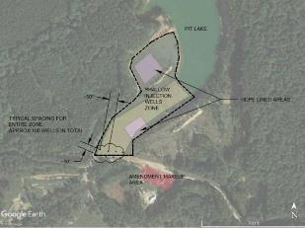
Next Steps
Phase 2
Refine site model
Mass release estimates
Determine optimum addition rates
Application methods
Drip irrigation
Wells
Trenches
Field Testing
Shallow Wells/Trench

Slide 44
Acknowledgements
Candice Teichert, US EPA
Reginald G. Dawkins, Black and Veatch Special Projects
Joel Padgett, South Carolina, DHEC

Slide 45
The Choice
Quest
ions
?
IN PERPETUITY
Innovation Works!
Notes:
The mining industry suffers from a huge bacterial infection and acidithiobacillus ferro-oxidans is the main cause of this geological disease. Unless we figure out a remedy for the patient, we’re looking at PERPETUAL TREATMENT; in perpetuity is a long time. This is NOT a sustainable outcome.

