Slide 1
Abatement of AMD at Abandoned Coal Mines in North Central Missouri: An Overview
Paul Behum¹ and Daniel Wedemeyer²
1 Office of Surface Mining, Mid-Continent Region
2 Missouri Department of Natural Resources, Land Reclamation Program

Slide 2
What we will be discussing:
Coal Resources/geologic settings for mine discharges in the Bevier Coal Field, North Central Missouri.
Overview of passive treatment technologies used to abate net acidic artesian discharges in the Missouri.
Review of existing case example sites:
Old Bevier Passive Treatment System (PTS), Bevier, MO.
Implications of lessons-learned from at the Old Bevier PTS and similar systems for the abatement of untreated net–acid AMD discharges in nearby Huntsville, MO:
Huntsville Gob Refuse Area Seep and UG Mine Discharge.
Calfee Slope Mine Discharge.
Mitchell Mine Discharge.
Notes:
We will first look at the geologic settings for mine discharges in the Bevier Coal Field, North Central Missouri. Our goal will be to Overview of passive treatment technologies used to abate moderate to relatively severe net acidic artesian discharges in central Missouri.
Our overview will center on al review of an existing case example site:
Old Bevier Passive Treatment System (PTS), Bevier, MO.
The Implications of lessons-learned from at the Old Bevier PTS and similar Missouri systems will be used the development of plans for the AMD abatement in the nearby Huntsville, MO area. These discharges include:
The Huntsville Gob Refuse Area Seep and UG Mine Discharge.
The Calfee Slope Mine Discharge.
and The Mitchell Mine Discharge.

Slide 3
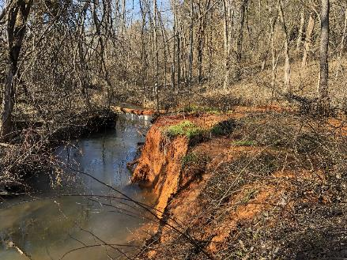
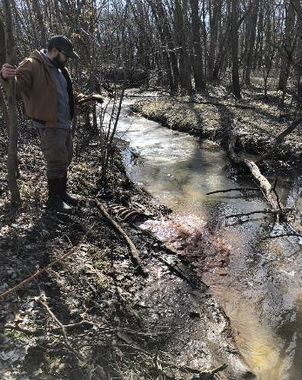
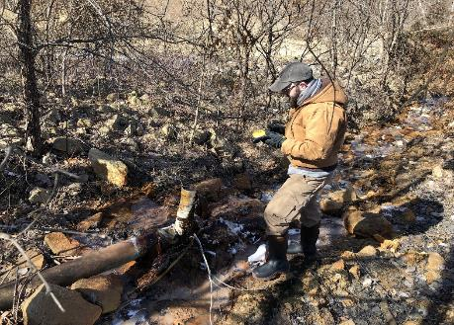
Huntsville Discharges: Jackson County, Missouri
Mitchell Mine High Flow Discharge
Huntsville Gob: Low flow refuse pile toe seep HG-4M.
Calfee Slope Mine: High Flow UG Mine Discharge
Huntsville Gob: Moderate Flow UG Mine Seal Discharge HG-2M.
Notes:
Here we see these Huntsville Missouri discharges clockwise from the top: terraced iron deposits at the Mitchell Mine discharge, seepage from a reclaimed gob pile at the Huntsville Gob AML site, and a couple of wet seal discharges from an underground mine at the Huntsville Gob site and at the Calfee slope mine.

Slide 4
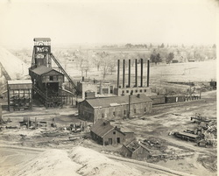
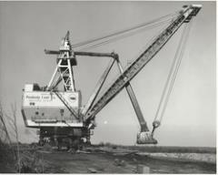
Western Interior Coal Region
Notes:
The western interior coal region shown here in orange lies immediately west of the Mississippi River and the Illinois Coal Basin. Initial coal production centered on underground mining in the beginning in late 1800’s to support railroads engaged in the western expansion of the US. Some of these such as the mines near Bevier, Missouri were somewhat large. The rural electrification program of the post-WWII era triggered a large increase in surface mining clustered around several large coal power plants in the region.

Slide 5
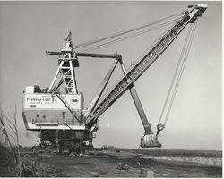
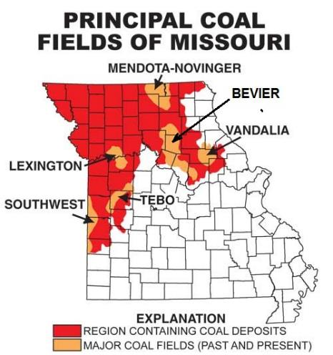
Western Interior Coal Region
Stripping Shovel at the Bee Veer Mine, Macon Co., MO
Location of the Bevier Coal Field, North Central Missouri
Notes:
The entire northwestern part of Missouri is covered with primarily high sulfur coal deposits. Principle production fields are shown here. The Southwestern, Tebo and the area we will be discussing, the Bevier field, were the areas with the biggest historical production.

Slide 6
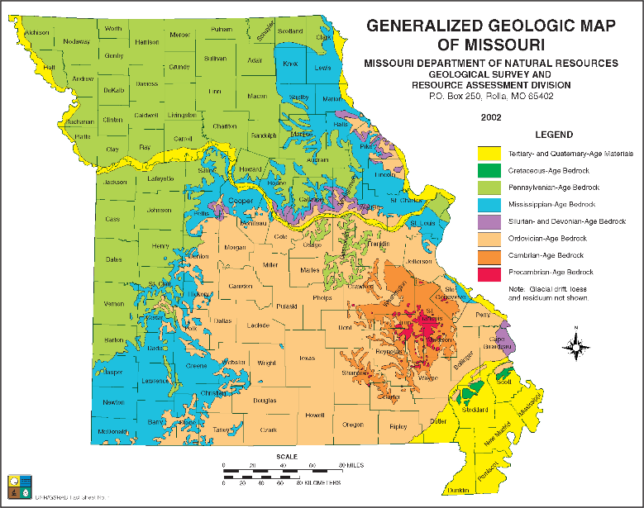
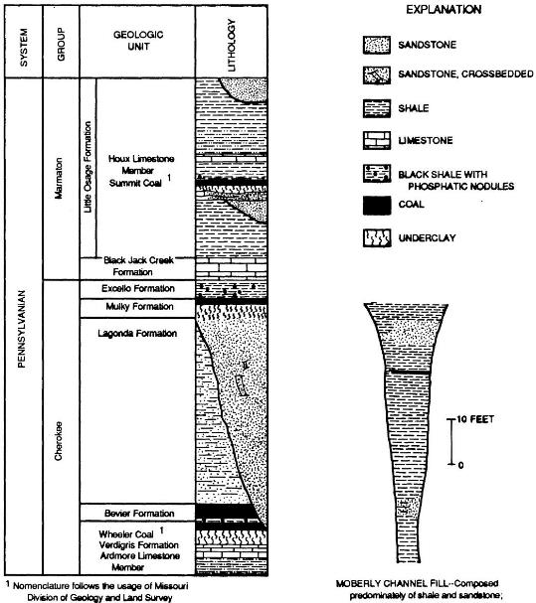
Geology of the Bevier Coal Field
Bedrock Geology
Stratigraphy
Notes:
The area underlain by the coal-bearing Pennsylvanian age strata are shown in the geologic map in green. Most coal production in the Bevier Field is from the Bevier and Wheeler coal beds of the Cherokee Group.

Slide 7
1) 8-ft. thick coal seam was discovered at Bevier, Missouri in the1855. 2) Underground coal mining began in the around 1856. 3) Underground mining ceased during the Great Depression in the 1930’s.
Underground Mining in the Bevier Coal Field
Underground Coal Mine, Huntsville, Missouri
Large Shipping UG Coal Mine, Bevier, MO
Notes:
Underground coal mining began a year after an 8-ft. thick coal seam was discovered at Bevier, Missouri in the1855. This mining era continued until the Great Depression in the 1930’s. There were several larger shipping coal mines in both the Bevier and Huntsville mining areas but the majority of Huntsville mines were quite small.

Slide 8
1) 1936 and 1979: Surface mining by the Binkley, Sinclair and Peabody coal companies. 2) 1979 - 1993: Operated by (Associated Electric Cooperative, Inc. (AECI).
Bee Veer Mine:
1980’s: Recovery of 1 million C.Y. of coal slurry at the Bee Veer Wash Plant.
The “Big David,” a 65-cubic yard Marion 5863 stripping shovel.
Notes:
The largest historic surface mine in the vicinity of our case example site was the Bee Veer Mine. Bee Veer incredibly operated between 1936 and 1993. First by the Binkley, Sinclair, and Peabody coal companies and then finally by the local power company, Associated -- AECI. Peabody produced the bulk of the coal using the “Big David” stripping shovel. AECI finished the operation using large draglines and a dredge to recover coal slurry for processing and combustion.

Slide 9
Artesian AMD Discharges in the Bevier Coal Field: Two Categories:
Moderate flow w/moderate-high acidity & low aluminum (Al).
Artesian/gravity drainage from wet seals - quality more similar to Appalachian discharges - Easier to treat passively, but potentially costly due to system size.
Mitchell Mine and Calfee Slope Discharges.
Old Bevier Swale Area Seeps.
Low-moderate flow w/moderate-high acidity & elevated Al.
Refuse & UG mine discharges – More difficult and costly to treatment passively due to presence of high acidity and Al.
Huntsville Gob Area - UG Mine Discharge and Gob Seeps.
Old Bevier Treatment System and Old Bevier Seep 3.
Notes:
Bevier Coal Field mine discharges can be lumped into two categories:
Moderate flow discharges with moderate-high acidity & low aluminum, and
Low-moderate flow w/moderate-high acidity & elevated Al.
The moderate acidity discharges are characterized by artesian or gravity drainage from previously constructed wet seals – The quality of these discharges are more similar to Appalachian discharges - Easier to treat passively, but potentially costly due to system size. These include:
The Mitchell Mine and Calfee Slope Discharges in Huntsville, and
Seeps in the what is termed the “Old Bevier Swale Area.”
The higher acidity discharges are More difficult and costly to treatment passively due to the presence of aluminum and the need to offset the excessive acidity.
In this study these include:
The Huntsville Gob Area discharges (a UG Mine Discharge and several
Gob area Seeps, and
The Old Bevier Treatment System inlet AMD and nearby Seep 3.

Slide 10
Huntsville, Missouri - Mine Features and Sample Locations
Notes:
Using a map developed by the USGS we see here the principle mine discharges in Huntsville, Missouri. The Bevier crop line is shown in blue. Three sub basins define the AMD impact area. The largest discharges are the Mitchell Mine and Calfee slope sites in the western sub basins. Additional AMD is found in a separate sub basin to the east at Huntsville Gob Pile, a former AML reclamation project site.

Slide 11
Problem Identification: Sugar Creek below the Huntsville Gob tributary is a 303D-list, non-attainment stream.
Notes:
In a map derived from the states’s TMDL assessment we see her that Sugar Creek, a major tributary of the East Fork Chariton River, is rated as non-attainment water body blow the confluence with the Huntsville Gob drainage channel.

Slide 12
AMD in the Mitchell Mine, Sub-Basin
MM-3M = mine discharge
MM-6S = public sewage plant discharge
Notes:
The Mitchell Mine discharge flows directly to the East Fork and impacts an unnamed waterway flowing through the western part of the town. This AMD is partially abated by alkaline dilution water from a downstream sewage treatment plant discharge.

Slide 13
Mitchell Mine, Huntsville, MO: Median Water Quality Data
Location | pH | D. Al (mg/L) | D. Fe (mg/L) | D. Mn (mg/L) | D. Ca (mg/L) | SO₄ (mg/L) | Acidity_{calc} (mg/L CCE)* | Alkalinity (mg/L CCE) | Net Acidity (mg/L CCE)
Mitchell Mine MM-3M - 1992 data* | 5.60 | 0.090 | 251.5 | 4.60 | 370.0 | 1,900.0 | 541.8 | 153.0 | 388.8
Mitchell Mine MM-3M - 2005 data** | 6.00 | 0.050 | 154.5 | 3.05 | 337.0 | 1,920.0 | 351.5 | 160.0 | 191.5
Mitchell Mine MM-3M – This study | 6.09 | 0.163 | 89.0 | 2.20 | 110.0 | 1,610.0 | 170.9 | 162.0 | 8.9
W. Mine Pool Wells - 1992 data* | 6.20 | 0.050 | 34.0 | 2.30 | 260.0 | 1,100.0 | 80.65 | 220.0 | -139.4
W. Sewage Plant Discharge: 2005** | 7.90 | 0.005 | 0.068 | 0.476 | 82.0 | 140.0 | 1.0 | 190.0 | -208.0
*Blevins, D.W. and A.C. Ziegler, 1992, Hydrology, water chemistry, and subsidence of underground
coal mines at Huntsville, Missouri-July 1987 to December 1988, U.S. Geological Survey, Water-
Resources Investigations Report 92-4001, 56 pp.
**Christensen, E.D., 2005, Assessment, water-quality trends, and options for remediation of acidic
drainage from abandoned coal mines near Huntsville, Missouri, 2003–2004, U.S. Geological Survey,
Scientific Investigations Report 2005-5202, 84 pp.
Notes:
Huntsville surface water quality data from this study is supplemented by two prior USGS studies, one by Blevins and Ziegler in 1992 and a second by Christensen in 2005. Looking at this water quality data we see that there has been a significant improvement in the untreated AMD’s water quality over time. In particular, iron decreased from the late 1980’s to present from about 250 mg/L to 89 mg/L. This reduced the acidity from 541 to 171 mg/L, a level that converts the water to net alkaline and therefore much simpler to treat passively.
*Blevins, D.W. and A.C. Ziegler, 1992, Hydrology, water chemistry, and subsidence of underground coal mines
at Huntsville, Missouri-July 1987 to December 1988, U.S. Geological Survey, Water-Resources Investigations
Report 92-4001, 56 pp.
**Christensen, E.D., 2005, Assessment, water-quality trends, and options for remediation of acidic drainage
from abandoned coal mines near Huntsville, Missouri, 2003–2004, U.S. Geological Survey, Scientific
Investigations Report 2005-5202, 84 pp.

Slide 14
Mitchell Mine, Huntsville, MO: Contaminant Loading
Location | Discharge (L/min) | Al (g/D) | Fe (g/D) | Mn (g/D) | Ni (g/D) | Zn (mg/D) | Acidity_{calc} (g\D CCE)* | SO₄ (g/L) | Alkalinity (g/D CCE)
Mitchell Mine MM-3M - All data | 129.1 | 9.85 | 29,657 | 567.1 | 2.23 | 11.62 | 65,356 | 353,286 | 29,750
W. Sewage Plant Discharge: 2005* | 212.4 | 1.53 | 20.8 | 145.6 | 2.14 | 0.92 | 295.2 | 42,815 | 58,106
MM-3M:WSP 1:1.65 Blend** | 341.50 | 11.38 | 29,678 | 712.7 | 5.75 | 13.13 | 65,651 | 423,705 | 87,857
Initial Blend*** Concentration (mg/L) |  | 0.023 | 60.35 | 1.45 | 0.012 | 0.027 | 133.5 | 861.6 | 178.7
*Reported by Christensen, 1992.
**Simple blend to stated ratio and not the result of geochemical modelling.
***Back calculated from blend loading data.
Notes:
A preliminary assessment was conducted to evaluate the impact of adding alkaline dilution water to offset the alkalinity in the AMD prior to discharge into the East Fork. Using the limited flow information and sewage plant discharge data provided by the Christensen’s 2005 study the contaminant load of the blend can be determined as well as an initial blend concentration of a geochemical modelling software would provide an improved estimate of the blend concentration that better reflects changed in the master parameters such as pH. Again net alkaline drainage is predicted.

Slide 15
AMD in the Calfee Slope Mine, Sub-Basin
CS-3M = mine discharge
CS-8S = public sewage plant discharge
MW-04-04 – USGS monitoring well
Notes:
The Calfee Slope discharge flows north to the Sugar Creek and northern part of the town. This AMD is also partially abated by alkaline dilution water from a downstream sewage treatment plant discharge.

Slide 16
Calfee Slope Discharge, Huntsville, MO: Median Water Quality Data
Location | pH | D. Al (mg/L) | D. Fe (mg/L) | D. Mn (mg/L) | D. Ca (mg/L) | SO₄ (mg/L) | Acidity_{calc} (mg/L CCE)* | Alkalinity (mg/L CCE) | Net Acidity (mg/L CCE)
Calfee Slope CS-5M - 1992 data* | 4.80 | 0.370 | 569.0 | 13.0 | 440.0 | 3,600 | 1,413.9 | 40.5 | 1,370.9
Calfee Slope CS-5M - 2005 data** | 5.20 | 0.874 | 566.0 | 12.0 | 442.0 | 4,370 | 1,016.5 | 43.0 | 1,016.5
Calfee Slope CS-5M – This study | 5.25 | 0.880 | 272.0 | 9.25 | 400.0 | 2,360 | 659.4 | 39.0 | 618.9
N. Sewage Plant Discharge: 2005** | 8.10 | 0.028 | 0.285 | 0.339 | 104.0 | 216.5 | 0.723 | 146.0 | -178.7
*Blevins, D.W. and A.C. Ziegler, 1992, Hydrology, water chemistry, and subsidence of underground
coal mines at Huntsville, Missouri-July 1987 to December 1988, U.S. Geological Survey, Water-
Resources Investigations Report 92-4001, 56 pp.
**Christensen, E.D., 2005, Assessment, water-quality trends, and options for remediation of acidic
drainage from abandoned coal mines near Huntsville, Missouri, 2003–2004, U.S. Geological Survey,
Scientific Investigations Report 2005-5202, 84 pp.
Notes:
Again the surface water quality data from this study is supplemented by the two prior USGS in 1992 and 2005. There has again been a significant improvement in the untreated AMD’s iron content over time decreasing from the late 1980’s to present from about 570 mg/L to 272 in the more recent sampling event. This reduced the acidity from 1,414 to 659 mg/L. However, at that level a level remains difficult to treat passively. Blending of this AMD with alkaline sewage plant discharge should improve treatability.
*Blevins, D.W. and A.C. Ziegler, 1992, Hydrology, water chemistry, and subsidence of underground coal mines
at Huntsville, Missouri-July 1987 to December 1988, U.S. Geological Survey, Water-Resources Investigations
Report 92-4001, 56 pp.
**Christensen, E.D., 2005, Assessment, water-quality trends, and options for remediation of acidic drainage
from abandoned coal mines near Huntsville, Missouri, 2003–2004, U.S. Geological Survey, Scientific
Investigations Report 2005-5202, 84 pp.

Slide 17
Huntsville Calfee Slope Discharge: Contaminant Loading
Location | Discharge (L/min)) | Al (g/D) | Fe (g/D) | Mn (g/d) | Ni (g/d) | Zn (g/s) | Acidity_{calc} (g/D CCE)* | SO₄ (g/d) | Alkalinity (g/D CCE)
Calfee Slope CS-5M - All data | 90.90 | 104.8 | 74,477 | 1,263.1 | 2.618 | 8.115 | 138,682 | 540,583 | 5,236
N. Sewage Plant Discharge (NSP): 2005 Data* | 47.57 | 0.48 | 4.4 | 23.2 | 0.411 | 0.206 | 49.5 | 14,831 | 10,002
CS-5M:NSP** Blend (1.00:0.52) | 138.47 | 105.3 | 74,481 | 1,286.3 | 3.029 | 8.321 | 138,732 | 555,414 | 15,237
Initial Blend Concentration: (mg/L)*** |  | 0.528 | 373.5 | 6.45 | 0.015 | 0.042 | 695.8 | 2,786 | 76.4
*Reported by Christensen, 1992.
**Simple blend to stated ratio and not the result of geochemical modelling.
***Back calculated from blend loading data.
Notes:
A preliminary assessment of the impact of adding alkaline dilution water to offset the alkalinity in the AMD prior to discharge into the East Fork. Using the limited flow information and sewage plant discharge data provided by the Christensen’s 2005 study the contaminant load of the blend can be determined as well as an initial blend concentration of a geochemical modelling software would provide an improved estimate of the blend concentration that better reflects changed in the master parameters such as pH. Again net alkaline drainage is predicted.

Slide 18
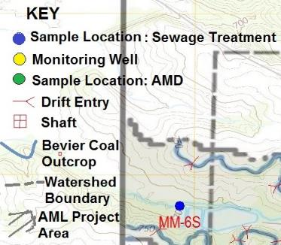
AMD in the Huntsville Gob, Sub-Basin
HG-2M = UG mine discharge
HG-4M = Gob Pile Seep
MW-04-01/-02/-03 – USGS monitoring wells
Notes:
The Huntsville Gob sub basin which was identified in the 2005 USGS study, has had considerable reclamation activity in the 1980s and early 1990’s. A large volume of highly acidic coal waste was excavated and hauled to the AECI Bee Veer reprocessing facility and refuse disposal area. However, contaminated soil and remnant refuse continues to seep into the headwaters of the unnamed drainage. Where it comingles with a perennial underground mine wet seal discharge. The mine pool for these workings is intercepted by three USGS wells drilled in 2003.

Slide 19
Huntsville Gob Discharges: Median Water Quality Data
Location | pH | D. Al (mg/L) | D. Fe (mg/L) | D. Mn (mg/L) | D. Zn (mg/L) | SO₄ (mg/L) | Acidity_{calc}(mg/L CCE)* | Alkalinity (mg/L CCE) | Net Acidity (mg/L CCE)
Huntsville Gob UG Mine Discharge: 2005 data* | 4.60 | 42.20 | 465.0 | 9.26 | 0.503 | 3,800 | 1,133.4 | 21.0 | 1,104.2
Huntsville Gob UG Mine Discharge: This study | 4.63 | 11.63 | 201.5 | 7.14 | 0.200 | 2,080 | 558.8 | 12.5 | 546.3
E. Mine Pool Wells: 2005 data* | 6.15 | 5.0 | 284.2 | 4.68 | 0.468 | 2,940 | 677.5 | 278.0 | - 82.2
Huntsville Gob Pile HG-4M: 2005 data* | 2.70 | 395.0 | 1,910 | 28.50 | 1.25 | 9,570 | 6,220 | 0.0 | 6,220
Huntsville Gob Pile HG-4M: This study | 2.70 | 92.8 | 446.3 | 10.50 | 5.06 | 3,230 | 1,632 | 0.0 | 1,632
*Christensen, E.D., 2005, Assessment, water-quality trends, and options for remediation of acidic
drainage from abandoned coal mines near Huntsville, Missouri, 2003–2004, U.S. Geological Survey,
Scientific Investigations Report 2005-5202, 84 pp.
Notes:
Our preliminary data indicates that there has again been a significant improvement in the untreated AMD from the Huntsville Gob area underground mine discharge iron and aluminum content over time with decreasing from the late 1980’s to present from 465 mg/L to 202 mg/L in the more recent sampling events. This reduced the acidity from over 1,100 to 546 mg/L. However, at this level the discharge still remains difficult to treat passively. Blending of this AMD with alkaline sewage plant discharge should improve treatability. Again the surface water quality data from this study is supplemented by the two prior USGS studies in 1992 and 2005.

Slide 20
Huntsville Gob Discharges: Contaminant Loading
Location | Discharge (L/min) | Al (g/D) | Fe (g/D) | Mn (g/D) | Ni (g/D) | Zn (g/D) | Acidity_{calc} (g/D)* | SO₄ (g/D) | Alkalinity (g/D)
Huntsville Gob UG Mine Discharge HG-2M: All data | 16.99 | 1,019 | 11,377 | 224.4 | 3.43 | 11.30 | 27,711 | 90,768 | 464.8
Huntsville Gob Pile HG-4M: All data | 5.10 | 2,836 | 13,432 | 206.3 | 11.67 | 32.30 | 43,602 | 68,847 | 0.0
HG-2M: HG-4M 1.00: 0.30 Blend* | 22.09 | 3,856 | 24,808 | 430.6 | 15.10 | 43.60 | 71,313 | 159,615 | 464.8
Initial Blend Concentration: (mg/L)** |  | 121.2 | 780.0 | 13.54 | 0.475 | 1.371 | 2,242 | 5,018 | 14.6
*Simple blend to stated ratio and not the result of geochemical modelling.
**Back calculated from blend loading data.

Slide 21
Possible Solutions: Huntsville AMD Problems Areas
Mitchell Mine –ALD? with Oxidation Ponds and an Aerobic Wetland (with sewage discharge).
Calfee Slope – ALD with Oxidation Ponds and an Aerobic Wetland (with sewage discharge).
Huntsville Gob UG Mine Discharge – Sulfate-reducing Bioreactor with an Oxidation Ponds and Aerobic Wetland.
Huntsville Gob Pile Seeps – Anaerobic Wetland (OLA).

Slide 22
Old Bevier PTS: Site Mining/Reclamation History
Mining/Reclamation Activity
Technology Employed
1920’s Underground Coal Mining
1950’s- 1960’s Area-type Surface Coal Mining
1990-1991: Bevier I Reclamation Project.
2001: Bevier II Reconstruction.
Ongoing: Bevier II System Maintenance.
Room and pillar mining
Stripping shovel, partial daylighting of UG workings.
Land reclamation, AFM cover, AMD collection, dilution and aerobic wetland treatment.
2-stage vertical flow ponds with oxidation ponds and aerobic wetlands.
Renovation of VFPs: iron sludge removal, VFP compost, piping, and limestone replacement.

Slide 23
Old Bevier PTS Site Map and Sample Locations

Slide 24
Old Bevier PTS Site Map and Sample Locations

Slide 25
Old Bevier Water Quality Data
Location | pH | SC (µS/cm) | D. Al (mg/L) | D. Fe (mg/L) | D. Mn (mg/L) | D. Ca (mg/L) | SO₄ (mg/L) | Acidity** (mg/L CCE) | Alkalinity (mg/L CCE) | Net Acidity (mg/L CCE)
SysIn: Bevier II (2001-present)* | 5.97 | 3,707 | 0.55 | 311.1 | 8.36 | 504 | 2,250 | 728 | 193 | 537
SysIn: Bevier II (2014-present)* | 5.98 | 3,040 | 0.18 | 211.8 | 7.65 | 477 | 2,280 | 487 | 251 | 236
SysOut: Bevier II* | 4.75 | 3,190 | 0.40 | 7.46 | 7.17 | 542 | 1,700 | 62.5 | 0.0 | 22.4
Upstream: Swale Area*** | 6.55 | 2,420 | 0.20 | 89.6 | 5.16 | 422 | 1,166 | 185 | 114 | 104
Seep #3*** (Downstream) | 2.57 | 4,130 | 2.65 | 198.1 | 15.5 | 434 | 2,534 | 512 | 0.0 | 512
* Median Values (n ~ 20 samples);
flow = 88 LPM (23 GPM).
** Calculated acidity.
*** Swale: n= 7 (flow = 152 LPM) and
Seep #3: n = 5 (flow = 27.4 LPM).
Passive treatment with 2 VFPs in series is more appropriate due to the decline in Fe levels in inlet AMD!

Slide 26
Bevier II Inlet AMD: Improvements with time
Limited data and data reliability suggests the decline in pollutant levels follows a power factor.

Slide 27
Bevier II Inlet AMD: Improvements with time
Lowering of Iron and aluminum levels reduces the acidity that must be neutralized by the VFPs. Again, limited data and data reliability suggests the decline in acidity and specific conductance follows a power factor.

Slide 28
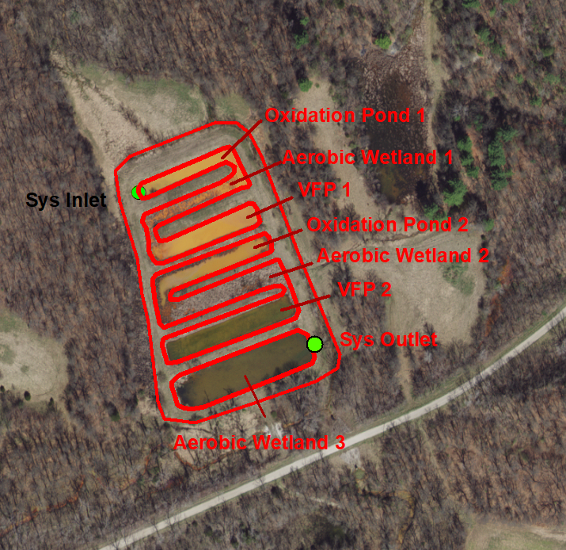
Old Bevier PTS Rehabilitation: Treatment Cell Layout
Oxidation Ponds 1 and 2 and Wetlands 1 and 2 will be undisturbed!
VFP 1 and 2 will be partially reconstructed.

Slide 29
Old Bevier Rehabilitation: Vertical Flow Pond 2 (lower) Autopsy

Slide 30
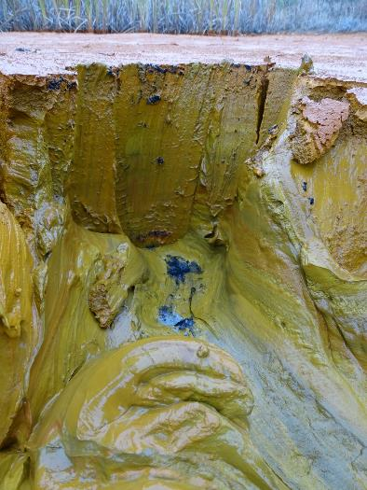
Old Bevier Rehabilitation: Vertical Flow Pond 1 (upper) Autopsy

Slide 31
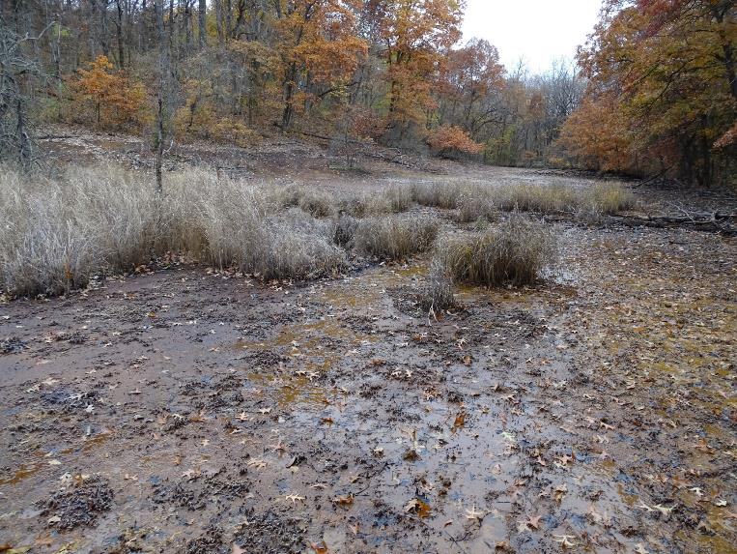
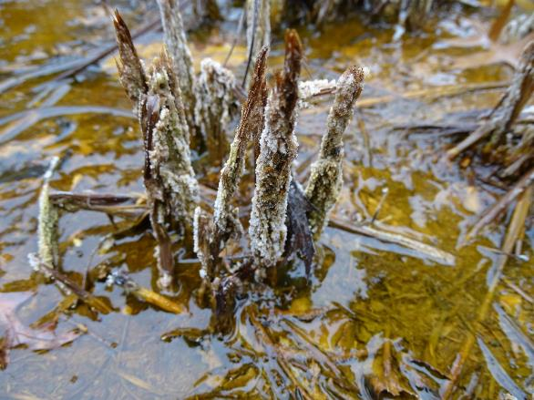
Old Bevier Rehabilitation: Seep #3 Across Road

Slide 32
Old Bevier Rehabilitation: Rehab Plans and Status Update
Bypass inlet AMD and temporarily dewater PTS (completed).
Treat bypassed AMD with soda ash (ongoing).
Excavate wet Fe hydroxide sludge and stack and dry on top of embankments (ongoing).
Remove and replace PVC piping, limestone and compost in VFPs (planned)
Post construction monitoring and evaluation (planned)
Develop revamped system operation plan (planned)

Slide 33
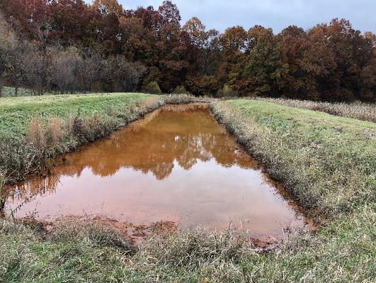
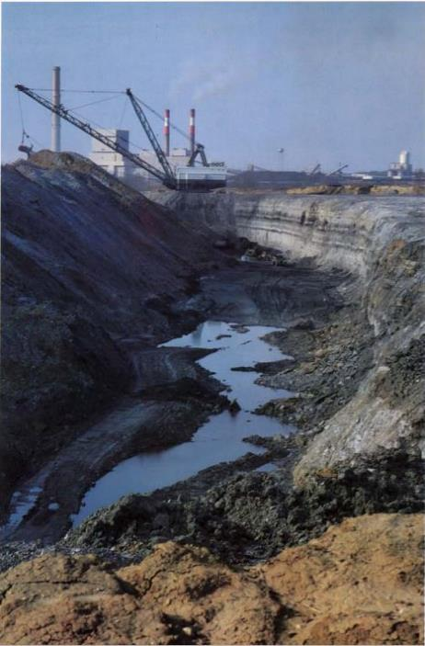
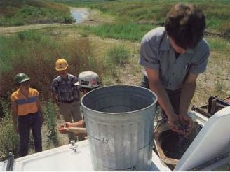
The End
AECI’s Prairie => Hill Mine
Old Bevier Oxidation <= Pond 1
Comments?
1983: AECI mine reclamation =>

