Slide 1
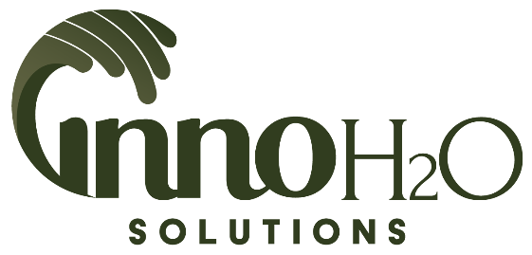
Acid Mine Drainage Remediation
using
Advanced Membrane Filtration
American Society of Mining and Reclamation
36th Annual Meeting
June 5, 2019
MIKE McCLUSKEY
InnoH2O Solutions, LLC
mike@innoh2osolutions.com
www.innoh2osolutions.com

Slide 2
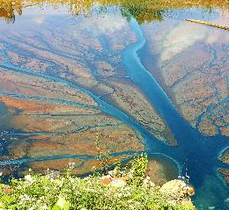
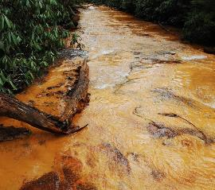
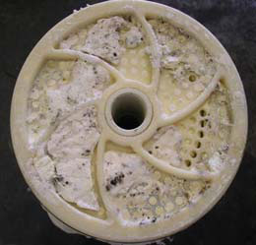
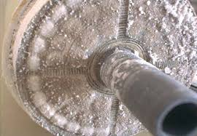
Previous Approaches
Membrane Filtration of AMD has been attempted before
Major issue is primarily Gypsum fouling of membranes
Typical scheme is to raise pH prior to attempting membrane separation
The idea is to precipitate the Gypsum/Iron prior to doing separation
Higher pH (>4.5) typically required for conventional membrane materials
Major issues typically include:
Cost – both Cap-ex and Op-ex
Maintenance Requirements
Membrane Replacement
Membrane images courtesy of Lenntech.com
American Society of Mining and Reclamation
36th Annual Meeting
June 5, 2019

Slide 3
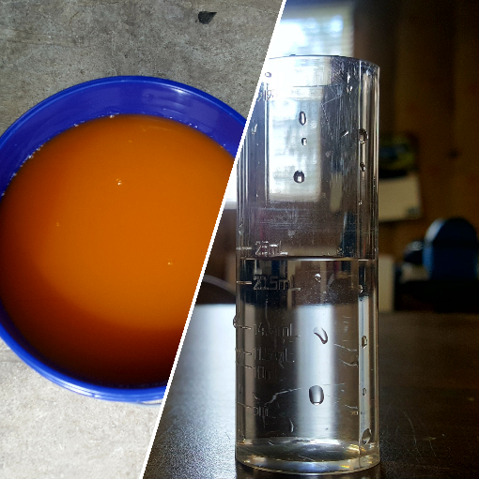
InnoH2O Approach
Zero chemical modification of Raw AMD
Process scheme is a three-stage filtration process:
Particulate Filtration
Microfiltration
Ultra Low-Pressure Reverse Osmosis (< 200 psig)
Low pressure separation of the entrained anions/cations results in highly purified filtrate and virtually eliminates membrane fouling
Blending of Raw AMD and system filtrate to produce water that meets NPDES specs but limits energy content in water (sub-10 watt-hours per gallon)
American Society of Mining and Reclamation
36th Annual Meeting
June 5, 2019

Slide 4
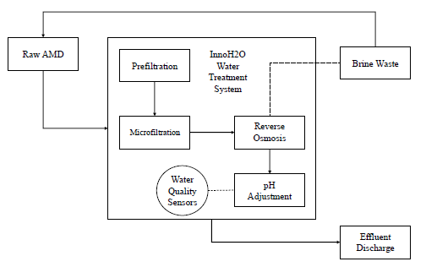
InnoH2O Process Schematic
Raw, unmodified AMD enters the System from the source
The filtration process removes particulates and dissolved solids
Permeate pH is adjusted prior to discharge
Brine/concentrate is recycled back to source
Water Quality sensors monitor influent and effluent water
American Society of Mining and Reclamation
36th Annual Meeting
June 5, 2019

Slide 5
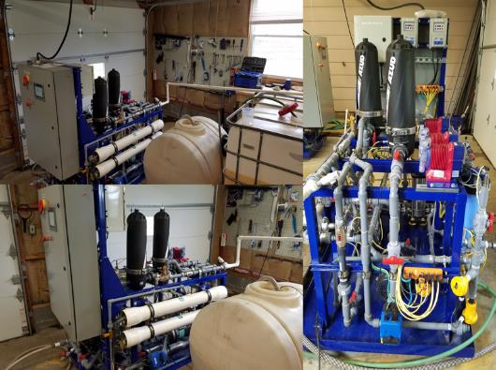
InnoH2O Process – Keys to Success
Maintaining a low feed pH by using Raw AMD eliminates precipitation of iron/calcium solids at modified pH (4+) levels
Allows process to continue to remove anions and cations without significant fouling or sludge formation
Significant particulate pretreatment of influent water to manage maintenance of reverse osmosis process
Removal of particulate to achieve a Silt-Density Index of ~5
Recycling of concentrate/brine from RO process to achieve very high recovery rates (90%+)
Blending of raw influent to final filtrate to achieve a specific result (i.e. legal water) at the lowest energy required
American Society of Mining and Reclamation
36th Annual Meeting
June 5, 2019

Slide 6
Differential Pressure – A Telling Sign
RO differential pressure is a great way to determine if the influent water is fouling the membrane
Over the course of 8 months of testing, RO pressures increased ~30% and RO differential pressures increased 100%
This is a typical increase for the type of water being treated – especially high-iron/high-sulfate water
At 8 month period, increases finally indicated cleaning was required
Membrane was cleaned with a light (pH=1) Muriatic Acid solution to remove metals fouling
Noted fouling was primarily on feed end; overall, membrane was relatively clear of fouling
Membrane was cleaned and returned to service
RO Pressures - Month over Month
(PSI) | Month
 | 1 | 2 | 3 | 4 | 5 | 6 | 7 | 8
Influent | 102 | 102 | 102 | 114 | 120 | 120 | 120 | 132
Concentrate | 96 | 96 | 96 | 104 | 110 | 109 | 108 | 120
Delta P | 6 | 6 | 6 | 10 | 10 | 11 | 12 | 12
American Society of Mining and Reclamation
36th Annual Meeting
June 5, 2019

Slide 7
Typical Water Quality Results
Typical raw acid mine drainage, InnoH2O produced water, and NPDES allowable limits.
(in ppm except where noted)
Note: Filtrate pH modified with minimal amounts of caustic soda (less than 2 mL of 25% by WT NaOH per 100 gallons of filtrate)
American Society of Mining and Reclamation
36th Annual Meeting
June 5, 2019

Slide 8
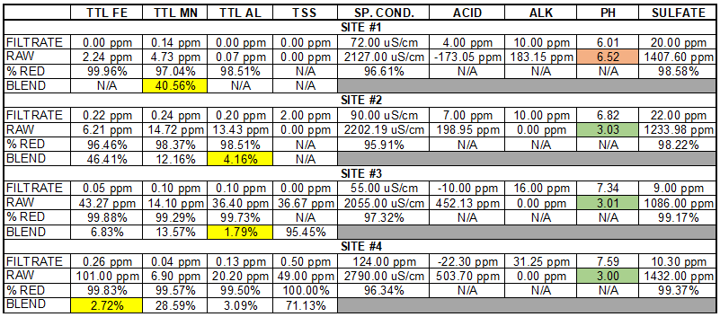
In-Depth Water Quality Results
Note: Filtrate pH modified with minimal amounts of caustic soda (less than 2 mL of 25% by WT NaOH per 100 gallons of filtrate)
American Society of Mining and Reclamation
36th Annual Meeting
June 5, 2019

Slide 9
In-Depth Water Quality Results
Note: Filtrate pH modified with minimal amounts of caustic soda (less than 2 mL of 25% by WT NaOH per 100 gallons of filtrate)
American Society of Mining and Reclamation
36th Annual Meeting
June 5, 2019

Slide 10
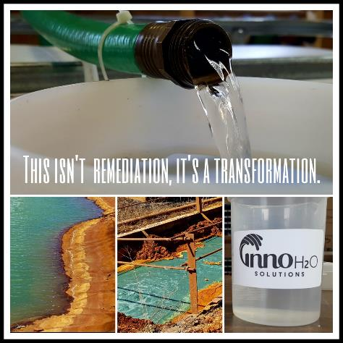
Advantages of High Purity Water
Ability to blend raw water to filtrate water to achieve NPDES legal water which increases flow rates
Especially in times of high-flow/low-concentration events (i.e. rainfalls)
Highly-predictable metals concentrations in filtrate water eliminating the need to constantly adjust caustic soda/lime/hydrogen peroxide dosing
Dissolved metals are relegated to concentrate stream
Metal cations and sulfate anions are typically at the solubility point; can be precipitated out via aeration/oxidation or sent back to headworks/source for recycle
American Society of Mining and Reclamation
36th Annual Meeting
June 5, 2019

Slide 11
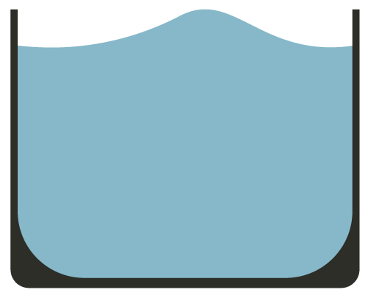
InnoH2O System Hydrologic Loop
InnoH2O Process
Raw AMD
Clean Water
Stage 1 Reject
to
Stage 2
Stage
1
Receiving Stream
AMD Source
Total Recovery >97%
Stage 2 Clean Water
Stage
2
Bucket Volumes Representative of InnoH2O Recovery Rates
Stage 2 Reject
American Society of Mining and Reclamation
36th Annual Meeting
June 5, 2019

Slide 12
Treatment Costs
1 GPM Pilot
10 GPM
25 GPM
50 GPM
O&M Costs Represent InnoH2O Service Contract Costs for maintaining, monitoring, adjusting and sampling results from treatment system; service contract includes all monthly maintenance, required pH adjustment chemicals, bi-yearly cleanings and any replacement filters
Operational Costs range from $0.11 per 1,000 gallons treated to $2+ per 1,000 gallons treated depending on source of maintenance labor, volume of water being treated, water characteristics, location, etc.
American Society of Mining and Reclamation
36th Annual Meeting
June 5, 2019

Slide 13
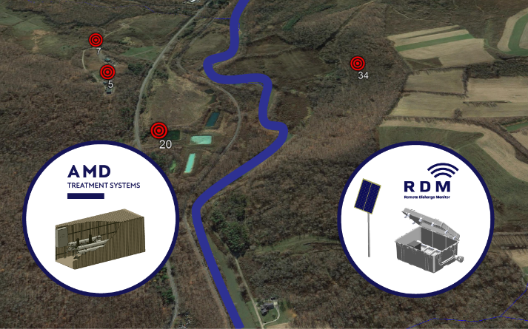
How to Deploy an InnoH2O Treatment System
First, we implement our RDM – Remote Discharge Monitor – to validate water quality and to build a data profile of the proposed treatment stream
The RDM is a remote system that can be used to monitor discharge parameters such as pH, Conductivity and Oxidation-Reduction Potential
Automatically records data on the discharge up to 5 times per day and can store on either a SD card or send a SMS text message
After gathering the data, treatment can be focused on the “worst offenders” instead of treating large volumes
Small discharges sometimes contribute significant amounts of metals to the overall discharge load
American Society of Mining and Reclamation
36th Annual Meeting
June 5, 2019

Slide 14
Questions?
For More Information:
MIKE McCLUSKEY
President
InnoH2O Solutions, LLC
O: 814-445-4491
C: 814-594-4491
mike@innoh2osolutions.com
www.innoh2osolutions.com
Thank You!
American Society of Mining and Reclamation
36th Annual Meeting
June 5, 2019

