Slide 1
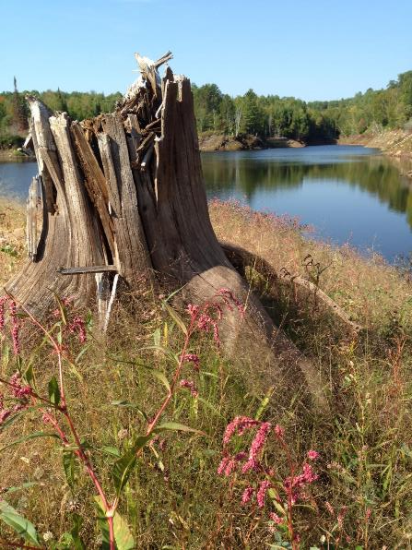
Hector Mine / Mesabi Trail Washout
Pete Kero, PE and Linda Johnson
Presentation to American Society of Mining & Reclamation
June 5, 2019
Notes:
Unlike some presentations, this is a story that tells itself. It a chronological retelling of the washout that occurred in 2018 near the Hector Mine in Biwabik, Minnesota. As you will see, the project featured some environmental issues requiring urgent action, a lot of visibility via press coverage and some dramatic scenes as documented by the photos to come. Overall, while this was not a project that anyone asked for, I think it is a positive restoration story that, through good cooperation among many stakeholders, resulted increased resiliency, functionality and aesthetics for this former mine site.

Slide 2
Hector Mine History
Hector and Ajax Mines, 1949
Source: Minnesota DNR
Notes:
The Hector Mine was a “natural” iron ore mine near Biwabik, Minnesota. It was operated off-and-on as both an underground and open pit mine from 1893 to 1911. It had a brief resurgence in 1952-1953. The final shipment occurred in 1953. Total tonnage produced was 566,280.
The adjacent Ajax Mine was similarly operated from the 1890’s (1899) to mid-1950’s (last shipment in 1954). Total tonnage produced was 357,624.
Map and photo above show the mine as it was in 1949, with the Hector Mine pit already filled with water, and Skubic Brothers operated an active mining operation and washing plant at the adjacent Ajax Mine to the west.
The photo of the water filled pit, doesn’t look too different from the photo of the mine today that shown on the intro slide.

Slide 3
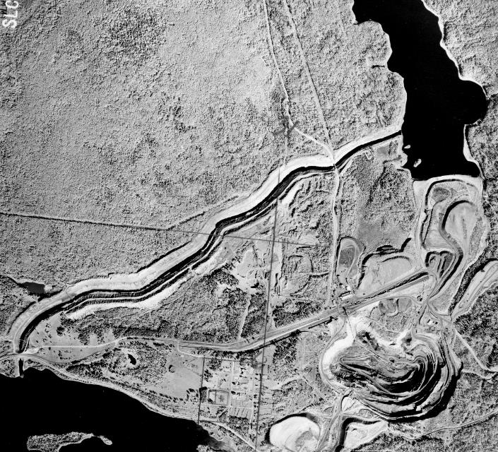
History of the Embarrass River Diversion Channel
Embarrass River Diversion Channel, 1949
Source: Minnesota DNR
Notes:
The area changed dramatically between the 1940 and 1948 aerial photographs shown here. Embarrass (Lake) Mine was started in 1942 by Winston brothers. Drained Syracuse Lake, and rerouted Embarass River to create the Embarrass River Diversion Channel. Shipped 18,624,258 tons. Mainly operated 1944-1964. Last shipment was 1977.

Slide 4
Post-mining status of the site
Source: Great Northern Iron Ore Properties Maps, 1986

Slide 5
Washout April 24, 2018
https://www.mprnews.org/story/2018/06/04/northern-minnesota-mine-breach-leaves-messy-cleanup-damages
Excerpt from mprnews.org
Notes:
The story was covered by news media including Minnesota Public Radio and Duluth’s The Reader. Recently, we were able to identify at lease 8 news stories from regional and national publications. The media coverage led to some criticism of the mining industry by environmental groups; however, by in large, the “media storm” was fairly mild because of strong communication and cooperation between agencies – including those that were most seriously affected by the spill. Weekly interagency conference calls and regular factual, outgoing communications from the IRRR were key elements of the response actions.

Slide 6
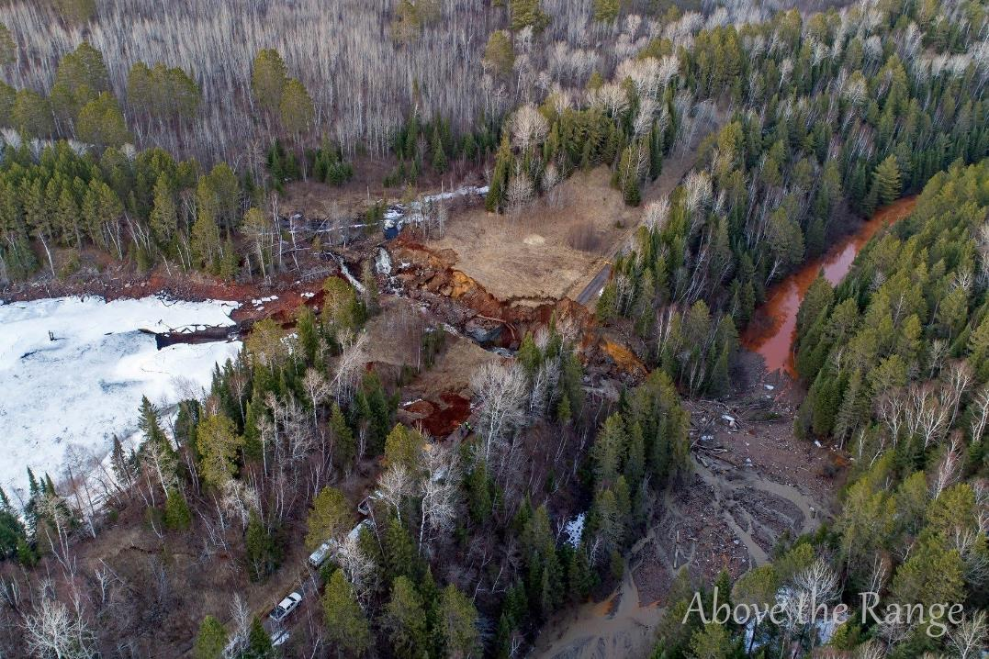
April 24, 2018
Photo courtesy of Above the Range
Notes:
On April 24, 2018, a combination of factors led to the overtopping and erosion of a series of historic culverts that drained the former Hector Mine and some upstream tributaries into the manmade Embarrass River Diversion Channel. As a result of the washout, the water level in the Hector Mine dropped 13 feet and a large volume of material (mainly sand and gravel) was washed into the Embarrass River Diversion Channel.

Slide 7
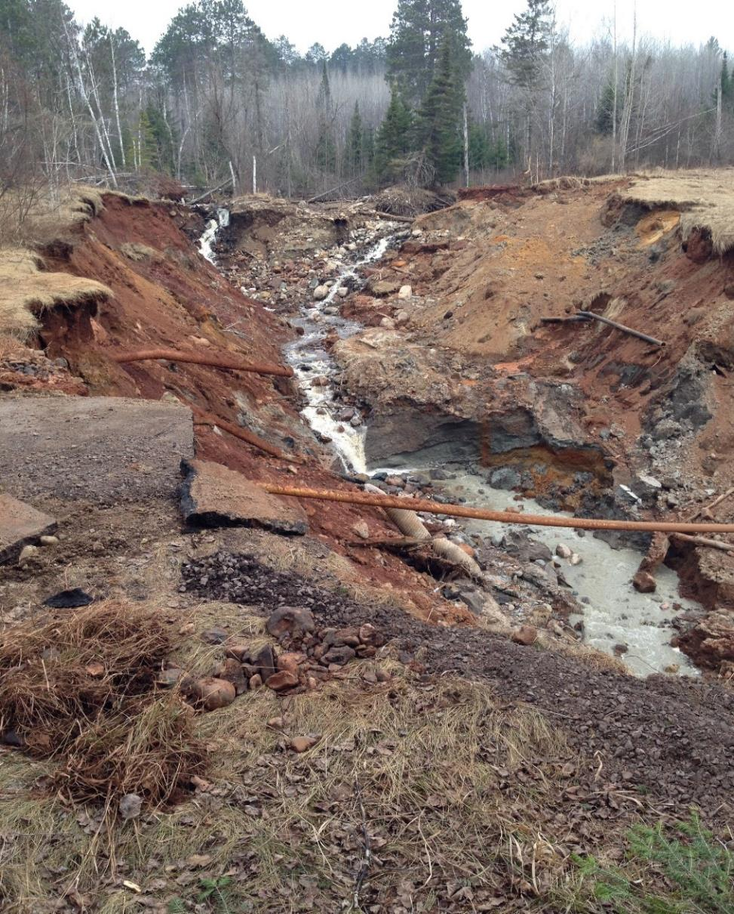
May 1, 2018
Notes:
Water and sewer utilities between the City of Biwabik and Giants Ridge were severed during the washout, resulting in a need for pumping and transport of sewage from Giants Ridge. The gas line remained intact, but was hanging unsupported in the air, and or course, the Mesabi Trail was rendered impassable. Sediment from the bottom of the newly-cut ravine was eroding into the Embarrass River Diversion Channel.

Slide 8
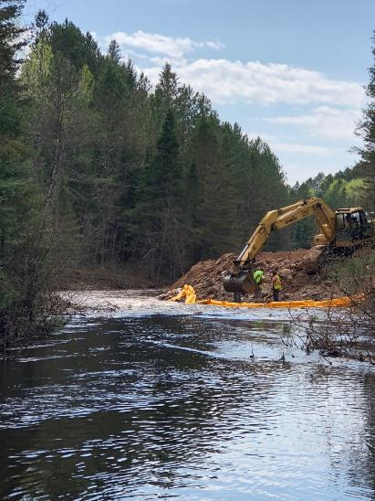
Sediment removal
Notes:
JESSICA - Sediment removal occurred in two phases: the initial emergency response (to restore flow through the ERDC) and a secondary dredging activity to restore the full depth of the ERDC. The depth for sediment removal was primarily determined by the run-out control elevation for Wynne Lake, as determined by Mn DNR hydrologists.

Slide 9
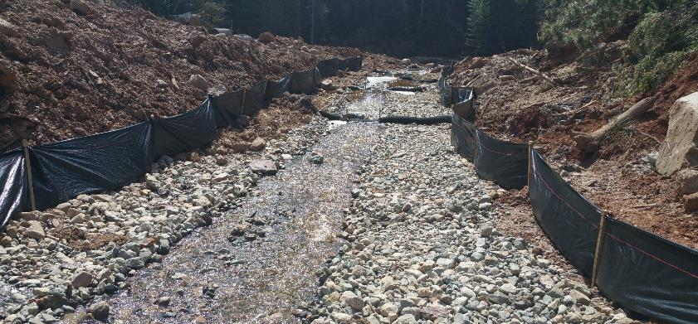
Ravine stabilization 5/14/2018
Notes:
JESSICA – Ravine stabilization was also conducted in two phases: initial placement of filter material covered by stone (to limit further sediment release from the site) followed by final placement of rip rap and boulder drop drop structures in the ravine (see design on later slide).

Slide 10
Utility reconnection
Notes:
JESSICA - Utility reconnection occurred during a series of emergency and permanent actions. Within the first few days after the event, the water service was restored to Giants Ridge by completing an inter-connection with the City of Aurora’s water service line (which will build redundancy into the system for greater flexibility during any future water supply issues). Approximately one month later, the gas line was directionally-drilled deeper beneath the ravine. The sewer force main was reconnected by September (thereby eliminating costs for septic pumping and hauling). The permanent water line reconnection was completed in October and final testing of that line is taking place now.

Slide 11
Geotechnical boring 5/24/2018
Notes:
JESSICA - Geotechnical borings were conducted to help determine stable sideslopes and foundation design for the new box culvert.

Slide 12
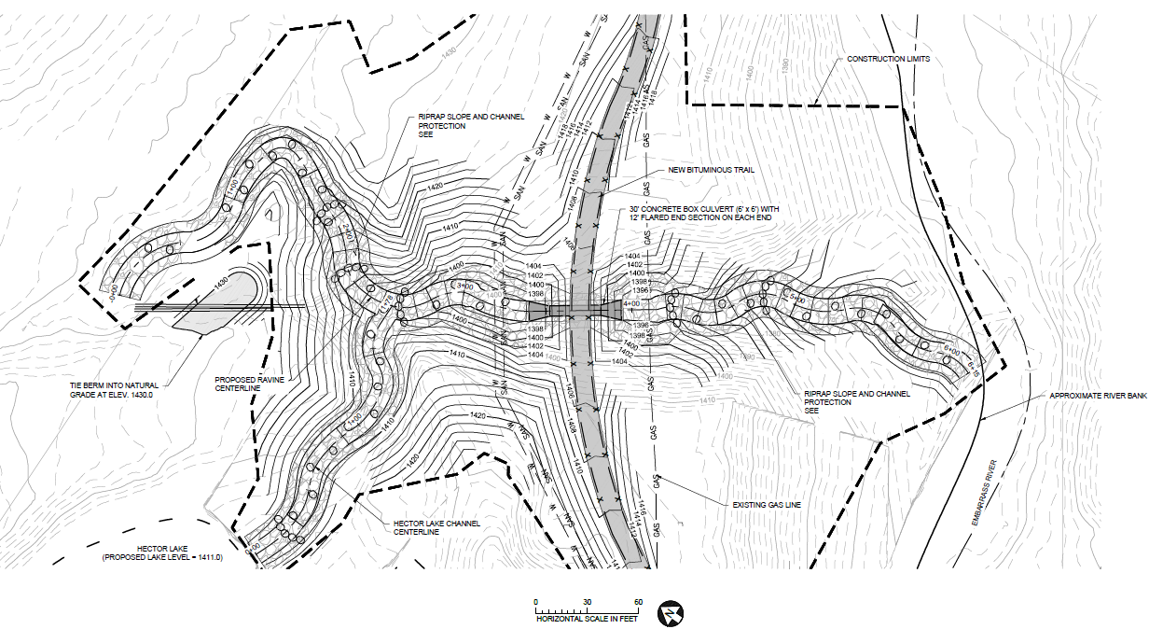
Long-Term Trail Repair and Ravine Stabilization Plan
Notes:
JESSICA - The final stabilization plan was completed in July and August. The selected design includes a 6x6 poured-in-place concrete box culvert. Also, the long-term plan involves inserting a slight westward bend in the Mesabi Trail. The bend allows for less earthwork to cross the ravine and a shorter box culvert. The ravine will be lined with rip rap and series of boulder drop structures to dissipate the flow. GeoHECAS was used to model flows in the channel, and the rock boulder drop structures and riprap channel were designed to withstand design shear stresses associated with velocities and depths for a variety of flow events.

Slide 13
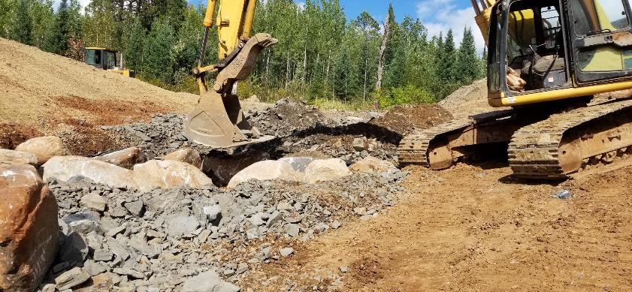
Boulder drop structure placement 9/13/2018
Notes:
JESSICA - Boulder drop structures were placed in September, designed at 20-ft intervals along the steeper channel reaches. Re-used boulders from site. The system was modeled with HEC-RAS, HY-8, and

Slide 14
Ravine Stabilization Profile
Notes:
JESSICA - The slide shows an elevation box culvert, ravine slopes, drop structures and energy dissipation pools both upstream and downstream of the culvert. The box culvert and trail are designed to pass the 50-year event before overtopping, and the sideslopes of the trail are armored with riprap on the upstream and downstream side to prevent erosion from occurring during an extreme event.

Slide 15
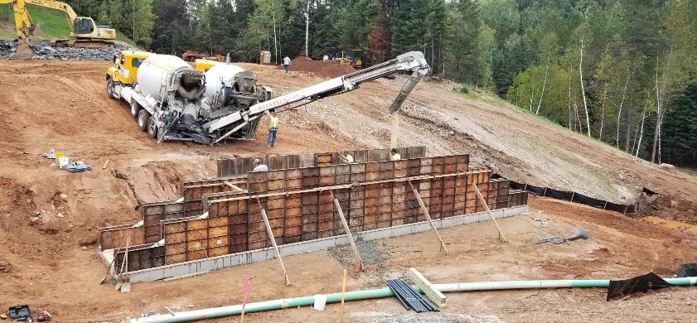
Box culvert placement 9/13/2018
Notes:
JESSICA - A 6’ x 6’ box culvert was poured on site, lowering the overall cost of this phase of the project.

Slide 16
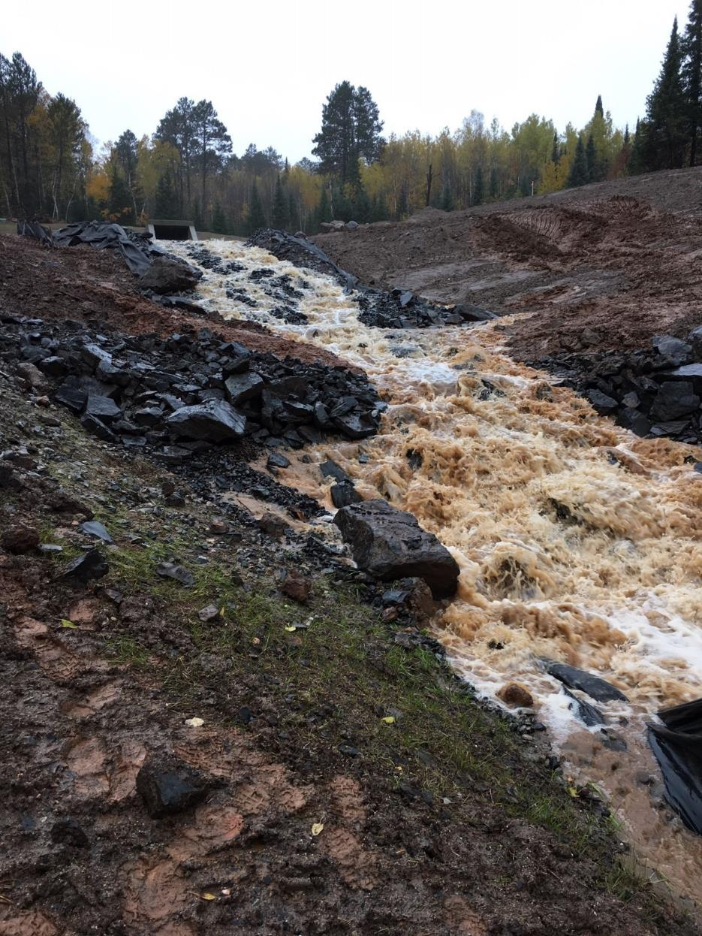
High flows exiting the box culvert 10/10/2018
Notes:
JESSICA - 1.5 inches of rain fell in less than 24 hours on October 10th, so we got to see the partially-constructed project in action.

Slide 17
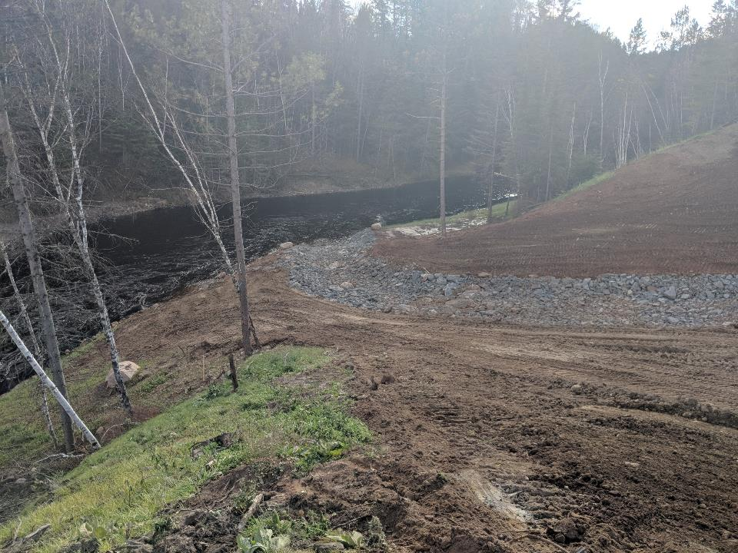
Rock-lined channel looking toward the Embarrass Diversion Channel 10/19/2018
Notes:
JESSICA - Construction progressed and was 90% complete in November of 2018. Work that still needs completion includes: placing bituminious on the trail, any touch-ups to the site grading, and final vegetation establishment.

Slide 18
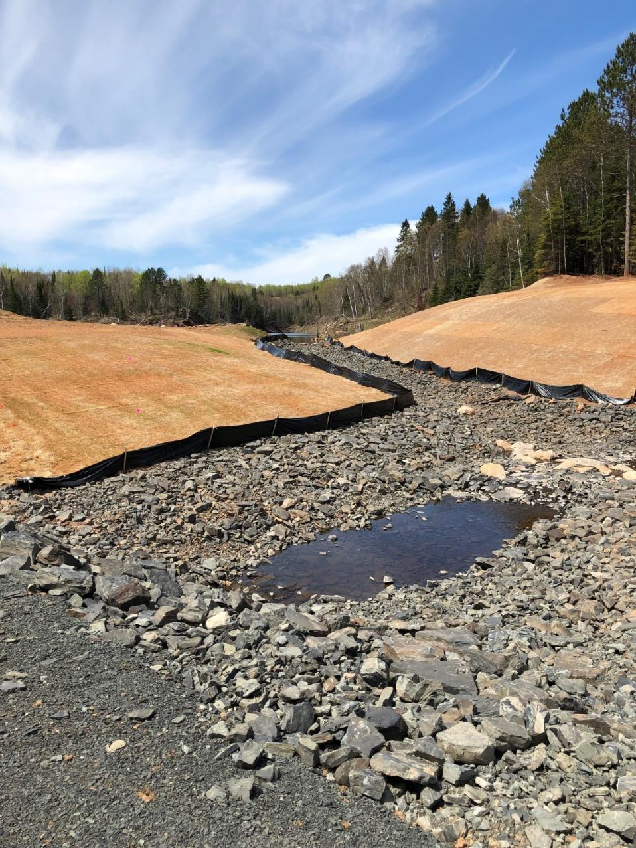
Hector Mine in the Spring 5/19/2018
Notes:
JESSICA - Construction progressed and was 90% complete in November of 2018. Work that still needs completion includes: placing bituminious on the trail, any touch-ups to the site grading, and final vegetation establishment.

Slide 19
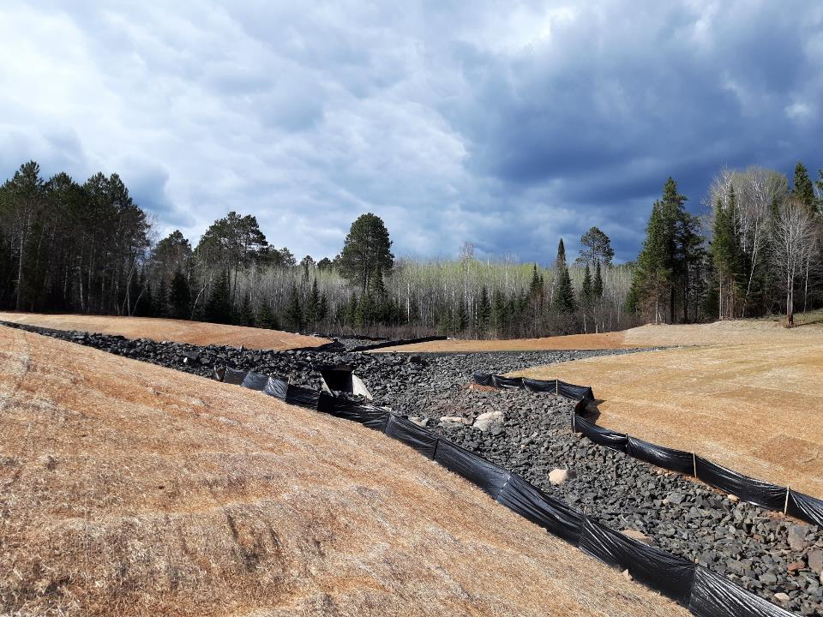
Channel after spring thaw 5/13/2019
Notes:
JESSICA - Construction progressed and was 90% complete in November of 2018. Work that still needs completion includes: placing bituminious on the trail, any touch-ups to the site grading, and final vegetation establishment.

Slide 20
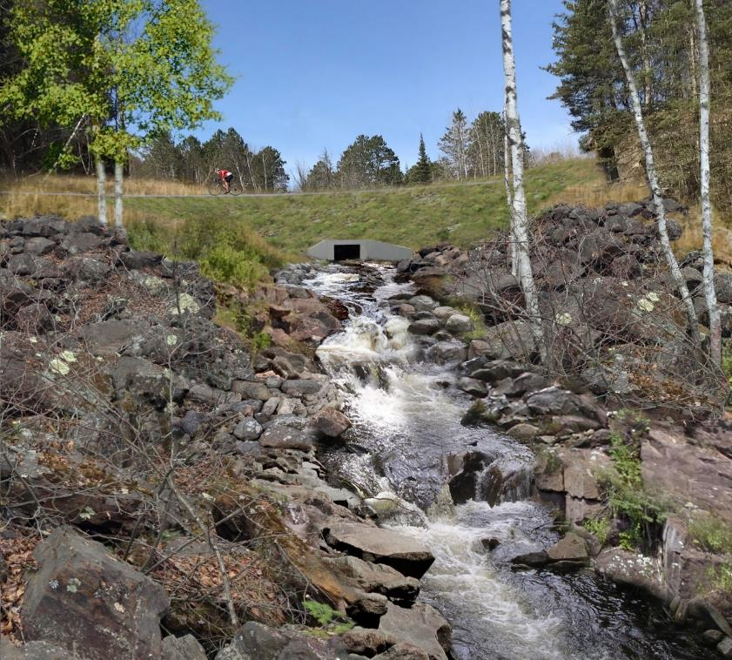
Concept rendering of the site after full revegetation
Notes:
JESSICA - This is a landscape designers rendering of what the site will look like after full revegetation. As a whole, the site much more resilient and functional than it was in the past. The functional improvements include 1) an appropriately sized culvert will be less susceptible to overtopping, 2) utilities that will be newer, more secure and accessible when in need of repairs, 3) a lower water level in the Hector mine which places less head pressure on the embankment, and 4) new blacktop on one of the oldest stretches of the Mesabi Trail. Also, the site will be far more aestethically pleasing than it was in the past – providing Mesabi Trail users with waterfront views of the Hector Mine and the Embarrass River Diversion Channel that were unable with the pats configuration.

Slide 21
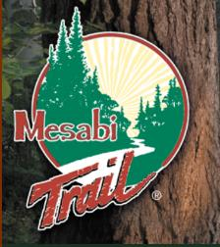
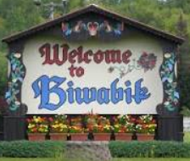
Partnerships
C&C Winger, Inc.
Notes:
LINDA

