Slide 1
Phillips Mine Fire A Containment & Extinguishment Design Plan
Case Study
ASMR Big Sky Montana: June 3rd-7th, 2019
By: Buck Neely, P.E.; Tim Danehy, QEP; Ryan Mahony; Bryan Page; Margaret Dunn, P.G.; Dan Guy P.G.; Rich Beam P.G.; Dean Baker P.E.; Roger Rummel P.E.

Slide 2
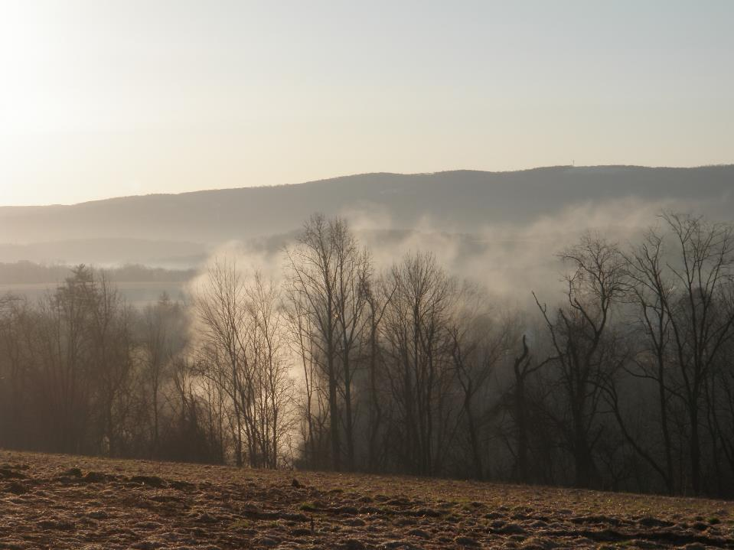
OVERVIEW
Site History
Site Evaluation / Design Approach
Containment
Extinguishment
Monitoring Wells
Temperature Buttons
Mine-atmosphere readings
Final Design Configuration
Current Construction Progress

Slide 3
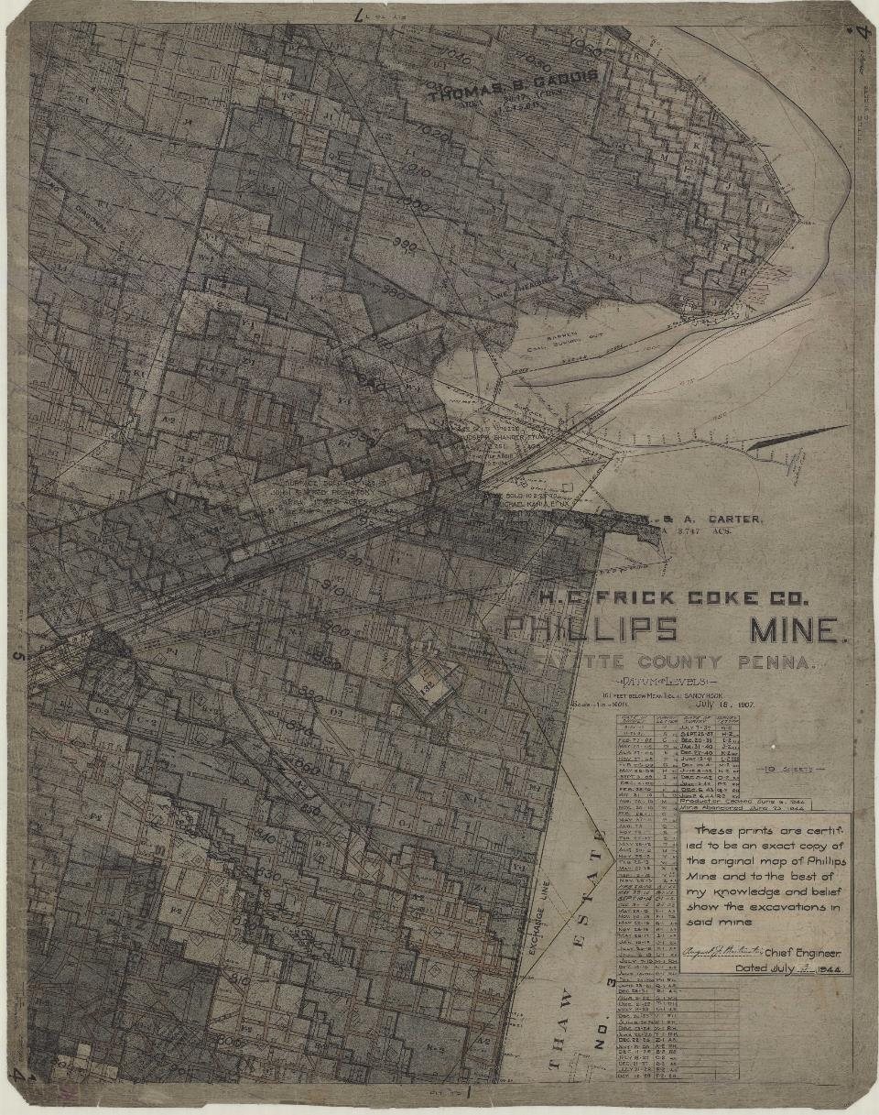
Site History
H.C. Frick Coal and Coke Company – Phillips Mine
Location South of Pittsburgh
North Union Twp., Fayette Co. PA
1907 – 1944 (Pittsburgh Coalbed)
Fire Age & Origin Uncertain
“Barren – Coal Burned Out”
“Burned Sec”
1950’s and Earlier
Current Fire
Observed & Reported to PA DEP 1997
Bureau of Abandoned Mine Reclamation (BAMR)
Subsurface Investigations: 2003 & 2008
Fire Extent, Potential to Migrate, Potential to Impact Man-made Structures
BioMost, Inc. – 2014 Contract
Notes:
BAMR subsurface investigation performed to evaluate: Fire’s Extent, Potential to Migrate, and Potential to impact made-made structures

Slide 4
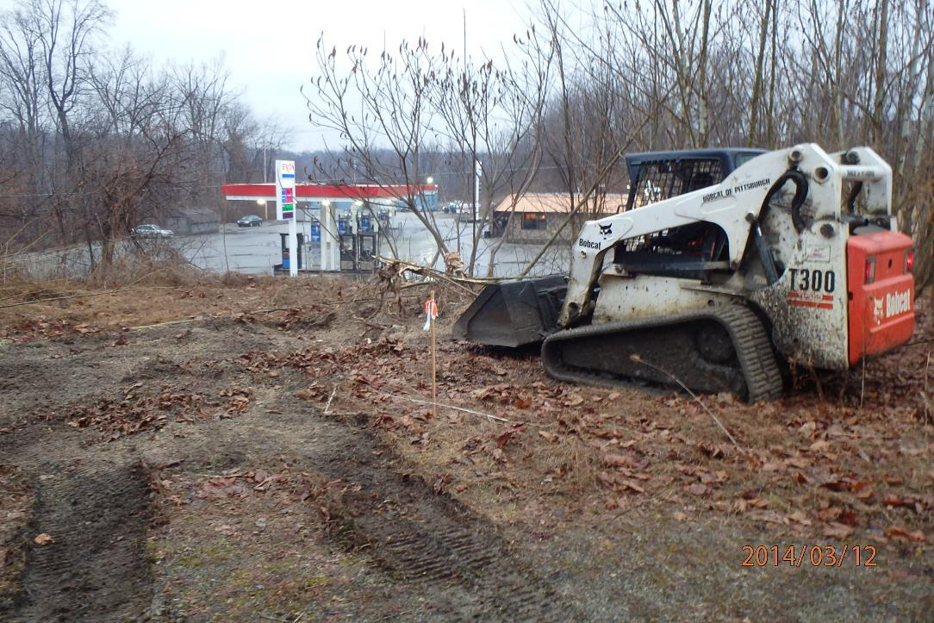
Site Investigation
Gas Station Proximity
Vents & ‘Hoar Frost’
BAMR Wells
On-site Materials

Slide 5
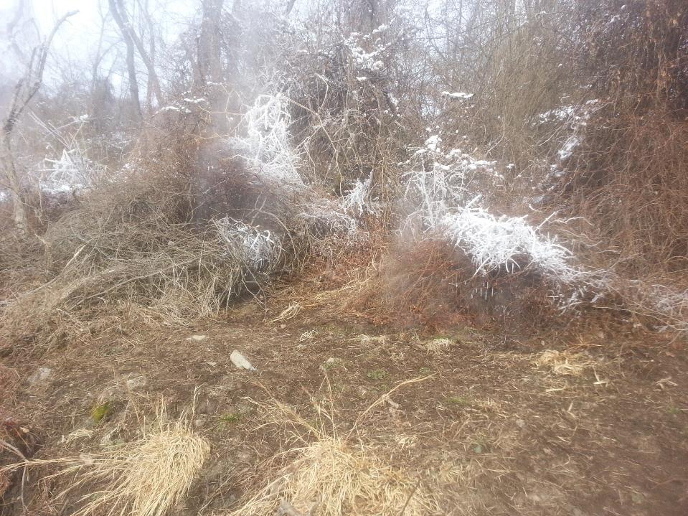
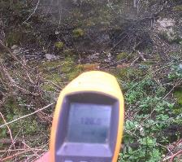
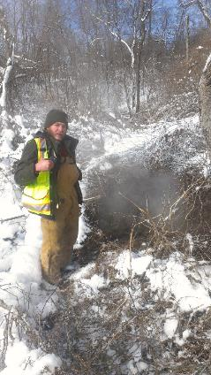
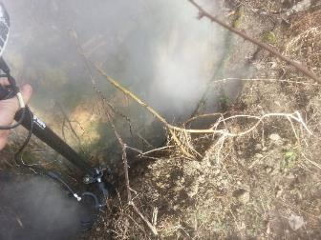
Site Investigation
Gas Station Proximity
Vents & ‘Hoar Frost’
BAMR Wells
On-site Materials

Slide 6
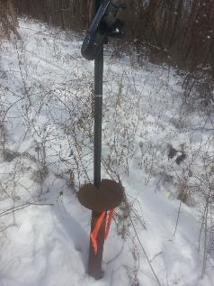
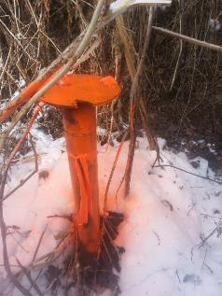
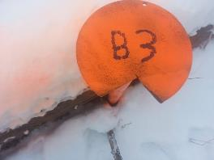
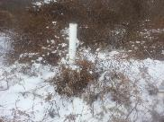
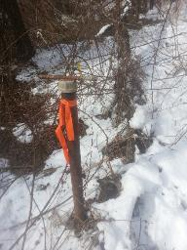
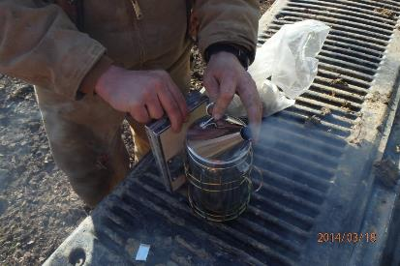
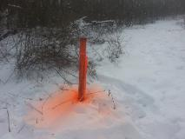
Site Investigation
Gas Station Proximity
Vents & ‘Hoar Frost’
BAMR Wells
On-site Materials

Slide 7
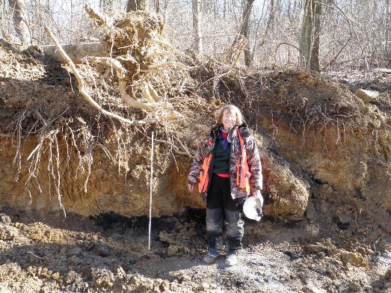
Site Investigation
Gas Station Proximity
Vents & ‘Hoar Frost’
BAMR Wells
On-site Materials

Slide 8
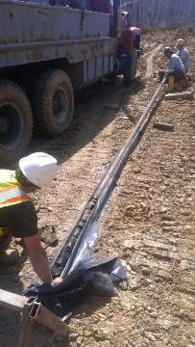
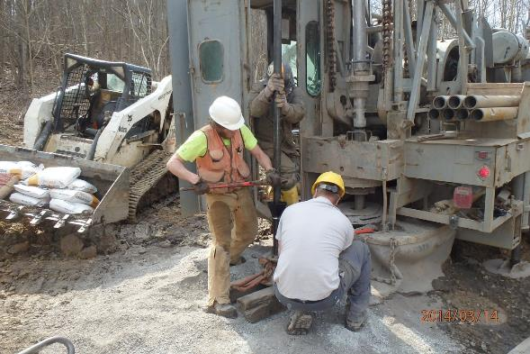
Drill Baby Drill!
Exploratory Bore Holes (48)
Monitoring Wells (43)
Mine Pool (6)
Mine Atmosphere
VOIDS
Cores
Goal = Cold Perimeter

Slide 9
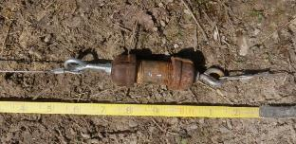
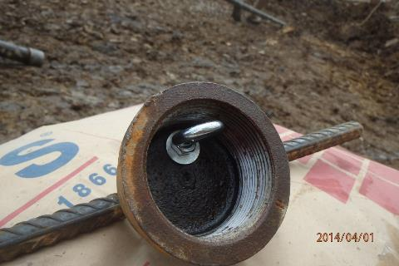
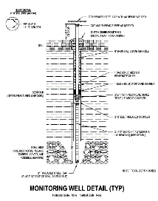
Monitoring Wells
Steel – sch40
Custom Slotted Screens
PVC Casing 5 ft Screen Height
Steel Casing 21 ft Screen Height
Shale Traps
Air Tight – (Capped)
Road Building

Slide 10
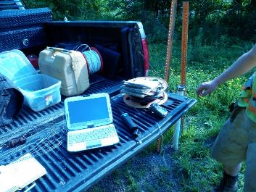
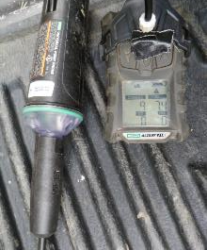
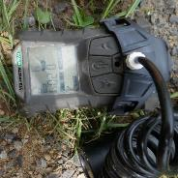
Monitoring Wells
Data Collection
Temperature (°F)
Deployable Buttons
Highest Recorded Temp: 158 °F (#9)
Gas Composition (MSA Altair 4x Multigas Detector
O₂ – (vol %)
Lowest: 0.9% (#13)
H₂S – (ppm)
N/D
CO – (ppm)
Highest: 512 ppm (#9)
Combined Explosives – (%LEL)
Highest: 14% (#38)
Water Samples (as necessary)

Slide 11
Design Concept
Safety Related Appurtenances
Water Source Tie-in, Holding Pond, Firefighting Foam & Equipment
Water Handling
Temporary Infiltration Structure, Diversion Ditches & Sed. Basin
Temporary Surface Seal: Smother the Vents
Northern Air Barrier (Crop)
Eastern Air Barrier / Seal (Crop)
Southern Fire Barrier (Cut-Off Trench)
Permanent Infiltration System

Slide 12
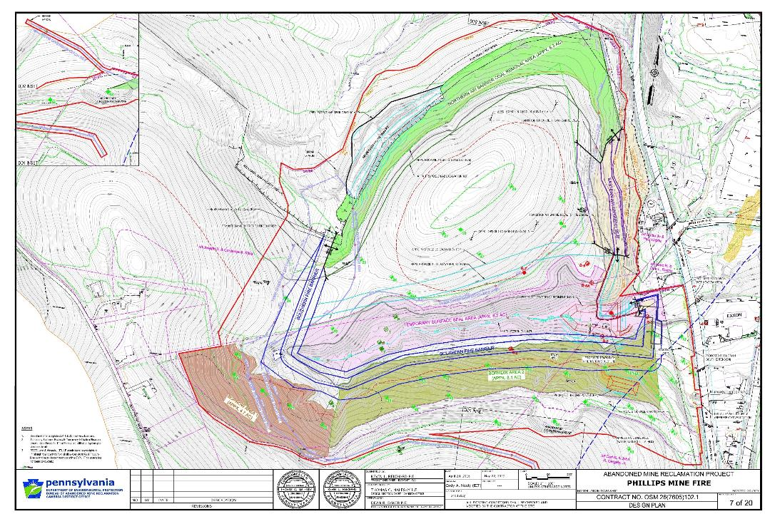
Design Plan

Slide 13
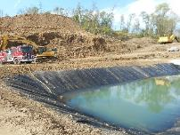
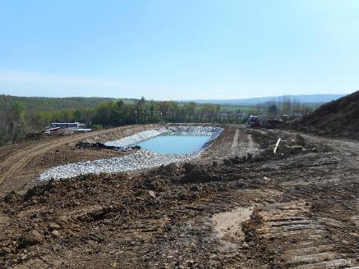
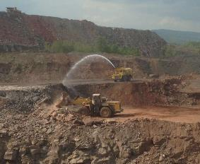
Safety Related Appurtenances
Holding Pond
Public Water Source Connection
Firefighting Foam & Equipment

Slide 14
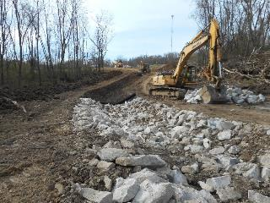
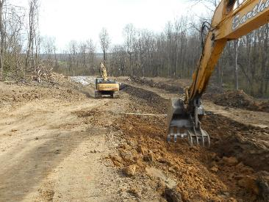
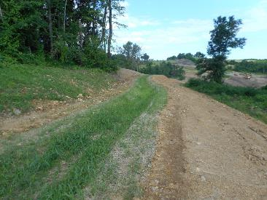
Water Handling
Diversion Ditches
Temporary Infiltration Structure
Temporary Sediment Basin

Slide 15
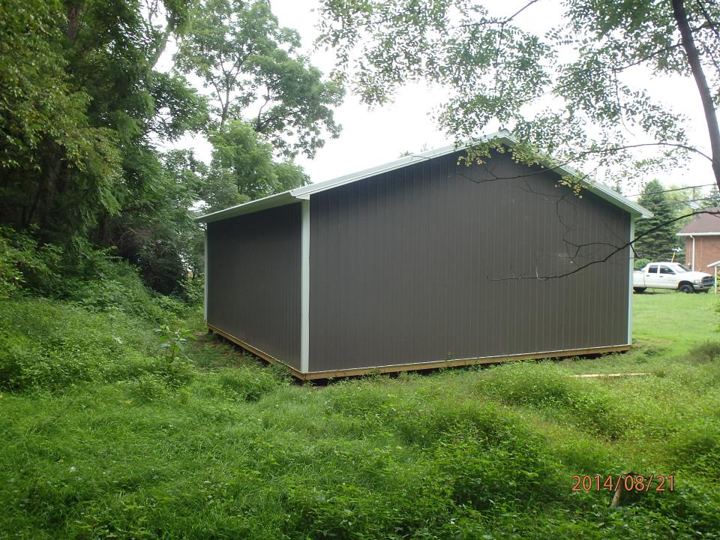
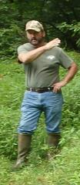
Water Handling
Diversion Ditches
Temporary Infiltration Structure
Temporary Sediment Basin

Slide 16
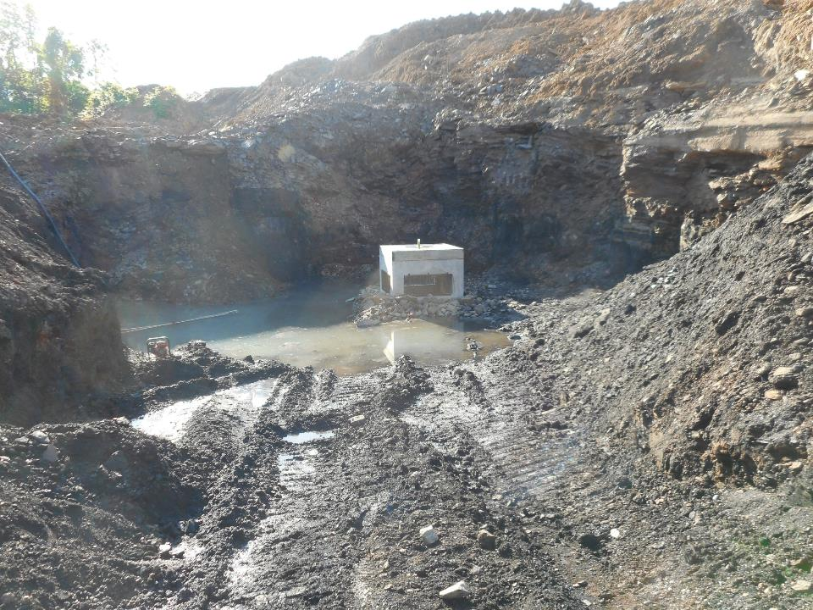
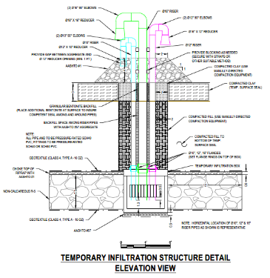
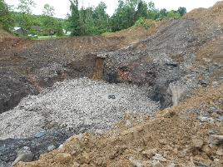
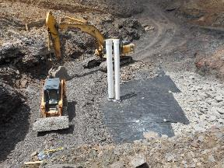
Water Handling
Diversion Ditches
Temporary Infiltration Structure
Temporary Sediment Basin

Slide 17
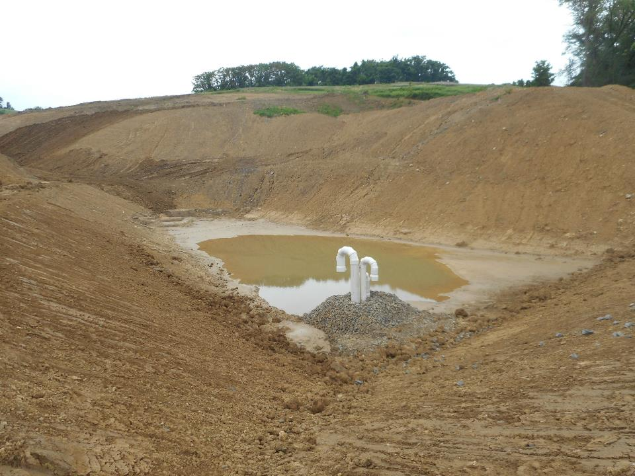
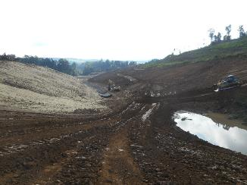
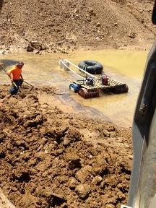
Water Handling
Diversion Ditches
Temporary Infiltration Structure
Temporary Sediment Basin

Slide 18
Temporary Surface Seal
Clay Thickness: 3 FT

Slide 19
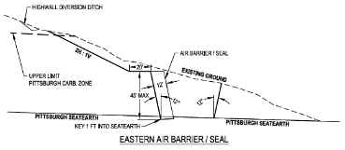
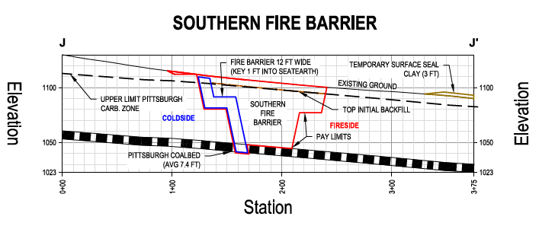
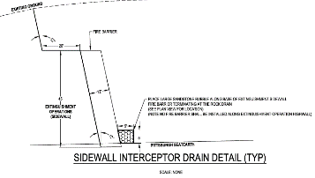
Air Barrier Details

Slide 20
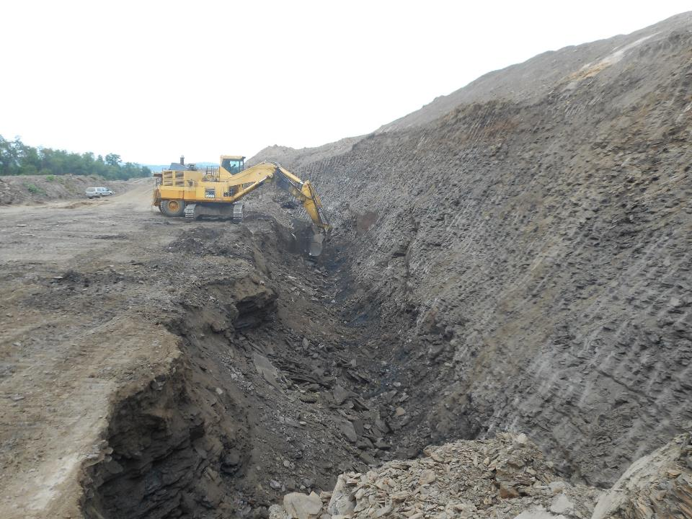
Northern Air Barrier
Old Piccolomini Strip Pit (Crop)
Aided in Restricting Oxygen

Slide 21
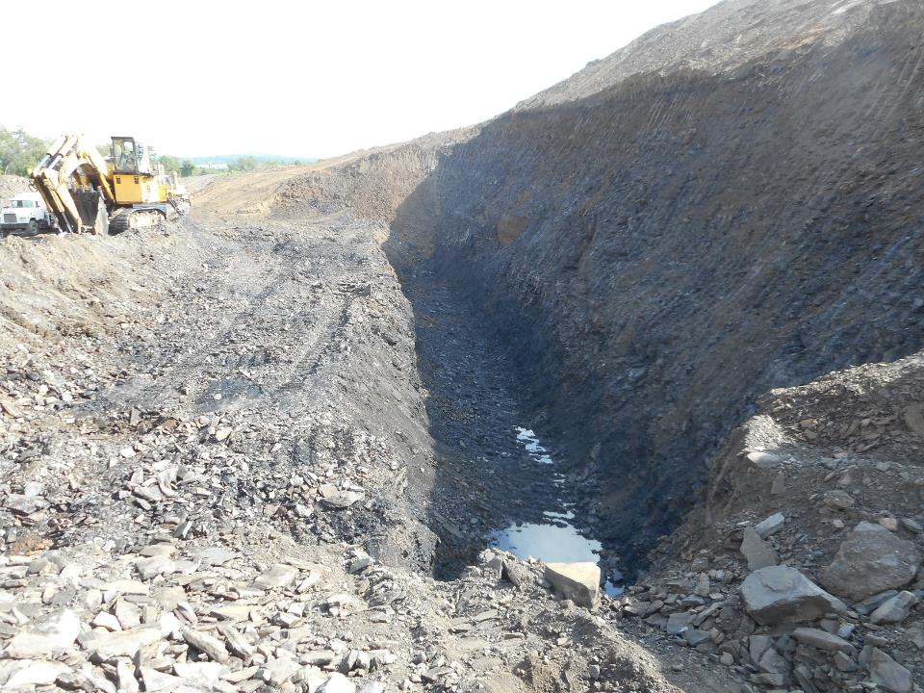
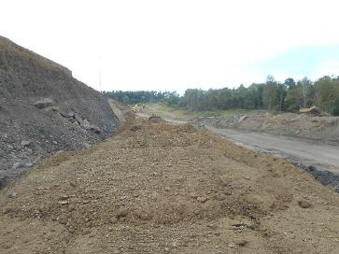
Northern Air Barrier

Slide 22
Northern Air Barrier

Slide 23
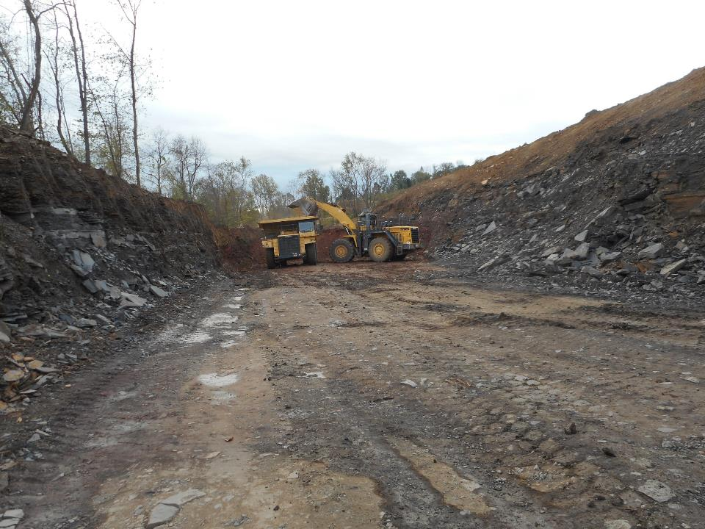
Eastern Air Barrier / Seal
Crop Area Historically Identified as Burned

Slide 24
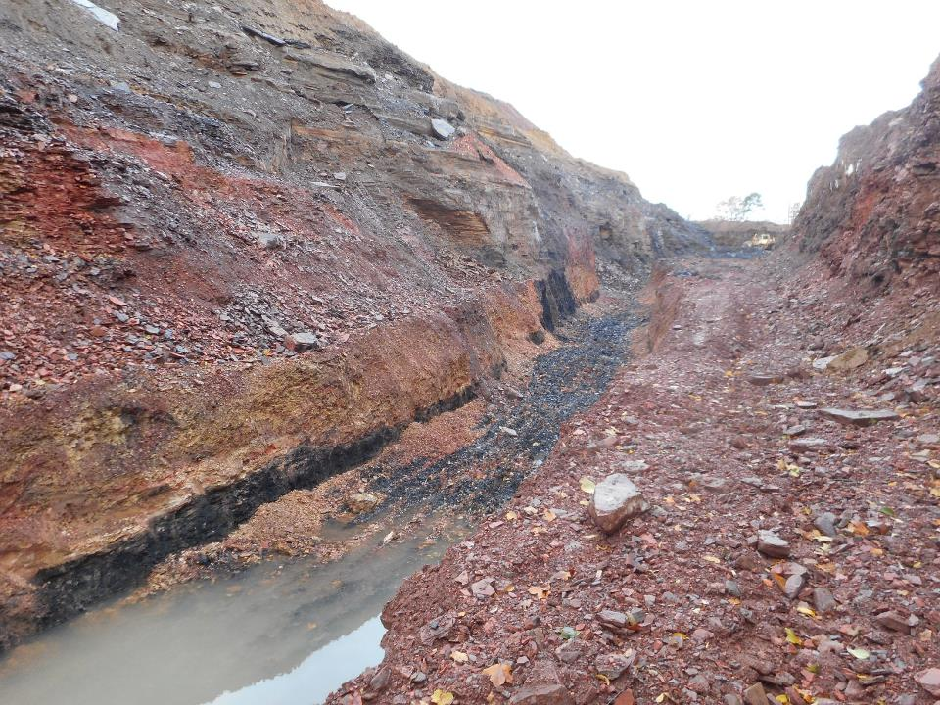
Eastern Air Barrier / Seal
Red Dog & Bony Present

Slide 25
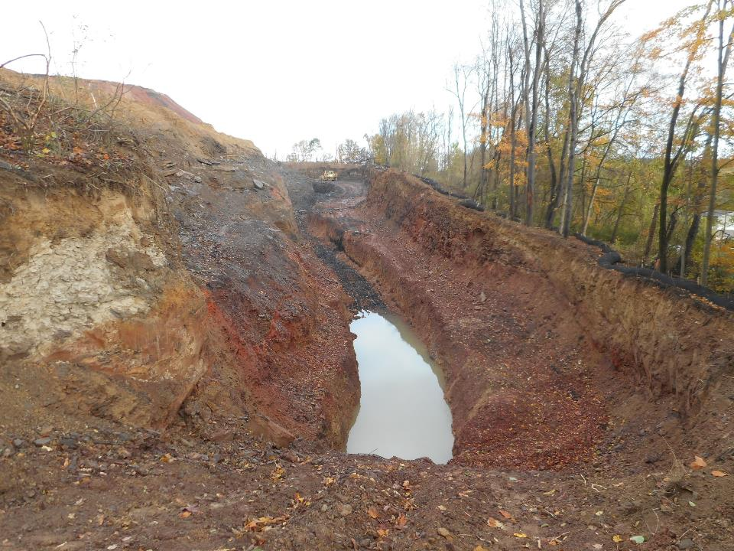
Eastern Air Barrier / Seal

Slide 26
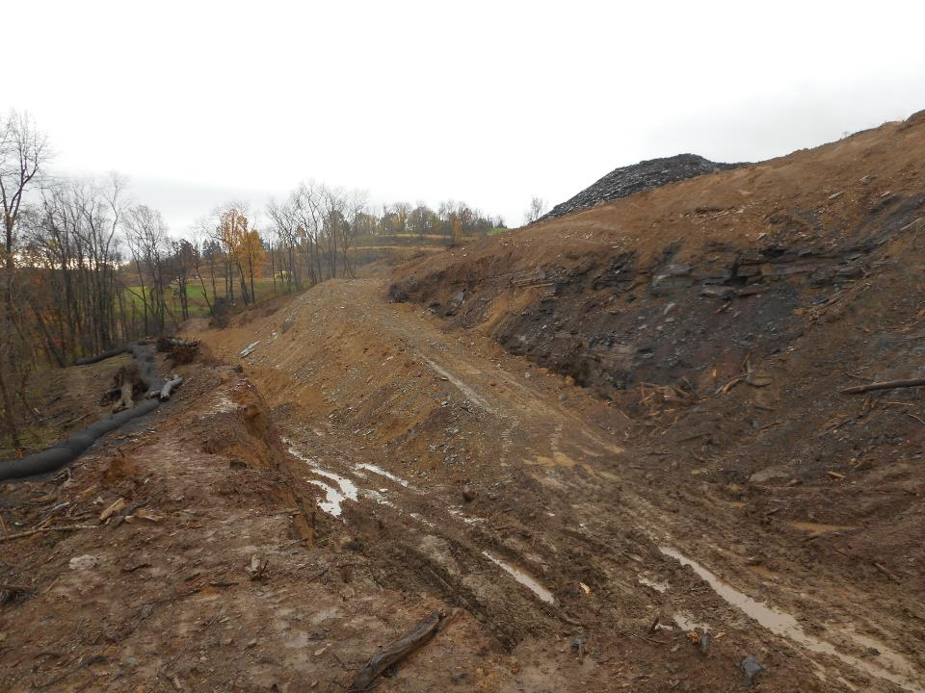
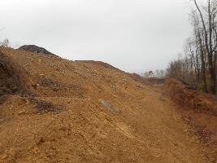
Eastern Air Barrier / Seal
Air Barrier / Seal Installation

Slide 27
Southern Fire Barrier
Cut-Off Trench

Slide 28
Southern Fire Barrier
Cut-Off Trench w/ Fire Barrier

Slide 29
Southern Fire Barrier
Cut-Off Trench

Slide 30
Southern Fire Barrier
Cut-Off Trench

Slide 31
Southern Fire Barrier
Southern Fire Barrier

Slide 32
Permanent Infiltration System
Permanent Wet Meadow
Rock Drain Extending to Daylight

Slide 33
Extinguishment
Mine Through the Actively Burning Areas
Extinguish & Quench

Slide 34
Extinguishment
Preparing to Excavate Through Hot Area
Proceeding up-valley
~80 Degree Soil on Grade 3/20/2019

Slide 35
Extinguishment

Slide 36
Construction Cost Projection
Design Completed 2015
Engineers Est. Construction Cost (BioMost, Inc): $7,220,000
~1.5 Million CY JOB
Winning Contractor Bid: $7,197,263 – $6.9M Awarded
Earthmovers Unlimited, Inc. (Contractor)
Estimate was 0.3% Higher than Bid (~5% > Award)

Slide 37
Construction Status
Construction Began: Spring 2017
Construction Delays
2018 Wettest Year on Record (PIT – 57.8”)
Average Precipitation ~38”
Current Status: All Barriers are Installed, Staging to Mine Through the Actively Burning Zones
Extinguish & Quench as Needed

Slide 38
Gloom & Doom - Expectations
Construction Delays Possibly a Blessing
So Far - Safer, Easier, Less Dramatic

Slide 39
QUESTIONS?
-Thank You-
&
Acknowledgements
PA DEP (BAMR)
Earthmovers Unlimited Inc. (Contractor)
Landowners

