Slide 1
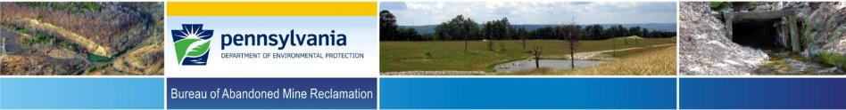

Tom Wolf, Governor
Patrick McDonnell, Secretary
Implementation of the 2018 AML Pilot Program in Pennsylvania – AML Reclamation as an Economic Catalyst
36th Annual Meeting of the American
Society of Mining and Reclamation
June 3-7, 2019
Big Sky, Montana
Patrick M. Webb , PE,
PA-DEP-Bureau of Abandoned Mine Reclamation
Notes:
Good afternoon, my name is Pat Webb and I would like to thank you for attending this presentation on Pennsylvania’s 2018 AML Pilot program.

Slide 2

AML Pilot Program Background
The 2018 AML Pilot Program was authorized by Congress under the Consolidated Appropriations Act, 2018 (Public Law 115-141) and provides an additional $25 million of US Treasury Funds to PA’s AML Program
The funds are to be used “to accelerate the remediation of AML sites with economic and community development end uses”
Notes:
For 2018, Pennsylvania is eligible to receive up to $25 million dollars of General Fund Money, which is not part of the regular OSMRE funding for AML and AMD projects that is removed from active coal mining permits.

Slide 3

Continuation of the AML Pilot Program
This is the third year that Pennsylvania has received funding from the AML Pilot Program
In FY2018 Pennsylvania along with Kentucky and West Virginia, each received $25 million of AML Pilot Funding; Ohio, Alabama, and Virginia each received $10 million; and the Hopi, Navajo, Crow Indian Tribes each received $3.33 million
In FY2017 Pennsylvania along with Kentucky and West Virginia, each received $25 million of AML Pilot Funding, and Ohio, Alabama, and Virginia each received $10 million
In FY2016 Pennsylvania, along with Kentucky and West Virginia, also each received $30 million of AML Pilot Funding
Notes:
As you may see in your conference program, 2018 is now the 3rd consecutive year of the AML Pilot program. In addition to the $25 Million that is eligible to Pennsylvania;
Kentucky and West Virginia are also eligible to receive $25 Million each.
Also Ohio, Alabama, and Virginia are eligible for $10 Million each.
Lastly, the Hopi, Navajo, and Crow Indian Tribes are eligible to receive $3.33 Million each.

Slide 4


Language from OSMRE Guidance for the 2018 AML Pilot Program
“State/Tribal AML Programs, in consultation with State/Tribal, local economic and community development authorities, must develop eligible projects that demonstrate a nexus with AML land and water reclamation, and economic and community development.”
Notes:
Above is actual language from the 2018 AML Pilot guidance that again specifies that reclamation projects be repurposed for economic development.

Slide 5

Use of AML Pilot Program Funds
States, Tribes, and local communities have the flexibility to use AML Pilot funds for both the reclamation of impacted lands and waters and brick and mortar needs related to the end-use development project
The Pilot Program offers maximum flexibility in this regard, letting States, Tribes, and local communities balance the needs of an individual project with the ability to fund other priority Pilot projects
Notes:
This additional slide is more OSMRE guidance that specifies the use of AML Pilot funds are for Reclamation of AML and or the treatment of AMD to repurpose abandoned mine lands for economic development.

Slide 6

AML Pilot Program Guidelines and Grant Application Timelines
AML Pilot Program Guidance for the 2018 AML Pilot funding was issued by OSMRE on September 14, 2018
PA submitted its 2018 AML Economic & Community Development Pilot Program Grant Application to OSMRE on November 1, 2018 (to make the funding available for projects)
PA’s AML Pilot Program Grant Application was approved by OSMRE on November 19, 2018 with a period of performance of December 1, 2018 to November 30, 2021
Notes:
The 2018 AML Pilot program for Pennsylvania is eligible for reclamation of AML/AMD that is repurposed for economic development from restoration activities that occur between December 1, 2018 up until November 30, 2021.

Slide 7

Proposed AML Pilot Projects
PA DEP solicited proposals for AML Pilot projects from other states agencies, county and local governments, NGOs, Watershed Groups, and other AML advocacy groups
PA DEP received 29 proposals which were evaluated using the OSMRE 2018 AML Pilot Program Guidance and also for project costs and benefits
Notes:
So for the AML pilot project selection process in Pennsylvania, it all started out in 2018 in us receiving up to 29 AML Pilot project proposals.

Slide 8

Proposed AML Pilot Projects
From the proposals PA selected a wide variety of project types with a variety of possible economic or community development benefits and partners
DEP is targeting 15 proposed AML Pilot Projects (9 Bituminous and 6 Anthracite) which are located in 16 coal field counties (Note: 2 of the projects are located in multiple counties)
Two (2) contingent projects were also identified should any of the primary projects experience issues or delays
Notes:
Of the original 29 proposals that were reviewed, a total of 15 projects rose to the top of the list to be accepted by our Governor.
We also identified 2 additional projects to serve as back ups or replacement projects, when any of the original 15 selected projects hit snags.
Just recently, 2 of the original 15 have dropped out, therefore we are now using our contingency projects as replacements.

Slide 9


AML Pilot Program Proposed Projects
Vetting documents were submitted to OSMRE for all 15 of the proposed 2018 AML Pilot Projects by January 18, 2019
OSMRE reviewed the proposed projects during February 2019 and provided feedback along with requests for additional information for a few of the projects during February and March of 2019
To date, OSMRE has approved all 15 projects and are currently reviewing the 2 replacement projects.
Notes:
Once our PA Governor had approved our 15 projects, along with the 2 extra contingency projects,
Then the economic vetting documents for all projects were submitted to OSMRE to be reviewed.
All 15 projects have been reviewed and approved for economic vetting.
Authorization to Proceed (ATP) submissions for OSMRE to review the projects for NEPA compliance have followed this economic vetting round.
About half of the projects have been submitted and have achieved the OSMRE NEPA ATP.
While the others are currently being reviewed or are soon to be submitted for the OSMRE NEPA ATP.
As mentioned before, 2 of the originals have hit snags, therefore, the economic vetting documents of the 2 these backup project have been submitted for OSMRE to review.
The OSMRE NEPA ATP submissions will follow if OSMRE approves the economic vetting documents.

Slide 10

AML Pilot Project Types
The Original 15 AML Pilot Projects include:
6 surface mine reclamation projects
6 acid mine drainage treatment or remediation projects
2 coal refuse pile/culm bank remediation projects
1 historic mining preservation project to move an historic mine fan and other artifacts to a mine museum
Notes:
As you can see, a summary of the 15 original projects for economic and community development end uses are:
6 traditional health and safety AML projects
6 AMD projects for stream and watershed restoration
2 coal refuse pile remediation projects
And
1 historic mining structure preservation project for a mine museum
Each of these 15 projects are traditional AML reclamation and or AMD mitigation.
Once reclamation and mitigation are complete, there are other components of all of 15 projects that promote and end use of economic development in the creation of:
Part time and
Full time jobs
Recreation, and
Tourism

Slide 11


2018 AML Pilot Projects Location Map
Notes:
This map is an good illustration of how all the projects are spread amongst Pennsylvania.

Slide 12

Pennsylvania’s 2018 AML Pilot Projects
Notes:
In addition to eliminating a number high-priority AML/AMD features, here is a summary of all of the 15 projects:
The Presto-Sygan is a AMD treatment project and hiking trails will be combined with the development of the Newbury Market.
Next, the Six Mile Run is a AMD treatment project that is to perform crucial maintenance work of 35 existing AMD systems to support stream recreation.
Next, the Slippery Rock AMD treatment project is to perform crucial maintenance work of 5 existing AMD systems and the Restoration of a historic one-room schoolhouse for environmental education and eco-tourism
Next, the No. 9 Mine and Museum Complex is for the expansion of a local mine museum complex through preservation and display of a unique and historic mine fan and associated components.
Next, The West Decatur Post Office (Morgan Run Recreational Facility) will reclaim dangerous highwalls that are within the CenClear Child and Youth Services Facility in which the reclaimed area will then be repurposed for the construction over a mile of recreational trail for the children to use.
Next, The Crowley Run Stream Diversion will eliminate AMD pollution from entering Cooks Run (to improve stream miles of Cooks Run) by redirecting Crowley Run into the much shorter Milligan Run. The total combined AMD of shorter Milligan Run will then be diluted into the much larger West Branch of the Susquehanna River.
Next, The Huling Branch East is the AML reclamation of dangerous highwalls and acidic refuse piles for the reforestation and restoration of public lands to then construct ATV Trails on public lands.
Next, The Earth Conservancy Bliss Bank 4 is an dangerous pile embankment AML reclamation project for the expansion of an existing industrial/business park

Slide 13

Pennsylvania’s 2018 AML Pilot Projects
Notes:
Next, the Anthracite Outdoor Adventure Area (aka AOAA) is AML dangerous highwall reclamation project to be repurpose as a unique and extreme jeep crawling recreational trail.
This project will add to and enhance this large public outdoor recreation area.
Next, the Anthracite Upland Pointing Dog Association project is both surface and dangerous mine opening AML reclamation for the creation of a hunting dog skills competition facility which will also include wild bird habitat restoration.
Next, the Stonycreek and Little Conemaugh River Improvement and Reinvestment Project is a multi area AMD treatment project to maintain and improve AMD impaired areas of the watershed, while also implementing recreational trail improvements and extensions.
This project will also increase tourism through the construction of a boat access and public trail development will be performed at the base of the Historic Johnstown Inclined Plane.
The Johnstown Inclined Plane is the steepest vehicular inclined plane in the world.
Next, the Forest City East project is for AML reclamation of refuse piles and stream bank improvement due to the existing mine refuse that is within Lackawanna River.
Once completed the reclaimed area will provide for river recreational options of fishing and canoeing.
Next, the Tioga River Restoration (Morris Run AMD Treatment Plant) is for the AMD remediation to restore 20 miles of stream within the watershed to promote stream recreation.
Next, the Cecil Township Municipal Park project WAS for the removal of an AML refuse pile for the construction of a new municipal office complex, equipment storage, and a public park/trail.
The Red X indicates that Cecil Township has changed their minds and has back out of their own project.
Lastly, the West Newton Coal Logistics project WAS for the reclamation of a large refuse pile and low-hazard AMD underground slurry ponds that was to be repurposed for land redevelopment.
Due to newly discovered site information, the Red X indicates that Project is now too expensive for economic redevelopment, therefore this project is now being reconsidered for a lower cost option that will use basic AML reclamation that would not support economic land redevelopment.
Therefore, these 15 Proposed AML Pilot Projects have the potential to leverage up to an additional $3 for every $1 of AML Pilot Program funding from other AML/AMD funds and/or economic development funds (Both public and private)

Slide 14
Pennsylvania’s 2018 AML Pilot Projects
The 2 Contingency (Replacement) projects:
  Electric Street Development, (Eastern PA)
    37 acres of AML (Dangerous Refuse piles) for:
      4,700 Linear Feet of recreational trail
  Eden East Waterline Extension, (Western PA)
    Up to 10 miles of waterline installation
    Pump Station and Water Storage Tank
    25 AML eligible water supply replacements
      Plus 13 incidental homes, for a total of 38 homes
      Countless additional homes are expected to be built that will tap into waterline, once installed.
Notes:
The 2 Contingency (Replacement) projects:
Electric Street Development, (Eastern PA)
37 acres of AML (Dangerous Refuse piles) for:
4,700 Linear Feet of recreational trail
Eden East Waterline Extension, (Western PA)
Up to 10 miles of waterline installation
Pump Station and Water Storage Tank
25 AML eligible water supply replacements
Plus 13 incidental homes, for a total of 38 homes
Countless additional homes are expected to be built that will tap into waterline, once installed.

Slide 15
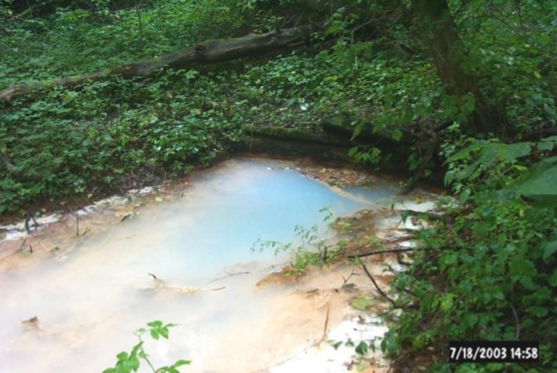
1/15: Presto-Sygan AMD Remediation at Newbury Market
Presto-Sygan Discharge: 650 gpm, 5.5 field pH, 38 mg/L Total Fe, 13 mg/L Total Al
Notes:
The first project is the Presto-Sygan AMD Remediation at Newbury Market.
The Presto-Sygan discharge is one of the most pollutive discharges in Chartiers Creek Watershed.
The mine water is contaminated with aluminum hydroxide giving it a white, milky look.
Presto-Sygan Discharge: 650 gpm, 5.5 field pH, 38 mg/L Total Fe, 13 mg/L Total Al

Slide 16
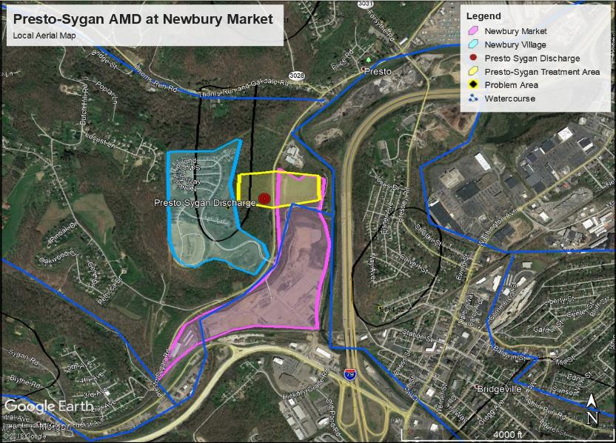
Presto-Sygan AMD Remediation at Newbury Market
Notes:
The AML Pilot funding, in combination with other funding, will be used to complete the Presto-Sygan Passive Treatment System (PTS) and will repurposed construction site access to be transformed into hiking trails
The construction of the PTS is being paired with the development of the Newbury Market, which is a $500 million, multi-use redevelopment of a former industrial facility that was in operation from 1928 to 1995.

Slide 17
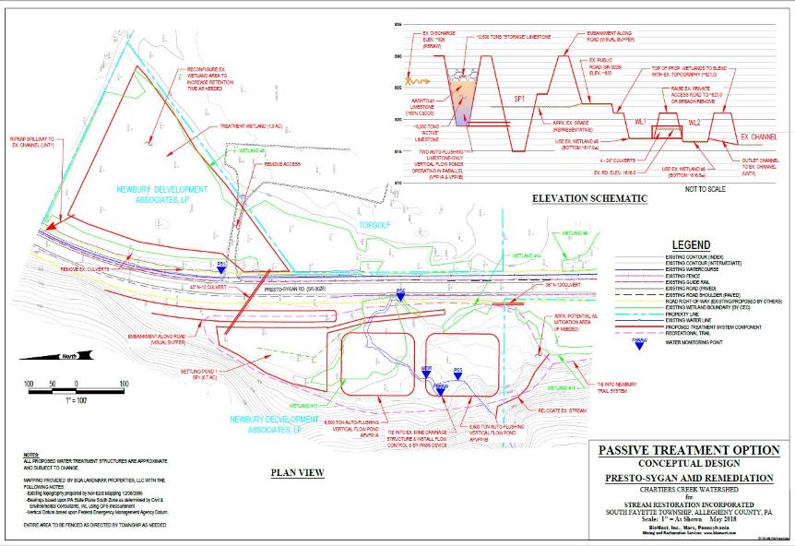
Presto-Sygan AMD Remediation at Newbury Market
Project Maps, Plans, and/or Photos
Notes:
Designed with two 8,500 ton auto-flushing limestone only vertical flow ponds (VFP’s), a settling pong, and a large aerobic wetland.
The total project cost of constructing the treatment system is $1,556,944 in which $64,944 has already been provided by other grants and money sources.
Leaving the grant amount at $1,492,000.

Slide 18

Significant Benefits
Seven (7) miles of new local roads, including several new bridges are to be constructed.
Over 10,000 linear feet of new sanitary sewer mains.
Over 12,000 linear feet of new water and gas mains.
$10 million+ worth of improvements to the existing local and state highway infrastructure are going to be upgraded.
Generation of jobs: 5,838 full time, 636 permanent indirect created by support/supplier industries, 821 non-permanent direct construction jobs. The creation of these positions the tax generation is estimated to be $64,460,406.
Notes:
Here you can see the project benefits.
(………….PAUSE…………….)

Slide 19
Project Partners
Stream Restoration, Inc.
BioMost, Inc.
Newbury Development Associates
Chartiers Nature Conservancy
Quality Aggregates, Inc.
Office of Surface Mining Reclamation and Enforcement
Pennsylvania Department of Environmental Protection
Notes:
Here you can see the project partners.
(………….PAUSE…………….)

Slide 20
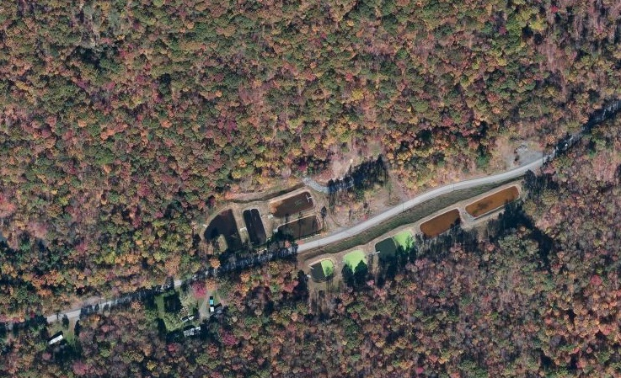
2/15: Six Mile, Longs Run/Sandy Run Watersheds
Notes:
Next, the Six Mile Run is a AMD treatment project that is to perform crucial maintenance work of 35 existing AMD systems to support stream recreation.
They have restored 14.5 miles of stream to warm water fisheries – migratory fishes with young of the year trout now present in Six Mile Run.
The project will sustain three full-time employee positions.

Slide 21
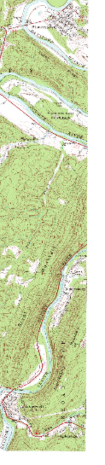
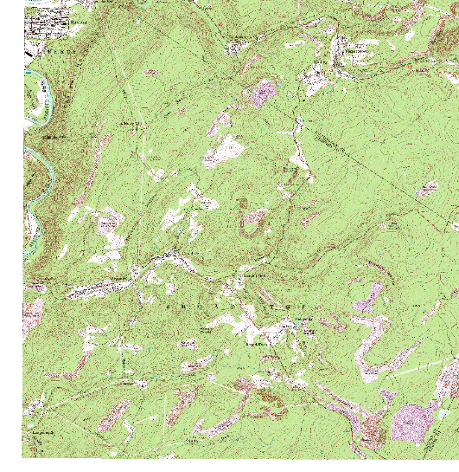

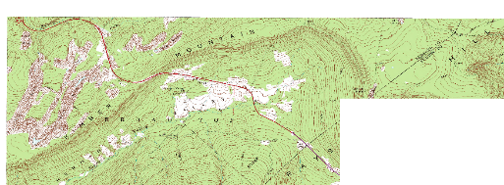
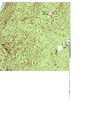
Broad Top Township Passive Treatment Systems
Notes:
Here is a map of the watershed to illustrate the locations of 35 AMD systems.

Slide 22
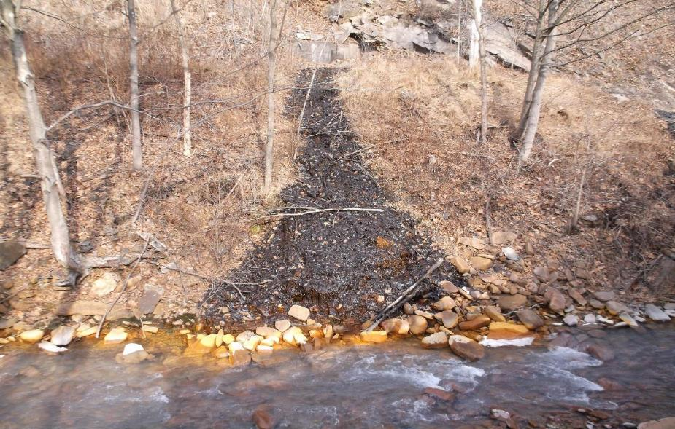
Existing AMD Discharge on Six Mile Run
Project Maps, Plans, and/or Photos
Notes:
Here is a picture of one of the existing AMD Discharges on Six Mile Run

Slide 23
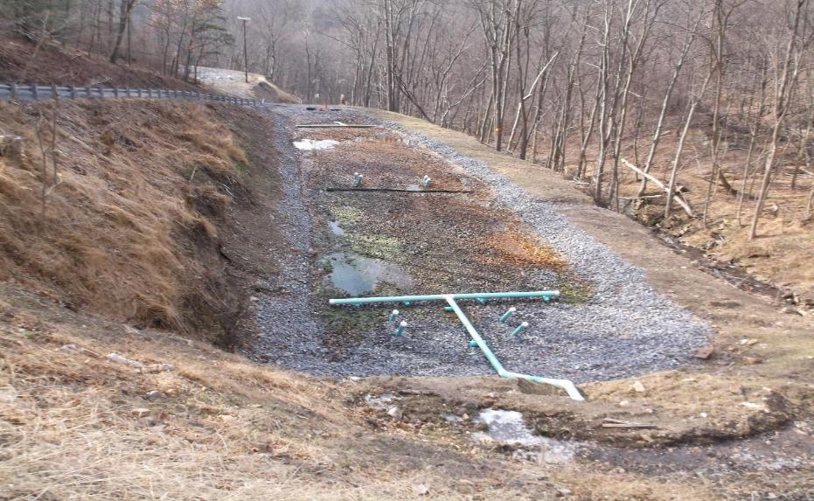
Passive Treatment System SX 10D2
Project Maps, Plans, and/or Photos
Notes:
Here is a picture of one of the AMD treatment systems.

Slide 24
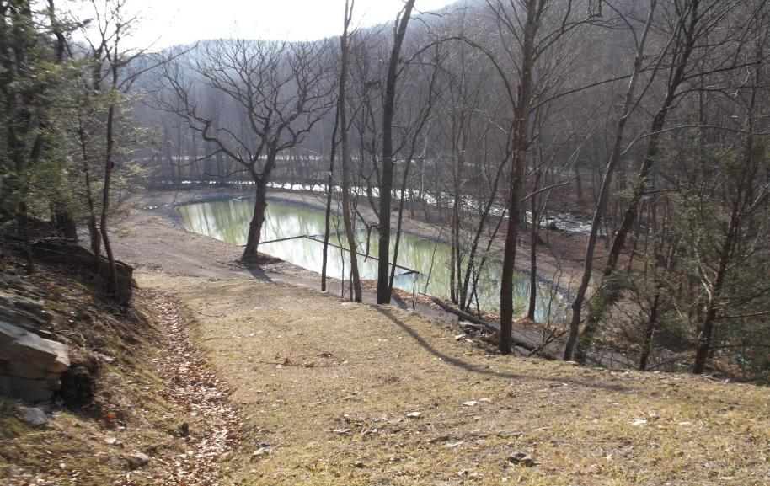
Passive Treatment SX 10D2 Settling Pond
Project Maps, Plans, and/or Photos
Notes:
And here is the settling pond for the treatment system.

Slide 25
Significant Benefits
The 35 AMD treatment systems sustain over 14.5 miles of stream which have been restored to WWF-MF fishery.
Supports three full-time positions.
Sustains Longs Run removal from the 303(d) list in 2014.
Moves Six Mile Run Watershed closer to delisting.
Restored streams provide $581,900.00 in economic benefit through recreation.
Notes:
Here you can see the project benefits.
(………….PAUSE…………….)

Slide 26
Project Partners
Six mile Run Watershed Committee
Bedford County Conservation District
Broad Top Township
S. Alleghenies Planning & Dev Comm.
Skelly and Loy, Inc.
Bedford County Commissioners
Trout Unlimited
OSMRE
PADEP - BAMR
Notes:
Here you can see the project partners.
(………….PAUSE…………….)

Slide 27
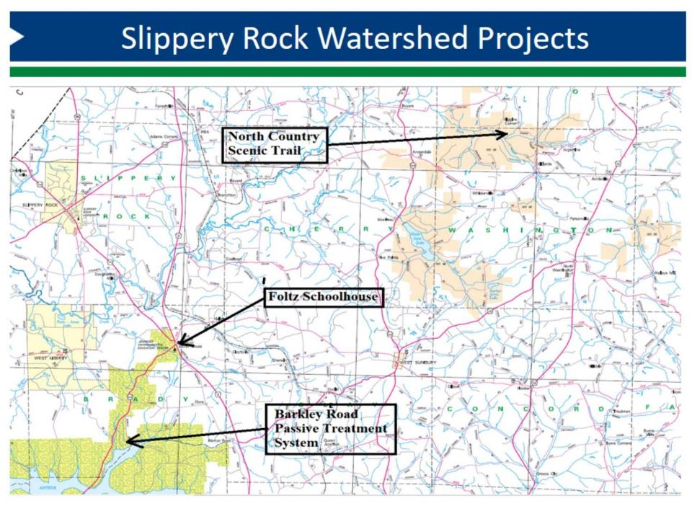
3/15:
Notes:
Next, the Slippery Rock AMD treatment project is to perform crucial maintenance work of 5 existing AMD systems and the Restoration of a historic one-room schoolhouse for environmental education and eco-tourism.
Additionally, significant repairs to bridges and trails on the North Country National Scenic Trail System will be performed.

Slide 28
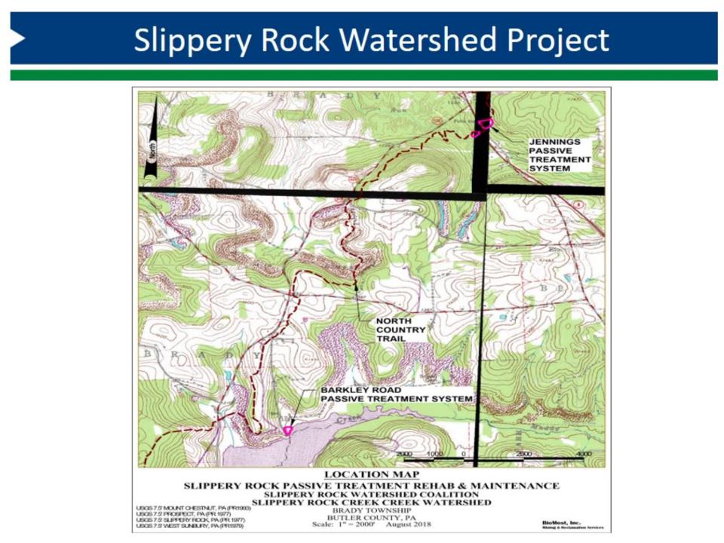
Notes:
Here is an illustration of the location of 2 of the AMD treatment systems and the trail.

Slide 29
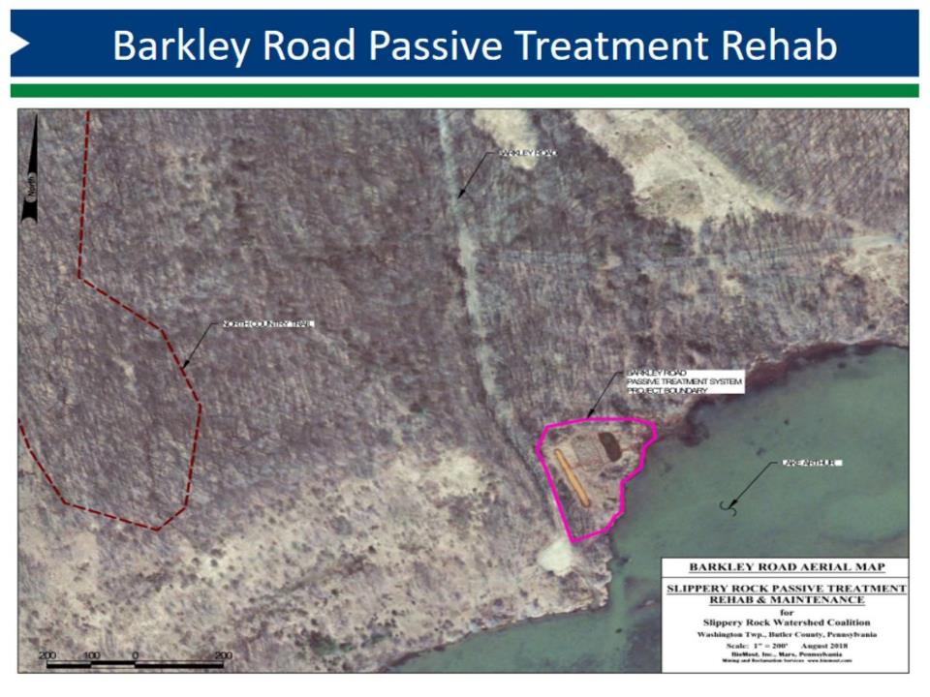
Notes:
Here is an overview of the Barkley AMD system.

Slide 30
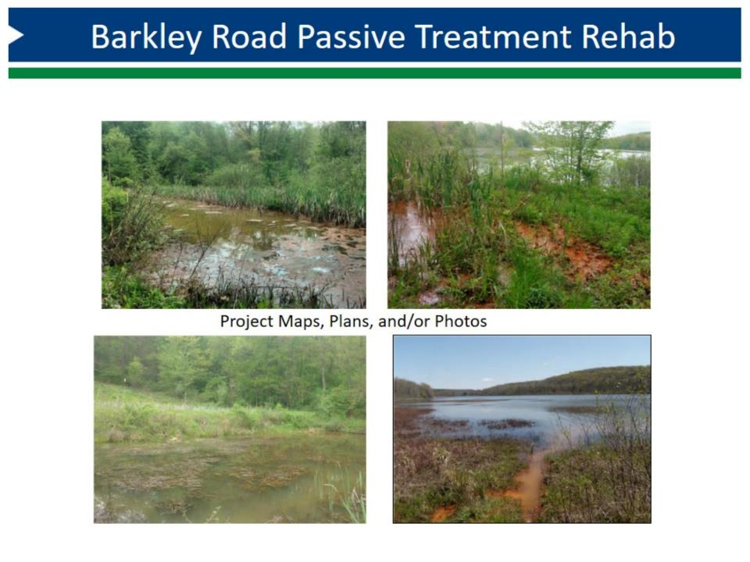
Notes:
Here are some close up pictures of the Barkley AMD systems.

Slide 31
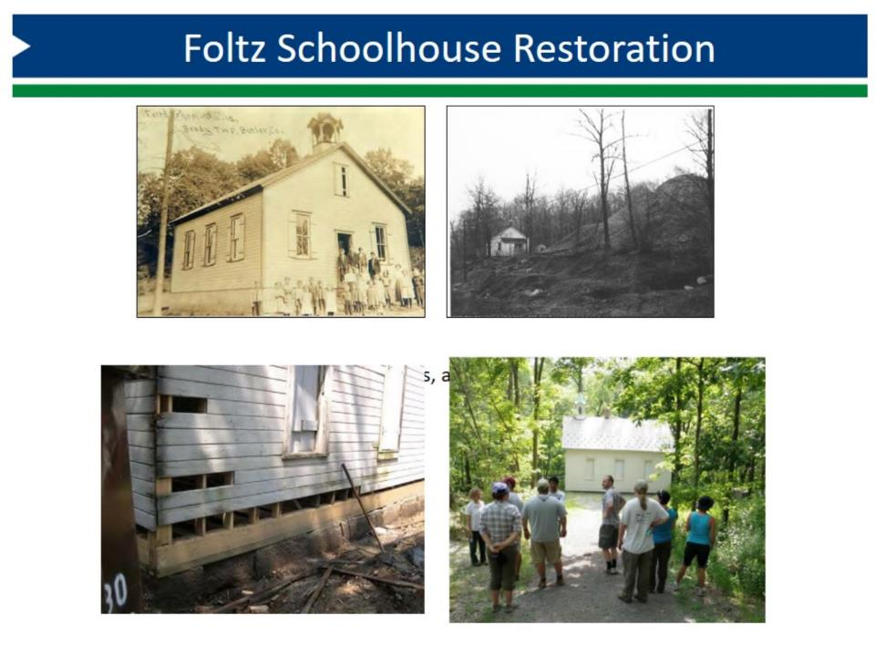
Notes:
Here are some interesting pictures of the schoolhouse.

Slide 32
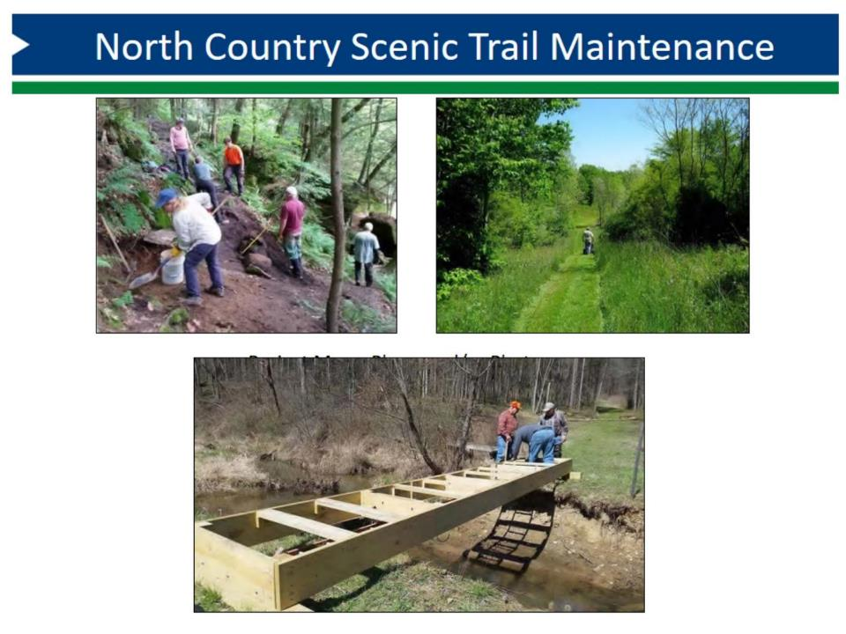
Notes:
Lastly, here are some pictures of the trail maintenance.

Slide 33
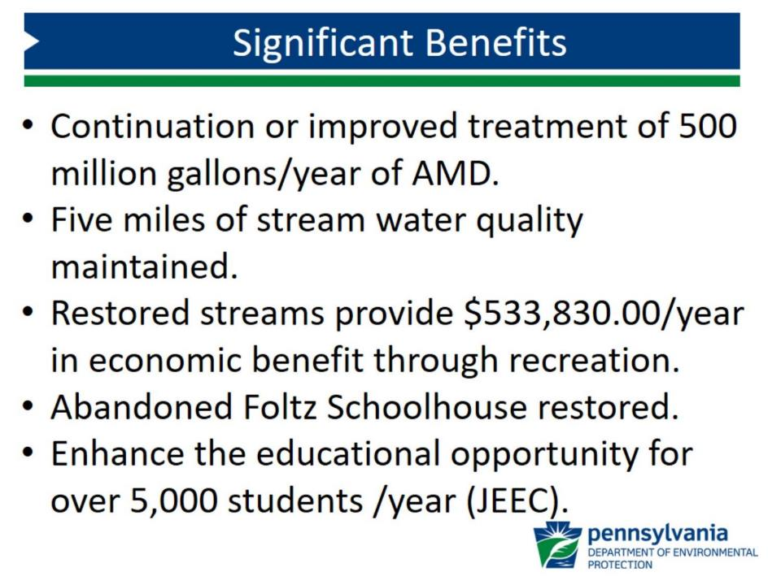
Notes:
Here you can see the project benefits.
(………….PAUSE…………….)

Slide 34
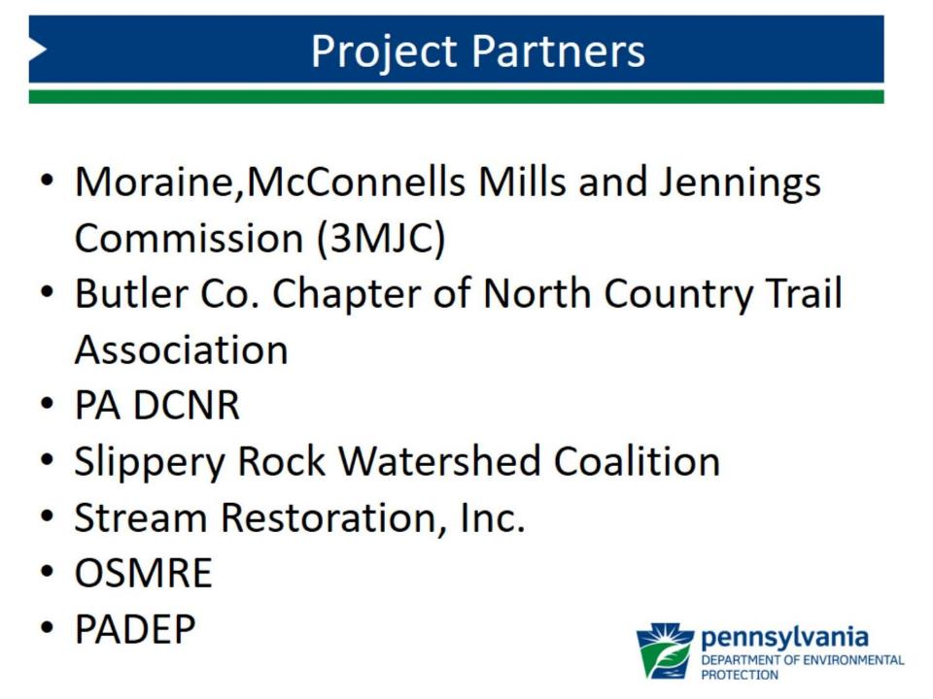
Notes:
Here you can see the project partners.
(………….PAUSE…………….)

Slide 35
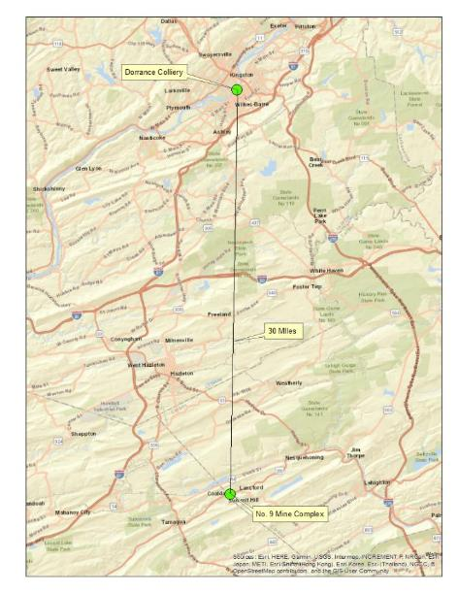
4/15: No. 9 Mine and Museum Complex/Dorrance Colliery
Notes:
In order to comply with Pennsylvania's Historic and Museum Commission,
The No. 9 Coal Mine and Museum Complex project will extract historic equipment from the Dorrance Colliery Complex and transport them to the No. 9 Coal Mine and Museum Complex.
This project will abate the P-1 Hazardous Equipment & Facilities at Dorrance Colliery Complex.

Slide 36
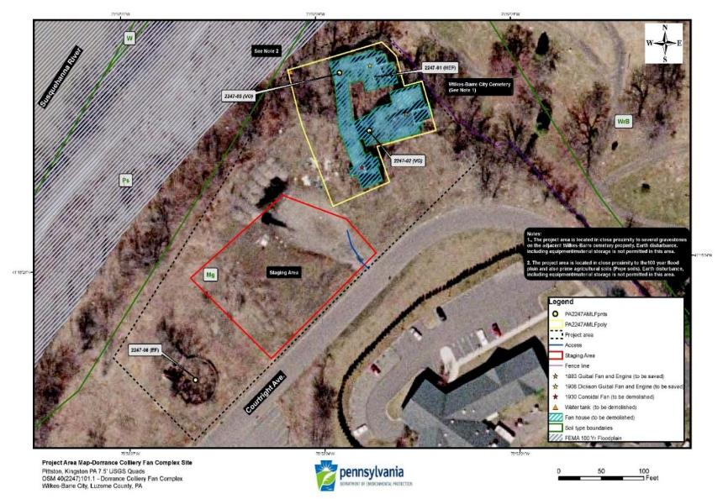
Dorrance Colliery
Notes:
Illustrated is the Dorrance Colliery-

Slide 37
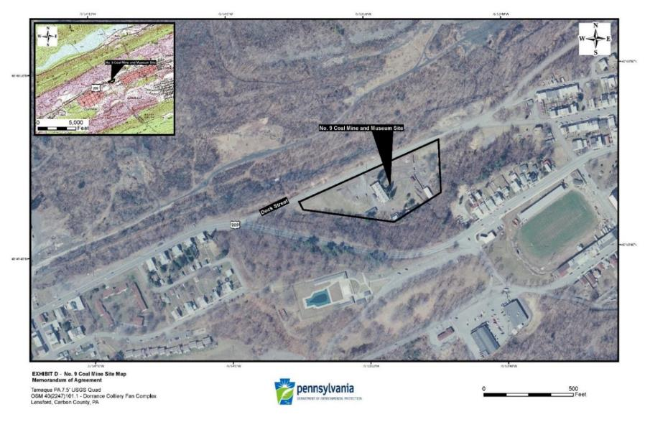
No. 9 Mine and Museum Complex
Notes:
Illustrated is the No. 9 Mine and Museum Complex.

Slide 38
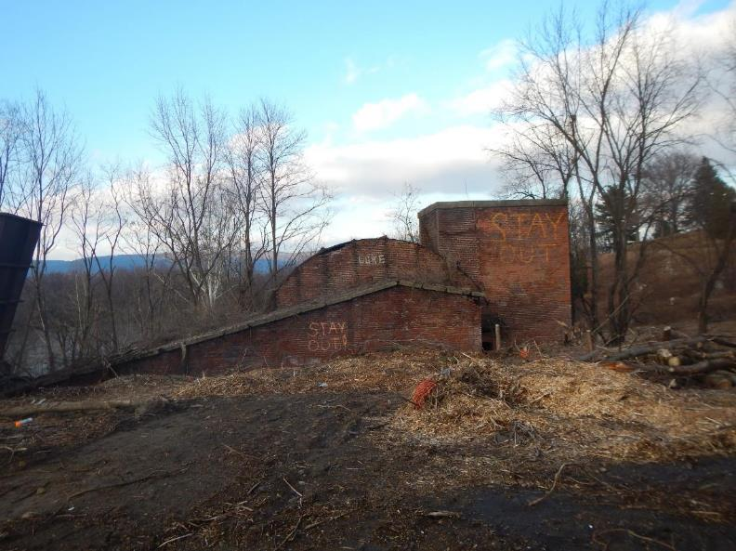
Dorrance Colliery -Building housing the Guibal Fan
Notes:
Building that houses the 1883 cast iron and wood 35 foot diameter Guibal Fan.

Slide 39
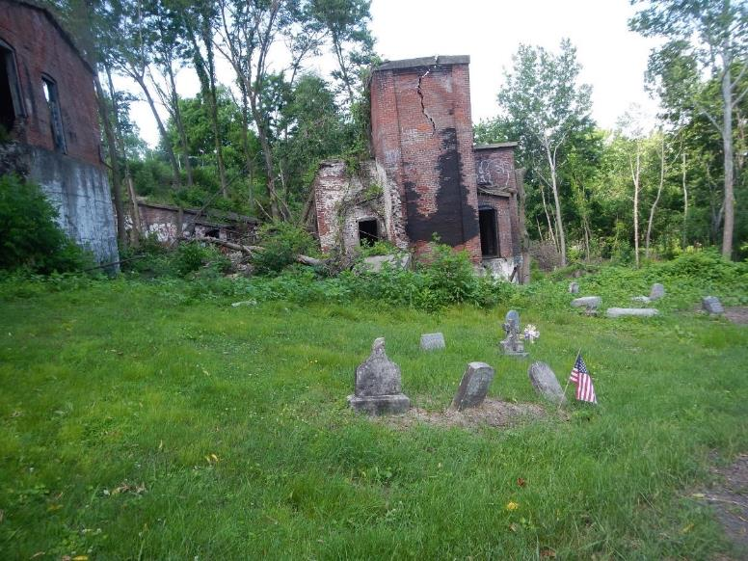
Building for the 28 foot Dickson-Guibal Fan
Notes:
Here is the other side of the Building that houses the 1883 cast iron and wood 35 foot diameter Guibal Fan.

Slide 40
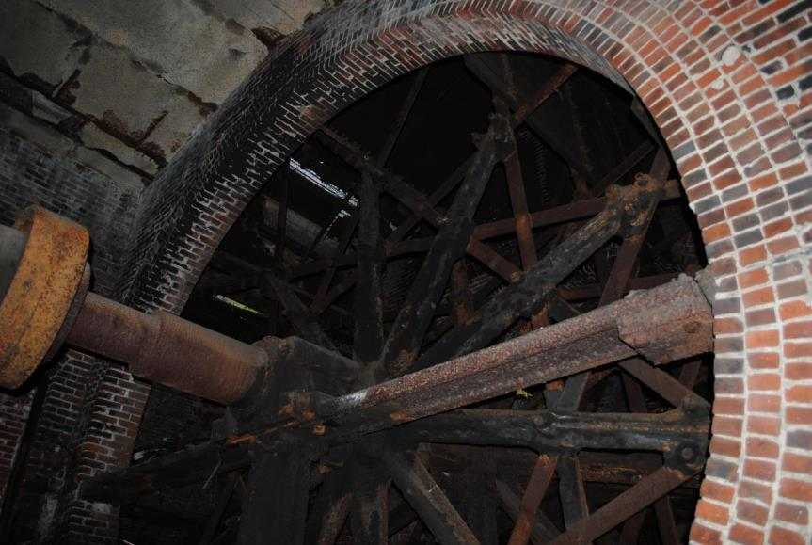
35 foot Guibal Fan
Notes:
Here is the 1883 cast iron and wood 35 foot diameter Guibal Fan

Slide 41
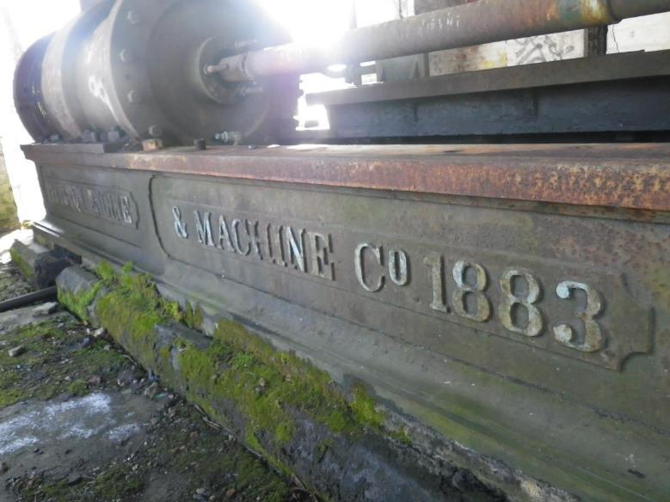
1883 Pittston Steam Driven Motor
Notes:
Here is the1883 Pittston horizontal slide valve steam engine.

Slide 42
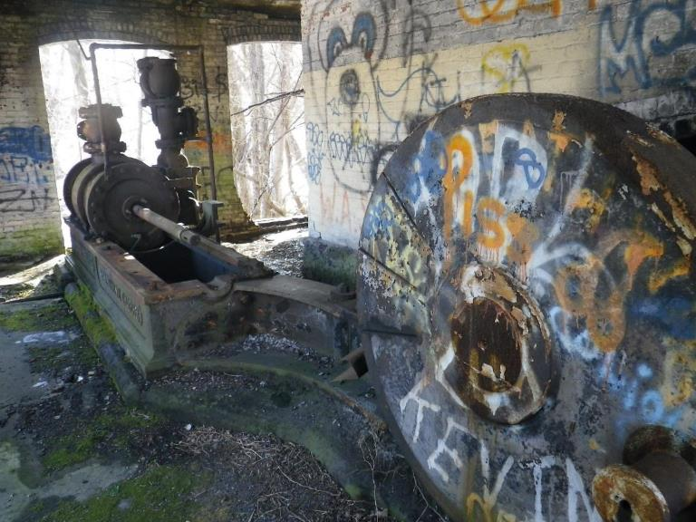
1883 Pittston Steam Driven Motor
Notes:
Here is another picture of the1883 Pittston horizontal slide valve steam engine.

Slide 43
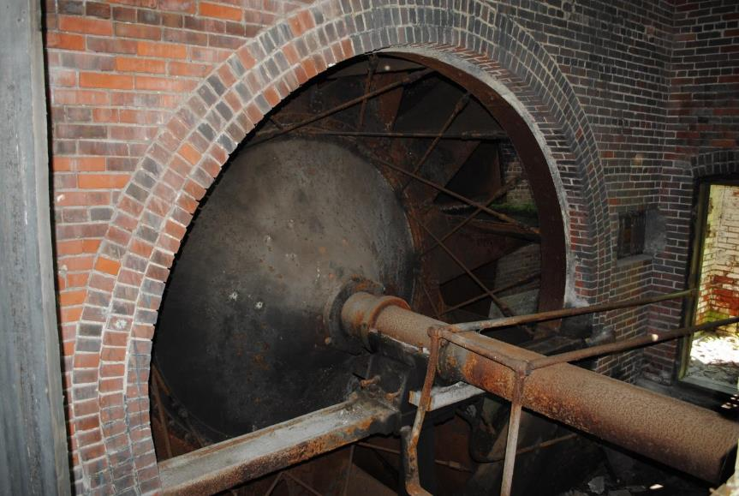
28 foot Dickson-Guibal Fan
Notes:
Here is the 1908 28 foot diameter Dickson-Guibal Fan.

Slide 44
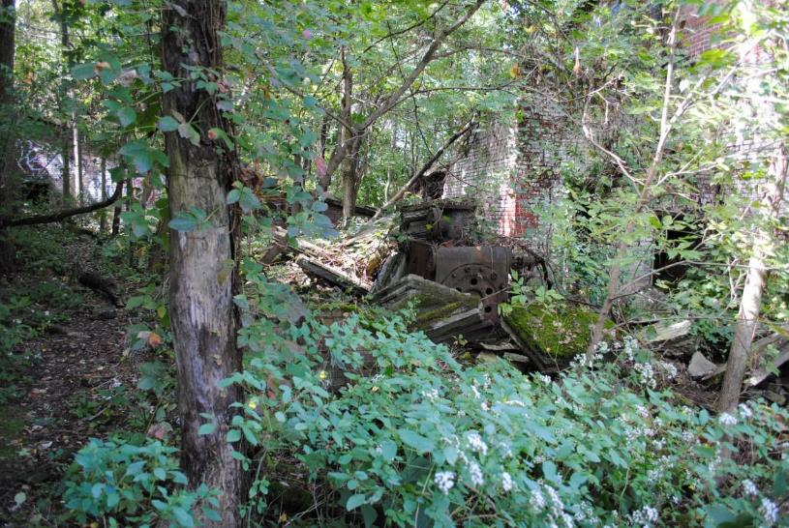
Corliss Steam Driven Motor
Notes:
Here is the matching Corliss steam engine for the Dickson-Guibal Fan.

Slide 45
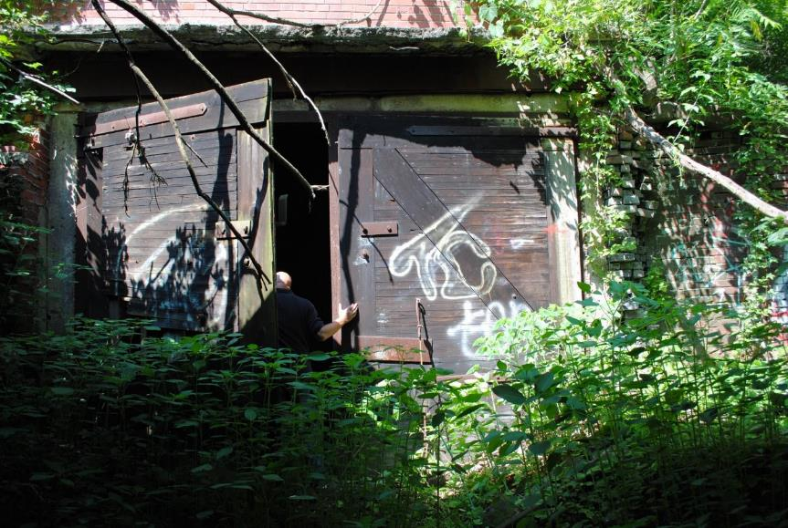
Air Control Doors between the Guibal Fan and Air Tunnel
Notes:
Here are the chamber doors of the Dorrance Colliery Complex.

Slide 46
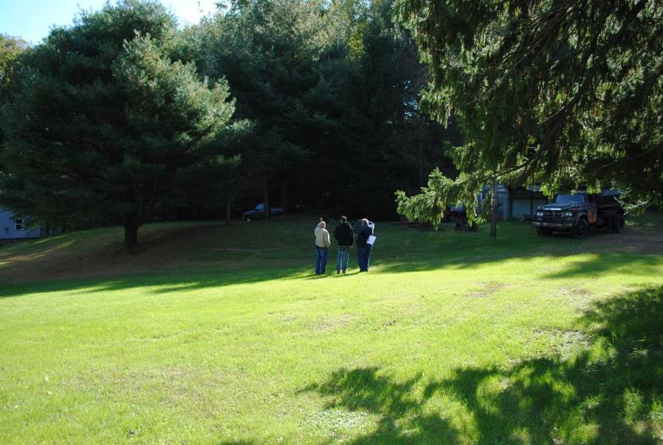
No. 9 Mine and Museum Fan Display Location
Notes:
And here is where all the components of the Dorrance Colliery Complex will be moved to at the No. 9 Coal Mine Museum.

Slide 47
Significant Benefits
Significantly expand the No. 9 Mine Mine and Museum Complex
Preserve unique pieces of Coal Mining History
Strengthen the presence of Historic Sites in the Coal mining area
Development of the new display is expected to increase the visitation by 15 to 20% a the tour site.
Increase in utilization of all types of personal visitor services in the vicinity of Lansford, Tamaqua and Jim Thorpe
Notes:
Here you can see the project benefits.
(………….PAUSE…………….)

Slide 48
Project Partners
Panther Creek Valley Foundation
Office of Surface Mining Reclamation and Enforcement
Pagnotti Enterprises Inc.
PA. Department of Environmental Protection
Notes:
Here you can see the project partners.
(………….PAUSE…………….)

Slide 49
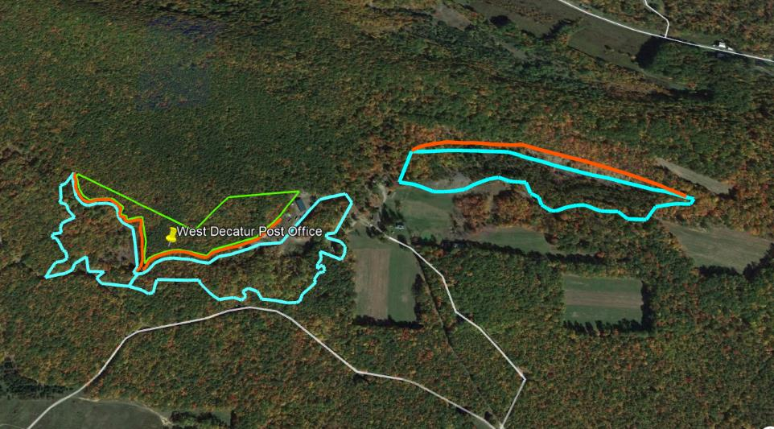
5/15: West Decatur Post Office (Morgan Run Recreational Facility)
Dangerous Highwalls
Spoil Areas
Subsidence Area
Project Maps, Plans, and/or Photos
Cen-Clear Camp Buildings
Notes:
Next, The West Decatur Post Office (Morgan Run Recreational Facility) will reclaim dangerous highwalls that are within the CenClear Child and Youth Services Facility in which the reclaimed area will then be repurposed for the construction over a mile of recreational trail for the children to use.
This project will enable Cen-Clear Child Services, LLC. to continue to promote and expand use at the site.

Slide 50
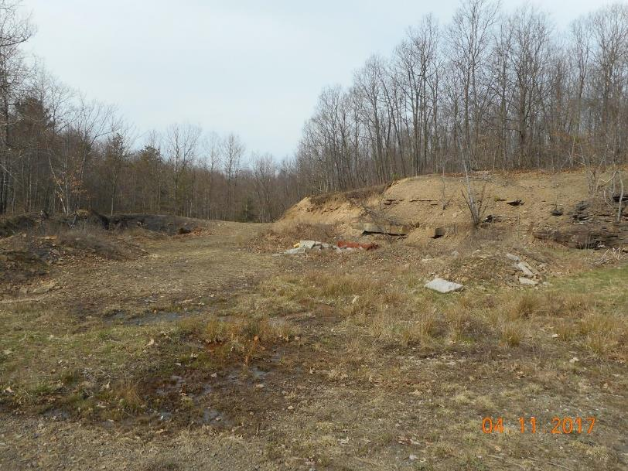
West Decatur Post Office (Morgan Run Recreational Facility)
Notes:
Here is a picture of a portion of the 3,700lf of dangerous highwall, 20 acres of spoil area and 7 acres of subsidence area. This project will enable Cen-Clear Child Services, LLC. to continue to promote and expand use at the site.

Slide 51
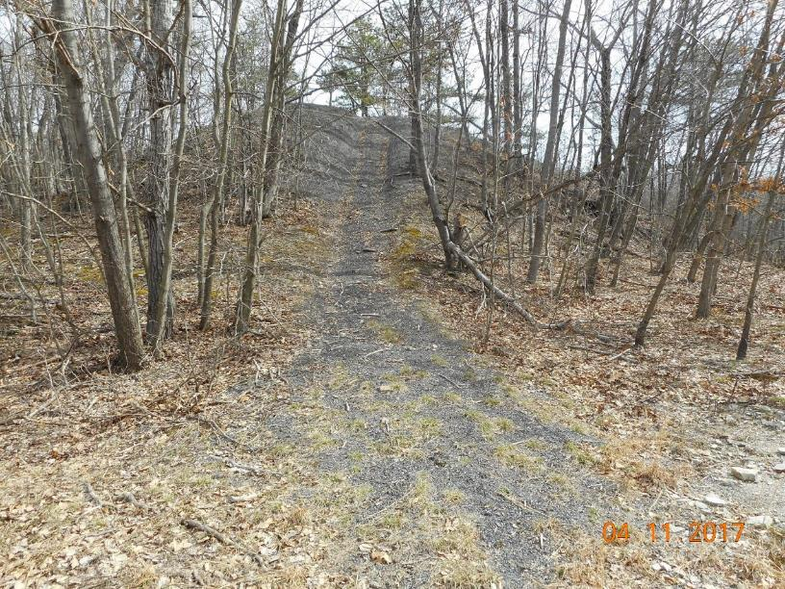
West Decatur Post Office (Morgan Run Recreational Facility)
Project Maps, Plans, and/or Photos
Notes:
Here is a picture of a portion of the 20 acres of spoil area.

Slide 52
Significant Benefits
Reclamation of 3,700lf of dangerous highwall, 20 acres of spoil area and 7 acres of subsidence area
Expanded use of the facilities for CenClear and other local organizations
1 mile of multi-use recreational trail
Parking Lot for public using the facility
Increase of jobs for CenClear
Notes:
Here you can see the project benefits.
(………….PAUSE…………….)

Slide 53
Project Partners
Cen-Clear Child Services, LLC
Office of Surface Mining Reclamation and Enforcement
Pennsylvania Department of Environmental Protection
Notes:
Here you can see the project partners.
(………….PAUSE…………….)

Slide 54
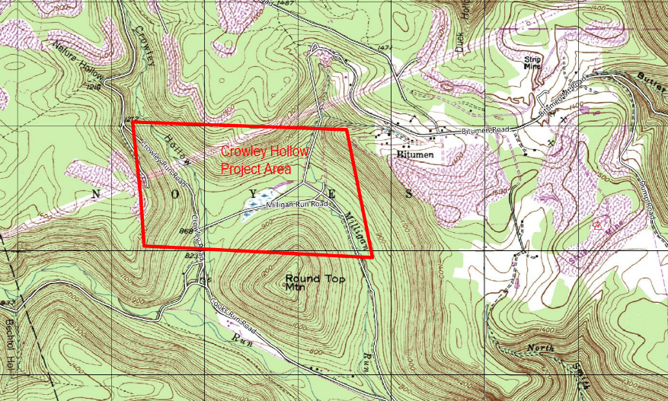
6/15: Crowley Hollow Diversion Channel
Notes:
Next, The Crowley Run Stream Diversion will eliminate AMD pollution from entering Cooks Run (to improve stream miles of Cooks Run) by redirecting Crowley Run 5,000 Linear Feet into the much shorter Milligan Run. The total combined AMD of shorter Milligan Run will then be diluted into the much larger West Branch of the Susquehanna River.
Above the confluence of Crowley Run, Cooks Run is designated as a High Quality Cold Water Fishery with Native Brook Trout and Wild Brown Trout. Because of Crowley Run, Cooks Run is severely impacted by the AMD of Crowley Run.

Slide 55
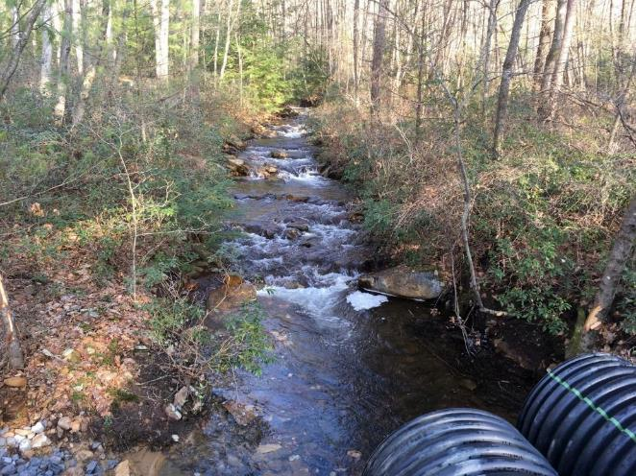
Crowley Hollow Diversion Channel
View of Crowley Hollow at Milligan Run Road, looking upstream.

Slide 56
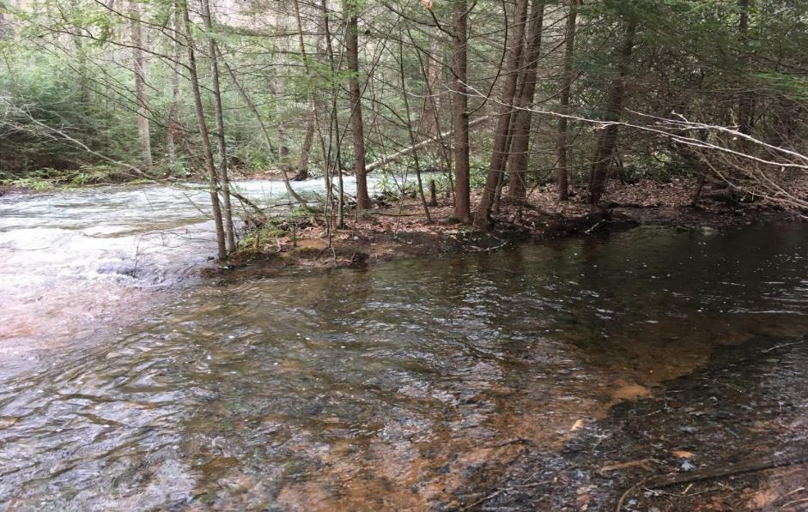
Crowley Hollow Diversion Channel
View of the confluence of Cooks Run (left) and Crowley Hollow (right)
Notes:
View of the confluence of Cooks Run (left) and Crowley Hollow (right).
Above the confluence of Crowley Run, Cooks Run is designated as a High Quality Cold Water Fishery with Native Brook Trout and Wild Brown Trout. Because of Crowley Run, Cooks Run is severely impacted by the AMD of Crowley Run.

Slide 57
Significant Benefits
The removal of Crowley Hollow is an integral and necessary part of restoring the quality of the Cooks Run watershed. 1,230 pounds per day of acid, 70 pounds of aluminum, 120 pounds of iron, and 30 pounds of manganese will be removed from Cooks Run when the project is completed.
The project is located within the Sproul State Forest and is open to the public. The project will help bring back the land and water to its natural state to be enjoyed by all the citizens that enjoy hunting, fishing, hiking, camping, ATV riding, and sightseeing, which will attract increased tourism to the area.
Using the PFBC formula for calculating the value of a Cold Water Fishery (1,100 fishing trips per year X $78.02 spent per fishing trip X Stream Miles), the value for the 1.1 miles of impacted stream on Cooks Run is approximately $94,404.20 in lost revenue for the local economy per year.
The short term gain in employment during the construction of an estimated 2 years will benefit the local economy by providing work. The project will need materials such as clay, stone, pipe, and seeding materials from local suppliers, which will help sustain the local economy during the construction period. The project will create or maintain approximately 30 jobs during the construction period.
Notes:
Here you can see the project benefits.
(………….PAUSE…………….)

Slide 58
Project Partners
Lock Haven University
Pennsylvania Fish and Boat Commission
Penn State University - Hazelton
Clinton County Conservation District
Pennsylvania Department of Conservation and Natural Resources
Pennsylvania Department of Environmental Protection
Notes:
Here you can see the project partners.
(………….PAUSE…………….)

Slide 59
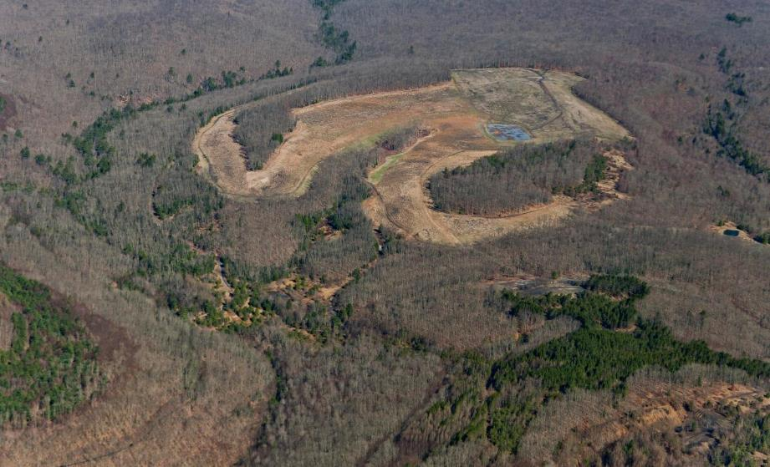
7/15: Huling Branch East
Previous Huling Branch Project
AMLF 6679-02(SL) & 6679-01(GO)
AMLF 1123-07(DH) & 1123-08(SA)
AMLF 1123-09(DPE)
Project Maps, Plans, and/or Photos
AMLF 1123-05(DH) & 1123-06(SA)
Notes:
Next, The Huling Branch East is the AML reclamation of dangerous highwalls and acidic refuse piles for the reforestation and restoration of public lands to then construct ATV Trails on public lands.
The backfilling of the dangerous highwalls will also incorporate alkaline addition to be blended within the highly acidic mine spoil areas and mine refuse to improve the negative impacts that AMD has caused with the watershed for years.

Slide 60
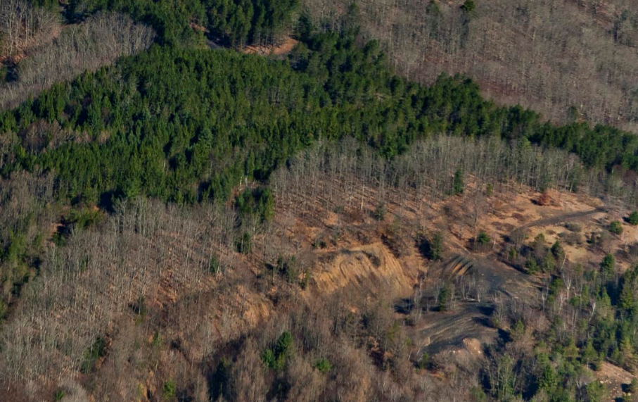
Huling Branch East
AMLF No. 1123-05(DH) is often referred to as “The Pit” where ATVs attempt to climb the 80-foot dangerous highwall. There have been many failed hill-climb attempts which result in life-flight evacuations.
Notes:
This is an illustration of a portion of the 3,000’ linear feet of dangerous highwalls and a 10-acre highly acidic dangerous pile and embankment area. These AML features will be backfilled and regraded with blended alkaline addition to remove these dangerous AML conditions and to then repurpose the area for parking, authorized ATV trail riding, and a Helicopter emergency evacuation area.

Slide 61
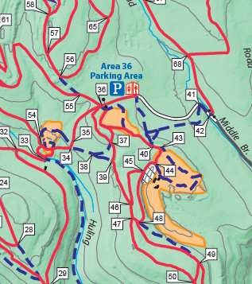
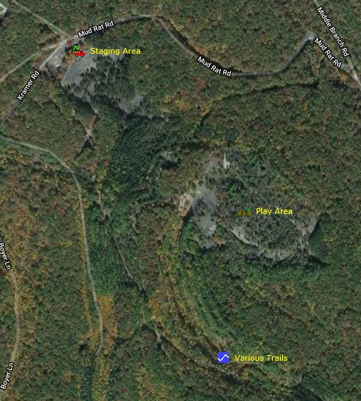
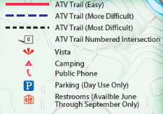

Huling Branch East
Camping Allowed
Proposed Reclamation
Hazard Area is start of 1123-05(DH).
Map of Whiskey Springs Trail System in Sproul State Forest
Notes:
This project will also create:
5,000 linear feet of promoted and authorize ATV trails within Sproul State Forest and
create additional parking area for visitors and
a flat area for Helicopter emergency evacuations.

Slide 62
Significant Benefits
Reclamation of 3,000 L.F. of dangerous highwalls, 10-acre dangerous pile and embankment consisting of acid-forming shale, 0.5-acre slurry pond and 2-acre gob material
Construction of 5,000 L.F. of ATV trails within Sproul State Forest
Construction of a grass parking area and flat area to be used by helicopters for emergency evacuations
Promote outdoor recreation
Improve watershed quality
Notes:
Here you can see the project benefits.
(………….PAUSE…………….)

Slide 63
Significant Benefits
Improvement of Huling Branch and Middle Branch Twomile Run which are Trout Stocking Fisheries (TSF)
Local campgrounds, hotels, and businesses would see increase in tourists and revenue
Elk are starting to migrate towards the area and reclamation would promote a more natural environment
Annual events include Relay for Life’s Cruise for a Cure & the National Rattlesnake Enduro Race
Notes:
Here you can see the project benefits.
(………….PAUSE…………….)

Slide 64
Project Partners
Pennsylvania Department of Conservation and Natural Resources (Land owner)
American Chestnut Foundation
Office of Surface Mining Reclamation and Enforcement
Pennsylvania Department of Environmental Protection
Notes:
Here you can see the project partners.
(………….PAUSE…………….)

Slide 65
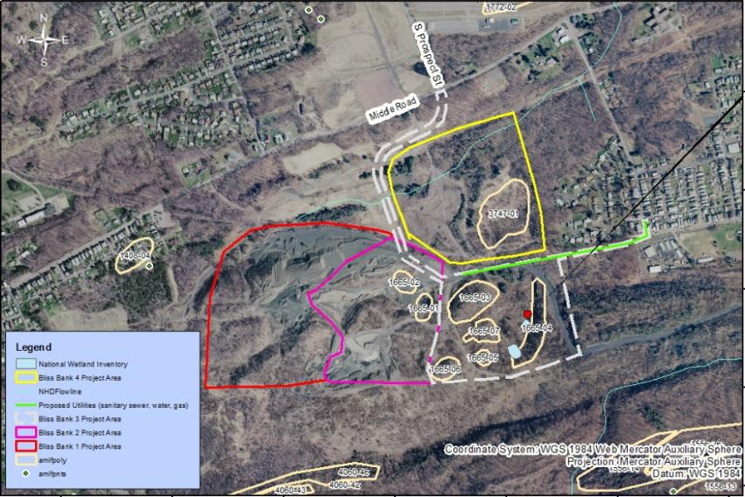
8/15: Earth Conservancy Bliss Bank 4
Notes:
Next, The Earth Conservancy Bliss Bank 4 is an dangerous pile embankment AML reclamation project for the expansion of an existing industrial/business park.
This project will reclaim up to 31 acres of AML that is part of the 220 plus acre Bliss Bank Industrial park.
AML Pilot funding will be used to bring natural gas, water, and sanitary sewer services to the entire Earth Conservancy (EC) Bliss Bank Development (+220 acres).
This project will sustain over 1,000 permanent full time positions.

Slide 66
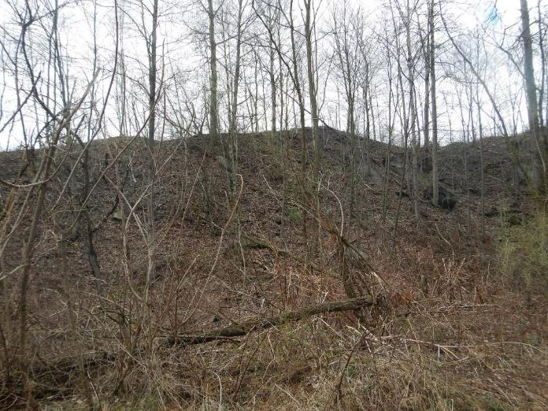
Earth Conservancy Bliss Bank 4
AML Feature 3747-03: Looking west at the base of the DPE
Notes:
Here is a closer look of the dangerous refuse pile.

Slide 67
Significant Benefits
Reclamation of 31 acres of AML, of the overall 220-acre Bliss Bank project, which allows the site to be developed
Nationwide companies potentially coming to the area
Creation of over 1,000 permanent full-time positions
Provides reclamation for a section of Espy Creek.
Notes:
Here you can see the project benefits.
(………….PAUSE…………….)

Slide 68
Project Partners
Earth Conservancy (Land owner, Non-profit)
NorthPoint Development Real Estate
Office of Surface Mining Reclamation and Enforcement
Pennsylvania Department of Environmental Protection
Notes:
Here you can see the project partners.
(………….PAUSE…………….)

Slide 69
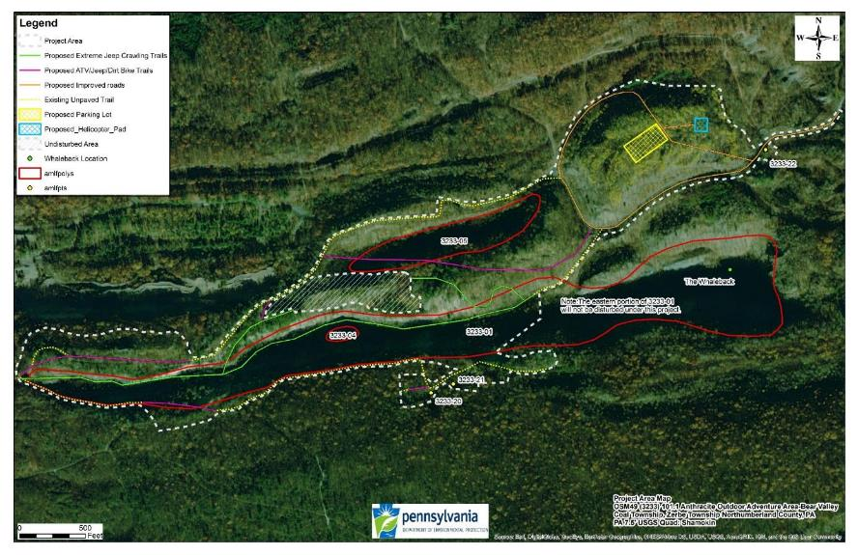
9/15: Anthracite Outdoor Adventure Area (AOAA)
Notes:
Next, the Anthracite Outdoor Adventure Area (aka AOAA) is AML dangerous highwall reclamation project to be repurpose as a unique and extreme jeep crawling recreational trail.
This project will add to and enhance this large public outdoor recreation area.
Total AML project area is 88 acres.
This project will reclaim approximately 5,000 feet of Dangerous Highwall
1 Hazardous Water Body
(2) Vertical Openings and
1 Hazardous Equipment & Facilities.
In addition, the AOAA trails will be expanded to include approximately 6,600’ of extreme Jeep crawling trails and
re-establishing and/or constructing approximately 4,370’ of Jeep/ATV/dirt bike trails, which would be owned and operated by the AOAA staff.
A parking lot (150’ x 300’)
helicopter pad (100’x100’) and
Approximately 4,900’ Linear feet of improved roads passable by two-wheel drive vehicles will also be constructed.
Work is anticipated to begin late fall 2019.

Slide 70
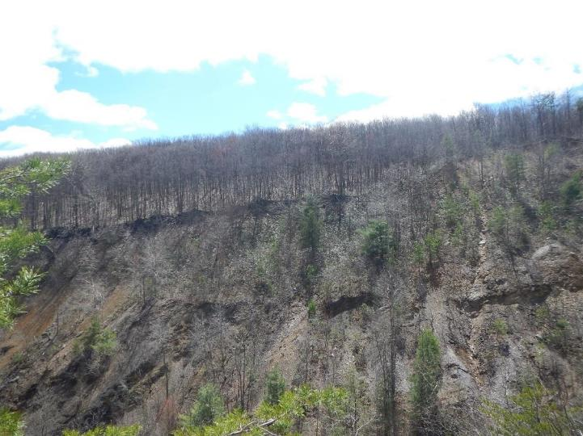
Anthracite Outdoor Adventure Area
AML Feature 3233-01: Looking north at the Dangerous Highwall
Notes:
Here is a picture of the Dangerous Highwall

Slide 71
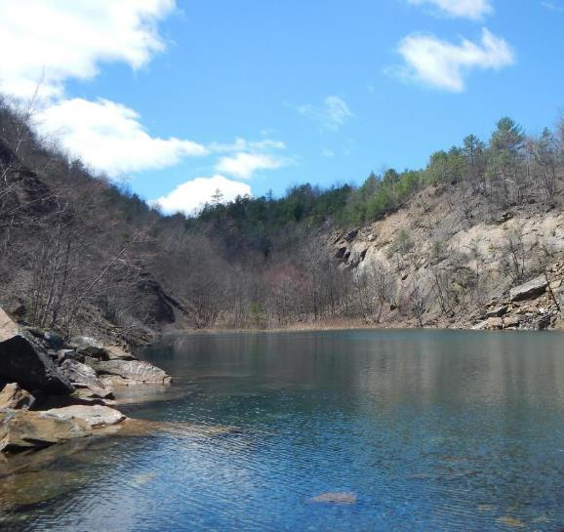
Anthracite Outdoor Adventure Area
AML Feature 3233-04: Looking west at the Hazardous Waterbody
Notes:
Here is a picture of the Hazardous Waterbody

Slide 72
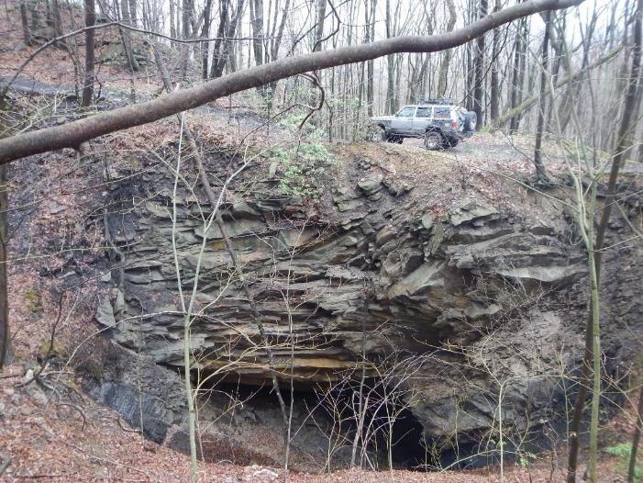
Anthracite Outdoor Adventure Area
AML Feature 3233-20: Looking north at the vertical opening
Notes:
Here is a picture of the mine opening

Slide 73
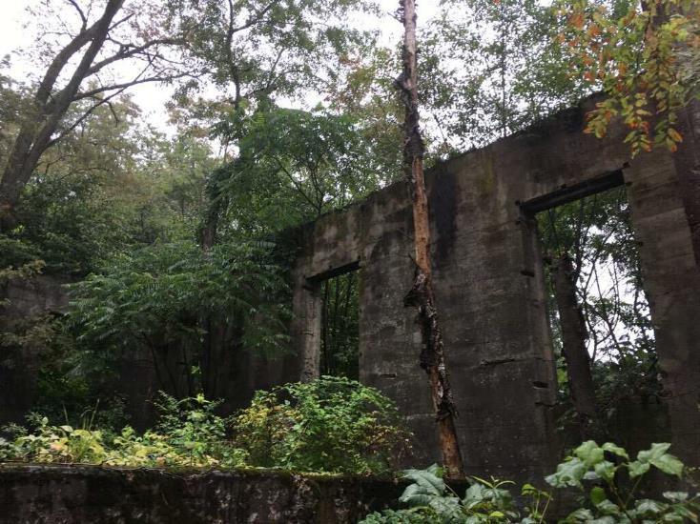
Anthracite Outdoor Adventure Area
AML Feature 3233-22: Looking southeast at the building to be demolished
Notes:
Here is a picture of the hazardous mine structure.

Slide 74
Significant Benefits
Total AML project area is 88 acres.
This project will reclaim approximately 5,000 feet of Dangerous Highwall
1 Hazardous Water Body
(2) Vertical Openings and
1 Hazardous Equipment & Facilities.
In addition, the AOAA trails will be expanded to include approximately 6,600’ of extreme Jeep crawling trails and
re-establishing and/or constructing approximately 4,370’ of Jeep/ATV/dirt bike trails, which would be owned and operated by the AOAA staff.
A parking lot (150’ x 300’)
helicopter pad (100’x100’) and
Approximately 4,900’ Linear feet of improved roads passable by two-wheel drive vehicles will also be constructed.
Work is anticipated to begin late fall 2019.
Notes:
Here you can see the project benefits.
(………….PAUSE…………….)

Slide 75
Project Partners
Northumberland County Anthracite Outdoor Adventure Area (AOAA) Authority
Office of Surface Mining Reclamation and Enforcement
Pennsylvania Department of Environmental Protection
Notes:
Here you can see the project partners.
(………….PAUSE…………….)

Slide 76


10/15: Anthracite Upland Pointing Dog Association 2018 Pilot Project
Area to be backfilled/regraded
Wildlife Seeding Area
Mine Openings (Cropfall) reclamation area.
Notes:
The AML pilot funding will be used to reclaim 10.6 acres of abandoned surface and underground mining features.
The reclamation will enable the Anthracite Upland Pointing Dog Association to hold competitive hunting dog skills events and educational outreach to local schools.
An additional 18.2 acres will be planted in a wildlife bird mix to promote use of the property by game birds.
A total of 28.8 acres will be improved and it is anticipated that over 600 people will use the property each year.

Slide 77

Anthracite Upland Pointing Dog Association 2018 Pilot Project
Notes:
Here is a closer look at the abandoned surface mine features.

Slide 78

Anthracite Upland Pointing Dog Association 2018 Pilot Project
Project Site
Notes:
As you can see that the location of the Anthracite Upland Pointing Dog Association is located within close proximity of 2 exits from Interstate 80.

Slide 79

Significant Benefits
Provide a completely reclaimed area to be used for dog competitions and educational outreach. This project will complement the previous reclamation in the area and the current Donaldson 2017 Pilot Project.
Over 350 people per year are anticipated to use the property per year for dog events and over 250 students per year are expected for educational programs.
Elimination of dangerous mine openings.
Creation of wild bird habitat.
Improved eligibility for hosting the North American Versatile Hunting Dog Association annual competition.
Notes:
Here you can see the project benefits.
(………….PAUSE…………….)

Slide 80
Project Partners
Schuylkill County Conservation District
PA Game Commission
Ruffed Grouse Society
Pennsylvania Department of Environmental Protection
Pheasants Forever
North American Versatile Hunting Dog Association
Office of Surface Mining Reclamation and Enforcement (OSMRE)
American Kennel Club
Notes:
Here you can see the project partners.
(………….PAUSE…………….)

Slide 81

11/15:

Slide 82

Notes:
Next, the Stonycreek and Little Conemaugh River Improvement and Reinvestment Project is a multi area AMD treatment project to maintain and improve AMD impaired areas of the watershed, while also implementing recreational trail improvements and extensions.
This project will also increase tourism through the construction of a boat access and public trail development will be performed at the base of the Historic Johnstown Inclined Plane.
The Johnstown Inclined Plane is the steepest vehicular inclined plane in the world.

Slide 83


Slide 84


Slide 85


Slide 86


Slide 87


Slide 88


Slide 89


Slide 90


Slide 91


Slide 92


Slide 93


Slide 94


Slide 95


Slide 96


Slide 97


Slide 98


Slide 99


Slide 100


Slide 101

Notes:
Here you can see the project benefits.
(………….PAUSE…………….)

Slide 102

Notes:
Here you can see the project benefits.
(………….PAUSE…………….)

Slide 103

Notes:
Here you can see the project benefits.
(………….PAUSE…………….)

Slide 104

Notes:
Here you can see the project benefits.
(………….PAUSE…………….)

Slide 105

Notes:
Here you can see the project benefits.
(………….PAUSE…………….)

Slide 106

Notes:
Here you can see the project partners.
(………….PAUSE…………….)

Slide 107


12/15: Forest City east-PFBC Access
Concrete Structures
Wash House
Concrete Structures
Dangerous Pile & Embankment
Notes:
Next, the Forest City East project is for AML reclamation of refuse piles and stream bank improvement due to the existing mine refuse that is within Lackawanna River.
Once completed the reclaimed area will provide for river recreational options of fishing and canoeing.
Pictured is the a portion of the 16.2 acre refuse pile along with remnants of an abandoned mine structure.

Slide 108

Forest City east-PFBC Access
Dangerous Pile & Embankment
Concrete Structures
Concrete Structures
Wash House
Full Site View
Notes:
Illustrated is a map of the overall site.
This project may aid in the creation to increase of tourism in this area for fishing and canoe/kayaking sports.
It is anticipated that PFBC Access will attract up to 500-600 fishing enthusiast and an average of 15-20 boats/canoes/Kayaks per day during highwater season.
The Lackawanna conservation River Association and the American Canoe associations hosts a nonprofit fundraiser feasts twice a year attracting hundreds of visitors,
For Canoe and paddling demonstrations
Music, food, Crafts and outdoor fun for the whole family at the Lackawanna River banks.
These people will be using local facilities from gas stations, restaurants, and possible hotel accommodations.
There are seasonal Class 3 and 4 White Water Rapides just downstream of this location.

Slide 109

Forest City east-PFBC Access
Dangerous Pile & Embankment
Concrete Structures
Concrete Structures
Wash House
Full
Eroded Stream Channel Diversion
Notes:
Illustrated is a portion 4,000 feet along the Lackawanna River that will be restored, while the refuse is removed and regraded.

Slide 110

Forest City east-PFBC Access
Dangerous Pile & Embankment
Concrete Structures
Concrete Structures
Wash House
Futurenber
Gob Area
Notes:
Here is portion of the 34.5 acres of Gob.

Slide 111

Forest City east-PFBC Access
Dangerous Pile & Embankment
Concrete Structures
Concrete Structures
Wash House
Futurener
Gob Area
Northern View drone photo Showing project site detail
Notes:
Lastly, picture is an overall oblique image of the project site.

Slide 112

Significant Benefits
Reclamation of 55 acres of Abandoned Mine Land (AML).
Elimination of dangerous AML features
Future community Attraction/Fishing & Canoeing Hot Spot.
Creating job and Development opportunities
Notes:
Here you can see the project benefits.
(………….PAUSE…………….)

Slide 113
Project Partners
Linde Corporation.
Office of Surface Mining Reclamation and Enforcement.
Forest City Partnership LLC .
Pennsylvania Fish &Boat Commission(PFBC).
Pennsylvania Department of
Environmental Protection
Notes:
Here you can see the project partners.
(………….PAUSE…………….)

Slide 114

13/15: Morris Run AMD Treatment Plant
Tioga River at Blossburg, PA – Photo shows severe impact from acid mine drainage. There is little to no aquatic life in the river.
Notes:
Next, the Tioga River Restoration (Morris Run AMD Treatment Plant) is for the AMD remediation to restore 20 miles of stream within the watershed to promote stream recreation.
Picture is the Tioga River in Blossburg, PA, as illustrated the photo shows severe impact from acid mine drainage.
There is little to no aquatic life in the river.

Slide 115

Morris Run AMD Treatment Plant
Notes:
This is an illustration of the proposed AMD plant location.

Slide 116

Morris Run AMD Treatment Plant

Slide 117

Morris Run AMD Treatment Plant
AMD discharge from the Lake Mine Complex. Average flow is 1,300 GPM. Average water chemistry values: pH=3.2, Al=20 mg/l, Fe=8 mg/l, Mn=25 mg/l, acidity=230 mg/l, alkalinity=0 mg/l.
Notes:
Pictured is an AMD discharge from the Lake Mine Complex.
Average flow is 1,300 GPM. Average water chemistry values: pH=3.2, Al=20 mg/l, Fe=8 mg/l, Mn=25 mg/l, acidity=230 mg/l, alkalinity=0 mg/l.

Slide 118

Morris Run AMD Treatment Plant
The Coal Creek Discharge is the largest volume discharge within the Tioga River Watershed and is responsible for 45% of the total acidity load to the Tioga River.
Notes:
Pictured is The Coal Creek acid mine discharge is the largest volume discharge within the Tioga River Watershed. It has the most degraded water quality and is responsible for 45% of the total acidity load to the Tioga River.
Average flow is 2,500 GPM. Average water chemistry values: pH=2.8, Al=33 mg/l, Fe=43 mg/l, Mn=10 mg/l, acidity=440 mg/l, alkalinity=0 mg/l.

Slide 119

Morris Run AMD Treatment Plant
Tioga/Hammond Dam
Notes:
Tioga River meets the Tioga/Hammond Dam Complex: As the acid mine drainage from the Tioga River is mixed with the alkaline water of the lakes, it slowly becomes neutralized and the high levels of dissolved metals begin to precipitate. The unnatural blue-green color that is visible in Tioga Lake is due to precipitation of these metals, such as aluminum.

Slide 120
Significant Benefits
Restore a total of twenty (20) miles of streams back to a natural state as a wild trout and stocked trout fishery
Improve water quality within 500-acre Tioga Lake and ultimately the entire 1,200-acre Tioga/Hammond Dam Complex; only half of the complex is good water quality
Produce positive economic benefits to the Tioga/ Hammond Dam Complex recreation area
Increase the number of visitors to this rural area in the form of fishing, boating, camping, tourism and sightseeing
Establish new businesses in the area, create jobs and fuel economic growth
Generate approximately $875,000 per year in revenue for the local economy
Notes:
Here you can see the project benefits.
(………….PAUSE…………….)

Slide 121
Project Partners
Pennsylvania Department of Conservation and Natural Resources
Susquehanna River Basin Commission
Tioga County Conservation District
Tioga County Concerned Citizens Committee
Office of Surface Mining Reclamation and Enforcement
Pennsylvania Department of Environmental Protection
Notes:
Here you can see the project partners.
(………….PAUSE…………….)

Slide 122


14/15: Electric Street Development
Notes:
The 1st of 2 Contingency (Replacement) projects is the Electric Street Development located in (Eastern PA).
This project will reclaim up to 37 acres of AML (Dangerous Refuse piles) for the development of 4,700 Linear Feet of recreational trail.

Slide 123

Electric Street Development
AML Feature 3756-02: Looking southwest at the spoil area
Notes:
Pictured is a portion of the 37 acre refuse pile.

Slide 124
Significant Benefits
Reclamation of 37 acres of AML
Lackawanna River Access which will further the goal of the LHVA transforming the entire length of the river into a comprehensive recreational area
Creation of 20-30 permanent full-time positions
Construction of the trail will bring people to the area and also allow a portion of the Steamtown Marathon to move from a narrow very congested portion of Rt. 6.
Notes:
Here you can see the project benefits.
(………….PAUSE…………….)

Slide 125
Project Partners
D & L Realty(Land owner)
Lackawanna Heritage Valley Authority
Office of Surface Mining Reclamation and Enforcement
Pennsylvania Department of Environmental Protection
Notes:
Here you can see the project partners.
(………….PAUSE…………….)

Slide 126


15/15: Eden East Waterline
Notes:
The 2nd of 2 Contingency (Replacement) projects if the Eden East Waterline Extension located in (Western PA).
This project will construct:
Up to 10 miles of waterline installation
30,360 L.F. new line
23,866 L.F. upgrade , from 3” to 6”
Pump Station and Water Storage Tank
25 AML eligible water supply replacements
Plus 13 incidental homes, for a total of 38 homes
Countless additional homes are expected to be built that will tap into waterline, once installed.

Slide 127

Eden East Waterline
Project Maps, Plans, and/or Photos
Proposed Tank Location
Notes:
Picture is where the new tank will be constructed.

Slide 128

Eden East Waterline
Project Maps, Plans, and/or Photos
Existing Pump Station
Notes:
Picture is the existing pump station that will be upgraded and replaced.

Slide 129

Eden East Waterline
Project Maps, Plans, and/or Photos
Typical existing location of waterline installation.
Notes:
Picture is the typical setting for the waterline installation.

Slide 130
Significant Benefits
10 miles of waterline
Tank and Pump station
38 total homes will receive water: 25 AML impacted homes will have reliable water, 13 non-AML impacted homes will also benefit from waterline upgrade/extension.
CKGAA will receive increased revenue.
Potential future residential & commercial development.
Notes:
Here you can see the project benefits.
(………….PAUSE…………….)

Slide 131
Project Partners
Covington Karthaus Girard Area Authority (CKGAA)
Office of Surface Mining Reclamation and Enforcement
Pennsylvania Department of Environmental Protection
Notes:
Here you can see the project partners.
(………….PAUSE…………….)

Slide 132

Questions?
Contact
Information: pawebb@pa.gov
814-472-1800
www.NAAMLP2019.com
Tom Wolf, Governor
Patrick McDonnell, Secretary
Notes:
Any questions????

Slide 133



Access : www.NAAMLP2019.com to see the details!!!!
Notes:
Don’t forget to checkout Pennsylvania’s NAAMLP 2019 website for next year’s conference in Pittsburgh. Preconference tours start on Wednesday, September the 4th. The conference will be at the Wyndham Grand Pittsburgh Downtown.

Slide 134
2018 AML Pilot
Project Summaries

Slide 135

Presto-Sygan AMD Remediation at Newbury Market
The Presto-Sygan discharge is one of the most pollutive discharges in Chartiers Creek Watershed. The mine water is contaminated with aluminum hydroxide giving it a white, milky look. This suggests that low-pH Al-contaminated waters are mixing with flows of alkaline water within the mine near the discharge point.
Compared to the other discharges in the watershed, Presto Sygan was the most variable in flow, 175 -775 gpm, and chemistry; acidity of 19-261 mg/L and Aluminum of 8 – 19 mg/L. The iron and manganese content of the mine drainage is somewhat more stable but averages 40 mg/L of iron and 1.4 mg/L of manganese.

Slide 136
Presto-Sygan AMD Remediation at Newbury Market
The AML Pilot funding, in combination with other funding, will be used to complete the Presto-Sygan Passive Treatment System (PTS).
Designed with two 8,500 ton auto-flushing limestone only vertical flow ponds (VFP’s), a settling pong, and a large aerobic wetland. The total project cost of constructing the treatment system is $1,556,944 in which $64,944 has already been provided by other grants and money sources. Leaving the grant amount at $1,492,000.
The construction of the PTS is being paired with the development of the Newbury Market, a $500 million, multi-use redevelopment of a former industrial facility that was in operation from 1928 to 1995

Slide 137
Six Mile, Longs Run/Sandy Run Watersheds
The AML Pilot Funding, in combination with Match Money, will be used to perform crucial maintenance on 35 existing passive treatment systems located in Broad Top Township, Bedford County. Combined, the existing passive treatment systems remove 222 lbs./day of iron, 207 lbs./day of aluminum, and 2,145 lbs./day of acidity. They have restored 14.5 miles of stream to warm water fisheries – migratory fishes with young of the year trout now present in Six Mile Run. The project will sustain three full-time employee positions.

Slide 138
Slippery Rock Watershed Project
The AML Pilot Funding, in combination with Growing Greener and Match Money, will be used to perform crucial maintenance on five existing passive treatment systems located in Brady and Washington Townships, Butler County. Additionally, the project will enhance educational, recreational, and tourism activities by restoring the Foltz Schoolhouse (part of the Jennings Environmental Educational Center) and provide significant repairs to bridges and trails on the North Country National Scenic Trail System.

Slide 139
No. 9 Mine and Museum Complex/Dorrance Colliery
The No. 9 Coal Mine and Museum Complex is proposing a project that will identify and mark equipment components; submit a transportation plan for approval to the BAMR and the PA SHPO; temporarily brace equipment, disassemble as necessary and extract equipment from the Dorrance Colliery Complex; and transport the equipment to the No. 9 Coal Mine and Museum Complex where the equipment will be refurbished (including replacing broken/lost parts for the fans), reassembled and incorporate the equipment into displays constructed under this project at the Museum Complex. This grant work will allow the OSM 40(2247)101.1 project (that will abate the P-1 Hazardous Equipment & Facilities) to move forward by completing the historic mitigation requirements of Section 106 of the National Historic Preservation Act for the historic equipment that exists at the site.
The equipment to be transported from the Dorrance Colliery to the No. 9 Coal mine and Museum is identified in the “Stipulations” of the April 2014 Memorandum of Agreement between: the Office of Surface mining Reclamation and Enforcement, the Pennsylvania State Historic Preservation Office, the DEP Bureau of Abandoned Mine Reclamation, and the No. 9 Coal Mine Museum and basically consists of: the 1883 cast iron and wood 35 foot diameter Guibal Fan and matching 1883 Pittston horizontal slide valve steam engine; and the 1908 28 foot diameter Dickson-Guibal Fan and matching Corliss steam engine. The work will also include salvaging the chamber doors of the Dorrance Colliery Complex where feasible.

Slide 140
West Decatur Post Office
The AML Pilot Funding will be used to complete the West Decatur Post Office Project (20 acres) and will construct approximately 1 mile of multi-use recreational trails and a parking lot on the property. West Decatur Post Office will abate 3,700lf of dangerous highwall, 20 acres of spoil area and 7 acres of subsidence area. This project will enable Cen-Clear Child Services, LLC. to continue to promote and expand use at the site.

Slide 141
Crowley Hollow Diversion Channel
Cooks Run is designated as a High Quality Cold Water Fishery above the confluence with Crowley Hollow. Crowley Hollow is severely degraded by AMD. Below the confluence of Crowley Hollow and Cooks Run, Cooks Run is severely impacted and virtually void of aquatic life. Above the confluence, Cooks Run has a population of Native Brook Trout and Wild Brown Trout as well as a variety of aquatic invertebrates.
Milligan Run discharges directly into the West Branch of the Susquehanna River and is severely degraded by AMD. The proposed project will divert Crowley Hollow away from Cooks Run and into Milligan Run, eliminating the AMD pollution entering Cooks Run. An estimated 1,230 pounds of acid, 70 pounds of aluminum, 120 pounds of iron, and 30 pounds of manganese per day will be eliminated from entering Cooks Run.
The AML Pilot funding, in combination with other funding, will be used to complete the Crowley Hollow Diversion Channel.
An approximately 5,000 foot channel will be constructed to divert Crowley Hollow into Milligan Run. The total project cost is estimated at $2,000,000.

Slide 142
Huling Branch East
The AML Pilot Funding, in combination with other funding, will be used to complete the Huling Branch East project and will create 5,000 linear feet of ATV trails within Sproul State Forest. Huling Branch will reclaim 3,000’ of dangerous highwalls. A 10-acre dangerous pile and embankment will be regraded onsite to form a parking area for visitors and a flat area for emergency evacuations. A 0.5-acre slurry pond will be reclaimed with gob material. Alkaline addition will be added to neutralize soil acidity and improve watershed quality.

Slide 143
Earth Conservancy Bliss Bank 4
The Abandoned Mine Land (AML) Pilot Project funding, in combination with AML Title IV funding, will be used to complete the Bliss Bank 4 Project (31 acres) and will bring natural gas, water, and sanitary sewer services to the entire Earth Conservancy (EC) Bliss Bank Development (+220 acres). Bliss Bank 4 will abate 2 acres of dangerous piles and embankments. EC and NorthPoint Development are working on the Bliss Bank Development. NorthPoint Development calculates this project will sustain over 1,000 permanent full time positions.

Slide 144
Anthracite Outdoor Adventure Area
The Abandoned Mine Land (AML) Pilot Project funding, in combination with AML Title IV funding, will be used to complete the Anthracite Outdoor Adventure Area (AOAA) project (88 acres). This project will reclaim approximately 5,000 feet of Dangerous Highwall, one Hazardous Water Body, two (2) Vertical Openings and one Hazardous Equipment & Facilities. In addition, the AOAA trails will be expanded to include approximately 6,600’ of extreme Jeep crawling trails and re-establishing and/or constructing approximately 4,370’ of Jeep/ATV/dirt bike trails, which would be owned and operated by the AOAA staff. A parking lot (150’ x 300’), helicopter pad (100’x100’) and approximately 4,900’ of improved roads passable by two-wheel drive vehicles will also be constructed. Work is anticipated to begin late fall 2019.

Slide 145

Anthracite Upland Pointing Dog Association 2018 Pilot Project
The AML pilot funding will be used to reclaim 10.6 acres of abandoned surface and underground mining features. The reclamation will enable the Anthracite Upland Pointing Dog Association to hold competitive hunting dog skills events and educational outreach to local schools. An additional 18.2 acres will be planted in a wildlife bird mix to promote use of the property by game birds. A total of 28.8 acres will be improved and it is anticipated that over 600 people will use the property each year.

Slide 147
Forest City east-PFBC Access
The AML pilot funding and Title IV AML funding, will be used to eliminating 16.2 acres of dangerous piles and embankment, and 34.5 acres of Gob, removal of one each hazardous Equipment and Facility and the restorations of the eroded section of river bank measuring approximately 4,000 feet along the Lackawanna River, removing highly erodible material from riverbank. Through an easement between Mr. Linde and the PFBC an access for fishing and/or canoe access to the Lackawanna River will be constructed which will consist of an access trail/road with a parking area
Dangerous Pile & Embankment
Concrete Structures
Concrete Structures
Wash House
Full Site View

Slide 148
Forest City east-PFBC Access
The forest City Project may create an increase of visitor thus thriving of local economy. The PFBC Access at this location will be an attraction bringing fishing and canoe/kayaking sports people to the area, its anticipated that PFBC Access will attract 500-600 fishing enthusiast and an average of 15-20 boats/canoes/Kayaks per day during highwater season. The Lackawanna conservation River Association and the American Canoe associations hosts a nonprofit fundraiser feasts twice a year attracting hundreds of visitors, approximately 200 Canoe-A-Thon, Regatta, paddling demonstrations, music, food, Crafts and outdoor fun for the whole family at the Lackawanna River banks. These people will be using local facilities from gas stations, restaurants, and possible hotel accommodations. There are seasonal Class 3 and 4 White Water Rapides just downstream of this location.
Dangerous Pile & Embankment
Concrete Structures
Concrete Structures
Wash House
Full Site View

Slide 149
Morris Run AMD Treatment Plant
AML Pilot funding will be used to design and construct an active AMD treatment system with the intent of restoring the Tioga River. The Tioga River is impaired due to low pH and high concentrations of metals. AMD will be collected from discharges along Morris Run, Coal Creek and adjacent mine pools via directional-drilled pipes, then conveyed to a centralized treatment plant near Morris Run. 20 miles of streams will be restored, along with improved water quality at the Tioga/Hammond Dam Complex, generating approximately $875,000 per year in revenue for the local economy.

Slide 150
Electric Street Development
The Abandoned Mine Land (AML) Pilot Project funding, in combination with AML Title IV funding, will be used to complete the Electric Street Development Project (37 acres) and will bring a river access to the Lackawanna River and 4,700’ of walking trails along the river. Electric Street Development will abate 6 acres of Dangerous Pile and Embankment and 8 acres of Pits. D & L Realty will deed the river access to Lackawanna Heritage Valley Authority (LHVA). D & L Realty is also actively marketing this area for industrial development.

Slide 151
Eden East Waterline
The AML Pilot Funding, in combination with other funding, will be used to extend a public waterline approximately 30,360 L.F. & also to upgrade an existing 3” line to a 6” line, approximately 23,866 L.F., in order to provide enough water supply to extend the waterline to the twenty-five (25) eligible homes in Eden. The combined total of infrastructure upgrade and new waterline installation is approximately 54,226 L.F. (10.27 miles) of waterline constructed as part of this project.

