Slide 1
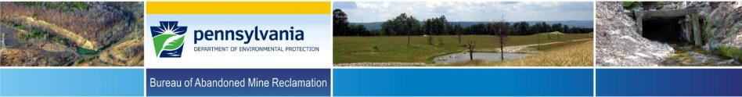

Tom Wolf, Governor
Patrick McDonnell, Secretary
Non-Traditional Reclamation of Abandoned Mine Lands (AML) to Support Economic Revitalization and Community Development –
Implementation of the 2017 AML Pilot Program in Pennsylvania
By Eric Cavazza, PE, Director
PA-DEP-Bureau of Abandoned Mine Reclamation
36th Annual Meeting of the American
Society of Mining and Reclamation
June 3-7, 2019
Big Sky, Montana

Slide 2

AML Pilot Program Background
The 2017 AML Pilot Program was authorized by Congress under the Consolidated Appropriations Act, 2017 (Public Law 115-31) and provides an additional $25 million of US Treasury Funds to PA’s AML Program
The funds are to be used “for the reclamation of abandoned mine lands in conjunction with economic revitalization and community development and reuse goals”

Slide 3


Language from OSMRE Guidance for the 2017 AML Pilot Program
“This AML Pilot is an opportunity for local communities and states to return impacted areas to productive reuse, which should be defined by the state in cooperation with local communities, to achieve the economic and community development goals identified for the community and/or region.”

Slide 4

Proposed AML Pilot Projects
PA DEP solicited proposals for AML Pilot projects from other states agencies, county and local governments, NGOs, Watershed Groups, and other AML advocacy groups
PA DEP received 26 proposals which were evaluated using the OSMRE AML Pilot Program Guidance and also for project costs and benefits and 13 were selected for AML Pilot funding

Slide 5
PA’s Plan for the AML Pilot Funding
PADEP-BAMR will allocate the majority of the AML Pilot Program funds for the reclamation of Title IV eligible AML & AMD problems
Project partners will then work to fund and complete non-AML economic development aspects of the projects

Slide 6

AML Pilot Project Types
The 13 AML Pilot Projects include:
4 surface mine reclamation projects
2 acid mine drainage treatment projects
6 coal refuse pile/culm bank removal or remediation projects
1 project to remediate a potential subsidence prone area on a college campus

Slide 7
2017 AML Pilot Projects Location Map

Slide 8
Significant Benefits
In addition to eliminating a number high-priority AML/AMD features, benefits of the projects include:
development of a youth sports complex
creation or expansion of several industrial and/or business parks
a new housing development
protection of college campus buildings and surrounding grounds from future mine subsidence issues

Slide 9


Significant Benefits
reforestation and restoration of public lands
improved groundwater quality
significant stream water quality improvement including restored fisheries
increased tourism through public trail development
removal of refuse material from a floodplain to prevent stream flooding and to develop a community park

Slide 10

Leveraging of Funds
These 13 Proposed AML Pilot Projects have the potential to leverage up to an additional $2.34 for every $1 of AML Pilot Program funding from other AML/AMD funds and/or economic development funds (Both public and private)

Slide 11

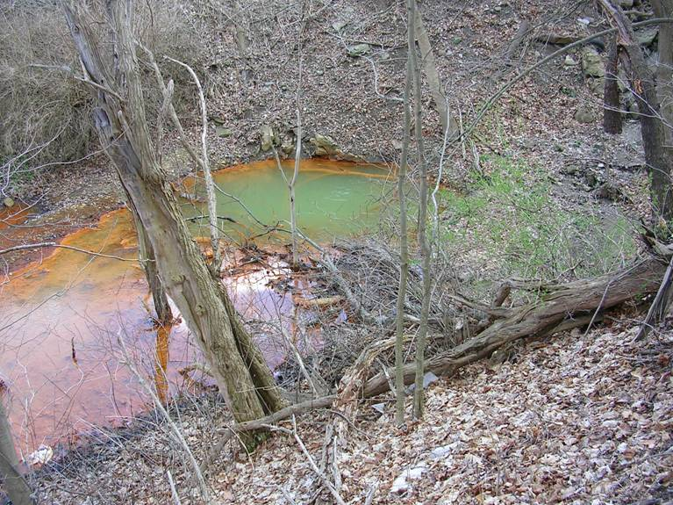
Gladden AMD Active Treatment Plant and Fishing Run Stream Sealing
The AML pilot funding in combination with other funding will be used to construct an AMD treatment facility to treat the Gladden AMD Discharge and to seal several stream channels to prevent the loss of stream flow into to the underlying abandoned mine workings. The treatment plant will restore four (4) miles of Millers Run and be instrumental in restoring over four (4) miles of Chartiers Creek to its confluence with the Ohio River.
Gladden Discharge

Slide 12
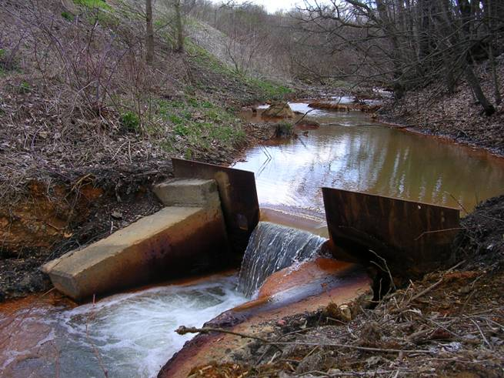
Gladden Discharge
Channel and
Flow Measuring Weir

Slide 13
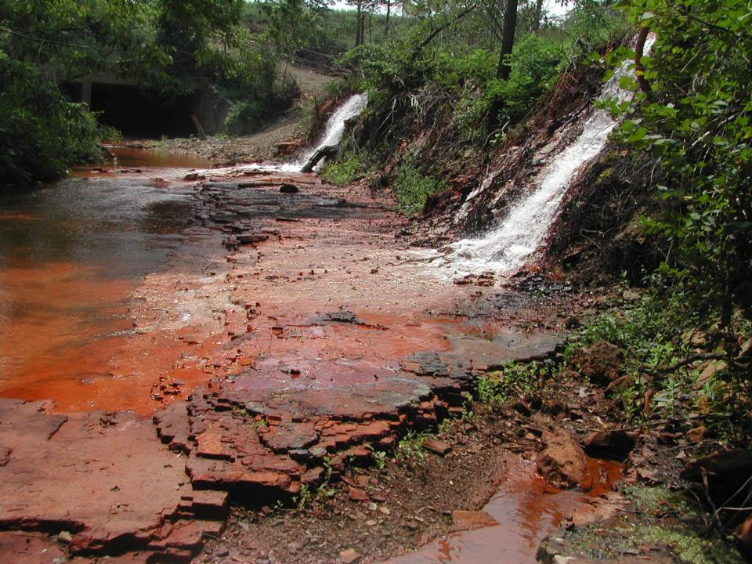
Gladden Discharge Flowing into Millers Run

Slide 14
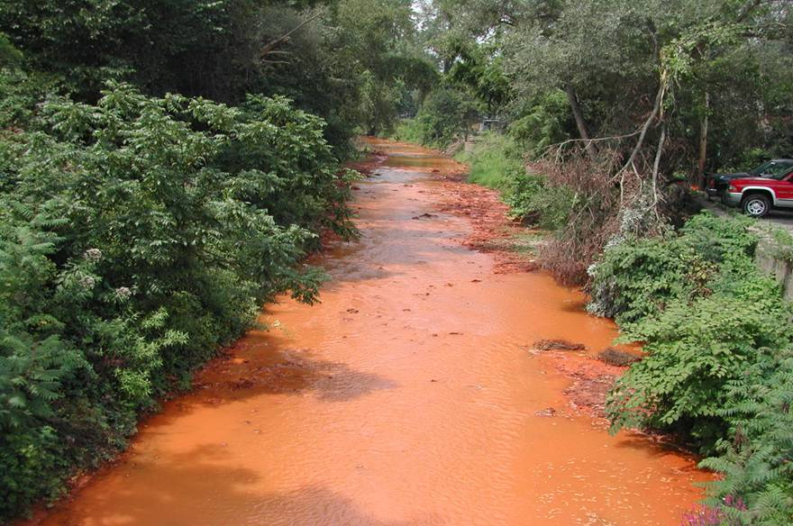
Millers Run Below
the Gladden Discharge

Slide 15
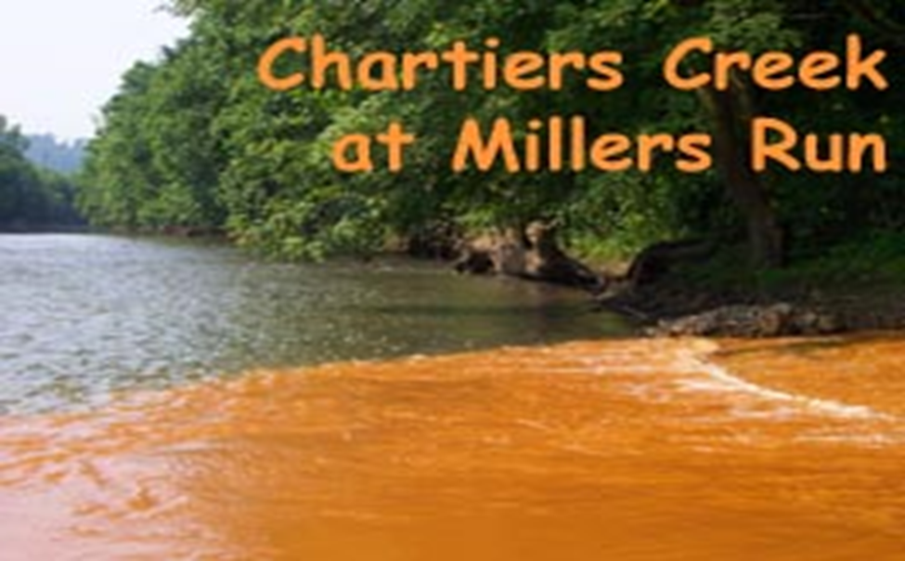
Confluence of Millers Run and Chartiers Creek

Slide 16
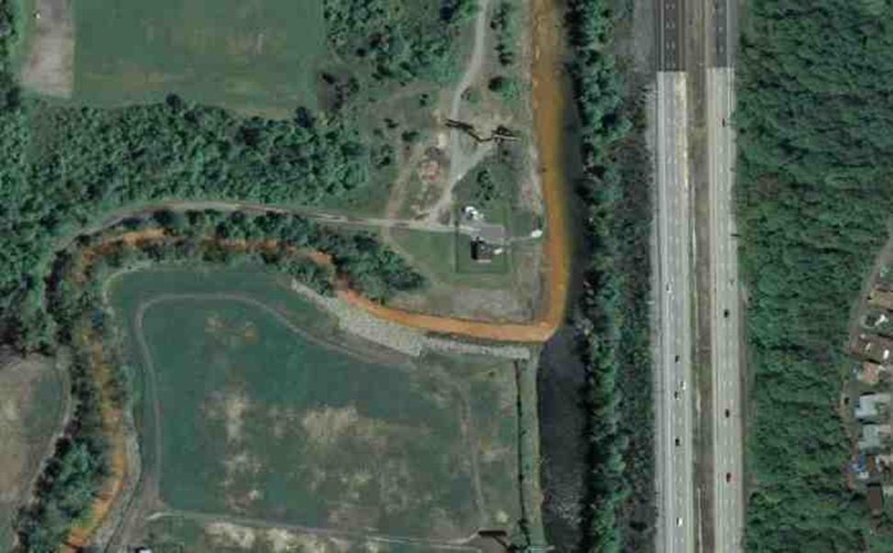
Aerial View of the Confluence of Millers Run and Chartiers Creek

Slide 17

Current Status
Proposal from South Fayette Conservation Group to construct Gladden Treatment Plant
Median flow 750 gallons per minute with 100 parts per million Iron
Treatment plant will remove 690 pounds per day of iron from Millers Run and hence Chartiers Creek
Designed primarily as a peroxide treatment plant
Construction to begin summer 2019

Slide 18
Preliminary Treatment Plant Layout

Slide 19
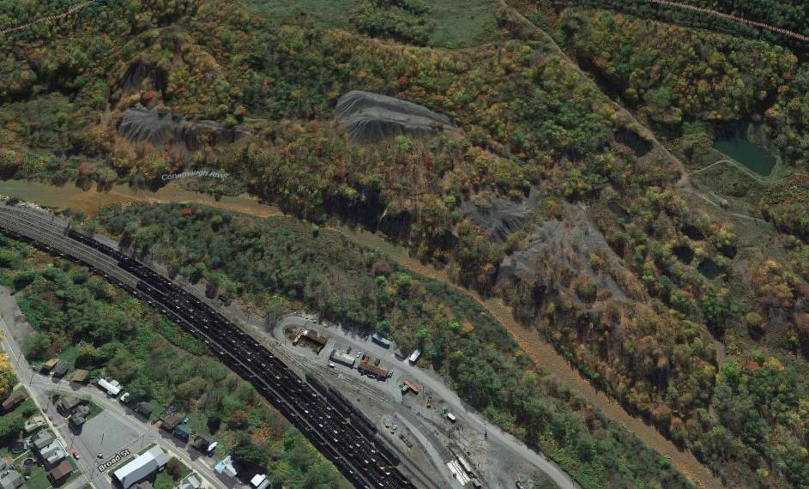
Stineman Refuse Pile Reclamation –
Path of the Flood Trail Extension
The AML pilot funding will be used to remove coal refuse with fuel value for use in electricity generation at a cogeneration facility and to regrade any remaining refuse material onsite. Alkaline material will be added to neutralize acidity, and the site will be revegetated resulting in improved water quality in the South Fork Little Conemaugh River. The project will also facilitate a 3 mile extension of the Path of the Flood Trail to connect the existing trail in Ehrenfeld Borough to the Johnstown Flood National Memorial.

Slide 20

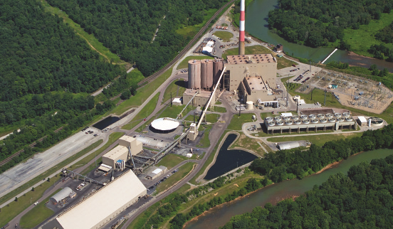
Seward Generating Station (Waste Coal to Energy)

Slide 21
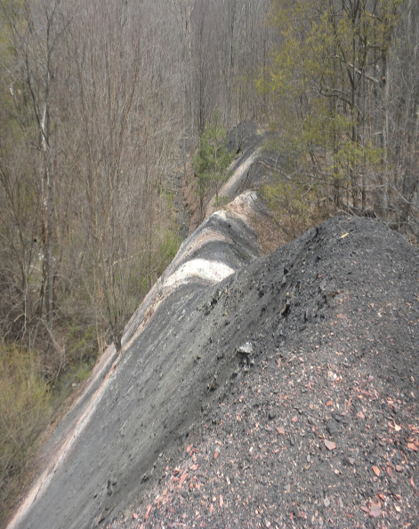
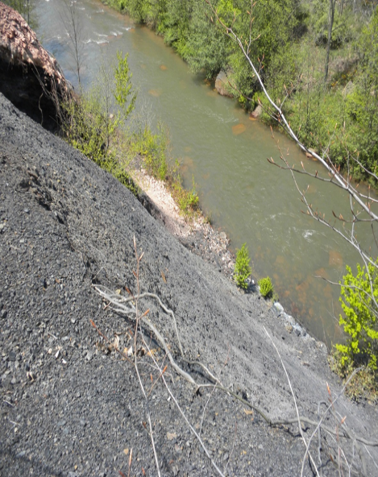
Stineman Refuse Pile

Slide 22
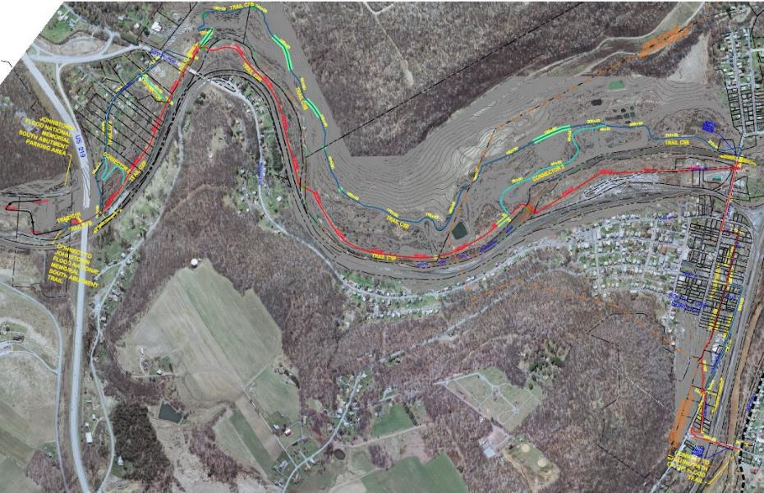
Path of the Flood Trail
Stineman Refuse Pile
Potential Trail Routes
Connect to the Johnstown
Flood National Memorial
Existing Path of the Flood
Trail in Ehrenfeld Boroough

Slide 23
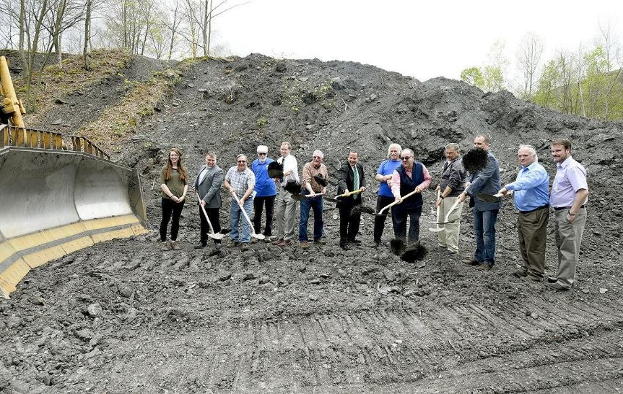
Project Groundbreaking May 3, 2019

Slide 24
Current Status (as of May 31, 2019)
Groundbreaking Ceremony held on 05/03/2019
As of May 28, 2019, 671 tons of refuse have been removed
Approximately 4% of the total grant ($2.1 million) has been paid out to the Cambria County Conservation Recreation Authority

Slide 25
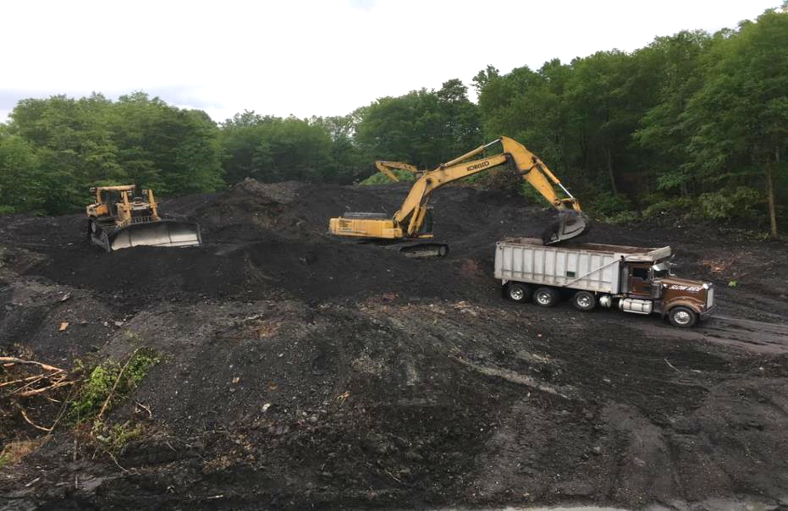
Project Construction

Slide 26
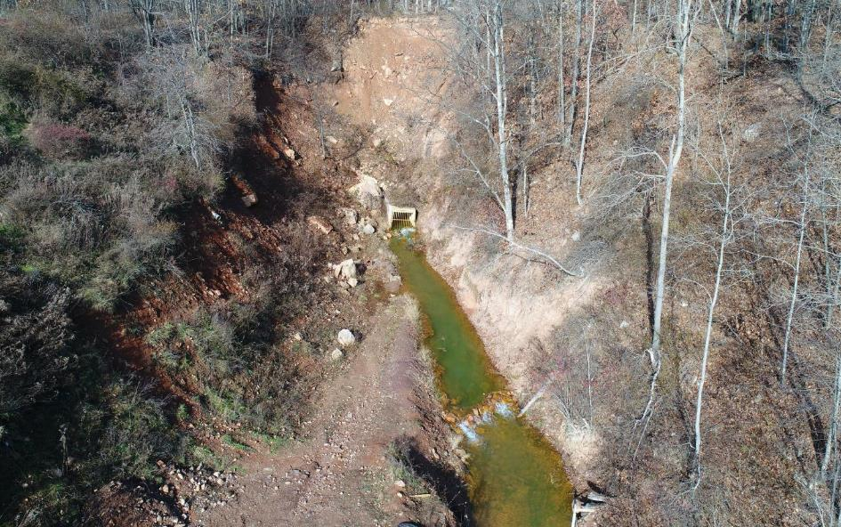
Quakake Tunnel & Weatherly Borough Trail
The AML Pilot funding, in combination with other funding, will be used to design and construct an active treatment system to treat the Quakake Tunnel discharge. Approximately 8 miles of wild trout stream (Quakake and Black Creeks) will be restored upon the completion and initiation of operation of the treatment system. Funding will also be used to create approximately 5 miles of new trail beginning at the existing Weatherly Borough building and extending into the Lehigh Gorge State Park. The new trail will traverse in close proximity to the restored stream.

Slide 27
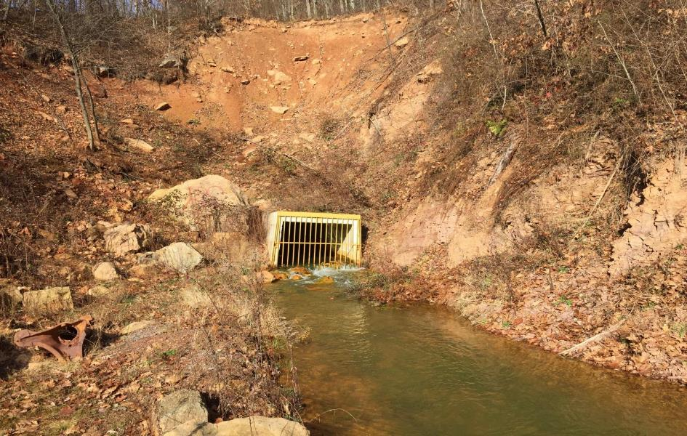
Quakake Tunnel & Weatherly Borough Trail
Typical flow: 13 CFS (6,000 GPM)
Low pH and Elevated Metals
– Primarily Aluminum

Slide 28
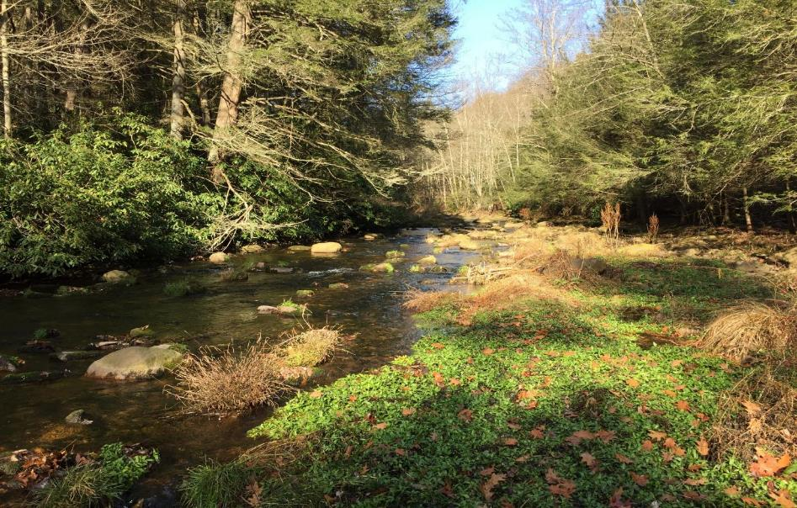
Black Creek Downstream of Quakake Tunnel

Slide 29

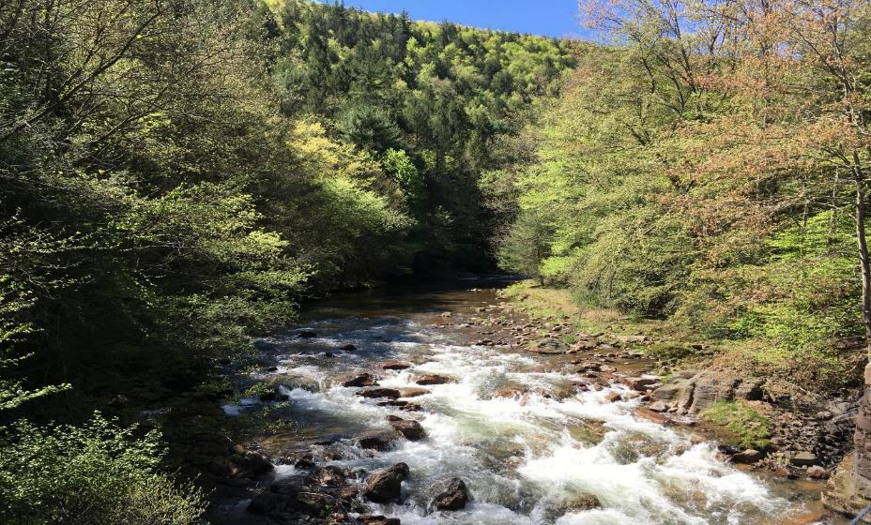
Black Creek Downstream of Weatherly Borough

Slide 30
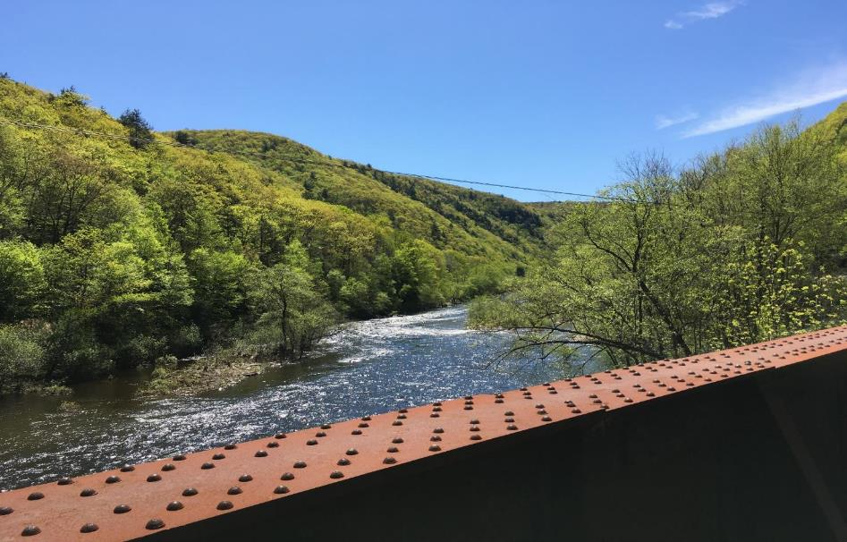
Lehigh Gorge State Park at Black Creek

Slide 31
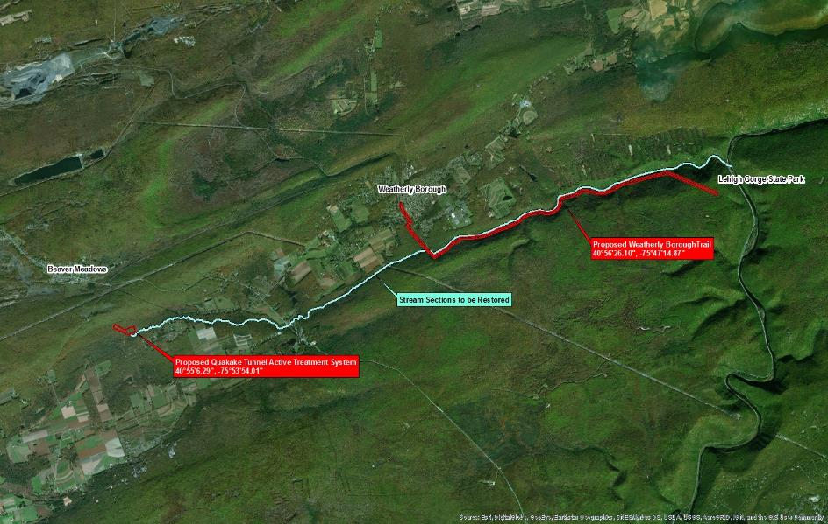
Quakake Tunnel & Weatherly Borough Trail

Slide 32
Current Status (as of May 24, 2019)
Design of the Quakake Tunnel AMD Treatment Plant has been invoiced to the 35% milestone.
Closing on the three property parcels for the treatment site is expected to occur in the next month.
Coordination with the consultant designer is ongoing for necessary geotechnical work and clarifier selection.
Weatherly Borough indicates that the trail is still under design.

Slide 33
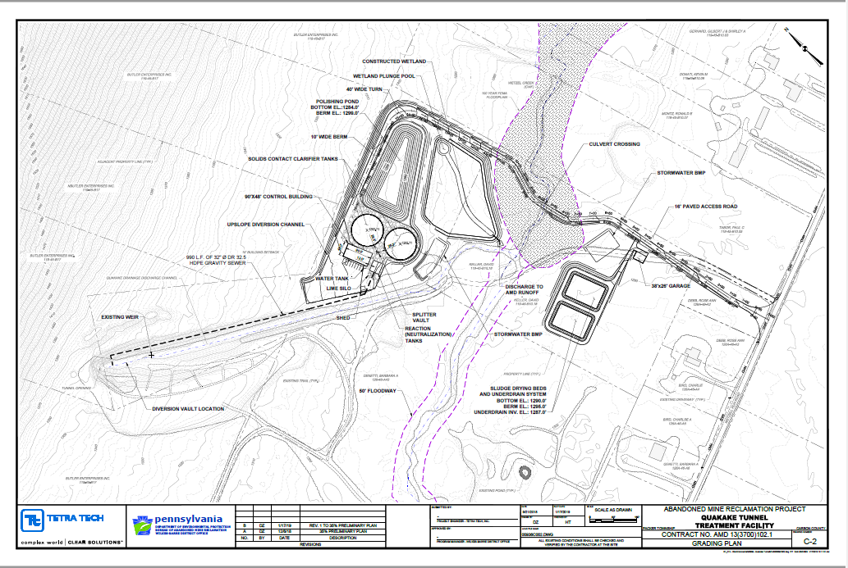
Preliminary Treatment Plant Layout

Slide 34
The Lackawanna Heritage Valley Authority (LHVA) Dickson City Trail Project
The AML pilot funding will be used to reclaim and stabilize approximately seven (7) acres of Abandoned Mine Land Spoil Area (SA) directly above the Lackawanna River in Dickson City Borough. The Lackawanna Heritage Valley Authority (LHVA) will, as part of the project, construct one (1) mile of trail along the river that consists of a 12’ paved trail with a 6’ gravel shoulder. The trail’s easement varies between 45’ to 80’ wide and will be planted with a combination of grass and trees.

Slide 35
The Lackawanna River Heritage Trail Facts
The Lackawanna River Heritage Trail (LRHT) is part of a seventy mile multi-purpose trail system that follows the Lackawanna River
The LRHT begins at the confluence of the Lackawanna & Susquehanna Rivers in Pittston and continues north where it connects with the Delaware & Hudson Rail Trail

Slide 36
Lackawanna River Heritage Trail Map

Slide 37
Lackawanna River Heritage Trail Map (Dickson City Area)
Dickson City AML Pilot Project Area

Slide 38
The Lackawanna Heritage Valley Authority (LHVA) Dickson City Trail Project

Slide 39

Significant Benefits and Project Status
A 2017 study performed by the LHVA shows that there are approximately 315,000 people that use the existing portions of the “Lackawanna River Heritage Trail” annually
The trail project is a multi-agency project with the Pennsylvania Department of Transportation (PennDOT) serving as the lead agency
PennDOT is anticipated to be bidding the project in the very near future

Slide 40
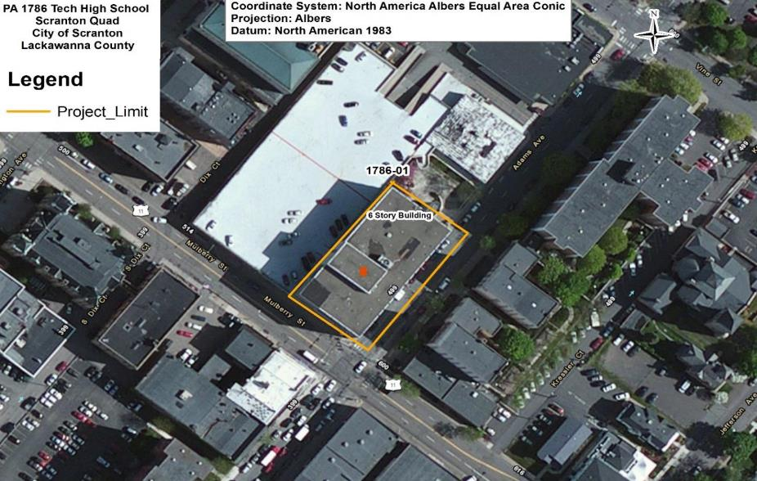
Lackawanna College Subsidence Abatement
Lackawanna College acquired several vacant buildings in downtown Scranton to expand the campus as part of their Cornerstone Commons Project . It was subsequently determined that the buildings were undermined and required abatement work to prevent mine subsidence. The College completed a project to address mine voids under a 2-story building and a central courtyard area at 409 Adams Avenue. The AML Pilot Funding will be used for a second phase of the project to address mine voids under a 6-story building at 401 Adams Avenue by drilling and injecting grout into the abandoned underground mine voids.

Slide 41
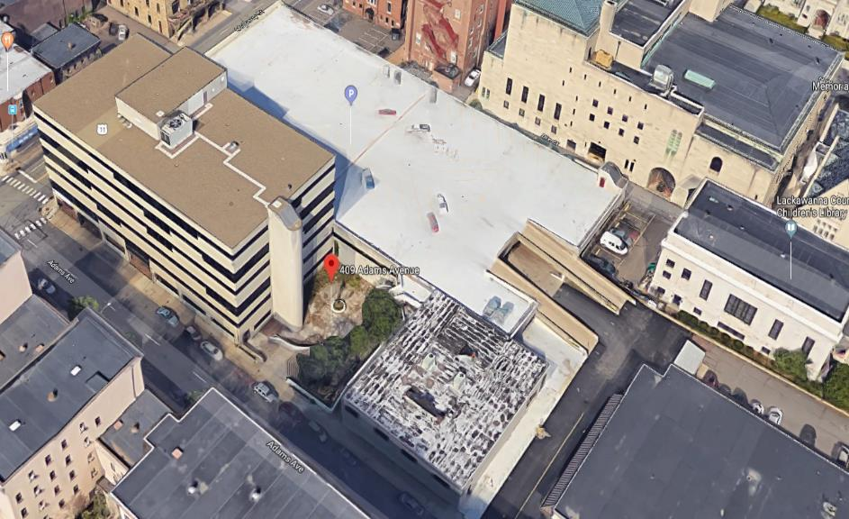
Lackawanna College Subsidence Abatement
Building and Courtyard Area Stabilized under Phase 1 of the Subsidence
Control Project

Slide 42
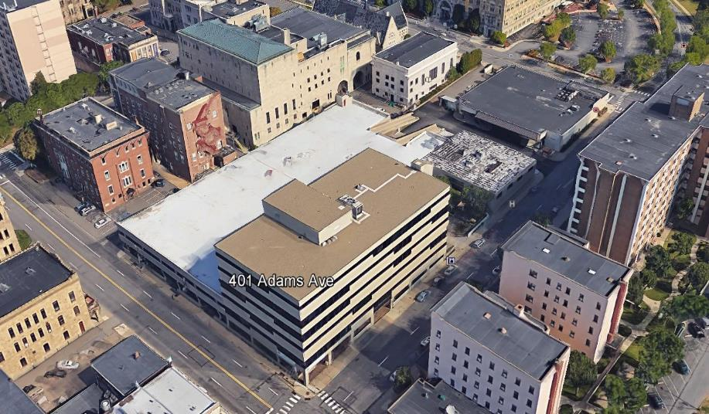
Lackawanna College Subsidence Abatement
Six Story Building Located at 401 Adams Avenue

Slide 43

Lackawanna College Campus Map and Project Location

Slide 44
Lackawanna College Subsidence Abatement
Students to be Served Annually in New 401 Complex
Main Dining Hall 1,625
School of Culinary and Hospitality 200
School of Engineering Technology 296
Degree Programs Related to
Ancillary Industry Growth 35
Vocational Technology & Certificates 240
Information Technology &
Other Related Programs 380
Petroleum & Natural Gas
Continuing Education Institute 820
Total 3,596

Slide 45

Current Status (as of May 28, 2019)
The project design is complete.
The project has been awarded.
Grouting under the building and common area was scheduled to begin the week of June 3, 2019.
Project should be completed by the end of June.

Slide 46

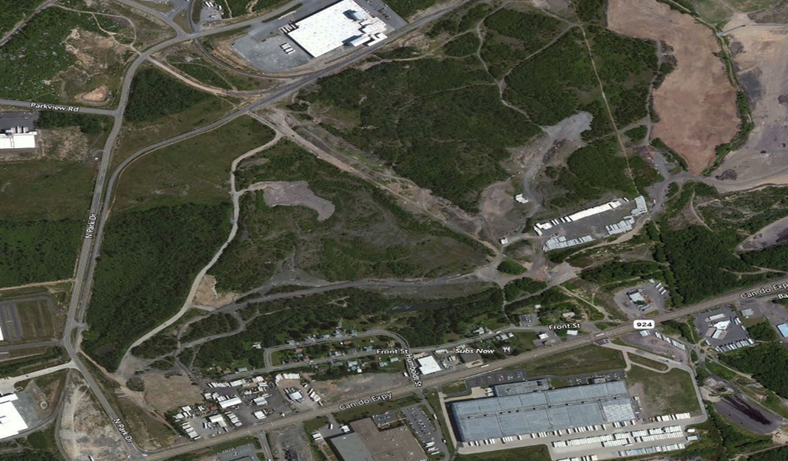
CAN DO – North Park Drive Business Park
The AML pilot funding will be used to regrade an area previously impacted by both coal and non-coal mining. A total of 129 acres of previously disturbed area will be regraded to its approximate pre-mining condition for the creation of 7 property parcels to be developed in the CAN DO Industrial Park. It is anticipated that 70-140 permanent full time positions will be created.

Slide 47
CAN DO – North Park Drive Business Park

Slide 48

CAN DO – North Park Drive Business Park
Project Location

Slide 49
Current Status (as of May 28, 2019)
The design is expected to be completed by June 15, 2019.
Bid documents are also being finalized ,and it is anticipated that the project will be advertised for bids on July 8, 2019.
Bid opening and award should occur in early August with construction to begin shortly thereafter.

Slide 50

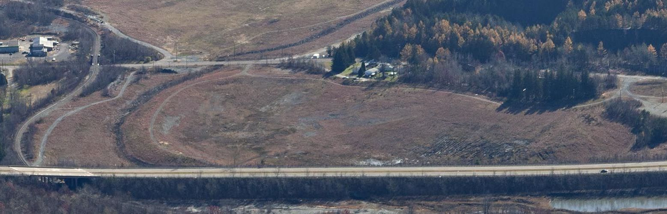
Hollars Hill South AML – Cranberry Creek Gateway Project
The AML pilot funding and Title IV AML funding, will be used to reclaim 150 acres, with 650 feet of dangerous highwall acres of dangerous mine spoil pile acres of industrial/residential waste, a mine shaft, and five (5) hazardous structures. A 30-acre portion of the overall project lies within CAN DO, Inc.’s future Cranberry Creek Gateway Project. On this 30-acre portion, the shaft will be backfilled and the hazardous structures will be demolished. Clean fill debris from the demolition work will be placed in a former coal silt basin and covered with mine spoil and topsoil to prepare for the future development of a community ballfield complex.

Slide 51
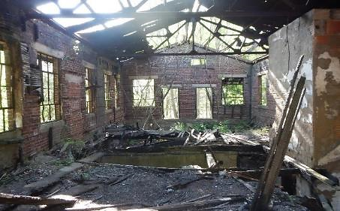
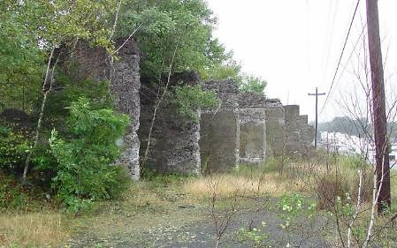

Hollars Hill South AML-Cranberry Creek Gateway Project
Concrete Structures
Wash House
Future Cranberry Creek Gateway Park

Slide 52
Hollars Hill South AML – Cranberry Creek Gateway Project

Slide 53
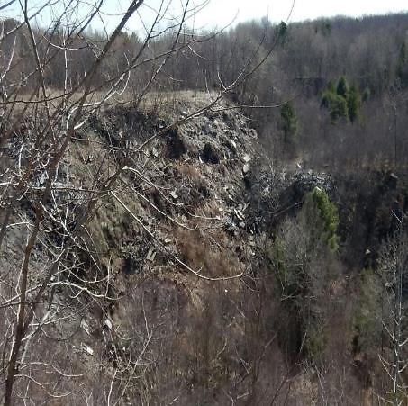
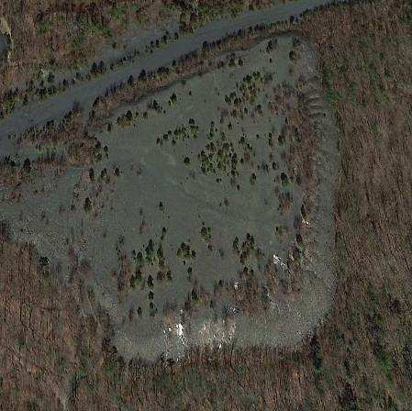
Hollars Hill South AML-Cranberry Creek Gateway Project
Dangerous Highwall with Unauthorized Dumping
Dangerous Pile & Embankment

Slide 54
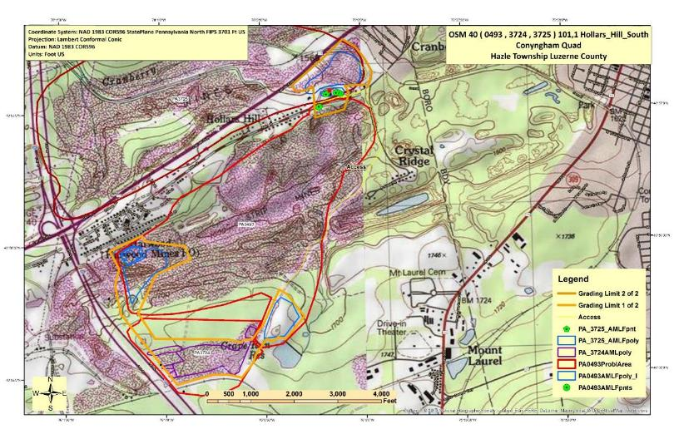
Hollars Hill South AML-Cranberry Creek Gateway Project

Slide 55

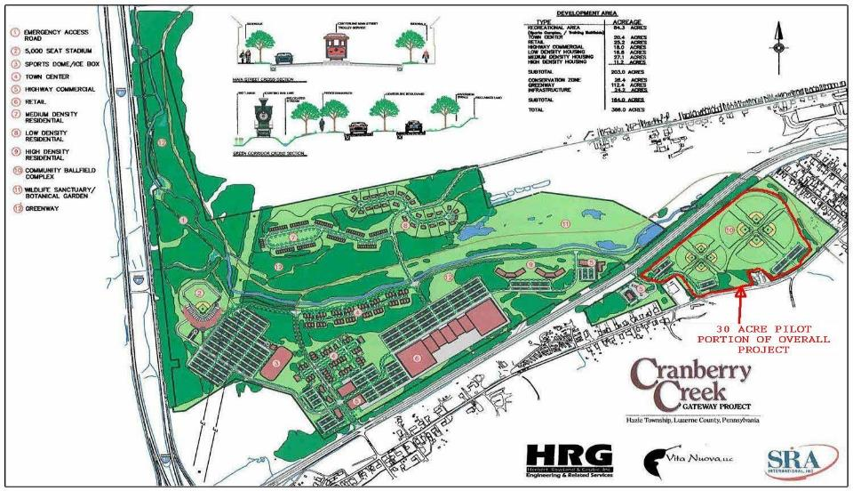
Hollars Hill South AML-Cranberry Creek Gateway Project

Slide 56
Current Status (as of May 22, 2019)
In house design progressing
Original project cost estimate: $5.1 million ($1.0 million AML Pilot program Funding)
Current project cost estimate: $7.2 million($2.9 million AML Pilot Project Funding)
Only part of the original project was eligible for AML Pilot Funding. A developer is finalizing the purchase of the entire property and working with the municipality to change zoning of the site which would make the project 100% eligible for AML Pilot Funding. Additional cost due to compaction requirement to support post-reclamation development.
Anticipate that project will be bid in winter 2019/20.

Slide 57
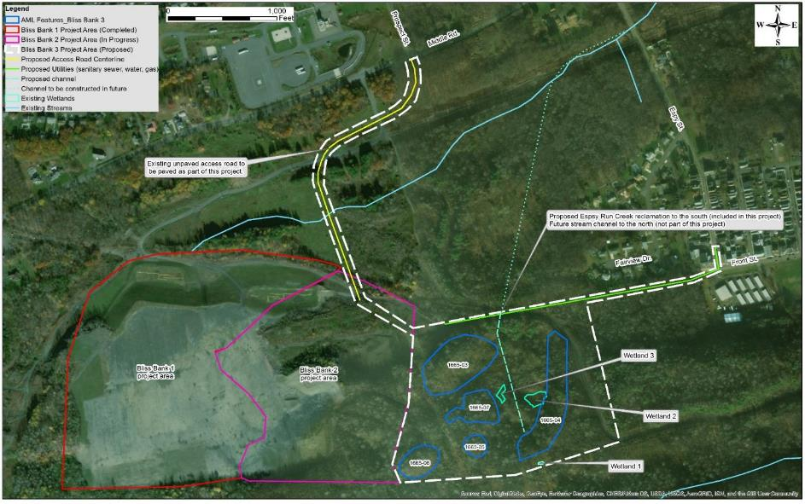
Earth Conservancy Bliss Bank 3 Business Park
The AML Pilot Funding, in combination with other funding, will be used to complete the Bliss Bank 3 Project (55 acres) and will bring natural gas, water, and sanitary sewer services to the entire Earth Conservancy Bliss Bank Development (+220 acres). Bliss Bank 3 will abate 1,200’ of dangerous highwalls and spoil areas. NorthPoint Development is working with Earth Conservancy to market the site and estimate this project will result in over 1,000 permanent full time positions.

Slide 58
Earth Conservancy Bliss Bank 3 Business Park
Hanover Ridge Development
City of Nanticoke
Bliss Bank Development

Slide 59
Earth Conservancy Bliss Bank 3 Business Park

Slide 60
Earth Conservancy Bliss Bank 3 Business Park
Under Negotiation with
Large National Companies

Slide 61
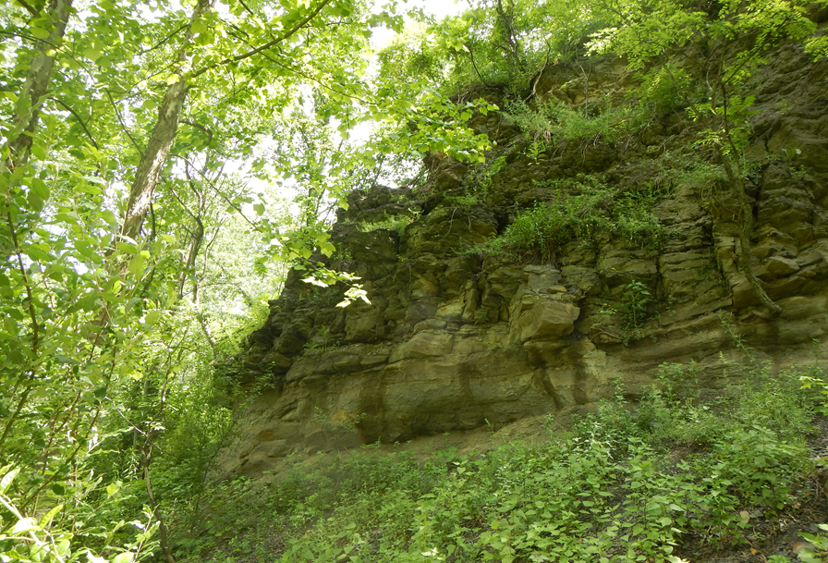
Earth Conservancy Bliss Bank 3 Business Park
Highwall to be backfilled as part of the Bliss Bank 3 Project

Slide 62
Current Status (as of May 28, 2019)
The project is under construction (work began in mid-May)
Two invoices have been paid totalling $97,698.45 (3.2%)

Slide 63
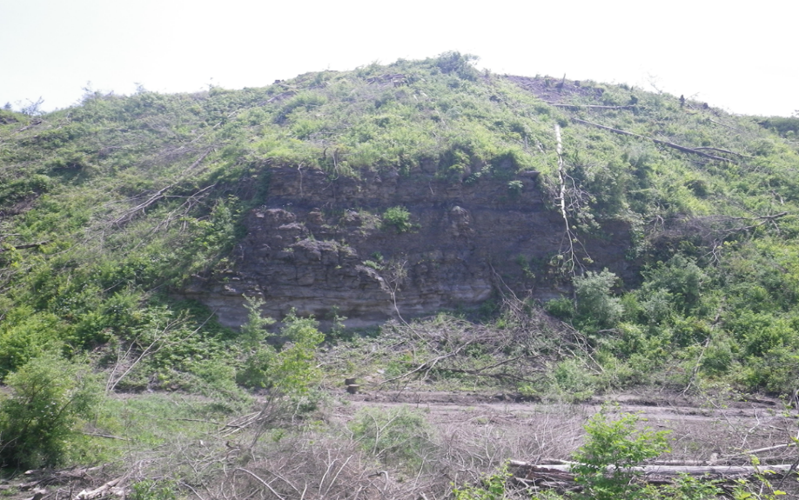
Project Construction – Clearing and Grubbing

Slide 64
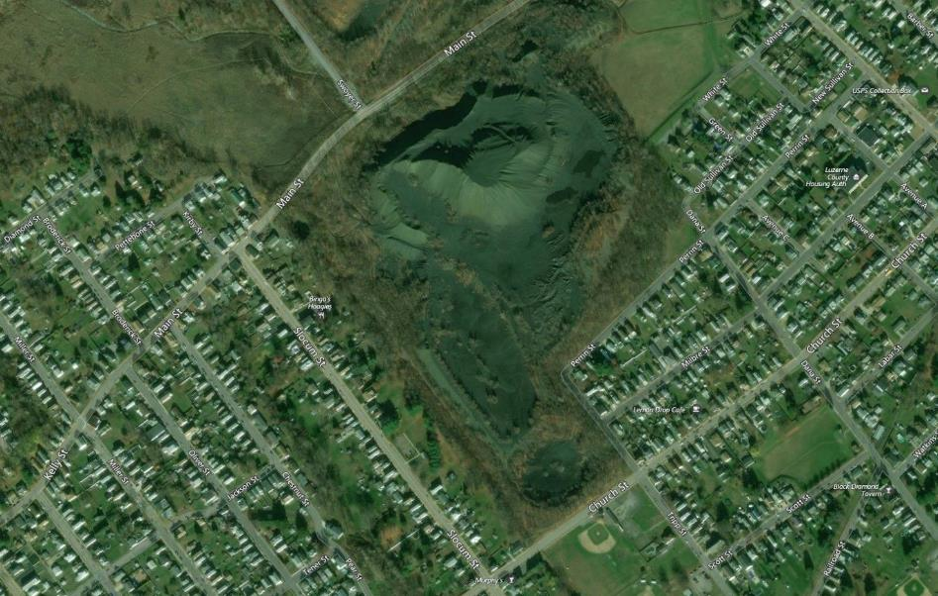
Swoyersville Refuse Pile – Community Athletic Area
The Swoyersville coal refuse pile is an abandoned coal refuse pile and associated coal silt basins from the long-abandoned Harry E colliery and coal breaker. The entire Swoyersville refuse site encompasses approximately 55 acres containing approximately 4 million +/- cubic yards of coal refuse and waste rock material. Approximately 2.8 million +/- cubic yards of the refuse material is anticipated to be usable as fuel for electric cogeneration facilities that utilize waste coal.
The project proposed for funding with AML Pilot Program funding will result in the complete reclamation of 7.5 acres of AML at the Swoyersville refuse pile site. 7.5 acres will be transferred to Swoyersville Borough for the development of community recreational facilities.

Slide 65
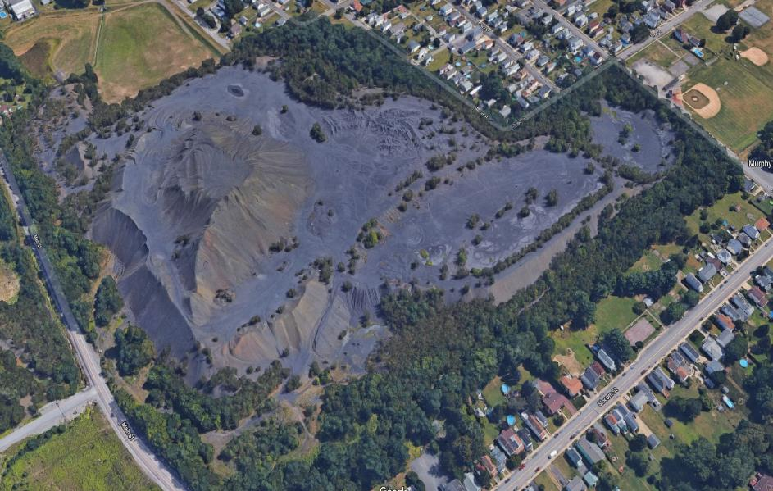
Swoyersville Refuse Pile – Community Athletic Area
Keystone Reclamation Fuel Management LLC has long range plans to reclaim the entire Swoyersville coal refuse pile which would ultimately restore 55 acres of AML which could all be used for industrial/commercial/recreational development within Swoyersville Borough. The coal material will be removed from the site using a Government Financed Construction Contract (GFCC). The overall project will also help to improve water quality in the Abrahams Creek Watershed and reduce flooding by restoring/improving areas of floodplain along Abrahams Creek. The community recreational facilities will provide for recreational opportunities for all residents of Swoyersville and the surrounding area.

Slide 66
GP-104
GFCC Boundary
Proposed Swoyersville Community Area
Main Street
Slocum Street
Tripp Street
Land to be
Transferred to
Swoyersville
Borough
Church Street

Slide 67
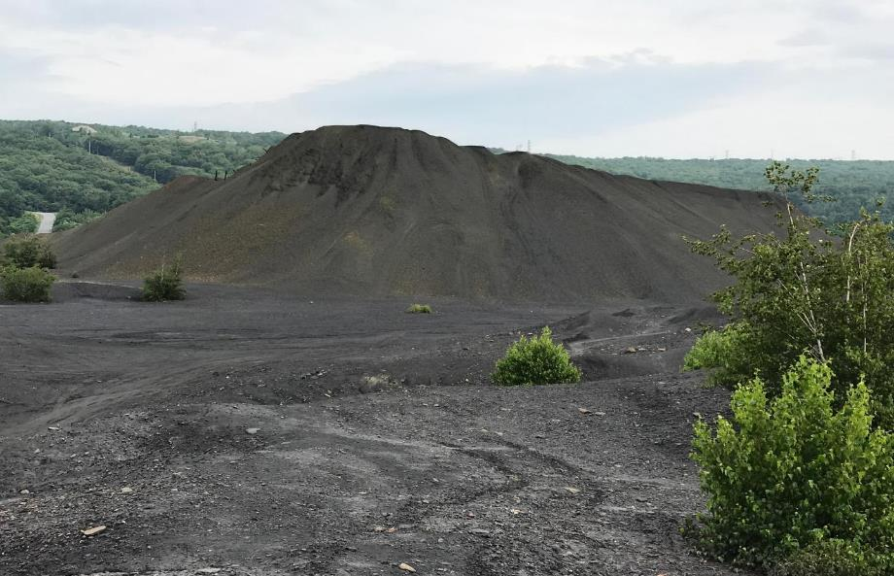
Swoyersville Refuse Pile – Community Athletic Area

Slide 68
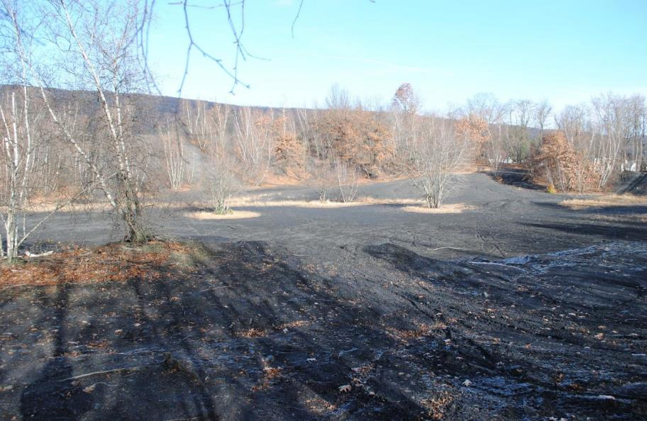
Swoyersville Refuse Pile – Community Athletic Area

Slide 69
Current Status (as of May 28, 2019)
Grant awarded to the Eastern Pennsylvania Coalition for Abandoned Mine Reclamation (EPCAMR).
Project Start Date: October, 2018
Scheduled Project Completion Date: October 31, 2023
Current Status: Under construction, two invoices paid to date totaling $202,136.85 (about 5% of the grant)

Slide 70
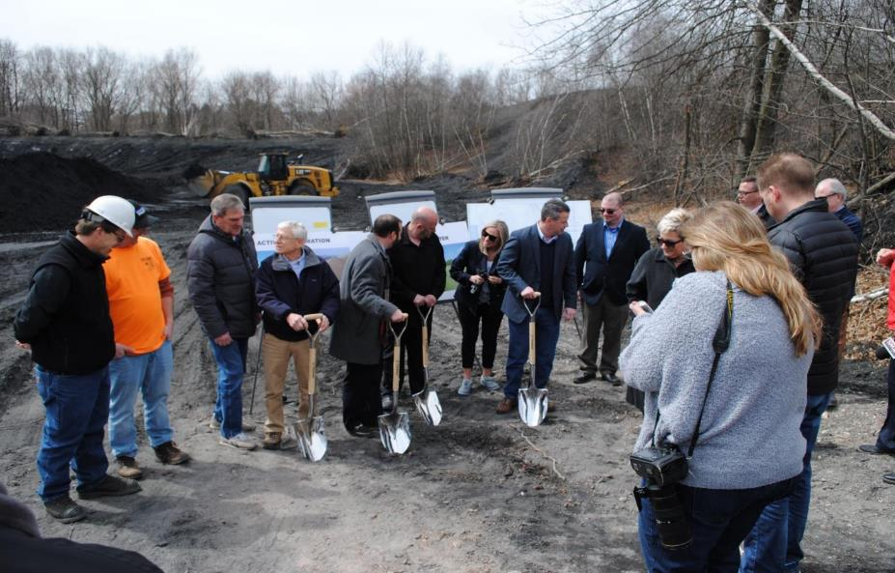

Project Groundbreaking (November 2018)

Slide 71
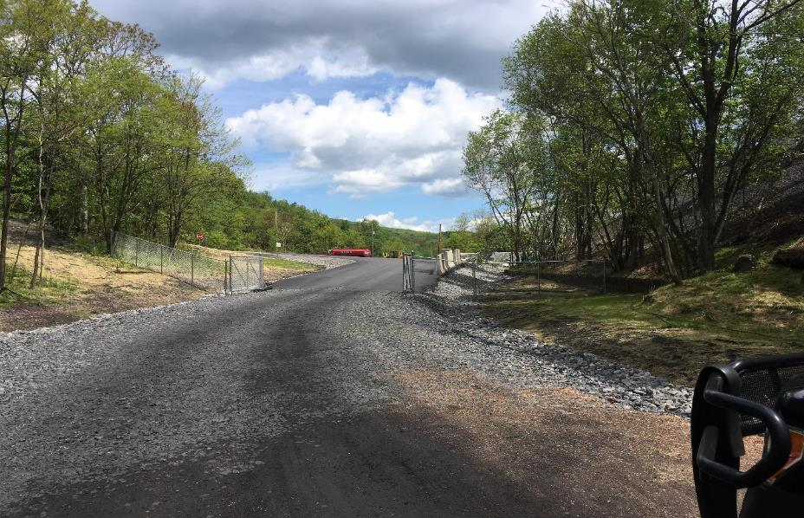
Project Access Road

Slide 72
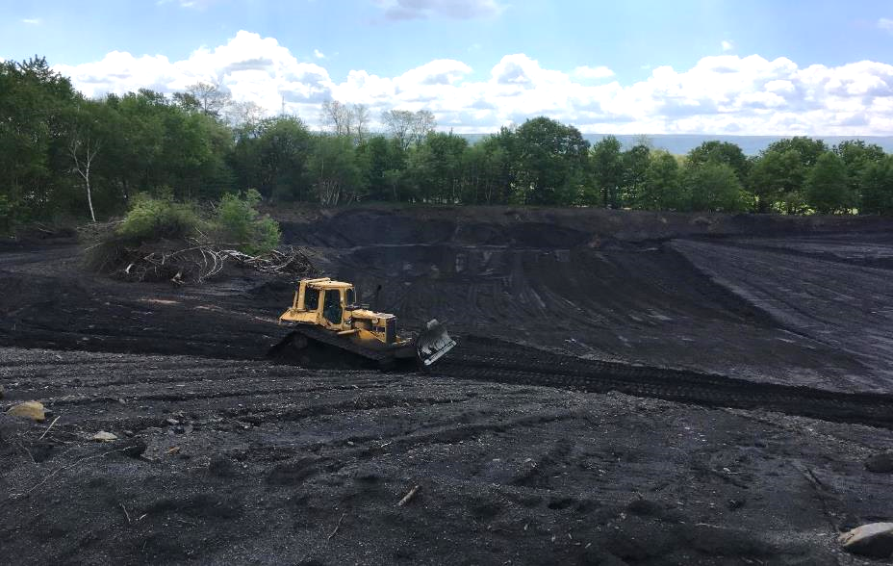
Project Construction

Slide 73
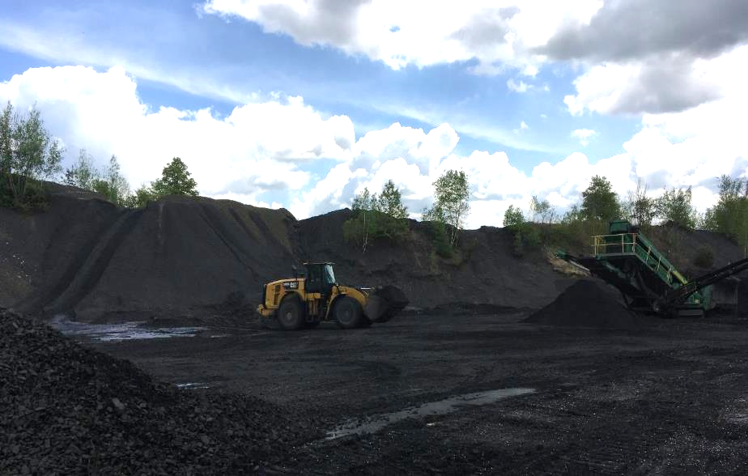
Project Construction

Slide 74
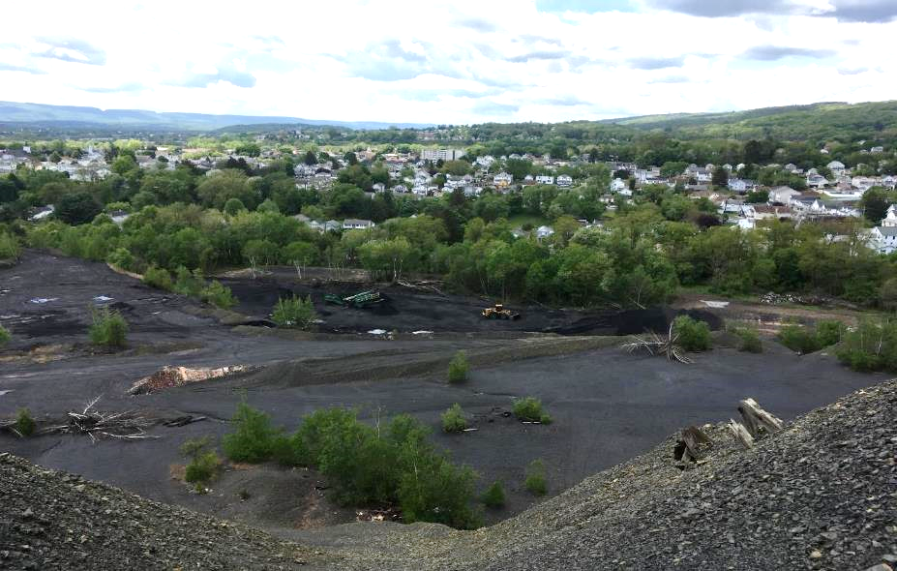
Project Construction

Slide 75
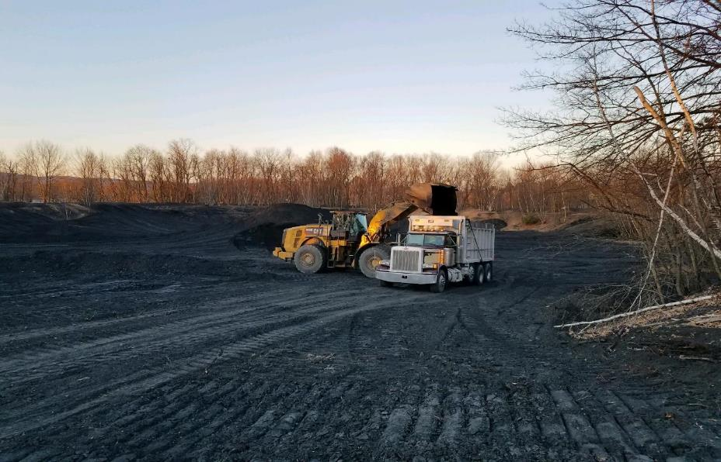
Project Construction
Loader loading a Triaxle
with Refuse Material

Slide 76

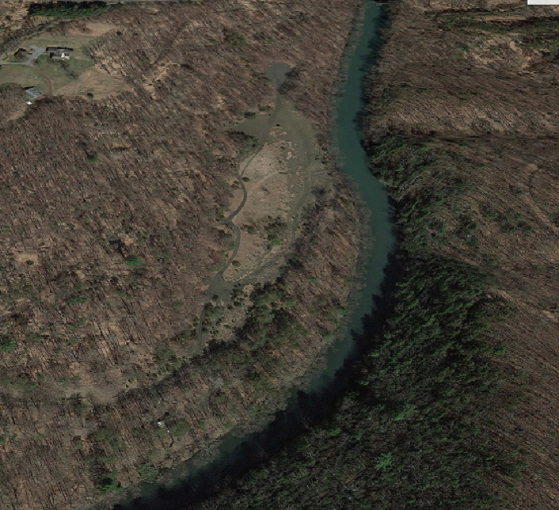
Porter Floodplain Restoration Project
The AML Pilot funding, in combination with other funding, will be used to remove 90,000 cubic yards of coal silt on approximately 10 acres clogged stream land. The coal silt material will be transported to Stoudt’s Ferry Preparation Company’s Auburn facility where it will be processed and sold. Funding will also be used to create a missing portion of trail within the Schuylkill River Trail Network involving the reconditioning of an abandoned railroad bridge and the conversion of access roads into trails.

Slide 77
Porter Floodplain Restoration Project Location
Project Location
Philadelphia

Slide 78
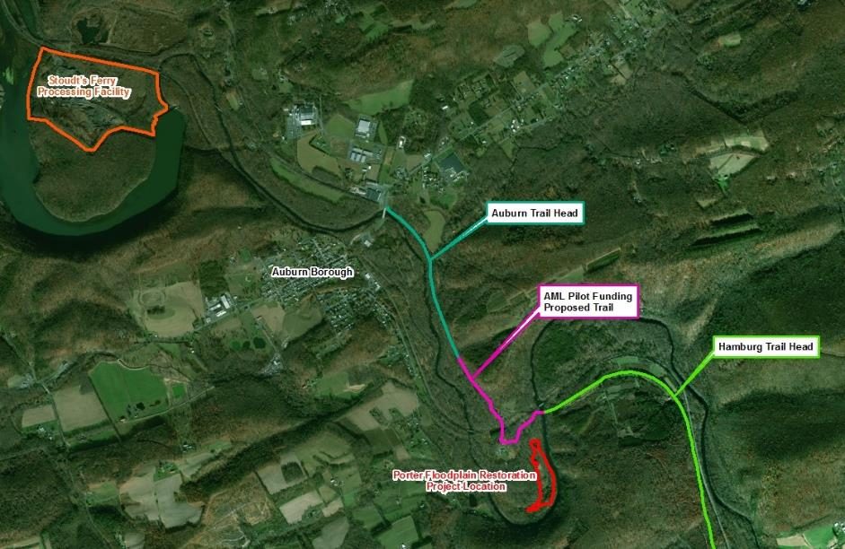
Porter Floodplain Restoration Project
The Schuylkill River Trail (SRT) attracts over 2.0 million hikers, bikers, and other pedestrians every year to southeastern Pennsylvania for recreational and Commuting purposes
Approximately 65,000 people annually use the SRT in Schuylkill County

Slide 79
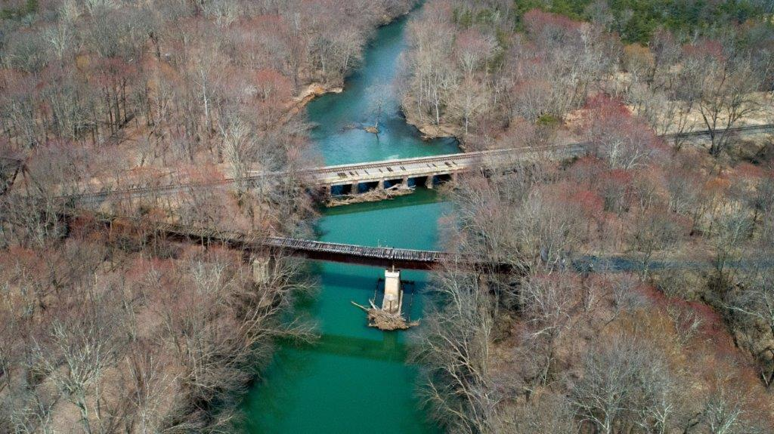
Future Trail Bridge over Schuylkill River

Slide 80
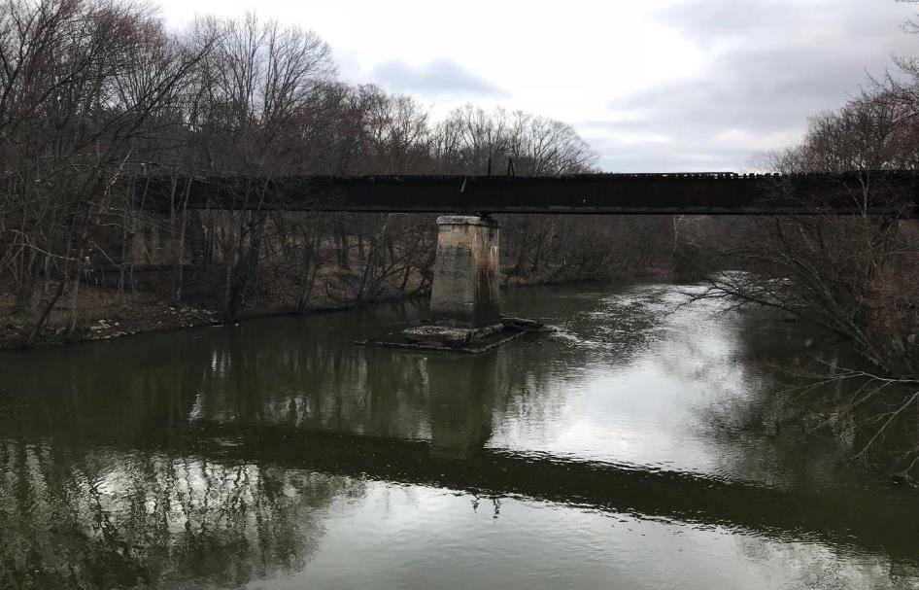
Abandoned Railroad Bridge to be Restored

Slide 81
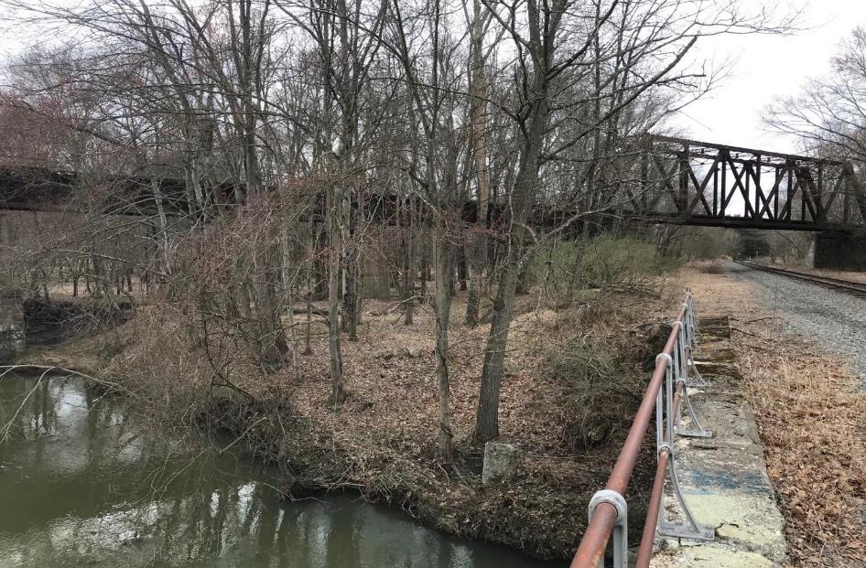
Abandoned Railroad Bridge to be Restored

Slide 82
Current Status (as of May 24, 2019)
Work on excavating and hauling coal refuse from the site began in the winter of 2018.
The contractor has invoiced $120,000 for the excavation and hauling of the coal refuse.
The contractor estimates the excavation and hauling portion of the project is 15% completed.
Easements for the trail have been completed.
Trail design contracts have been executed.
OSMRE completed a site inspection of the project on May 16, 2019.

Slide 83

Project Construction

Slide 84
Donaldson Culm Bank Stream Restoration
The AML Pilot funding, in combination with other funding, will be used to remove coal waste along Good Spring Creek that is designated as a clogged stream land. This restoration project will create a more natural, sinuous 4,600 feet long stream channel and constructing nearly 18 acres of floodplain and wetlands. Usable coal material will be transported to a local power generation plant. Poor quality material will be placed into nearby AML mining pits. The restored site will be utilized as a environmental park by the local township.
Donaldson Culm
Bank Project Limits
Village of
Donaldson
Good Spring Creek

Slide 85

Donaldson Culm Bank along Good Spring Creek

Slide 86
Donaldson Culm Bank Stream Restoration
Conceptual Plan

Slide 87

Donaldson Culm Bank Stream Restoration

Slide 88
Current Status (as of May 24, 2019)
The Phase 1 construction contract of the project funded by Growing Greener and the Commonwealth Financing Authority has been completed. This phase restored the floodplain in the eastern section of the overall culm bank.
Phase 2 of the project funded by AML Pilot Program funding has been invoiced for $14,210.79 for the installation of a gate and township road shoulder improvements.
The grantee has advertised for bids for the excavation and hauling of the refuse material (Phase 2 – AML Pilot Project Phase) with a bid opening date of June 11, 2019.
OSMRE completed a site inspection on April 10, 2019.

Slide 89

Phase 1 Project Construction

Slide 90

Phase 1 Project Construction

Slide 91

TASA Refuse Piles - South Sandy Creek Restoration
The AML Pilot funding will be used for a pass-through grant to South Sandy Creek Watershed Association to excavate 200,000 tons of acid forming material consisting of coal refuse & coal fines. The excavated material will be transported to Scrubgrass Generating Plant, an 85-megawatt generating facility fueled by bituminous waste coal. A portion of the resulting alkaline flyash byproduct will be returned to the site, blended with existing on-site soil & used to remediate the site.

Slide 92

TASA Refuse Piles - South Sandy Creek Restoration
Scrubgrass Generating Station
87 megawatt generating facility
Fueled by bituminous waste coal
Electricity sold to Pennsylvania Electric Co. (Penelec)
Generating plant employs over 50 people
Contributes more than $6.5 million per year to the local economy through payroll and purchases of local goods and services
Entered commercial service in June 1993

Slide 93

TASA Refuse Piles (Venango #1) Reclamation Plan
Acid forming
material to
be removed
UNT Williams Run
Limestone drain
UNT South
Sandy Creek

Slide 94
Significant Benefits
A major source of AMD pollution to unnamed tributaries to South Sandy Creek & Williams Run will be eliminated, resulting in approximately 13 miles of stream improvement.
Scrubgrass Generating Plant will receive an economic boost that will enable the company to employ over 100 individuals & continue to reclaim additional refuse piles in Pennsylvania.

Slide 95
Current Status (as of May 29, 2019)
Project Start Date: June 4, 2018
Approximately 55,000 tons of material removed to date.
$1,018,579.69 paid out to date.

Slide 96

Project Construction – May 2019

Slide 97

Project Construction

Slide 98

Black Dog Hollow/Fredericktown Coal Refuse Pile Reclamation Project
The AML pilot funding, along with other funding sources, will be used to complete reclamation of the abandoned Fredericktown Coal Refuse Pile which is located within 500 feet of sixty homes. The 45 acre coal refuse pile, which is 90 feet high with steep, unstable slopes and severely eroded channels, will be regraded to create more stable slopes, compacted, and capped with clean alkaline fill to allow for successful revegetation and future development of the site.

Slide 99

Black Dog Hollow/Fredericktown Coal Refuse Pile Reclamation Project

Slide 100
Current Status (as of May 30, 2019)
10-05-2018 – Project Design Completed.
10-19-2018 – Advertised for Bids .
11-16-2018 – Bids Opened. Bid range: $4,797,879 to $6,792,280.
12-06-2018 – Construction contract awarded to Earthmovers Unlimited, Inc. of Kylertown, PA at their total bid amount of $4,797,879.
01-18-2019 – Official Notice to Proceed sent to the contractor.
02-01-2019 – Preconstruction job conference held at the Fredericktown fire hall.
02-02-2019 – Official start of construction date. The contractor has 600 calendar days to complete all reclamation work.
05-20-2019 – NPDES Construction Stormwater Permit application submitted by the contractor.

Slide 101

Questions?
Contact Information: ecavazza@pa.gov
814-472-1800
36th Annual Meeting of the American
Society of Mining and Reclamation
June 3-7, 2019
Big Sky, Montana
Tom Wolf, Governor
Patrick McDonnell, Secretary

