Slide 1
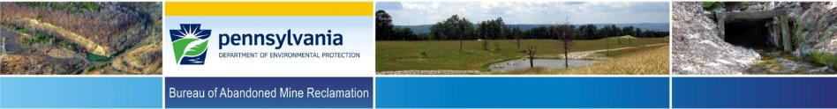

Tom Wolf, Governor
Patrick McDonnell, Secretary
Non-Traditional Reclamation of Abandoned Mine Lands (AML) to Support Economic Revitalization and Community Development –
Implementation of the 2016 AML Pilot Program in Pennsylvania
By Dean R. Baker , PE, Environmental Program Manager
PA-DEP-Bureau of Abandoned Mine Reclamation
36th Annual Meeting of the American
Society of Mining and Reclamation
June 3-7, 2019
Big Sky, Montana

Slide 2

PA’s Pilot Projects
$30 million Pilot Grant awarded to PA in 2016.
14 projects initially proposed.
Located in 10 counties.
PA allocated majority of funds for SMCRA Title IV eligible AML & AMD problems.
Project partners were responsible to complete the non-AML economic development aspects of the projects.

Slide 3
AML Pilot Projects Location Map
Notes:
This map shows where the projects are located. We have 12 in the western bituminous region and 6 in the eastern anthracite region.

Slide 4
Significant Benefits
Several Industrial Development or Business Park Opportunities
Significant Stream Water Quality Improvement and Restored Fisheries
Mine Pool Geothermal Project
MicroHydro Plant and Municipal Water Supply
Restored Public Lands

Slide 5
Significant Benefits
Increased Tourism, Public Trail Development and Mining Heritage Preservation
Reforestation/Restoration of American Chestnuts
Expansion of a Regional Botanic Garden
New or Upgraded Potable Water Supplies for over 600 Homes and Businesses in Coal Country

Slide 6

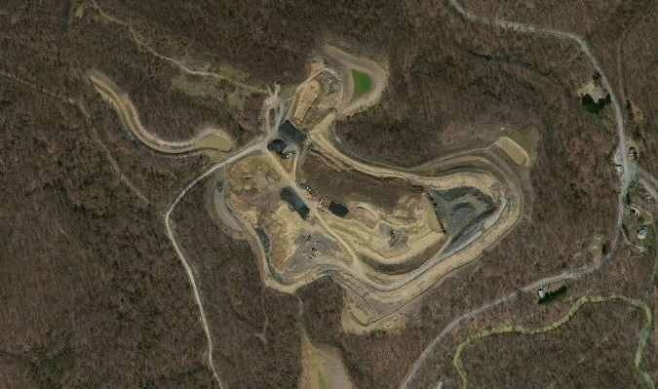
Pittsburgh Botanic Garden
Notes:
1st - The AML Pilot funding, in combination with other funding, will be used to help complete Phase 1 of the reclamation work and facilitate the phase 2 abandoned mine reclamation work at the Pittsburgh Botanic Garden. Phase 1 involves daylighting old underground mine workings and reclaiming pre-act surface mine cuts on approximately 100 acres of the site while phase 2 will address a dangerous highwall, mine subsidence and AMD on 50 additional acres of the property.

Slide 7
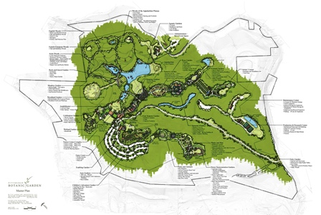
Pittsburgh Botanic Garden Master Plan
Area of Reclaimed
Mine Sites
Notes:
The Pittsburgh Botanic Garden will one day be a world-class botanic garden, including:
18 distinct gardens
five diverse woodland experiences
a visitor’s center
an amphitheater for outdoor concerts and performances
a celebration center to accommodate large outdoor or indoor weddings & corporate events
a center for botanic research

Slide 8
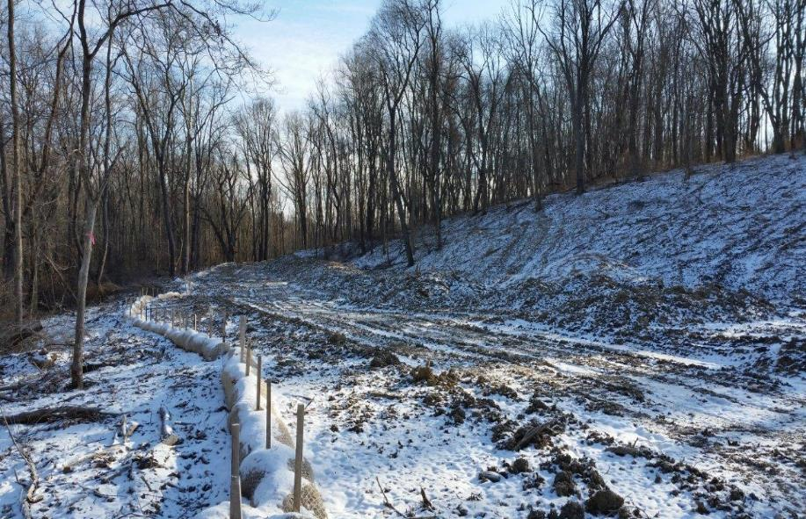
Pittsburgh Botanic Garden Construction

Slide 9
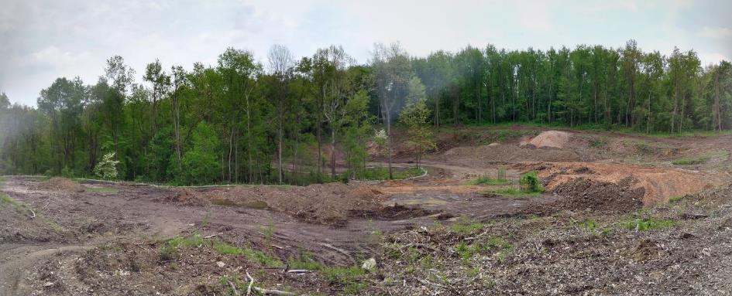
Pittsburgh Botanic Garden Construction

Slide 10
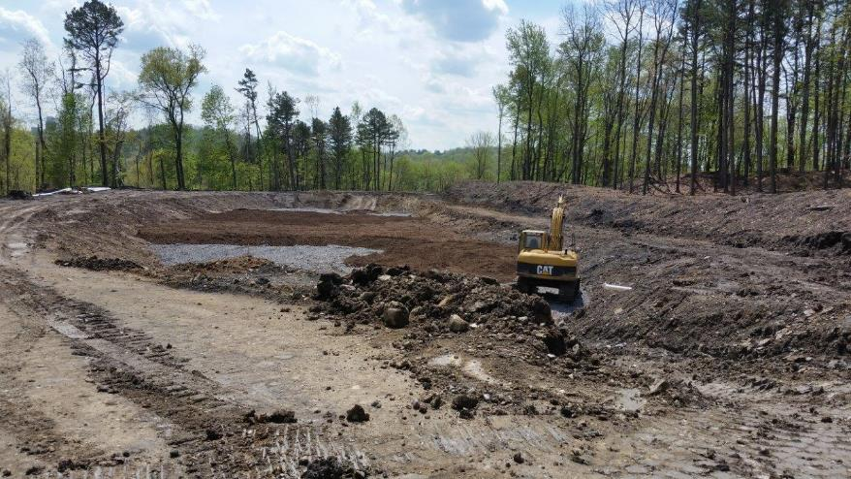
Pittsburgh Botanic Garden Construction

Slide 11
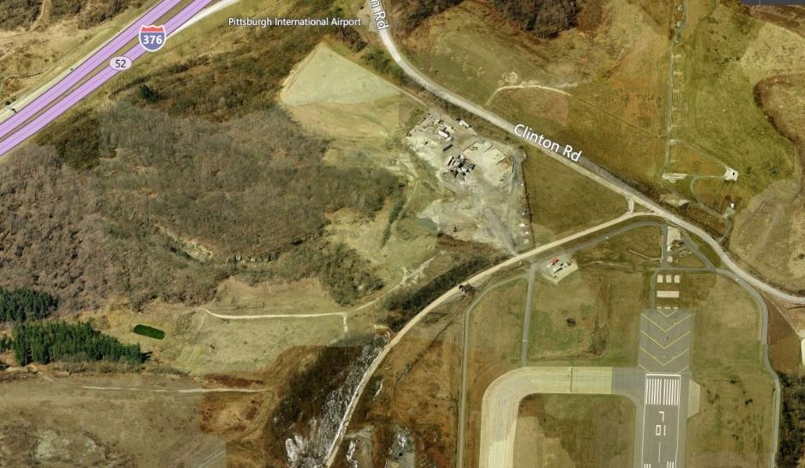
Allegheny County Airport Authority
PIT Innovation Campus
Notes:
2nd - The AML pilot funding will facilitate the reclamation of an abandoned surface mine with two dangerous highwalls. Once the dangerous AML condition is removed, the Airport Authority plans to develop the “Pittsburgh Innovation Campus Center.” This proposed international trade center will include office space, research and development facilities, and a 400 room hotel & convention center immediately adjacent to the Pittsburgh International Airport.

Slide 12

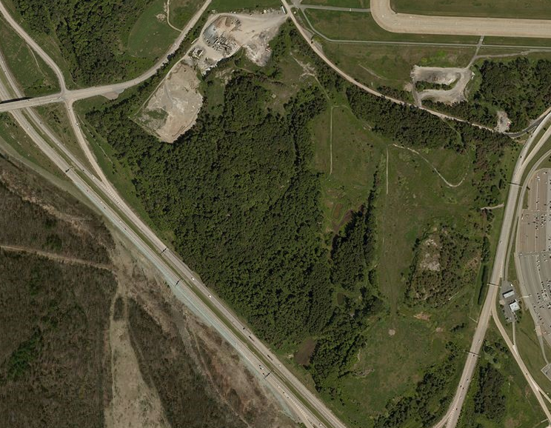
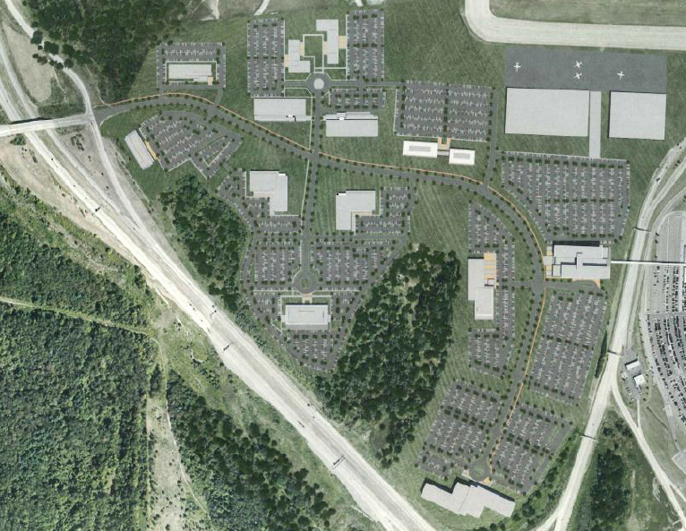
Pittsburgh International Airport
PIT Innovation Campus (Existing and Proposed)
Notes:
The redevelopment of the site will provide for:
over one million square feet of Class A office space
90,000 square feet for research and development
a 400 room hotel with convention space
up to six corporate airplane hangers which will allow corporate tenants to locate their headquarters in office space at the site

Slide 13
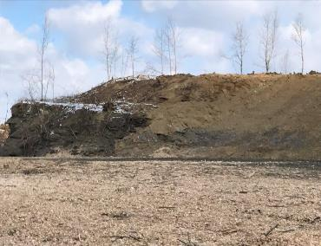
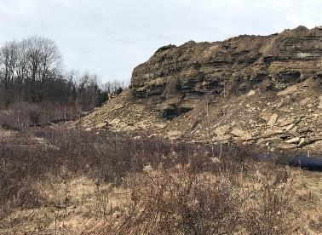
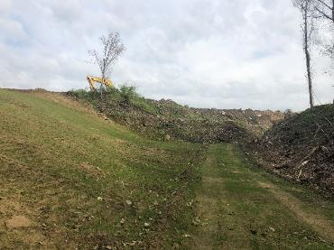
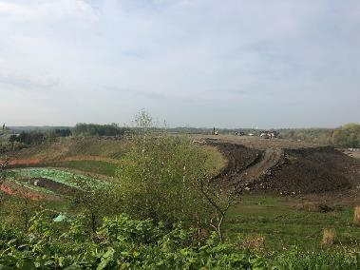
Pittsburgh International Airport
PIT Innovation Campus Under Construction
Notes:
The redevelopment of the site will provide for:
over one million square feet of Class A office space
90,000 square feet for research and development
a 400 room hotel with convention space
up to six corporate airplane hangers which will allow corporate tenants to locate their headquarters in office space at the site

Slide 14
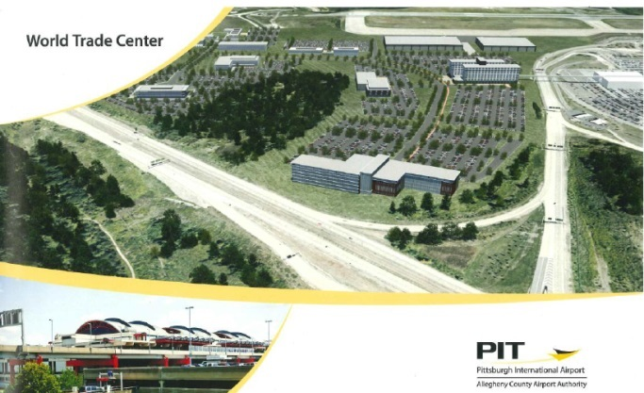
Pittsburgh International Airport
PIT Innovation Campus Rendering
Notes:
The project is projected to generate $250 million in private investment and will lead to the creation of 7,000 direct and indirect permanent positions.
The development of the site will also employ over 1200 construction workers.

Slide 15
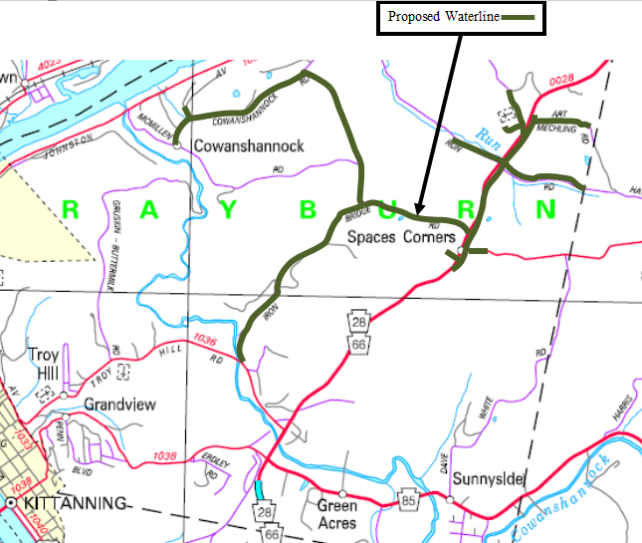
Spaces Corners South/Rayburn Township Waterline Extension Project
Notes:
3rd - The AML pilot funding was granted to the Rayburn Township Joint Municipal Authority to be used in combination with Pennvest funding to extend a waterline 47,000 L.F. to service 160 homes and businesses in Rayburn Township, Armstrong County. Of the 160 dwellings being serviced, 118 of the homes currently have wells or water supplies that are impacted or degraded by pre-act underground coal mining operations.

Slide 16
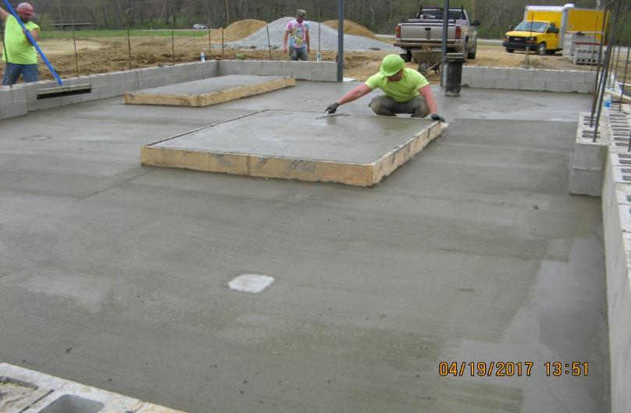
Spaces Corners South/Rayburn Township Waterline Extension Project Construction

Slide 17
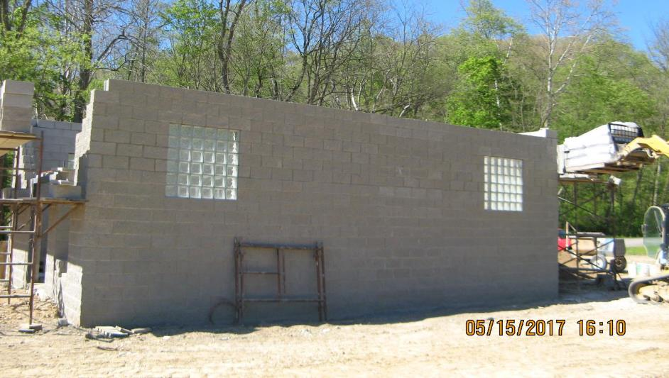
Spaces Corners South/Rayburn Township Waterline Extension Project Construction

Slide 18
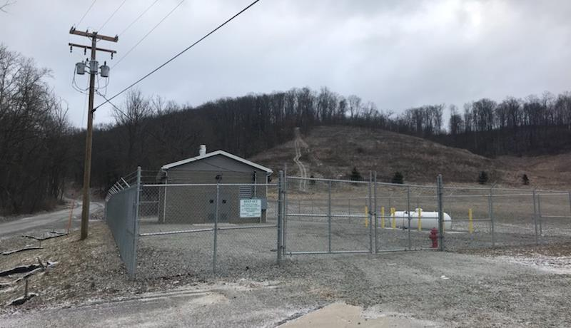
Spaces Corners South/Rayburn Township Waterline Extension Project Construction

Slide 19
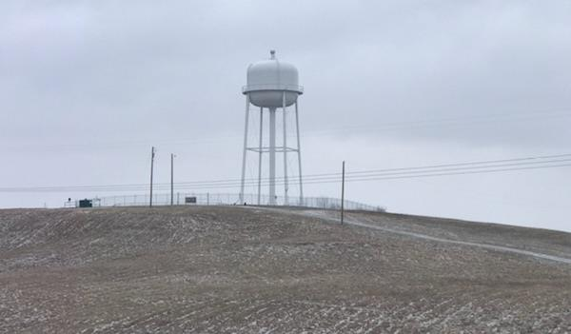
Spaces Corners South/Rayburn Township Waterline Extension Project Construction

Slide 20
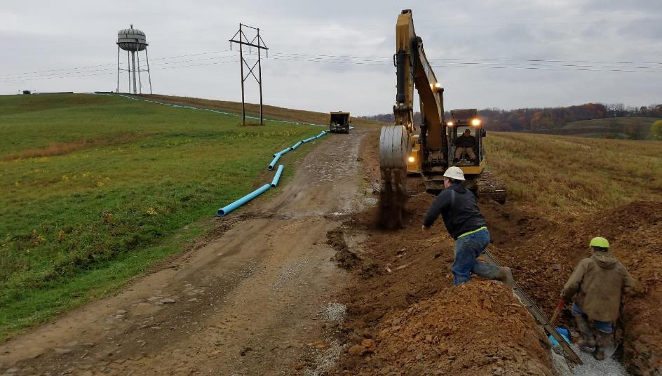
Spaces Corners South/Rayburn Township Waterline Extension Project Construction

Slide 21
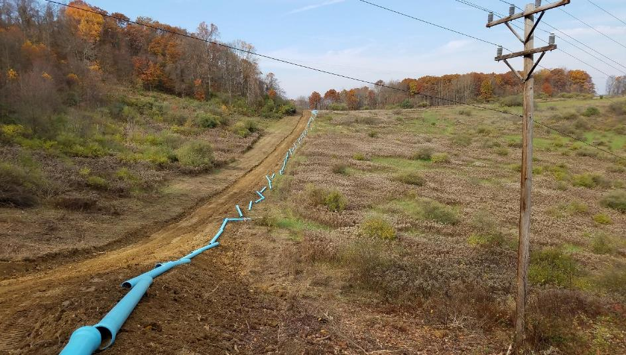
Spaces Corners South/Rayburn Township Waterline Extension Project Construction

Slide 22
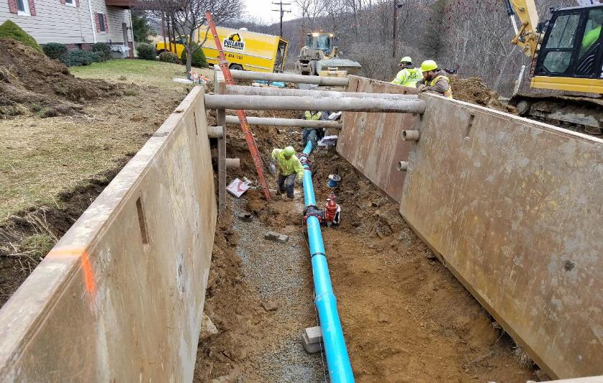
Spaces Corners South/Rayburn Township Waterline Extension Project Construction

Slide 23
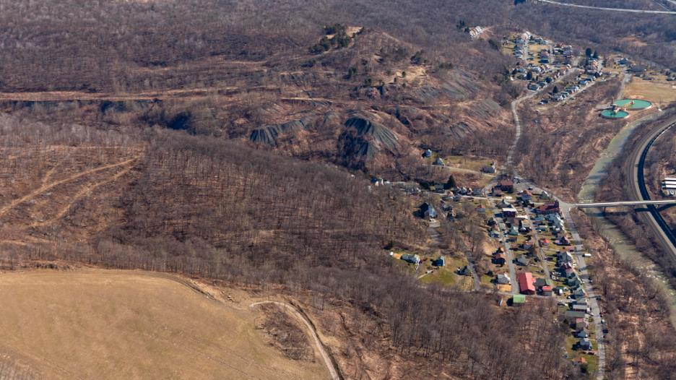
Ehrenfeld Coal Refuse Pile Reclamation Project
Notes:
5th - The AML pilot funding, along with other funding sources, will be used to complete reclamation of the abandoned Ehrenfeld Coal Refuse Pile. The 3.2 million tons of coal refuse material will be excavated, hauled away, blended with alkaline material, and disposed of in accordance with an approved handling and placement plan authorized within the mining permit for an adjacent surface mining site operated by the Rosebud Mining Company.

Slide 24

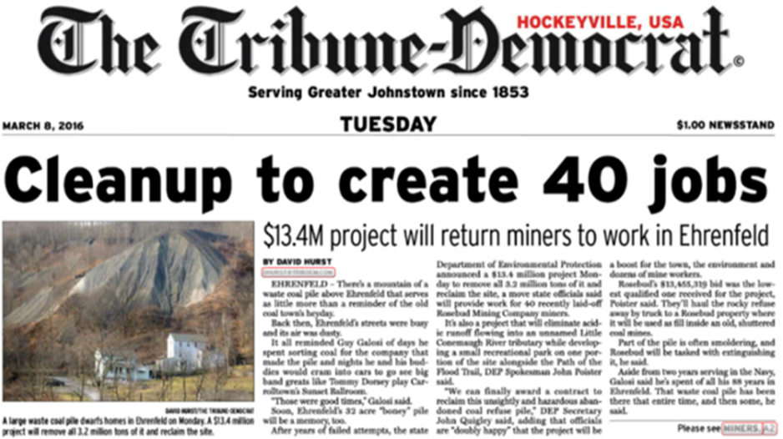
Ehrenfeld Coal Refuse Pile Reclamation Project Newspaper Headline
Notes:
This project sustained employment of 40 miners who would have been laid off due to a slump in the coal market

Slide 25
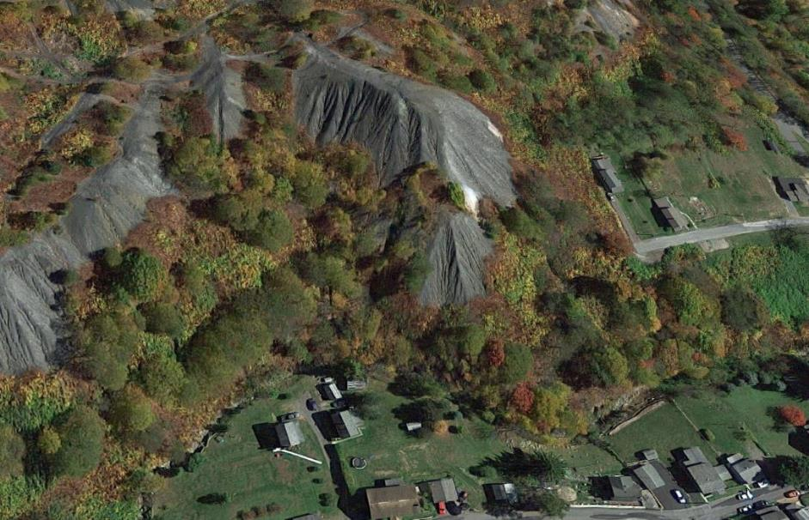
Significant Benefits
Notes:
Elimination of a 3.2 million ton abandoned coal refuse pile with the following significant environmental or health and safety issues:
Severe on-site erosion and off-site sedimentation issues in the Little Conemaugh River Watershed
Source of acid mine drainage laden runoff
Slope stability/past landslide issues
Burning coal refuse material
Unauthorized recreational use by ATVs
Restoration of 62 acres of barren undevelopable land situated in Ehrenfeld Borough and Croyle Township
Recreational development through construction of a parking area to access the Johnstown Flood Memorial Rails to Trails
Possible future industrial development
Water Quality Improvement /Watershed Restoration
Land Restoration including re-establishment of the American Chestnut

Slide 26
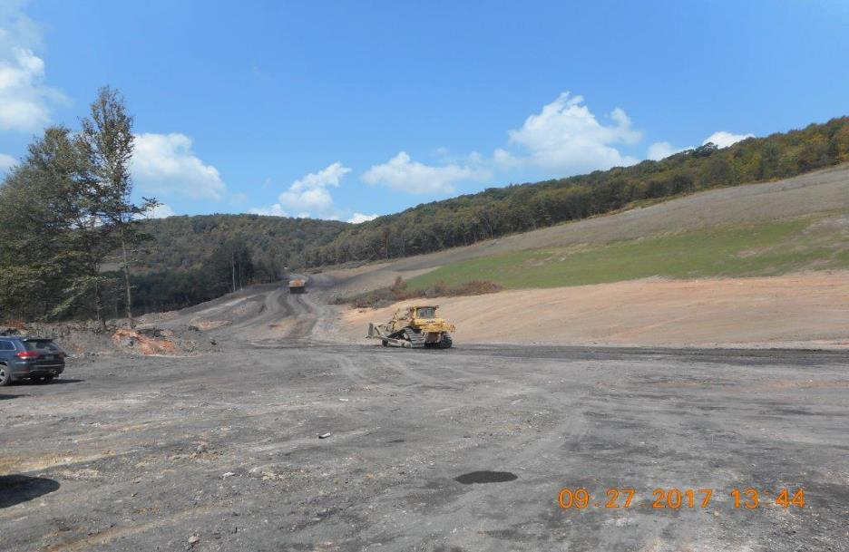
Ehrenfeld Construction

Slide 27

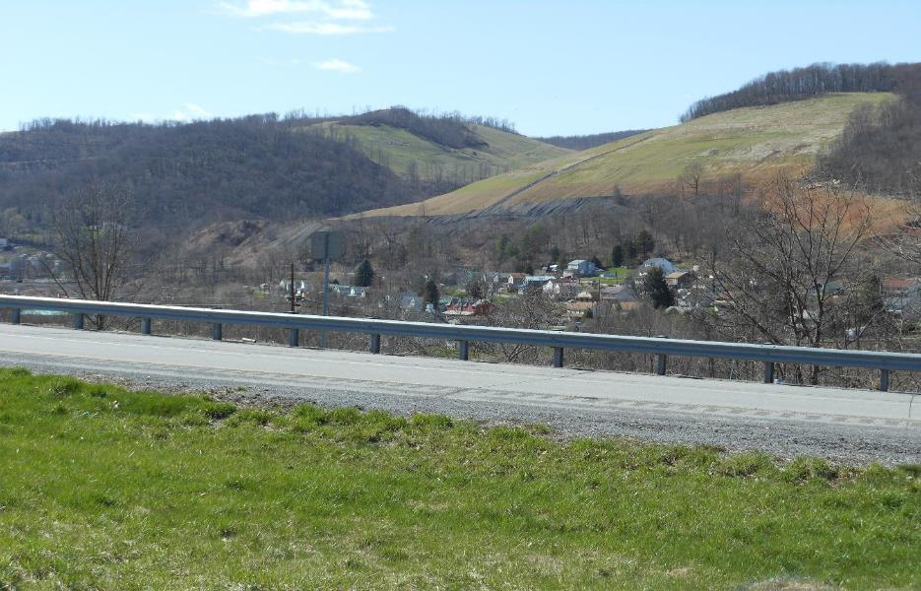
Ehrenfeld Construction

Slide 28

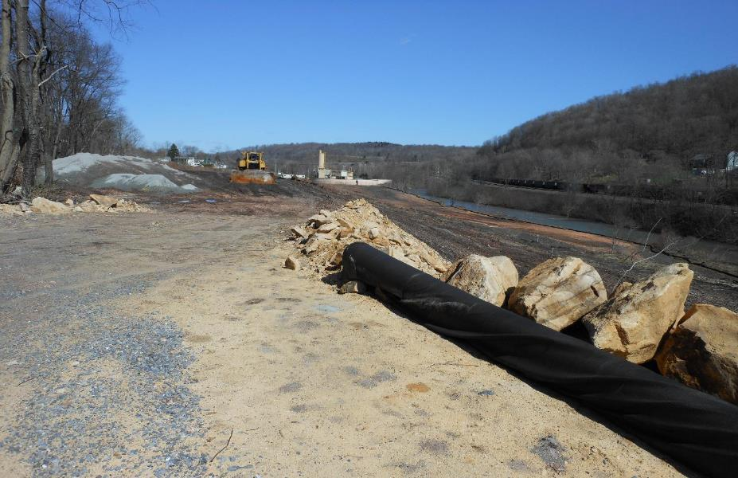
Ehrenfeld Construction

Slide 29
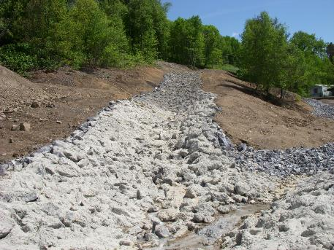
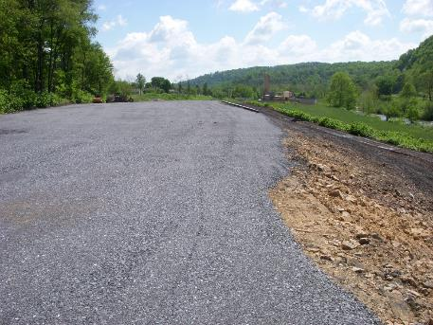
Ehrenfeld Construction

Slide 30

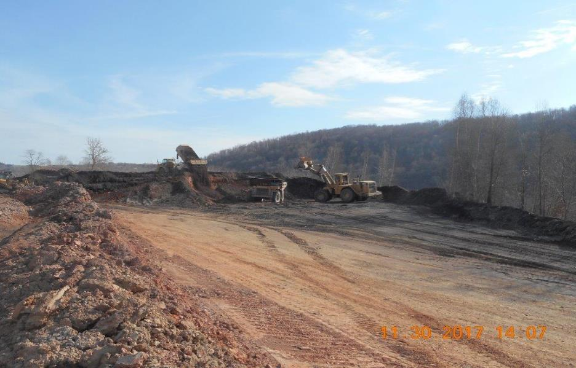
Ehrenfeld Construction

Slide 31
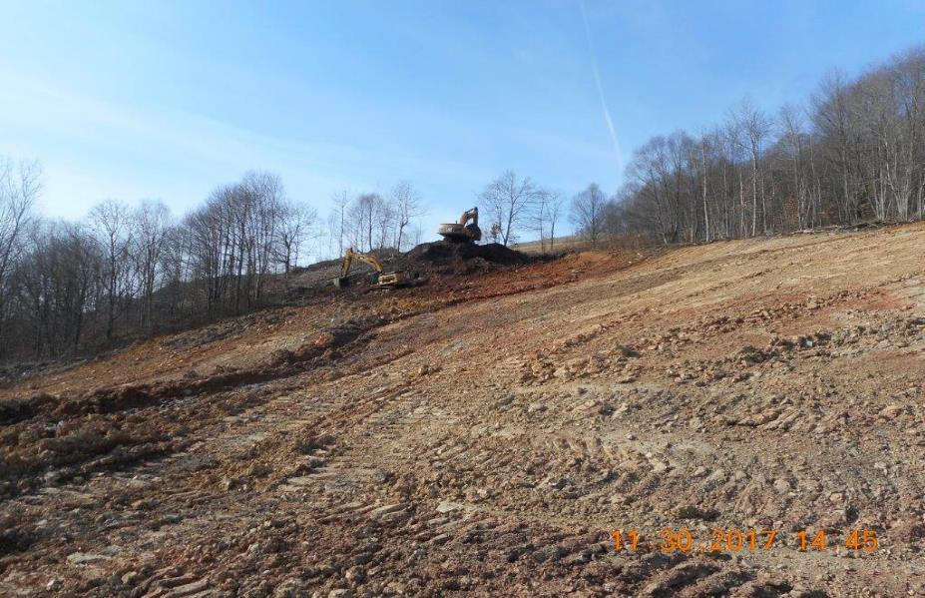
Ehrenfeld Construction

Slide 32
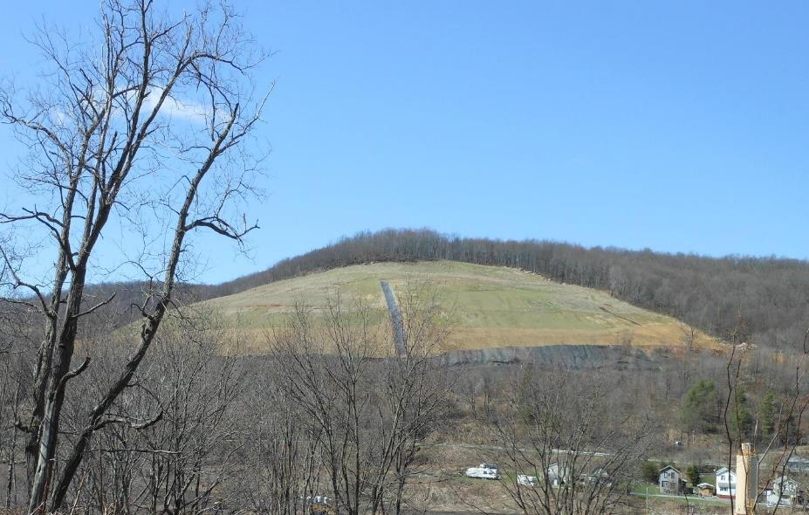
Ehrenfeld Construction
Notes:
Project is 80% complete so far.

Slide 33
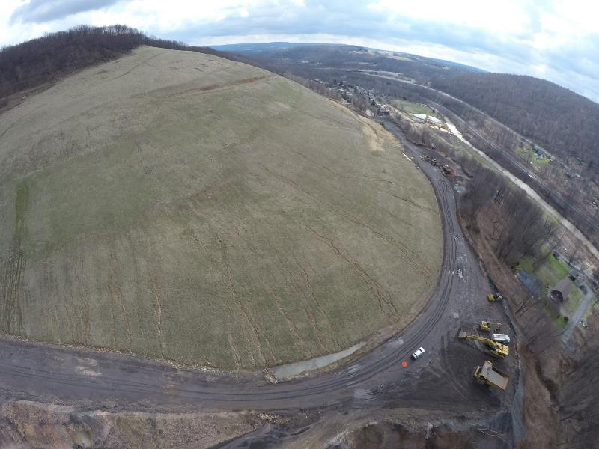
Ehrenfeld Construction
Notes:
Project is 80% complete so far.

Slide 34

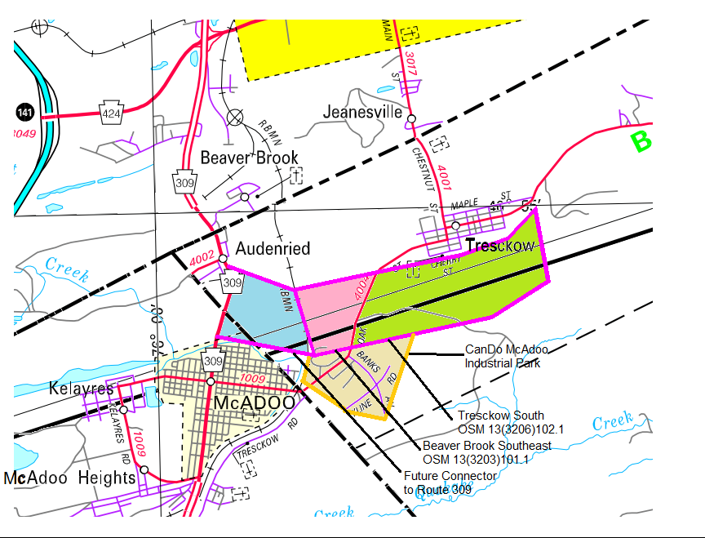
Tresckow/Beaver Brook Surface Mine Restoration Project
Tresckow Project
Beaver Brook Project
CanDo/McAdoo
Industrial Park
Notes:
6th - The AML pilot funding will be used in combination with other funding sources to backfill several huge strip pits using mine spoil materials obtained on-site to facilitate future industrial/commercial development and allow for the construction of a dedicated access road to the McAdoo Industrial Park. The project will also relocate a Kline Township Municipal Authority potable water line to service 400 residential customers in the village of Tresckow.

Slide 35
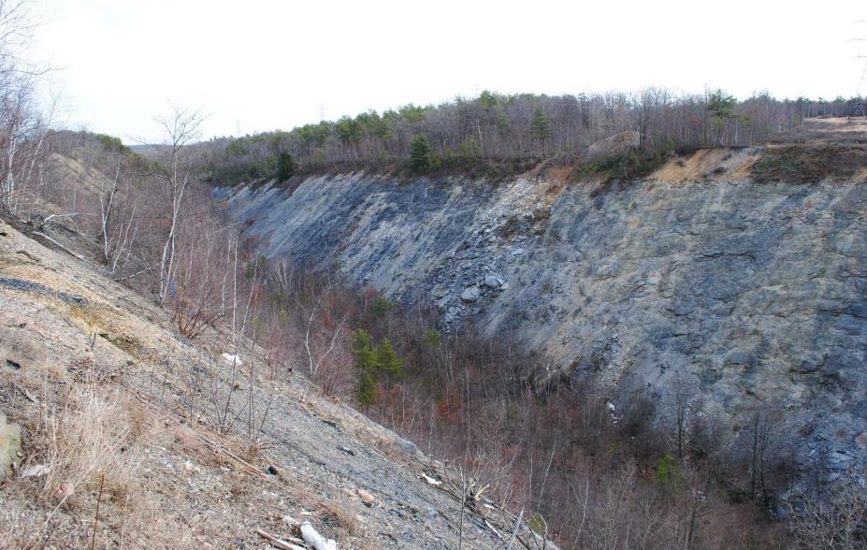
Tresckow Pit

Slide 36
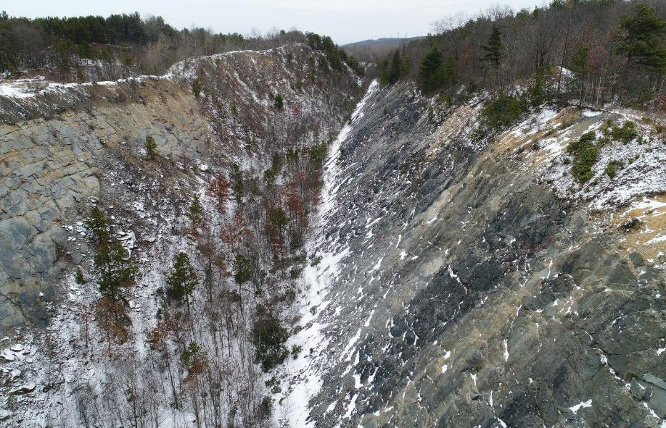
Tresckow South Highwall Reclamation

Slide 37
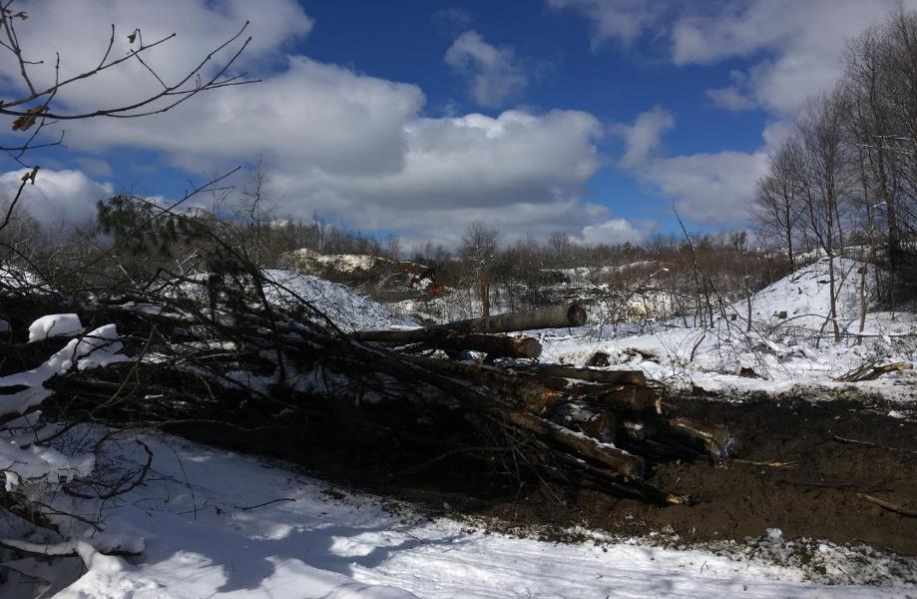
Tresckow South Highwall Reclamation

Slide 38
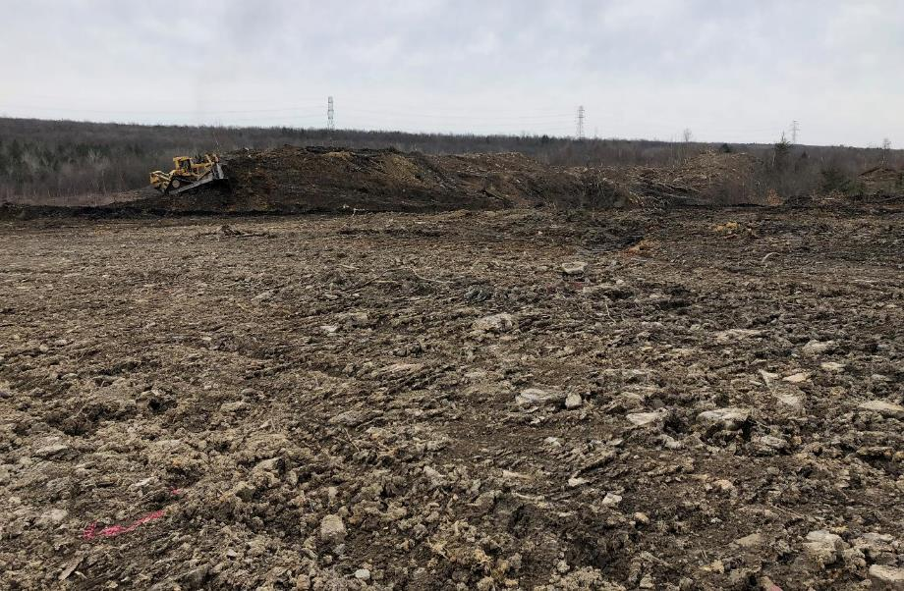
Tresckow South Highwall Reclamation

Slide 39
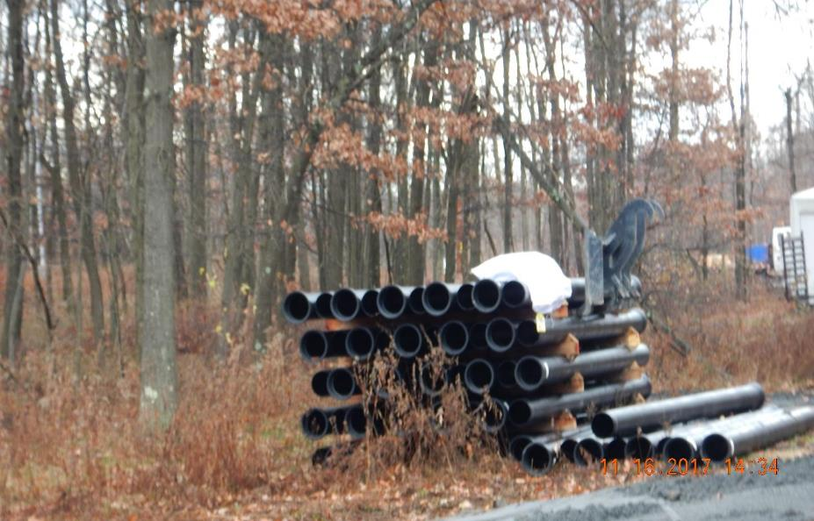
Pine Grove Waterline Construction
Notes:
The waterline project is nearly complete with the waterline in service since April 2018.

Slide 40
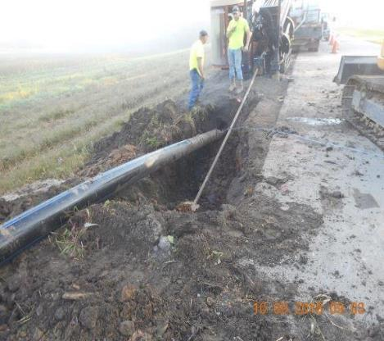
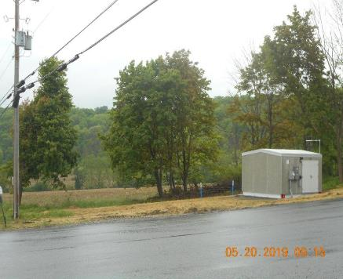
Waterline Construction
Pine Grove -Horizonal Boring Utilized, Pump Stations, 125 home, approximately 20 miles of waterline installed

Slide 41
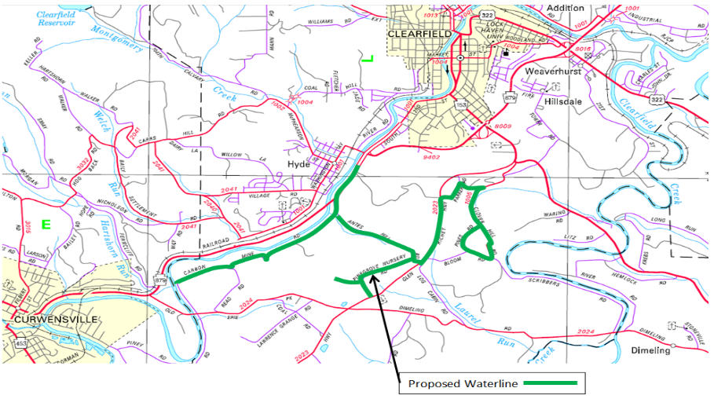
Pine Grove North/Lawrence Township Waterline Extension Project
Notes:
7th - The AML pilot funding will be used to construct Phase 1 of a waterline extension in cooperation with the Clearfield Municipal Authority to service approximately 153 homes and businesses in Lawrence Township, Clearfield County. Phase 1 will service 96 of the 153 homes and businesses which currently have wells or water supplies that are impacted or degraded by pre-act surface and underground coal mining operations.

Slide 42
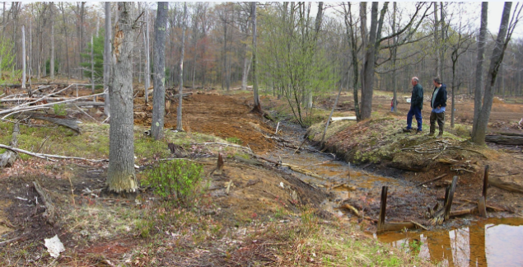
Fran Contracting Surface Mine Restoration Project (Rock and Camp Runs)
Notes:
8th - The AML pilot funding will be used to fund the reclamation of the Camp Run No. 2 AML site in Sproul State Forest to restore water quality in the Rock and Camp Run tributaries of Cooks Run. The site will be reclaimed by excavating and removing or treating the acid forming materials on site by mixing them with alkaline material to neutralize acidity. The reclaimed site will be reforested, including reintroduction of hybrid American Chestnut trees, to bring the land & water back to pre-mining conditions.

Slide 43
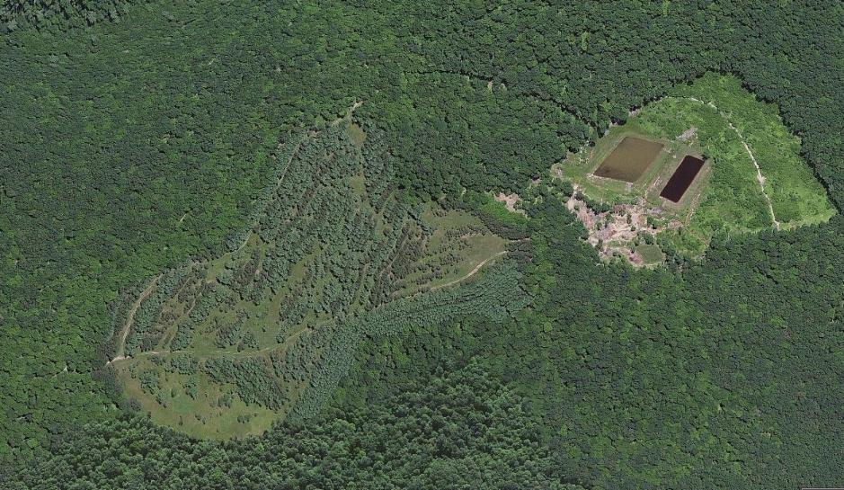
Fran Contracting Surface Mine Restoration Project (Rock and Camp Runs)
Fran Contracting Surface
Mine Restoration Project

Slide 44
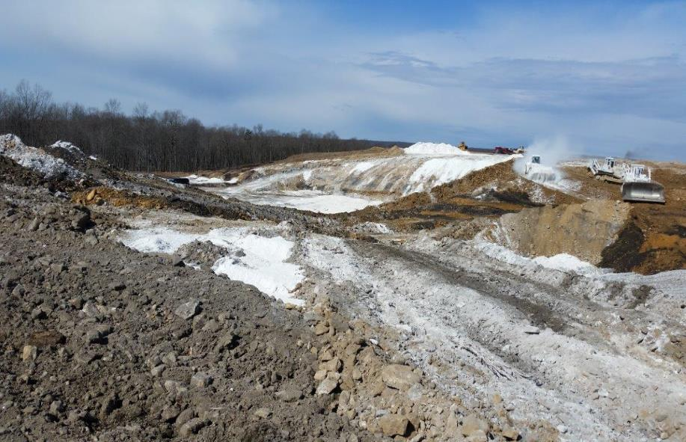
Fran Project Construction- Alkaline addition 160 K

Slide 45
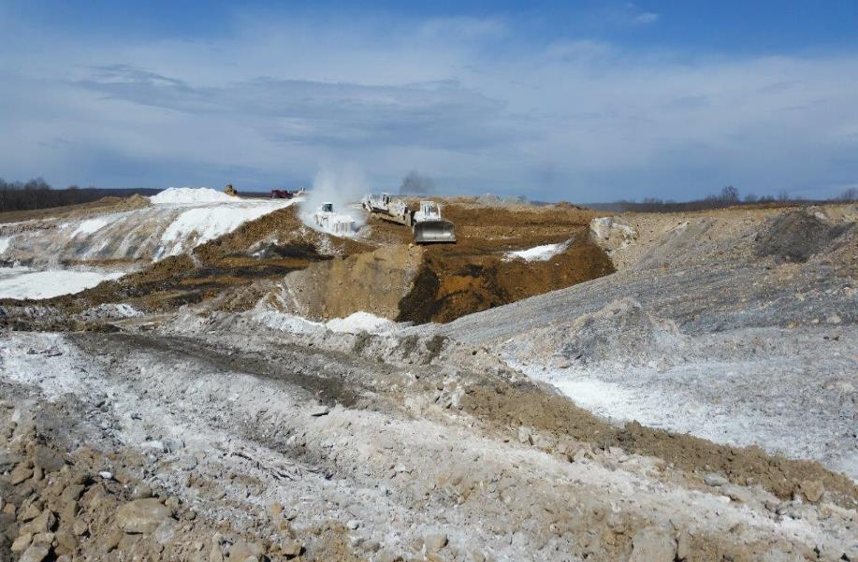
Fran Project Construction

Slide 46
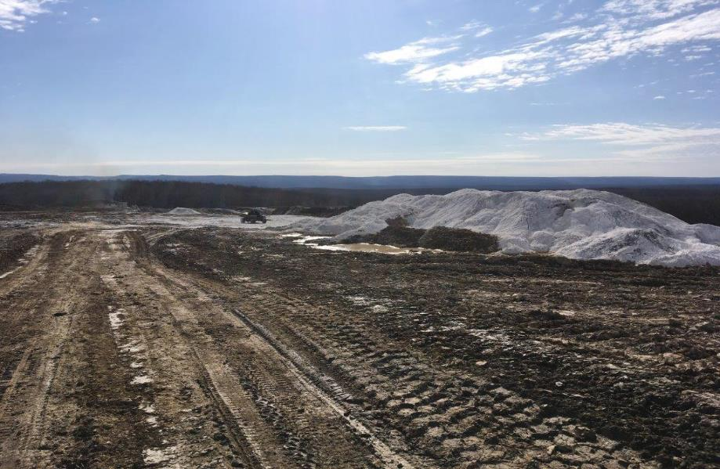
Fran Project Construction

Slide 47
Fran Project Construction
Data 07-09 shows the pH ranged 4- 4.5 and hot acidity averaging 1800 mg/l Construction 2017 – present - alkyline addition- pH is now 5.3 Hot acidity Acid averages 200 mg/l

Slide 48
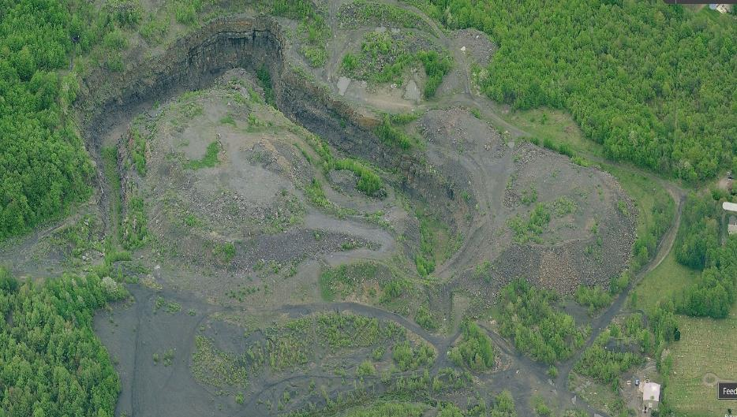
Powderly Creek NE Underground Mine Fire and Economic Development Project
Mine Fire Area
Notes:
9th - The AML pilot funding was used in combination with other funding to undertake a reclamation project to extinguish the Powderly Creek underground mine fire just outside of the City of Carbondale. Additional AML features adjacent to the mine fire area were also reclaimed in order to create site conditions suitable for future industrial development. The total acreage of AML reclaimed (including the mine fire area) is 82 acres.

Slide 49
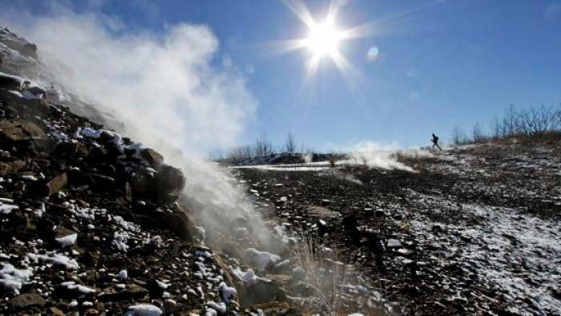
Powderly Creek NE Underground Mine Fire and Economic Development Project

Slide 50

Powderly Creek NE Underground Mine Fire and Economic Development Project
Carbondale

Slide 51

Powderly Project Construction

Slide 52

Powderly Project Construction

Slide 53

Powderly Project Construction

Slide 54

Powderly Project Construction

Slide 55

Powderly Project Construction
Notes:
Completed in January 2018 and is ready for development.

Slide 56

Eckley/Hazleton Rail Trail/Hazel Creek Cleanup
Notes:
10th - The AML pilot funding will be used to reclaim a 70 acre abandoned surface mine with 2500 linear feet of dangerous highwall ranging in height from 40 to 50 feet by backfilling and grading with on-site spoil material, including construction of wetlands, and reconstructing 3200 linear feet of stream.

Slide 57

Eckley/Hazleton Rail Trail/Hazel Creek Cleanup
Proposed Rail Trail (2
Options) to Eckley
Miner’s Village
Eckley Surface Mine
Restoration Project
Notes:
The project will facilitate an extension of the Greater Hazleton Rails to Trails to connect with the Eckley Miner’s Village and improve water quality in Hazel & Black Creeks.

Slide 58


Eckley Reclamation Project Construction

Slide 59

Eckley Reclamation Project Construction

Slide 60

Eckley Reclamation Project Construction

Slide 61

Eckley Reclamation Project Construction
Notes:
Construction is complete on the AML site. The rail trail is currently under construction.

Slide 62

Bowman’s Shaft - Pioneer Tunnel Mine Headframe & Hoist Preservation Project
Notes:
13th - The AML pilot funding will be used to paint and erect a salvaged headframe and hoisting drum as exhibits at the Pioneer Tunnel tourist coal mine in Ashland Borough, Schuylkill County.

Slide 63



Bowman’s Shaft - Pioneer Tunnel Mine Headframe & Hoist Preservation Project
Notes:
The mining artifacts were recovered from the North Mahanoy Colliery, Park No. 1 Shaft. The shaft, which was located near several homes in Mahanoy Township, was backfilled in 2015.

Slide 64

Pioneer Tunnel Project Construction
Notes:
During the project, the headframe and hoist were carefully disassembled and preserved.

Slide 65


Pioneer Tunnel Project Construction

Slide 66


Pioneer Tunnel Project Construction

Slide 67


Pioneer Tunnel Project Construction

Slide 68




Potts Run Land Reclamation ARRI
Notes:
The project.is being completed in 2 phases. Phase A is land reclamation with 13thousand Tons Alkaline addition and 21K RRI Tree planting technique with TP Sanitation for approximately 800,000

Slide 69




Potts Run Water Treatment
Trout Unlimited Pass thru Grant
Notes:
The project was built on a refuse pile 4K tons removed and will treat the water to clean up 3 miles of stream Cost 1.3 million E. M Brown, Heddin Enviromental Design

Slide 70




Zelienople Municipal Airport
TASA Air Field
Notes:
The Zelienople Airport is a key component to the region. An expansion will hire people, Land larger jets,
allow night Landing for life flight and other traffic while improving safety as the highway will be modified.

Slide 71




Cresson Treatment Plant
Notes:
The project is a 14 million dollar Treatment plant Capable of treating 4400 GPM from 3 deep mine
complexes to cleanup approximately 21 Miles of streams

Slide 72


Cresson Treatment Plant
Notes:
Pic 1 Drill Pad location from Cresson and AMD transport line

Slide 73


Cresson Treatment Plant
Notes:
Wetlands and Completed Treatment Plant

Slide 74


Wingfield Pines Passive Treatment System
Notes:
Allegheny Land Trust purchased the 87-acre conservation area in December 2001. Working in conjunction with local environmental groups, PA DEP BAMR and OSMRE, a passive mine drainage treatment system was implemented in 2009 to address abandoned underground mine AMD problems on the site.
The system operates by gravity and treats iron-laden mine discharge that is flowing at 1500 – 2,000 gallons per minute across the property before entering Chartiers Creek. The system accommodates trails, a wetland boardwalk, overlooks, and interpretative signage providing educational opportunities.

Slide 75

Wingfield Pines Passive Treatment System
Notes:
Wingfield Pines is a community hub for recreation and education. The AMD treatment wetlands offer an outdoor laboratory for students from local high schools, universities, and educational programs.

Slide 76

Wingfield Pines Passive Treatment System
Notes:
15th - The AML Pilot funding will be used to reconstruct the mine water collection system and to restore the inflow to the Wingfield Pines passive treatment system. The current intake structure is a concrete man-hole, used to collect and direct the mine pool water to the treatment system inlet. The intake structure has become inoperable due to mine subsidence which occurred in Dec. 2017 and has ruptured the base, and exposed a portion of the deep mine. This subsidence allowed the mine water to circumvent the intake structure and surface flow into the final pond without treatment.

Slide 77


Wingfield Pines Passive Treatment System
View looking at the concrete manhole, used as the old mine water collection system. The bottom and the area next to the manhole has been subsided and caused damage to the collection properties of the system.
Notes:
This is a picture of the subsidence around the man-hole that shows the mine water bypassing the intake.

Slide 78

Wingfield Pines Passive Treatment System
Notes:
As mentioned, in December of 2017 a mine subsidence event occurred near the treatment system inflow structure.

Slide 79
Update
3 additional projects have recently been added for 2016 AML Pilot Funds:
  Cresson AMD Treatment Plant
  Zelienople Municipal Airport Expansion AML Reclamation
  Potts Run AMD Treatment System

Slide 80


AML Pilot Project Implementation Successes
Extinguished the Powderly Underground Mine Fire resulting in ~100 acres of developable land
Provided a safe and reliable potable water supply to ~160 homes & businesses
Preserved and relocated a historic mine headframe to a tourist mine
Kept 40 miners employed who would have been laid off due to a slumping coal market
Successfully obligated $30M AML Pilot Program funding to qualified projects
Eliminated safety hazards and restored a lost stream to the surface
Facilitated a multi-use trail expansion to a historical site (Eckley Miner’s Village)

Slide 81

Project Implementation Challenges
Property owner support and concurrence for planned projects
Coordinating with project partners
Clearly identifying each partner’s roles and responsibilities
Project permitting
Follow through on the community development/economic revitalization component by partners
Timing of grants and other funding from other sources
Time required to get projects designed, permitted and under contract
Partners following all grant agreement terms and conditions
Municipal zoning inconsistent with post-reclamation development
Managing public/media attention

Slide 82
Lessons Learned
Secure landowner support and agreements up front
Clearly explain grant agreement terms & conditions to partners
Projects rely on good cooperation and follow through by all project partners
Verify other grants/funding sources identified by partners
3 years is a short amount of time to implement projects
  need to plan ahead and keep the projects moving
Property owners and municipalities need to work on rezoning at least 12 months in advance of reclamation completion
Very few “Shovel Ready” projects exist to utilize funding
Significantly more staff time and resources are required to meet deadlines and requirements for AML pilot projects

Slide 83



Access : www.NAAMLP2019.com to see the details!!!!
Notes:
Don’t forget to checkout NAAMLP 2019 for next year’s conference in Pittsburgh with preconference tours starting on Saturday, September the 7th. The conference will be at the Wyndham Grand Pittsburgh Downtown.

Slide 84

Questions?
Contact
Information: deabaker@pa.gov
814-472-1800
www.NAAMLP2019.com
Tom Wolf, Governor
Patrick McDonnell, Secretary

