Slide 1
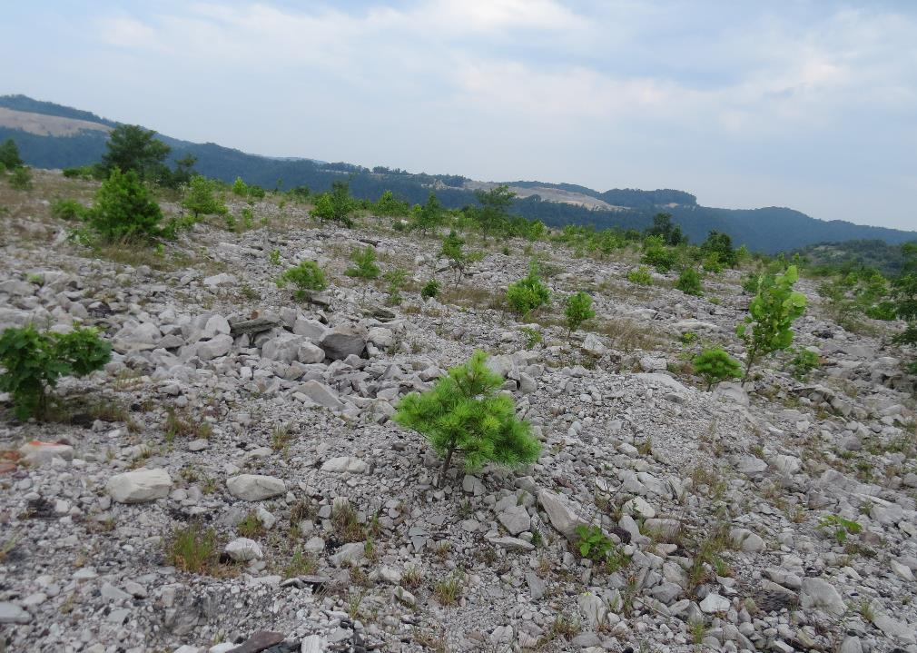
Soil Water Chemistry of Reforested Mine Site in West Virginia
Amir Hass
West Virginia State University
ASMR, June 3-7, 2019. Big Sky, MT

Slide 2
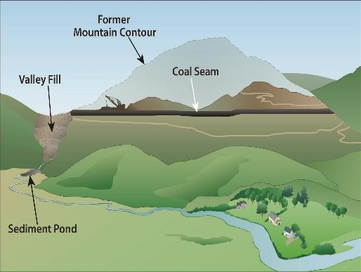
Coal Mining - Mountaintop Removal Operation
EPA. 2011. “The Effects of Mountaintop Mines and Valley Fills on Aquatic Ecosystems of the Central Appalachian Coalfields”, EPA/600/R-09/138F March 2011.

Slide 3
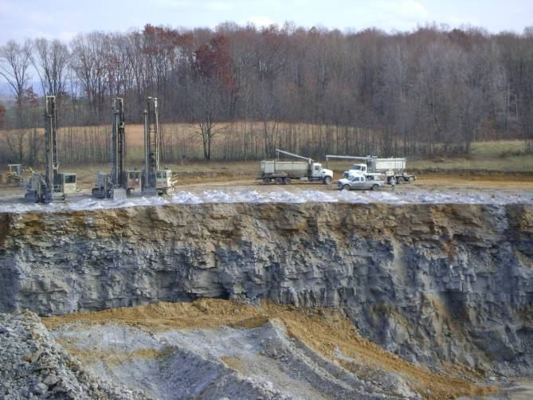
Typical Overburden Stratification
Native vegetation & landscape
Native soil
Brown Sandstone
Gray Sandstone
Skouson et al., 2011. Forest Reclamation Advisory No. 8, ARRI

Slide 4
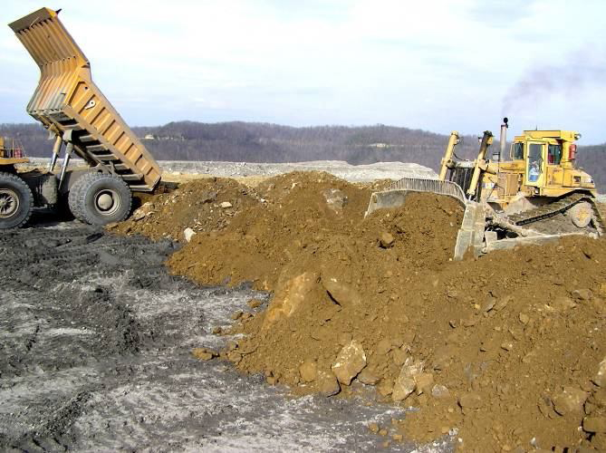
Placement of Topsoil Replacement Material
Brown Sandstone Plot
Skouson et al., 2011. Forest Reclamation Advisory No. 8, ARRI

Slide 5
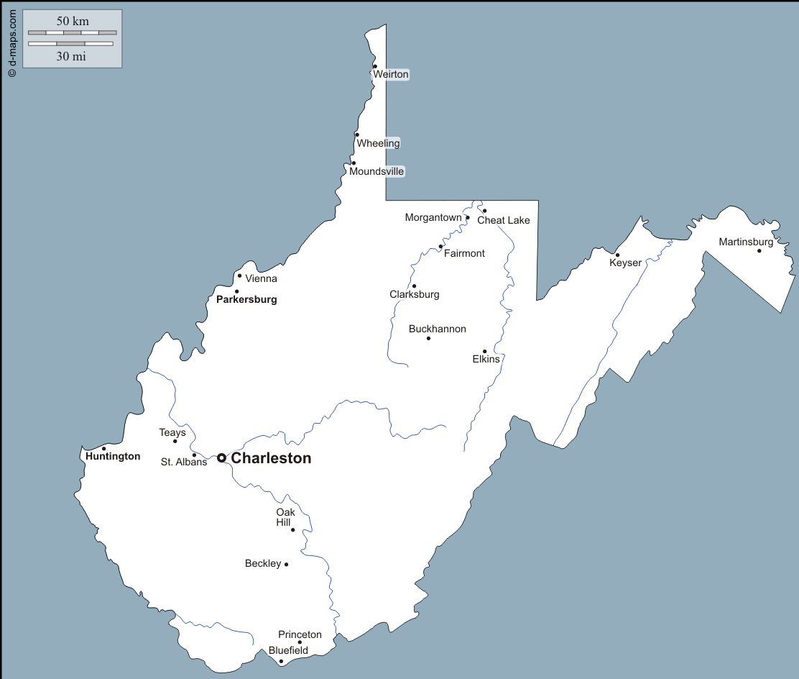
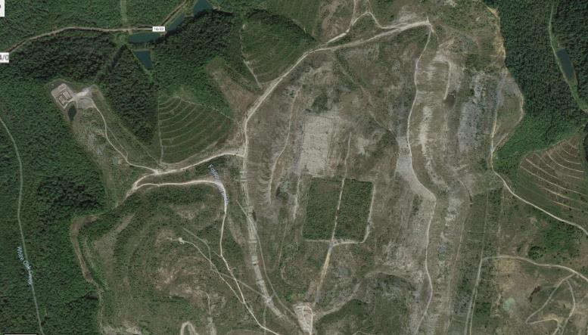
Catenary Mine Site – Field Plots

Slide 6
Catenary Mine Site – Field Plots
Compacted
Non-compacted
Gray Sandstone plot
Compacted
100 m
Brown
Sandstone plot
Non compacted

Slide 7
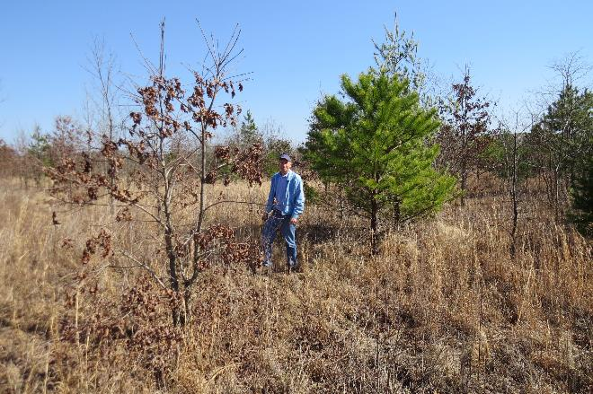
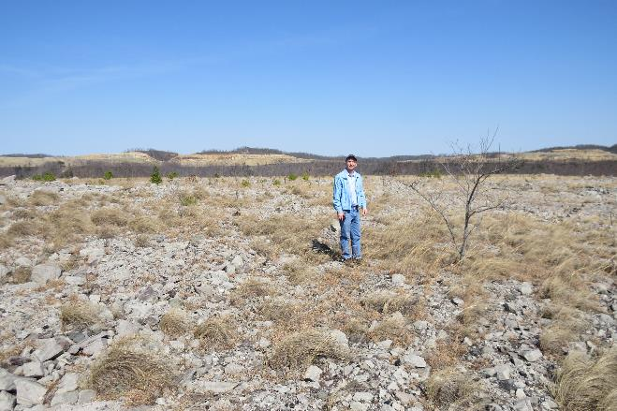
Catenary Mine Site – Field Plots
March 2017
Brown
Sandstone plot
Gray Sandstone plot

Slide 8
Objectives
Evaluate the mid-term impact of Forestry Reclamation Approach Practices on Soil Water Chemistry:
Effect of spoil type (brown vs. gray sandstone)
Effect of spoil placement practice (loose vs. compacted)

Slide 9
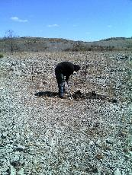
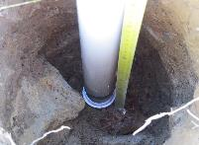
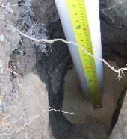
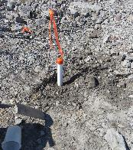
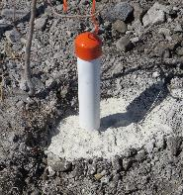
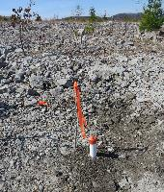
Catenary Mine Site – Well Locations
March-April 2017
115cm long, 5-cm ⌀ PVC pipe
2-cm perforated band @15cm from the bottom (water collected @ depth of 85 cm)
Acid-washed quartz sand layer put around perforated band
Hole refilled with dugout material
2-cm layer of bentonite to cap the well at the surface
Well is crowned at the surface

Slide 10
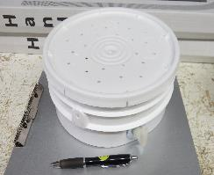
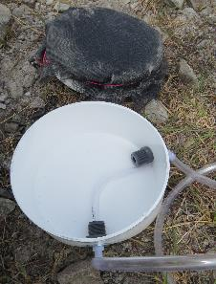
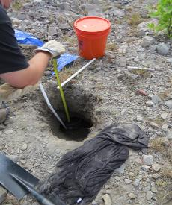
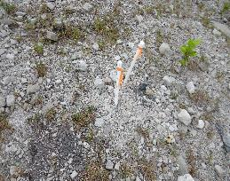
Catenary Mine Site – Pan Installation

Slide 11
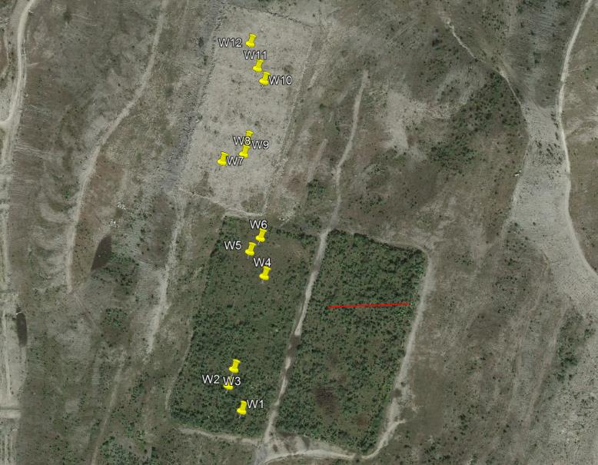
Catenary Mine Site – Wells Location
Compacted
Non-compacted
Gray Sandstone plot
Compacted
100 m
Brown
Sandstone plot
Non compacted

Slide 12
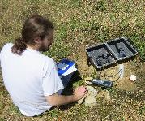
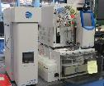
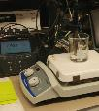
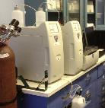
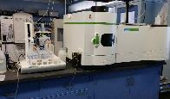
Catenary Mine Site – Water Sampling
Water level
YSI Multi-probe (Temp, EC, ORP, DO)
Water Sampling
(filtered <0.45 µm)
TC
(sealed, no headspace)
Total Alkalinity
(sealed, no headspace)
Ionic composition
(Li, Na, NH₄, Ca, Mg, K; F, Cl, NO₂, Br, NO₃, PO₄, SO₄)
ICP
(Acidified sample 4% HNO₃)
(Al, As, Ba, Ca, Cd, Co, Cr, Cu, Fe, K, Mg, Mn, Mo, Na, Ni, P, Pb, S, Se, Zn)
Notes:
Alk by gran plot on filtered sample with no head space; ICP on acidified sample (4% concentrated HNO₃); TC analysis (Aurora 1030W Total Organic Carbon Analyzer) followed by Dionex ICS 1100)

Slide 13
Results
pH – EC relationships
Notes:
Update values; include ratio

Slide 14
Results (Cont.)
pH – Eh relationships
Microbial Redox Reaction product:
CO₂ (from aerobic through methanogenic environment) → carbonic acid → pH ↓
Reduction Reactions – pH ↑
NO₃⁻ + nH⁺ + ne⁻ → N₂, N₂O + H₂O
MnO₂ + 4H⁺ + 2e⁻ → Mn²⁺ + 2H₂O
Fe(OH)₃ + 3H⁺ + e⁻ → Fe²⁺ + 3H₂O
SO₄⁻² + 8H⁺ + 6e⁻ → S + 4H₂O
CH₃OH + 2H⁺ + e⁻ → CH₄ + H₂O

Slide 15
Results (Cont.)
EC (uS cm⁻¹)
Eh (mV)
pH
Eh and EC are inversely related
Notes:
Avg of Eh (2ndary axis) and EC within 0.5 pH increments

Slide 16
Results (Cont.)
TDS (µS cm⁻¹)
pe

Slide 17
Results (Cont.)
Oxic
Suboxic
Anoxic
Notes:
Update values; include ratio

Slide 18
Results (Cont.)
pe, Conductivity, and Ionic Composition
pe

Slide 19
Results (Cont.)
pe, Conductivity, and Ionic Composition
SO₄⁻²
pe <2
(mg L⁻¹)
TDS (µS cm⁻¹)

Slide 20
Incubation Study - Effect of terminal electron acceptor on redox potential
Hypothesis: TEA abundance will govern solution redox potential
O₂
H₂O
NO₃⁻
N₂
MnO₂
Mn²⁺
Fe(OH)₃
Fe²⁺
SO₄²⁻
H₂S
CO₂
CH₄
H₂O
H₂

Slide 21
Incubation Study - Effect of terminal electron acceptor on redox potential
Hypothesis (cont.): Such effect will be more pronounce in soil of limited/initial pedogenic (soil development) stage
Meaning, we expect that ‘topsoil replacement material’ (i.e. crushed rock) contain limited pool(s) of available TEA

Slide 22
Free Iron Oxides Content in Soil and Rock Material

Slide 23
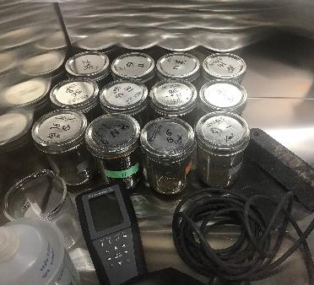
Incubation Study - Effect of terminal electron acceptor on redox potential
Soil Type (3):
Gray Sandstone
Brown Sandstone
Native Soil
Terminal e- Acceptor (4; 5.0mM):
NO₃
SO₄
Fe₂O₃
None
Notes:
6 different solutions: no terminal electron acceptor (#1) and with NaNO₃ (#2), NaSO₄ (#3), MnO₂ (#4), Fe₂O₃ (#5), and a mix of all reagents (#6). Different amount of CaCl₂ (as CaCl₂·2H₂O) was added to each solution of no terminal e- acceptor and that of NaNO₃, NaSO₄ to reach a common targeted total salt concentration and EC.

Slide 24
Results (Cont.)
Incubation Study - Effect of terminal electron acceptor on redox potential

Slide 25
Results (Cont.)
Incubation Study - Effect of terminal electron acceptor on redox potential

Slide 26
Results (Cont.)
Incubation Study - Effect of terminal electron acceptor on redox potential

Slide 27
Results (Cont.)
Incubation Study - Effect of terminal electron acceptor on redox potential (25 day)
(Native soil)
NO₃ > Fe ≈ None >> SO₄
b
b
c

Slide 28
Summary
Redox reactions dominated solution properties, affecting solution pH and composition.
High TDS associated with low pe
Reductive dissolution (as opposed to acid dissolution) likely play a significant role in producing excess TDS (though this is likely more complex than any binary system/choice)
Abundance of TEA (e.g. SO₄) may govern/maintain low(er) redox potential (that could otherwise be assumed judging from soil/site moisture regime)

Slide 29
Acknowledgements
Jeff Skousen, WVU
Robert Cantrell, John Lucas, Zac Lucas, Tigist Geberehiwot, Jake Harms, Edgar Lopez, Rein Yousef, Kim Cavender, Fatima Irfan
Kenny Daniel (ERP Environmental Fund, Inc.)
Randall Lester, Warren Haynes (USDA NRCS PMC, Alderson WV)
Funding Agencies:

