Slide 1
Effect of topsoil stockpiling on soil properties and organic amendment on tree growth during gold mine reclamation in Ghana
BY
PAUL KOFI NSIAH: Ph.D. Student
Schaaf Wolfgang: Supervisor
Brandenburg University of Technology
Cottbus - Germany
2019 ASMR Annual Conference
Big Sky – Montana
June 5, 2019

Slide 2
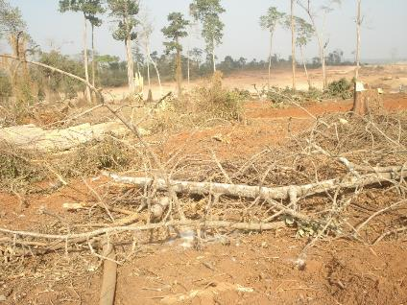
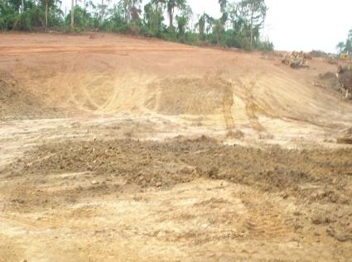
Introduction
Adverse impacts of surface mining on vegetation.
Adverse impacts of surface mining on soil.

Slide 3
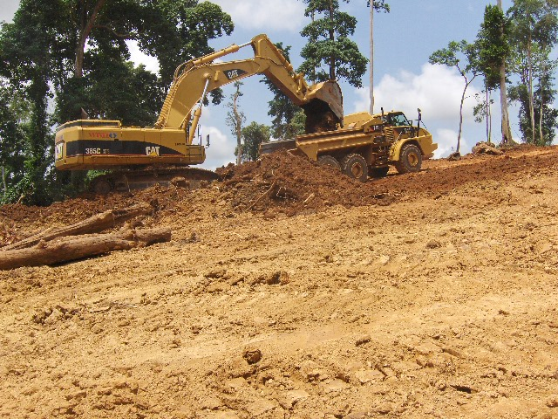
Topsoil salvaging and stockpiling at Newmont Ghana Gold Limited (NGGL)

Slide 4
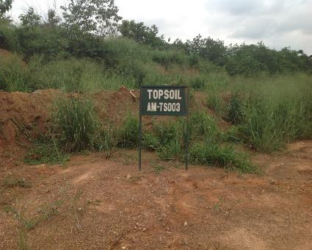
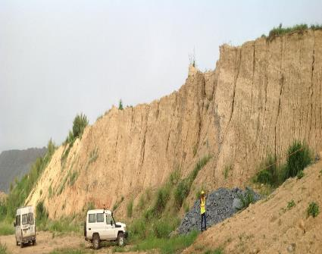
Stockpiled topsoil and subsoil at NGGL
Topsoil Subsoil

Slide 5
Effects of topsoil stockpiling on soil properties
Studies have, however, shown:
Long term stockpiling adversely affect soil properties.
That organic amendment with stockpiled topsoil is necessary in improving soil properties.
Hence, NGGL applies composted sewage sludge with the stockpiled topsoil to enhance revegetation success.

Slide 6
Hypotheses and objectives
Therefore, the study hypothesized that:
Topsoil stockpiling as practiced at NGGL has adverse impacts on soil properties.
Amending stockpiled topsoil with organic materials, composted sewage sludge and poultry layer manure, promotes the survival and growth of planted trees.
Objectives:
To assess the effects of stockpiling on soil properties (pH, nutrients, OM, bulk density and texture) during mine operations at NGGL.
To evaluate effects of organic amendments on survival and growth of planted trees.

Slide 7
The Study Location
NGGL Ahafo-South Project:
Kenyase in the Brong-Ahafo Region of Ghana.
Between Latitude 7⁰ 1’ 30” 6°40’, 7°15’, North and Longitude 2°15’, and 2°45’ West.
About 300km north-west Accra and 40 km south east Sunyani.
Rainfall: Double maxima pattern – from April to July; and September to November.
Average annual rainfall: 1400mm.
Mean monthly temperature ranges from 23.9ºC to 28.4ºC.
Soils: (Local): The Bekwai, Fwidiem and Birim-Chichiwere series.
(USDA and FAO): Ultisols and Inceptisols.

Slide 8
The study location of NGGL

Slide 9
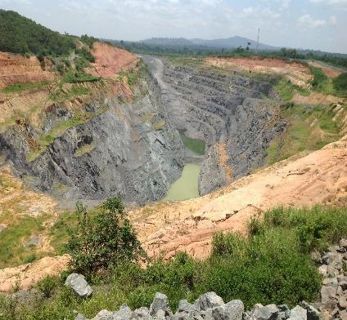
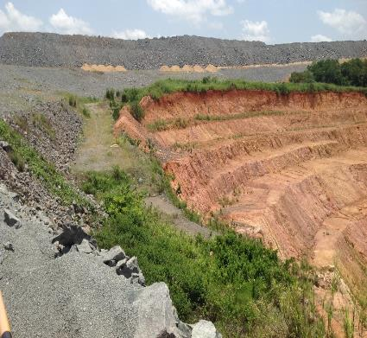
The Amoma Pit at NGGL

Slide 10
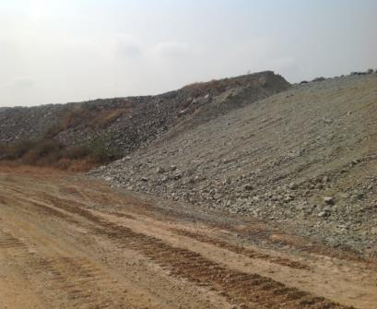
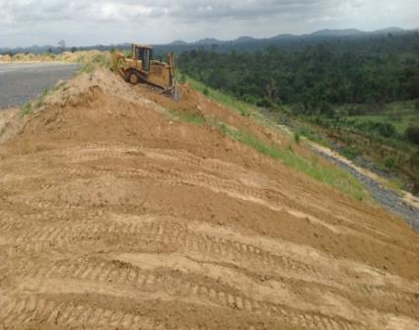
Methods
Waste-rock dump evenly graded to form a 3:1 slope.
Placement of a 70 cm layer of subsoil.

Slide 11
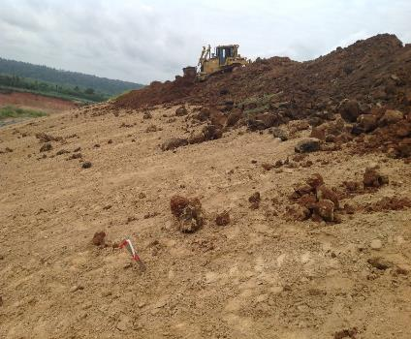
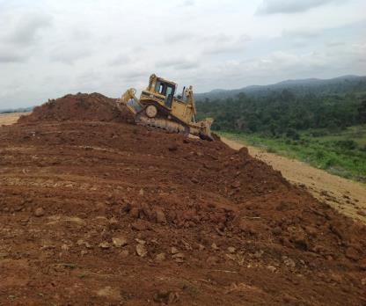
Re-instatement of a 30 cm layer stockpiled topsoil

Slide 12
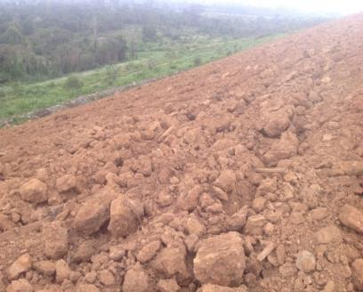
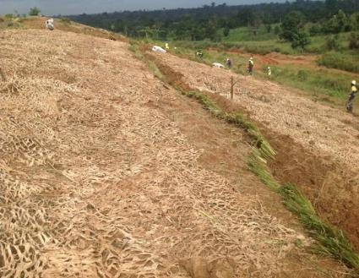
Soil stabilization activities
Scarification of re-instated topsoil.
Installation of biological geotextiles and planting of the Bermuda grass (Cynodon dactylon).

Slide 13
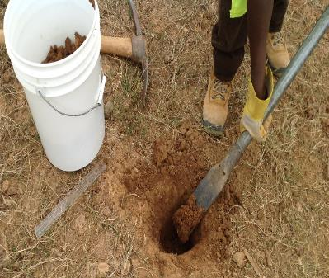
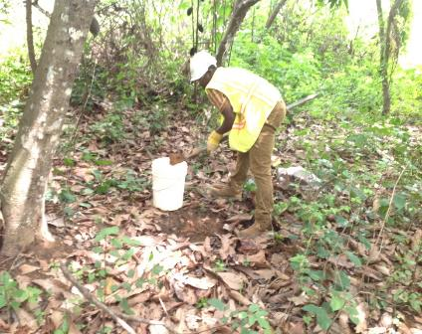
Soil sampling
Reclaimed site. Fresh soil: Reference site, (Larney and Angers, 2012).

Slide 14
Experimental Design
Site partitioned into three equal plots of 36m by 12m each.
The treatments Control (CON), PLM and CSS were randomly assigned.
12m
36m CONC PLM CSS
CON
PLM
CSS

Slide 15
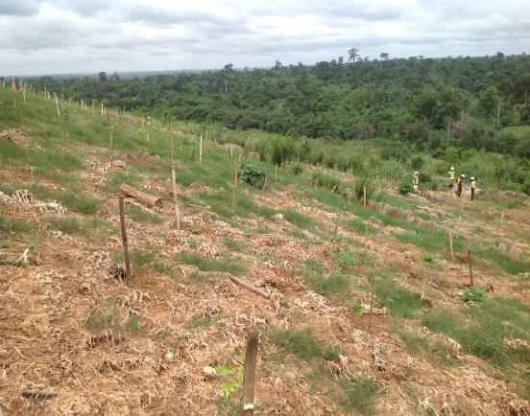
Tree planting
15 seedlings each of:
Terminalia superba,
Terminalia ivorensis,
Cedrela odorata;
together with
9 seedlings each
Mansonia altissima, and
Kola gigantea,
planted at 3m by 3m in May, 2016 (planting stock of 1,100 trees/ha).

Slide 16
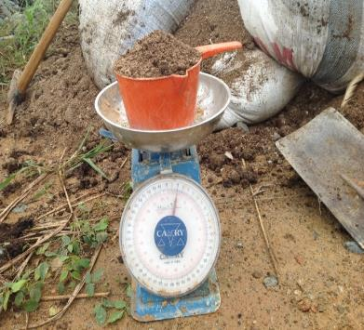
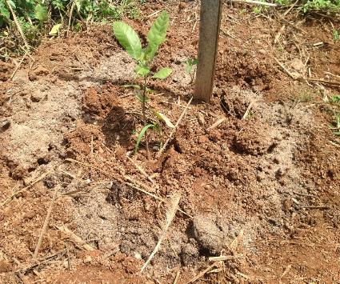
Application of organic amendment
1 kg PLM and 0.5 kg CSS per tree

Slide 17
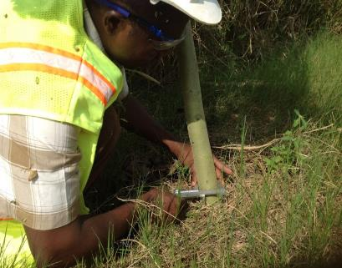
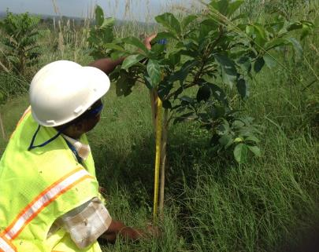
Measurement of tree diameter and height
Measuring tree diameter.
Measuring tree height.

Slide 18
Data analyses
All statistical analyses performed SPSS with Statistics Version 25.0.
The first hypothesis was tested using the independent samples t-test (n = 3) by comparing soil parameters (dependent variables) of TSP and REF, at 95% confidence interval (α = 0.05).
The second hypothesis, was tested by means of One-Way ANOVA combined with LSD and Duncan post-hoc multiple comparisons (α = 0.05).

Slide 19
Results: Effect of stockpiling on soil properties
Parameter | TSP | REF | P value
pH | 6.2 (0.19) | 5.5 (0.03)
EC (µS cm⁻¹) | 407.30 (80.64) a | 228.30 (1.53) b | 0.018
N (%) | 0.11 (0.01) a | 0.07 (0.002) b | 0.001
P (%) | 0.31 (0.001) a | 0.31 (0.002) a | 1.000
K (Cmol_{c} kg⁻¹) | 0.04 (0.00) b | 0.08 (0.006) a | 0.001
Mg (Cmol _{c} kg⁻¹) | 0.57 (0.63) a | 0.67 (0.10) a | 0.725
Ca (Cmol _{c} kg⁻¹) | 6.80 (1.09) b | 9.80 (0.40) a | 0.012
Na (Cmol _{c} kg⁻¹) | 0.71 (0.22) a | 0.98 (0.01) a | 0.099
H (Cmol _{c} kg⁻¹) | 0.65 (0.23) a | 0.40 (± 0.04) a | 0.143
Al Cmol _{c} kg⁻¹) | 0.34 (0.13) a | 0.39 (0.08) a | 0.435
ECEC(Cmol _{c} kg⁻¹) | 9.91 (0.24) b | 12.32 (0.07) a | 0.001
Base saturation (%) | 82.69 (9.45) a | 93.56 (0.37) a | 0.118
OM (%) | 6.20 (0.08) a | 5.80 (0.01) b | 0.003
OC (%) | 3.60 (0.04) a | 3.40 (0.01) b | 0.002
C/N Ratio | 32.29 (2.5) b | 50.96 (1.2) a | 0.001
bulk density (g cm⁻³) | 1.53 (0.03) a | 1.32 (0.01) b | 0.001
Sand (%) | 40.75 (2.79) b | 57.74 (0.45) a | 0.001
Silt (%) | 27.99 (2.16) a | 16.08 (0.71) b | 0.001
Clay (%) | 31.26 (1.05) a | 26.52 (0.41) b | 0.001
Texture | Clay-loam | Sandy clay-loam

Slide 20
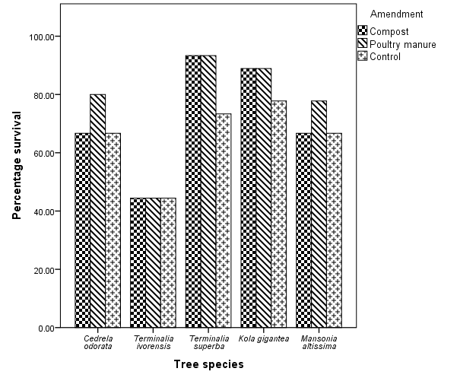
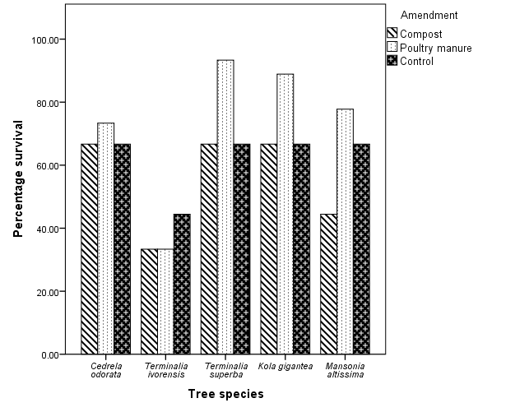
Effect of organic amendment on tree survival
7-months after planting
14-months after planting

Slide 21
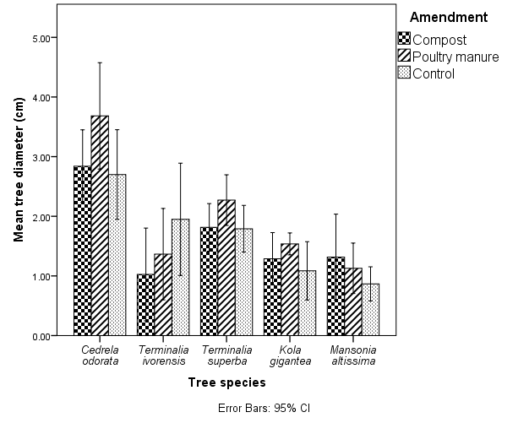
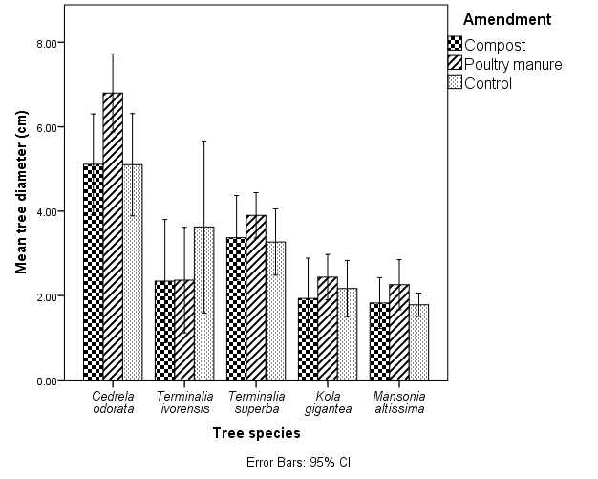
Effect of organic amendment on diameter growth
7 months
14 months

Slide 22
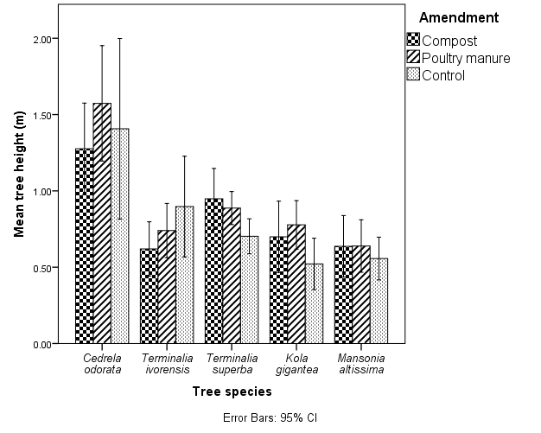
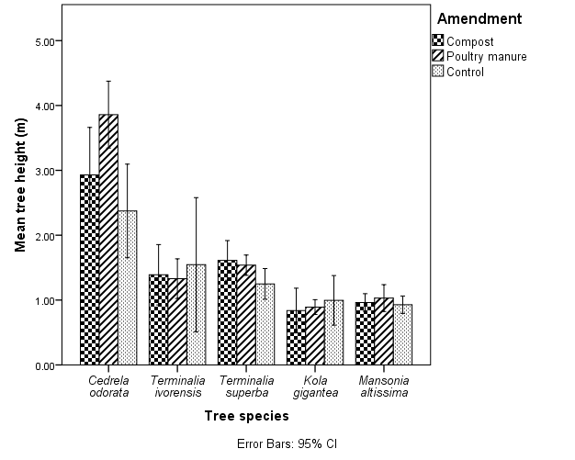
Effect of organic amendment on height growth
7 months
14 months

Slide 23
Discussion
Contrary to previous studies (Akala and Lal, 2000; Harris et al. 1989; Visser et al, 1984; Abdul and McRae, 1984) and the first hypothesis, stockpiling did not cause any significant adverse impacts on soil properties compared to reference site.
Soil OM, nutrients and pH, which have been described as the most important determinants of the suitability of a site for restoration (Bending et al.1999) were all optimum.
TSS texture of Clay-loam with a bulk density of 1.5 g/cm³ were ideal for crop production (Hazleton and Murphy 2007; Brady and Weil 2008).
These findings were mainly attributed to effective topsoil management technique adopted by NGGL such as:
Double stripping of topsoil and separation of topsoil from subsoil.
Installation of BGTs.
Seeding with deep-rooted perennial plants.
Absence of tillage or cultivation within stockpiling period.

Slide 24
Effect of amendment on tree survival and growth
Again, no significant effect of amendment on tree survival and growth was observed, thus falsifying the second hypothesis.
This was attributed:
Mainly to the effective topsoil management technique adopted by NGGL that resulted in optimum conditions of the stockpiled topsoil.
Partly to the low application rate of amendment materials (Chantigny et al. 1999).

Slide 25
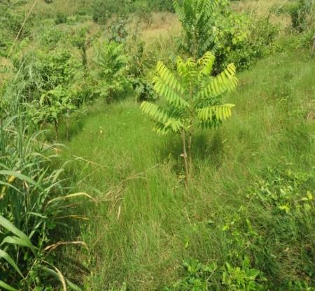
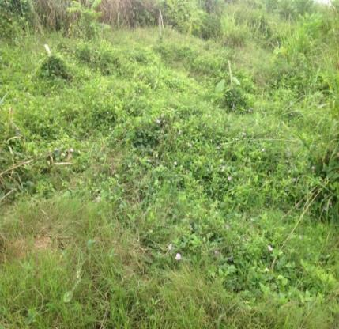
Competition from herbaceous ground cover affected tree survival and growth
Burger et al., 2005 (FRA and GRA)

Slide 26

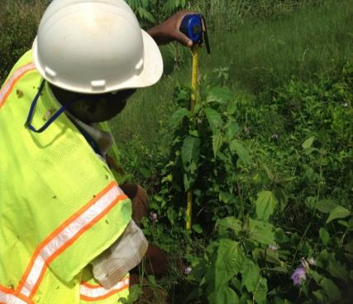
Effect of ground cover competition on tree growth
Low competition, fast growth
High competition, slow growth
Terminalia superba = 0.96 m
Terminalia superba = 0.72 m

Slide 27
Conclusions
Contrary to our expectations and the first hypothesis, topsoil stockpiling did not cause any significant adverse impacts on soil properties.
This was attributed:
Mainly to effective topsoil management technique adopted by NGGL that resulted in optimum conditions of the TSS (pH, OM, nutrients, texture and bulk density).
Similarly, there was no significant effect of organic amendment on survival and tree growth, thus defeating the second hypothesis.
This was ascribed:
Mainly to the optimum conditions of the stockpiled topsoil, which was the same in all treatment plots, and
Partly to Low application rate of amendment materials, dictated by the optimum substrate conditions.

Slide 28
Conclusions
Competition from herbaceous plants due to ineffective weed control was the main driving factor hindering survival and growth of planted trees.
Therefore, planting the intended tree species concurrently with ground cover species in the first growing season combined with adequate weed control to influence tree growth and survival at the site, rather than the application of organic amendments, is warranted.
Even so, a policy on TSP and re-application of same as being implemented by NGGL must be in place for all mining companies in Ghana to ensure successful reclamation.

Slide 29
THANK YOU

