Slide 1
Reclamation Soil Stockpiles: What happens to the plant community?
Jennifer Buss MSc Student
Supervisor: Dr. Brad Pinno

Slide 2
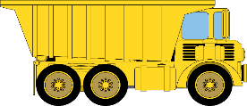
Background
Notes:
Soil stockpiles are created from mining and industrial activities. The first step in surface mining is to strip away any vegetation and soil above the deposit (Wu, 2015). Stockpiled somewhere closeby, for future use in reclamation

Slide 3
Background
Notes:
Soil stockpiles are created from mining and industrial activities. The first step in surface mining is to strip away any vegetation and soil above the deposit (Wu, 2015). Stockpiled somewhere closeby, for future use in reclamation

Slide 4
Background
Notes:
Soil stockpiles are created from mining and industrial activities. The first step in surface mining is to strip away any vegetation and soil above the deposit (Wu, 2015). Stockpiled somewhere closeby, for future use in reclamation

Slide 5
Background
Notes:
Soil stockpiles are created from mining and industrial activities. The first step in surface mining is to strip away any vegetation and soil above the deposit (Wu, 2015). Stockpiled somewhere closeby, for future use in reclamation

Slide 6
Background
Notes:
Soil stockpiles are created from mining and industrial activities. The first step in surface mining is to strip away any vegetation and soil above the deposit (Wu, 2015). Stockpiled somewhere closeby, for future use in reclamation

Slide 7
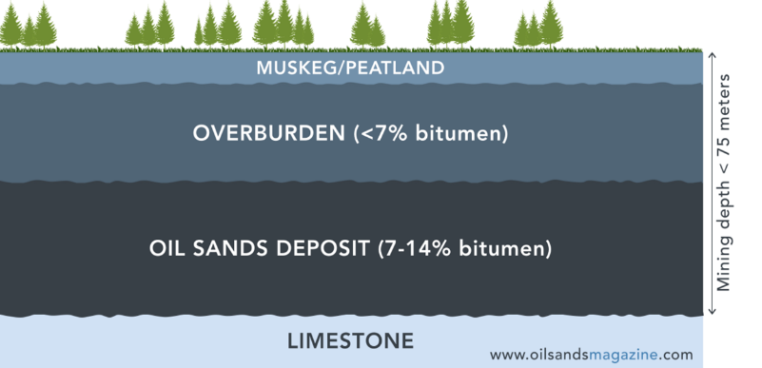
Background
Seed density
Microbial activity
Nutrient cycling
TOPSOIL/COVERSOIL (top 15-30cm)
Adapted from:

Slide 8
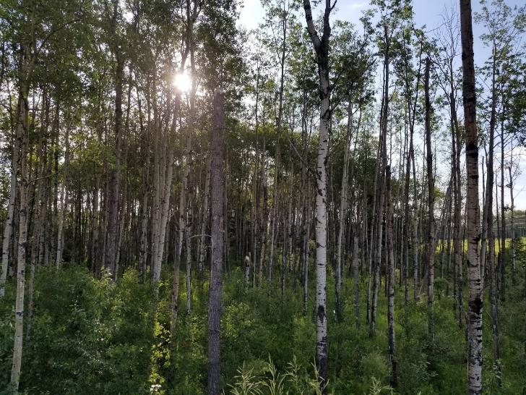
Background
Goal is to restore to a diverse native plant community
Stockpiles low in plant propagules
Direct placement

Slide 9
Background
Direct Placement
Notes:
Soil stockpiles are created from mining and industrial activities. The first step in surface mining is to strip away any vegetation and soil above the deposit (Wu, 2015). Stockpiled somewhere closeby, for future use in reclamation

Slide 10
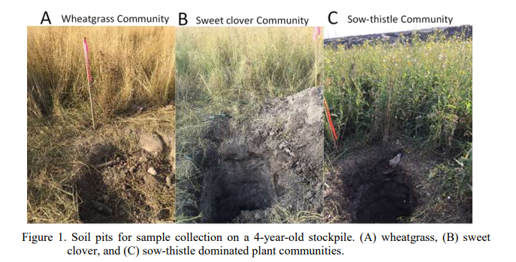
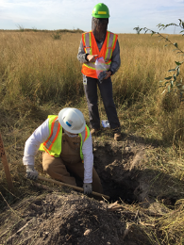
Stockpile Project
Stockpile Project: Creating Ecologically Viable Soil Stockpiles for Future Reclamation
EST 2017
Buss and Pinno 2019
Notes:
Been apart of the GERI project since 2017
Terrible name, but basically just trying to help create ecologicaly viable stockpiles for future reclamation
We have/had 3 members
1 looking at soil physical properties, 1 at microbial communities, and meee looking at plant communities

Slide 11
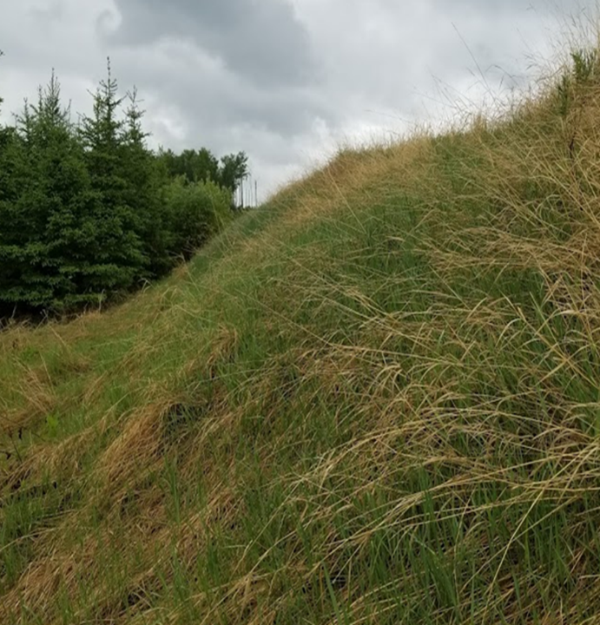
PLANTS
Plant Communities
What plants are growing on the stockpile
And what plants will grow (SEEDBANK)
Will give us an idea of what will grow once stockpile is placed on a reclamation site

Slide 12
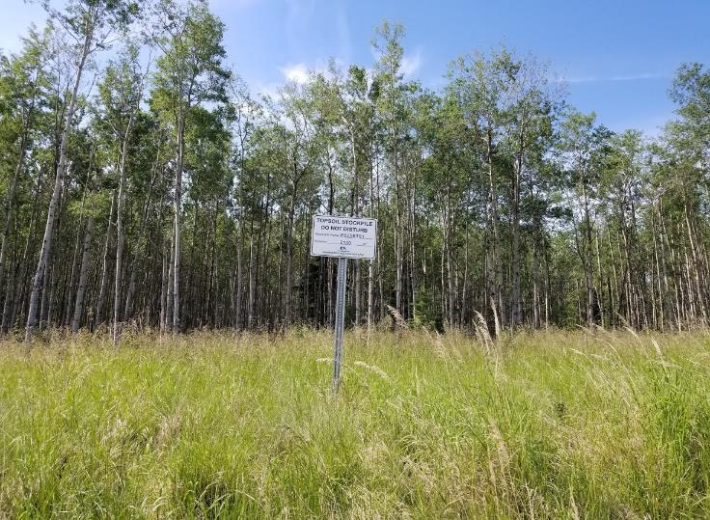
Changes due to stockpiling
in bulk density
in aggregate stability
in compaction
in ammonium
Initial of mycorrhizal fungi
earthworms
Notes:
Aggregate stability=ability of soil aggregates to resist disruption when outside forces are applied. So if aggregate stability is decreased, the pore spaces between aggregates, which allow retention and exchange of air and water, could become sealed/clogged etc, and therefore it is harder for water to get to plants and for roots to grow (grow in zones of weakness in pore space).

Slide 13
Changes to the seedbank
Seed viability with depth and stockpile age due to:
Germination
Predation
Fungal pathogens
Lack of input
Buss & Pinno 2019
Notes:
We know seeds are going to be on the surface. Just a matter of where? Most studies only specific to 10cm.
2017 did a study and found that most seeds were in top 10cm, and we had mostly native species regardless of what species was the most abundant on the surface

Slide 14
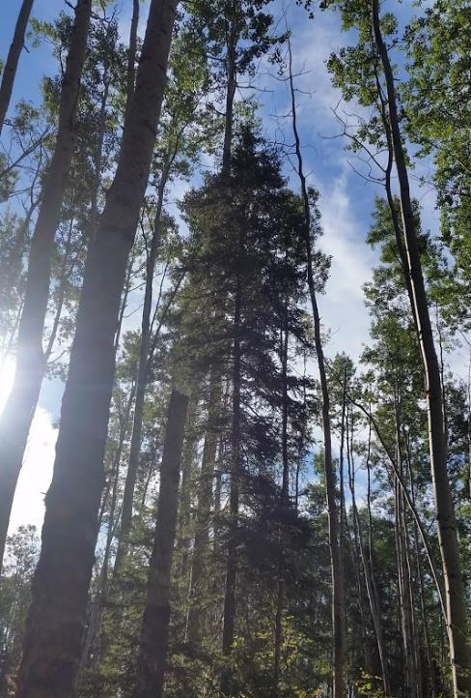
What about undisturbed forests?
in viable seeds with depth also occurs in undisturbed forest sites
Problem is of viable seeds over time

Slide 15
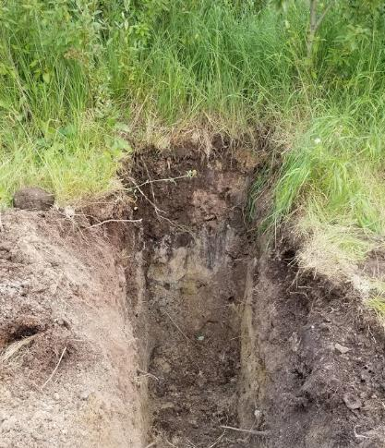
Research Questions
Where are the majority of the viable seeds in soil stockpiles?
Do older stockpile plant communities closer resemble natural forest communities?
Does the relationship between the above ground plant community and seed bank community change with site age?

Slide 16
Methods
Horizon
2 sites
Horizon= oil sands
Wolf Lake= thermal insitu oil sands (cyclic steam stimulation)
Wolf Lake

Slide 17
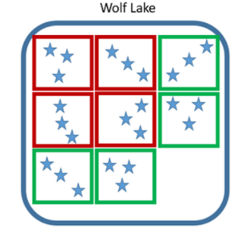
Methods
4 stockpiles/ site
Each a different age
Mature sites sampled near stockpiles

Slide 18
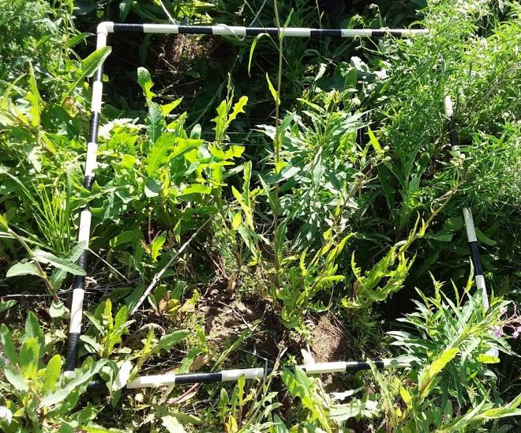
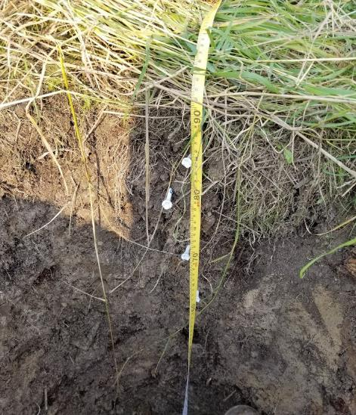
Methods

Slide 19
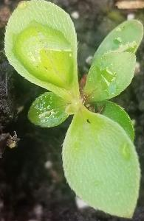
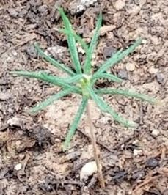
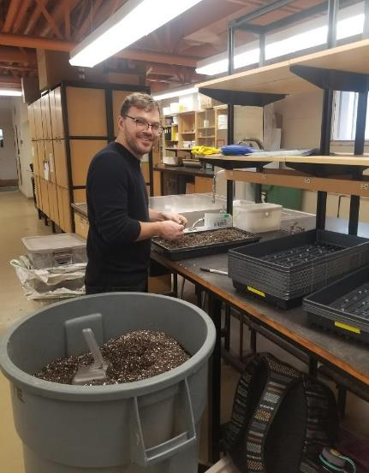
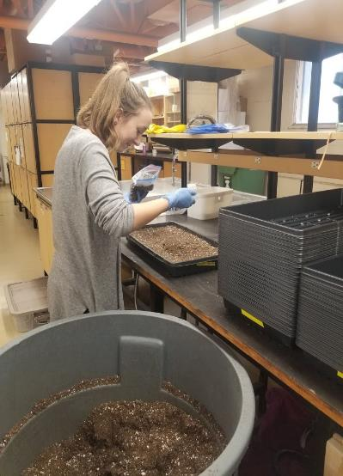
Methods

Slide 20
Methods

Slide 21
Results
a)
b)
Litter Layer
Fig. 1. Relative Seedling Abundance for stockpile (a) and mature sites (b). Different colours represent different functional groups. ES = early successional, LS= late successional.
Notes:
Soil stockpiles are created from mining and industrial activities. The first step in surface mining is to strip away any vegetation and soil above the deposit (Wu, 2015). Stockpiled somewhere closeby, for future use in reclamation

Slide 22
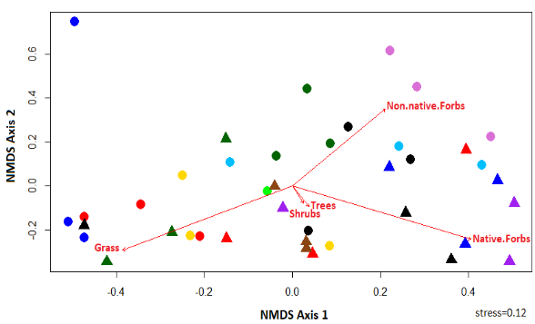
Results
a)
Above ground
b)
Seed bank
Fig 3. 2D NMDS of aboveground plant community functional group cover (a) and the surface seed bank functional groups (b). Color represents site name. Triangles represent mature sites and circles stockpile sites. Vectors represent the influence of functional group cover. Variance explained by 2 axes is 63% and 28% respectively.
Notes:
Soil stockpiles are created from mining and industrial activities. The first step in surface mining is to strip away any vegetation and soil above the deposit (Wu, 2015). Stockpiled somewhere closeby, for future use in reclamation

Slide 23
Results
a)
Above ground
b)
Seed bank
Fig 3. 2D NMDS of aboveground plant community functional group cover (a) and the surface seed bank functional groups (b). Color represents site name. Triangles represent mature sites and circles stockpile sites. Vectors represent the influence of functional group cover. Variance explained by 2 axes is 63% and 28% respectively.
Notes:
Soil stockpiles are created from mining and industrial activities. The first step in surface mining is to strip away any vegetation and soil above the deposit (Wu, 2015). Stockpiled somewhere closeby, for future use in reclamation

Slide 24
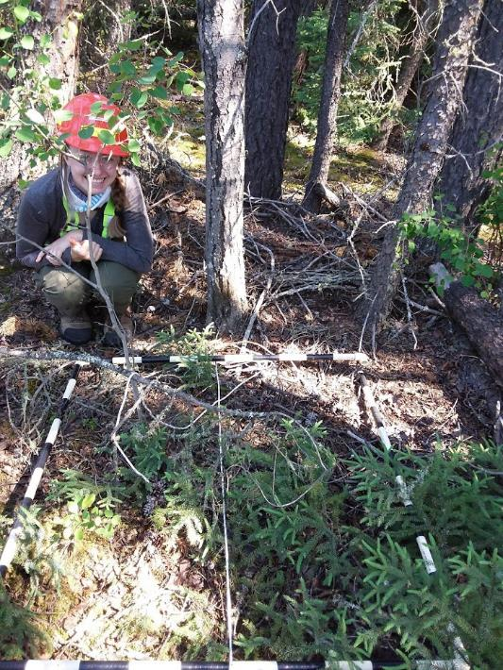
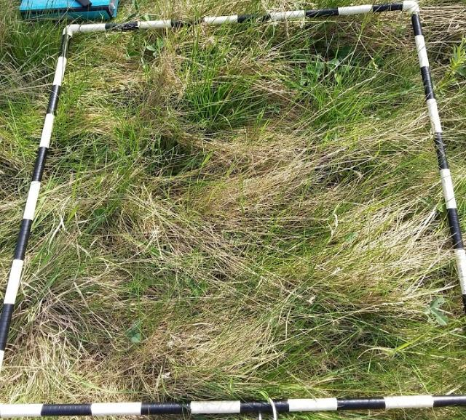
Results
Above ground
Notes:
Soil stockpiles are created from mining and industrial activities. The first step in surface mining is to strip away any vegetation and soil above the deposit (Wu, 2015). Stockpiled somewhere closeby, for future use in reclamation

Slide 25
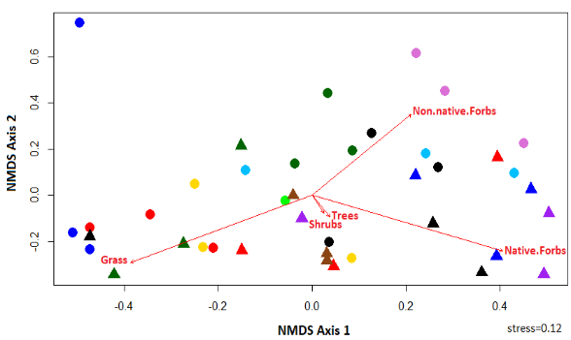
Results
a)
Above ground
b)
Seed bank
Fig 3. 2D NMDS of aboveground plant community functional group cover (a) and the surface seed bank functional groups (b). Color represents site name. Triangles represent mature sites and circles stockpile sites. Vectors represent the influence of functional group cover. Variance explained by 2 axes is 63% and 28% respectively.
Notes:
Soil stockpiles are created from mining and industrial activities. The first step in surface mining is to strip away any vegetation and soil above the deposit (Wu, 2015). Stockpiled somewhere closeby, for future use in reclamation

Slide 26
Results
Sorensen’s index:
Similarity index
Presence/absence data
Between 0 and 1
1 = the two communities share all species
Excluding rare species
Fig 2. Sorensen’s index per site. Species with low abundances were excluded.
Notes:
Soil stockpiles are created from mining and industrial activities. The first step in surface mining is to strip away any vegetation and soil above the deposit (Wu, 2015). Stockpiled somewhere closeby, for future use in reclamation

Slide 27
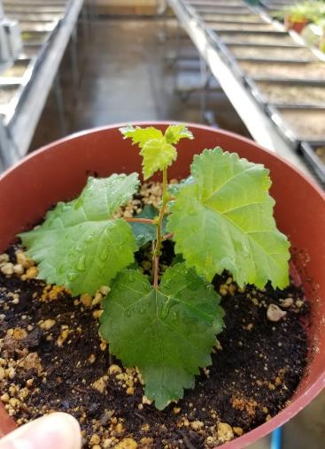
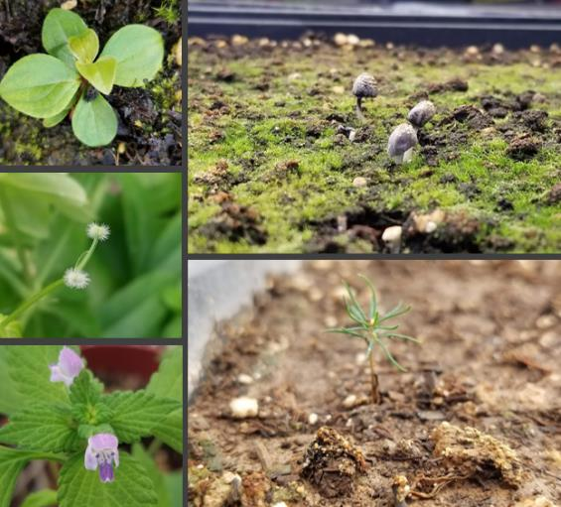
Conclusions
Shorter stockpiles
Salvage from a shallower depth
Planting trees/shrubs/late successional forbs on reclamation sites
Notes:
Soil stockpiles are created from mining and industrial activities. The first step in surface mining is to strip away any vegetation and soil above the deposit (Wu, 2015). Stockpiled somewhere closeby, for future use in reclamation

Slide 28
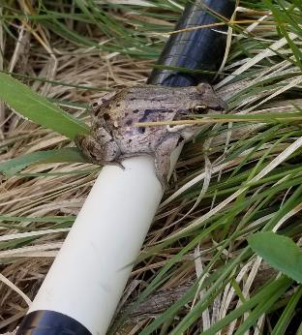
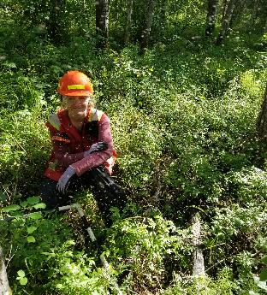
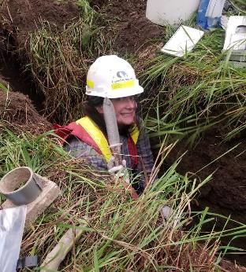
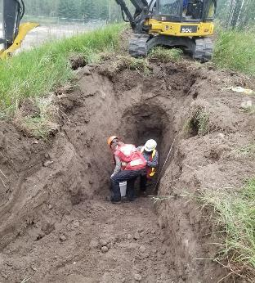
Thank you
Silviculture lab group
Soil Biogeochemistry lab group
Notes:
Soil stockpiles are created from mining and industrial activities. The first step in surface mining is to strip away any vegetation and soil above the deposit (Wu, 2015). Stockpiled somewhere closeby, for future use in reclamation

Slide 29
Seedling abundance over time
Notes:
Soil stockpiles are created from mining and industrial activities. The first step in surface mining is to strip away any vegetation and soil above the deposit (Wu, 2015). Stockpiled somewhere closeby, for future use in reclamation

Slide 30
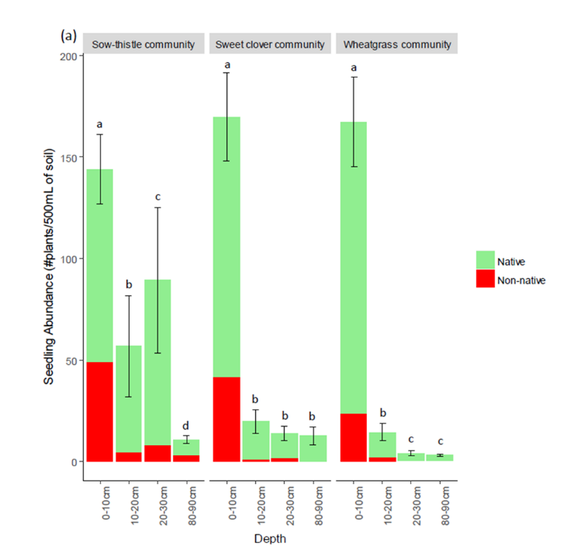
Seedling abundance over time
Notes:
Soil stockpiles are created from mining and industrial activities. The first step in surface mining is to strip away any vegetation and soil above the deposit (Wu, 2015). Stockpiled somewhere closeby, for future use in reclamation

Slide 31
Seedling abundance over time
Notes:
Soil stockpiles are created from mining and industrial activities. The first step in surface mining is to strip away any vegetation and soil above the deposit (Wu, 2015). Stockpiled somewhere closeby, for future use in reclamation

Slide 32
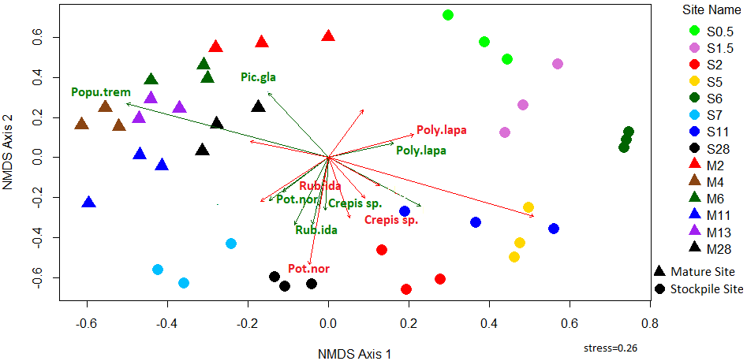
Direct Gradient Analysis
Notes:
Soil stockpiles are created from mining and industrial activities. The first step in surface mining is to strip away any vegetation and soil above the deposit (Wu, 2015). Stockpiled somewhere closeby, for future use in reclamation

