Slide 1
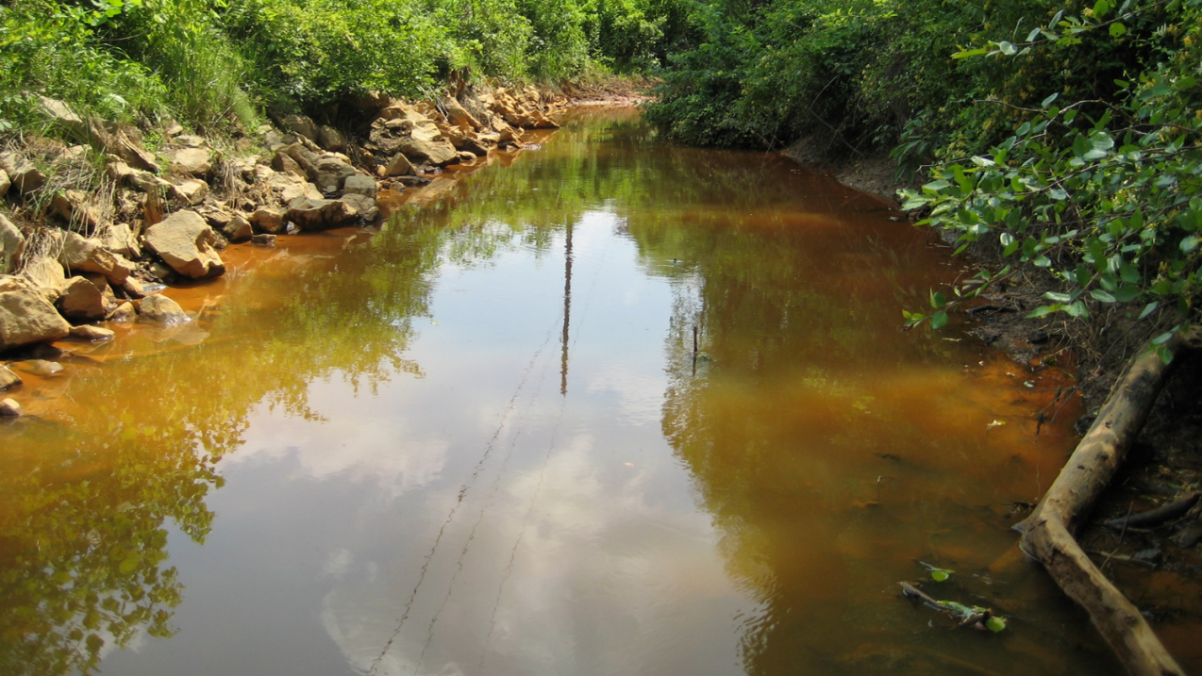
Effects of Precipitation Patterns on Sediment, Nutrient, and Biofilm Dynamics in an AMD Stream
Jennie Brancho and Dr. Natalie Kruse Daniels

Slide 2
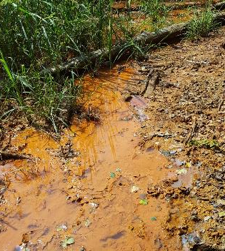
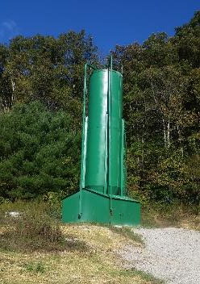
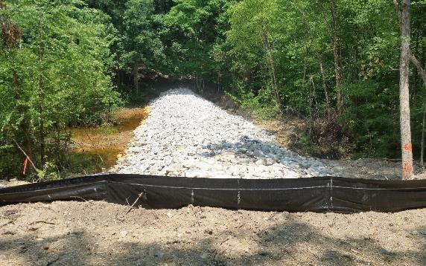
AMD Overview
Formed when pyrite (FeS₂) interacts with water and oxygen
Harmful to aquatic life
Treatment goal: reduce stream acidity and maintain pH > 6 .5
Active systems (i.e. dosers)
Passive systems (i.e. wetlands)
Notes:
Formed when pyrite (FeS₂) interacts with water and oxygen
Forms iron hydroxide (Fe(OH)₃), sulfate, and hydrogen ions
Acidity leaches other metals from surrounding rocks (i.e. Al)
Harmful to aquatic life
Direct and indirect effects
Treatment goal: reduce stream acidity and maintain pH > 6 .5
Active systems (i.e. dosers)
Passive systems (i.e. wetlands)

Slide 3
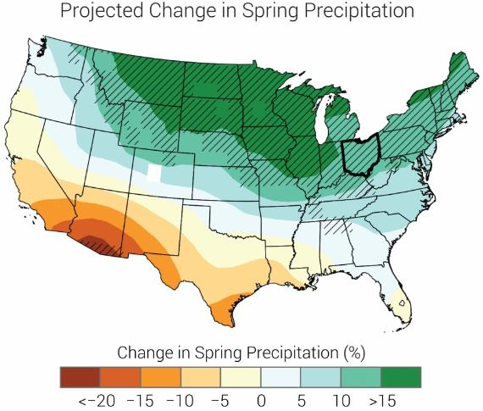
Storm Projections and AMD
Three behaviors, depending on site and storm duration
Sparing
Flushing
Normal
Other impacts: sediment scouring, nutrient inputs, sediment and nutrient export
Images retrieved from: NOAA National Centers for Environmental Information

Slide 4
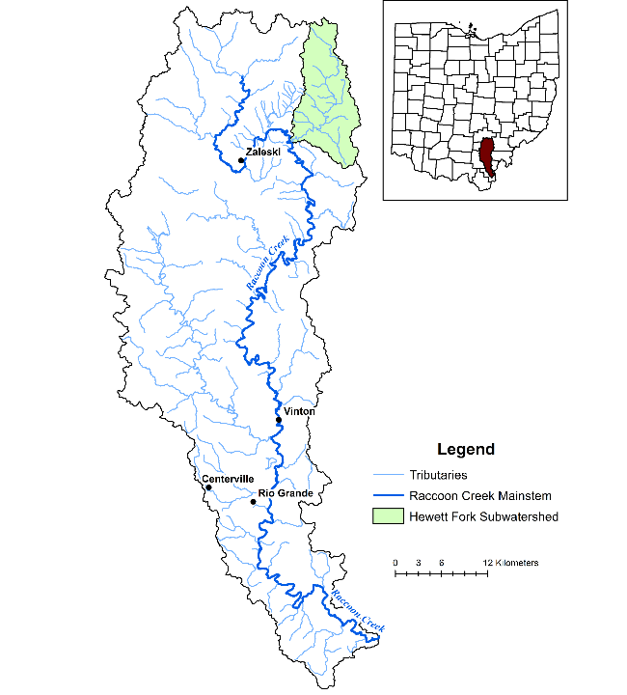
Hewett Fork
Subwatershed in Raccoon Creek

Slide 5
Land Use in Hewett Fork

Slide 6
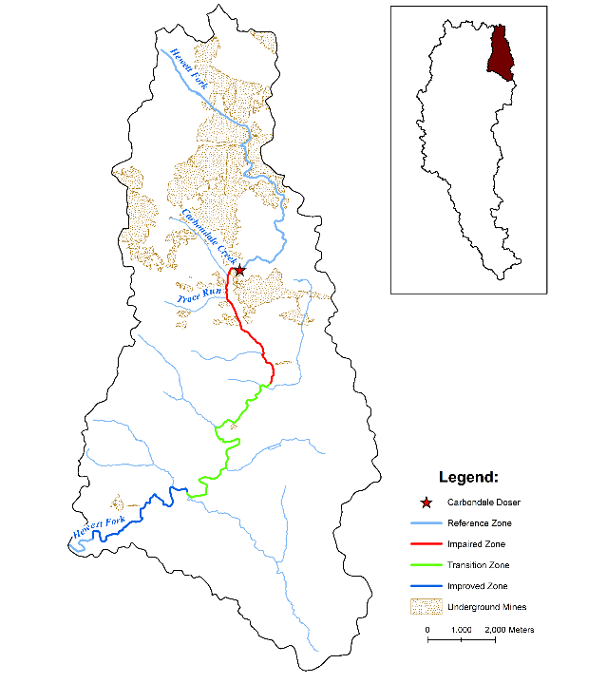
Water Quality in Hewett Fork
Three sources of AMD before doser
Zones of water quality
Impaired
Transition
Improved

Slide 7
Hypotheses
Storms:
Increase sediment transport
Lower nutrient concentrations and biofilm abundance
Water quality improvement:
Decrease sediment transport
Increase biofilm abundance
No change in nutrient concentrations
Phosphorus unavailable in impaired zone

Slide 8
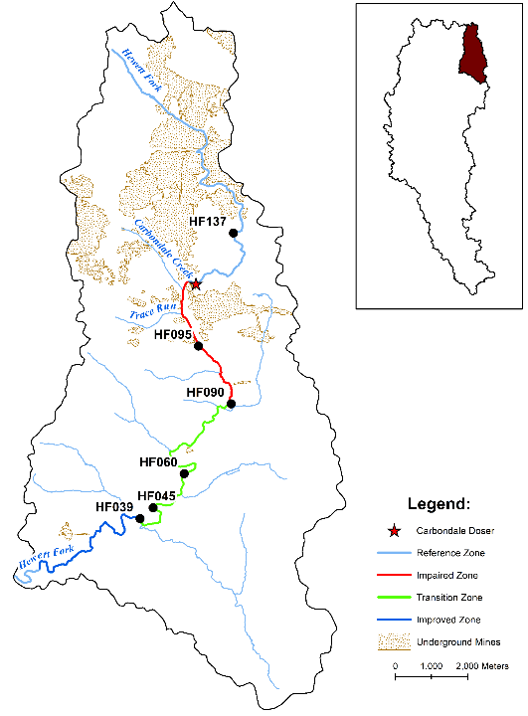
Hewett Fork
Sampling sites

Slide 9
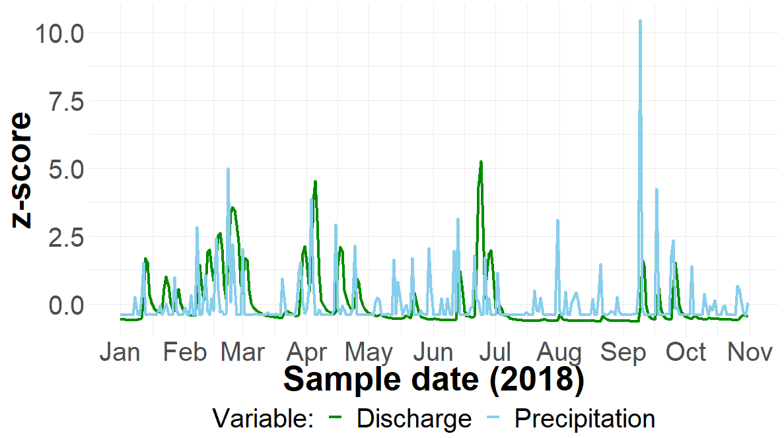
Methods
Sampling schedule:
Storms - 1 cm or more rainfall over a consecutive 3-day period
Sample 3 days after end
Normal conditions
Sampled weekly

Slide 10
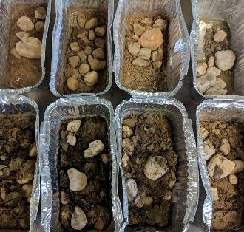
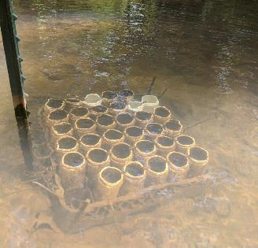
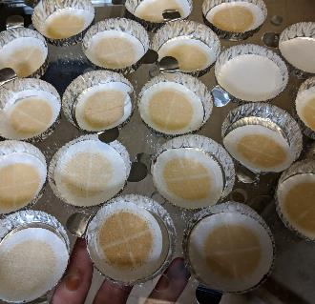
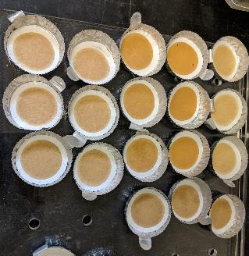
Methods
Field parameters
Sediment deposition – traps
Dry weight
Grain size analysis
Sediment transport – total suspended solids (TSS)

Slide 11
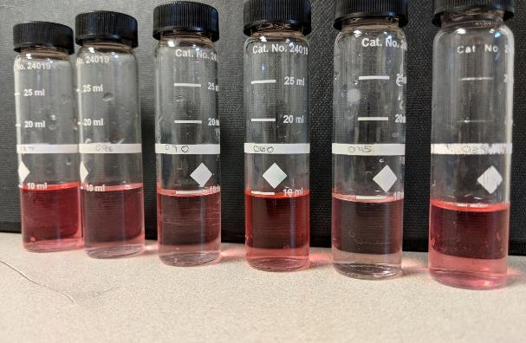
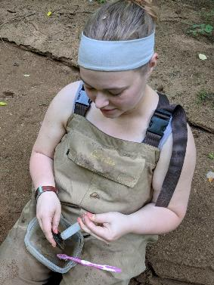
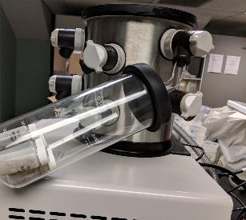
Methods
Biofilm abundance – benthic chlorophyll a
Nutrient concentrations – nitrate, sulfate, total reactive phosphorus
HACH colorimeter, spectrophotometer

Slide 12
Data Analysis
Couple results with other long-term data sources:
USGS discharge data for Bolins Mill gauge station, Raccoon Creek watershed
Weather data from Ohio University’s Scalia Lab
Water chemistry data from the Appalachian Watershed Research Group
Analysis using R:
Hydrographs
Time-series
Relative chlorophyll a between sites
Antecedent precipitation index (API)

Slide 13
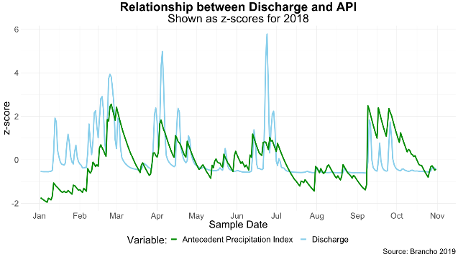
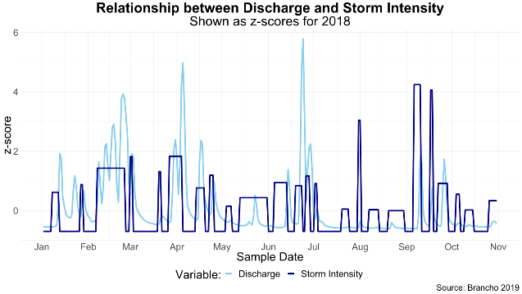
Antecedent Precipitation Index
API_{d} = k(API_{d-1}) + P_{d}

Slide 14
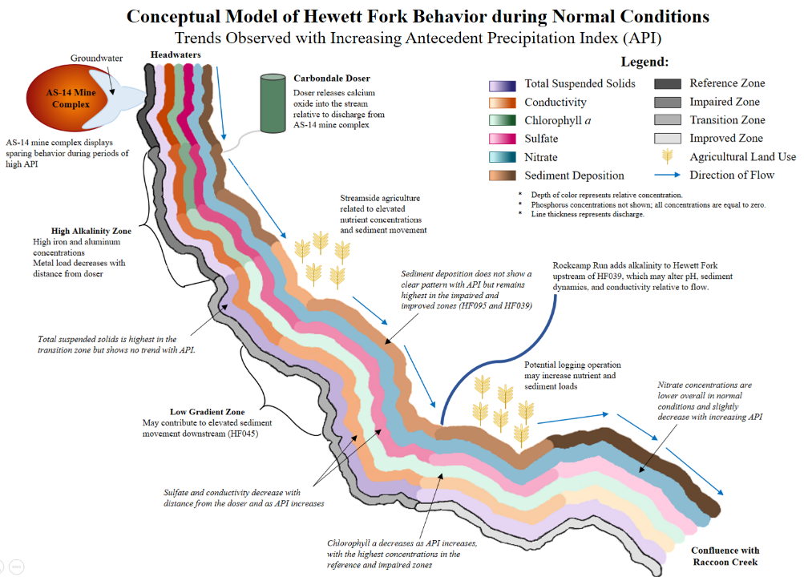

Slide 15
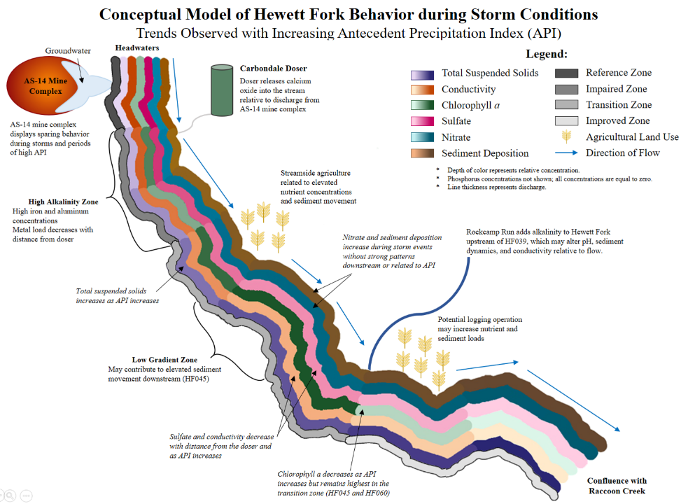

Slide 16
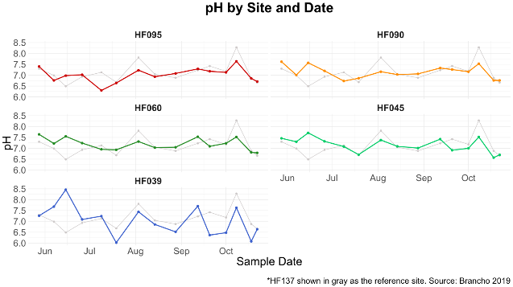
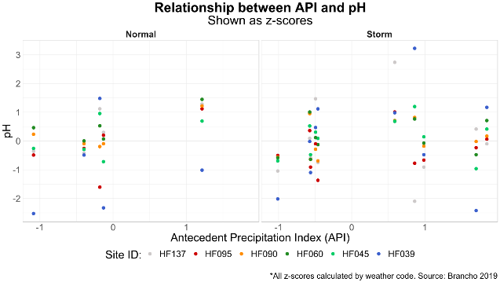
pH
Similar pattern at all sites
Highest variation at HF039
No pattern with API or weather

Slide 17
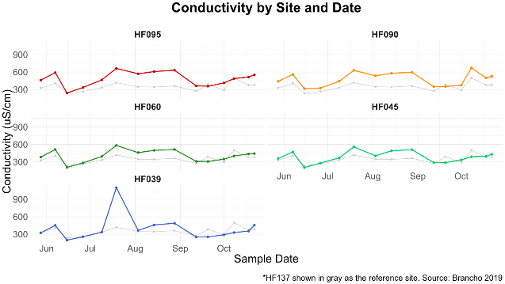
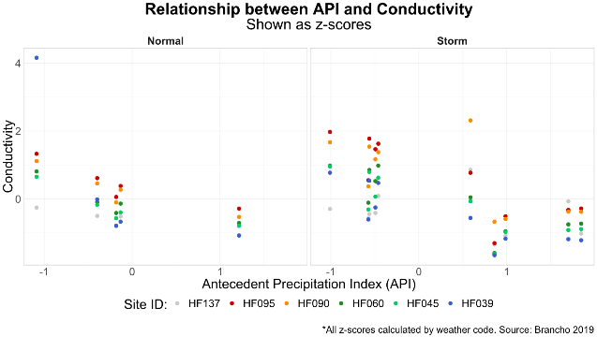
Conductivity
Similar pattern at all sites
Decreases with API and water quality improvement

Slide 18
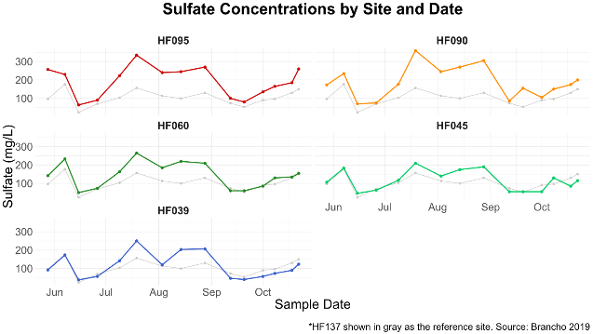
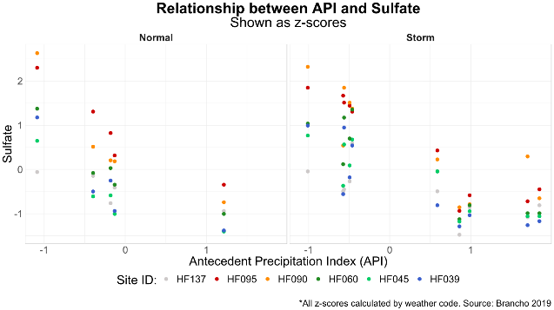
Sulfate
Similar pattern at all sites
Decreases with API and water quality improvement

Slide 21
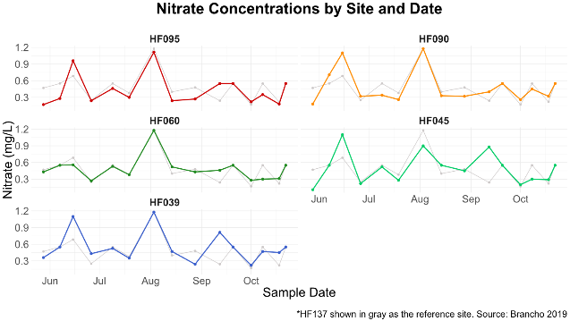
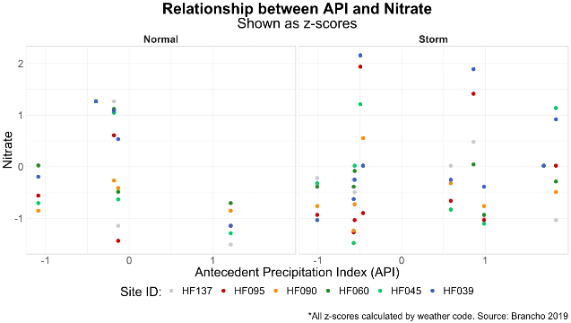
Nitrate
Similar pattern at all sites until fall
No pattern with API
Overall slightly higher in storms

Slide 22
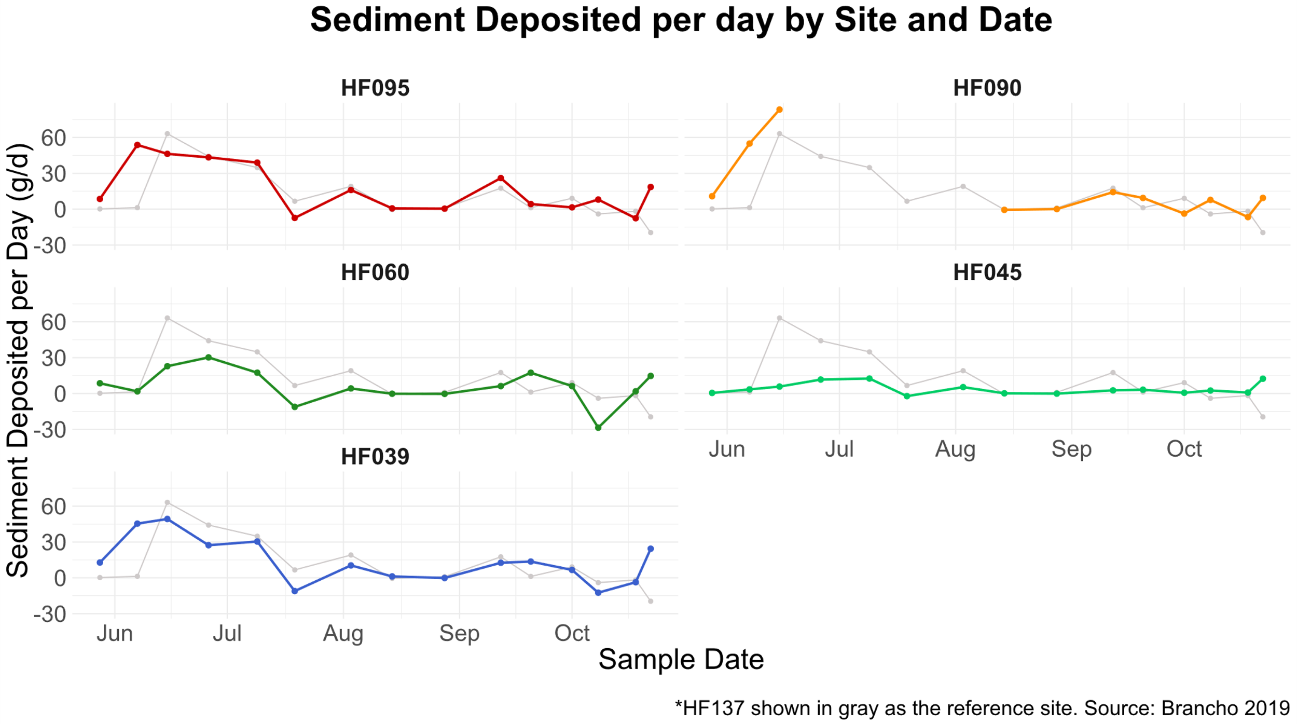
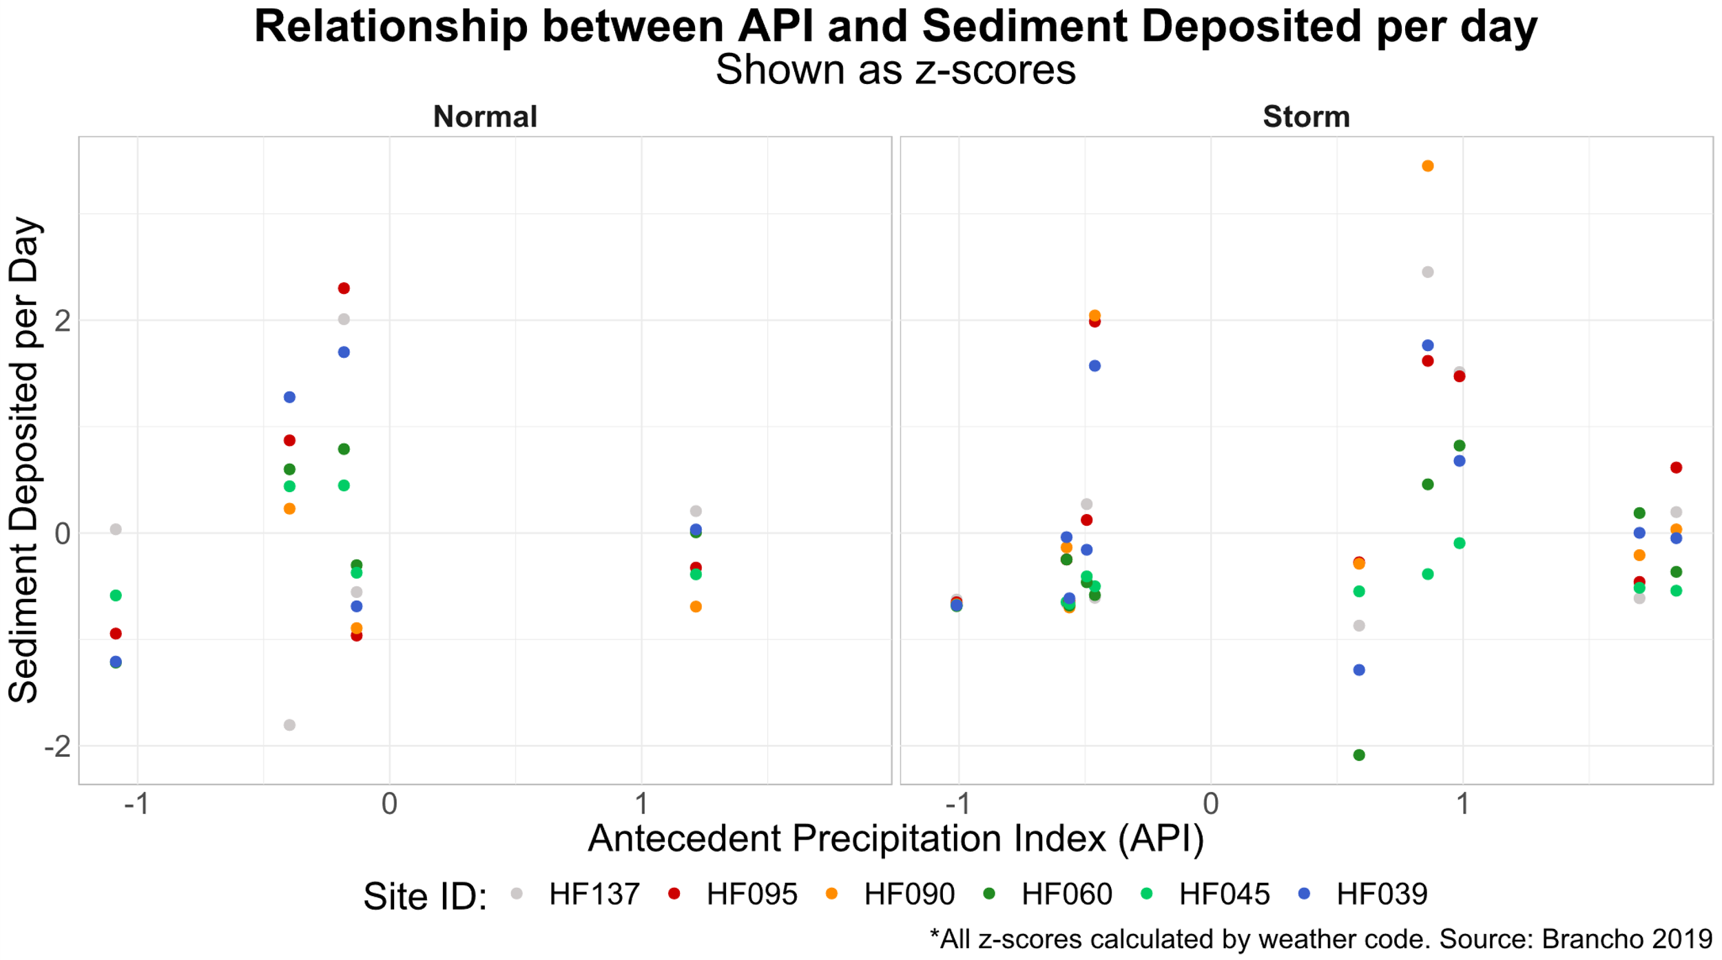
Sediment Deposition
Same pattern at all sites except HF045
No pattern with between sites or API
Slightly higher in storms

Slide 25
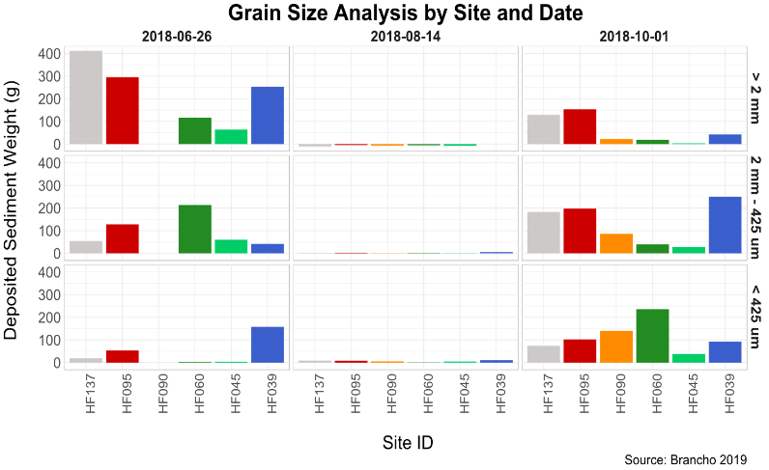
Grain Size Distribution of Deposited Sediment
Notes:
Change to geom point or geom line – keep each sampling event separate

Slide 26
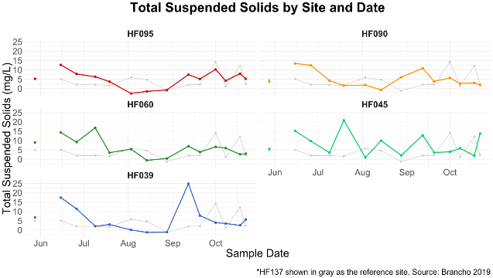
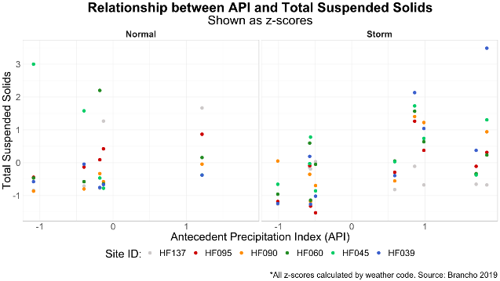
Total Suspended Solids
Different timing of peaks
Relationship with API dependent on weather

Slide 27
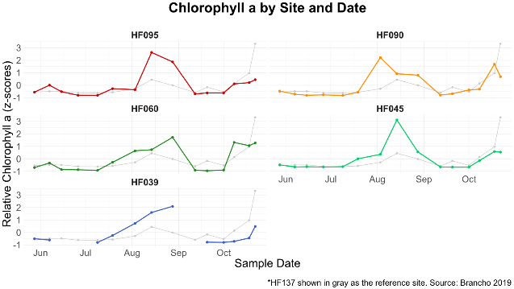
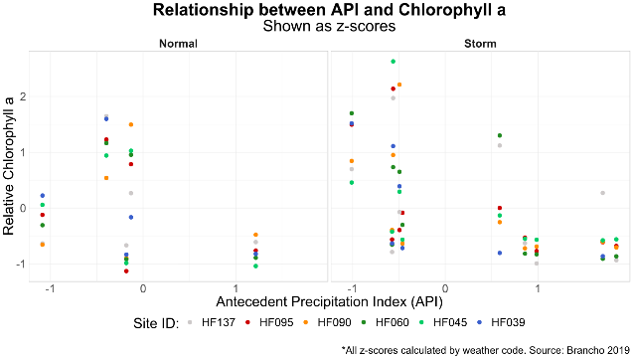
Biofilm Abundance
Different timing of peaks
Seasonal changes
Decreased with increasing API

Slide 30
Seasonal Effects
Yellow = large particles ( > 2 mm)
Purple = Resuspension
Green = Small particles ( < 2 mm)

Slide 31
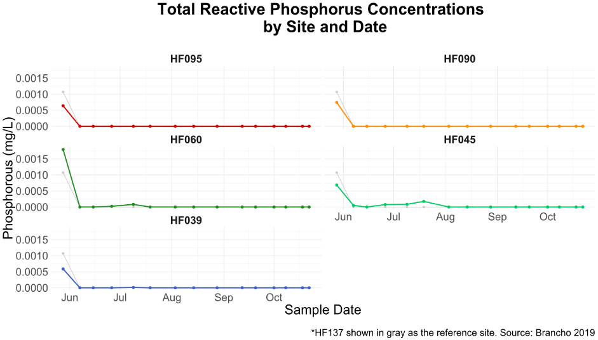
Phosphorous limitation

Slide 32
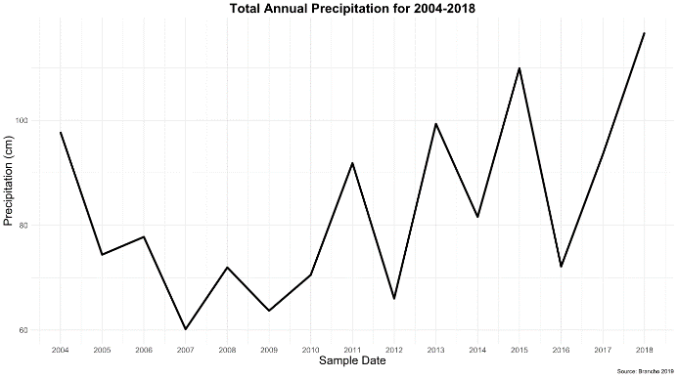
Summary Statistics for Phosphorous Concentrations in Normal Weather Conditions:
Source: | Site ID: | Median: | Mean: | Standard Deviation: | Minimum: | Maximum:
Brancho 2019 | HF137 | 0.00000 | 0.00000 | 0.000000 | 0.00000 | 0.00000
 | HF095 | 0.00000 | 0.00000 | 0.000000 | 0.00000 | 0.00000
 | HF090 | 0.00000 | 0.00000 | 0.000000 | 0.00000 | 0.00000
 | HF045 | 0.00000 | 0.00005 | 0.000078 | 0.00000 | 0.00018
Keil 2016 | HF137 | 0.02000 | 0.01924 | 0.004619 | 0.01429 | 0.02343
 | HF090 | 0.01200 | 0.01276 | 0.002379 | 0.01086 | 0.01543
 | HF045 | 0.01543 | 0.01543 | 0.001143 | 0.01429 | 0.01657
Maj 2016 | HF095 | 0.01000 | 0.00933 | 0.005742 | 0.00000 | 0.02000
 | HF045 | 0.00800 | 0.00733 | 0.004459 | 0.00000 | 0.01600
* Phosphate concentrations not measured by Voinovich School of Leadership and Public Affairs 2015a
Comparison to Previous Studies

Slide 35
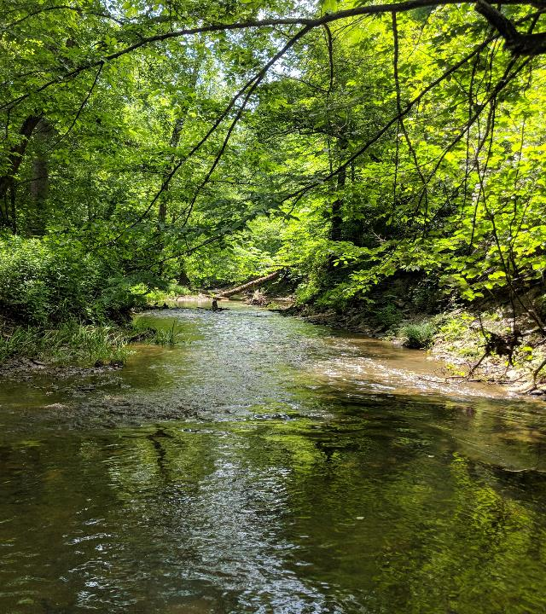
Conclusions
Precipitation patterns as a strong driver of stream characteristics
Other potential stressors in watershed
Future research: long-term effects of observed changes

Slide 36
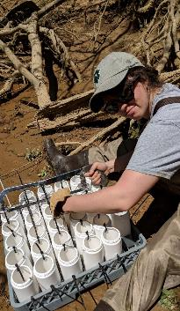
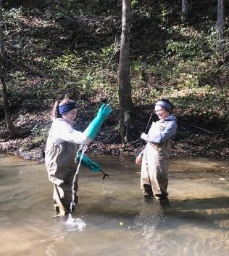
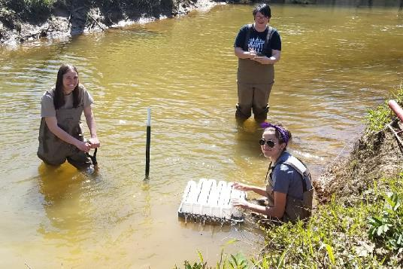
Acknowledgments
Amy Mackey, Raccoon Creek Watershed Coordinator
Dr. Anirudh Ruhil, Professor at Ohio University’s Voinovich School of Leadership and Public Affairs
Emily Keil-Loudner, RCP AmeriCorps (2017-2018)
Abby Costilow, RCP AmeriCorps (2017-2018)
Brooke Sanderson, Middle Tuscarawas River Watershed AmeriCorps
Rebecca Steinberg, MSES candidate
Ian Wentzlaff
Ashley Cobbs, Undergraduate Chemistry student
Andrew Fox, MSES candidate
Annika Gurrola, RCP AmeriCorps (2018-2019)
Nikki Salas, RCP AmeriCorps (2018-2019)
Nora Sullivan, Voinovich School of Leadership and Public Affairs
Andreana Madera, MSES candidate
Support provided by GSS and ODNR and OEPA through the Watershed Support Grant
Notes:
Support coming from ODNR and OEPA (Watershed Support Grant) & GSS

