Slide 1
50 years of AMD Pollution and Remediation at the Anna S Mine, Tioga County, PA
Robert Hedin
Hedin Environmental
Pittsburgh PA

Slide 2
Anna S Mine

Slide 3
Mining and monitoring activities at Anna S Mine
Year | Activity
1890s – 1930s | Underground mining, Bloss seam
1976-1986 | Daylighting, Bloss and Cushing seams
1975-76 | Monitoring, Operation Scarlift
1976-1984 | Monitoring, USGS
1985-1989 | Monitoring, Antrim Mining
1996-2000 | Monitoring, PADEP and BCWA
2004-present | Monitoring, BCWA and HE

Slide 4
 | Period | type | Flow | pH | Acid | Fe | Mn | Al | SO4 | Acid
 |  |  | gpm |  | ----------- mg/L ----------- |  |  |  |  | kg/d
HD | 1975-78 | Pre DL | 438 | 2.8 | 358 | 38 | 4 | na | 475 | 794
HD | 1979-89 | Post DL
HD | 1995-98 | Pre PTS
HD | 2004-18 | PTS
S1 | 1975-78 | Pre DL | 436 | 3.0 | 218 | 13 | 4 | na | 340 | 516
S1 | 1979-89 | Post DL
S1 | 1995-98 | Pre PTS
S1 | 2004-18 | PTS
S2 | 1975-76 | Pre DL | 39 | 3.8 | 39 | <1 | na | na | 96 | 8
S2 | 1980-91 | Post DL
S2 | 1995-98 | Pre PTS
S2 | 2004-18 | PTS

Slide 5
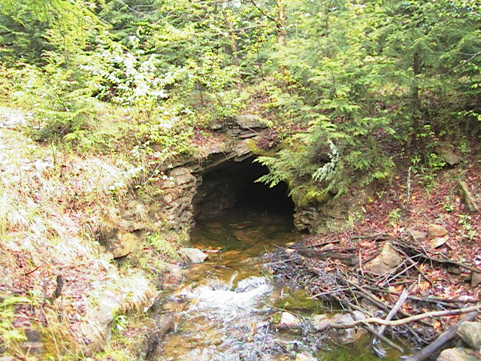

Slide 6
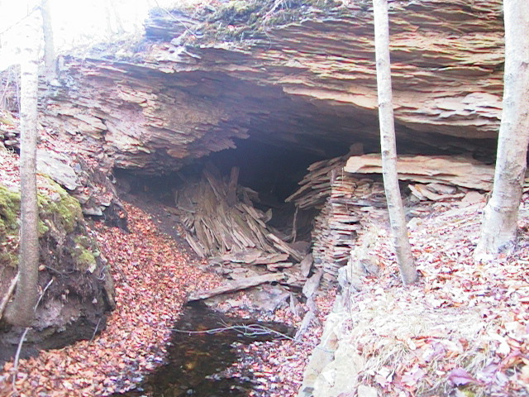

Slide 7
Daylighting / Remining
Removal of stumps from deep mine
Mining of Cushing coal seam above the mine
Existing deep mine discharges avoided
Overburden net acidic
No alkaline addition (pre-ABA requirements)

Slide 8
Daylighting starts
Daylighting ends
Passive Systems installed

Slide 10
 | Period | type | Flow | pH | Acid | Fe | Mn | Al | SO4 | Acid
 |  |  | gpm |  | ----------- mg/L ----------- |  |  |  |  | kg/d
HD | 1975-78 | Pre DL | 438 | 2.8 | 358 | 38 | 4 | na | 475 | 794
HD | 1979-89 | Post DL | 282 | 2.7 | 1000 | 112 | 24 | 74 | 715 | 1361
HD
HD
S1 | 1975-78 | Pre DL | 436 | 3.0 | 218 | 13 | 4 | na | 340 | 516
S1 | 1979-89 | Post DL | 219 | 2.9 | 480 | 38 | 18 | 33 | 704 | 583
S1
S1
S2 | 1975-76 | Pre DL | 39 | 3.8 | 39 | <1 | na | na | 96 | 8
S2 | 1980-91 | Post DL | 28 | 3.0 | 294 | 20 | 21 | 15 | 639 | 47
S2
S2

Slide 11
Consequences of Increased AMD
Severely polluted 6 miles of Babb Creek
Degraded 5 miles of Pine Creek downstream of Babb
1990: Fish Commission found no fish in Babb Creek below Wilson
1990: Babb Creek Watershed Association formed
1996: Babb Creek placed on 303(d) list
1996: Antrim Mining builds lime treatment plant for Antrim discharges
1996: Push to install treatment on Anna S discharges

Slide 12
Daylighting starts
Daylighting ends
Passive Systems installed

Slide 13
 | Period | type | Flow | pH | Acid | Fe | Mn | Al | SO4 | Acid
 |  |  | gpm |  | ----------- mg/L ----------- |  |  |  |  | kg/d
HD | 1975-78 | Pre DL | 438 | 2.8 | 358 | 38 | 4 | na | 475 | 794
HD | 1979-89 | Post DL | 282 | 2.7 | 1000 | 112 | 24 | 74 | 715 | 1361
HD | 1995-98 | Pre PTS | 311 | 2.8 | 491 | 44 | 10 | 36 | 715 | 845
HD | 2004-18 | PTS
S1 | 1975-78 | Pre DL | 436 | 3.0 | 218 | 13 | 4 | na | 340 | 516
S1 | 1979-89 | Post DL | 219 | 2.9 | 480 | 38 | 18 | 33 | 704 | 583
S1 | 1995-98 | Pre PTS | 278 | 3.0 | 271 | 12 | 14 | 16 | 542 | 425
S1 | 2004-18 | PTS
S2 | 1975-76 | Pre DL | 39 | 3.8 | 39 | <1 | na | na | 96 | 8
S2 | 1980-91 | Post DL | 28 | 3.0 | 294 | 20 | 21 | 15 | 639 | 47
S2 | 1995-98 | Pre PTS | 58 | 3.2 | 140 | 2 | 8 | 7 | 286 | 60
S2 | 2004-18 | PTS

Slide 14
Characterize Mine Water
Net alkaline
Net acid
DO, Fe³⁺, Al all < 1 mg/L
(high Fe²⁺)
DO, Fe³⁺, Al any > 1 mg/L
DO, Fe³⁺, Al any > 1 mg/L
Fe < 10 mg/L
Anoxic Limestone Drain
High Fe²⁺
Net
Alkaline
Net acid
Ponds
Ponds
Vertical Flow Pond
Oxic Limestone Bed (drainable)
Repeat As Needed
Wetland
Ponds
Ponds
Mn
Oxic Limestone Bed
Wetland
Mn
Final Discharge

Slide 16
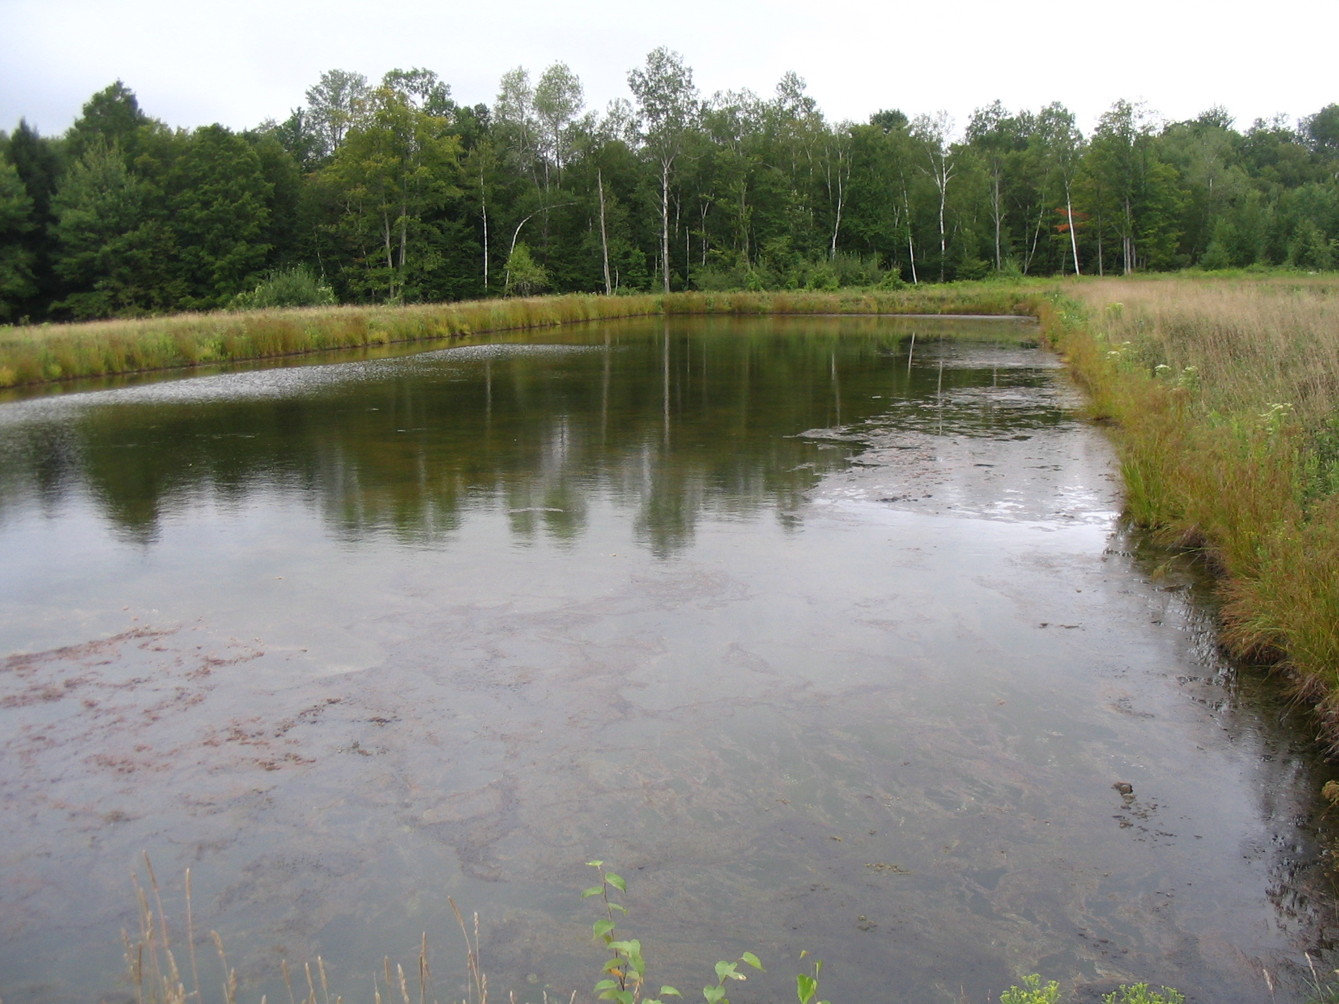

Slide 17
General Site Layout
Treated water to stream
Wetland 3
Wetland 2
Wetland 1
Hunter’s VFPs
Wetland 4
Anna VFPs
VFP8
VFP4
Anna S1
VFP7
VFP3
VFP6
VFP1
VFP2
VFP5
Anna S2
Hunter’s Drift

Slide 18
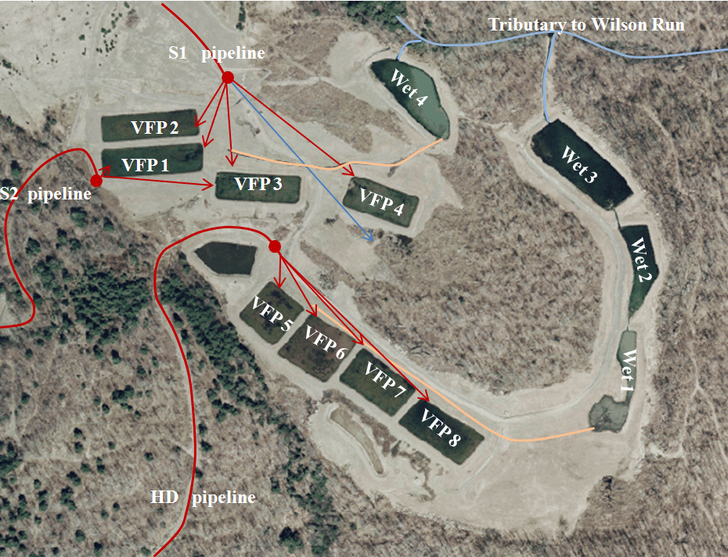

Slide 19
Anna S Mine Complex Passive System
Largest project undertaken by citizen group in PA
$2.5 million (2002) in state, federal, and private funds
Three pipelines totaling 8,000 ft of pipe
8 vertical flow ponds covering 7 acres
  39,000 tons of limestone
  6,500 cubic yards of compost
4 constructed wetlands covering 4 acres

Slide 20
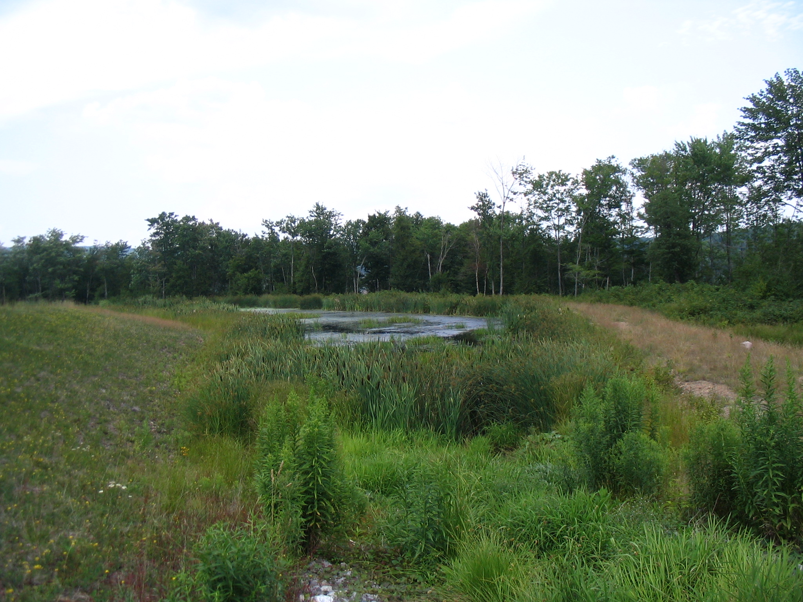

Slide 21
 | Period | type | Flow | pH | Acid | Fe | Mn | Al | SO4 | Acid
 |  |  | gpm |  | ----------- mg/L ----------- |  |  |  |  | kg/d
HD | 1975-78 | Pre DL | 438 | 2.8 | 358 | 38 | 4 | na | 475 | 794
HD | 1979-89 | Post DL | 282 | 2.7 | 1000 | 112 | 24 | 74 | 715 | 1361
HD | 1995-98 | Pre PTS | 320 | 2.8 | 491 | 44 | 10 | 36 | 715 | 845
HD | 2004-18 | PTS |  | 2.8 | 335 | 33 | 6 | 31 | 545 | 396
S1 | 1975-78 | Pre DL | 436 | 3.0 | 218 | 13 | 4 | na | 340 | 516
S1 | 1979-89 | Post DL | 219 | 2.9 | 480 | 38 | 18 | 33 | 704 | 583
S1 | 1995-98 | Pre PTS | 278 | 3.0 | 271 | 12 | 14 | 16 | 542 | 425
S1 | 2004-18 | PTS |  | 3.1 | 136 | 7 | 8 | 12 | 339 | 125
S2 | 1975-76 | Pre DL | 39 | 3.8 | 39 | <1 | na | na | 96 | 8
S2 | 1980-91 | Post DL | 28 | 3.0 | 294 | 20 | 21 | 15 | 639 | 47
S2 | 1995-98 | Pre PTS | 58 | 3.2 | 140 | 2 | 8 | 7 | 286 | 60
S2 | 2004-18 | PTS |  | 3.8 | 29 | 1 | 5 | 2 | 125 | 5

Slide 22
Average flow and chemistry for Anna and HD treatment systems, 2004 – 2019
Point | Flow | pH | Alk | Acid | Fe | Al | Mn | SO4
 | gpm |  | mg/L CaCO₃ |  | mg/L | mg/L | mg/L | mg/L
Anna System
S1 & S2 in | 206 | 3.1 | 0 | 123 | 6.0 | 10.9 | 7.4 | 314
VFPs out | na | 7.0 | 157 | -123 | 5.6 | 0.5 | 6.5 | 310
Final | na | 7.5 | 134 | -108 | 1.1 | 0.3 | 3.2 | 302
Hunters Drift System
HD in | 243 | 2.8 | 0 | 335 | 33.3 | 31.4 | 6.1 | 545
VFPs out | na | 6.8 | 194 | -130 | 17.8 | 0.5 | 5.2 | 521
Final | na | 7.5 | 141 | -114 | 0.5 | 0.2 | 1.9 | 480

Slide 25
Maintenance of the Systems
Routine Maintenance
Babb Creek Watershed Association
Monthly inspections; semi-annual sampling; simple maintenance
$10,711 in 2018
Major Maintenance
Activities that require fund raising and outside contracting
Replacement of organic substrates, repairs to collection structures; access road improvements

Slide 26
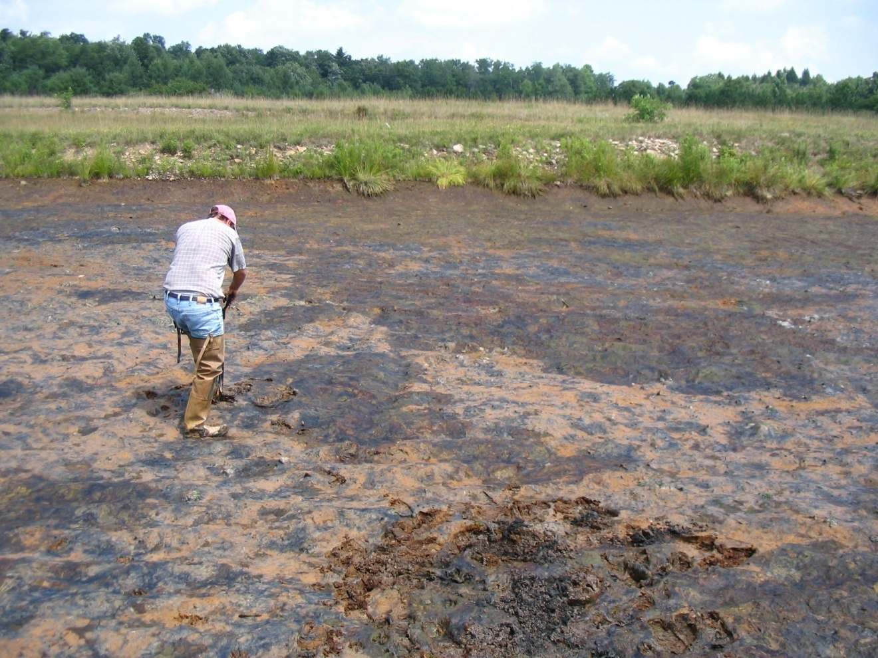
Substrate Investigation

Slide 27
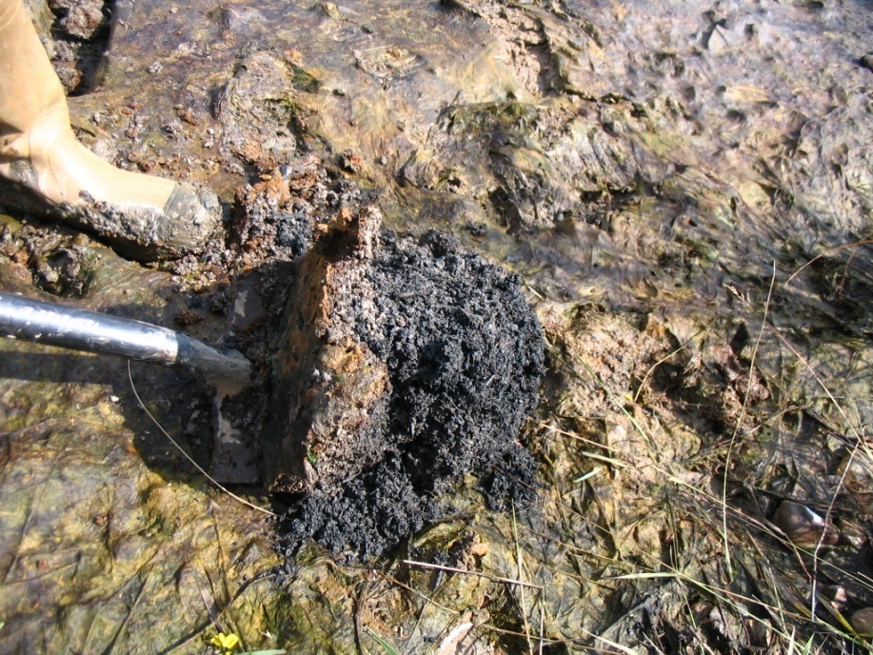
Substrate Investigation, Good Result

Slide 28
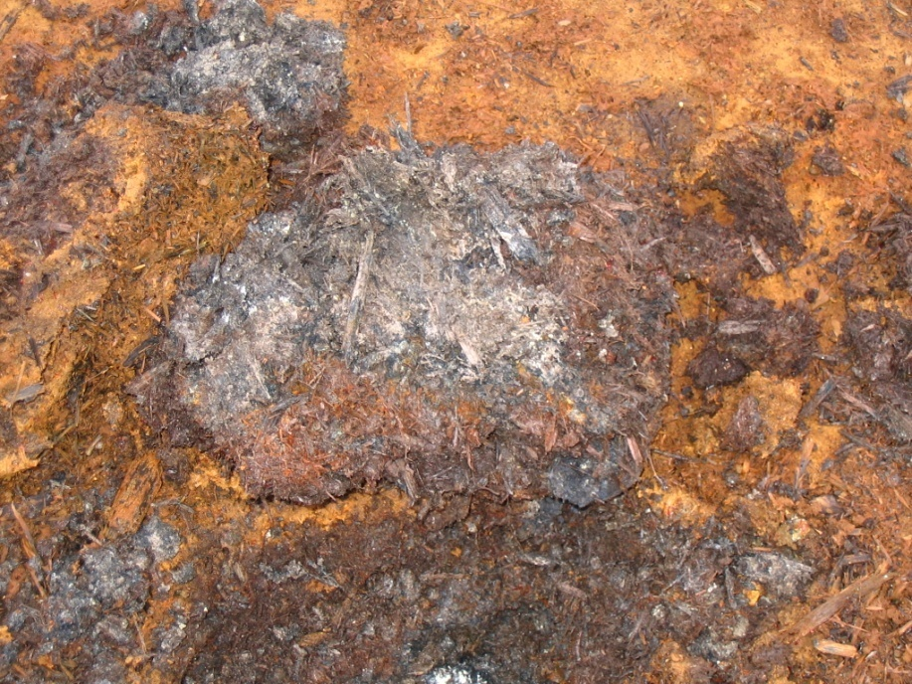
Substrate Investigation, Bad Result

Slide 29
Organic Substrate Rehab Process
Isolate VFP
Strip off existing substrate
scarify limestone aggregate
Place 9-12” of new alkaline substrate
replace old substrate on top

Slide 30
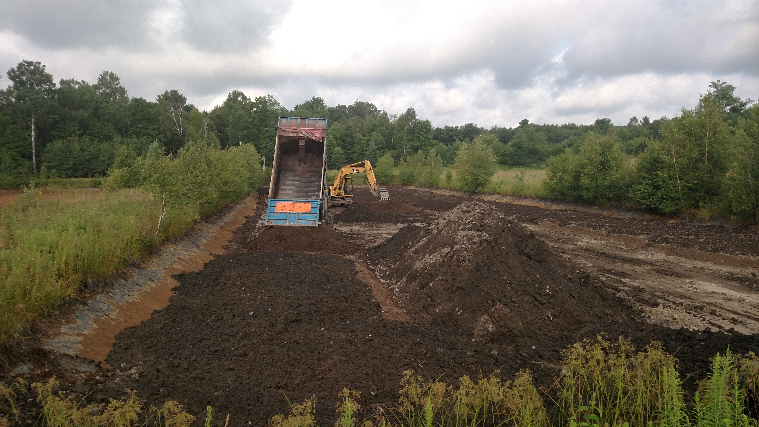

Slide 31
Organic Substrate Rehabilitation
Hunters Drift VFP Rehab
VFP8 in 2012
VFP5, VFP6, VFP7 in 2013
$210,008
Anna VFP Rehab
VFP1, VFP2, VFP3, VFP4 in 2016
$201,706

Slide 32
Water Quality Impacts of Mining and Treatment
Year | Activity
1890s – 1930s | Underground mining, Bloss seam
1975-76 | Monitoring, Operation Scarlift
1976-1986 | Daylighting, Bloss and Cushing seams
1976-1984 | Monitoring, USGS
1985-1989 | Monitoring, Antrim Mining
1996 | Babb Creek placed on 303(d) list
1996-2000 | Monitoring, PADEP and BCWA
2003-2004 | Construction of treatment system
2004-present | Monitoring, BCWA and HE
2010 | Babb Creek removed from 303(d) list Sections of Babb Creek designated as Wild Trout stream
2012-2013 | Hunters Drift organic substrate replacement
2016 | Anna organic substrate replacement

Slide 33
Looking Forward
Deep mines will continue to discharge low pH Al and Fe contaminated mine water
Continued operation of the passive treatment systems will be required to maintain Babb Creek as a cold water fishery
Long-term O&M commitment includes
  Routine maintenance by BCWA
  Major maintenance (organic substrate rehab) every 10-25 years

Slide 34
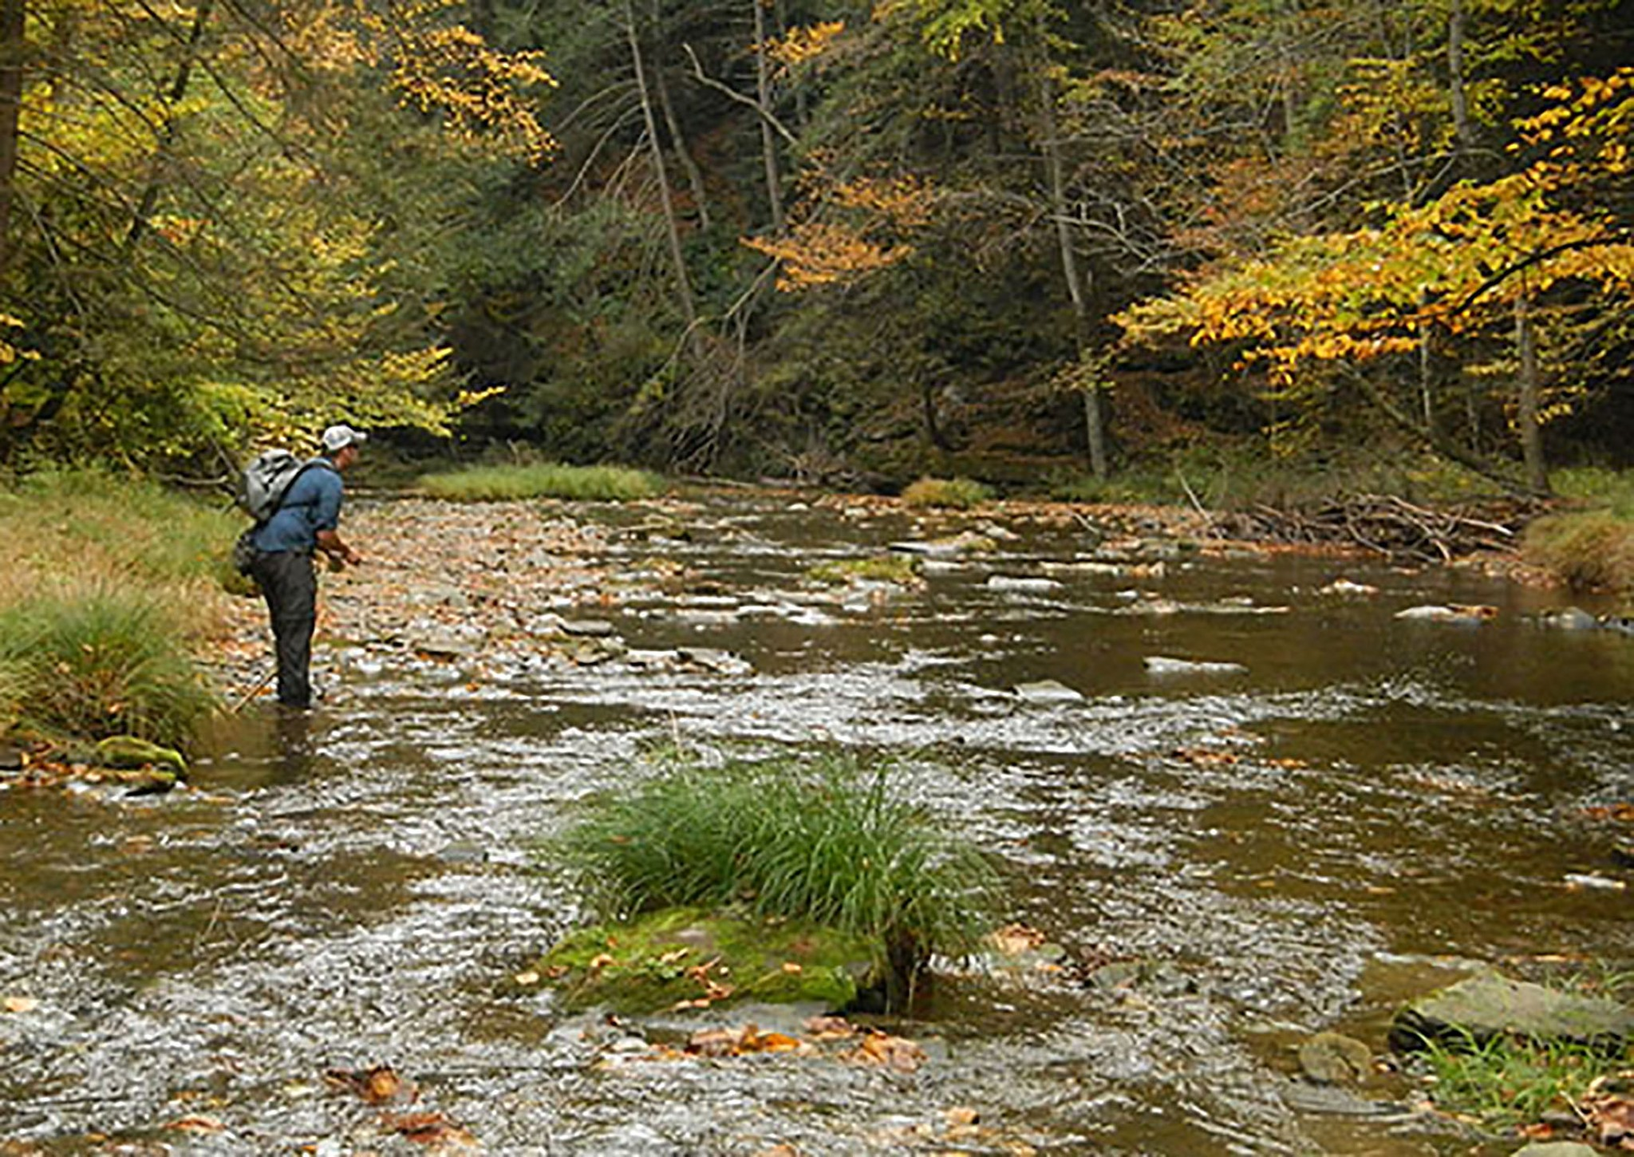
Questions / Comments

