Slide 1

Developing a Long-Term Hydrologic Monitoring Plan for Surface Coal Mines
Kevin Krogstad
Montana Department of Environmental Quality
^{Helena, Montana}
Notes:
Mine operators and regulators all want to see the operation and reclamation of a mine proceed smoothly, with no issues. It generally doesn’t happen quite that way, of course.
One of the problems that frequently crops up is water quality. Nobody wants to find out at final bond release that there is a water problem that will require a perpetual treatment plan. The best way to avoid this is the development of a good, robust monitoring plan that guides water monitoring from baseline through final reclamation, and discovers potential problems early.

Slide 2
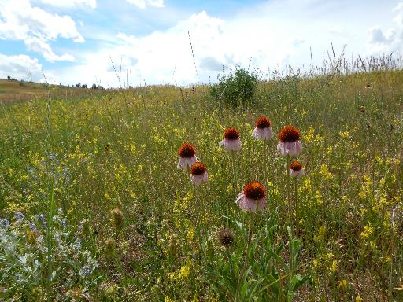

Designing a Monitoring Plan
Determine Data Needed
  Statutes
  Historical Sampling
  Future Possibilities
Define Analysis Area
  Surface Water
  Groundwater
Develop A Sampling Plan
  Methods
  Equipment
Notes:
A monitoring plan simply lays out clearly what data is needed, where we need to collect it, and how we need to collect it.
By using the monitoring plan and the data collected under it, we can work with the progress of the mine and reclamation to leave a legacy that makes the world a better place.

Slide 3









Data Needs
What Is Required By Law?
OFFICE of SURFACE MINING
RECLAMATION and ENFORCEMENT
U.S. Department of the Interior
Notes:
The first thing to establish is what the law requires. This involves not only Federal agencies, but state and sometimes county or local agencies.
Find out what you are legally required to monitor, and add it to the list. It can be intimidating to wade through the often conflicting regulations, but you can usually find an existing plan for a similar operation to use as a template.

Slide 4

Data Needs
What Is Required By Law?
What Is Likely To Be Challenged?
Notes:
Any time you propose a surface mine, there will be litigation. Every permitting action will bring legal challenges. This can be difficult, as it requires a bit of future forecasting.
In Montana, we are unlikely to be sued over boron or lithium levels. They are present in most natural waters in the state, but not a potential problem.
Arsenic, nitrate and selenium are fairly dependable as sources of legal challenge. Iron, aluminum, and sulfate can be problematic. In areas prone to acid mine drainage, and areas with more perennial surface water, the risk factors will be completely different.
The point is, if you expect to be sued over something at some point in the future, start monitoring it now. The time to start monitoring is not when a toxin shows up in the taps at the elementary school.
A comprehensive plan will permit proactive responses to potential problems and legal defense for unrelated environmental issues.
You will never wish you had less background data.

Slide 5
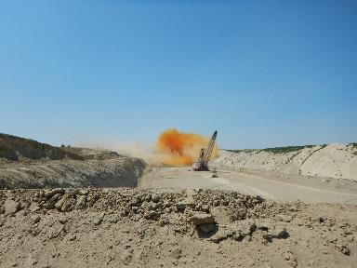
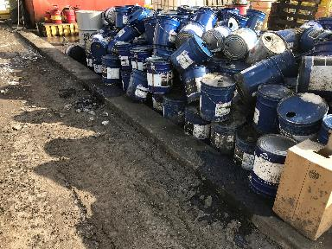
Data Needs
What Is Required By Law?
What Is Likely To Be Challenged?
What Are The Potential Hazards?
Notes:
Chemical assessments of coal reserves are routinely done as part of the prospecting process. Knowing what is likely to be in the coal and other materials to be disturbed will give you a look at what could potentially pose difficulties in the future. Work with the operators to determine what processes will be used to grade and handle the coal, what water issues they expect, and how spoil will be handled.
There is always a potential for oil, grease, and hydraulic fluid spills wherever there is equipment working. Including the appropriate analyses from the beginning provides a background level for use in potential future spills.
Blasting as done with modern materials and methods does not generally contribute significant contaminants, but fingers will always be pointed at it. Have solid background nitrate data, and you’re covered.

Slide 6
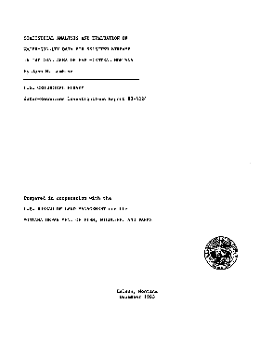
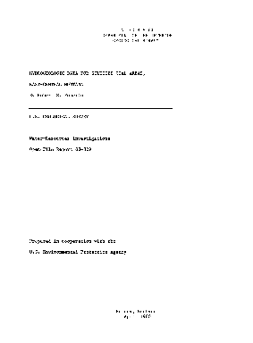
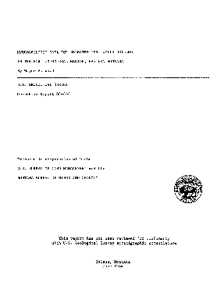
Data Needs
What Is Required By Law?
What Is Likely To Be Challenged?
What Are The Potential Hazards?
What Has Already Been Done?
Notes:
Every year, hundreds of reports are released by the USGS, EPA, and other government agencies. There are dozens of journals that publish relevant papers. Universities publish theses and dissertations.
A lot of papers relating to a particular water quality issue in your area may mean there is a problem, or at least the perception of a problem, which amounts to the same thing.
Talk to Federal and state regulators to find out if they are aware of any potentially relevant research.

Slide 7
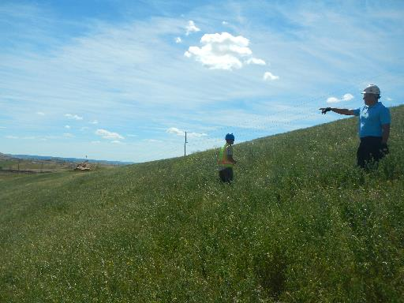
Data Needs
What Is Required By Law?
What Is Likely To Be Challenged?
What Are The Potential Hazards?
What Has Already Been Done?
How Could The Operation Change In The Future?
Notes:
Now you need to put on your fortune teller hat.
Is there a long range plan for mine expansion?
Is there a possibility of adding a railroad loop or conveyor system?
Is there anything on the horizon in the local area that might impact the local population?
The last thing you want to be doing is scrambling to try to cover an unexpected change.
If the main highway through the area is slated for expansion in the next few years, what will that mean to the mine?
If a river running near the mine property is on the list to be evaluated for a TMDL in the next few years, find out what the pollutants of concern are and make sure you have them covered.

Slide 8
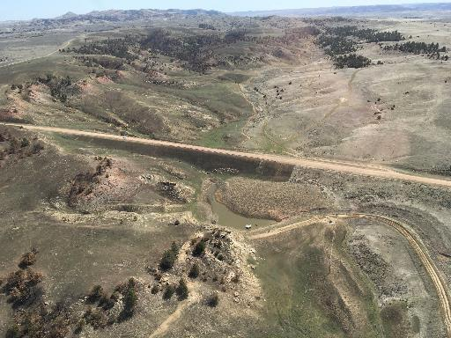
Define The Analysis Area
Surface Water
  Include All Watersheds That May Be Impacted
  Include Baseline Areas Upstream Of Development
Notes:
Now you need to decide where you need to collect samples.
Let’s start with surface water. Any watershed that will be disturbed needs to be sampled. Include baseline areas upstream from development.
If your permit only extends to the road here, you still need to be sampling upstream. Of course, this is in an ideal situation, and the reality may have access issues.

Slide 9
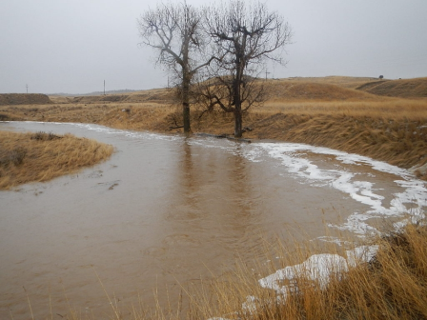
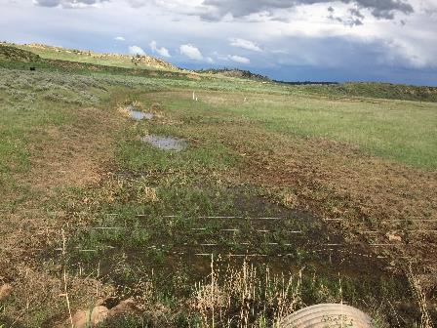
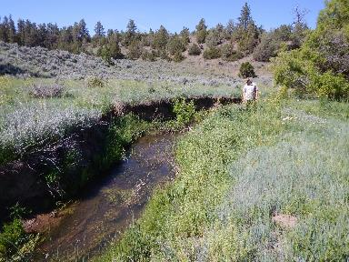
Define The Analysis Area
Surface Water
  Include All Watersheds That May Be Impacted
  Include Baseline Areas Upstream Of Development
  Account For Normal Flows As Well As Exceptional Conditions
  Field Visits Are Very Helpful
Notes:
If you have perennial streams, you can schedule routine sampling at whatever interval works for your plan.
However, include opportunistic sampling during extremely high flows and extremely low flows. Routine sampling generally does not capture these exceptional events.
Especially for surface water, it is critical to actually put boots on the ground in your sampling area, preferably before you finalize the plan. Data on flow rates and drainage area is important, but there is no replacement for first-hand knowledge of the site conditions.

Slide 10
Define The Analysis Area
Surface Water
  Include All Watersheds That May Be Impacted
  Include Baseline Areas Upstream Of Development
  Account For Normal Flows As Well As Exceptional Conditions
  Field Visits Are Very Helpful
Groundwater
  Determine Groundwater Divides, If Possible
  Literature Search For Past Modeling
  Represent Any And All Significant Aquifers- May Not All Have The Same Analysis Area
Notes:
Groundwater is a little more complicated.
If you have access to premine piezometric contours, you can determine groundwater divides, to make sure you have observation wells in all the major groundwater basins.
If you can find previous modeling reports in the area, it can help with this.
Keep in mind, there may be more than one aquifer in the area, and they may not all have the same analysis areas. You will need to go through this process for each aquifer to be disturbed, and at least one below that.

Slide 11
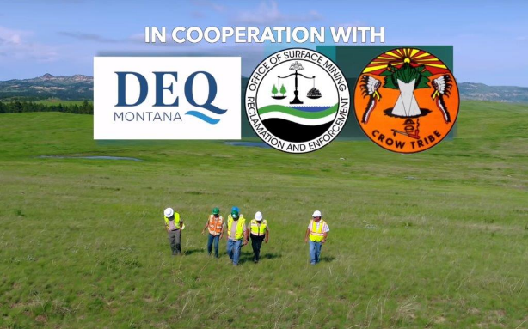
Develop A Plan
Work With Federal, State, Tribal, And Local Agencies Where Appropriate
Notes:
Regulators can provide insights and advice on development of your plan. Most agencies have guidelines to help develop a useful monitoring plan, and will be happy to assist if asked.
The regulators are the ones approving the mine; why guess what they need?
Keep in mind, though- they will help point you in the right direction, but they don’t have the time or the budget to do the work for you.

Slide 12
Develop A Plan
Work With Federal, State, And Local Agencies Where Appropriate
Work With An Accredited Laboratory With Local Experience
Notes:
Find a laboratory early in the process. Each lab has slightly different procedures and processes, and a good lab will be extremely helpful in designing your plan.
For example, all accredited laboratories use the same EPA-approved methods for analysis. If you just send the lab a list of analytes, they will send you back a list of results for each sample. If you work with the lab, though, you will find that the standard methods for the analytes you listed also provide results for a dozen or so others. If you ask for these, you will get them. Sometimes if you don’t ask, you don’t get the data.
They will also have quality control and custody procedures you can hijack for inclusion in your plan.

Slide 13
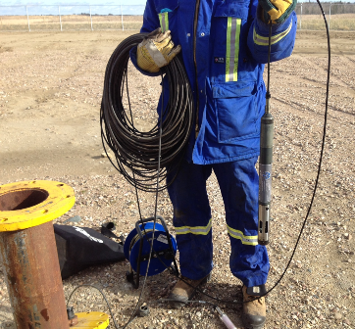
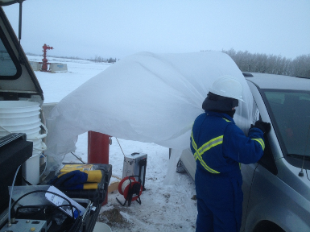
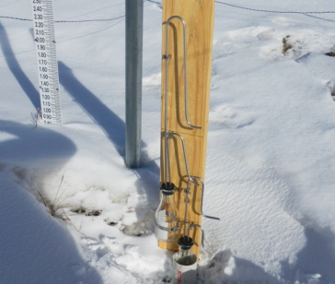
Develop A Plan
Work With Federal, State, And Local Agencies Where Appropriate
Work With An Accredited Laboratory With Local Experience
Specify Accepted Methods- USGS, EPA, Major Authors
Notes:
The USGS, the EPA, universities, and even the USDA have released guidelines on the appropriate methods to collect useful samples. Specify the methods to be used, and cite the source.
Keep in mind this plan will be in effect for a long time, possibly decades, and the only way to make sure the data you collect today is relevant twenty years down the road is to stick to accepted and published methods.

Slide 14
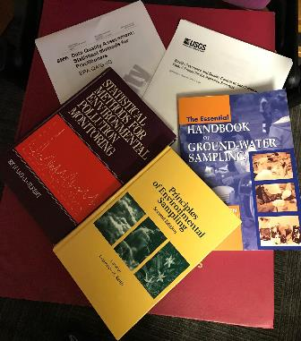
Develop A Plan
Work With Federal, State, And Local Agencies Where Appropriate
Work With An Accredited Laboratory With Local Experience
Specify Accepted Methods- USGS, EPA, Major Authors
Include QA/QC Based On Published Recommendations
Notes:
The quality of your data is likely to be challenged in court. There are accepted practices to assure that your data is collected, handled, and analyzed properly.
Even if it is never challenged, the presence of blanks, duplicates, and balance calculations is a transparent means of establishing that your data is of high quality and should be taken seriously. Data without QA/QC really isn’t data.

Slide 15
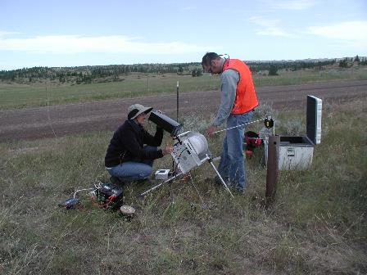
Develop A Plan
Work With Federal, State, And Local Agencies Where Appropriate
Work With An Accredited Laboratory With Local Experience
Specify Accepted Methods- USGS, EPA, Major Authors
Include QA/QC Based On Published Recommendations
Include Provisions For Field Audits
Notes:
Field audits are important. They can range from a simple ride-along by regulatory personnel to completely independent re-sampling runs.
It is not just a hassle; it doesn’t mean the regulators don’t trust you; it increases the confidence the regulatory agency has in your sampling program, and by extension your commitment to doing things right.
The people collecting the data get a better feel for what is important, and what happens to the information they collect.

Slide 16
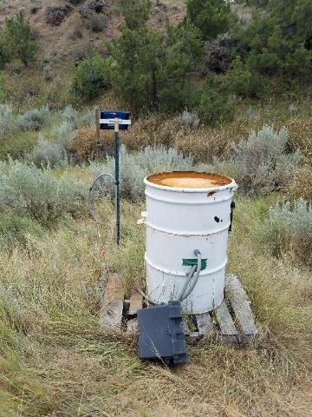
Develop A Plan
Work With Federal, State, And Local Agencies Where Appropriate
Work With An Accredited Laboratory With Local Experience
Specify Accepted Methods- USGS, EPA, Major Authors
Include QA/QC Based On Published Recommendations
Include Provisions For Field Audits
Include Procedures For Change
Notes:
No plan stays unchanged forever. In the case of a mine, wells will be mined through as part of the mine plan. Additional wells will be added in spoil areas. Extra wells may be needed to track an unexpected trend.
Surface water stations will be mined through. They can be damaged by equipment or livestock. Or bears, in this case. New stations will be needed in reclaimed areas.
Water quality standards change. Your plan needs to have a way to change with the times as needed.
A clearly defined procedure allows relatively painless and traceable change without loss of data integrity.

Slide 17
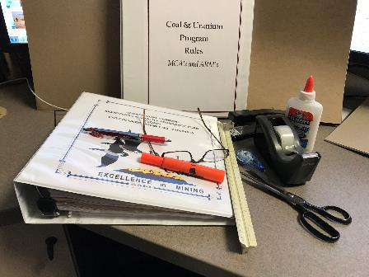
Develop A Plan
Work With Federal, State, And Local Agencies Where Appropriate
Work With An Accredited Laboratory With Local Experience
Specify Accepted Methods- USGS, EPA, Major Authors
Include QA/QC Based On Published Recommendations
Include Provisions For Field Audits
Include Procedures For Change
If Necessary, Specify Periodic Reviews
Notes:
Sometimes a plan goes along with no changes for a number of years, then suddenly there is an issue and everyone is scrambling to address it.
If the plan is reviewed periodically, these issues can be anticipated a bit.
Even if no change is needed, documented reviews are evidence that the plan is active and being managed.

Slide 18
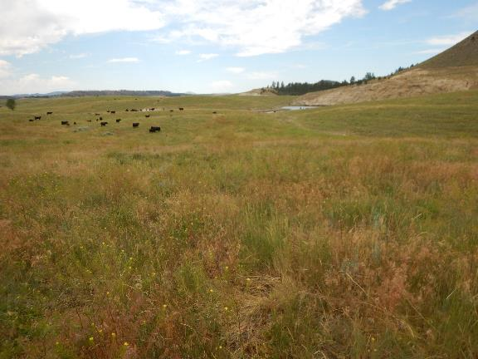
Manage Your Plan
Schedule Regular Reviews
Field Audits
Make Changes As Needed
Review Or Update With Every Permitting Action
Manage Data
Communication!
Notes:
Finally, once your plan is developed and implemented, don’t forget to manage it.
As I mentioned earlier, review the plan regularly.
Plan field audits to make sure everyone has the same expectations for the field program.
Make changes as they are needed.
Every time a renewal, revision, or amendment comes in, take the opportunity to review or update your monitoring plan to keep it current.
Manage your data. The operators should have a complete set of data onsite, and regulatory agencies will likely maintain a separate set. If your data is in multiple locations, in multiple formats, it is far less vulnerable to loss or corruption.
And make sure you are communicating. Don’t wait until your annual report to bring up an issue you knew about four months ago. Get on the telephone. Any points you are not completely sure about, or unusual situations, make the call.
The monitoring plan is your early warning system for upcoming problems, your defense against litigation, and one of the metrics that will someday confirm that you have done a great job right through reclamation.

Slide 19
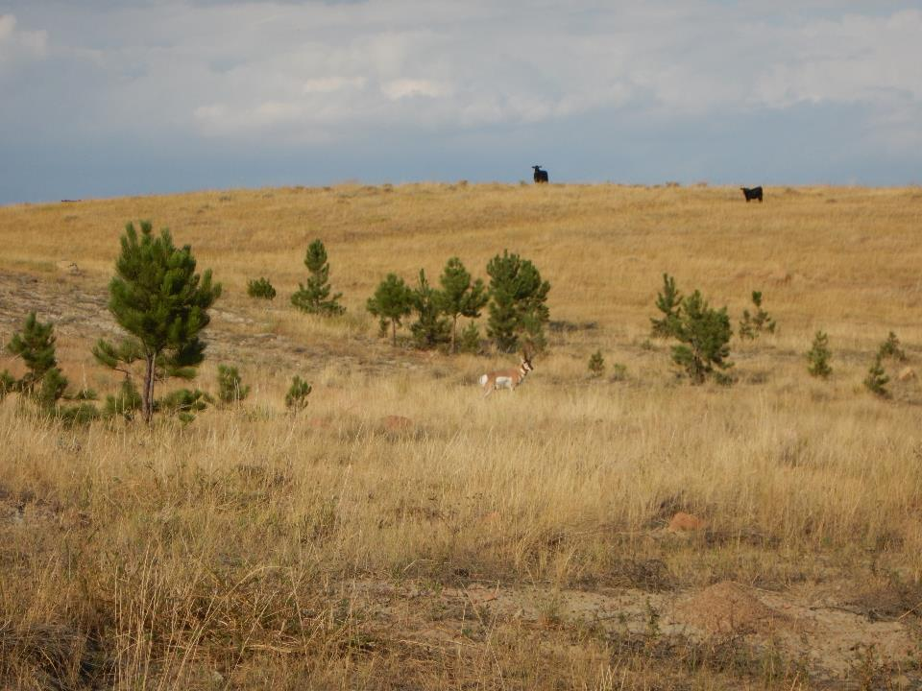
Thanks for Your Attention!
Kevin Krogstad
Montana Department of Environmental Quality
Helena, Montana

