Slide 1



LONG TERM FINANCIAL ASSURANCE
TRUST FUNDING MATH
Donald Sutton P.E (406-670-7270)
Drew Herrera P.E. (307- 680-0026)

Slide 2
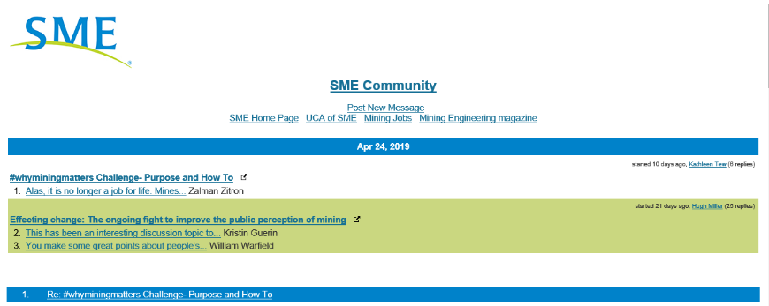
Question: What does the mining Industry need to do to improve it’s reputation for leaving abandoned mines, superfund sites, polluted water for the taxpayer to pay to remediate?
Answer: Make sure it never happens again.
I’ll discuss one way to make sure long term reclamation costs are properly funded.
Notes:
A discussion on the SME web site involved what can the Mining Industry do to improve it’s reputation.
Spectrum Engineering operates 6 WTP plants that are all being partly or completely paid for by the tax payers. Most taxpayers think that the industry should be responsible for the long term or perpetual site maintenance and water treatment, not the taxpayers. I am going to discuss how the industry and regulators can make more aacurate estimates of the amount of money needed at day 1 to pay for the long-term O&M and place a probability on the likelyhodd of surviving the required term without running out of money.

Slide 3
LONG TERM TRUST
FUNDING LOGIC
Financial Assurance
For Long Term Items Like Water Treatment and Site Maintenance
Not short term reclamation
Notes:
I am limiting this discussion to calculating the NPV of a fund that will pay for decades long or indefinite length O&M, not short term reclamation. Reclamation that can be completed in a few years after closure or bankruptcy can be handled by bonding and doesn’t suffer long term market risk.

Slide 4
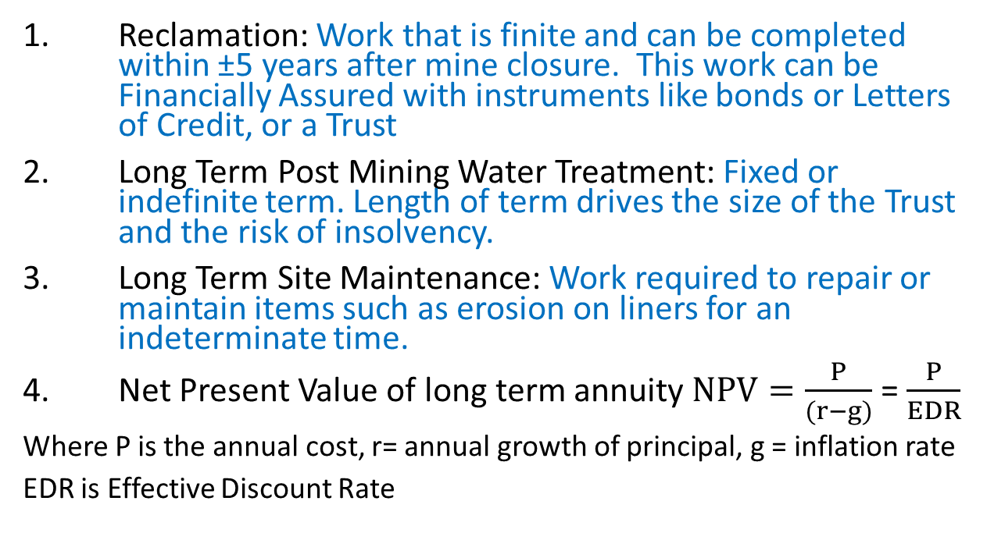
TERMINOLOGY
Reclamation: Work that is finite and can be completed within ±5 years after mine closure. This work can be Financially Assured with instruments like bonds or Letters of Credit, or a Trust
Long Term Post Mining Water Treatment: Fixed or indefinite term. Length of term drives the size of the Trust and the risk of insolvency.
Long Term Site Maintenance: Work required to repair or maintain items such as erosion on liners for an indeterminate time.
Net Present Value of long term annuity $NPV=\frac{P}{(r−g)}$ = $\frac{P}{EDR}$
Where P is the annual cost, r= annual growth of principal, g = inflation rate
EDR is Effective Discount Rate
Notes:
During the presentation I will explain the math

Slide 5
SHORT ANSWER
Using Monte Carlo Simulation to model the Expected Annual Return on the Trust Principal and Expected Inflation
Notes:
This shows the relationship between the effective discount rate discount factor and the probability of the fund surviving different lives. The lower the EDR or spread between the assumed fund investment yield and inflation the chance of not running out of money increases, but so does the up front cost of the fund, which affects the project economics.

Slide 6
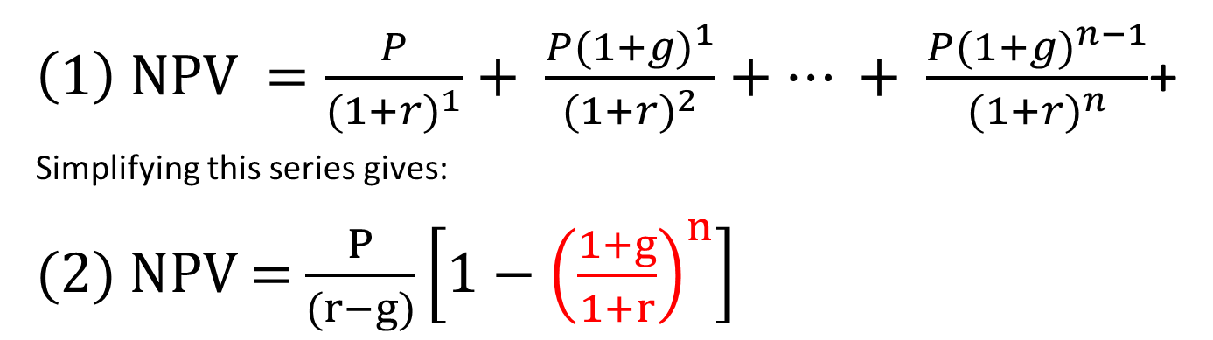
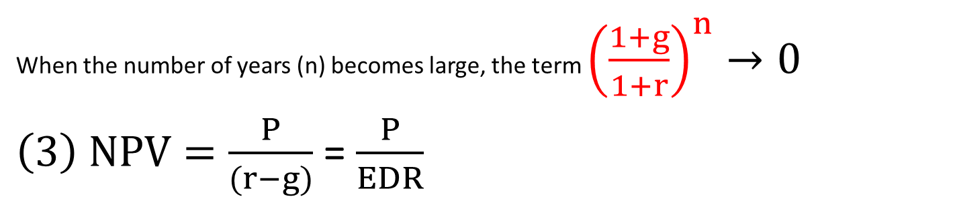
NPV of ANNUITY
$\left(1\right) NPV =\frac{P}{{(1+r)}^{1}}+ \frac{P({1+g)}^{1}}{{(1+r)}^{2}}+… + \frac{P({1+g)}^{n−1}}{{(1+r)}^{n}}$+
Simplifying this series gives:
(2) NPV = $\frac{P}{(r−g)}\left[1−{\left(\frac{1+g}{1+r}\right)}^{n}\right]$
When the number of years (n) becomes large, the term ${\left(\frac{1+g}{1+r}\right)}^{n}→0$
$\left(3\right) NPV=\frac{P}{(r−g)}$ = $\frac{P}{EDR}$
EDR = Effective Discount Ratio
PV = Present Value
P = Annual Payment
r = Interest Rate
g = inflation (growth) rate
n = Life in Years
Assumes Interest and Inflation Rates are Constant
How does this change the answer if they aren’t?
Notes:
Emphasize that this logic assumes a constant growth rate and constant inflation rate.
The growth rate of the investment and the O&O is not going to be constant. An additional factor needs to be included to account for the market and inflation volatility. Let’s consider the S&P 500 behavior since it is a representative basket of the stock market. Note that there needs to be a difference between yield and inflation rate. Presently yields on safe investments like CDs and T-Bills is about the same as inflation.

Slide 7
S&P Since 1960
7%-10% compound growth rate depending on time interval
Some time intervals the growth rate was negative
Notes:
I am not recommending putting all the funds in the S&P, but for illustration of market returns and risks here’s how it’s behaved since 1960 the year I started high school.

Slide 8
Volatility of Stock Market Since 1960
S&P Yield is Negative 27% of the time
Notes:
The up and down movement is called volatility. Mathematically it is the same as the standard deviation if one assumes it is normally distributed. More on this later.

Slide 9
Inflation Volatility Since 1960
Notes:
The CPI has been on a wild ride since 1960, but in recent years has settled down. This is probably because the Federal Reserve is attempting to stabilize it in the 2% range. If it is higher than anticipated, then a few high inflation years can consume the trust faster than expected. This happened to us at Zortman/Landusky when fuel prices spiked in the middle of the earthwork phase.

Slide 10
S&P Annual Change Since 1960
S&P Yield is Negative 27% of the time
Normal Distribution?
Notes:
This is a collection of the number of times the S&P closed up or down in5% binds since 1960. It is not exactly a perfect bell curve, but to make the math easier to model and explain, for this example I assume it is normally distributed. As you can see, it reality is is slightly skewed to the negative side, which makes my conclusions slightly optimistic.

Slide 11
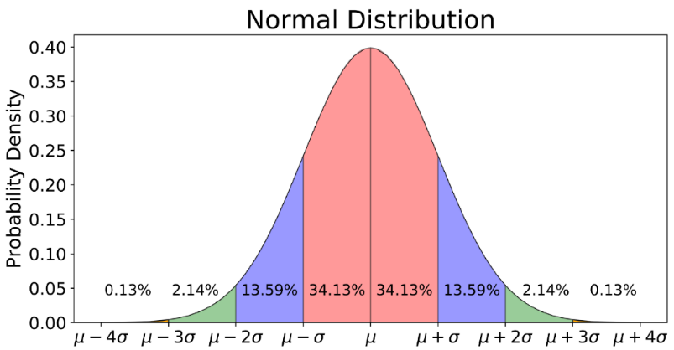
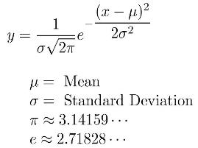
Normal Probability Distribution
Notes:
This is a quick refresher of mean and standard deviation for the normal distribution. 68% of the samples are within 1 standard deviation.

Slide 12
S&P Normal Probability Distribution
Notes:
This is how the S&P looks when normally distributed for one specific time interval. The mean varies depending on which time interval one selects. The risk involves the red area or in fact, the area left of the mean. Any year when the yield is less than anticipated can reduce the principal. If the O&M were never paid, then the principal and compound yield will return to the long-term projection, but when the O&M is deducted there is a chance that the principal shrinks too much to recover.

Slide 13
Expected Trust Fund Yield
It Loses 31% of the time but gains 69% of the time
Notes:
If the trust principal is placed in a safer portfolio, say 6.3% yield with STD= 13% then the shape of the distribution changes a little, but it will still have negative years.

Slide 14
Yield and Volatility
It Loses 31% of the time but gains 69% of the time
Notes:
This graph from BlackRock shows the relationship between yield and volatility (STD). The R² value is .75 so it is a little fuzzy, but in general the volatility is about double the mean except for cash. Note that the small yield for “safe” low volatility is about the same or les than inflation so in fact safe is not really safe, it’s just a guarantee that the trust will lose. Which means that one must assume risk to beat inflation.

Slide 15
Excel Spread Sheet Setup
End year | (A) Trust Fund Balance | (B) Fund Growth Rate % | (C) $ Growth of Fund | (D) CPI Growth Rate % | (E) O&M
Year 0 | $100.0M |  |  |  | -$1.00M
 | = A₀+C₁+E₁ | NORM.INV( RAND(), Portfolio_Yield, Portfolio_Volatility) | = A₀xB₁ | =NORM.INV( RAND(), Inflation_Rate, Inflation_Volatility) | = E₀ x D₁
Year 1 | $122.9M | 24% | $23.9M | 3% | -$1.0M
Year 2 | $141.2M | 16% | $19.3M | 2% | -$1.0M
Year 3 | $137.6M | -2% | -$2.5M | 3% | -$1.1M
Year 4 | $166.2M | 22% | $29.7M | 2% | -$1.1M
..... Year n | = A_{n-1}+C_{n}+E_{n} |  | = A_{n-1}xB_{n} |  | = E_{n-1} x D_{n}
Notes:
The equations to calculate the proforma performance of the trust over a 100 year period is shown above.
The normal distribution of the yield and inflation are calculated each year to simulate whatever time period is needed.

Slide 16
Open Excel Spread Sheet

Slide 17
Random Snapshot of Monte Carlo Simulation
Trust Becomes Insolvent in Year 47
From a Monte Carlo Simulation with Effective Discount Rate = 4.3%
Effective Discount Rate (EDR) = Expected Yield - Expected Inflation

Slide 18
Probability of Trust Remaining Solvent

Slide 19
OTHER CONSIDERATIONS
Annual operating costs
Periodic capital replacements costs
Cost estimate contingency
Contingencies for unanticipated extreme natural events, engineering errors and omissions, changes to environmental regulations, etc. (Include insurance costs if appropriate)
Cost to administer the O&M work including government oversight.
Trust administration fee
The expected annual return on investment of the Trust Principal
Investment portfolio mix, annual yield, volatility
The anticipated inflation rate and standard deviation.
Recommend ±6-7% yield with standard deviation about double the yield per Figure 10 Yield versus Volatility for different Types of Investments (Blackrock).
The factor of safety or risk the stakeholders (government and stakeholders) are willing to assume regarding the probability of premature insolvency. Increasing the probability of surviving increases the NPV of the trust, which has a direct impact on the project economics.

Slide 20
The End
Donald Sutton P.E (406-670-7270)
donsutton@spectrum-eng.com
Drew Herrera P.E. (307- 680-0026)
dherrera@spectrum-eng.com
Open Excel

