Slide 1
Acid Mine Drainage Takes Its Time to Burn Out – a case for Interceding with Spot Treatments?
M. Coleman¹, K.E. Butler^{2,} D. Loomer³
+
¹ NB Power
²University of New Brunswick Dept. of Earth Sciences
³ University of New Brunswick Dept. of Civil Engineering
36th Annual Meeting of ASMR Big Sky Resort, Montana June 3-7, 2019
Notes:
This presentation is a case history about the reclamation of a strip coal mine who’s life expectancy was cut short when it was determined that acid generation had started during mining operations. After three and a half decades of acid generation and acid mine drainage neutralization, a much reduced annual lime consumption, geophysical surveys and ground water monitoring have illustrated that acid generation is much reduced at the site. The concept of spot treatments of the higher acidity areas has been considered for several years now with discussions about source materials and application location and methodologies being pursued.

Slide 2
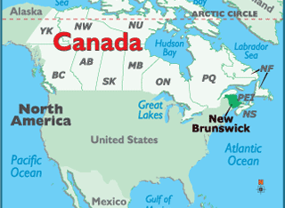
Mine Location
36th Annual Meeting of ASMR Big Sky Resort, Montana June 3-7, 2019
Notes:
The mine in this case study was a surface coal mining company located in New Brunswick, in eastern Canada.
Point out US, Maine, Atlantic Ocean, Nova Scotia
Weather – snow on the ground from before Christmas until late April- Sometimes from early November until early May.
Growing season – early to mid June until early Sept.
Precipitation 1100cm or 43 inches

Slide 3
Outline
Site conditions
Natural effects - precipitation
Our impacts
Geophysics – apparent conductivity and electrical resistivity
Groundwater chemistry
Discussion
Conclusions and comments
36th Annual Meeting of ASMR Big Sky Resort, Montana June 3-7, 2019

Slide 4
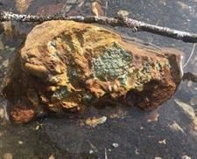
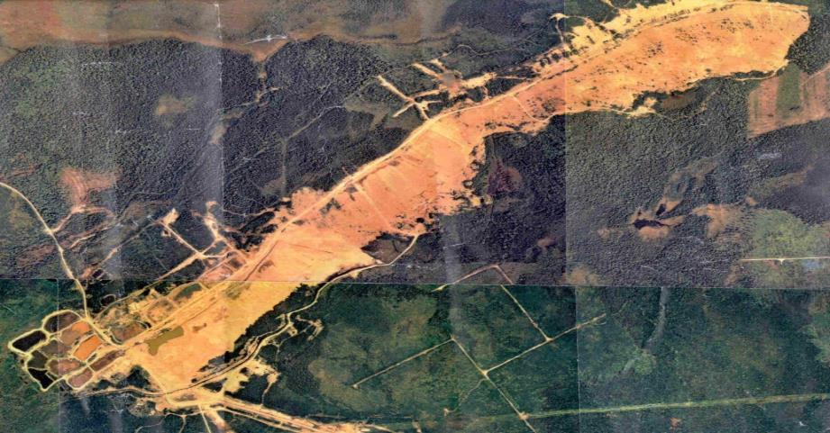
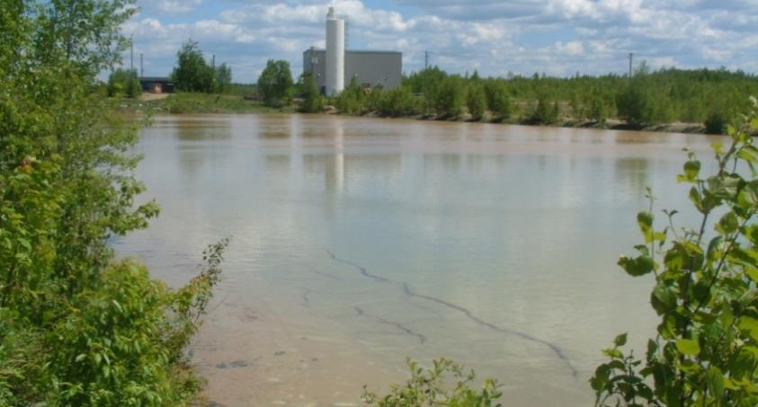
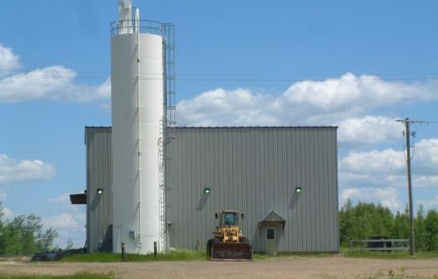
Background
Surface coal mine 1982-1985;
250 acre site (100 ha).
Acid mine drainage identified 1984-1985
Waste rock contoured
Sludge disposal areas
Notes:
High wall filled in, with the exception of a holding pond.
A cost benefit analysis was done on all other closure options of the day
Treatment most reliable results to meet discharge parameters.
Hydrated lime treatment
Issue--4 one -acre sludge ponds/yr
Twenty four ponds had been constructed by 1992. After six years of treatment and no alternatives in site, land use became a major concern.
The sludge has nowhere to go in the bathtub layout of the mine so the Regulator approved of the relocation trials back in 1992. The method approved would be to dredge the material back into the mine site waste rock.
Since 1992, (1992-2016), a conservative recollection is that at least 25 ponds have been dredged of their treatment pond solids; approximately 250,000m3 of solids have been placed back onto the waste rock or reinjected into the waste rock voids.
Long term solution-sludge disposal into waste rock

Slide 5
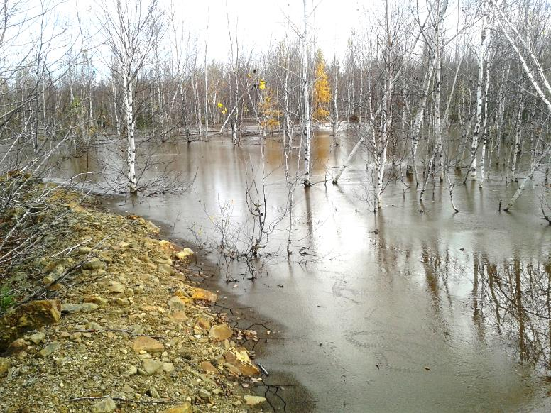
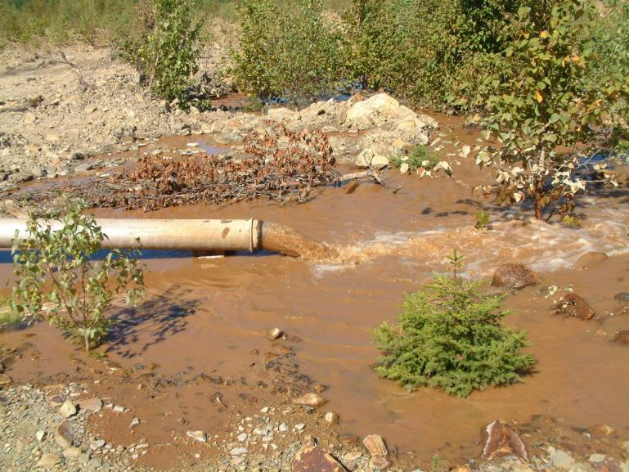
Initial Dredging Rationale
Disposing of lime neutralization sludge into acid generating rock could provide several benefits including:
1. utilization of the excess alkalinity in both the sludge and the water used to transport the sludge
2. final disposal area for sludge
3. minimize additional land disturbance
4. decrease personal liability
5. reduce accessibility of oxygen into the waste rock.
36th Annual Meeting of ASMR Big Sky Resort, Montana June 3-7, 2019
Notes:
Dredging of sludge has additional benefits:
pH 7.5 water used to carry the sludge.
Ratio treated water:sludge 9:1 - 5:1.
Small amount of sludge is being generated in-situ.
These are benefits that would not be realized to this extent if the sludge is manually relocated to the mine site.

Slide 6
Objectives
Years of monitoring mine water chemistry
it is not homogenous
becoming less acidic.
Where is it changing?
How is it changing?
How to push the in-situ neutralization?
Mine owner now wants to fast track closure
Target date 2021
36th Annual Meeting of ASMR Big Sky Resort, Montana June 3-7, 2019
Notes:
Phinney by 2016, Based on the consumption of lime since 1987, only 15% of the sulphide material above the water table had been oxidized. Reflects on limited accessibility of the sulphide minerals to atmospheric oxygen

Slide 7
Trend in Decreasing Lime Demand
2012 prediction - decrease in lime demand trending to near zero 2023.
Spot treatment or other option to meet the required mine water discharge parameters.
Little efforts towards closure since 2012
15 years
15 years
36th Annual Meeting of ASMR Big Sky Resort, Montana June 3-7, 2019
Notes:
Measurement of all water pulled into mine water holding pond
Corresponding decrease in hydrated lime
Annual average values
What is causing this decrease?
Phinney by 2016, Based on the consumption of lime since 1987, only 15% of the sulphide material above the water table had been oxidized. Reflects on limited accessibility of the sulphide minerals to atmospheric oxygen

Slide 8
What Natural Factors are Affecting Lime Consumption?
Precipitation data compared to lime consumption-
decreases due to lower precipitation years
15 years
36th Annual Meeting of ASMR Big Sky Resort, Montana June 3-7, 2019
Notes:
Measurement of all water pulled into mine water holding pond
Corresponding decrease in hydrated lime
Annual average values
What is causing this decrease?
Phinney by 2016, Based on the consumption of lime since 1987, only 15% of the sulphide material above the water table had been oxidized. Reflects on limited accessibility of the sulphide minerals to atmospheric oxygen

Slide 9
What Induced Factors are Affecting Lime Consumption?
Decreases in hydrated lime and mine water acidity after dredging
We aren’t doing this enough to increase the rate of decrease
15 years
36th Annual Meeting of ASMR Big Sky Resort, Montana June 3-7, 2019
Notes:
Measurement of all water pulled into mine water holding pond
Corresponding decrease in hydrated lime
Annual average values
What is causing this decrease?

Slide 10
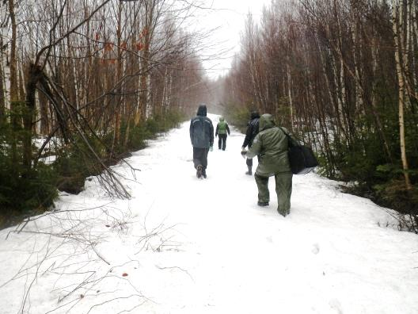
UNB Earth Science Field Camps- Geophysical surveys
36th Annual Meeting of ASMR Big Sky Resort, Montana June 3-7, 2019
Notes:
ERI and apparent conductivity reconnaissance during field camp.

Slide 11
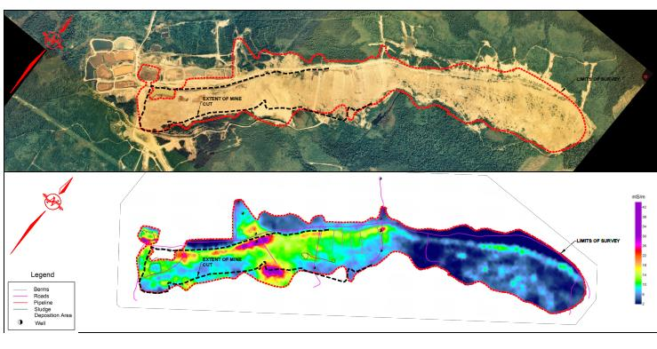
EM31 Apparent Conductivity to identify high conductivity areas
Apparent conductivity measures ions in a moist/ saturated environment.
Measures conductivity across surface
(40m spacings)
Apparent conductivity is not homogenous across site
But does this represent where the conductivity is being generated or just where it is pooling?
36th Annual Meeting of ASMR Big Sky Resort, Montana June 3-7, 2019
Notes:
Conductivity measurements require the ions to be in a moist / saturated environment. Areas too high above the water table and unsaturated (dry) will not exhibit measurable conductivity.
Phinney by 2016, Based on the consumption of lime since 1987, only 15% of the sulphide material above the water table had been oxidized. Reflects on limited accessibility of the sulphide minerals to atmospheric oxygen

Slide 12
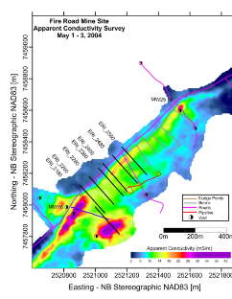
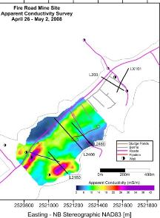
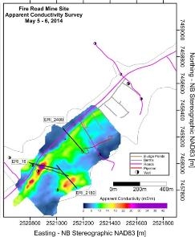
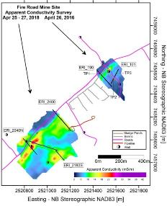
Where is the AMD changing?
Apparent Conductivity: Variation over Time
2004
2008
2014
2018
*Conductivities increased by 2.9 mS/m to give comparable off-mine values
Electrical conductivity of the waste rock backfill appears to be decreasing over time
Higher conductive area due to more porous or saturated backfill pooling in that area?
36th Annual Meeting of ASMR Big Sky Resort, Montana June 3-7, 2019
Notes:
Electrical conductivity of the waste rock backfill appears to be decreasing over time
although we cannot rule out possible effects of annual variability including heavy snow and late snow melt.

Slide 13
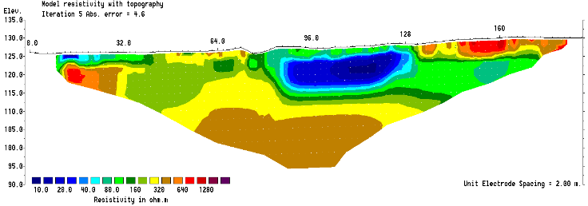
Acidity distribution verified with Electrical Resistivity?
ERI Measures resistivity 2- dimensional vertically
Wells 16 and 17
Are these areas pools of highly conductive mine water or acid generating hot spots?
verifying resistivity also not homogenous vertically
MW16
MW17
36th Annual Meeting of ASMR Big Sky Resort, Montana June 3-7, 2019
Notes:
Note wells 16/ 17, highwall, pool of low resistivity, high conductivity water

Slide 14
How is the Groundwater Acidity Changing?- Evaluation of groundwater wells
Generated acidity (initial acidity)
Acidity as a result of oxidation of sulfide minerals
Equivalent to SO₄⁻² concentration
Residual acidity
Acidity due to mineral acidity (H⁺)
and conc. of metallic ions (Al, Fe, Mn, Cu and Zn)
Equivalent to CaCO₃ demand for neutralization
% Acidity removed in-situ in the waste rock
Difference between (initial and residual)/initial)
36th Annual Meeting of ASMR Big Sky Resort, Montana June 3-7, 2019
Notes:
Calculations on initial acidity and residual acidity were conducted on wells of interest for the period between 1988 and 2016.
Initial acidity was considered to be the acid generated by the reaction of pyrite with oxygen and water and it was quantified by the sulfate measurement. It was considered that all of the sulfate was the result of acid generation (FeSO4).
Residual acidity is the acidity of the mine water that has to be neutralized. It was measured as the sum of pH, total Fe, Mn, Al, Cu and Zn, all converted to milli equivalents.
The difference between the initial and the residual acidity would be the amount of acidity that was neutralized within the waste mine (the backfilled mine site) through the mixing of neutral pH groundwater and the reaction with any available alkalinity (Ca and Mg) from the weathering waste rock.

Slide 15
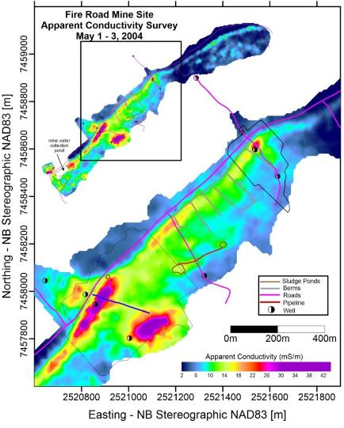
How is AMD changing? Monitoring Groundwater Wells
Measuring chemistry/ acidity at the well (spot) location
Back row wells
Surface water channel
Middle row well 17
36th Annual Meeting of ASMR Big Sky Resort, Montana June 3-7, 2019
Notes:
Conductivity measurements require the ions to be in a moist / saturated environment. Areas too high above the water table and unsaturated (dry) will not exhibit measurable conductivity.

Slide 16
Initial and Residual Acidity in ground water well 25 - Back Row, off site
No impact from acid mine drainage
Could this be the target water quality for closure?
36th Annual Meeting of ASMR Big Sky Resort, Montana June 3-7, 2019

Slide 17
Initial and Residual Acidity in Mine Water Well 26 – Back Row in waste rock
Wells up-gradient of most sludge depositional areas
SO₄⁻ 970 ppm (2018)
36th Annual Meeting of ASMR Big Sky Resort, Montana June 3-7, 2019
Notes:
These wells are in the mine fill; shallow(S) is in the approximate middle of the fill column; deep (D) is at the bottom drilled partially into bedrock. Trends show decreasing initial and residual acidity over time.
These are just notes not to be discussed in 2019 presentation.
When we graph the amount of acid removed, we are really looking at the difference in the two lines on these graphs; the wider apart the initial and residual acidity lines, the higher percentage of in situ neutralization that has occurred. Look at the more recent years for well 26 when the % acid removed has increased significantly. When the lines get very close at the lower acidities, even the close lines can mean significant in-situ neutralization occurring, as is evident in well 26S. The residual acidity line indicates very low acidity concentrations in the mine water.
For wells 26S the residual acidity has decreased from 4000 to 60;
for 26D, it has decreased from 3000mg/L to 227 so there is still a significant amount of acidity to treat. The same is for well 27D well 27 2000 to 124
In MW 26, Decreases in aluminum and manganese concentrations were the greatest declines in metal concentrations (not iron!). But would this signify that the alkalinity is coming from the weathering of a different mineral source?
Very low Ca and Mg concentrations in MW27, which manifests in low %acidity removed.
When the lines get very close at the lower acidities, even the close lines can mean significant in-situ neutralization occurring, as is evident in well 26W.
These are examples of wells which had been exhibiting limited in-situ neutralization but the rate has increased in the past decade.
The general trend for well 26 has been an increase in the percentage of acid removed (in-situ reaction) especially over the past six years. Even with the great declines in acidity noted and the increases in percent of acid removed, the percent acid removed is still close to or just moving above 60% for MW 26D but is approaching 80% in well 26S.
Between 2006 and 2016, most sludge had been down gradient from wells 26 and 27 so these impacts are all from in-situ neutralization.
What else could be affecting these trends? Can we assume these trends will continue?
The wells will be sampled again in the Spring of 2018 so we shall see.

Slide 18
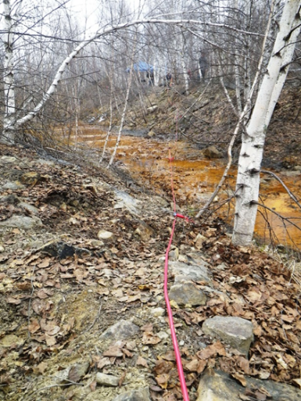
Initial and Residual Acidity in surface water channel- middle row, in waste rock
Chemistry of Surface water in channel at first spring
pH 3
Fe 177 mg/l
Al 6 mg/l
SO4- 950 mg/l

Slide 19
Initial and Residual Acidity in surface water channel- middle row, in waste rock
36th Annual Meeting of ASMR Big Sky Resort, Montana June 3-7, 2019

Slide 20
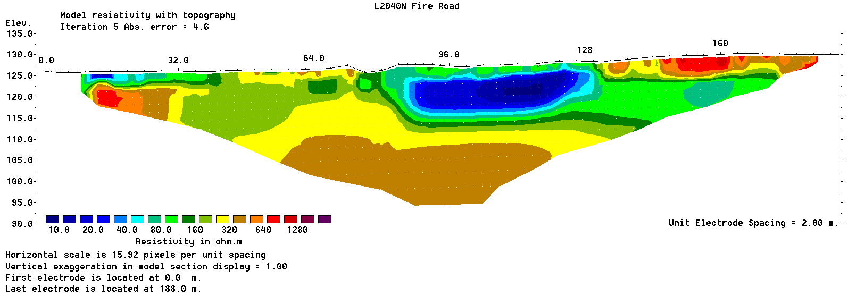
Initial and Residual Acidity in Mine Water Well, in waste rock Well 17 D
Wells are down gradient of sludge depositional areas
L2040N
MW16
MW17
36th Annual Meeting of ASMR Big Sky Resort, Montana June 3-7, 2019
Notes:
Background notes not to be discussed in 2019 presentations
These wells are in the mine fill; shallow(S) is in the approximate middle of the fill column; deep (D) is at the bottom drilled partially into bedrock. Trends show decreasing initial and residual acidity over time.
When we graph the amount of acid removed, we are really looking at the difference in the two lines on these graphs; the wider apart the initial and residual acidity lines, the higher percentage of in situ neutralization that has occurred. Look at the more recent years for well 26 when the % acid removed has increased significantly. When the lines get very close at the lower acidities, even the close lines can mean significant in-situ neutralization occurring, as is evident in well 26S. The residual acidity line indicates very low acidity concentrations in the mine water.
Well 17s pH 4 Fe 33-600 Al 20-60 SO4 700-2200
17D pH 4.4 Fe 124 Al 16-35 SO4 900-1100

Slide 21
Discussion- What is being done to reduce AMD
Ongoing- In-situ neutralization is naturally occurring in waste rock
Occasional- Dredging of sludge has additional benefits:
pH 7.5 water used to carry the sludge.
Sludge reducing rate of acid generation in vadose zone?
What could be done- Recirculating treated water back onto waste rock
Low flow periods- summer
winter but more complicated
36th Annual Meeting of ASMR Big Sky Resort, Montana June 3-7, 2019
Notes:
In-situ neutralization is occurring in waste rock all of the time and the site will most likely eventually burn itself out.
Dredging of sludge has realized these additional benefits :
6. Because sludge is being relocated using treated water, a large volume of pH 7.5 water is being injected into the site as the carrier of the sludge. The ratio of treated water to sludge has been measured to range between 9:1 and 5:1.
7. Due to the interaction with the higher pH water, a small amount of sludge is being generated in-situ.
8.These are benefits that would not be realized to this extent if the sludge is manually relocated to the mine site.

Slide 22
Discussion- Results require Action
Dredging or recirculating not happening often enough to make a huge impact on the high conductivity areas
But would treating just those high conductive areas drive the site to closure more quickly.
Projects are not met with much enthusiasm
due to cost (dredging)
Recirculating can only be done seasonally
Pipeline ($) and flow monitoring required
36th Annual Meeting of ASMR Big Sky Resort, Montana June 3-7, 2019

Slide 23
Discussion- Results require Action
UNB Senior Engineering Design Project (2018) determined that seafood compost at a cost $10-$120k (materials only) could address the volume of water in the high conductivity area surrounding well 17.
Would require additional lab testing to confirm
Results would take time
Concerns about attracting more wildlife, smell
Not met with much enthusiasm (see above)
36th Annual Meeting of ASMR Big Sky Resort, Montana June 3-7, 2019

Slide 24
Conclusions
Acid mine drainage takes time to naturally burn out.
Dredging/recirculating treated water, seafood compost, other alkaline editions
Drawbacks to each- timing.
These won’t solve the problem by 2021.
But if we do not do anything differently, operating costs are going to continue on as they are!
36th Annual Meeting of ASMR Big Sky Resort, Montana June 3-7, 2019
Notes:
Lime costs are 1/10th of operating budget; Manpower, contractors and other fixed costs the majority of the budget.

Slide 25
Conclusions
As per previous recommendations, excess alkalinity added directly to the site may be the way to force it to closure.
Constraints/ considerations-
Need site buy in ($, manpower)
site access
minimize damage to established vegetation,
impact on groundwater flow path,
implementation (injection wells?), where to apply?
monitoring groundwater leaving the site
36th Annual Meeting of ASMR Big Sky Resort, Montana June 3-7, 2019

Slide 26
Going Forward
How do we fast forward this process to have it closed by 2021?
Recommendation-Action, any action.
If we do not do anything differently, operating costs are going to continue on as they are because….. Acid mine drainage takes time to burn out.
36th Annual Meeting of ASMR Big Sky Resort, Montana June 3-7, 2019

Slide 27
Acid Mine Drainage Takes Its Time to Burn Out – a case for Interceding with Spot Treatments?
M. Coleman¹, K.E. Butler^{2,} D. Loomer³
+
¹ NB Power
²University of New Brunswick Dept. of Earth Sciences
³ University of New Brunswick Dept. of Civil Engineering
36th Annual Meeting of ASMR Big Sky Resort, Montana June 3-7, 2019

