Slide 1
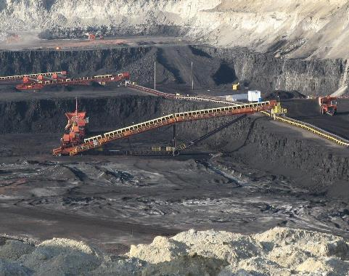
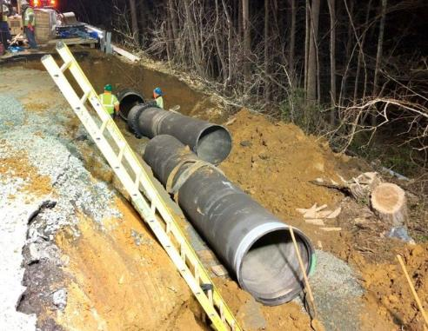
Analysis of coal production, severance tax revenues, and water infrastructure relationships in West Virginia
https://www.wyomingpublicmedia.org/post/inside-energy-western-coal-country-wyomings-industry-runs-deep#stream/0
https://wtop.com/prince-georges-county/2019/04/boil-water-advisory-issued-for-southern-prince-georges-co/
Hannah Patton¹, Dr. Leigh-Anne Krometis¹, Dr. Emily Sarver²
Virginia Polytechnic and State University Biological Systems Engineering Department
Virginia Polytechnic and State University Mining and Minerals Engineering Department
Notes:
Add coauthors and Ethan Casey Austin

Slide 2
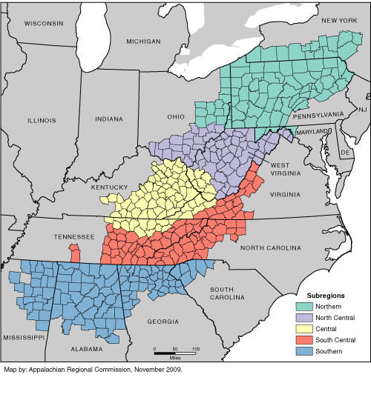
Socioeconomic Landscape of Appalachia
Rich natural resources
- Highly biodiverse
- Abundant mineral resources
Economic History
- Resource extraction
Geography
- Low density, rural communities
- Challenging topography
Current Socioeconomic Situation
- Areas of low income
- Lack of public resources/infrastructure
- Public health issues
Notes:
“one of widespread poverty to one of economic contrast” some communities have successfully diversified their economies, while others still require basic infrastructure such as roads and water and sewer systems
every county in central Appalachia reported poverty rates of 20 percent + for the period of 2007-2011 (compared to a national average of 14.3 percent) and that this region as a whole had a poverty rate of 23.5 percent reveals that many people are still struggling

Slide 3
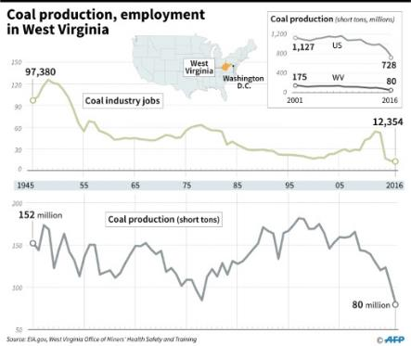
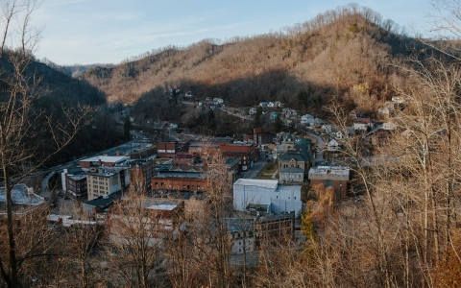
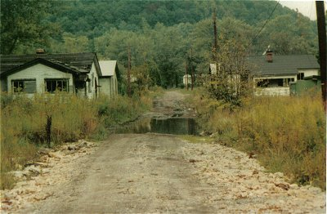
Resource Extraction Economies
Boom and bust cycle
Coal Severance Tax
http://america.aljazeera.com/articles/2016/2/14/fortunes-of-black-miners-in-wva-are-a-casualty-of-coal.html
http://www.coalcampusa.com/sowv/gulf/tams/tams.htm

Slide 4
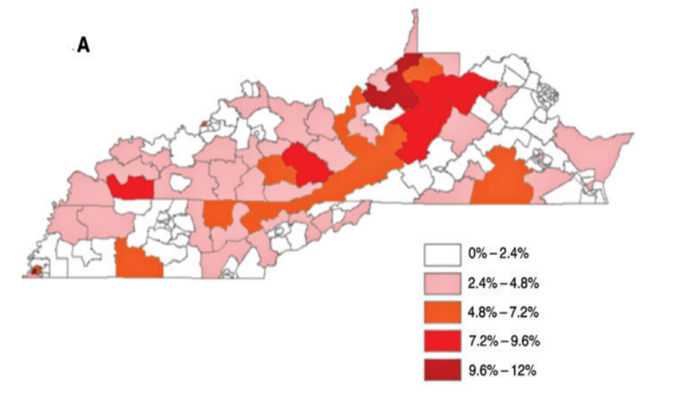
Central Appalachia Infrastructure Challenges
Percentage of occupied homes in Central Appalachian states without indoor plumbing (drinking water tap)
Krometis, L.-A., Gohlke, J., Kolivras, K., Satterwhite, E., Marmagas, S. W., Marr, L. C. (2017). Environmental health disparities in the Central Appalachian region of the United States. Reviews on Environmental Health, 32(3), 253–266. https://doi.org/10.1515/reveh-2017-0012

Slide 5
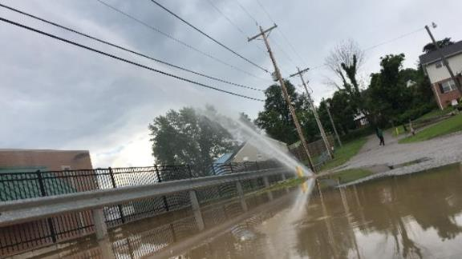
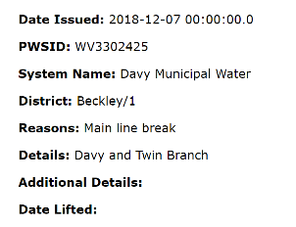
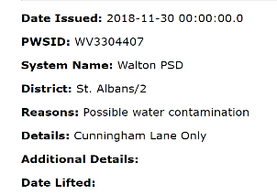
Infrastructure Challenges
In 2018, West Virginia American Water stated that their average rate of water main replacement was 100 years
Public Boil Water Notices from WVDHHR website as of 6/4/2019
https://www.wsaz.com/content/news/Water-spraying-from-ground-causing-issues-in-Cross-Lanes-427310113.html
Between 2003 and 2018 Wyoming County, WV has received SDWA 11,180 violations
Notes:
In 2018, West Virginia American Water stated that their average rate of water main replacement was 100 years

Slide 6
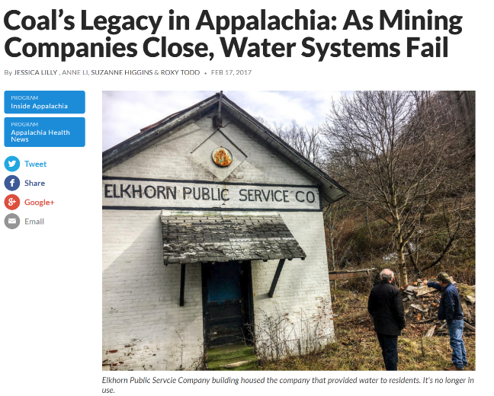
http://wvpublic.org/post/coal-s-legacy-appalachia-mining-companies-close-water-systems-fail#stream/0
Notes:
We don’t know what the indirect effects of coal mining are on potable water

Slide 7
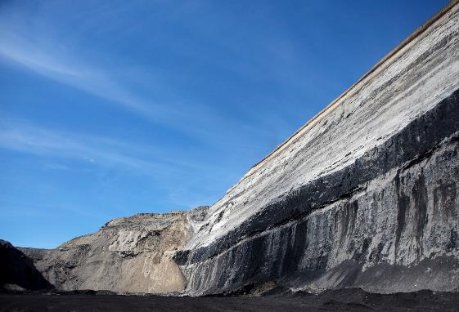
Hypothesis
As coal production in West Virginia counties increases, SDWA violations will decrease as there is more money available (via Coal Severance tax) for reinvestment in water infrastructure.
https://www.brookings.edu/blog/the-avenue/2017/01/25/automation-guarantees-a-bleak-outlook-for-trumps-promises-to-coal-miners/

Slide 8
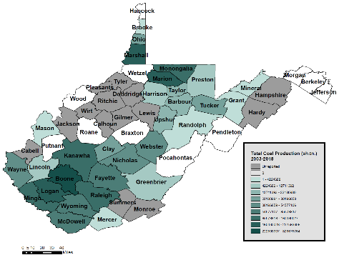
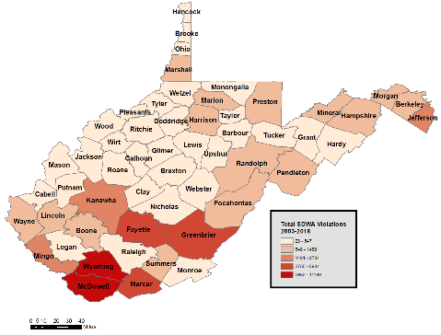
Study Area: West Virginia

Slide 9
Methods: Data Collection
Safe Drinking Water Information System
(SDWIS)
https://www.mccrarencompliance.com/calendar-2/#!event/2018/11/16/msha-annual-refresher-surface-part-48
West Virginia Safe Drinking Water Act violations by county
West Virginia coal production by county
Coal Severance Tax
by county

Slide 10
Methods: Data Manipulation
2003-2018
Nationwide -> County
Eliminated duplicates
Eliminated inconsistencies
Combined data sets
County-Year-Y
Summed Ys
Spearman’s Rho for correlation

Slide 11
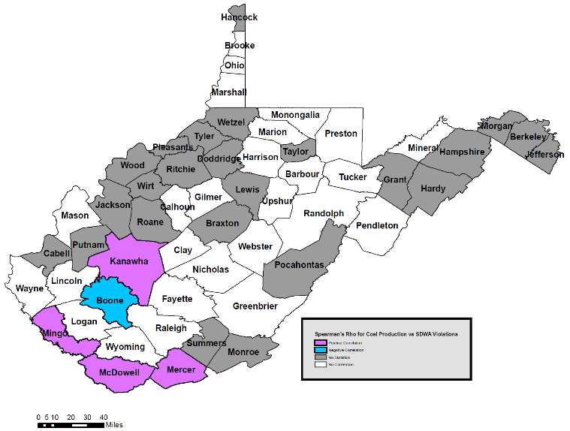
Coal Production ↑ SDWA Violations ↓
Countyc | Spearman’s Rho | P-value (95% Confidence)
Boone | -0.53 | 0.0354
Kanawha | 0.55 | 0.0282
Mingo | 0.71 | 0.0031
McDowell | 0.59 | 0.0186
Mercer | 0.85 | 3.41E-05

Slide 12
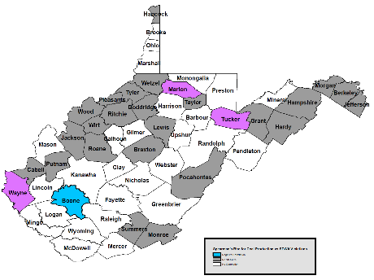
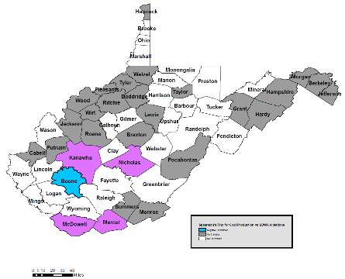
Does correlation change based on violation type?
Health-Based
Monitoring &
Reporting
Total Violations

Slide 13
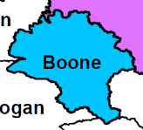
Coal Severance Tax and water infrastructure investment coupled
Fiscal Year | Coal Severance Tax | Total Revised Coal Fund | Water Investment from Coal Fund | Water Investment from General Fund
2012-2013 | $3,200,000 | $10,135,931 | $500,000 | $700,000
2013-2014 | $2,800,000 | $6,487,973 | $400,000 | $500,000
2014-2015 | $2,000,000 | $5,092,141 | $170,000 | $700,000
2015-2016 | $2,000,000 | $3,515,868 | $0 | $983,300
2016-2017 | $1,000,000 | $1,719,254 | $0 | $0
2017-2018 | $750,000 | $1,653,432 | $0 | $0
2018-2019 | $800,000 | $1,890,515 | $0 | $0

Slide 14
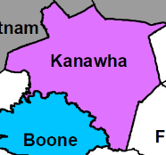
Coal Severance Tax and water infrastructure investment uncoupled
Fiscal Year | Coal Severance Tax | Total Revised Coal Fund | Water Investment from Coal Fund | Water Investment from General Fund
2012-2013 | $1,600,000 | $3,087,326 | $0 | $397,832
2013-2014 | $1,476,568 | $2,963,894 | $0 | $113,500
2014-2015 | $1,592,762 | $2,465,159 | $0 | $113,500
2015-2016 | $1,218,319 | $1,651,631 | $0 | $113500
2016-2017 | $915,372 | $1,116,559 | $0 | $110,500
2017-2018 | $934,656 | $1,136,969 | $0 | $110,500
2018-2019 | $930,700 | $1,170,477 | $0 | $110,500

Slide 15
How can we reclaim communities?
Coal Severance Tax
Sustainable mineral resource extraction
Corporate social responsibility
Citizen science/community engagement
How do other community issues fit in?

Slide 16
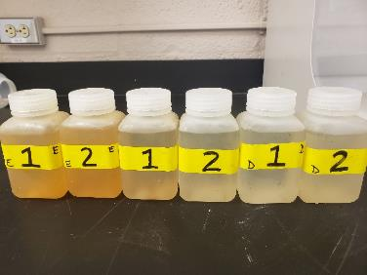
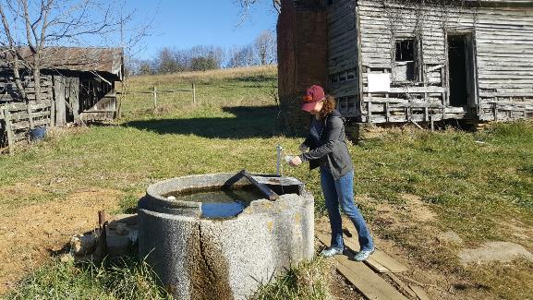
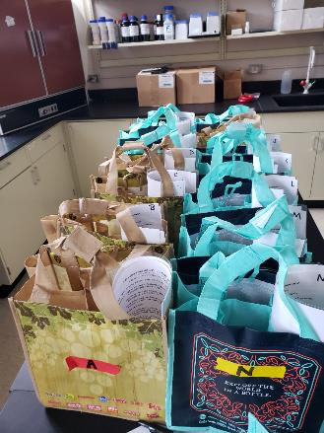
Future Work
Home F Conc. | Contaminant – SDWA Standard | Local Spring Sample Conc.
PRESENT | Coliform bacteria – 0 MPN | PRESENT
ABSENT | E. coli bacteria – 0 MPN | PRESENT
7.33 | pH – 6.5 – 8.5 | 8.41
5,673 | Iron - 300 ppb | 71.3
260 | Manganese - 50 ppb | 0.9
0.1 | Lead - 15 ppb | 0.1
2.8 | Arsenic - 10 ppb | 0.1
604,435 | Sodium – 20,000 ppb | 10,186
9.4 | Strontium – 1.5 ppm | 0.3
12.4 | Barium – 2 ppm | 0.06

Slide 17
This work has been supported by the Virginia Tech Institute for Critical Technology and Applied Science (ICTAS) Center for Science and Engineering of the Exposome (SEE) since 2017
Advisors:
Dr. Leigh-Anne Krometis & Dr. Emily Sarver
Committee Member:
Dr. Cully Hession
Research Group Members:
Lauren Wind, Cristina Marcillo, Ethan Smith, Grant McMillan
THANK YOU!

Slide 18
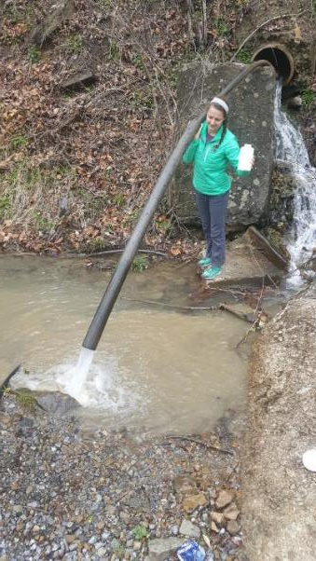
Hannah Patton Virginia Polytechnic and State University Biological Systems Engineering Department Hpatton@vt.edu 240-812-2976
Questions?

