Slide 1
NEW GENERATION COAL-FIRED POWER PLANTS: INNOVATION AT THE DRY FORK STATION, GILLETTE, WYOMING
Brenda K. Schladweiler, BKS Environmental Associates, Inc., Gillette, WY

Slide 2
Current Coal Electrical Generation
According to the U.S. Energy Information Administration (EIA):
In 2017 coal-fired power generation provided 30% of the electrical demand for the United States (U.S.). That is down from 44.5% in 2010.
14 gigawatts (GW) of coal-fired generating capacity were expected to retire in 2018.
Another 4 GW of capacity are planning to retire by the end of 2019.

Slide 3
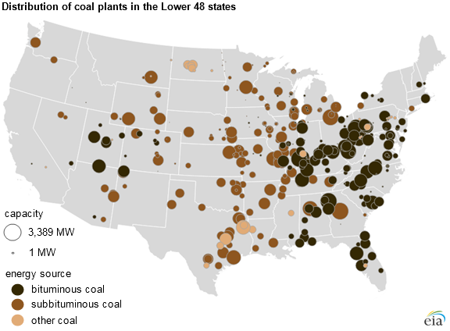
Extent of Coal-Fired Power Plants
Wyoming has 23 operating coal-fired power stations at 9 locations totaling 6,168 megawatts (MW).
Source: U.S. Energy Information Administration

Slide 4
Coal in Campbell County and Wyoming

Slide 5
Campbell County - Energy Capital of the Nation
Producer of approximately 10% of Total U.S. Energy (BTUs)
Powder River Basin coal accounts for
40% of the total coal-fired power
generation provided to the U.S.
#2 Oil producing county in
Wyoming
Uranium and wind resources
Credit: Mark A. Christensen, MC Aegis LLC

Slide 6
Campbell County
Assessed Valuation
2018
Credit: Mark A. Christensen, MC Aegis LLC

Slide 7
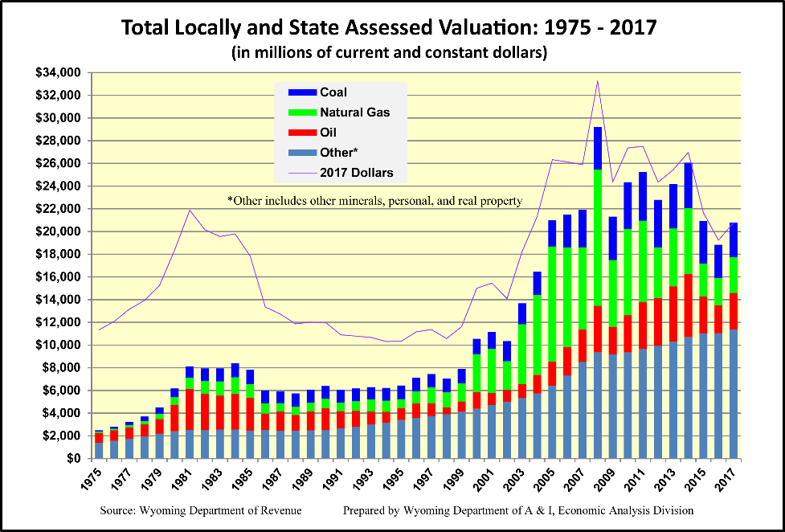
Credit: Mark A. Christensen, MC Aegis LLC

Slide 8
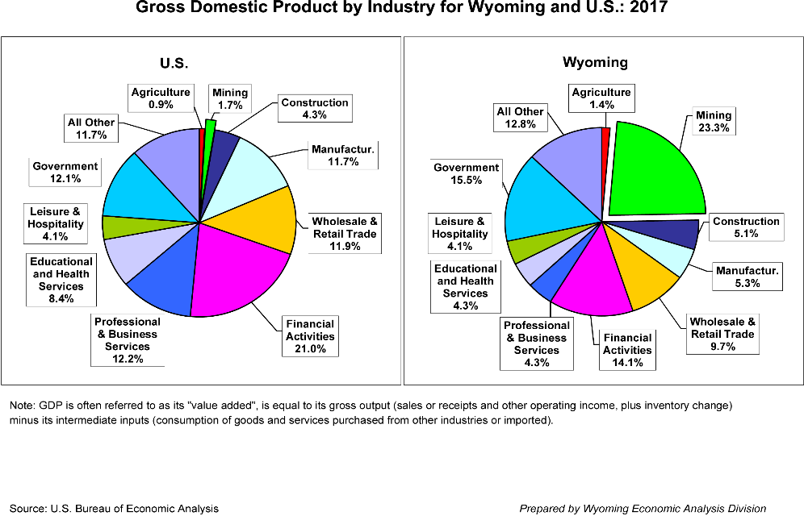
Credit: Mark A. Christensen, MC Aegis LLC

Slide 9
Old Generation Coal-Fired Power Plant-According to the EIA
Most coal-fired power plants in the U.S. were built before 1990.
Most of the generators projected to retire are older, inefficient units primarily concentrated in the Mid-Atlantic, Ohio River Valley, and Southeastern U.S.

Slide 10
Old Generation Coal-Fired Power Plant Concerns
Emissions
Water Conservation and Reuse
Ash Generation and Storage

Slide 11
Emissions
According to the EIA:
About 43% of all coal-fired plants did not have flue gas desulfurization (FGD) systems installed as of 2010.
Coal plants without FGD systems will likely be required to install either a FGD or dry sorbent injection (DSI) system to continue operating in compliance with the Mercury and Air Toxic Standards(MATS).

Slide 12
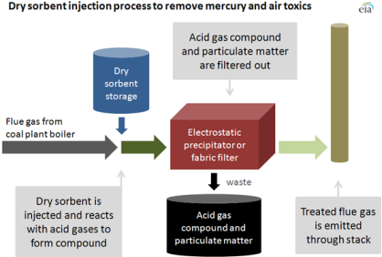
Source: U.S. Energy Information Administration

Slide 13
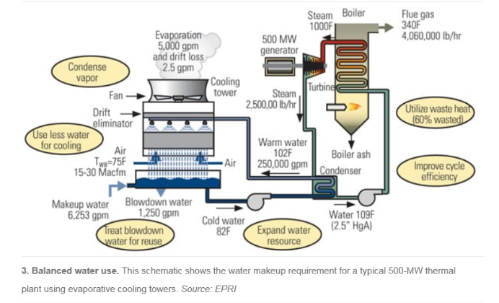
Water Conservation and Reuse
Low Water Efficiency and Reuse.

Slide 14
Ash Generation and Storage
According to the Environmental Protection Agency (EPA), coal ash is any of the following:
  Fly Ash
  Bottom Ash
  Boiler Slag
  Flue Gas Desulfurization Material
Previously, some power plants may have disposed of ash in surface impoundments or in landfills. Discharge water associated with impoundments could be discharged into a nearby waterway through a water discharge permit after treatment. However, recent regulations do not allow this.

Slide 15
Challenges - Coal Ash Regulations
Surface water and groundwater issues in the eastern United States
Potential Groundwater contamination – four listed in Wyoming
  PacifiCorp’s Jim Bridger power plant outside of Rock Springs
  Naughton power plant outside of Kemmerer
  Dave Johnston power plant near Glenrock
  Basin Electric Power Coop’s Laramie River Station coal plant outside of Wheatland

Slide 16
New Generation Coal-Fired Power Plants
Emissions
Water Conservation and Reuse
Ash Generation and Storage

Slide 17
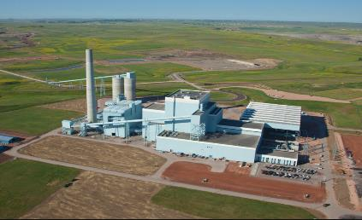
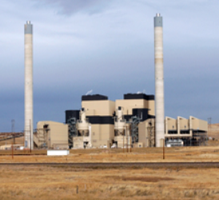
New Generation Coal-Fired Power Plants

Slide 18
Emissions
The latest generation of pollution control technologies are utilized resulting in very low emissions.
  Nitrogen oxides (NOx)
  Sulfur dioxide (SO₂)
  Particulates (PM)
  Mercury (Hg)

Slide 19
Water Conservation and Reuse
The plant used an air-cooled condenser, technology chosen to conserve water resources.
The water-to-steam-to-water cycle is a closed-loop process, and make-up water is added as needed to maintain water quality and quantity.

Slide 20
Ash Generation and Storage
Ash is placed above ground.
Ash is compacted as it is laid down to create a hard-packed surface to reduce dust and maintain stability.
Sprinklers are in place to minimize dust.
Contemporaneous reclamation will occur after each cell is complete.
Ponds are lined with geomembrane material.
Groundwater monitoring wells are sampled quarterly.

Slide 21
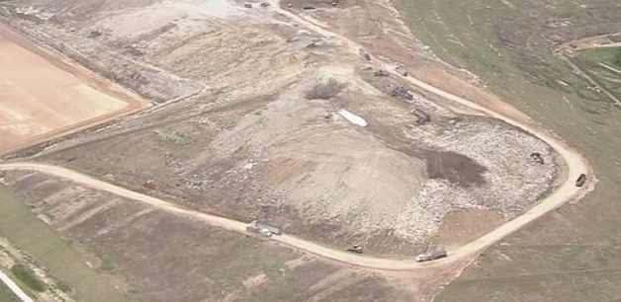
Ash Generation and Storage

Slide 22
Future Outlook for
Coal Power Generation

Slide 23
Credit: Esther Wagner, Petroleum Association of Wyoming

Slide 24
Potential Coal-fired Plant Shutdowns
Rocky Mountain Power evaluating closing four WY power plants.
Two units at Jim Bridger in Sweetwater County and two units at Naughton in Lincoln County.
Customers would save approx. $248m, if the retirement of the plants was accelerated according to the company.
  Publicly traded company
RMP will produce a plan for the closures August 1st 2019.
Source: Gillette News Record 4-25-19

Slide 25
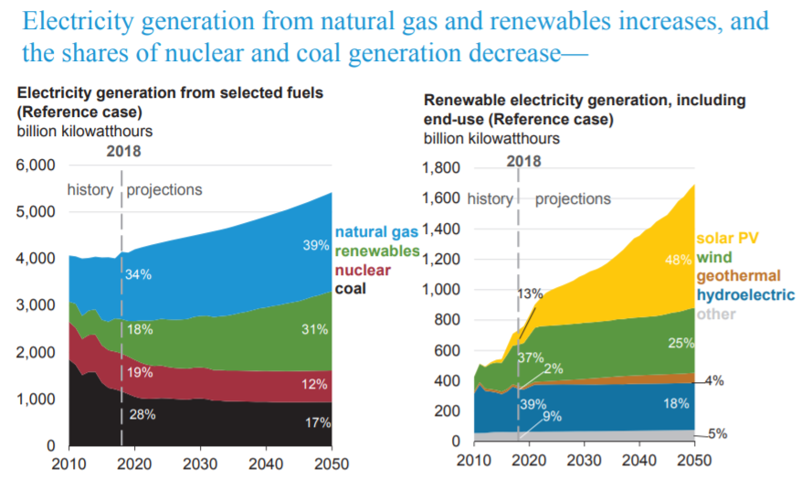
EIA Forecasts Coal at 17% of Electricity Generation by 2050, Down from 30% Today
Source: U.S. Energy Information Administration.

Slide 26
Innovation to Address Concerns

Slide 27
Background
In 2014, the Wyoming State Legislature allocated $15 million for the design, construction, and operation of the Integrated Test Center (ITC) at Dry Fork Station in Gillette, WY.
The goal is to study the capture, sequestration and management of carbon emissions.
The ITC is one of a handful of such facilities around the world and only the second one in the United States.
The ITC Project was started by Governor Mead and spearheaded by the WY Infrastructure Authority.

Slide 28
Carbon XPrize Competition
An NRG COSIA Carbon XPrize sponsored a $20 million prize to a commercially viable technology developed from the effort at the ITC.
  The competition is structured as a two-track prize, with the new technologies tested at either a coal power plant or a natural gas power plant. A total of US$20M will be awarded to winning teams, with US$10M awarded for each track. https://carbon-xprize.cosia.ca/xprize-about
Researchers from around the world will test Carbon Capture, Utilization and Sequestration (CCUS) technologies using 20 megawatts (MW) of actual coal-based flue gas.
Along with testing capture technologies, additional research will look at taking flue gas and turning it into a marketable commodities such as concrete, biofuels, and fertilizers.

Slide 29
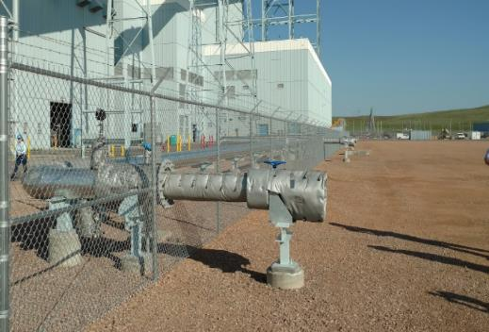
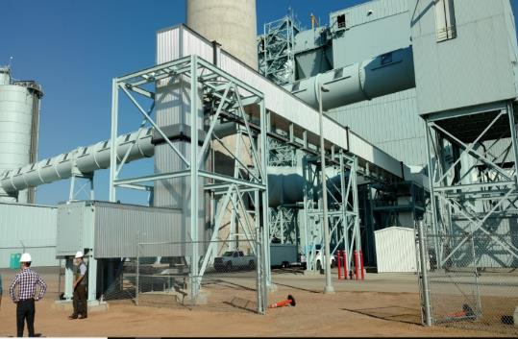
The ITC will utilize two different sized test bays for the competitors in the Carbon XPrize competition
Small Test Bays
Large Test Bays
Source: University of Wyoming School of Energy Resources

Slide 30
CarbonSAFE
CarbonSAFE (Storage, Assurance, and Facility Enterprise) project.
Initiated by the University of Wyoming’s School of Energy Resources.
Hosted at Dry Fork Station in Gillette, Wyoming.
This is a 4-phase project:
  Phase 1: Integrated CCS Pre-Feasibility,
  Phase 2: Storage Complex Feasibility,
  Phase 3: Site Characterization,
  Phase 4: Permitting and Construction.

Slide 31
CarbonSAFE Phase 2
University of Wyoming’s Research Questions:
Is there sufficient volume in the subsurface to store commercial quantities (2 million tons per year ) of CO₂?
Can the CO₂ be injected safely? Stored permanently?
What are the risks?
Source: University of Wyoming School of Energy Resources

Slide 32
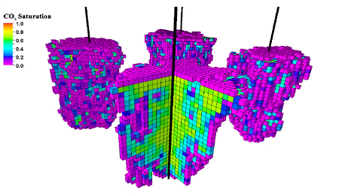
CarbonSAFE Phase 2 (cont.)
How they will attempt to answer these questions:
Drill a 10,200 foot deep research well. Gillette-based company, Cyclone Drilling began Mid April 2019
Collect subsurface well data.
Acquire 12.5 mi² 3D seismic survey.
Create a complex computer model from the well data to test various scenarios.
Source: University of Wyoming School of Energy Resources

Slide 33
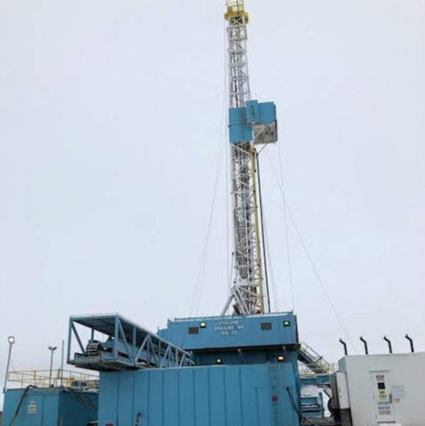
Research Well

Slide 34
CarbonSAFE Location Advantages
CO₂ Source: Engaged Industry Partners
Saline Storage: Text book geologic reservoirs, that have a low risk of leaking, for storage.
Induced seismicity: Low risk of induced seismicity (Earthquakes).
Favorable Economics: Proximal enhanced oil recovery and CO₂ transport opportunity.
Source: University of Wyoming School of Energy Resources

Slide 35
CarbonSAFE - Why Wyoming
Capable Coordination Team: Experienced and diverse coordination team (Academia, Industry and Regulatory).
CO₂ Transport: Existing statewide CO₂ pipeline and pipeline ROW’s.
Pore Space Ownership: Pore space ownership is defined.
Regulatory: CCUS friendly regulatory environment, pending application for WY Class VI primacy.
Public Awareness: Energy educated community.
Trained Workforce: CCUS industry jobs analogous to energy industry jobs.
Source: University of Wyoming School of Energy Resources

Slide 36
Additional Related Opportunities
Clean Coal Technologies, Inc.
  $1m from University of Wyoming School of Energy Resources.
  CCTI has developed a process that will remove water but prevents spontaneous combustion – thus reducing weight, increasing BTU value and making it safer to transport.
  Set up test facility at the former Fort Union Mine.
Carbontech Labs
  Uses ITC as an incubator.
  Launchpad for new carbon related products or uses.
  Business accelerator group, help up and coming groups find capital and business leadership.

Slide 37
Continued Energy Development is Important to Wyoming

Slide 38

Energy Development and a Clean Environment are not mutually exclusive

Slide 39
Wyoming’s State of the Environment 2018
Since 2008, NO_{x} emissions from 115 (Title V) large facilities have been reduced by 47,537 tons. Equivalent to emissions from 5.4 mil. cars or 3.9 mil. light trucks
Since 1977 under the AML program:
  25,155 acres reclaimed as habitat and range land.
  2,473 mine openings closed.
  127 miles of impaired streams restored.
Source: Wyoming DEQ

Slide 40
Wyoming’s State of the Environment 2018 (cont.)
Active Coal mines:
  184,488 total acres disturbed
  37,835 acres of long-term support facilities
  106,964 acres in reclamation phases
  39,689 acres actively being mined
Source: Wyoming DEQ

Slide 41
Possible Strategies
to Maintain Wyoming’s Role

Slide 42
Be Forward Thinking
“It doesn’t matter whether or not you believe in man-induced global warming, the world does.”
“Crude coal” can be used for other products the same way “crude oil” is used to derive other products such as plastics.
Wyoming, as the first in so many issues, needs to be part of the solution. “If you are not at the table, you are on the menu.”

Slide 43
Current Entities in Wyoming Working on Solutions
University of Wyoming School of Energy Resources
Wyoming Infrastructure Authority
Western Research Institute
Wyoming Business Council
ENDOW
Campbell County Commissioners
City of Gillette
Energy Capital Economic Development
Wyoming Mining Association
Many others

Slide 44
Local or Regional Policies
Building off CarbonSAFE and other initiatives, develop – and thereafter export – business, finance & regulatory models for Carbon Capture and Storage (CCS) / Carbon Capture, Utilization, and Storage (CCUS) and other low-carbon projects and technologies.
Continue to evaluate the use of CCS/CCUS in northeastern WY and elsewhere in the state.
Continue to bring world innovators and researchers to this area.
Source: University of Wyoming School of Energy Resources

Slide 45
National and International Policies
Engage in the low-carbon energy & related energy bills to ensure Wyoming’s interests are protected.
The Paris Agreement’s “Rulebook” is set to be completed at Conference of the Parties (COP25) in Chile in December 2019.
A key remaining unknown is the fate of the Article 6 Market Mechanisms; Article 6 has the potential to help CCS / CCUS.
  Article 6 of the Paris Agreement form the legal framework to allow use of market-based climate change mitigation mechanisms.
Wyoming needs to be at the table.
Source: University of Wyoming School of Energy Resources

Slide 46
Coal in a New Carbon Age
Key questions
  What significant market-scale opportunities exist for new markets for coal?
  What are the economic, energy security, trade and other issues the U.S. faces now that can be addressed with new markets for coal?
Recommendations
  Establish a focused R&D program on coal-to-products
  Accelerate research-to-commercial deployment in coal-to-products markets
  Incentivize private sector investment in coal-to-products production and manufacturing sectors
National Coal Council, https://www.nationalcoalcouncil.org (August 31, 2018)

Slide 47

Questions ?

