Slide 1
Assessment of Native Warm-Season Grasses for Post-Mining Reclamation
Jesse I. Morrison, M.K. Parker, N.R. McGrew & B.S. Baldwin
American Society of Mining and Reclamation
June 5, 2019

Slide 2
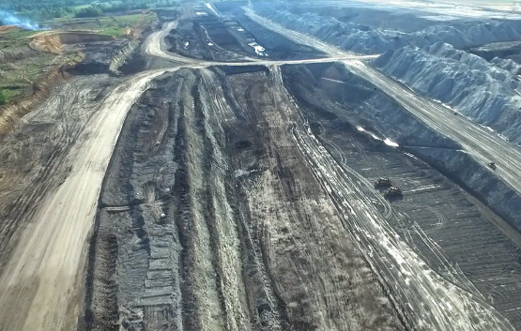
Background
The Red Hills Mine (RHM) is a currently operating, large-scale, surface lignite mine.
Located in Ackerman, MS
Adjacent to 440-MW power plant
Commercial lignite delivery began in 2002
Annual production of ~3.6M tons year⁻¹
Current permit includes ~6,000 acres
Active lignite coal extraction at Red Hills Mine

Slide 3
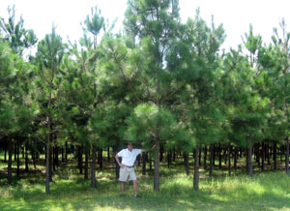
Land Reclamation
Reclamation to Date
Currently reclaiming ~100 acres yr⁻¹
1,400 acres reclaimed to date
Largely (~85%) forestry post-mine use
Loblolly pine
Mixed hardwoods
Approx. 10% cropland post-mine use
Open grasslands
Eight year-old loblolly pines at Red Hills Mine

Slide 4
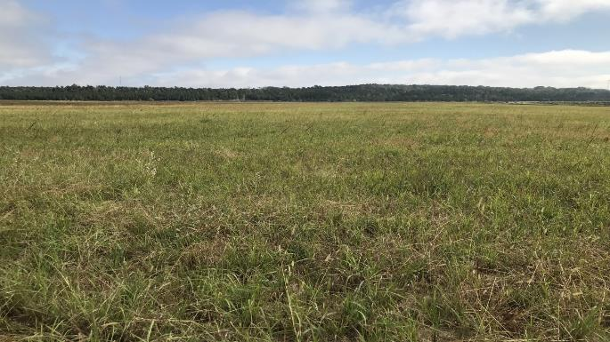
Land Reclamation
Reclamation to Date
Currently reclaiming ~100 acres yr⁻¹
1,400 acres reclaimed to date
Largely (~85%) forestry post-mine use
Loblolly pine
Mixed hardwoods
Approx. 10% cropland post-mine use
Open grasslands
Reclaimed native grassland at Red Hills Mine

Slide 5
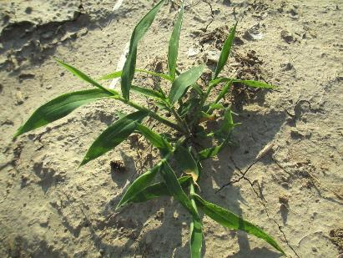
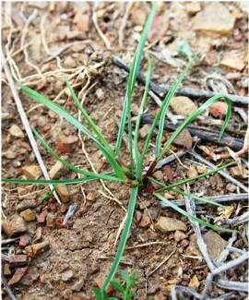
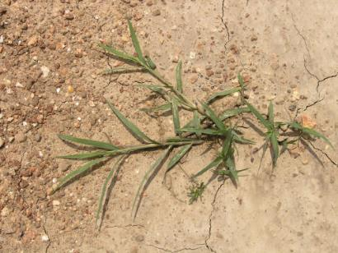
Land Reclamation
Early reclamation utilizes rapidly establishing annual and perennial grasses.
Browntop millet (Urochloa ramosa)
Annual ryegrass (Lolium multiflorum)
Bermudagrass (Cynodon dactylon)

Slide 6
The Issue…
Environmental Department at RHM was interested in incorporating native warm-season grasses (NWSGs) in future reclamation
Minimum productivity requirement in revegetation standards
Mean yield 5 DM tons acre⁻¹ yr⁻¹ over 5-yr period
Tendency for slow establishment
No native species listed in approved revegetation standards
Required MDEQ approval
Majority of grasslands harvested for hay or managed for wildlife habitat
Sought increased habitat quality in native species

Slide 7
Objectives
Evaluate ability of NWSGs to meet minimum productivity standards
Following 1-yr establishment
Compare nutritive value of NWSGs to BG under similar management
Current fertility and harvest scenario at RHM
If successful, evaluate possibility of minimizing fertilizer use at RHM
Managing environmental impact
Decreasing disturbance of wildlife nesting sites

Slide 8
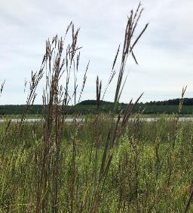
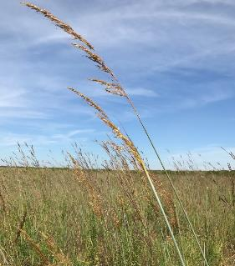
Native Warm-Season Grass Cultivars
Big bluestem (Andropogon gerardii Vitman; BBS)
Kaw
Little bluestem [Schizachyrium scoparium (Michx.) Nash.; LBS]
Cimarron
Indiangrass [Sorghastrum nutans (L.) Nash.; IG]
Cheyenne
Upland switchgrass (Panicum virgatum L.; USWG)
Cave-in-Rock
Common bermudagrass
All native seed sourced from Roundstone Native Seed, LLC

Slide 9
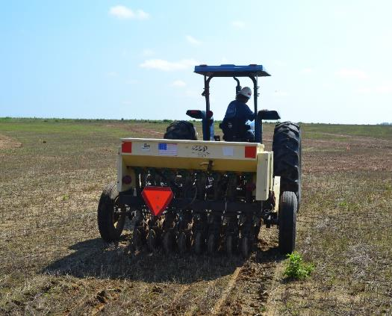
Establishment Methods
Glyphosate applied 21d pre-plant
0.84 lb a.i. acre⁻¹
All species were established from seed
June, 2015 and 2016
Drilled at ¼” using a Truax® FlexII no-till drill
Target pure live seed (PLS) rates:
BBS - 10 lb a⁻¹
LBS - 10 lb a⁻¹
IG - 11 lb a⁻¹
USWG - 12 lb a⁻¹
BG - 19 lb a⁻¹
Establishing research plots at Red Hills Mine

Slide 10
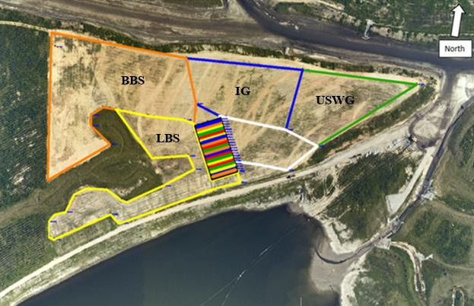
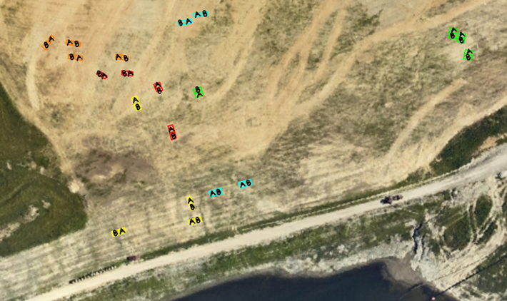
Experimental Design
A total of 20 test plots were identified
Plots measured 12’ x 12’,
Randomized Complete Block
Block = Species
Split Plot
Main plot factor = Harvest #
Sub plot factor = Supplemental N fertilizer
-BBS -LBS -IG -USWG -BG

Slide 11
Methods Following Establishment Year
March: Controlled burn was performed
April: 2,4-D was applied at a rate of 2.0 lb a.i. a⁻¹
May: Apply Permit (halosulfuron, 0.6 lb a.i. a⁻¹) and Plateau (imazapic, 0.06 lb a.i. a⁻¹)
Mid-May - HARVEST ALL PLOTS
45 day rest
Late June - HARVEST 3-CUT PLOTS ONLY
July: Apply 65 lb of N, P, & K (13-13-13 granular)
August: Apply 20 lb N (33-0-0 granular) treatments
November: HARVEST ALL PLOTS

Slide 12
Harvest Methods
Prior to the first harvest, each test plot was divided into a 2-harvest or a 3-harvest plot.
2-harvest: mid-May, end of season
3-harvest: mid-May, late-June (45 days), end of season
A 54” swath was harvested from the middle of each plot
Zero-turn mower equipped with a bagging system
5” stubble height
Whole plot weights were collected for yield estimation
Subsamples (~0.25lb) were collected for dry matter determination and nutritive analysis

Slide 13
Results: Summer, 2017 Harvests Biomass Yield x Harvest Regime
NWSG significantly increased biomass yields over BG
Mixed results in 2-Cut vs 3-Cut system
Short stature LBS performed exceptionally well
AB
AB
CD
CD
2 Cut
3 Cut

Slide 14
Results: Fall, 2017 Harvest Biomass Yield x Harvest Regime
Decrease in end-of-season yields in 3-cut system
Short stature LBS performs well
Upland switchgrass responds negatively to increased harvesting
CD
CD
D
2 Cut
3 Cut

Slide 15
Results: 2017 2-Cut Treatment Biomass Yield x Fertilizer Treatment
Non-uniform response to fertilizer treatment
CD
CD
CD

Slide 16
Conclusions and Discussion: 2017-2018 Biomass Yield
Native species out-yielded bermudagrass for all included treatments
Given added ecological benefit over bermudagrass, inclusion of natives in future reclamation will likely be permanent
Supplemental N had little effect on yield
Timing of application and fertilizer rate should be evaluated to maximize fertilizer use efficiency, forage/habitat quality, and profitability
Little bluestem produced unexpected sustained yield throughout season
Perhaps an effect of cutting height (~5”)
Two-year old NWSG stands do not meet required 5 ton acre⁻¹ year⁻¹
Yield expected to increase until stand reaches ~4 years
Monoculture vs. mixed species

Slide 17
references
DeLong, C. and M. Brittingham. 2014. Warm-season grasses and wildlife. Pennsylvania State University Extension Publ. UH158, State College, PA
Harper, C.A., G.E. Bates, M.P. Hansbrough, M.J. Gudlin, J.P. Gruchy, and P.D. Keyser. 2007. Native warm-season grasses identification, establishment, and management for wildlife and forage production in the Mid-South. Univ. of Tennessee Extension Publ. 1752, Knoxville, TN.
Keyser, P., G. Bates, J. Waller, C. Harper, and E. Dixon. 2011. Producing hay from native warm-season grasses in the Mid-South. Univ. of Tennessee Extension Publ. SP731-D, Knoxville, TN.
Kuenstler, W.F., D.S. Henry, and S.A. Sanders. 1983. Using prairie grasses for forage production on mine spoil. 7th North American Prairie Conference, p. 215-218.
Mississippi Commission on Environmental Quality (MCEQ). 2007. Regulations governing surface coal mining in Mississippi. http://sos.ms.gov/ACProposed/00014610b.pdf (accessed 20 Sept. 2016).
Seymour, R., J. Seymour, and C. Blackford. 2008. Six basic elements for a successful native grass and forb establishment. Roundstone Native Seed, LLC, Upton, KY. https://www.tn.gov/assets/entities/twra/attachments/nativegrass6elements.pdf (accessed 9 June 2015).
All photo credits: Jesse Morrison and Red Hills Mine

Slide 18
Questions? Contact: JESSE.MORRISON@msstate.edu
Acknowledgements
North American Coal Corporation
Mississippi State University
Red Hills Mine

