Slide 1

Native Warm-Season Grasses That Germinate on Command
Brian S. Baldwin¹, Jesse I. Morrison¹, and J. Brett Rushing²
¹Dept. of Plant & Soil Sciences, Mississippi State, MS
²Dept. of Plant & Soil Sciences, Coastal Plains Res. & Ext. Center, Newton, MS
5 June 2019
American Society of Mining and Restoration
Big Sky, Montana

Slide 2
Characteristics
Co-adapted with North American ecosystems and wildlife
  Especially ground-nesting birds
Very deep rooted
  Drought tolerant
  Marginal soils
Tall, bunch-type grasses
Long-lived perennial grasses
  >25 yrs
Notes:
These are all warm-season meaning they begin to grow vegetatively at the end of spring, when the temperatures are on the rise.
Because they are perennial we can compare our selected populations within any given year-when determining progress this allows us to reduce un-accountable variation due to the environment
They are difficult to establish in a field from seed for several reasons:
1)the growth rate is slow during the seedling stage, giving weeds the opportunity to shade-out and out-compete these grasses.
2)Also, these grasses have extensive seed dormancy which prevents uniform germination and this also allows weeds to get an upper-hand
Dormancy can be defined as viable seed that does not germinate under ideal conditions. Most crops have been domesticated and the dormancy is all but removed. However, this is not the case with these grasses. To break the dormancy the seed are typically stratified prior to planting. This involves subjecting moist seed to cold temperatures (around 4 degrees C) for 2 weeks. The alternative is storing the seed for about a year to reduce dormancy. Both options are an inconvenience to producers.

Slide 3
Uses
Restoration and reclamation
  Mining and other disturbed industrial sites
Conservation and wildlife
Roadside vegetation
Livestock pasture and hay
  Gains of greater than1-2 lbs/day
Notes:
These are all warm-season meaning they begin to grow vegetatively at the end of spring, when the temperatures are on the rise.
Because they are perennial we can compare our selected populations within any given year-when determining progress this allows us to reduce un-accountable variation due to the environment
They are difficult to establish in a field from seed for several reasons:
1)the growth rate is slow during the seedling stage, giving weeds the opportunity to shade-out and out-compete these grasses.
2)Also, these grasses have extensive seed dormancy which prevents uniform germination and this also allows weeds to get an upper-hand
Dormancy can be defined as viable seed that does not germinate under ideal conditions. Most crops have been domesticated and the dormancy is all but removed. However, this is not the case with these grasses. To break the dormancy the seed are typically stratified prior to planting. This involves subjecting moist seed to cold temperatures (around 4 degrees C) for 2 weeks. The alternative is storing the seed for about a year to reduce dormancy. Both options are an inconvenience to producers.

Slide 4
Deleterious characteristics
Difficult to establish in the field
  Extensive seed dormancy
    Failure of seed to germinate even though conditions are optimal
  Slow initial growth
    Attributed to crown development
  Weed competition
  Doak et al. ENGS 2002

Slide 5
Domestication of grasses
Old World grass species
  Selection pressure on Old World grasses/forages for about 6,000 yrs

Slide 6
Domestication of grasses
Old World grass species
  Selection pressure on Old World grasses/forages for about 6,000 yrs
New World grass species
  About 80 yrs, or so

Slide 7
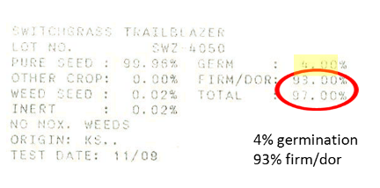
Native seed and percentage germination
Switchgrass Trailblazer
Lot No.: SWZ 4050
Pure Seed : 99.98% Germ: 4.00%
Other Crop : 0.00% Firm/Dor : 93.00%
Weed Seed : 0.02% Total : 97.00%
Inert %: 0.02%
NO NOX WEEDS
Origin: KS.
Test Date: 11/09
300 lbs/A

Slide 8
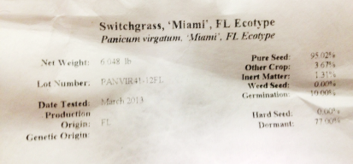


Examples
77% dormant
66% dormant
77% dormant

Slide 9
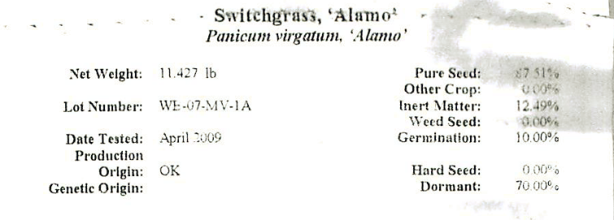

Seed dormancy
“Incorporation of native species into a breeding program for other traits [and the subsequent seed increases] reduces seed dormancy by eliminating seed that don’t germinate.”
‘Alamo’ released in 1978

Slide 10
Let’s do the Math $
If the seed lot is 77% dormant, then only 23% of the seed will germinate immediately after planting.
Planting rate of 8 lbs/A PLS for most native grasses = 1.84 lbs/A living seedlings.
Planting rate goes up 4.35 to get equivalent of 8 lbs = 34.8 lbs/A for minimum recommended coverage
At a price of $10.95 per ¼ lb = $1,523.47/A
At a price of $18.95 per ¼ lb = $2,637.84/A

Slide 11
Methods to overcome seed dormancy
Stratification – 8-10 wks
Scarification – acids or mechanical abrasion
Chemical treatments – K₂NO₃, H₂O₂, Na₂HClO₃
Hormones/PGRs - GA₃
Priming – limited success
Generally:
  Ineffective commercially
  Use caustic chemicals
  Reversible upon drying
Add cost and only circumvent the problem
In the South . . . . . .

Slide 12
Our objective
Select to reduce seed dormancy
  Develop native germplasm adapted to the southeastern U.S. that “germinates on demand” without stratification

Slide 13
Species
Switchgrass, UL & LL [Panicum virgatum L.]
Big bluestem [Andropogon gerardii Vitman]
Indiangrass [Sorghastrum nutans (L.) Nash]
Little bluestem [Schizachyrium scoparium (Michx.) Nash]
Beaked panicum [Panicum anceps L.]
Purpletop [Tridens flavus (L.) Hitchc.]
Eastern gamagrass [Tripsacum dactyloides (L.) L.]
Notes:
PART 2, Seed dormancy is an issue. Note that these two cultivars are 70 and 93% seed dormant seed. Stratification, a cold wet treatment, is used to overcome dormancy, but it is messy, and sometimes is ineffective. Occasionally the seed dormancy resumes after it is dried for planting. These are the seedlots purchased for planting in the field study (they were wet stratified for the field study.)

Slide 14
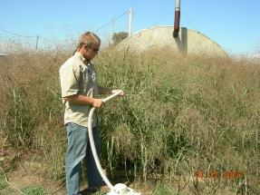
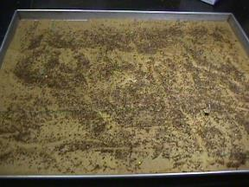
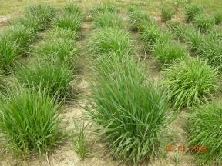
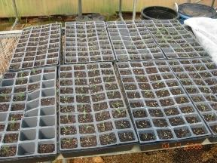
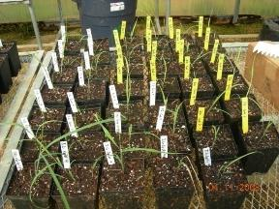
Phenotypic
Recurrent
Selection

Slide 15
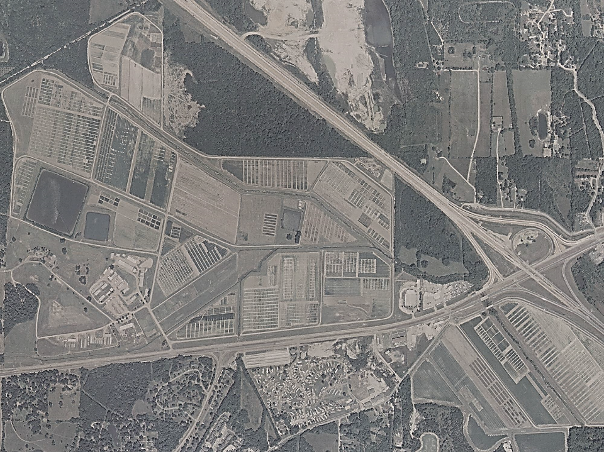
Cycle 4
R.R. Foil Plant Science Research Center
Mississippi State University
Cycle 5
Cycle 0
Cycle 3
Cycle 1
Cycle 6
Cycle 8
Cycle 7
Cycle 2

Slide 16
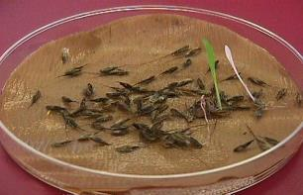
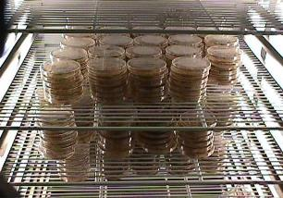
Materials and methods
Population evaluation (AOSA)
  Collected seed from established species blocks
  4 months storage (60% RH @ 70º F)
  6 reps of 100 seed/species/cycle placed in Petri dishes
  Captan®/water solution; germination paper

Slide 17
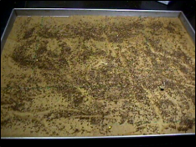
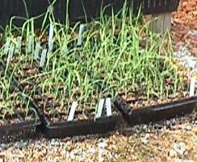
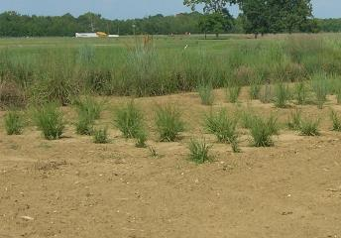
Materials and methods
Mass screening of populations
  Seedlings transplanted to six-packs.
  Surviving seedlings transferred to the greenhouse (transitional period)
  New cycles were established >¼ mile from other cycles.

Slide 18
Big bluestem: 14-day
Cycle | Evaluation/Screening Year |  |  |  |  |  |  |  |  |  | Mean (%) LSD=3.35
 | 2002 | 2003 | 2004 | 2005 | 2006 | 2007 | 2008 | 2009 | 2010 | 2018
 | Mean Germination Percentage by Year
0 | 2.30 | 0.30 | 0.00 | 0.30 | 0.00 | 1.67 | 0.33 | 0.83 | 0.50 | 2.0 | 0.69
1 | 1.50 | 0.20 | 1.50 | 1.00 | 1.60 | 2.53 | 1.83 | 1.33 | 0.00 | 3.2 | 1.27
2 |  |  | 0.50 | 3.30 | 3.50 | 2.00 | 5.33 | 6.50 | 1.00 | 9.0 | 3.02
3 |  |  |  | 3.20 | 4.10 | 16.00 | 9.83 | 13.83 | 6.00 | 19.6 | 8.45
4 |  |  |  |  | 2.30 | 16.33 | 20.17 | 10.00 | 1.50 | 41.0 | 9.91
5 |  |  |  |  |  |  | 0.33 | 27.67 | 14.67 | 14.7 | 14.17
6 |  |  |  |  |  |  |  |  | 16.50 | 35.8 | 13.59
7 |  |  |  |  |  |  |  |  |  | 48.6 | 39.67
†Letter denotes significant differences within the column (P ≤ 0.05)
Kaw = 0.0; Roundtree = 0.0

Slide 19
Indiangrass: 14-day
Cycle | Evaluation/Screening Year |  |  |  |  |  |  |  |  |  | Mean (%) LSD=3.40
 | 2002 | 2003 | 2004 | 2005 | 2006 | 2007 | 2008 | 2009 | 2010 | 2018
 | Mean Germination Percentage by Year
0 | 0.20 | 1.70 | 0.30 | 0.33 | 0.83 | 0.33 | 2.33 | 0.00 | 0.00 | 11.6 | 0.64
1 | 0.30 | 2.70 | 2.20 | 2.17 | 2.67 | 11.83 | 4.00 | 0.34 | 0.34 | 11.7 | 2.82
2 |  | 1.00 | 7.50 | 7.50 | 11.67 | 7.17 | 31.67 | 6.00 | 5.66 | 47.3 | 9.54
3 |  |  | 17.00 | 17.00 | 18.50 | 1.00 | 25.83 | 6.00 | 4.66 | 60.1 | 12.54
4 |  |  |  | 1.67 | 0.53 | 18.67 | 19.50 | 11.00 | 19.34 | 48.3 | 17.39
5 |  |  |  |  |  |  | 10.83 | 14.34 | 11.00 | 65.8 | 25.5
6 |  |  |  |  |  |  |  |  | 9.34 | 84.6 | 46.5
7 |  |  |  |  |  |  |  |  |  | 74.0 | 55.67
†Letter denotes significant differences within the column (P ≤ 0.05)
Americus = 0.0; Holt = 0.0

Slide 20
Velocity of Germination
Sometimes called mean germination rate (MGR)
MGT = ΣFx/ ΣF; where F is the number of seed germinated on day x.
MGR =CV/100 =1/T; where T is mean germination time and CV; coefficient of velocity

Slide 21
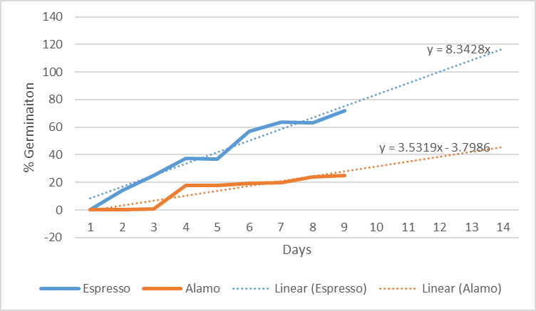
Velocity of Germination
LL switchgrass

Slide 22
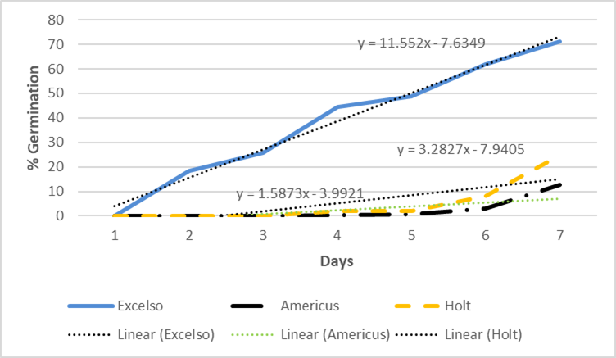
Velocity of Germination
Indiangrass

Slide 23
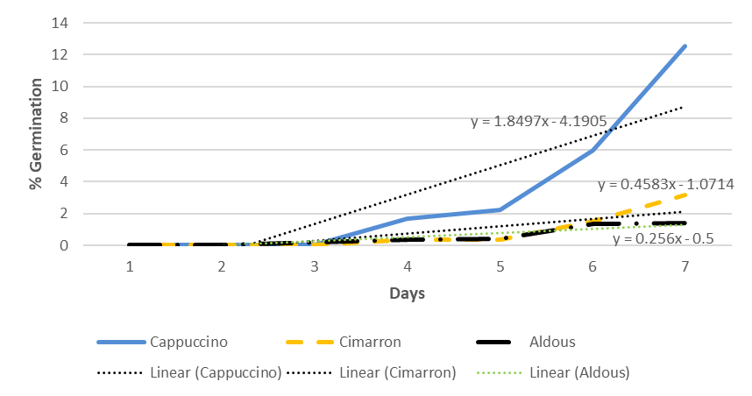
Velocity of Germination
Little bluestem

Slide 24
Results
Species at various levels of improvement for pre-stratification germination
Inadvertently increased velocity of germination
    0.2% precocious germination in 28 days
    94 % precocious germination in 5 days
Five ready for commercial release
  ‘Espresso’ (syn Expresso) LL switchgrass
  ‘Robusto’ UP switchgrass
  ‘Supremo’ big bluestem
  ‘Excelso’ Indiangrass
  ‘Cappuccino’ little bluestem

Slide 25
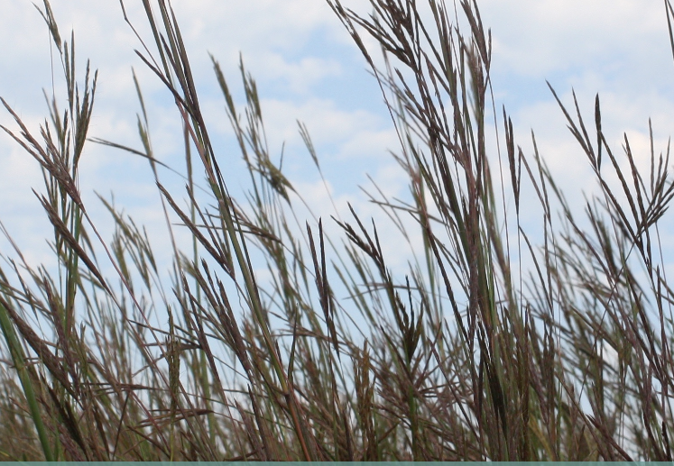

Questions?

