Slide 1
Spaghetti Hole:
Retrofit Options for an Aging Passive Treatment System
Jack Gaughan, Nick McKnight, Logan Madison,
Travis Tasker PhD, Jim Eckenrode, Bill Strosnider PhD
ASMR Annual Meeting
Big Sky, MT
June 5th, 2019
Notes:
JG

Slide 2
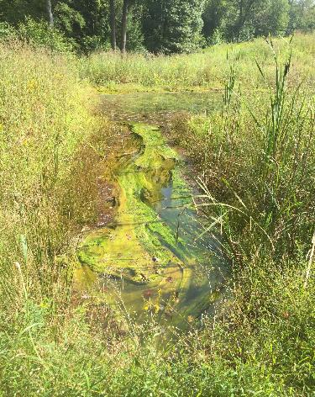
Outline
Site History
Project Introduction
Sampling and Data Collection
Field & Lab Work
Site Evaluation
Choosing & Finalizing Design Solution
Cost Analysis
Grant Proposal
Notes:
LM

Slide 3
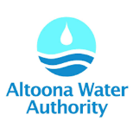
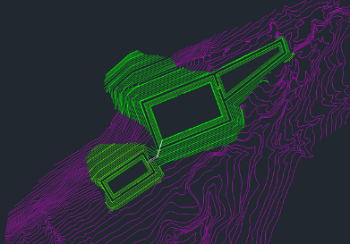
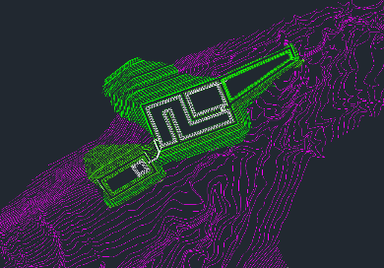
Senior Capstone Project

Slide 4
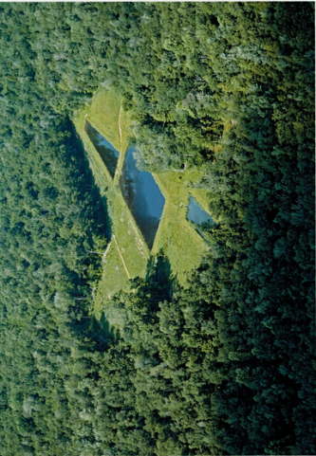
Spaghetti Hole, an aging AMD treatment system
Passive treatment system
Located in the Glenwhite Watershed
1 of 6 passive treatment systems
Constructed in 2002 by DEP
Approximately 20 year lifespan
Maintained by the Altoona Water Authority (AWA)
Notes:
LM

Slide 5
Introduction to the Project
Evaluate existing system:
Determine the efficiency of the existing system
Assess mass loading of metals from the treatment system utilizing field data
Design solution:
Identify problems with the existing passive treatment system
Propose a new design to improve treatment performance
Funding Opportunities
Growing Greener Grant
Notes:
LM

Slide 6
Existing Site
Stabilization Basin: Large unused area where water flows and no reactions occur
Vertical Flow Pond: Anoxic basin filled with limestone and organic layer
Sulfate reducing microorganisms use the sulfate in water and organic layer to convert metals to metal sulfides
Plan View
Isometric View
Stabilization Basin
Wetland Pond
Vertical Flow Pond
Notes:
nm

Slide 7
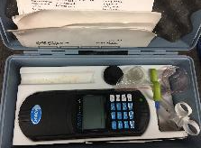
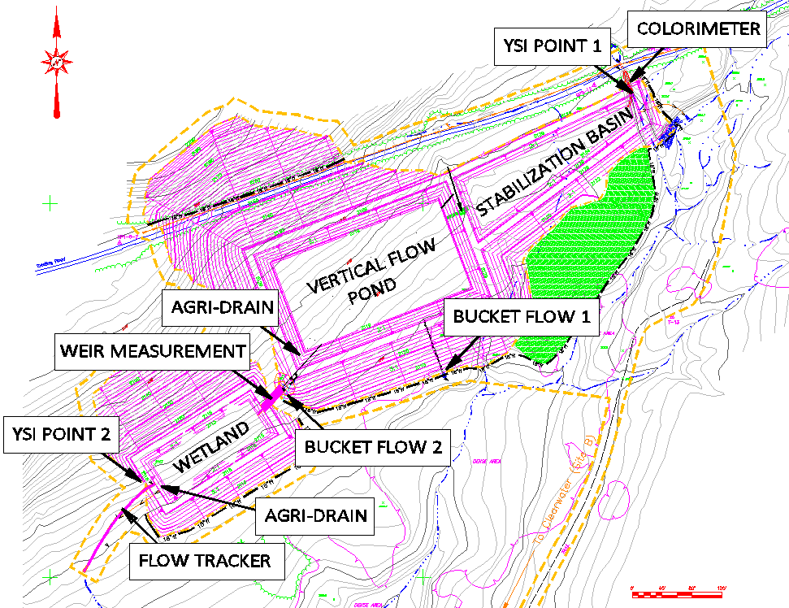
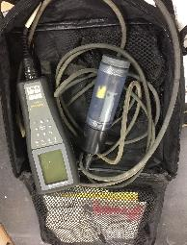
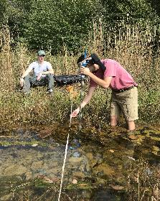
Sampling & Data Collection
Notes:
LM

Slide 8
[Fe] Assessment Comparing Influent & Effluent Water Quality
Secondary MCL (0.3 mg/L)
Notes:
Title & Trendline

Slide 9
[Al] Assessment Comparing Influent & Effluent Water Quality
Secondary MCL (0.2 mg/L)

Slide 10
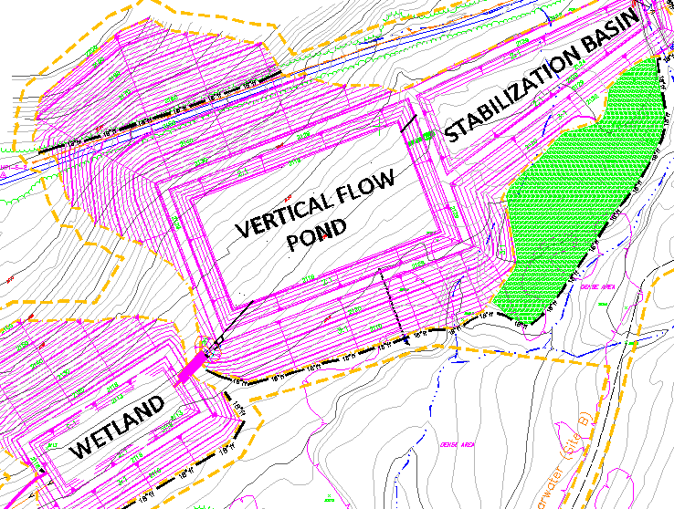
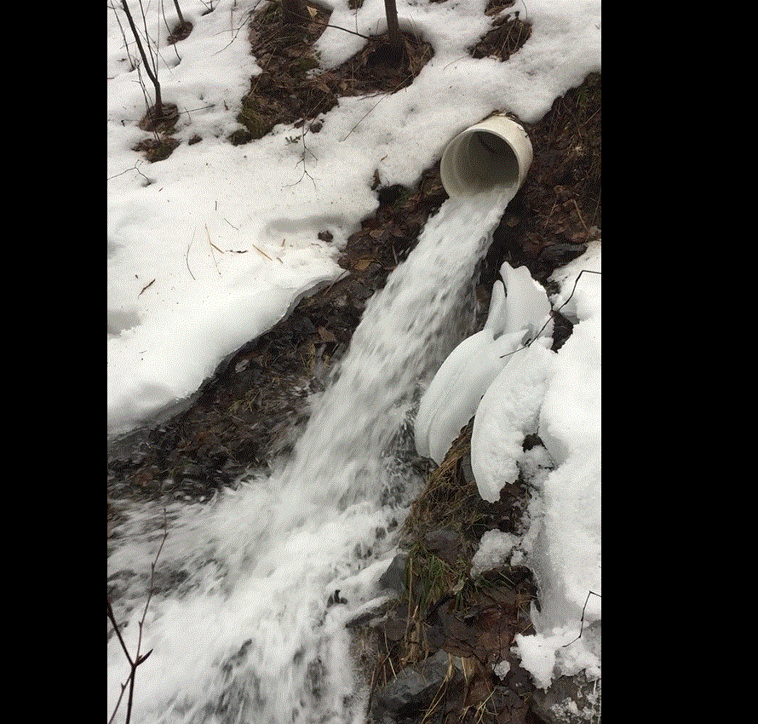
Overflow System

Slide 11
Relative Percentage of Water Bypassing System

Slide 12
Mass Loading of Constituents in Overflow

Slide 13
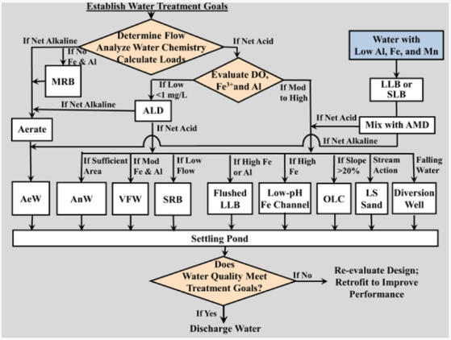
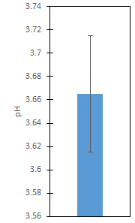
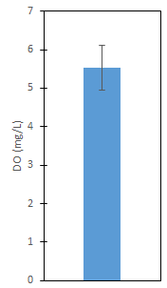
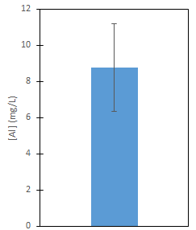
Selecting Possible Solutions for the Spaghetti Hole System Based on Influent Water Quality
Skousen, J., et al. Mine Water Environ (2017) 36: 133. https://doi.org/10.1007/s10230-016-0417-1
Notes:
NM: Skousen, J., Zipper, C.E., Rose, A. et al. Mine Water Environ (2017) 36: 133. https://doi.org/10.1007/s10230-016-0417-1

Slide 14
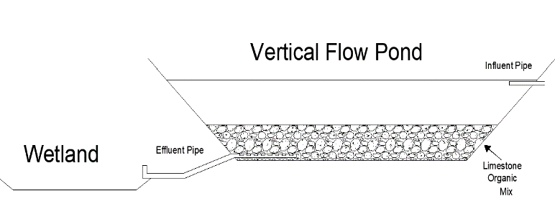
Option 1: Mixed VFP Upgrading the Spaghetti Hole Vertical Flow
Mixing the organic layer and the limestone
Keep permeability of organic layer
Keep pH in range to maintain efficiency of sulfate bacteria
Notes:
NM: JLN Engineering’s idea is to reduce the amount of limestone present and increase the organic layer, to aim to uniformly increase the pH of the system and decrease the potential for dead zones. Also changing the ratio of the organic layer to limestone will help to keep the focus on using the sulfate reducing bacteria to create metal sulfides that can precipitate and fall out of solution when exposed to the atmosphere. Unfortunately because of the pH problems with Al precipitating out at the perfect range that the Sulfate reducing bacteria are most efficient, a flushing system will need to be used, similarly to the system being used right now, to remove the aluminum that will inevitably build up. Looking forward this is a great technology that can be used, but more information is going to need to be uncovered and some wrinkles ironed out.

Slide 15
Option 1: Mixed VFP
Benefits
Relatively cheap solution
Less system downtime
Adequate water treatment
Drawbacks
Clogging of organic layer / underdrainage
Generation of nutrients downstream
Added cost of new organic layer

Slide 16
Option 2: AFLB Retrofit Automatic Flushing Limestone Basin
Choosing a Location
Important to place:
After the stabilization basin
Before the sedimentation basin
Automatic Flushing Limestone Basin
Periodic flushing to treat aluminum and iron
Notes:
LM

Slide 17
Option 2: AFLB
Benefits
Successfully raises the alkalinity and pH
Effectively removes aluminum
Limestone is present at site
Smaller footprint
Drawbacks
System downtime during construction
Relatively more expensive
Limited space
More earthwork

Slide 18
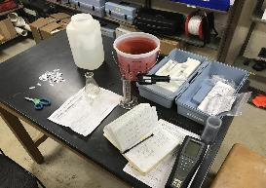
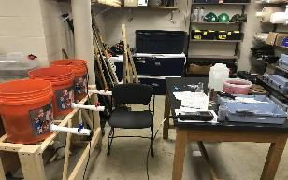
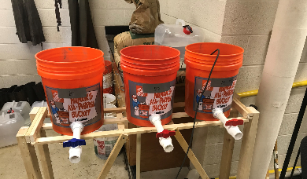
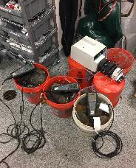
Sizing AFLB: Bench Scale Bucket Testing

Slide 19
Determining a Retention Time

Slide 20
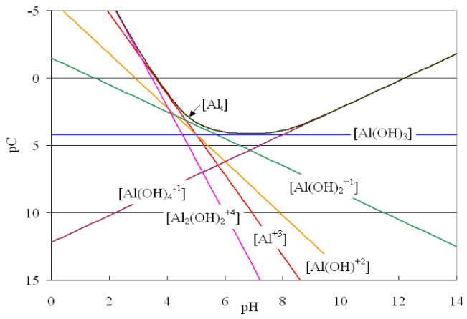
Discussing Solubility & Speciation of [Al] with respect to pH

Slide 21
AutoCad: Existing Site
AutoCad: Proposed Site
Stabilization Basin
Stabilization Basin
Wetland
Automatic Flushing Limestone Basin
Wetland
Vertical Flow Pond
Sedimentation Basin
Notes:
NM

Slide 22
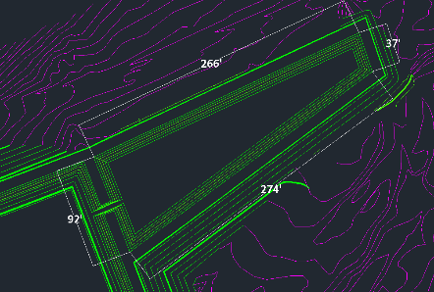
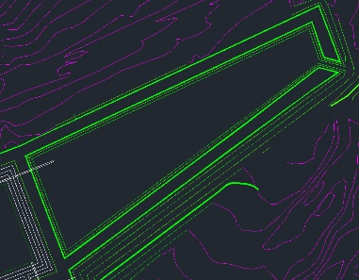
AutoCad: Proposed Stabilization Basin
Stabilization Basin
Moving the organic layer from the VFP to the stabilization basin
Shrink the volume of the basin from 70,000 cubic ft to 30,000 cubic ft
Moving the organic layer to a new site
Before
After
Notes:
NM

Slide 23
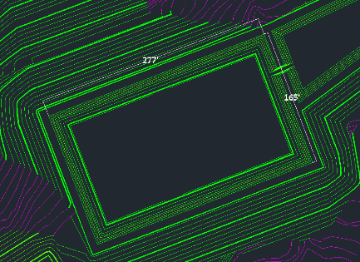
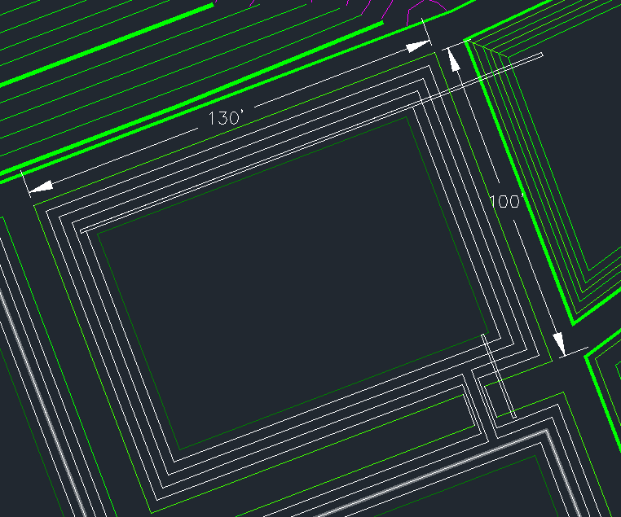
AutoCad: Automatic Flushing Limestone Basin
Automatic flushing limestone basin:
Limestone increases alkalinity and pH of the water
Increased pH reduces metal solubility resulting in metal hydroxide precipitate
Before
After
Notes:
NM

Slide 24
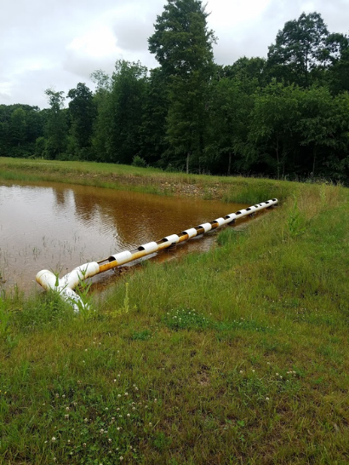
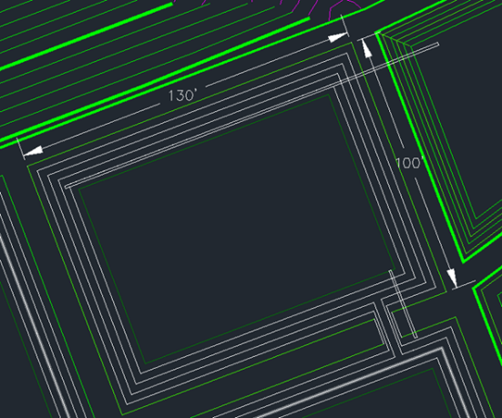
Inflow Structure to Limestone Bed

Slide 25
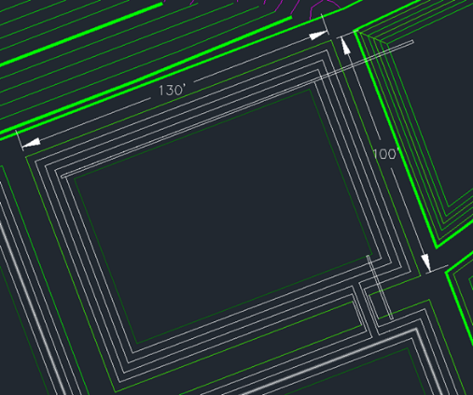
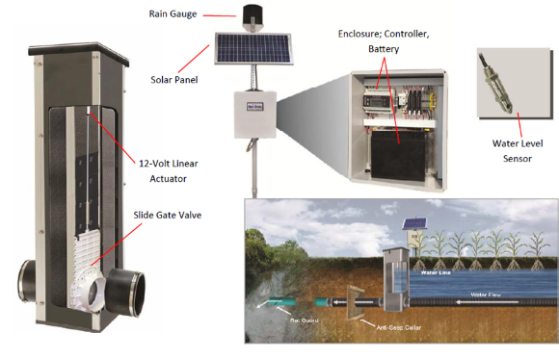
Automatic Flushing Device

Slide 26
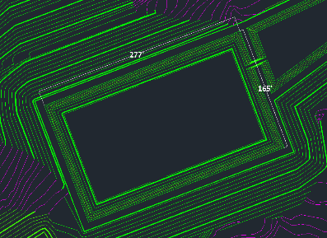
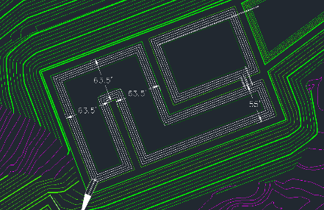
AutoCad: Sedimentation Basin
Sedimentation Basin:
Slow flow allows solid metal hydroxide to settle
Meander to increase time for settling to occur
Before
After
Stabilization Basin
Wetland
Automatic Flushing Limestone Basin
Sedimentation Basin
Notes:
NM

Slide 27
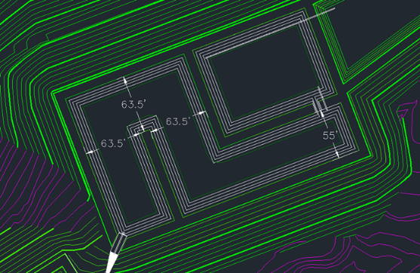
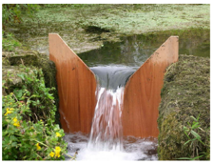
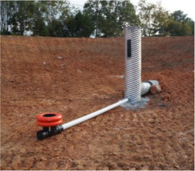
Outlet Structures in Tandem

Slide 28
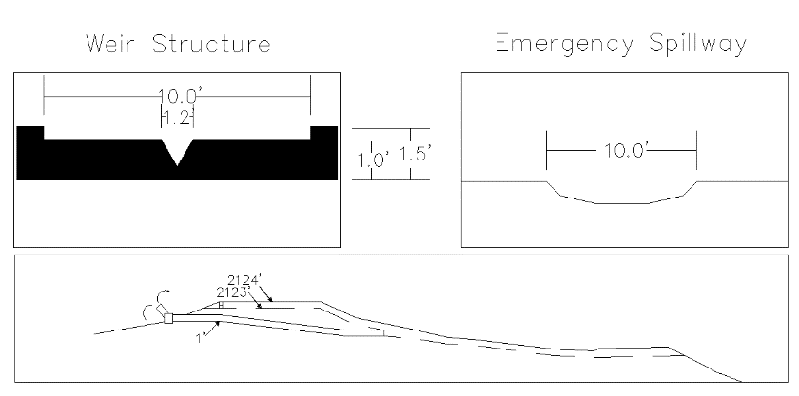
AutoCad: OverFlow Structure Cross Section
Wetland
Automatic Flushing Limestone Basin
Sedimentation Basin
Notes:
NM

Slide 29
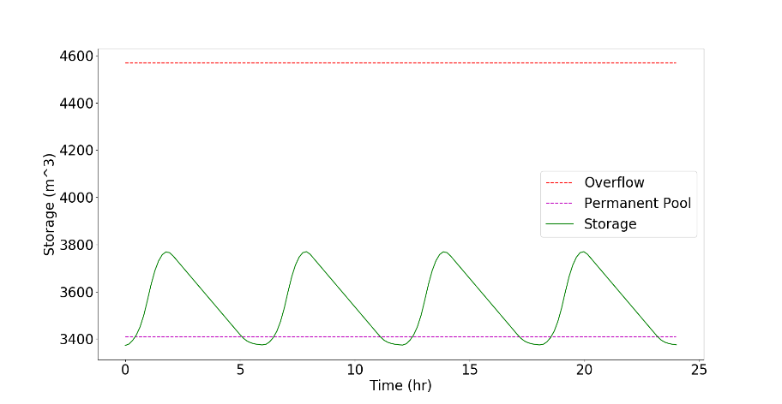
Level Pool Routing: Sedimentation Basin

Slide 30
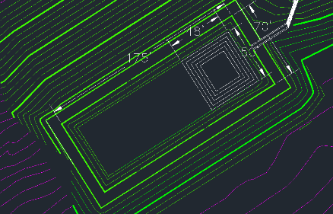
AutoCad: Wetland
Wetland:
Forebay to catch the flushed metal solids
4 ft deep to stop cat tail growth
Approximately 25% of width of site based on in-wetland-plant-growth
Magnanese removal option with limestone implimentation
Before
After
Notes:
NM

Slide 31
Cost Analysis
Construction
Site inspection
Earth work
Limestone
PVC piping - underdrainage
Outlet structures - agri drain, floating outlet structure and weir
E & S control and seeding/mulching
PVC underdrainage removal
Access road
Notes:
LM

Slide 32
Reuse of On-site Materials
Limestone rock currently in the VFP
Total Quantity Present: 3,538 yd³
Limestone to be placed in the automatic flushing limestone basin
1,308 yd³
Left over limestone
3,538 yd³ - 1,308 yd³ = 2,230 yd³
Can be used on the access road, diversion channels, etc.
Notes:
LM

Slide 33
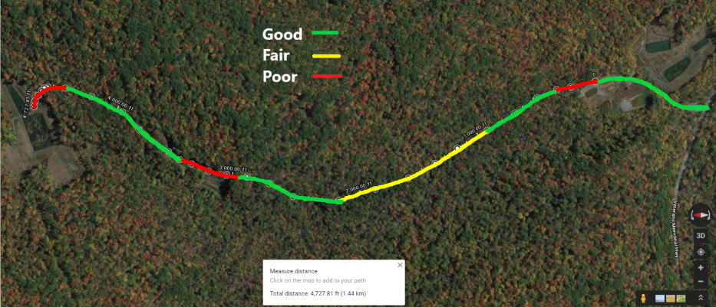
Access Road Breakdown
Notes:
LM

Slide 34
Cost Analysis
Project Component | Cost
Mobilization & Demobilization | $2,000
Construction | $136,500
Engineering (10%) | $13,800
Maintenance | $1500 - $15,000
TOTAL | $153,000
Notes:
LM
Round the numbers

Slide 35
Final Deliverable: Growing Greener Grant
Growing greener grant
Detailed project description
Justification of funding
Scope of work
Cost
Signed letters of commitment

Slide 36
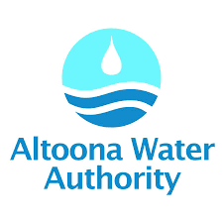
Thanks to...

