Slide 1

Modeling the Effects of Mass Transfer in Limestone-Based Passive Treatment Systems
Joel Bandstra¹, CJ Spellman², and
Dr. William H. J. Strosnider, Ecological Engineer³
¹Environmental Engineering, Saint Francis University
²Civil & Env. Engineering, University of Rhode Island
³Baruch Marine Field Lab, Univ. South Carolina

Slide 2
Outline
Background on mass transfer in calcite dissolution kinetics
Data from an open limestone channel (OLC)
Modeling an OLC assuming MT limited kinetics
Speculation about channel geometry in OLC performance
Points of application

Slide 3
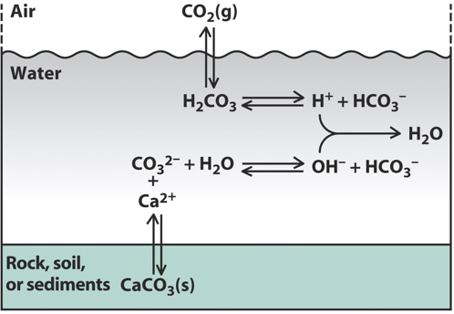
Limestone dissolution requires mass transfer
Ca²⁺
H⁺
Ca²⁺
butane.chem.uiuc.edu/pshapley/
CaCO₃

Slide 4
Limestone dissolution requires mass transfer
Ca²⁺
z
Ca²⁺
butane.chem.uiuc.edu/pshapley/
CaCO₃
[Ca]

Slide 5
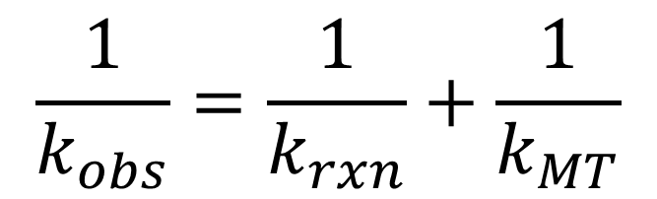
Mass transfer can limit kinetics
$$\frac{1}{k_{obs}}=\frac{1}{k_{rxn}}+\frac{1}{k_{MT}}$$
Ca²⁺
z
Ca²⁺
CaCO₃
[Ca]

Slide 6
Calcite dissolution kinetics can be MT limited
Brantley et al. Kinetics of Water-Rock Interaction (2008)

Slide 7
Recent work suggests broader range of pH
Brantley et al. Kinetics of Water-Rock Interaction (2008)

Slide 8
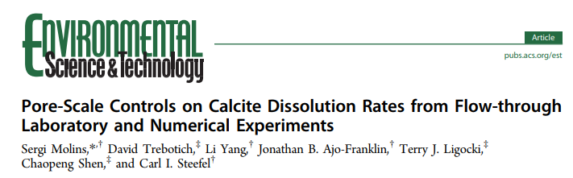
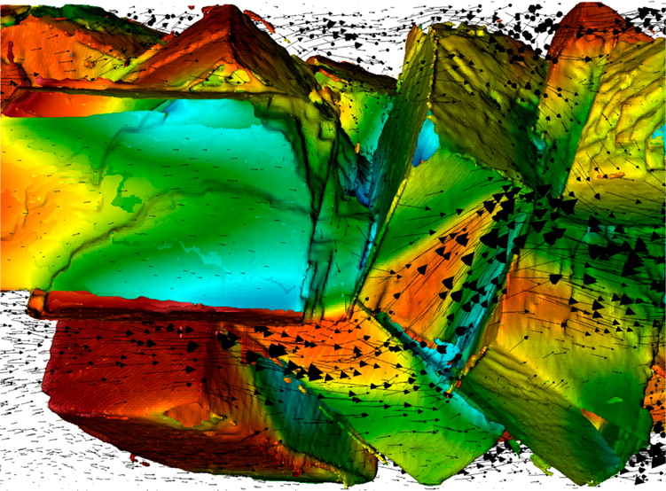
Calcite dissolution kinetics can be MT limited
Brantley et al. Kinetics of Water-Rock Interaction (2008)

Slide 9
Outline
Background on mass transfer in calcite dissolution kinetics
Data from an open limestone channel (OLC)
Modeling an OLC assuming MT limited kinetics
Speculation about channel geometry in OLC performance
Points of application

Slide 10
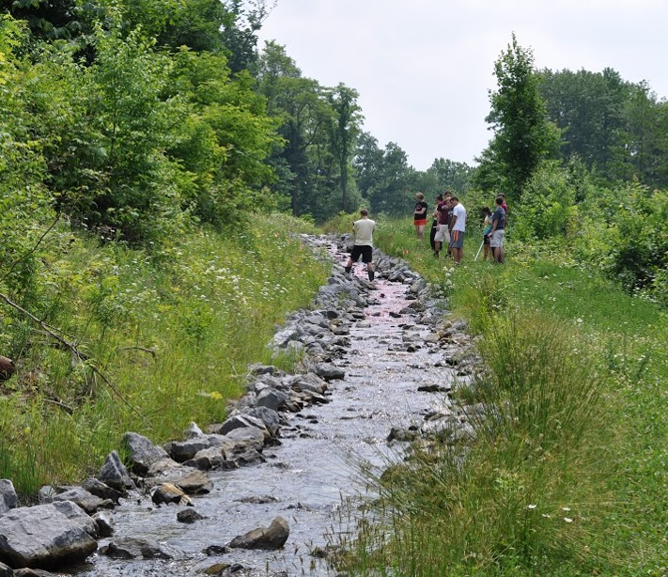
Swank Open Limestone Channel
Length 275 m
Width 1.5 m
Slope 6-9%
Avg. Flow 35 L/s
Avg. Influent
pH 3.5
Al 7.4 mg/L
Fe 0.5 mg/L
Mn 0.7 mg/L
Sampled over 4 year period for metals, pH, T, flow (at top and bottom)
Five sampling points along length of channel
Performed tracer tests

Slide 11
Time series suggest residence time is important

Slide 12
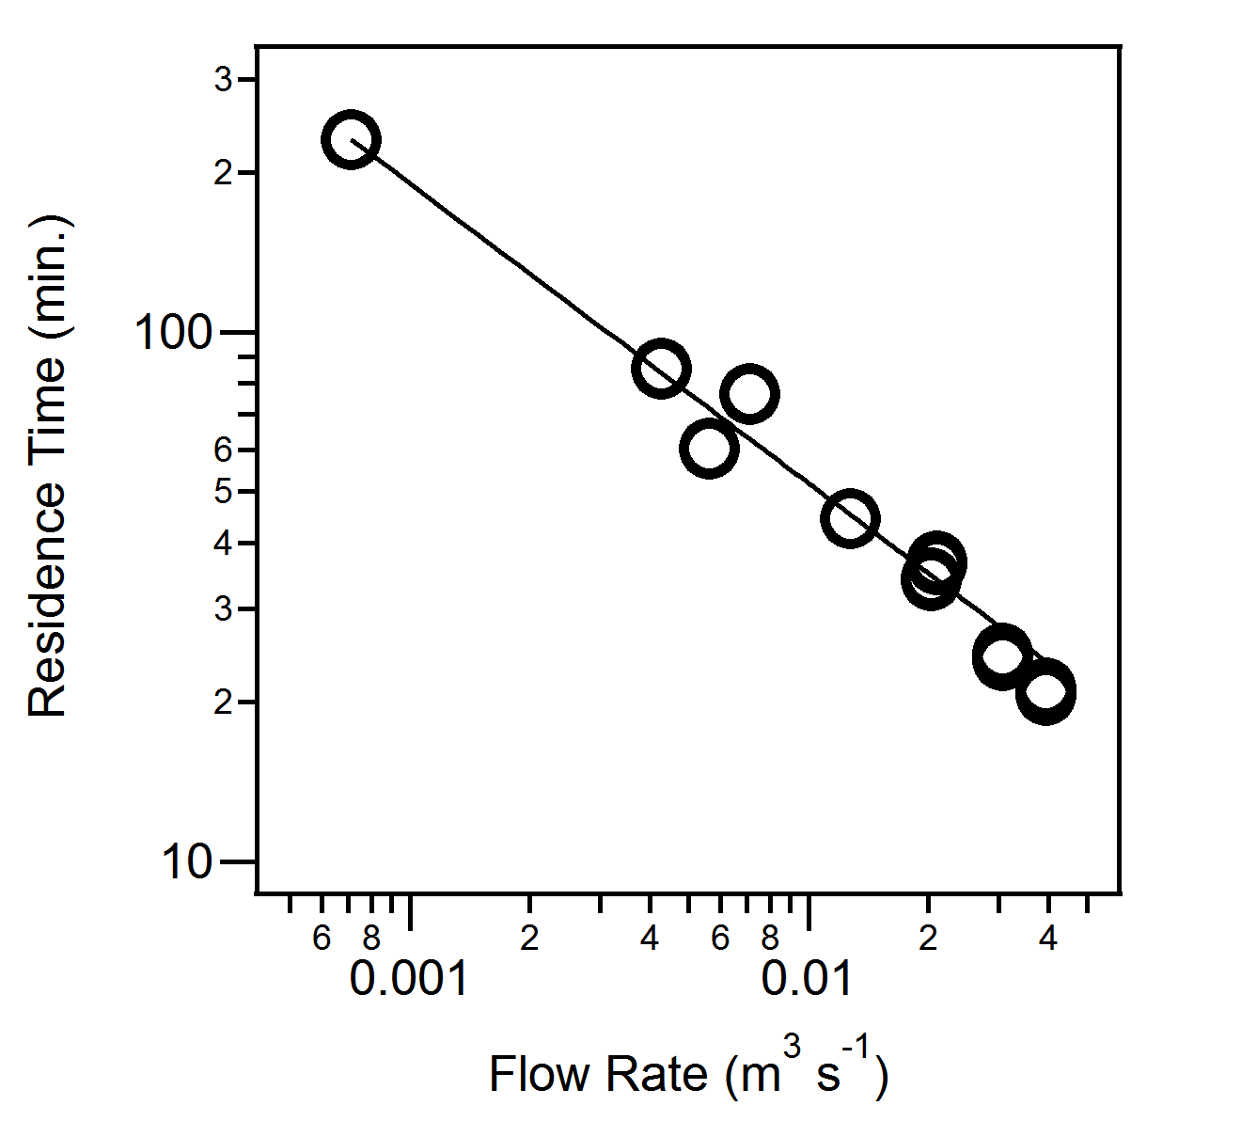
Residence time follows a power law w/ Q
Length 275 m
Width 1.5 m
Avg. Flow 35 L/s
Avg. Influent
pH 3.5
Al 7.4 mg/L
Fe 0.5 mg/L
Mn 0.7 mg/L

Slide 13
Al is removed at a “low” pH
Solubility of Al:
870 mg/L

Slide 14
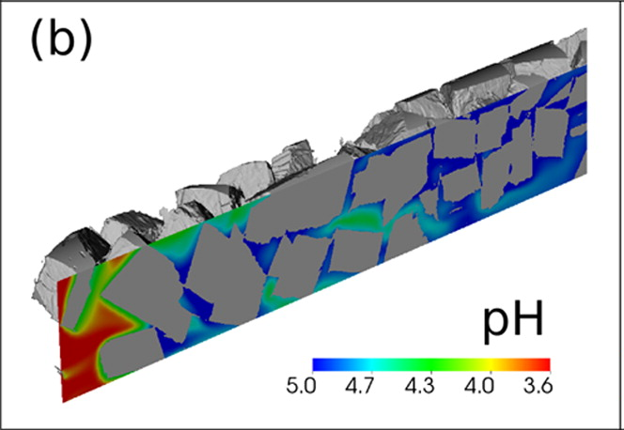
High pH zone may exist near surface or in pores

Slide 15
Outline
Background on mass transfer in calcite dissolution kinetics
Data from an open limestone channel (OLC)
Modeling an OLC assuming MT limited kinetics
Speculation about channel geometry in OLC performance
Points of application

Slide 16
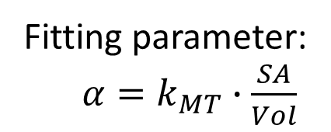
A mass transfer limited model
5 m
CO₂
CO₂
CO₂
=
=
=
…
Q, Al, Ca, pH
Mobile
α
α
α
α
α
Ca²⁺ CO₃⁻
Ca²⁺ CO₃⁻
Ca²⁺ CO₃⁻
Ca²⁺ CO₃⁻
Immobile
=
=
=
=
CaCO₃
CaCO₃
CaCO₃
CaCO₃
275 m
Implemented in PHREEQC
Inputs:
Flow & influent chemistry
Fitting parameter:
$α=k_{MT}∙\frac{SA}{Vol}$

Slide 17
General behavior of the model
Notes:
Step through the results:
-Ca goes up driven by alpha and vel.
-pH goes up, leveling out at equil
-Al is removed, first at slow rate, then at fast rate
-can be understood in terms of pH and SI

Slide 18
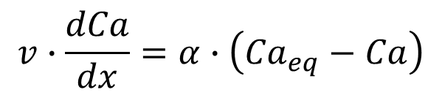
Ca increases with time constant α/v
$$v∙\frac{dCa}{dx}=α∙\left({Ca}_{eq}−Ca\right)$$
Notes:
Step through the results:
-Ca goes up driven by alpha and vel.
-pH goes up, leveling out at equil
-Al is removed, first at slow rate, then at fast rate
-can be understood in terms of pH and SI

Slide 19
pH increases, but with a pause around 5.2
Notes:
Step through the results:
-Ca goes up driven by alpha and vel.
-pH goes up, leveling out at equil
-Al is removed, first at slow rate, then at fast rate
-can be understood in terms of pH and SI

Slide 20
Al disappears, slow at first then fast
Notes:
Step through the results:
-Ca goes up driven by alpha and vel.
-pH goes up, leveling out at equil
-Al is removed, first at slow rate, then at fast rate
-can be understood in terms of pH and SI

Slide 21
Slow Al disappearance is at low pH and MT limited
Notes:
Step through the results:
-Ca goes up driven by alpha and vel.
-pH goes up, leveling out at equil
-Al is removed, first at slow rate, then at fast rate
-can be understood in terms of pH and SI

Slide 22
Sat. Index tells same story as pH
Notes:
Step through the results:
-Ca goes up driven by alpha and vel.
-pH goes up, leveling out at equil
-Al is removed, first at slow rate, then at fast rate
-can be understood in terms of pH and SI

Slide 23
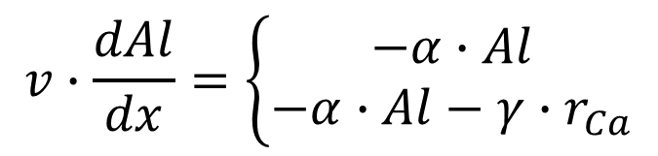
Both slow and fast Al removal are MT limited
$$v∙\frac{dAl}{dx}=\left\{\begin{matrix}−α∙Al \\ −α∙Al−γ∙r_{Ca}\end{matrix}\right.$$
Notes:
Step through the results:
-Ca goes up driven by alpha and vel.
-pH goes up, leveling out at equil
-Al is removed, first at slow rate, then at fast rate
-can be understood in terms of pH and SI

Slide 24
This example simulation is much longer than Swank
Notes:
Step through the results:
-Ca goes up driven by alpha and vel.
-pH goes up, leveling out at equil
-Al is removed, first at slow rate, then at fast rate
-can be understood in terms of pH and SI

Slide 25



Model parameterization
Power Law for α:
$$r_{init.}=ξ{∙α}_{0}∙Q^{m}$$
Global Fitting:
$$α_{0}=\left(1.0±0.4\right)×{10}^{−5}$$
$$m=0.20±0.06$$

Slide 26
Model Validation: Works for Δ Al and Ca

Slide 27
Model Validation: Not as good for pH, but elevating initial P_{CO2} helps
P_{CO2} = 10^{-3.5} atm
P_{CO2} = 10 atm

Slide 28
So, is limestone treatment of AMD MT limited?
Probably
literature on calcite dissolution
low pH Al removal
able to fit Ca and Al w/ single parameter
But
existence of several potential rate limiting steps
gas exchange
other metals
precipitates, scale formation, clogging

Slide 29
Outline
Background on mass transfer in calcite dissolution kinetics
Data from an open limestone channel (OLC)
Modeling an OLC assuming MT limited kinetics
Speculation about channel geometry in OLC performance
Points of application

Slide 30
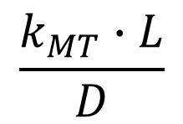
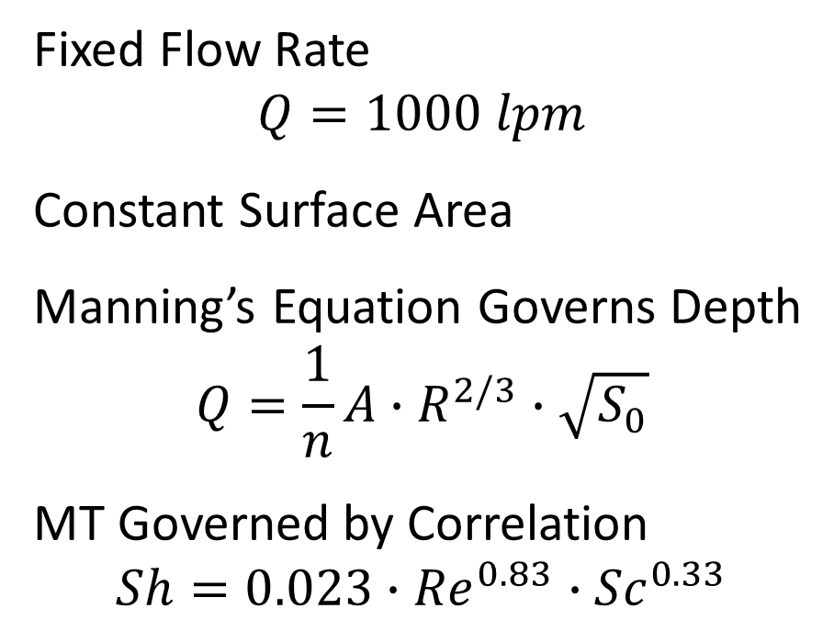
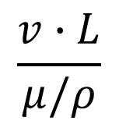
Assume a rectangular channel…
Fixed Flow Rate
$$Q=1000 lpm$$
Constant Surface Area
Manning’s Equation Governs Depth
$$Q=\frac{1}{n}A∙R^{2/3}∙\sqrt{S_{0}}$$
MT Governed by Correlation
$$Sh=0.023∙{Re}^{0.83}∙{Sc}^{0.33}$$
y
B
$$\frac{k_{MT}∙L}{D}$$
$$\frac{v∙L}{μ/ρ}$$

Slide 31
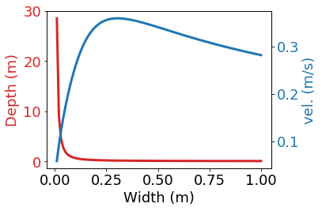
Wider channel is shallower, but vel. hits a max

Slide 32
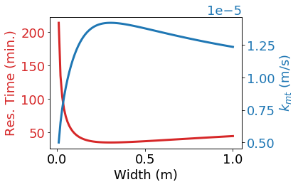
At BHS, t_{res} is min and k_{mt} is max

Slide 33
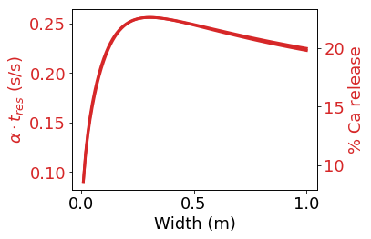
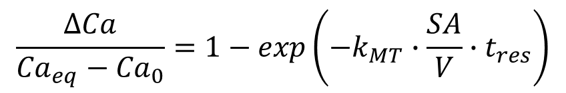
Combined effect of t_{res} and k_{mt}? BHS is Optimum
$$\frac{ΔCa}{{Ca}_{eq}−{Ca}_{0}}=1−exp\left(−k_{MT}∙\frac{SA}{V}∙t_{res}\right)$$

Slide 34
Outline
Background on mass transport in calcite dissolution kinetics
Data from an open limestone channel (OLC)
Modeling an OLC assuming MT limited kinetics
Speculation about channel geometry in OLC performance
Points of application

Slide 35
If limestone-based treatment is MT limited, then:
Published lab rates will tend to over-predict field rates
“Bucket tests” will tend to under-predict field rates
Anoxic Limestone Drains will have an optimum velocity
Flushable Limestone Beds will be influenced by rate of filling and flushing

Slide 36
Acknowledgments
Art Rose – Field Data
Ed Zovinka – Column Data (not shown but also supporting MT limits)
Sergio Carvajal – Tracer Tests
David Madl – Early Model Development
SFU’s Center for Watershed Research and Service
Clearfield Creek Watershed Association

Slide 37
Questions?

Slide 38
Backup Slides

Slide 39
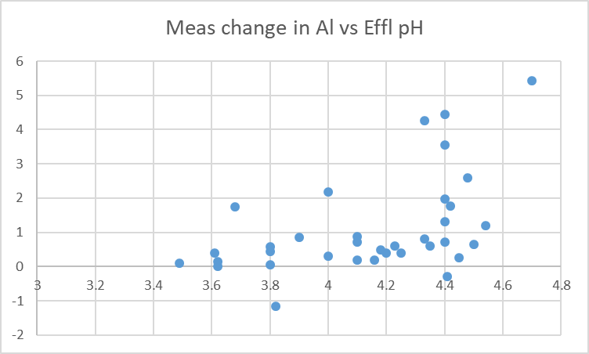
Al is removed at a “low” pH
Change in [Al] (mg/L)
pH

