Slide 1
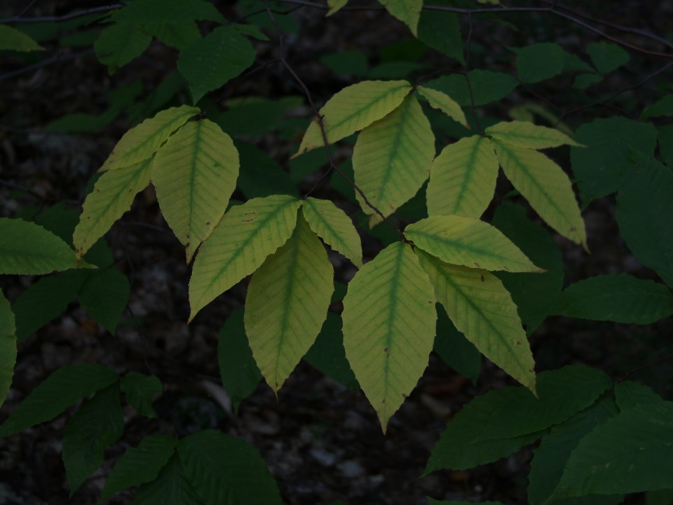
Use of GPS Treatment Data & ArcGIS Tools: Evaluating Herbicide Treatment Effectiveness at a Reclaimed Coal Mine
W. Erickson & J. Feeback
Notes:
Picture with background removed
(Intermediate)
To reproduce the picture effects on this slide, do the following:
On the Home tab, in the Slides group, click Layout, & then click Blank.
On the Insert tab, in the Images group, click Picture.
In the Insert Picture dialog box, select a picture & then click Insert.
Select the picture. Under Picture Tools, on the Format tab, in the Size group, click the Size & Position dialog box launcher. In the Format Picture dialog box, resize or crop the image so that the height is set to 7.5” & the width is set to 10”. To crop the picture, click Crop in the left pane, & in the right pane, under Crop position, enter values into the Height, Width, Left, & Top boxes. To resize the picture, click Size in the left pane, & in the right pane, under Size & rotate, enter values into the Height & Width boxes.
Also under Picture Tools, on the Format tab, in the Adjust group, click Color, & then under Recolor click Grayscale.
Also in the Adjust group, click Corrections, & then under Brightness & Contrast, click Brightness: -40% Contrast: +20%.
On the Home tab, in the Clipboard group, click the arrow to the right of Copy, & then click Duplicate.
Select the second picture. On the Home tab, in the Drawing group, click Arrange, point to Align, & then do the following:
Click Align to Slide.
Click Align Middle.
Click Align Center.
Under Picture Tools, on the Format tab, in the Adjust group, click Reset Picture.
Also under Picture Tools, on the Format tab, in the Size group, click the Size & Position dialog box launcher.. In the Format Picture dialog box, resize or crop the image to focus on the main subject in the picture. (Example picture is set to 3.54” height & 3.24” width). To crop the picture, click Crop in the left pane, & in the right pane, under Crop position, enter values into the Height, Width, Left, & Top boxes. To resize the picture, click Size in the left pane, & in the right pane, under Size & rotate, enter values into the Height & Width boxes.
Also under Picture Tools, on the Format tab, in the Adjust group, click Remove Background, & then do the following:
To remove additional background areas from the picture, on the Background Removal tab, in the Refine group, click Mark Areas to Remove. Select all of the additional areas to be removed.
To keep additional areas of the picture that have been removed, on the Background Removal tab, in the Refine group, click Mark Areas to Keep. Select all of the additional areas to be kept.
Click Keep Changes in the Close group when finished.
To reproduce the shape effects on this slide, do the following:
On the Home tab, in the Drawing group, select Rectangle.
On the slide, drag to draw a rectangle.
Select the rectangle. Also on the Home tab, in the Drawing group, click the Format Shape dialog box launcher.
In the Format Shape dialog box, in the Size tab, enter 7.5” into the Height box & enter 4” into the Width box.
Also in the Format Shape dialog box, in the Fill tab, select Gradient fill, & then do the following:
In the Type list, select Linear.
In the Angle box, enter 90°.
Under Gradient stops, click Add gradient stops or Remove gradient stops until three stops appear in the slider.
Also under Gradient stops, customize the gradient stops as follows:
Select the first stop from the left in the slider, & then do the following:
In the Position box, enter 0%.
Click the button next to Color, & then under Theme Colors click Black, Text 1 (first row, second option from the left).
In the Transparency box, enter 100%.
Select the second stop from the left in the slider, & then do the following:
In the Position box, enter 40%.
Click the button next to Color, click More Colors, & then in the Colors dialog box, on the Custom tab, enter values for Red: 47, Green: 91, & Blue: 77.
In the Transparency box, enter 0%.
Select the third stop from the left in the slider, & then do the following:
In the Position box, enter 100%.
Click the button next to Color, & then under Theme Colors click Black, Text 1 (first row, second option from the left).
In the Transparency box, enter 90%.
Also in the Format Shape dialog box, in the Line Color tab, select No Line.
Select the second picture. On the Home tab, in the Drawing group, click Arrange, & then click Bring to Front.
To reproduce the text effects on this slide, do the following:
On the Insert tab, in the Text group, click Text Box, & then on the slide drag to draw your text box.
Enter text in the text box, & then select the text. On the Home tab, in the Font group, do the following:
In the Font list, click Calisto MT.
In the Font Size list, click 36 pt.
Click Font Color, & then under Theme Colors click White, Background 1 (first row, first option from the left).
Position text over the least transparent part of the gradient.

Slide 2
Background: Southwestern Mine
Permitted Acres: 25,000
Disturbed & Reclaimed Acres: 12,500
Mine Operated 60 years with contemporaneous reclamation
Mine is in Final Reclamation Phase
SMCRA Authority: Federal/Indian & State Agencies
Notes:
Picture with background removed
(Intermediate)
To reproduce the picture effects on this slide, do the following:
On the Home tab, in the Slides group, click Layout, & then click Blank.
On the Insert tab, in the Images group, click Picture.
In the Insert Picture dialog box, select a picture & then click Insert.
Select the picture. Under Picture Tools, on the Format tab, in the Size group, click the Size & Position dialog box launcher. In the Format Picture dialog box, resize or crop the image so that the height is set to 7.5” & the width is set to 10”. To crop the picture, click Crop in the left pane, & in the right pane, under Crop position, enter values into the Height, Width, Left, & Top boxes. To resize the picture, click Size in the left pane, & in the right pane, under Size & rotate, enter values into the Height & Width boxes.
Also under Picture Tools, on the Format tab, in the Adjust group, click Color, & then under Recolor click Grayscale.
Also in the Adjust group, click Corrections, & then under Brightness & Contrast, click Brightness: -40% Contrast: +20%.
On the Home tab, in the Clipboard group, click the arrow to the right of Copy, & then click Duplicate.
Select the second picture. On the Home tab, in the Drawing group, click Arrange, point to Align, & then do the following:
Click Align to Slide.
Click Align Middle.
Click Align Center.
Under Picture Tools, on the Format tab, in the Adjust group, click Reset Picture.
Also under Picture Tools, on the Format tab, in the Size group, click the Size & Position dialog box launcher.. In the Format Picture dialog box, resize or crop the image to focus on the main subject in the picture. (Example picture is set to 3.54” height & 3.24” width). To crop the picture, click Crop in the left pane, & in the right pane, under Crop position, enter values into the Height, Width, Left, & Top boxes. To resize the picture, click Size in the left pane, & in the right pane, under Size & rotate, enter values into the Height & Width boxes.
Also under Picture Tools, on the Format tab, in the Adjust group, click Remove Background, & then do the following:
To remove additional background areas from the picture, on the Background Removal tab, in the Refine group, click Mark Areas to Remove. Select all of the additional areas to be removed.
To keep additional areas of the picture that have been removed, on the Background Removal tab, in the Refine group, click Mark Areas to Keep. Select all of the additional areas to be kept.
Click Keep Changes in the Close group when finished.
To reproduce the shape effects on this slide, do the following:
On the Home tab, in the Drawing group, select Rectangle.
On the slide, drag to draw a rectangle.
Select the rectangle. Also on the Home tab, in the Drawing group, click the Format Shape dialog box launcher.
In the Format Shape dialog box, in the Size tab, enter 7.5” into the Height box & enter 4” into the Width box.
Also in the Format Shape dialog box, in the Fill tab, select Gradient fill, & then do the following:
In the Type list, select Linear.
In the Angle box, enter 90°.
Under Gradient stops, click Add gradient stops or Remove gradient stops until three stops appear in the slider.
Also under Gradient stops, customize the gradient stops as follows:
Select the first stop from the left in the slider, & then do the following:
In the Position box, enter 0%.
Click the button next to Color, & then under Theme Colors click Black, Text 1 (first row, second option from the left).
In the Transparency box, enter 100%.
Select the second stop from the left in the slider, & then do the following:
In the Position box, enter 40%.
Click the button next to Color, click More Colors, & then in the Colors dialog box, on the Custom tab, enter values for Red: 47, Green: 91, & Blue: 77.
In the Transparency box, enter 0%.
Select the third stop from the left in the slider, & then do the following:
In the Position box, enter 100%.
Click the button next to Color, & then under Theme Colors click Black, Text 1 (first row, second option from the left).
In the Transparency box, enter 90%.
Also in the Format Shape dialog box, in the Line Color tab, select No Line.
Select the second picture. On the Home tab, in the Drawing group, click Arrange, & then click Bring to Front.
To reproduce the text effects on this slide, do the following:
On the Insert tab, in the Text group, click Text Box, & then on the slide drag to draw your text box.
Enter text in the text box, & then select the text. On the Home tab, in the Font group, do the following:
In the Font list, click Calisto MT.
In the Font Size list, click 36 pt.
Click Font Color, & then under Theme Colors click White, Background 1 (first row, first option from the left).
Position text over the least transparent part of the gradient.

Slide 3
Environment
Elevation 6,300 to 8,000 Feet above MSL
Annual Precipitation
Average 13 inches
Monsoon Rains - July through November
Temperature: Typically varies 16°F to 87°F; rarely below 2°F or above 93°F
Growing Season: Early May thru mid October
Early Spring Bloom April 3rd
Notes:
Picture with background removed
(Intermediate)
To reproduce the picture effects on this slide, do the following:
On the Home tab, in the Slides group, click Layout, & then click Blank.
On the Insert tab, in the Images group, click Picture.
In the Insert Picture dialog box, select a picture & then click Insert.
Select the picture. Under Picture Tools, on the Format tab, in the Size group, click the Size & Position dialog box launcher. In the Format Picture dialog box, resize or crop the image so that the height is set to 7.5” & the width is set to 10”. To crop the picture, click Crop in the left pane, & in the right pane, under Crop position, enter values into the Height, Width, Left, & Top boxes. To resize the picture, click Size in the left pane, & in the right pane, under Size & rotate, enter values into the Height & Width boxes.
Also under Picture Tools, on the Format tab, in the Adjust group, click Color, & then under Recolor click Grayscale.
Also in the Adjust group, click Corrections, & then under Brightness & Contrast, click Brightness: -40% Contrast: +20%.
On the Home tab, in the Clipboard group, click the arrow to the right of Copy, & then click Duplicate.
Select the second picture. On the Home tab, in the Drawing group, click Arrange, point to Align, & then do the following:
Click Align to Slide.
Click Align Middle.
Click Align Center.
Under Picture Tools, on the Format tab, in the Adjust group, click Reset Picture.
Also under Picture Tools, on the Format tab, in the Size group, click the Size & Position dialog box launcher.. In the Format Picture dialog box, resize or crop the image to focus on the main subject in the picture. (Example picture is set to 3.54” height & 3.24” width). To crop the picture, click Crop in the left pane, & in the right pane, under Crop position, enter values into the Height, Width, Left, & Top boxes. To resize the picture, click Size in the left pane, & in the right pane, under Size & rotate, enter values into the Height & Width boxes.
Also under Picture Tools, on the Format tab, in the Adjust group, click Remove Background, & then do the following:
To remove additional background areas from the picture, on the Background Removal tab, in the Refine group, click Mark Areas to Remove. Select all of the additional areas to be removed.
To keep additional areas of the picture that have been removed, on the Background Removal tab, in the Refine group, click Mark Areas to Keep. Select all of the additional areas to be kept.
Click Keep Changes in the Close group when finished.
To reproduce the shape effects on this slide, do the following:
On the Home tab, in the Drawing group, select Rectangle.
On the slide, drag to draw a rectangle.
Select the rectangle. Also on the Home tab, in the Drawing group, click the Format Shape dialog box launcher.
In the Format Shape dialog box, in the Size tab, enter 7.5” into the Height box & enter 4” into the Width box.
Also in the Format Shape dialog box, in the Fill tab, select Gradient fill, & then do the following:
In the Type list, select Linear.
In the Angle box, enter 90°.
Under Gradient stops, click Add gradient stops or Remove gradient stops until three stops appear in the slider.
Also under Gradient stops, customize the gradient stops as follows:
Select the first stop from the left in the slider, & then do the following:
In the Position box, enter 0%.
Click the button next to Color, & then under Theme Colors click Black, Text 1 (first row, second option from the left).
In the Transparency box, enter 100%.
Select the second stop from the left in the slider, & then do the following:
In the Position box, enter 40%.
Click the button next to Color, click More Colors, & then in the Colors dialog box, on the Custom tab, enter values for Red: 47, Green: 91, & Blue: 77.
In the Transparency box, enter 0%.
Select the third stop from the left in the slider, & then do the following:
In the Position box, enter 100%.
Click the button next to Color, & then under Theme Colors click Black, Text 1 (first row, second option from the left).
In the Transparency box, enter 90%.
Also in the Format Shape dialog box, in the Line Color tab, select No Line.
Select the second picture. On the Home tab, in the Drawing group, click Arrange, & then click Bring to Front.
To reproduce the text effects on this slide, do the following:
On the Insert tab, in the Text group, click Text Box, & then on the slide drag to draw your text box.
Enter text in the text box, & then select the text. On the Home tab, in the Font group, do the following:
In the Font list, click Calisto MT.
In the Font Size list, click 36 pt.
Click Font Color, & then under Theme Colors click White, Background 1 (first row, first option from the left).
Position text over the least transparent part of the gradient.

Slide 4
Environment
Wind Speed-Significant seasonal variation
Westerly Predominates
Calmest Day - August 15th avg 6.7 mph
Windiest Day - April 11th avg 12.1 mph
Wind Speed: 10/90 percentiles – 4 & 22 mph
Notes:
Picture with background removed
(Intermediate)
To reproduce the picture effects on this slide, do the following:
On the Home tab, in the Slides group, click Layout, & then click Blank.
On the Insert tab, in the Images group, click Picture.
In the Insert Picture dialog box, select a picture & then click Insert.
Select the picture. Under Picture Tools, on the Format tab, in the Size group, click the Size & Position dialog box launcher. In the Format Picture dialog box, resize or crop the image so that the height is set to 7.5” & the width is set to 10”. To crop the picture, click Crop in the left pane, & in the right pane, under Crop position, enter values into the Height, Width, Left, & Top boxes. To resize the picture, click Size in the left pane, & in the right pane, under Size & rotate, enter values into the Height & Width boxes.
Also under Picture Tools, on the Format tab, in the Adjust group, click Color, & then under Recolor click Grayscale.
Also in the Adjust group, click Corrections, & then under Brightness & Contrast, click Brightness: -40% Contrast: +20%.
On the Home tab, in the Clipboard group, click the arrow to the right of Copy, & then click Duplicate.
Select the second picture. On the Home tab, in the Drawing group, click Arrange, point to Align, & then do the following:
Click Align to Slide.
Click Align Middle.
Click Align Center.
Under Picture Tools, on the Format tab, in the Adjust group, click Reset Picture.
Also under Picture Tools, on the Format tab, in the Size group, click the Size & Position dialog box launcher.. In the Format Picture dialog box, resize or crop the image to focus on the main subject in the picture. (Example picture is set to 3.54” height & 3.24” width). To crop the picture, click Crop in the left pane, & in the right pane, under Crop position, enter values into the Height, Width, Left, & Top boxes. To resize the picture, click Size in the left pane, & in the right pane, under Size & rotate, enter values into the Height & Width boxes.
Also under Picture Tools, on the Format tab, in the Adjust group, click Remove Background, & then do the following:
To remove additional background areas from the picture, on the Background Removal tab, in the Refine group, click Mark Areas to Remove. Select all of the additional areas to be removed.
To keep additional areas of the picture that have been removed, on the Background Removal tab, in the Refine group, click Mark Areas to Keep. Select all of the additional areas to be kept.
Click Keep Changes in the Close group when finished.
To reproduce the shape effects on this slide, do the following:
On the Home tab, in the Drawing group, select Rectangle.
On the slide, drag to draw a rectangle.
Select the rectangle. Also on the Home tab, in the Drawing group, click the Format Shape dialog box launcher.
In the Format Shape dialog box, in the Size tab, enter 7.5” into the Height box & enter 4” into the Width box.
Also in the Format Shape dialog box, in the Fill tab, select Gradient fill, & then do the following:
In the Type list, select Linear.
In the Angle box, enter 90°.
Under Gradient stops, click Add gradient stops or Remove gradient stops until three stops appear in the slider.
Also under Gradient stops, customize the gradient stops as follows:
Select the first stop from the left in the slider, & then do the following:
In the Position box, enter 0%.
Click the button next to Color, & then under Theme Colors click Black, Text 1 (first row, second option from the left).
In the Transparency box, enter 100%.
Select the second stop from the left in the slider, & then do the following:
In the Position box, enter 40%.
Click the button next to Color, click More Colors, & then in the Colors dialog box, on the Custom tab, enter values for Red: 47, Green: 91, & Blue: 77.
In the Transparency box, enter 0%.
Select the third stop from the left in the slider, & then do the following:
In the Position box, enter 100%.
Click the button next to Color, & then under Theme Colors click Black, Text 1 (first row, second option from the left).
In the Transparency box, enter 90%.
Also in the Format Shape dialog box, in the Line Color tab, select No Line.
Select the second picture. On the Home tab, in the Drawing group, click Arrange, & then click Bring to Front.
To reproduce the text effects on this slide, do the following:
On the Insert tab, in the Text group, click Text Box, & then on the slide drag to draw your text box.
Enter text in the text box, & then select the text. On the Home tab, in the Font group, do the following:
In the Font list, click Calisto MT.
In the Font Size list, click 36 pt.
Click Font Color, & then under Theme Colors click White, Background 1 (first row, first option from the left).
Position text over the least transparent part of the gradient.

Slide 5
Noxious Weed Treatment
2010: Habitat Management began treatment operations.
2011: Extent of noxious weed infestations was recognized by mine management.
2012: Mine wide survey documented & mapped infestations.
Survey & mapping used to plan treatments.
Notes:
Picture with background removed
(Intermediate)
To reproduce the picture effects on this slide, do the following:
On the Home tab, in the Slides group, click Layout, & then click Blank.
On the Insert tab, in the Images group, click Picture.
In the Insert Picture dialog box, select a picture & then click Insert.
Select the picture. Under Picture Tools, on the Format tab, in the Size group, click the Size & Position dialog box launcher. In the Format Picture dialog box, resize or crop the image so that the height is set to 7.5” & the width is set to 10”. To crop the picture, click Crop in the left pane, & in the right pane, under Crop position, enter values into the Height, Width, Left, & Top boxes. To resize the picture, click Size in the left pane, & in the right pane, under Size & rotate, enter values into the Height & Width boxes.
Also under Picture Tools, on the Format tab, in the Adjust group, click Color, & then under Recolor click Grayscale.
Also in the Adjust group, click Corrections, & then under Brightness & Contrast, click Brightness: -40% Contrast: +20%.
On the Home tab, in the Clipboard group, click the arrow to the right of Copy, & then click Duplicate.
Select the second picture. On the Home tab, in the Drawing group, click Arrange, point to Align, & then do the following:
Click Align to Slide.
Click Align Middle.
Click Align Center.
Under Picture Tools, on the Format tab, in the Adjust group, click Reset Picture.
Also under Picture Tools, on the Format tab, in the Size group, click the Size & Position dialog box launcher.. In the Format Picture dialog box, resize or crop the image to focus on the main subject in the picture. (Example picture is set to 3.54” height & 3.24” width). To crop the picture, click Crop in the left pane, & in the right pane, under Crop position, enter values into the Height, Width, Left, & Top boxes. To resize the picture, click Size in the left pane, & in the right pane, under Size & rotate, enter values into the Height & Width boxes.
Also under Picture Tools, on the Format tab, in the Adjust group, click Remove Background, & then do the following:
To remove additional background areas from the picture, on the Background Removal tab, in the Refine group, click Mark Areas to Remove. Select all of the additional areas to be removed.
To keep additional areas of the picture that have been removed, on the Background Removal tab, in the Refine group, click Mark Areas to Keep. Select all of the additional areas to be kept.
Click Keep Changes in the Close group when finished.
To reproduce the shape effects on this slide, do the following:
On the Home tab, in the Drawing group, select Rectangle.
On the slide, drag to draw a rectangle.
Select the rectangle. Also on the Home tab, in the Drawing group, click the Format Shape dialog box launcher.
In the Format Shape dialog box, in the Size tab, enter 7.5” into the Height box & enter 4” into the Width box.
Also in the Format Shape dialog box, in the Fill tab, select Gradient fill, & then do the following:
In the Type list, select Linear.
In the Angle box, enter 90°.
Under Gradient stops, click Add gradient stops or Remove gradient stops until three stops appear in the slider.
Also under Gradient stops, customize the gradient stops as follows:
Select the first stop from the left in the slider, & then do the following:
In the Position box, enter 0%.
Click the button next to Color, & then under Theme Colors click Black, Text 1 (first row, second option from the left).
In the Transparency box, enter 100%.
Select the second stop from the left in the slider, & then do the following:
In the Position box, enter 40%.
Click the button next to Color, click More Colors, & then in the Colors dialog box, on the Custom tab, enter values for Red: 47, Green: 91, & Blue: 77.
In the Transparency box, enter 0%.
Select the third stop from the left in the slider, & then do the following:
In the Position box, enter 100%.
Click the button next to Color, & then under Theme Colors click Black, Text 1 (first row, second option from the left).
In the Transparency box, enter 90%.
Also in the Format Shape dialog box, in the Line Color tab, select No Line.
Select the second picture. On the Home tab, in the Drawing group, click Arrange, & then click Bring to Front.
To reproduce the text effects on this slide, do the following:
On the Insert tab, in the Text group, click Text Box, & then on the slide drag to draw your text box.
Enter text in the text box, & then select the text. On the Home tab, in the Font group, do the following:
In the Font list, click Calisto MT.
In the Font Size list, click 36 pt.
Click Font Color, & then under Theme Colors click White, Background 1 (first row, first option from the left).
Position text over the least transparent part of the gradient.

Slide 6
Biennial & Perennial Noxious Weed Species:
Canada thistle
musk thistle
Scotch thistle
bull thistle
hoary cress
Russian knapweed
salt cedar
halogeton
Russian olive
Notes:
Picture with background removed
(Intermediate)
To reproduce the picture effects on this slide, do the following:
On the Home tab, in the Slides group, click Layout, & then click Blank.
On the Insert tab, in the Images group, click Picture.
In the Insert Picture dialog box, select a picture & then click Insert.
Select the picture. Under Picture Tools, on the Format tab, in the Size group, click the Size & Position dialog box launcher. In the Format Picture dialog box, resize or crop the image so that the height is set to 7.5” & the width is set to 10”. To crop the picture, click Crop in the left pane, & in the right pane, under Crop position, enter values into the Height, Width, Left, & Top boxes. To resize the picture, click Size in the left pane, & in the right pane, under Size & rotate, enter values into the Height & Width boxes.
Also under Picture Tools, on the Format tab, in the Adjust group, click Color, & then under Recolor click Grayscale.
Also in the Adjust group, click Corrections, & then under Brightness & Contrast, click Brightness: -40% Contrast: +20%.
On the Home tab, in the Clipboard group, click the arrow to the right of Copy, & then click Duplicate.
Select the second picture. On the Home tab, in the Drawing group, click Arrange, point to Align, & then do the following:
Click Align to Slide.
Click Align Middle.
Click Align Center.
Under Picture Tools, on the Format tab, in the Adjust group, click Reset Picture.
Also under Picture Tools, on the Format tab, in the Size group, click the Size & Position dialog box launcher.. In the Format Picture dialog box, resize or crop the image to focus on the main subject in the picture. (Example picture is set to 3.54” height & 3.24” width). To crop the picture, click Crop in the left pane, & in the right pane, under Crop position, enter values into the Height, Width, Left, & Top boxes. To resize the picture, click Size in the left pane, & in the right pane, under Size & rotate, enter values into the Height & Width boxes.
Also under Picture Tools, on the Format tab, in the Adjust group, click Remove Background, & then do the following:
To remove additional background areas from the picture, on the Background Removal tab, in the Refine group, click Mark Areas to Remove. Select all of the additional areas to be removed.
To keep additional areas of the picture that have been removed, on the Background Removal tab, in the Refine group, click Mark Areas to Keep. Select all of the additional areas to be kept.
Click Keep Changes in the Close group when finished.
To reproduce the shape effects on this slide, do the following:
On the Home tab, in the Drawing group, select Rectangle.
On the slide, drag to draw a rectangle.
Select the rectangle. Also on the Home tab, in the Drawing group, click the Format Shape dialog box launcher.
In the Format Shape dialog box, in the Size tab, enter 7.5” into the Height box & enter 4” into the Width box.
Also in the Format Shape dialog box, in the Fill tab, select Gradient fill, & then do the following:
In the Type list, select Linear.
In the Angle box, enter 90°.
Under Gradient stops, click Add gradient stops or Remove gradient stops until three stops appear in the slider.
Also under Gradient stops, customize the gradient stops as follows:
Select the first stop from the left in the slider, & then do the following:
In the Position box, enter 0%.
Click the button next to Color, & then under Theme Colors click Black, Text 1 (first row, second option from the left).
In the Transparency box, enter 100%.
Select the second stop from the left in the slider, & then do the following:
In the Position box, enter 40%.
Click the button next to Color, click More Colors, & then in the Colors dialog box, on the Custom tab, enter values for Red: 47, Green: 91, & Blue: 77.
In the Transparency box, enter 0%.
Select the third stop from the left in the slider, & then do the following:
In the Position box, enter 100%.
Click the button next to Color, & then under Theme Colors click Black, Text 1 (first row, second option from the left).
In the Transparency box, enter 90%.
Also in the Format Shape dialog box, in the Line Color tab, select No Line.
Select the second picture. On the Home tab, in the Drawing group, click Arrange, & then click Bring to Front.
To reproduce the text effects on this slide, do the following:
On the Insert tab, in the Text group, click Text Box, & then on the slide drag to draw your text box.
Enter text in the text box, & then select the text. On the Home tab, in the Font group, do the following:
In the Font list, click Calisto MT.
In the Font Size list, click 36 pt.
Click Font Color, & then under Theme Colors click White, Background 1 (first row, first option from the left).
Position text over the least transparent part of the gradient.

Slide 7
Treatment Methods
Backpack Sprayers
Truck Mounted Spray Rigs
4X4 UTV Mounted Low Profile Tank
Spring Loaded Hose Reels/Spray Guns
Broadcasters
Chainsaws
Notes:
Picture with background removed
(Intermediate)
To reproduce the picture effects on this slide, do the following:
On the Home tab, in the Slides group, click Layout, & then click Blank.
On the Insert tab, in the Images group, click Picture.
In the Insert Picture dialog box, select a picture & then click Insert.
Select the picture. Under Picture Tools, on the Format tab, in the Size group, click the Size & Position dialog box launcher. In the Format Picture dialog box, resize or crop the image so that the height is set to 7.5” & the width is set to 10”. To crop the picture, click Crop in the left pane, & in the right pane, under Crop position, enter values into the Height, Width, Left, & Top boxes. To resize the picture, click Size in the left pane, & in the right pane, under Size & rotate, enter values into the Height & Width boxes.
Also under Picture Tools, on the Format tab, in the Adjust group, click Color, & then under Recolor click Grayscale.
Also in the Adjust group, click Corrections, & then under Brightness & Contrast, click Brightness: -40% Contrast: +20%.
On the Home tab, in the Clipboard group, click the arrow to the right of Copy, & then click Duplicate.
Select the second picture. On the Home tab, in the Drawing group, click Arrange, point to Align, & then do the following:
Click Align to Slide.
Click Align Middle.
Click Align Center.
Under Picture Tools, on the Format tab, in the Adjust group, click Reset Picture.
Also under Picture Tools, on the Format tab, in the Size group, click the Size & Position dialog box launcher.. In the Format Picture dialog box, resize or crop the image to focus on the main subject in the picture. (Example picture is set to 3.54” height & 3.24” width). To crop the picture, click Crop in the left pane, & in the right pane, under Crop position, enter values into the Height, Width, Left, & Top boxes. To resize the picture, click Size in the left pane, & in the right pane, under Size & rotate, enter values into the Height & Width boxes.
Also under Picture Tools, on the Format tab, in the Adjust group, click Remove Background, & then do the following:
To remove additional background areas from the picture, on the Background Removal tab, in the Refine group, click Mark Areas to Remove. Select all of the additional areas to be removed.
To keep additional areas of the picture that have been removed, on the Background Removal tab, in the Refine group, click Mark Areas to Keep. Select all of the additional areas to be kept.
Click Keep Changes in the Close group when finished.
To reproduce the shape effects on this slide, do the following:
On the Home tab, in the Drawing group, select Rectangle.
On the slide, drag to draw a rectangle.
Select the rectangle. Also on the Home tab, in the Drawing group, click the Format Shape dialog box launcher.
In the Format Shape dialog box, in the Size tab, enter 7.5” into the Height box & enter 4” into the Width box.
Also in the Format Shape dialog box, in the Fill tab, select Gradient fill, & then do the following:
In the Type list, select Linear.
In the Angle box, enter 90°.
Under Gradient stops, click Add gradient stops or Remove gradient stops until three stops appear in the slider.
Also under Gradient stops, customize the gradient stops as follows:
Select the first stop from the left in the slider, & then do the following:
In the Position box, enter 0%.
Click the button next to Color, & then under Theme Colors click Black, Text 1 (first row, second option from the left).
In the Transparency box, enter 100%.
Select the second stop from the left in the slider, & then do the following:
In the Position box, enter 40%.
Click the button next to Color, click More Colors, & then in the Colors dialog box, on the Custom tab, enter values for Red: 47, Green: 91, & Blue: 77.
In the Transparency box, enter 0%.
Select the third stop from the left in the slider, & then do the following:
In the Position box, enter 100%.
Click the button next to Color, & then under Theme Colors click Black, Text 1 (first row, second option from the left).
In the Transparency box, enter 90%.
Also in the Format Shape dialog box, in the Line Color tab, select No Line.
Select the second picture. On the Home tab, in the Drawing group, click Arrange, & then click Bring to Front.
To reproduce the text effects on this slide, do the following:
On the Insert tab, in the Text group, click Text Box, & then on the slide drag to draw your text box.
Enter text in the text box, & then select the text. On the Home tab, in the Font group, do the following:
In the Font list, click Calisto MT.
In the Font Size list, click 36 pt.
Click Font Color, & then under Theme Colors click White, Background 1 (first row, first option from the left).
Position text over the least transparent part of the gradient.

Slide 8
Treatment Documentation
Paper field maps & colored markers
GPS units
PDF Maps on tablets
Dataloggers & ARCGIS
Treatments recorded by species, lat & long, date, time
Daily herbicide use reports-mixtures & concentrations
Notes:
Picture with background removed
(Intermediate)
To reproduce the picture effects on this slide, do the following:
On the Home tab, in the Slides group, click Layout, & then click Blank.
On the Insert tab, in the Images group, click Picture.
In the Insert Picture dialog box, select a picture & then click Insert.
Select the picture. Under Picture Tools, on the Format tab, in the Size group, click the Size & Position dialog box launcher. In the Format Picture dialog box, resize or crop the image so that the height is set to 7.5” & the width is set to 10”. To crop the picture, click Crop in the left pane, & in the right pane, under Crop position, enter values into the Height, Width, Left, & Top boxes. To resize the picture, click Size in the left pane, & in the right pane, under Size & rotate, enter values into the Height & Width boxes.
Also under Picture Tools, on the Format tab, in the Adjust group, click Color, & then under Recolor click Grayscale.
Also in the Adjust group, click Corrections, & then under Brightness & Contrast, click Brightness: -40% Contrast: +20%.
On the Home tab, in the Clipboard group, click the arrow to the right of Copy, & then click Duplicate.
Select the second picture. On the Home tab, in the Drawing group, click Arrange, point to Align, & then do the following:
Click Align to Slide.
Click Align Middle.
Click Align Center.
Under Picture Tools, on the Format tab, in the Adjust group, click Reset Picture.
Also under Picture Tools, on the Format tab, in the Size group, click the Size & Position dialog box launcher.. In the Format Picture dialog box, resize or crop the image to focus on the main subject in the picture. (Example picture is set to 3.54” height & 3.24” width). To crop the picture, click Crop in the left pane, & in the right pane, under Crop position, enter values into the Height, Width, Left, & Top boxes. To resize the picture, click Size in the left pane, & in the right pane, under Size & rotate, enter values into the Height & Width boxes.
Also under Picture Tools, on the Format tab, in the Adjust group, click Remove Background, & then do the following:
To remove additional background areas from the picture, on the Background Removal tab, in the Refine group, click Mark Areas to Remove. Select all of the additional areas to be removed.
To keep additional areas of the picture that have been removed, on the Background Removal tab, in the Refine group, click Mark Areas to Keep. Select all of the additional areas to be kept.
Click Keep Changes in the Close group when finished.
To reproduce the shape effects on this slide, do the following:
On the Home tab, in the Drawing group, select Rectangle.
On the slide, drag to draw a rectangle.
Select the rectangle. Also on the Home tab, in the Drawing group, click the Format Shape dialog box launcher.
In the Format Shape dialog box, in the Size tab, enter 7.5” into the Height box & enter 4” into the Width box.
Also in the Format Shape dialog box, in the Fill tab, select Gradient fill, & then do the following:
In the Type list, select Linear.
In the Angle box, enter 90°.
Under Gradient stops, click Add gradient stops or Remove gradient stops until three stops appear in the slider.
Also under Gradient stops, customize the gradient stops as follows:
Select the first stop from the left in the slider, & then do the following:
In the Position box, enter 0%.
Click the button next to Color, & then under Theme Colors click Black, Text 1 (first row, second option from the left).
In the Transparency box, enter 100%.
Select the second stop from the left in the slider, & then do the following:
In the Position box, enter 40%.
Click the button next to Color, click More Colors, & then in the Colors dialog box, on the Custom tab, enter values for Red: 47, Green: 91, & Blue: 77.
In the Transparency box, enter 0%.
Select the third stop from the left in the slider, & then do the following:
In the Position box, enter 100%.
Click the button next to Color, & then under Theme Colors click Black, Text 1 (first row, second option from the left).
In the Transparency box, enter 90%.
Also in the Format Shape dialog box, in the Line Color tab, select No Line.
Select the second picture. On the Home tab, in the Drawing group, click Arrange, & then click Bring to Front.
To reproduce the text effects on this slide, do the following:
On the Insert tab, in the Text group, click Text Box, & then on the slide drag to draw your text box.
Enter text in the text box, & then select the text. On the Home tab, in the Font group, do the following:
In the Font list, click Calisto MT.
In the Font Size list, click 36 pt.
Click Font Color, & then under Theme Colors click White, Background 1 (first row, first option from the left).
Position text over the least transparent part of the gradient.

Slide 9
Treatment Documentation
2013-2015
Weed treatment emphasized
Treatment data collected using maps & sharpies, & various GPS equipment
Rudimentary GIS database compiled
Notes:
Picture with background removed
(Intermediate)
To reproduce the picture effects on this slide, do the following:
On the Home tab, in the Slides group, click Layout, & then click Blank.
On the Insert tab, in the Images group, click Picture.
In the Insert Picture dialog box, select a picture & then click Insert.
Select the picture. Under Picture Tools, on the Format tab, in the Size group, click the Size & Position dialog box launcher. In the Format Picture dialog box, resize or crop the image so that the height is set to 7.5” & the width is set to 10”. To crop the picture, click Crop in the left pane, & in the right pane, under Crop position, enter values into the Height, Width, Left, & Top boxes. To resize the picture, click Size in the left pane, & in the right pane, under Size & rotate, enter values into the Height & Width boxes.
Also under Picture Tools, on the Format tab, in the Adjust group, click Color, & then under Recolor click Grayscale.
Also in the Adjust group, click Corrections, & then under Brightness & Contrast, click Brightness: -40% Contrast: +20%.
On the Home tab, in the Clipboard group, click the arrow to the right of Copy, & then click Duplicate.
Select the second picture. On the Home tab, in the Drawing group, click Arrange, point to Align, & then do the following:
Click Align to Slide.
Click Align Middle.
Click Align Center.
Under Picture Tools, on the Format tab, in the Adjust group, click Reset Picture.
Also under Picture Tools, on the Format tab, in the Size group, click the Size & Position dialog box launcher.. In the Format Picture dialog box, resize or crop the image to focus on the main subject in the picture. (Example picture is set to 3.54” height & 3.24” width). To crop the picture, click Crop in the left pane, & in the right pane, under Crop position, enter values into the Height, Width, Left, & Top boxes. To resize the picture, click Size in the left pane, & in the right pane, under Size & rotate, enter values into the Height & Width boxes.
Also under Picture Tools, on the Format tab, in the Adjust group, click Remove Background, & then do the following:
To remove additional background areas from the picture, on the Background Removal tab, in the Refine group, click Mark Areas to Remove. Select all of the additional areas to be removed.
To keep additional areas of the picture that have been removed, on the Background Removal tab, in the Refine group, click Mark Areas to Keep. Select all of the additional areas to be kept.
Click Keep Changes in the Close group when finished.
To reproduce the shape effects on this slide, do the following:
On the Home tab, in the Drawing group, select Rectangle.
On the slide, drag to draw a rectangle.
Select the rectangle. Also on the Home tab, in the Drawing group, click the Format Shape dialog box launcher.
In the Format Shape dialog box, in the Size tab, enter 7.5” into the Height box & enter 4” into the Width box.
Also in the Format Shape dialog box, in the Fill tab, select Gradient fill, & then do the following:
In the Type list, select Linear.
In the Angle box, enter 90°.
Under Gradient stops, click Add gradient stops or Remove gradient stops until three stops appear in the slider.
Also under Gradient stops, customize the gradient stops as follows:
Select the first stop from the left in the slider, & then do the following:
In the Position box, enter 0%.
Click the button next to Color, & then under Theme Colors click Black, Text 1 (first row, second option from the left).
In the Transparency box, enter 100%.
Select the second stop from the left in the slider, & then do the following:
In the Position box, enter 40%.
Click the button next to Color, click More Colors, & then in the Colors dialog box, on the Custom tab, enter values for Red: 47, Green: 91, & Blue: 77.
In the Transparency box, enter 0%.
Select the third stop from the left in the slider, & then do the following:
In the Position box, enter 100%.
Click the button next to Color, & then under Theme Colors click Black, Text 1 (first row, second option from the left).
In the Transparency box, enter 90%.
Also in the Format Shape dialog box, in the Line Color tab, select No Line.
Select the second picture. On the Home tab, in the Drawing group, click Arrange, & then click Bring to Front.
To reproduce the text effects on this slide, do the following:
On the Insert tab, in the Text group, click Text Box, & then on the slide drag to draw your text box.
Enter text in the text box, & then select the text. On the Home tab, in the Font group, do the following:
In the Font list, click Calisto MT.
In the Font Size list, click 36 pt.
Click Font Color, & then under Theme Colors click White, Background 1 (first row, first option from the left).
Position text over the least transparent part of the gradient.

Slide 10
Treatment Documentation
2016 – Present
Increased emphasis on infestation characterization
Data collection:
More detail
Increased accuracy
Standardized collection methods
Notes:
Picture with background removed
(Intermediate)
To reproduce the picture effects on this slide, do the following:
On the Home tab, in the Slides group, click Layout, & then click Blank.
On the Insert tab, in the Images group, click Picture.
In the Insert Picture dialog box, select a picture & then click Insert.
Select the picture. Under Picture Tools, on the Format tab, in the Size group, click the Size & Position dialog box launcher. In the Format Picture dialog box, resize or crop the image so that the height is set to 7.5” & the width is set to 10”. To crop the picture, click Crop in the left pane, & in the right pane, under Crop position, enter values into the Height, Width, Left, & Top boxes. To resize the picture, click Size in the left pane, & in the right pane, under Size & rotate, enter values into the Height & Width boxes.
Also under Picture Tools, on the Format tab, in the Adjust group, click Color, & then under Recolor click Grayscale.
Also in the Adjust group, click Corrections, & then under Brightness & Contrast, click Brightness: -40% Contrast: +20%.
On the Home tab, in the Clipboard group, click the arrow to the right of Copy, & then click Duplicate.
Select the second picture. On the Home tab, in the Drawing group, click Arrange, point to Align, & then do the following:
Click Align to Slide.
Click Align Middle.
Click Align Center.
Under Picture Tools, on the Format tab, in the Adjust group, click Reset Picture.
Also under Picture Tools, on the Format tab, in the Size group, click the Size & Position dialog box launcher.. In the Format Picture dialog box, resize or crop the image to focus on the main subject in the picture. (Example picture is set to 3.54” height & 3.24” width). To crop the picture, click Crop in the left pane, & in the right pane, under Crop position, enter values into the Height, Width, Left, & Top boxes. To resize the picture, click Size in the left pane, & in the right pane, under Size & rotate, enter values into the Height & Width boxes.
Also under Picture Tools, on the Format tab, in the Adjust group, click Remove Background, & then do the following:
To remove additional background areas from the picture, on the Background Removal tab, in the Refine group, click Mark Areas to Remove. Select all of the additional areas to be removed.
To keep additional areas of the picture that have been removed, on the Background Removal tab, in the Refine group, click Mark Areas to Keep. Select all of the additional areas to be kept.
Click Keep Changes in the Close group when finished.
To reproduce the shape effects on this slide, do the following:
On the Home tab, in the Drawing group, select Rectangle.
On the slide, drag to draw a rectangle.
Select the rectangle. Also on the Home tab, in the Drawing group, click the Format Shape dialog box launcher.
In the Format Shape dialog box, in the Size tab, enter 7.5” into the Height box & enter 4” into the Width box.
Also in the Format Shape dialog box, in the Fill tab, select Gradient fill, & then do the following:
In the Type list, select Linear.
In the Angle box, enter 90°.
Under Gradient stops, click Add gradient stops or Remove gradient stops until three stops appear in the slider.
Also under Gradient stops, customize the gradient stops as follows:
Select the first stop from the left in the slider, & then do the following:
In the Position box, enter 0%.
Click the button next to Color, & then under Theme Colors click Black, Text 1 (first row, second option from the left).
In the Transparency box, enter 100%.
Select the second stop from the left in the slider, & then do the following:
In the Position box, enter 40%.
Click the button next to Color, click More Colors, & then in the Colors dialog box, on the Custom tab, enter values for Red: 47, Green: 91, & Blue: 77.
In the Transparency box, enter 0%.
Select the third stop from the left in the slider, & then do the following:
In the Position box, enter 100%.
Click the button next to Color, & then under Theme Colors click Black, Text 1 (first row, second option from the left).
In the Transparency box, enter 90%.
Also in the Format Shape dialog box, in the Line Color tab, select No Line.
Select the second picture. On the Home tab, in the Drawing group, click Arrange, & then click Bring to Front.
To reproduce the text effects on this slide, do the following:
On the Insert tab, in the Text group, click Text Box, & then on the slide drag to draw your text box.
Enter text in the text box, & then select the text. On the Home tab, in the Font group, do the following:
In the Font list, click Calisto MT.
In the Font Size list, click 36 pt.
Click Font Color, & then under Theme Colors click White, Background 1 (first row, first option from the left).
Position text over the least transparent part of the gradient.

Slide 11
Treatment Documentation
2017-2018
Treatment data 2012 to 2018 Compiled into a geodatabase
GIS treatment database analyzed
Findings submitted in annual reports
Notes:
Picture with background removed
(Intermediate)
To reproduce the picture effects on this slide, do the following:
On the Home tab, in the Slides group, click Layout, & then click Blank.
On the Insert tab, in the Images group, click Picture.
In the Insert Picture dialog box, select a picture & then click Insert.
Select the picture. Under Picture Tools, on the Format tab, in the Size group, click the Size & Position dialog box launcher. In the Format Picture dialog box, resize or crop the image so that the height is set to 7.5” & the width is set to 10”. To crop the picture, click Crop in the left pane, & in the right pane, under Crop position, enter values into the Height, Width, Left, & Top boxes. To resize the picture, click Size in the left pane, & in the right pane, under Size & rotate, enter values into the Height & Width boxes.
Also under Picture Tools, on the Format tab, in the Adjust group, click Color, & then under Recolor click Grayscale.
Also in the Adjust group, click Corrections, & then under Brightness & Contrast, click Brightness: -40% Contrast: +20%.
On the Home tab, in the Clipboard group, click the arrow to the right of Copy, & then click Duplicate.
Select the second picture. On the Home tab, in the Drawing group, click Arrange, point to Align, & then do the following:
Click Align to Slide.
Click Align Middle.
Click Align Center.
Under Picture Tools, on the Format tab, in the Adjust group, click Reset Picture.
Also under Picture Tools, on the Format tab, in the Size group, click the Size & Position dialog box launcher.. In the Format Picture dialog box, resize or crop the image to focus on the main subject in the picture. (Example picture is set to 3.54” height & 3.24” width). To crop the picture, click Crop in the left pane, & in the right pane, under Crop position, enter values into the Height, Width, Left, & Top boxes. To resize the picture, click Size in the left pane, & in the right pane, under Size & rotate, enter values into the Height & Width boxes.
Also under Picture Tools, on the Format tab, in the Adjust group, click Remove Background, & then do the following:
To remove additional background areas from the picture, on the Background Removal tab, in the Refine group, click Mark Areas to Remove. Select all of the additional areas to be removed.
To keep additional areas of the picture that have been removed, on the Background Removal tab, in the Refine group, click Mark Areas to Keep. Select all of the additional areas to be kept.
Click Keep Changes in the Close group when finished.
To reproduce the shape effects on this slide, do the following:
On the Home tab, in the Drawing group, select Rectangle.
On the slide, drag to draw a rectangle.
Select the rectangle. Also on the Home tab, in the Drawing group, click the Format Shape dialog box launcher.
In the Format Shape dialog box, in the Size tab, enter 7.5” into the Height box & enter 4” into the Width box.
Also in the Format Shape dialog box, in the Fill tab, select Gradient fill, & then do the following:
In the Type list, select Linear.
In the Angle box, enter 90°.
Under Gradient stops, click Add gradient stops or Remove gradient stops until three stops appear in the slider.
Also under Gradient stops, customize the gradient stops as follows:
Select the first stop from the left in the slider, & then do the following:
In the Position box, enter 0%.
Click the button next to Color, & then under Theme Colors click Black, Text 1 (first row, second option from the left).
In the Transparency box, enter 100%.
Select the second stop from the left in the slider, & then do the following:
In the Position box, enter 40%.
Click the button next to Color, click More Colors, & then in the Colors dialog box, on the Custom tab, enter values for Red: 47, Green: 91, & Blue: 77.
In the Transparency box, enter 0%.
Select the third stop from the left in the slider, & then do the following:
In the Position box, enter 100%.
Click the button next to Color, & then under Theme Colors click Black, Text 1 (first row, second option from the left).
In the Transparency box, enter 90%.
Also in the Format Shape dialog box, in the Line Color tab, select No Line.
Select the second picture. On the Home tab, in the Drawing group, click Arrange, & then click Bring to Front.
To reproduce the text effects on this slide, do the following:
On the Insert tab, in the Text group, click Text Box, & then on the slide drag to draw your text box.
Enter text in the text box, & then select the text. On the Home tab, in the Font group, do the following:
In the Font list, click Calisto MT.
In the Font Size list, click 36 pt.
Click Font Color, & then under Theme Colors click White, Background 1 (first row, first option from the left).
Position text over the least transparent part of the gradient.

Slide 12
Treatment GIS Database Analyses
2017 Client/regulatory agencies
Request herbicide treatment effectiveness evaluation
Used yearly treatment density information to assess effectiveness
Yearly reports compare current & previous year(s) treatment locations
Notes:
Picture with background removed
(Intermediate)
To reproduce the picture effects on this slide, do the following:
On the Home tab, in the Slides group, click Layout, & then click Blank.
On the Insert tab, in the Images group, click Picture.
In the Insert Picture dialog box, select a picture & then click Insert.
Select the picture. Under Picture Tools, on the Format tab, in the Size group, click the Size & Position dialog box launcher. In the Format Picture dialog box, resize or crop the image so that the height is set to 7.5” & the width is set to 10”. To crop the picture, click Crop in the left pane, & in the right pane, under Crop position, enter values into the Height, Width, Left, & Top boxes. To resize the picture, click Size in the left pane, & in the right pane, under Size & rotate, enter values into the Height & Width boxes.
Also under Picture Tools, on the Format tab, in the Adjust group, click Color, & then under Recolor click Grayscale.
Also in the Adjust group, click Corrections, & then under Brightness & Contrast, click Brightness: -40% Contrast: +20%.
On the Home tab, in the Clipboard group, click the arrow to the right of Copy, & then click Duplicate.
Select the second picture. On the Home tab, in the Drawing group, click Arrange, point to Align, & then do the following:
Click Align to Slide.
Click Align Middle.
Click Align Center.
Under Picture Tools, on the Format tab, in the Adjust group, click Reset Picture.
Also under Picture Tools, on the Format tab, in the Size group, click the Size & Position dialog box launcher.. In the Format Picture dialog box, resize or crop the image to focus on the main subject in the picture. (Example picture is set to 3.54” height & 3.24” width). To crop the picture, click Crop in the left pane, & in the right pane, under Crop position, enter values into the Height, Width, Left, & Top boxes. To resize the picture, click Size in the left pane, & in the right pane, under Size & rotate, enter values into the Height & Width boxes.
Also under Picture Tools, on the Format tab, in the Adjust group, click Remove Background, & then do the following:
To remove additional background areas from the picture, on the Background Removal tab, in the Refine group, click Mark Areas to Remove. Select all of the additional areas to be removed.
To keep additional areas of the picture that have been removed, on the Background Removal tab, in the Refine group, click Mark Areas to Keep. Select all of the additional areas to be kept.
Click Keep Changes in the Close group when finished.
To reproduce the shape effects on this slide, do the following:
On the Home tab, in the Drawing group, select Rectangle.
On the slide, drag to draw a rectangle.
Select the rectangle. Also on the Home tab, in the Drawing group, click the Format Shape dialog box launcher.
In the Format Shape dialog box, in the Size tab, enter 7.5” into the Height box & enter 4” into the Width box.
Also in the Format Shape dialog box, in the Fill tab, select Gradient fill, & then do the following:
In the Type list, select Linear.
In the Angle box, enter 90°.
Under Gradient stops, click Add gradient stops or Remove gradient stops until three stops appear in the slider.
Also under Gradient stops, customize the gradient stops as follows:
Select the first stop from the left in the slider, & then do the following:
In the Position box, enter 0%.
Click the button next to Color, & then under Theme Colors click Black, Text 1 (first row, second option from the left).
In the Transparency box, enter 100%.
Select the second stop from the left in the slider, & then do the following:
In the Position box, enter 40%.
Click the button next to Color, click More Colors, & then in the Colors dialog box, on the Custom tab, enter values for Red: 47, Green: 91, & Blue: 77.
In the Transparency box, enter 0%.
Select the third stop from the left in the slider, & then do the following:
In the Position box, enter 100%.
Click the button next to Color, & then under Theme Colors click Black, Text 1 (first row, second option from the left).
In the Transparency box, enter 90%.
Also in the Format Shape dialog box, in the Line Color tab, select No Line.
Select the second picture. On the Home tab, in the Drawing group, click Arrange, & then click Bring to Front.
To reproduce the text effects on this slide, do the following:
On the Insert tab, in the Text group, click Text Box, & then on the slide drag to draw your text box.
Enter text in the text box, & then select the text. On the Home tab, in the Font group, do the following:
In the Font list, click Calisto MT.
In the Font Size list, click 36 pt.
Click Font Color, & then under Theme Colors click White, Background 1 (first row, first option from the left).
Position text over the least transparent part of the gradient.

Slide 13
GIS Quantitative Grid Pattern Analysis
Established 10,000 SF fishnets covering extent of the permits.
Empty fishnets discarded.
GPS point data was spatially joined to fishnets.
Notes:
Picture with background removed
(Intermediate)
To reproduce the picture effects on this slide, do the following:
On the Home tab, in the Slides group, click Layout, & then click Blank.
On the Insert tab, in the Images group, click Picture.
In the Insert Picture dialog box, select a picture & then click Insert.
Select the picture. Under Picture Tools, on the Format tab, in the Size group, click the Size & Position dialog box launcher. In the Format Picture dialog box, resize or crop the image so that the height is set to 7.5” & the width is set to 10”. To crop the picture, click Crop in the left pane, & in the right pane, under Crop position, enter values into the Height, Width, Left, & Top boxes. To resize the picture, click Size in the left pane, & in the right pane, under Size & rotate, enter values into the Height & Width boxes.
Also under Picture Tools, on the Format tab, in the Adjust group, click Color, & then under Recolor click Grayscale.
Also in the Adjust group, click Corrections, & then under Brightness & Contrast, click Brightness: -40% Contrast: +20%.
On the Home tab, in the Clipboard group, click the arrow to the right of Copy, & then click Duplicate.
Select the second picture. On the Home tab, in the Drawing group, click Arrange, point to Align, & then do the following:
Click Align to Slide.
Click Align Middle.
Click Align Center.
Under Picture Tools, on the Format tab, in the Adjust group, click Reset Picture.
Also under Picture Tools, on the Format tab, in the Size group, click the Size & Position dialog box launcher.. In the Format Picture dialog box, resize or crop the image to focus on the main subject in the picture. (Example picture is set to 3.54” height & 3.24” width). To crop the picture, click Crop in the left pane, & in the right pane, under Crop position, enter values into the Height, Width, Left, & Top boxes. To resize the picture, click Size in the left pane, & in the right pane, under Size & rotate, enter values into the Height & Width boxes.
Also under Picture Tools, on the Format tab, in the Adjust group, click Remove Background, & then do the following:
To remove additional background areas from the picture, on the Background Removal tab, in the Refine group, click Mark Areas to Remove. Select all of the additional areas to be removed.
To keep additional areas of the picture that have been removed, on the Background Removal tab, in the Refine group, click Mark Areas to Keep. Select all of the additional areas to be kept.
Click Keep Changes in the Close group when finished.
To reproduce the shape effects on this slide, do the following:
On the Home tab, in the Drawing group, select Rectangle.
On the slide, drag to draw a rectangle.
Select the rectangle. Also on the Home tab, in the Drawing group, click the Format Shape dialog box launcher.
In the Format Shape dialog box, in the Size tab, enter 7.5” into the Height box & enter 4” into the Width box.
Also in the Format Shape dialog box, in the Fill tab, select Gradient fill, & then do the following:
In the Type list, select Linear.
In the Angle box, enter 90°.
Under Gradient stops, click Add gradient stops or Remove gradient stops until three stops appear in the slider.
Also under Gradient stops, customize the gradient stops as follows:
Select the first stop from the left in the slider, & then do the following:
In the Position box, enter 0%.
Click the button next to Color, & then under Theme Colors click Black, Text 1 (first row, second option from the left).
In the Transparency box, enter 100%.
Select the second stop from the left in the slider, & then do the following:
In the Position box, enter 40%.
Click the button next to Color, click More Colors, & then in the Colors dialog box, on the Custom tab, enter values for Red: 47, Green: 91, & Blue: 77.
In the Transparency box, enter 0%.
Select the third stop from the left in the slider, & then do the following:
In the Position box, enter 100%.
Click the button next to Color, & then under Theme Colors click Black, Text 1 (first row, second option from the left).
In the Transparency box, enter 90%.
Also in the Format Shape dialog box, in the Line Color tab, select No Line.
Select the second picture. On the Home tab, in the Drawing group, click Arrange, & then click Bring to Front.
To reproduce the text effects on this slide, do the following:
On the Insert tab, in the Text group, click Text Box, & then on the slide drag to draw your text box.
Enter text in the text box, & then select the text. On the Home tab, in the Font group, do the following:
In the Font list, click Calisto MT.
In the Font Size list, click 36 pt.
Click Font Color, & then under Theme Colors click White, Background 1 (first row, first option from the left).
Position text over the least transparent part of the gradient.

Slide 14
GIS Quantitative Grid Pattern Analysis
Number of treatments by species per grid characterized.
ArcMap-Jenks Natural Breaks classification method used to create 3 grid density classes
Low: <5 per 10,000 SF
Medium: >5<10 per 10,000 SF
High: >10 per 10,000 SF
Notes:
Picture with background removed
(Intermediate)
To reproduce the picture effects on this slide, do the following:
On the Home tab, in the Slides group, click Layout, & then click Blank.
On the Insert tab, in the Images group, click Picture.
In the Insert Picture dialog box, select a picture & then click Insert.
Select the picture. Under Picture Tools, on the Format tab, in the Size group, click the Size & Position dialog box launcher. In the Format Picture dialog box, resize or crop the image so that the height is set to 7.5” & the width is set to 10”. To crop the picture, click Crop in the left pane, & in the right pane, under Crop position, enter values into the Height, Width, Left, & Top boxes. To resize the picture, click Size in the left pane, & in the right pane, under Size & rotate, enter values into the Height & Width boxes.
Also under Picture Tools, on the Format tab, in the Adjust group, click Color, & then under Recolor click Grayscale.
Also in the Adjust group, click Corrections, & then under Brightness & Contrast, click Brightness: -40% Contrast: +20%.
On the Home tab, in the Clipboard group, click the arrow to the right of Copy, & then click Duplicate.
Select the second picture. On the Home tab, in the Drawing group, click Arrange, point to Align, & then do the following:
Click Align to Slide.
Click Align Middle.
Click Align Center.
Under Picture Tools, on the Format tab, in the Adjust group, click Reset Picture.
Also under Picture Tools, on the Format tab, in the Size group, click the Size & Position dialog box launcher.. In the Format Picture dialog box, resize or crop the image to focus on the main subject in the picture. (Example picture is set to 3.54” height & 3.24” width). To crop the picture, click Crop in the left pane, & in the right pane, under Crop position, enter values into the Height, Width, Left, & Top boxes. To resize the picture, click Size in the left pane, & in the right pane, under Size & rotate, enter values into the Height & Width boxes.
Also under Picture Tools, on the Format tab, in the Adjust group, click Remove Background, & then do the following:
To remove additional background areas from the picture, on the Background Removal tab, in the Refine group, click Mark Areas to Remove. Select all of the additional areas to be removed.
To keep additional areas of the picture that have been removed, on the Background Removal tab, in the Refine group, click Mark Areas to Keep. Select all of the additional areas to be kept.
Click Keep Changes in the Close group when finished.
To reproduce the shape effects on this slide, do the following:
On the Home tab, in the Drawing group, select Rectangle.
On the slide, drag to draw a rectangle.
Select the rectangle. Also on the Home tab, in the Drawing group, click the Format Shape dialog box launcher.
In the Format Shape dialog box, in the Size tab, enter 7.5” into the Height box & enter 4” into the Width box.
Also in the Format Shape dialog box, in the Fill tab, select Gradient fill, & then do the following:
In the Type list, select Linear.
In the Angle box, enter 90°.
Under Gradient stops, click Add gradient stops or Remove gradient stops until three stops appear in the slider.
Also under Gradient stops, customize the gradient stops as follows:
Select the first stop from the left in the slider, & then do the following:
In the Position box, enter 0%.
Click the button next to Color, & then under Theme Colors click Black, Text 1 (first row, second option from the left).
In the Transparency box, enter 100%.
Select the second stop from the left in the slider, & then do the following:
In the Position box, enter 40%.
Click the button next to Color, click More Colors, & then in the Colors dialog box, on the Custom tab, enter values for Red: 47, Green: 91, & Blue: 77.
In the Transparency box, enter 0%.
Select the third stop from the left in the slider, & then do the following:
In the Position box, enter 100%.
Click the button next to Color, & then under Theme Colors click Black, Text 1 (first row, second option from the left).
In the Transparency box, enter 90%.
Also in the Format Shape dialog box, in the Line Color tab, select No Line.
Select the second picture. On the Home tab, in the Drawing group, click Arrange, & then click Bring to Front.
To reproduce the text effects on this slide, do the following:
On the Insert tab, in the Text group, click Text Box, & then on the slide drag to draw your text box.
Enter text in the text box, & then select the text. On the Home tab, in the Font group, do the following:
In the Font list, click Calisto MT.
In the Font Size list, click 36 pt.
Click Font Color, & then under Theme Colors click White, Background 1 (first row, first option from the left).
Position text over the least transparent part of the gradient.

Slide 15
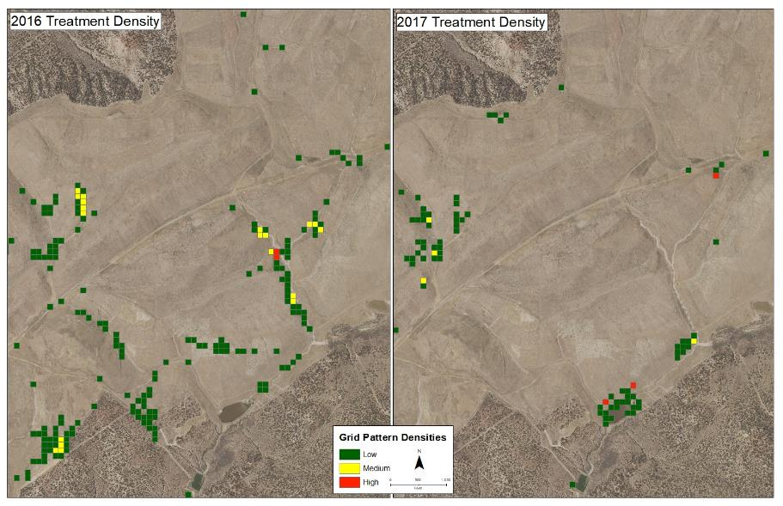
GIS Grid Pattern Analysis
Notes:
Picture with background removed
(Intermediate)
To reproduce the picture effects on this slide, do the following:
On the Home tab, in the Slides group, click Layout, & then click Blank.
On the Insert tab, in the Images group, click Picture.
In the Insert Picture dialog box, select a picture & then click Insert.
Select the picture. Under Picture Tools, on the Format tab, in the Size group, click the Size & Position dialog box launcher. In the Format Picture dialog box, resize or crop the image so that the height is set to 7.5” & the width is set to 10”. To crop the picture, click Crop in the left pane, & in the right pane, under Crop position, enter values into the Height, Width, Left, & Top boxes. To resize the picture, click Size in the left pane, & in the right pane, under Size & rotate, enter values into the Height & Width boxes.
Also under Picture Tools, on the Format tab, in the Adjust group, click Color, & then under Recolor click Grayscale.
Also in the Adjust group, click Corrections, & then under Brightness & Contrast, click Brightness: -40% Contrast: +20%.
On the Home tab, in the Clipboard group, click the arrow to the right of Copy, & then click Duplicate.
Select the second picture. On the Home tab, in the Drawing group, click Arrange, point to Align, & then do the following:
Click Align to Slide.
Click Align Middle.
Click Align Center.
Under Picture Tools, on the Format tab, in the Adjust group, click Reset Picture.
Also under Picture Tools, on the Format tab, in the Size group, click the Size & Position dialog box launcher.. In the Format Picture dialog box, resize or crop the image to focus on the main subject in the picture. (Example picture is set to 3.54” height & 3.24” width). To crop the picture, click Crop in the left pane, & in the right pane, under Crop position, enter values into the Height, Width, Left, & Top boxes. To resize the picture, click Size in the left pane, & in the right pane, under Size & rotate, enter values into the Height & Width boxes.
Also under Picture Tools, on the Format tab, in the Adjust group, click Remove Background, & then do the following:
To remove additional background areas from the picture, on the Background Removal tab, in the Refine group, click Mark Areas to Remove. Select all of the additional areas to be removed.
To keep additional areas of the picture that have been removed, on the Background Removal tab, in the Refine group, click Mark Areas to Keep. Select all of the additional areas to be kept.
Click Keep Changes in the Close group when finished.
To reproduce the shape effects on this slide, do the following:
On the Home tab, in the Drawing group, select Rectangle.
On the slide, drag to draw a rectangle.
Select the rectangle. Also on the Home tab, in the Drawing group, click the Format Shape dialog box launcher.
In the Format Shape dialog box, in the Size tab, enter 7.5” into the Height box & enter 4” into the Width box.
Also in the Format Shape dialog box, in the Fill tab, select Gradient fill, & then do the following:
In the Type list, select Linear.
In the Angle box, enter 90°.
Under Gradient stops, click Add gradient stops or Remove gradient stops until three stops appear in the slider.
Also under Gradient stops, customize the gradient stops as follows:
Select the first stop from the left in the slider, & then do the following:
In the Position box, enter 0%.
Click the button next to Color, & then under Theme Colors click Black, Text 1 (first row, second option from the left).
In the Transparency box, enter 100%.
Select the second stop from the left in the slider, & then do the following:
In the Position box, enter 40%.
Click the button next to Color, click More Colors, & then in the Colors dialog box, on the Custom tab, enter values for Red: 47, Green: 91, & Blue: 77.
In the Transparency box, enter 0%.
Select the third stop from the left in the slider, & then do the following:
In the Position box, enter 100%.
Click the button next to Color, & then under Theme Colors click Black, Text 1 (first row, second option from the left).
In the Transparency box, enter 90%.
Also in the Format Shape dialog box, in the Line Color tab, select No Line.
Select the second picture. On the Home tab, in the Drawing group, click Arrange, & then click Bring to Front.
To reproduce the text effects on this slide, do the following:
On the Insert tab, in the Text group, click Text Box, & then on the slide drag to draw your text box.
Enter text in the text box, & then select the text. On the Home tab, in the Font group, do the following:
In the Font list, click Calisto MT.
In the Font Size list, click 36 pt.
Click Font Color, & then under Theme Colors click White, Background 1 (first row, first option from the left).
Position text over the least transparent part of the gradient.

Slide 16
Treatment Effectiveness Looks Awesome!!!!!
Herbicide Treatment Effectiveness
Insert Mapping here
Mine wide all years vs 2018
Notes:
Picture with background removed
(Intermediate)
To reproduce the picture effects on this slide, do the following:
On the Home tab, in the Slides group, click Layout, & then click Blank.
On the Insert tab, in the Images group, click Picture.
In the Insert Picture dialog box, select a picture & then click Insert.
Select the picture. Under Picture Tools, on the Format tab, in the Size group, click the Size & Position dialog box launcher. In the Format Picture dialog box, resize or crop the image so that the height is set to 7.5” & the width is set to 10”. To crop the picture, click Crop in the left pane, & in the right pane, under Crop position, enter values into the Height, Width, Left, & Top boxes. To resize the picture, click Size in the left pane, & in the right pane, under Size & rotate, enter values into the Height & Width boxes.
Also under Picture Tools, on the Format tab, in the Adjust group, click Color, & then under Recolor click Grayscale.
Also in the Adjust group, click Corrections, & then under Brightness & Contrast, click Brightness: -40% Contrast: +20%.
On the Home tab, in the Clipboard group, click the arrow to the right of Copy, & then click Duplicate.
Select the second picture. On the Home tab, in the Drawing group, click Arrange, point to Align, & then do the following:
Click Align to Slide.
Click Align Middle.
Click Align Center.
Under Picture Tools, on the Format tab, in the Adjust group, click Reset Picture.
Also under Picture Tools, on the Format tab, in the Size group, click the Size & Position dialog box launcher.. In the Format Picture dialog box, resize or crop the image to focus on the main subject in the picture. (Example picture is set to 3.54” height & 3.24” width). To crop the picture, click Crop in the left pane, & in the right pane, under Crop position, enter values into the Height, Width, Left, & Top boxes. To resize the picture, click Size in the left pane, & in the right pane, under Size & rotate, enter values into the Height & Width boxes.
Also under Picture Tools, on the Format tab, in the Adjust group, click Remove Background, & then do the following:
To remove additional background areas from the picture, on the Background Removal tab, in the Refine group, click Mark Areas to Remove. Select all of the additional areas to be removed.
To keep additional areas of the picture that have been removed, on the Background Removal tab, in the Refine group, click Mark Areas to Keep. Select all of the additional areas to be kept.
Click Keep Changes in the Close group when finished.
To reproduce the shape effects on this slide, do the following:
On the Home tab, in the Drawing group, select Rectangle.
On the slide, drag to draw a rectangle.
Select the rectangle. Also on the Home tab, in the Drawing group, click the Format Shape dialog box launcher.
In the Format Shape dialog box, in the Size tab, enter 7.5” into the Height box & enter 4” into the Width box.
Also in the Format Shape dialog box, in the Fill tab, select Gradient fill, & then do the following:
In the Type list, select Linear.
In the Angle box, enter 90°.
Under Gradient stops, click Add gradient stops or Remove gradient stops until three stops appear in the slider.
Also under Gradient stops, customize the gradient stops as follows:
Select the first stop from the left in the slider, & then do the following:
In the Position box, enter 0%.
Click the button next to Color, & then under Theme Colors click Black, Text 1 (first row, second option from the left).
In the Transparency box, enter 100%.
Select the second stop from the left in the slider, & then do the following:
In the Position box, enter 40%.
Click the button next to Color, click More Colors, & then in the Colors dialog box, on the Custom tab, enter values for Red: 47, Green: 91, & Blue: 77.
In the Transparency box, enter 0%.
Select the third stop from the left in the slider, & then do the following:
In the Position box, enter 100%.
Click the button next to Color, & then under Theme Colors click Black, Text 1 (first row, second option from the left).
In the Transparency box, enter 90%.
Also in the Format Shape dialog box, in the Line Color tab, select No Line.
Select the second picture. On the Home tab, in the Drawing group, click Arrange, & then click Bring to Front.
To reproduce the text effects on this slide, do the following:
On the Insert tab, in the Text group, click Text Box, & then on the slide drag to draw your text box.
Enter text in the text box, & then select the text. On the Home tab, in the Font group, do the following:
In the Font list, click Calisto MT.
In the Font Size list, click 36 pt.
Click Font Color, & then under Theme Colors click White, Background 1 (first row, first option from the left).
Position text over the least transparent part of the gradient.

Slide 17
Herbicide Treatment Effectiveness
2018 Drought Conditions: Adjust for Impacts on Vegetation Germination & Growth
Compare & evaluate reduction between 2016, 2017 & 2018
Data Available for Evaluation
No Vegetation Monitoring
Evaluate Precipitation Affects
Notes:
Picture with background removed
(Intermediate)
To reproduce the picture effects on this slide, do the following:
On the Home tab, in the Slides group, click Layout, & then click Blank.
On the Insert tab, in the Images group, click Picture.
In the Insert Picture dialog box, select a picture & then click Insert.
Select the picture. Under Picture Tools, on the Format tab, in the Size group, click the Size & Position dialog box launcher. In the Format Picture dialog box, resize or crop the image so that the height is set to 7.5” & the width is set to 10”. To crop the picture, click Crop in the left pane, & in the right pane, under Crop position, enter values into the Height, Width, Left, & Top boxes. To resize the picture, click Size in the left pane, & in the right pane, under Size & rotate, enter values into the Height & Width boxes.
Also under Picture Tools, on the Format tab, in the Adjust group, click Color, & then under Recolor click Grayscale.
Also in the Adjust group, click Corrections, & then under Brightness & Contrast, click Brightness: -40% Contrast: +20%.
On the Home tab, in the Clipboard group, click the arrow to the right of Copy, & then click Duplicate.
Select the second picture. On the Home tab, in the Drawing group, click Arrange, point to Align, & then do the following:
Click Align to Slide.
Click Align Middle.
Click Align Center.
Under Picture Tools, on the Format tab, in the Adjust group, click Reset Picture.
Also under Picture Tools, on the Format tab, in the Size group, click the Size & Position dialog box launcher.. In the Format Picture dialog box, resize or crop the image to focus on the main subject in the picture. (Example picture is set to 3.54” height & 3.24” width). To crop the picture, click Crop in the left pane, & in the right pane, under Crop position, enter values into the Height, Width, Left, & Top boxes. To resize the picture, click Size in the left pane, & in the right pane, under Size & rotate, enter values into the Height & Width boxes.
Also under Picture Tools, on the Format tab, in the Adjust group, click Remove Background, & then do the following:
To remove additional background areas from the picture, on the Background Removal tab, in the Refine group, click Mark Areas to Remove. Select all of the additional areas to be removed.
To keep additional areas of the picture that have been removed, on the Background Removal tab, in the Refine group, click Mark Areas to Keep. Select all of the additional areas to be kept.
Click Keep Changes in the Close group when finished.
To reproduce the shape effects on this slide, do the following:
On the Home tab, in the Drawing group, select Rectangle.
On the slide, drag to draw a rectangle.
Select the rectangle. Also on the Home tab, in the Drawing group, click the Format Shape dialog box launcher.
In the Format Shape dialog box, in the Size tab, enter 7.5” into the Height box & enter 4” into the Width box.
Also in the Format Shape dialog box, in the Fill tab, select Gradient fill, & then do the following:
In the Type list, select Linear.
In the Angle box, enter 90°.
Under Gradient stops, click Add gradient stops or Remove gradient stops until three stops appear in the slider.
Also under Gradient stops, customize the gradient stops as follows:
Select the first stop from the left in the slider, & then do the following:
In the Position box, enter 0%.
Click the button next to Color, & then under Theme Colors click Black, Text 1 (first row, second option from the left).
In the Transparency box, enter 100%.
Select the second stop from the left in the slider, & then do the following:
In the Position box, enter 40%.
Click the button next to Color, click More Colors, & then in the Colors dialog box, on the Custom tab, enter values for Red: 47, Green: 91, & Blue: 77.
In the Transparency box, enter 0%.
Select the third stop from the left in the slider, & then do the following:
In the Position box, enter 100%.
Click the button next to Color, & then under Theme Colors click Black, Text 1 (first row, second option from the left).
In the Transparency box, enter 90%.
Also in the Format Shape dialog box, in the Line Color tab, select No Line.
Select the second picture. On the Home tab, in the Drawing group, click Arrange, & then click Bring to Front.
To reproduce the text effects on this slide, do the following:
On the Insert tab, in the Text group, click Text Box, & then on the slide drag to draw your text box.
Enter text in the text box, & then select the text. On the Home tab, in the Font group, do the following:
In the Font list, click Calisto MT.
In the Font Size list, click 36 pt.
Click Font Color, & then under Theme Colors click White, Background 1 (first row, first option from the left).
Position text over the least transparent part of the gradient.

Slide 18
Precipitation Influence
Precipitation Impacts on Weed Growth
Rain Gages: Year Around Collection
2016-2017: Moisture Conditions Favored Increase in Cool Season Noxious Weed Populations
Severe drought 2018: Or was it?

Slide 19
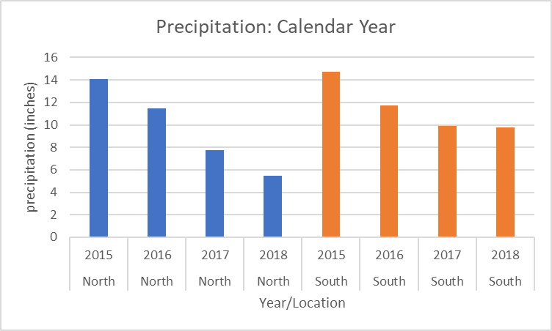
Precipitation Trends

Slide 20
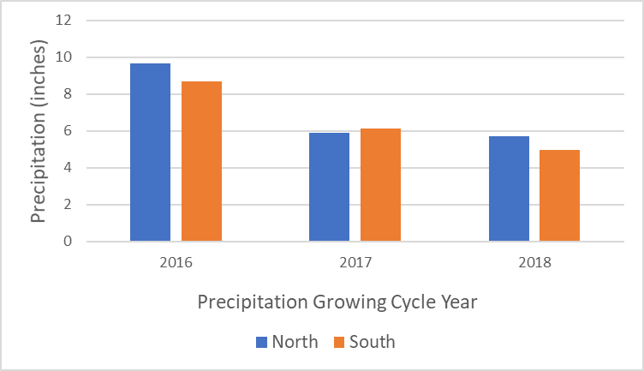
Precipitation Trends

Slide 21
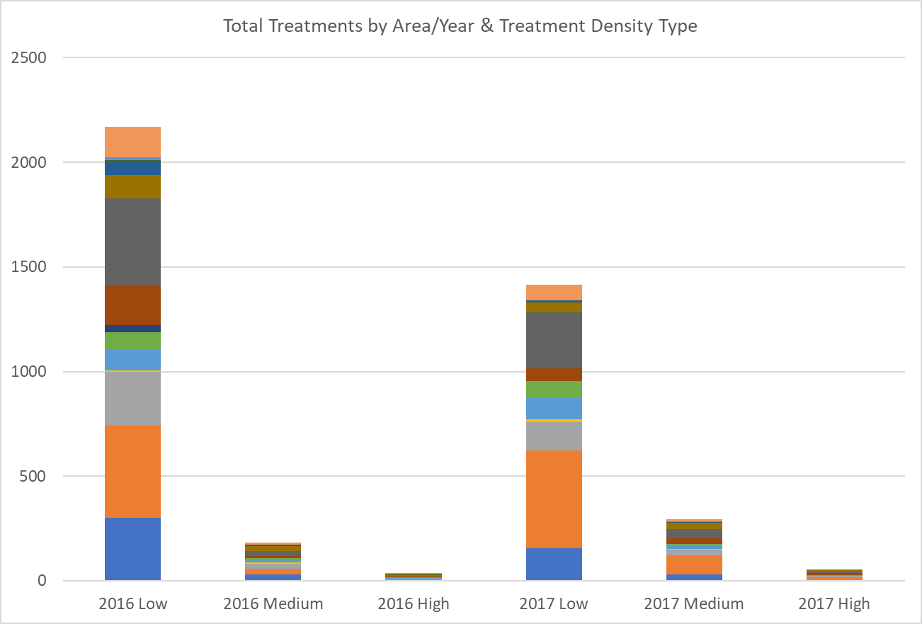
Herbicide Treatment Effectiveness
Treatment Category:
Low Density=Significant Decrease; Medium Density=Moderate Increase; High Density=Slight Increase
Notes:
Picture with background removed
(Intermediate)
To reproduce the picture effects on this slide, do the following:
On the Home tab, in the Slides group, click Layout, & then click Blank.
On the Insert tab, in the Images group, click Picture.
In the Insert Picture dialog box, select a picture & then click Insert.
Select the picture. Under Picture Tools, on the Format tab, in the Size group, click the Size & Position dialog box launcher. In the Format Picture dialog box, resize or crop the image so that the height is set to 7.5” & the width is set to 10”. To crop the picture, click Crop in the left pane, & in the right pane, under Crop position, enter values into the Height, Width, Left, & Top boxes. To resize the picture, click Size in the left pane, & in the right pane, under Size & rotate, enter values into the Height & Width boxes.
Also under Picture Tools, on the Format tab, in the Adjust group, click Color, & then under Recolor click Grayscale.
Also in the Adjust group, click Corrections, & then under Brightness & Contrast, click Brightness: -40% Contrast: +20%.
On the Home tab, in the Clipboard group, click the arrow to the right of Copy, & then click Duplicate.
Select the second picture. On the Home tab, in the Drawing group, click Arrange, point to Align, & then do the following:
Click Align to Slide.
Click Align Middle.
Click Align Center.
Under Picture Tools, on the Format tab, in the Adjust group, click Reset Picture.
Also under Picture Tools, on the Format tab, in the Size group, click the Size & Position dialog box launcher.. In the Format Picture dialog box, resize or crop the image to focus on the main subject in the picture. (Example picture is set to 3.54” height & 3.24” width). To crop the picture, click Crop in the left pane, & in the right pane, under Crop position, enter values into the Height, Width, Left, & Top boxes. To resize the picture, click Size in the left pane, & in the right pane, under Size & rotate, enter values into the Height & Width boxes.
Also under Picture Tools, on the Format tab, in the Adjust group, click Remove Background, & then do the following:
To remove additional background areas from the picture, on the Background Removal tab, in the Refine group, click Mark Areas to Remove. Select all of the additional areas to be removed.
To keep additional areas of the picture that have been removed, on the Background Removal tab, in the Refine group, click Mark Areas to Keep. Select all of the additional areas to be kept.
Click Keep Changes in the Close group when finished.
To reproduce the shape effects on this slide, do the following:
On the Home tab, in the Drawing group, select Rectangle.
On the slide, drag to draw a rectangle.
Select the rectangle. Also on the Home tab, in the Drawing group, click the Format Shape dialog box launcher.
In the Format Shape dialog box, in the Size tab, enter 7.5” into the Height box & enter 4” into the Width box.
Also in the Format Shape dialog box, in the Fill tab, select Gradient fill, & then do the following:
In the Type list, select Linear.
In the Angle box, enter 90°.
Under Gradient stops, click Add gradient stops or Remove gradient stops until three stops appear in the slider.
Also under Gradient stops, customize the gradient stops as follows:
Select the first stop from the left in the slider, & then do the following:
In the Position box, enter 0%.
Click the button next to Color, & then under Theme Colors click Black, Text 1 (first row, second option from the left).
In the Transparency box, enter 100%.
Select the second stop from the left in the slider, & then do the following:
In the Position box, enter 40%.
Click the button next to Color, click More Colors, & then in the Colors dialog box, on the Custom tab, enter values for Red: 47, Green: 91, & Blue: 77.
In the Transparency box, enter 0%.
Select the third stop from the left in the slider, & then do the following:
In the Position box, enter 100%.
Click the button next to Color, & then under Theme Colors click Black, Text 1 (first row, second option from the left).
In the Transparency box, enter 90%.
Also in the Format Shape dialog box, in the Line Color tab, select No Line.
Select the second picture. On the Home tab, in the Drawing group, click Arrange, & then click Bring to Front.
To reproduce the text effects on this slide, do the following:
On the Insert tab, in the Text group, click Text Box, & then on the slide drag to draw your text box.
Enter text in the text box, & then select the text. On the Home tab, in the Font group, do the following:
In the Font list, click Calisto MT.
In the Font Size list, click 36 pt.
Click Font Color, & then under Theme Colors click White, Background 1 (first row, first option from the left).
Position text over the least transparent part of the gradient.

Slide 22
Herbicide Treatment Effectiveness
Evaluate Growing Cycle Total Precipitation
Musk thistle vast majority of graticules
Cool season species-germination, establishment & growth summer-fall & spring
Deep taproot uses subsurface moisture for second year growth
Use PPT data
Summer previous to treatment year (Jun-Oct)
Plus Late Spring (April-May)
Growing Cycle Precipitation
Notes:
Picture with background removed
(Intermediate)
To reproduce the picture effects on this slide, do the following:
On the Home tab, in the Slides group, click Layout, & then click Blank.
On the Insert tab, in the Images group, click Picture.
In the Insert Picture dialog box, select a picture & then click Insert.
Select the picture. Under Picture Tools, on the Format tab, in the Size group, click the Size & Position dialog box launcher. In the Format Picture dialog box, resize or crop the image so that the height is set to 7.5” & the width is set to 10”. To crop the picture, click Crop in the left pane, & in the right pane, under Crop position, enter values into the Height, Width, Left, & Top boxes. To resize the picture, click Size in the left pane, & in the right pane, under Size & rotate, enter values into the Height & Width boxes.
Also under Picture Tools, on the Format tab, in the Adjust group, click Color, & then under Recolor click Grayscale.
Also in the Adjust group, click Corrections, & then under Brightness & Contrast, click Brightness: -40% Contrast: +20%.
On the Home tab, in the Clipboard group, click the arrow to the right of Copy, & then click Duplicate.
Select the second picture. On the Home tab, in the Drawing group, click Arrange, point to Align, & then do the following:
Click Align to Slide.
Click Align Middle.
Click Align Center.
Under Picture Tools, on the Format tab, in the Adjust group, click Reset Picture.
Also under Picture Tools, on the Format tab, in the Size group, click the Size & Position dialog box launcher.. In the Format Picture dialog box, resize or crop the image to focus on the main subject in the picture. (Example picture is set to 3.54” height & 3.24” width). To crop the picture, click Crop in the left pane, & in the right pane, under Crop position, enter values into the Height, Width, Left, & Top boxes. To resize the picture, click Size in the left pane, & in the right pane, under Size & rotate, enter values into the Height & Width boxes.
Also under Picture Tools, on the Format tab, in the Adjust group, click Remove Background, & then do the following:
To remove additional background areas from the picture, on the Background Removal tab, in the Refine group, click Mark Areas to Remove. Select all of the additional areas to be removed.
To keep additional areas of the picture that have been removed, on the Background Removal tab, in the Refine group, click Mark Areas to Keep. Select all of the additional areas to be kept.
Click Keep Changes in the Close group when finished.
To reproduce the shape effects on this slide, do the following:
On the Home tab, in the Drawing group, select Rectangle.
On the slide, drag to draw a rectangle.
Select the rectangle. Also on the Home tab, in the Drawing group, click the Format Shape dialog box launcher.
In the Format Shape dialog box, in the Size tab, enter 7.5” into the Height box & enter 4” into the Width box.
Also in the Format Shape dialog box, in the Fill tab, select Gradient fill, & then do the following:
In the Type list, select Linear.
In the Angle box, enter 90°.
Under Gradient stops, click Add gradient stops or Remove gradient stops until three stops appear in the slider.
Also under Gradient stops, customize the gradient stops as follows:
Select the first stop from the left in the slider, & then do the following:
In the Position box, enter 0%.
Click the button next to Color, & then under Theme Colors click Black, Text 1 (first row, second option from the left).
In the Transparency box, enter 100%.
Select the second stop from the left in the slider, & then do the following:
In the Position box, enter 40%.
Click the button next to Color, click More Colors, & then in the Colors dialog box, on the Custom tab, enter values for Red: 47, Green: 91, & Blue: 77.
In the Transparency box, enter 0%.
Select the third stop from the left in the slider, & then do the following:
In the Position box, enter 100%.
Click the button next to Color, & then under Theme Colors click Black, Text 1 (first row, second option from the left).
In the Transparency box, enter 90%.
Also in the Format Shape dialog box, in the Line Color tab, select No Line.
Select the second picture. On the Home tab, in the Drawing group, click Arrange, & then click Bring to Front.
To reproduce the text effects on this slide, do the following:
On the Insert tab, in the Text group, click Text Box, & then on the slide drag to draw your text box.
Enter text in the text box, & then select the text. On the Home tab, in the Font group, do the following:
In the Font list, click Calisto MT.
In the Font Size list, click 36 pt.
Click Font Color, & then under Theme Colors click White, Background 1 (first row, first option from the left).
Position text over the least transparent part of the gradient.

Slide 23
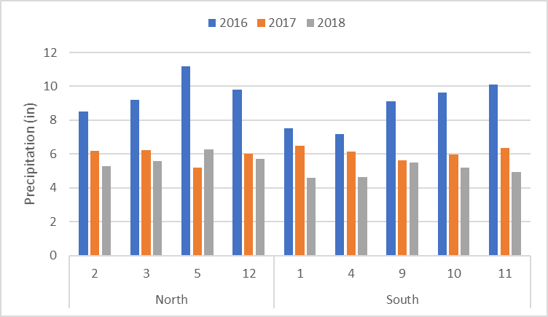
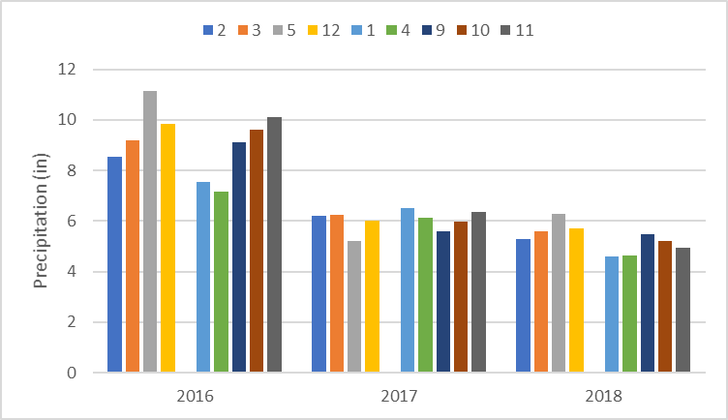
Precipitation Summary Graphs
Growing Cycle Total Precipitation
Reduced 2016-2018 ~ 40%
Reduced 2017–2018 ~ 15%
Notes:
Picture with background removed
(Intermediate)
To reproduce the picture effects on this slide, do the following:
On the Home tab, in the Slides group, click Layout, & then click Blank.
On the Insert tab, in the Images group, click Picture.
In the Insert Picture dialog box, select a picture & then click Insert.
Select the picture. Under Picture Tools, on the Format tab, in the Size group, click the Size & Position dialog box launcher. In the Format Picture dialog box, resize or crop the image so that the height is set to 7.5” & the width is set to 10”. To crop the picture, click Crop in the left pane, & in the right pane, under Crop position, enter values into the Height, Width, Left, & Top boxes. To resize the picture, click Size in the left pane, & in the right pane, under Size & rotate, enter values into the Height & Width boxes.
Also under Picture Tools, on the Format tab, in the Adjust group, click Color, & then under Recolor click Grayscale.
Also in the Adjust group, click Corrections, & then under Brightness & Contrast, click Brightness: -40% Contrast: +20%.
On the Home tab, in the Clipboard group, click the arrow to the right of Copy, & then click Duplicate.
Select the second picture. On the Home tab, in the Drawing group, click Arrange, point to Align, & then do the following:
Click Align to Slide.
Click Align Middle.
Click Align Center.
Under Picture Tools, on the Format tab, in the Adjust group, click Reset Picture.
Also under Picture Tools, on the Format tab, in the Size group, click the Size & Position dialog box launcher.. In the Format Picture dialog box, resize or crop the image to focus on the main subject in the picture. (Example picture is set to 3.54” height & 3.24” width). To crop the picture, click Crop in the left pane, & in the right pane, under Crop position, enter values into the Height, Width, Left, & Top boxes. To resize the picture, click Size in the left pane, & in the right pane, under Size & rotate, enter values into the Height & Width boxes.
Also under Picture Tools, on the Format tab, in the Adjust group, click Remove Background, & then do the following:
To remove additional background areas from the picture, on the Background Removal tab, in the Refine group, click Mark Areas to Remove. Select all of the additional areas to be removed.
To keep additional areas of the picture that have been removed, on the Background Removal tab, in the Refine group, click Mark Areas to Keep. Select all of the additional areas to be kept.
Click Keep Changes in the Close group when finished.
To reproduce the shape effects on this slide, do the following:
On the Home tab, in the Drawing group, select Rectangle.
On the slide, drag to draw a rectangle.
Select the rectangle. Also on the Home tab, in the Drawing group, click the Format Shape dialog box launcher.
In the Format Shape dialog box, in the Size tab, enter 7.5” into the Height box & enter 4” into the Width box.
Also in the Format Shape dialog box, in the Fill tab, select Gradient fill, & then do the following:
In the Type list, select Linear.
In the Angle box, enter 90°.
Under Gradient stops, click Add gradient stops or Remove gradient stops until three stops appear in the slider.
Also under Gradient stops, customize the gradient stops as follows:
Select the first stop from the left in the slider, & then do the following:
In the Position box, enter 0%.
Click the button next to Color, & then under Theme Colors click Black, Text 1 (first row, second option from the left).
In the Transparency box, enter 100%.
Select the second stop from the left in the slider, & then do the following:
In the Position box, enter 40%.
Click the button next to Color, click More Colors, & then in the Colors dialog box, on the Custom tab, enter values for Red: 47, Green: 91, & Blue: 77.
In the Transparency box, enter 0%.
Select the third stop from the left in the slider, & then do the following:
In the Position box, enter 100%.
Click the button next to Color, & then under Theme Colors click Black, Text 1 (first row, second option from the left).
In the Transparency box, enter 90%.
Also in the Format Shape dialog box, in the Line Color tab, select No Line.
Select the second picture. On the Home tab, in the Drawing group, click Arrange, & then click Bring to Front.
To reproduce the text effects on this slide, do the following:
On the Insert tab, in the Text group, click Text Box, & then on the slide drag to draw your text box.
Enter text in the text box, & then select the text. On the Home tab, in the Font group, do the following:
In the Font list, click Calisto MT.
In the Font Size list, click 36 pt.
Click Font Color, & then under Theme Colors click White, Background 1 (first row, first option from the left).
Position text over the least transparent part of the gradient.

Slide 24
Herbicide Treatment Effectiveness
Repetitive Graticule & PPT Analyses-No statistical significance
Divided PPT Records into Geographic Regions
North Precipitation: Areas 2, 3, 5, 12
South Precipitation: Areas 1, 4, 9, 10 & 11
Removed Treatment Areas with:
Small Data Sets
Variable Herbicide Treatment Intensity
Notes:
Picture with background removed
(Intermediate)
To reproduce the picture effects on this slide, do the following:
On the Home tab, in the Slides group, click Layout, & then click Blank.
On the Insert tab, in the Images group, click Picture.
In the Insert Picture dialog box, select a picture & then click Insert.
Select the picture. Under Picture Tools, on the Format tab, in the Size group, click the Size & Position dialog box launcher. In the Format Picture dialog box, resize or crop the image so that the height is set to 7.5” & the width is set to 10”. To crop the picture, click Crop in the left pane, & in the right pane, under Crop position, enter values into the Height, Width, Left, & Top boxes. To resize the picture, click Size in the left pane, & in the right pane, under Size & rotate, enter values into the Height & Width boxes.
Also under Picture Tools, on the Format tab, in the Adjust group, click Color, & then under Recolor click Grayscale.
Also in the Adjust group, click Corrections, & then under Brightness & Contrast, click Brightness: -40% Contrast: +20%.
On the Home tab, in the Clipboard group, click the arrow to the right of Copy, & then click Duplicate.
Select the second picture. On the Home tab, in the Drawing group, click Arrange, point to Align, & then do the following:
Click Align to Slide.
Click Align Middle.
Click Align Center.
Under Picture Tools, on the Format tab, in the Adjust group, click Reset Picture.
Also under Picture Tools, on the Format tab, in the Size group, click the Size & Position dialog box launcher.. In the Format Picture dialog box, resize or crop the image to focus on the main subject in the picture. (Example picture is set to 3.54” height & 3.24” width). To crop the picture, click Crop in the left pane, & in the right pane, under Crop position, enter values into the Height, Width, Left, & Top boxes. To resize the picture, click Size in the left pane, & in the right pane, under Size & rotate, enter values into the Height & Width boxes.
Also under Picture Tools, on the Format tab, in the Adjust group, click Remove Background, & then do the following:
To remove additional background areas from the picture, on the Background Removal tab, in the Refine group, click Mark Areas to Remove. Select all of the additional areas to be removed.
To keep additional areas of the picture that have been removed, on the Background Removal tab, in the Refine group, click Mark Areas to Keep. Select all of the additional areas to be kept.
Click Keep Changes in the Close group when finished.
To reproduce the shape effects on this slide, do the following:
On the Home tab, in the Drawing group, select Rectangle.
On the slide, drag to draw a rectangle.
Select the rectangle. Also on the Home tab, in the Drawing group, click the Format Shape dialog box launcher.
In the Format Shape dialog box, in the Size tab, enter 7.5” into the Height box & enter 4” into the Width box.
Also in the Format Shape dialog box, in the Fill tab, select Gradient fill, & then do the following:
In the Type list, select Linear.
In the Angle box, enter 90°.
Under Gradient stops, click Add gradient stops or Remove gradient stops until three stops appear in the slider.
Also under Gradient stops, customize the gradient stops as follows:
Select the first stop from the left in the slider, & then do the following:
In the Position box, enter 0%.
Click the button next to Color, & then under Theme Colors click Black, Text 1 (first row, second option from the left).
In the Transparency box, enter 100%.
Select the second stop from the left in the slider, & then do the following:
In the Position box, enter 40%.
Click the button next to Color, click More Colors, & then in the Colors dialog box, on the Custom tab, enter values for Red: 47, Green: 91, & Blue: 77.
In the Transparency box, enter 0%.
Select the third stop from the left in the slider, & then do the following:
In the Position box, enter 100%.
Click the button next to Color, & then under Theme Colors click Black, Text 1 (first row, second option from the left).
In the Transparency box, enter 90%.
Also in the Format Shape dialog box, in the Line Color tab, select No Line.
Select the second picture. On the Home tab, in the Drawing group, click Arrange, & then click Bring to Front.
To reproduce the text effects on this slide, do the following:
On the Insert tab, in the Text group, click Text Box, & then on the slide drag to draw your text box.
Enter text in the text box, & then select the text. On the Home tab, in the Font group, do the following:
In the Font list, click Calisto MT.
In the Font Size list, click 36 pt.
Click Font Color, & then under Theme Colors click White, Background 1 (first row, first option from the left).
Position text over the least transparent part of the gradient.

Slide 25
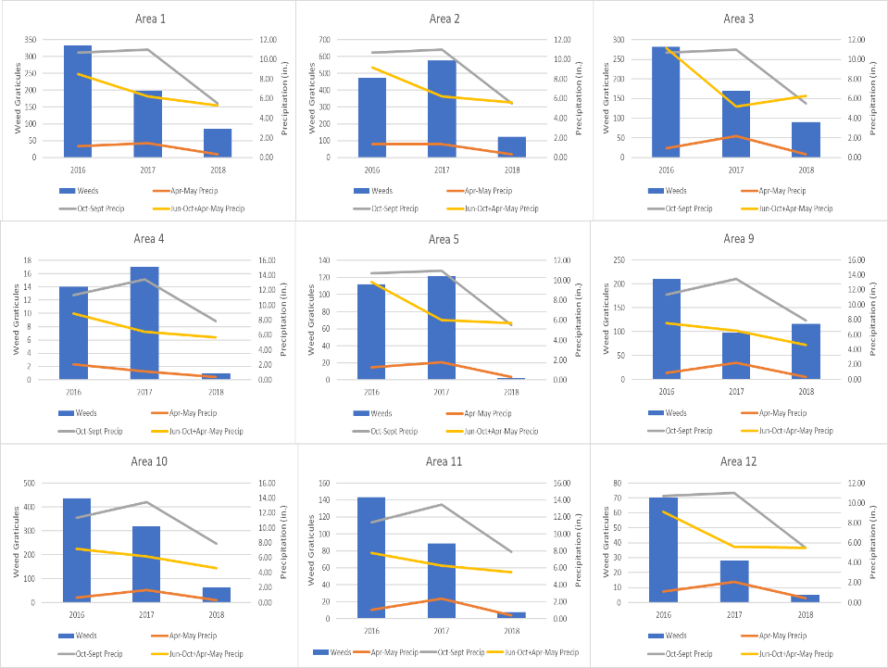
Herbicide Treatment Effectiveness
Notes:
Picture with background removed
(Intermediate)
To reproduce the picture effects on this slide, do the following:
On the Home tab, in the Slides group, click Layout, & then click Blank.
On the Insert tab, in the Images group, click Picture.
In the Insert Picture dialog box, select a picture & then click Insert.
Select the picture. Under Picture Tools, on the Format tab, in the Size group, click the Size & Position dialog box launcher. In the Format Picture dialog box, resize or crop the image so that the height is set to 7.5” & the width is set to 10”. To crop the picture, click Crop in the left pane, & in the right pane, under Crop position, enter values into the Height, Width, Left, & Top boxes. To resize the picture, click Size in the left pane, & in the right pane, under Size & rotate, enter values into the Height & Width boxes.
Also under Picture Tools, on the Format tab, in the Adjust group, click Color, & then under Recolor click Grayscale.
Also in the Adjust group, click Corrections, & then under Brightness & Contrast, click Brightness: -40% Contrast: +20%.
On the Home tab, in the Clipboard group, click the arrow to the right of Copy, & then click Duplicate.
Select the second picture. On the Home tab, in the Drawing group, click Arrange, point to Align, & then do the following:
Click Align to Slide.
Click Align Middle.
Click Align Center.
Under Picture Tools, on the Format tab, in the Adjust group, click Reset Picture.
Also under Picture Tools, on the Format tab, in the Size group, click the Size & Position dialog box launcher.. In the Format Picture dialog box, resize or crop the image to focus on the main subject in the picture. (Example picture is set to 3.54” height & 3.24” width). To crop the picture, click Crop in the left pane, & in the right pane, under Crop position, enter values into the Height, Width, Left, & Top boxes. To resize the picture, click Size in the left pane, & in the right pane, under Size & rotate, enter values into the Height & Width boxes.
Also under Picture Tools, on the Format tab, in the Adjust group, click Remove Background, & then do the following:
To remove additional background areas from the picture, on the Background Removal tab, in the Refine group, click Mark Areas to Remove. Select all of the additional areas to be removed.
To keep additional areas of the picture that have been removed, on the Background Removal tab, in the Refine group, click Mark Areas to Keep. Select all of the additional areas to be kept.
Click Keep Changes in the Close group when finished.
To reproduce the shape effects on this slide, do the following:
On the Home tab, in the Drawing group, select Rectangle.
On the slide, drag to draw a rectangle.
Select the rectangle. Also on the Home tab, in the Drawing group, click the Format Shape dialog box launcher.
In the Format Shape dialog box, in the Size tab, enter 7.5” into the Height box & enter 4” into the Width box.
Also in the Format Shape dialog box, in the Fill tab, select Gradient fill, & then do the following:
In the Type list, select Linear.
In the Angle box, enter 90°.
Under Gradient stops, click Add gradient stops or Remove gradient stops until three stops appear in the slider.
Also under Gradient stops, customize the gradient stops as follows:
Select the first stop from the left in the slider, & then do the following:
In the Position box, enter 0%.
Click the button next to Color, & then under Theme Colors click Black, Text 1 (first row, second option from the left).
In the Transparency box, enter 100%.
Select the second stop from the left in the slider, & then do the following:
In the Position box, enter 40%.
Click the button next to Color, click More Colors, & then in the Colors dialog box, on the Custom tab, enter values for Red: 47, Green: 91, & Blue: 77.
In the Transparency box, enter 0%.
Select the third stop from the left in the slider, & then do the following:
In the Position box, enter 100%.
Click the button next to Color, & then under Theme Colors click Black, Text 1 (first row, second option from the left).
In the Transparency box, enter 90%.
Also in the Format Shape dialog box, in the Line Color tab, select No Line.
Select the second picture. On the Home tab, in the Drawing group, click Arrange, & then click Bring to Front.
To reproduce the text effects on this slide, do the following:
On the Insert tab, in the Text group, click Text Box, & then on the slide drag to draw your text box.
Enter text in the text box, & then select the text. On the Home tab, in the Font group, do the following:
In the Font list, click Calisto MT.
In the Font Size list, click 36 pt.
Click Font Color, & then under Theme Colors click White, Background 1 (first row, first option from the left).
Position text over the least transparent part of the gradient.

Slide 26
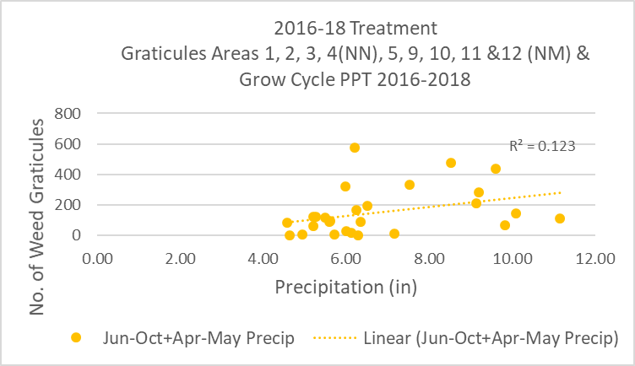
Herbicide Treatment Effectiveness
Regression Analyses-Mine Wide
Notes:
Picture with background removed
(Intermediate)
To reproduce the picture effects on this slide, do the following:
On the Home tab, in the Slides group, click Layout, & then click Blank.
On the Insert tab, in the Images group, click Picture.
In the Insert Picture dialog box, select a picture & then click Insert.
Select the picture. Under Picture Tools, on the Format tab, in the Size group, click the Size & Position dialog box launcher. In the Format Picture dialog box, resize or crop the image so that the height is set to 7.5” & the width is set to 10”. To crop the picture, click Crop in the left pane, & in the right pane, under Crop position, enter values into the Height, Width, Left, & Top boxes. To resize the picture, click Size in the left pane, & in the right pane, under Size & rotate, enter values into the Height & Width boxes.
Also under Picture Tools, on the Format tab, in the Adjust group, click Color, & then under Recolor click Grayscale.
Also in the Adjust group, click Corrections, & then under Brightness & Contrast, click Brightness: -40% Contrast: +20%.
On the Home tab, in the Clipboard group, click the arrow to the right of Copy, & then click Duplicate.
Select the second picture. On the Home tab, in the Drawing group, click Arrange, point to Align, & then do the following:
Click Align to Slide.
Click Align Middle.
Click Align Center.
Under Picture Tools, on the Format tab, in the Adjust group, click Reset Picture.
Also under Picture Tools, on the Format tab, in the Size group, click the Size & Position dialog box launcher.. In the Format Picture dialog box, resize or crop the image to focus on the main subject in the picture. (Example picture is set to 3.54” height & 3.24” width). To crop the picture, click Crop in the left pane, & in the right pane, under Crop position, enter values into the Height, Width, Left, & Top boxes. To resize the picture, click Size in the left pane, & in the right pane, under Size & rotate, enter values into the Height & Width boxes.
Also under Picture Tools, on the Format tab, in the Adjust group, click Remove Background, & then do the following:
To remove additional background areas from the picture, on the Background Removal tab, in the Refine group, click Mark Areas to Remove. Select all of the additional areas to be removed.
To keep additional areas of the picture that have been removed, on the Background Removal tab, in the Refine group, click Mark Areas to Keep. Select all of the additional areas to be kept.
Click Keep Changes in the Close group when finished.
To reproduce the shape effects on this slide, do the following:
On the Home tab, in the Drawing group, select Rectangle.
On the slide, drag to draw a rectangle.
Select the rectangle. Also on the Home tab, in the Drawing group, click the Format Shape dialog box launcher.
In the Format Shape dialog box, in the Size tab, enter 7.5” into the Height box & enter 4” into the Width box.
Also in the Format Shape dialog box, in the Fill tab, select Gradient fill, & then do the following:
In the Type list, select Linear.
In the Angle box, enter 90°.
Under Gradient stops, click Add gradient stops or Remove gradient stops until three stops appear in the slider.
Also under Gradient stops, customize the gradient stops as follows:
Select the first stop from the left in the slider, & then do the following:
In the Position box, enter 0%.
Click the button next to Color, & then under Theme Colors click Black, Text 1 (first row, second option from the left).
In the Transparency box, enter 100%.
Select the second stop from the left in the slider, & then do the following:
In the Position box, enter 40%.
Click the button next to Color, click More Colors, & then in the Colors dialog box, on the Custom tab, enter values for Red: 47, Green: 91, & Blue: 77.
In the Transparency box, enter 0%.
Select the third stop from the left in the slider, & then do the following:
In the Position box, enter 100%.
Click the button next to Color, & then under Theme Colors click Black, Text 1 (first row, second option from the left).
In the Transparency box, enter 90%.
Also in the Format Shape dialog box, in the Line Color tab, select No Line.
Select the second picture. On the Home tab, in the Drawing group, click Arrange, & then click Bring to Front.
To reproduce the text effects on this slide, do the following:
On the Insert tab, in the Text group, click Text Box, & then on the slide drag to draw your text box.
Enter text in the text box, & then select the text. On the Home tab, in the Font group, do the following:
In the Font list, click Calisto MT.
In the Font Size list, click 36 pt.
Click Font Color, & then under Theme Colors click White, Background 1 (first row, first option from the left).
Position text over the least transparent part of the gradient.

Slide 27
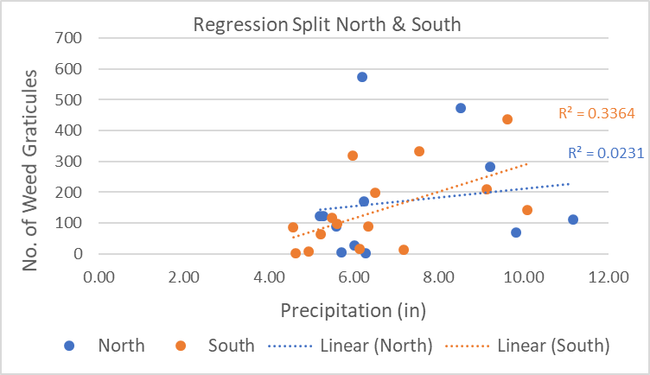
Herbicide Treatment Effectiveness
North 2% Insignificant : South Significant 34%
Notes:
Picture with background removed
(Intermediate)
To reproduce the picture effects on this slide, do the following:
On the Home tab, in the Slides group, click Layout, & then click Blank.
On the Insert tab, in the Images group, click Picture.
In the Insert Picture dialog box, select a picture & then click Insert.
Select the picture. Under Picture Tools, on the Format tab, in the Size group, click the Size & Position dialog box launcher. In the Format Picture dialog box, resize or crop the image so that the height is set to 7.5” & the width is set to 10”. To crop the picture, click Crop in the left pane, & in the right pane, under Crop position, enter values into the Height, Width, Left, & Top boxes. To resize the picture, click Size in the left pane, & in the right pane, under Size & rotate, enter values into the Height & Width boxes.
Also under Picture Tools, on the Format tab, in the Adjust group, click Color, & then under Recolor click Grayscale.
Also in the Adjust group, click Corrections, & then under Brightness & Contrast, click Brightness: -40% Contrast: +20%.
On the Home tab, in the Clipboard group, click the arrow to the right of Copy, & then click Duplicate.
Select the second picture. On the Home tab, in the Drawing group, click Arrange, point to Align, & then do the following:
Click Align to Slide.
Click Align Middle.
Click Align Center.
Under Picture Tools, on the Format tab, in the Adjust group, click Reset Picture.
Also under Picture Tools, on the Format tab, in the Size group, click the Size & Position dialog box launcher.. In the Format Picture dialog box, resize or crop the image to focus on the main subject in the picture. (Example picture is set to 3.54” height & 3.24” width). To crop the picture, click Crop in the left pane, & in the right pane, under Crop position, enter values into the Height, Width, Left, & Top boxes. To resize the picture, click Size in the left pane, & in the right pane, under Size & rotate, enter values into the Height & Width boxes.
Also under Picture Tools, on the Format tab, in the Adjust group, click Remove Background, & then do the following:
To remove additional background areas from the picture, on the Background Removal tab, in the Refine group, click Mark Areas to Remove. Select all of the additional areas to be removed.
To keep additional areas of the picture that have been removed, on the Background Removal tab, in the Refine group, click Mark Areas to Keep. Select all of the additional areas to be kept.
Click Keep Changes in the Close group when finished.
To reproduce the shape effects on this slide, do the following:
On the Home tab, in the Drawing group, select Rectangle.
On the slide, drag to draw a rectangle.
Select the rectangle. Also on the Home tab, in the Drawing group, click the Format Shape dialog box launcher.
In the Format Shape dialog box, in the Size tab, enter 7.5” into the Height box & enter 4” into the Width box.
Also in the Format Shape dialog box, in the Fill tab, select Gradient fill, & then do the following:
In the Type list, select Linear.
In the Angle box, enter 90°.
Under Gradient stops, click Add gradient stops or Remove gradient stops until three stops appear in the slider.
Also under Gradient stops, customize the gradient stops as follows:
Select the first stop from the left in the slider, & then do the following:
In the Position box, enter 0%.
Click the button next to Color, & then under Theme Colors click Black, Text 1 (first row, second option from the left).
In the Transparency box, enter 100%.
Select the second stop from the left in the slider, & then do the following:
In the Position box, enter 40%.
Click the button next to Color, click More Colors, & then in the Colors dialog box, on the Custom tab, enter values for Red: 47, Green: 91, & Blue: 77.
In the Transparency box, enter 0%.
Select the third stop from the left in the slider, & then do the following:
In the Position box, enter 100%.
Click the button next to Color, & then under Theme Colors click Black, Text 1 (first row, second option from the left).
In the Transparency box, enter 90%.
Also in the Format Shape dialog box, in the Line Color tab, select No Line.
Select the second picture. On the Home tab, in the Drawing group, click Arrange, & then click Bring to Front.
To reproduce the text effects on this slide, do the following:
On the Insert tab, in the Text group, click Text Box, & then on the slide drag to draw your text box.
Enter text in the text box, & then select the text. On the Home tab, in the Font group, do the following:
In the Font list, click Calisto MT.
In the Font Size list, click 36 pt.
Click Font Color, & then under Theme Colors click White, Background 1 (first row, first option from the left).
Position text over the least transparent part of the gradient.

Slide 28
Herbicide Treatment Effectiveness
34% of variability of graticule numbers is predicted by precipitation
66% of variability of graticule numbers is predicted by other factors
Precipitation in Areas 1, 4, 9, 10 & 11 is independent
Limited Number of Data Points (5 Each year)
Regression Analyses is linear
Expect Plant Germination, Establishment & Growth to be an “S-shaped” Polynomial
Notes:
Picture with background removed
(Intermediate)
To reproduce the picture effects on this slide, do the following:
On the Home tab, in the Slides group, click Layout, & then click Blank.
On the Insert tab, in the Images group, click Picture.
In the Insert Picture dialog box, select a picture & then click Insert.
Select the picture. Under Picture Tools, on the Format tab, in the Size group, click the Size & Position dialog box launcher. In the Format Picture dialog box, resize or crop the image so that the height is set to 7.5” & the width is set to 10”. To crop the picture, click Crop in the left pane, & in the right pane, under Crop position, enter values into the Height, Width, Left, & Top boxes. To resize the picture, click Size in the left pane, & in the right pane, under Size & rotate, enter values into the Height & Width boxes.
Also under Picture Tools, on the Format tab, in the Adjust group, click Color, & then under Recolor click Grayscale.
Also in the Adjust group, click Corrections, & then under Brightness & Contrast, click Brightness: -40% Contrast: +20%.
On the Home tab, in the Clipboard group, click the arrow to the right of Copy, & then click Duplicate.
Select the second picture. On the Home tab, in the Drawing group, click Arrange, point to Align, & then do the following:
Click Align to Slide.
Click Align Middle.
Click Align Center.
Under Picture Tools, on the Format tab, in the Adjust group, click Reset Picture.
Also under Picture Tools, on the Format tab, in the Size group, click the Size & Position dialog box launcher.. In the Format Picture dialog box, resize or crop the image to focus on the main subject in the picture. (Example picture is set to 3.54” height & 3.24” width). To crop the picture, click Crop in the left pane, & in the right pane, under Crop position, enter values into the Height, Width, Left, & Top boxes. To resize the picture, click Size in the left pane, & in the right pane, under Size & rotate, enter values into the Height & Width boxes.
Also under Picture Tools, on the Format tab, in the Adjust group, click Remove Background, & then do the following:
To remove additional background areas from the picture, on the Background Removal tab, in the Refine group, click Mark Areas to Remove. Select all of the additional areas to be removed.
To keep additional areas of the picture that have been removed, on the Background Removal tab, in the Refine group, click Mark Areas to Keep. Select all of the additional areas to be kept.
Click Keep Changes in the Close group when finished.
To reproduce the shape effects on this slide, do the following:
On the Home tab, in the Drawing group, select Rectangle.
On the slide, drag to draw a rectangle.
Select the rectangle. Also on the Home tab, in the Drawing group, click the Format Shape dialog box launcher.
In the Format Shape dialog box, in the Size tab, enter 7.5” into the Height box & enter 4” into the Width box.
Also in the Format Shape dialog box, in the Fill tab, select Gradient fill, & then do the following:
In the Type list, select Linear.
In the Angle box, enter 90°.
Under Gradient stops, click Add gradient stops or Remove gradient stops until three stops appear in the slider.
Also under Gradient stops, customize the gradient stops as follows:
Select the first stop from the left in the slider, & then do the following:
In the Position box, enter 0%.
Click the button next to Color, & then under Theme Colors click Black, Text 1 (first row, second option from the left).
In the Transparency box, enter 100%.
Select the second stop from the left in the slider, & then do the following:
In the Position box, enter 40%.
Click the button next to Color, click More Colors, & then in the Colors dialog box, on the Custom tab, enter values for Red: 47, Green: 91, & Blue: 77.
In the Transparency box, enter 0%.
Select the third stop from the left in the slider, & then do the following:
In the Position box, enter 100%.
Click the button next to Color, & then under Theme Colors click Black, Text 1 (first row, second option from the left).
In the Transparency box, enter 90%.
Also in the Format Shape dialog box, in the Line Color tab, select No Line.
Select the second picture. On the Home tab, in the Drawing group, click Arrange, & then click Bring to Front.
To reproduce the text effects on this slide, do the following:
On the Insert tab, in the Text group, click Text Box, & then on the slide drag to draw your text box.
Enter text in the text box, & then select the text. On the Home tab, in the Font group, do the following:
In the Font list, click Calisto MT.
In the Font Size list, click 36 pt.
Click Font Color, & then under Theme Colors click White, Background 1 (first row, first option from the left).
Position text over the least transparent part of the gradient.

Slide 29
Cumulative Records Mapping
Notes:
Picture with background removed
(Intermediate)
To reproduce the picture effects on this slide, do the following:
On the Home tab, in the Slides group, click Layout, & then click Blank.
On the Insert tab, in the Images group, click Picture.
In the Insert Picture dialog box, select a picture & then click Insert.
Select the picture. Under Picture Tools, on the Format tab, in the Size group, click the Size & Position dialog box launcher. In the Format Picture dialog box, resize or crop the image so that the height is set to 7.5” & the width is set to 10”. To crop the picture, click Crop in the left pane, & in the right pane, under Crop position, enter values into the Height, Width, Left, & Top boxes. To resize the picture, click Size in the left pane, & in the right pane, under Size & rotate, enter values into the Height & Width boxes.
Also under Picture Tools, on the Format tab, in the Adjust group, click Color, & then under Recolor click Grayscale.
Also in the Adjust group, click Corrections, & then under Brightness & Contrast, click Brightness: -40% Contrast: +20%.
On the Home tab, in the Clipboard group, click the arrow to the right of Copy, & then click Duplicate.
Select the second picture. On the Home tab, in the Drawing group, click Arrange, point to Align, & then do the following:
Click Align to Slide.
Click Align Middle.
Click Align Center.
Under Picture Tools, on the Format tab, in the Adjust group, click Reset Picture.
Also under Picture Tools, on the Format tab, in the Size group, click the Size & Position dialog box launcher.. In the Format Picture dialog box, resize or crop the image to focus on the main subject in the picture. (Example picture is set to 3.54” height & 3.24” width). To crop the picture, click Crop in the left pane, & in the right pane, under Crop position, enter values into the Height, Width, Left, & Top boxes. To resize the picture, click Size in the left pane, & in the right pane, under Size & rotate, enter values into the Height & Width boxes.
Also under Picture Tools, on the Format tab, in the Adjust group, click Remove Background, & then do the following:
To remove additional background areas from the picture, on the Background Removal tab, in the Refine group, click Mark Areas to Remove. Select all of the additional areas to be removed.
To keep additional areas of the picture that have been removed, on the Background Removal tab, in the Refine group, click Mark Areas to Keep. Select all of the additional areas to be kept.
Click Keep Changes in the Close group when finished.
To reproduce the shape effects on this slide, do the following:
On the Home tab, in the Drawing group, select Rectangle.
On the slide, drag to draw a rectangle.
Select the rectangle. Also on the Home tab, in the Drawing group, click the Format Shape dialog box launcher.
In the Format Shape dialog box, in the Size tab, enter 7.5” into the Height box & enter 4” into the Width box.
Also in the Format Shape dialog box, in the Fill tab, select Gradient fill, & then do the following:
In the Type list, select Linear.
In the Angle box, enter 90°.
Under Gradient stops, click Add gradient stops or Remove gradient stops until three stops appear in the slider.
Also under Gradient stops, customize the gradient stops as follows:
Select the first stop from the left in the slider, & then do the following:
In the Position box, enter 0%.
Click the button next to Color, & then under Theme Colors click Black, Text 1 (first row, second option from the left).
In the Transparency box, enter 100%.
Select the second stop from the left in the slider, & then do the following:
In the Position box, enter 40%.
Click the button next to Color, click More Colors, & then in the Colors dialog box, on the Custom tab, enter values for Red: 47, Green: 91, & Blue: 77.
In the Transparency box, enter 0%.
Select the third stop from the left in the slider, & then do the following:
In the Position box, enter 100%.
Click the button next to Color, & then under Theme Colors click Black, Text 1 (first row, second option from the left).
In the Transparency box, enter 90%.
Also in the Format Shape dialog box, in the Line Color tab, select No Line.
Select the second picture. On the Home tab, in the Drawing group, click Arrange, & then click Bring to Front.
To reproduce the text effects on this slide, do the following:
On the Insert tab, in the Text group, click Text Box, & then on the slide drag to draw your text box.
Enter text in the text box, & then select the text. On the Home tab, in the Font group, do the following:
In the Font list, click Calisto MT.
In the Font Size list, click 36 pt.
Click Font Color, & then under Theme Colors click White, Background 1 (first row, first option from the left).
Position text over the least transparent part of the gradient.

Slide 30
Cumulative Records Mapping Closer-up
Insert Mapping here
Mine wide all years vs 2018
Notes:
Picture with background removed
(Intermediate)
To reproduce the picture effects on this slide, do the following:
On the Home tab, in the Slides group, click Layout, & then click Blank.
On the Insert tab, in the Images group, click Picture.
In the Insert Picture dialog box, select a picture & then click Insert.
Select the picture. Under Picture Tools, on the Format tab, in the Size group, click the Size & Position dialog box launcher. In the Format Picture dialog box, resize or crop the image so that the height is set to 7.5” & the width is set to 10”. To crop the picture, click Crop in the left pane, & in the right pane, under Crop position, enter values into the Height, Width, Left, & Top boxes. To resize the picture, click Size in the left pane, & in the right pane, under Size & rotate, enter values into the Height & Width boxes.
Also under Picture Tools, on the Format tab, in the Adjust group, click Color, & then under Recolor click Grayscale.
Also in the Adjust group, click Corrections, & then under Brightness & Contrast, click Brightness: -40% Contrast: +20%.
On the Home tab, in the Clipboard group, click the arrow to the right of Copy, & then click Duplicate.
Select the second picture. On the Home tab, in the Drawing group, click Arrange, point to Align, & then do the following:
Click Align to Slide.
Click Align Middle.
Click Align Center.
Under Picture Tools, on the Format tab, in the Adjust group, click Reset Picture.
Also under Picture Tools, on the Format tab, in the Size group, click the Size & Position dialog box launcher.. In the Format Picture dialog box, resize or crop the image to focus on the main subject in the picture. (Example picture is set to 3.54” height & 3.24” width). To crop the picture, click Crop in the left pane, & in the right pane, under Crop position, enter values into the Height, Width, Left, & Top boxes. To resize the picture, click Size in the left pane, & in the right pane, under Size & rotate, enter values into the Height & Width boxes.
Also under Picture Tools, on the Format tab, in the Adjust group, click Remove Background, & then do the following:
To remove additional background areas from the picture, on the Background Removal tab, in the Refine group, click Mark Areas to Remove. Select all of the additional areas to be removed.
To keep additional areas of the picture that have been removed, on the Background Removal tab, in the Refine group, click Mark Areas to Keep. Select all of the additional areas to be kept.
Click Keep Changes in the Close group when finished.
To reproduce the shape effects on this slide, do the following:
On the Home tab, in the Drawing group, select Rectangle.
On the slide, drag to draw a rectangle.
Select the rectangle. Also on the Home tab, in the Drawing group, click the Format Shape dialog box launcher.
In the Format Shape dialog box, in the Size tab, enter 7.5” into the Height box & enter 4” into the Width box.
Also in the Format Shape dialog box, in the Fill tab, select Gradient fill, & then do the following:
In the Type list, select Linear.
In the Angle box, enter 90°.
Under Gradient stops, click Add gradient stops or Remove gradient stops until three stops appear in the slider.
Also under Gradient stops, customize the gradient stops as follows:
Select the first stop from the left in the slider, & then do the following:
In the Position box, enter 0%.
Click the button next to Color, & then under Theme Colors click Black, Text 1 (first row, second option from the left).
In the Transparency box, enter 100%.
Select the second stop from the left in the slider, & then do the following:
In the Position box, enter 40%.
Click the button next to Color, click More Colors, & then in the Colors dialog box, on the Custom tab, enter values for Red: 47, Green: 91, & Blue: 77.
In the Transparency box, enter 0%.
Select the third stop from the left in the slider, & then do the following:
In the Position box, enter 100%.
Click the button next to Color, & then under Theme Colors click Black, Text 1 (first row, second option from the left).
In the Transparency box, enter 90%.
Also in the Format Shape dialog box, in the Line Color tab, select No Line.
Select the second picture. On the Home tab, in the Drawing group, click Arrange, & then click Bring to Front.
To reproduce the text effects on this slide, do the following:
On the Insert tab, in the Text group, click Text Box, & then on the slide drag to draw your text box.
Enter text in the text box, & then select the text. On the Home tab, in the Font group, do the following:
In the Font list, click Calisto MT.
In the Font Size list, click 36 pt.
Click Font Color, & then under Theme Colors click White, Background 1 (first row, first option from the left).
Position text over the least transparent part of the gradient.

Slide 31
Summary
Efficient data collection technologies are available to document treatments.
Treatment variability will skew effectiveness evaluation results.
Using treatment data assumes weed density & distribution are reasonably represented.
GPS mapping & GIS tools can be used to evaluate treatment effectiveness.
Mapping effectively illustrates trends in weed infestations.
Notes:
Picture with background removed
(Intermediate)
To reproduce the picture effects on this slide, do the following:
On the Home tab, in the Slides group, click Layout, & then click Blank.
On the Insert tab, in the Images group, click Picture.
In the Insert Picture dialog box, select a picture & then click Insert.
Select the picture. Under Picture Tools, on the Format tab, in the Size group, click the Size & Position dialog box launcher. In the Format Picture dialog box, resize or crop the image so that the height is set to 7.5” & the width is set to 10”. To crop the picture, click Crop in the left pane, & in the right pane, under Crop position, enter values into the Height, Width, Left, & Top boxes. To resize the picture, click Size in the left pane, & in the right pane, under Size & rotate, enter values into the Height & Width boxes.
Also under Picture Tools, on the Format tab, in the Adjust group, click Color, & then under Recolor click Grayscale.
Also in the Adjust group, click Corrections, & then under Brightness & Contrast, click Brightness: -40% Contrast: +20%.
On the Home tab, in the Clipboard group, click the arrow to the right of Copy, & then click Duplicate.
Select the second picture. On the Home tab, in the Drawing group, click Arrange, point to Align, & then do the following:
Click Align to Slide.
Click Align Middle.
Click Align Center.
Under Picture Tools, on the Format tab, in the Adjust group, click Reset Picture.
Also under Picture Tools, on the Format tab, in the Size group, click the Size & Position dialog box launcher.. In the Format Picture dialog box, resize or crop the image to focus on the main subject in the picture. (Example picture is set to 3.54” height & 3.24” width). To crop the picture, click Crop in the left pane, & in the right pane, under Crop position, enter values into the Height, Width, Left, & Top boxes. To resize the picture, click Size in the left pane, & in the right pane, under Size & rotate, enter values into the Height & Width boxes.
Also under Picture Tools, on the Format tab, in the Adjust group, click Remove Background, & then do the following:
To remove additional background areas from the picture, on the Background Removal tab, in the Refine group, click Mark Areas to Remove. Select all of the additional areas to be removed.
To keep additional areas of the picture that have been removed, on the Background Removal tab, in the Refine group, click Mark Areas to Keep. Select all of the additional areas to be kept.
Click Keep Changes in the Close group when finished.
To reproduce the shape effects on this slide, do the following:
On the Home tab, in the Drawing group, select Rectangle.
On the slide, drag to draw a rectangle.
Select the rectangle. Also on the Home tab, in the Drawing group, click the Format Shape dialog box launcher.
In the Format Shape dialog box, in the Size tab, enter 7.5” into the Height box & enter 4” into the Width box.
Also in the Format Shape dialog box, in the Fill tab, select Gradient fill, & then do the following:
In the Type list, select Linear.
In the Angle box, enter 90°.
Under Gradient stops, click Add gradient stops or Remove gradient stops until three stops appear in the slider.
Also under Gradient stops, customize the gradient stops as follows:
Select the first stop from the left in the slider, & then do the following:
In the Position box, enter 0%.
Click the button next to Color, & then under Theme Colors click Black, Text 1 (first row, second option from the left).
In the Transparency box, enter 100%.
Select the second stop from the left in the slider, & then do the following:
In the Position box, enter 40%.
Click the button next to Color, click More Colors, & then in the Colors dialog box, on the Custom tab, enter values for Red: 47, Green: 91, & Blue: 77.
In the Transparency box, enter 0%.
Select the third stop from the left in the slider, & then do the following:
In the Position box, enter 100%.
Click the button next to Color, & then under Theme Colors click Black, Text 1 (first row, second option from the left).
In the Transparency box, enter 90%.
Also in the Format Shape dialog box, in the Line Color tab, select No Line.
Select the second picture. On the Home tab, in the Drawing group, click Arrange, & then click Bring to Front.
To reproduce the text effects on this slide, do the following:
On the Insert tab, in the Text group, click Text Box, & then on the slide drag to draw your text box.
Enter text in the text box, & then select the text. On the Home tab, in the Font group, do the following:
In the Font list, click Calisto MT.
In the Font Size list, click 36 pt.
Click Font Color, & then under Theme Colors click White, Background 1 (first row, first option from the left).
Position text over the least transparent part of the gradient.

Slide 32
Summary
Effectiveness evaluations should take yearly environmental conditions into consideration.
Precipitation grow cycle totals influence increases as amount decreases
Monitor vegetation in poor PPT years-document resiliency of reclamation community over time.
Infestation surveys could be performed periodically to document noxious weed infestations.
Avoid conclusions based on short time intervals-GET THE BIG PICTURE!!
Notes:
Picture with background removed
(Intermediate)
To reproduce the picture effects on this slide, do the following:
On the Home tab, in the Slides group, click Layout, & then click Blank.
On the Insert tab, in the Images group, click Picture.
In the Insert Picture dialog box, select a picture & then click Insert.
Select the picture. Under Picture Tools, on the Format tab, in the Size group, click the Size & Position dialog box launcher. In the Format Picture dialog box, resize or crop the image so that the height is set to 7.5” & the width is set to 10”. To crop the picture, click Crop in the left pane, & in the right pane, under Crop position, enter values into the Height, Width, Left, & Top boxes. To resize the picture, click Size in the left pane, & in the right pane, under Size & rotate, enter values into the Height & Width boxes.
Also under Picture Tools, on the Format tab, in the Adjust group, click Color, & then under Recolor click Grayscale.
Also in the Adjust group, click Corrections, & then under Brightness & Contrast, click Brightness: -40% Contrast: +20%.
On the Home tab, in the Clipboard group, click the arrow to the right of Copy, & then click Duplicate.
Select the second picture. On the Home tab, in the Drawing group, click Arrange, point to Align, & then do the following:
Click Align to Slide.
Click Align Middle.
Click Align Center.
Under Picture Tools, on the Format tab, in the Adjust group, click Reset Picture.
Also under Picture Tools, on the Format tab, in the Size group, click the Size & Position dialog box launcher.. In the Format Picture dialog box, resize or crop the image to focus on the main subject in the picture. (Example picture is set to 3.54” height & 3.24” width). To crop the picture, click Crop in the left pane, & in the right pane, under Crop position, enter values into the Height, Width, Left, & Top boxes. To resize the picture, click Size in the left pane, & in the right pane, under Size & rotate, enter values into the Height & Width boxes.
Also under Picture Tools, on the Format tab, in the Adjust group, click Remove Background, & then do the following:
To remove additional background areas from the picture, on the Background Removal tab, in the Refine group, click Mark Areas to Remove. Select all of the additional areas to be removed.
To keep additional areas of the picture that have been removed, on the Background Removal tab, in the Refine group, click Mark Areas to Keep. Select all of the additional areas to be kept.
Click Keep Changes in the Close group when finished.
To reproduce the shape effects on this slide, do the following:
On the Home tab, in the Drawing group, select Rectangle.
On the slide, drag to draw a rectangle.
Select the rectangle. Also on the Home tab, in the Drawing group, click the Format Shape dialog box launcher.
In the Format Shape dialog box, in the Size tab, enter 7.5” into the Height box & enter 4” into the Width box.
Also in the Format Shape dialog box, in the Fill tab, select Gradient fill, & then do the following:
In the Type list, select Linear.
In the Angle box, enter 90°.
Under Gradient stops, click Add gradient stops or Remove gradient stops until three stops appear in the slider.
Also under Gradient stops, customize the gradient stops as follows:
Select the first stop from the left in the slider, & then do the following:
In the Position box, enter 0%.
Click the button next to Color, & then under Theme Colors click Black, Text 1 (first row, second option from the left).
In the Transparency box, enter 100%.
Select the second stop from the left in the slider, & then do the following:
In the Position box, enter 40%.
Click the button next to Color, click More Colors, & then in the Colors dialog box, on the Custom tab, enter values for Red: 47, Green: 91, & Blue: 77.
In the Transparency box, enter 0%.
Select the third stop from the left in the slider, & then do the following:
In the Position box, enter 100%.
Click the button next to Color, & then under Theme Colors click Black, Text 1 (first row, second option from the left).
In the Transparency box, enter 90%.
Also in the Format Shape dialog box, in the Line Color tab, select No Line.
Select the second picture. On the Home tab, in the Drawing group, click Arrange, & then click Bring to Front.
To reproduce the text effects on this slide, do the following:
On the Insert tab, in the Text group, click Text Box, & then on the slide drag to draw your text box.
Enter text in the text box, & then select the text. On the Home tab, in the Font group, do the following:
In the Font list, click Calisto MT.
In the Font Size list, click 36 pt.
Click Font Color, & then under Theme Colors click White, Background 1 (first row, first option from the left).
Position text over the least transparent part of the gradient.

Slide 33
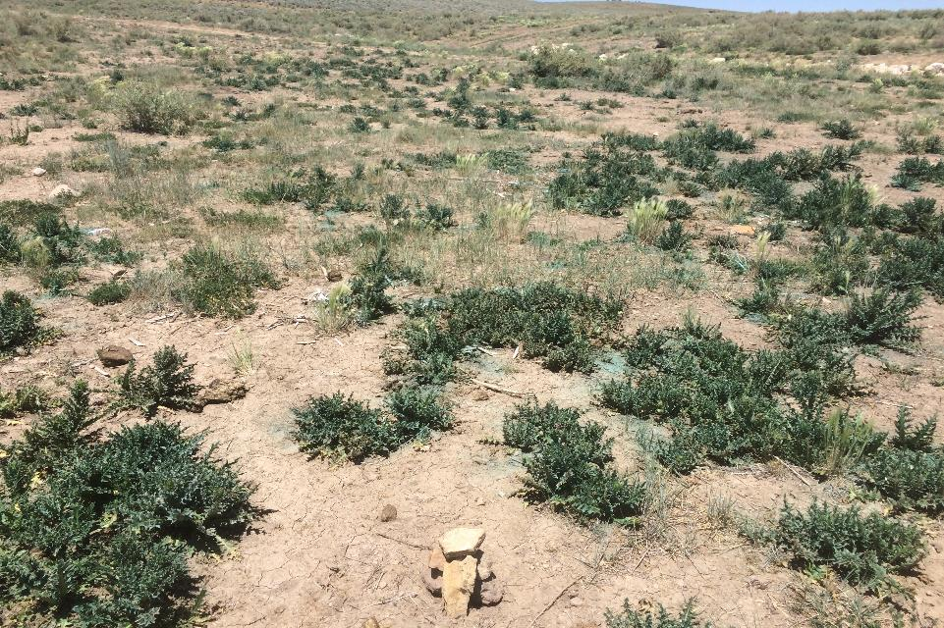

Slide 34
