Slide 1

Development of a GIS Tool for Estimating Post-Mining Water Levels in Underground Coal Mines of Ohio
Rebecca Steinberg*, Zachary Matthews, Natalie Kruse, Dina Lopez, Jen Bowman, Nora Sullivan

Slide 2
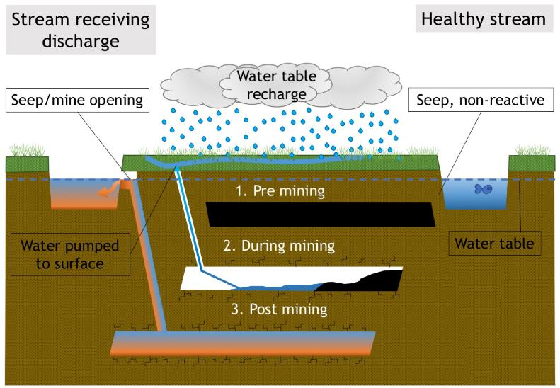
Environmental impact:
Acid Mine Drainage (AMD)
Notes:
Review on risks of underground coal mining
Simplified diagram during stages of mining
Once pumping has ceased, possible AMD
Variables such as limestone buffers in above lithology can mitigate naturally
Oxygen and water, fracturing changes permeability

Slide 3

Surface Mining Control and Reclamation Act (SMCRA) of 1977
Federal act that establishes Office of Surface Mining and Reclamation (OSMRE)
Requires mining companies to obtain a mining land permit
Places responsibility on coal companies to reclaim and protect land being mined
  Require hydrologic and geologic characterization of area
Notes:
To address this issue, in 1977
Companies take responsibility for environmental impact
Characterization to determine if a mine pool will form/discharge
Currently lack a reliable method for determining

Slide 4
‘Tools to predict the hydrological response and mine pool formation in underground mines’
Goal: To produce ArcGIS tool for prediction of post-mining water level
OSMRE funded project with Voinovich School & Geology Department
  Lindsey Schafer 2018, Fred Twumasi 2018
Coal companies lack a reliable method to predict a mine flooding post-closure
This research is a continuation of work related to Project OSM
Notes:
Where my project comes in, part of larger project
Fred and Lindsey
Lack of reliable prediction method
OU has been working on a project to develop an empirical prediction model

Slide 5
Project Question
Can post-mining water level be predicted, within acceptable error, through multivariate analysis of hydrologic and geologic parameters and spatial interpolation?

Slide 6
Project Goals & Outputs
Goals
  Expand on previous multivariate analysis
  Produce new algorithm
  Develop working GIS tool
  Predict post-mining water level within an acceptable range of error

Slide 7
Methods: Data Analysis
Previous analysis data by well, avg., min, and max measurements
Data separated by each event of measurement
  2872 data points
  53 outliers removed
  2581 points analyzed
  291 points validation (10%)
Notes:
Data used for this project…
Previous analysis data points: multi mine without withdraw: 381

Slide 8
Methods: Data Analysis
Parameters examined:
  Surface elevation (msl)
  Bottom elevation coal (msl)
  Measured potentiometric head (msl)
  Overburden thickness (ft)
  Mined coal seam thickness (ft)
  Clay/Shale thickness (ft)
  Sandstone thickness (ft)
  Limestone thickness (ft)
  Total coal thickness (ft)
  Accumulative coal extracted (Mm³)
  Underground mined area in 4 mile buffer (acres)
  Annual average precipitation (in)
Notes:
Determined by work of previous theses Schafer and Twumasi
Mostly values from or calc from permit required data
Coal extracted: proxy for water withdrawal
Buffer: void space

Slide 9
Methods: Data Analysis
Unscrambler X:
Multiple Linear Regression (MLR)
  Not appropriate, variables not independent of each other
Principle Component Analysis (PCA)
  Helped identify variables and relationships
Principle Component Regression (PCR)
  Produced useable regression
Principle Least Square Regression (PLSR)*
  Produced useable regression, less error than PCR
Neuroshell 2:
Artificial Neural Network (ANN)**
  Produced complex regression with less error than PLSR
Notes:
All previously run by Schafer and Twumasi
Focus on PLSR and PCR as previously best results
ANN

Slide 10
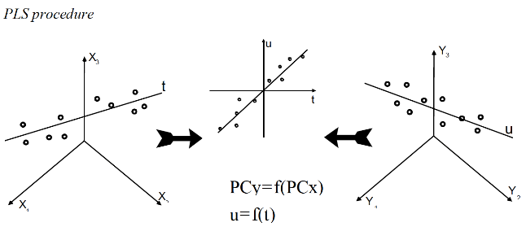
Methods: Multivariate Analysis
The Unscrambler X
PLSR defines multidimensional direction in X space that explains maximum multidimensional variance direction in Y space
Provides linear regression equation
CAMO Software AS, 2006, The Unscrambler User Manual - The Unscrambler Methods (Version 9.6):, https://www.camo.com/downloads/U9.6%20pdf%20manual/The%20Unscrambler%20Methods.pdf (accessed March 2019).
Notes:
After re-running analysis PLSR still best, focused on

Slide 11
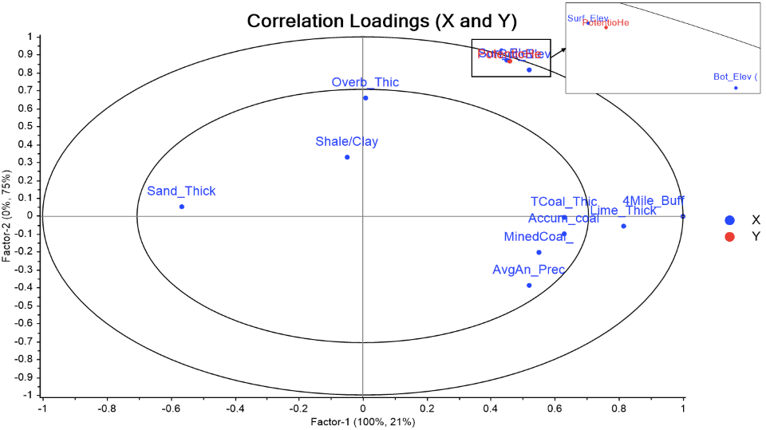
Results: Multivariate Analysis
PLS
Notes:
Location of variables determine explained variance
Inner 50%, outer 100%
Closer together more related, vice versa

Slide 12
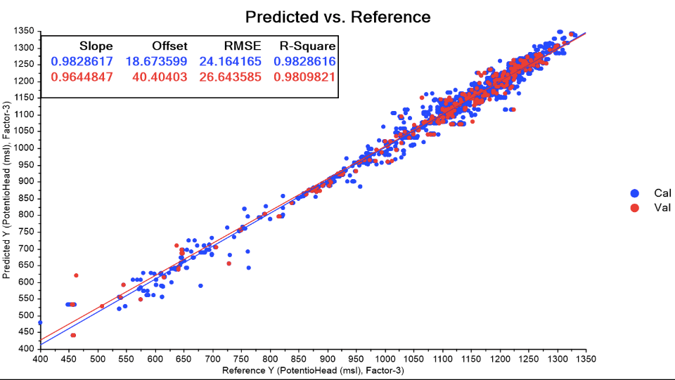
Results: Multivariate Analysis
Notes:
Validation set of random 10%
High R-squared, val set matches well

Slide 13
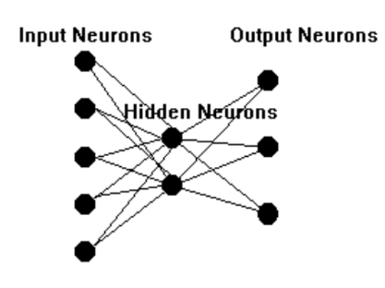
Methods: Multivariate Analysis
Neuroshell 2
Artificial Neural Network (ANN)
  Computer learning from data set to produce polynomial equation
Same data set and validation ran in Neuroshell as Unscrambler X
Ward Systems Group, Inc., 2019, NeuroShell 2 Help:, http://www.wardsystems.com/manuals/neuroshell2/index.html?idxhowuse.htm (accessed March 2019).
Notes:
While PLSR produced a usable regression, ANN also explored
mathematical model that runs a computational simulation that imitates the behavior patterns of neurons in the human brain to perceive patterns in data
analyze complex non-linear relationships between input data and determine ‘weights’ for input variables to form a polynomial equation

Slide 14
Results: Multivariate Analysis
GMDH Advanced training
  Trains all data
Model Optimization: Smart
  Balances speed and quality
Selection Criterion: FPE
  Final Prediction Error
  Min. variance, unbiased estimator of MSE prediction
Notes:
GMDH: group method of data handling (used by Twumasi)
Selection criterion (6): determines which candidates for survival actually become survivors to go on to the next layer
Prediction Squared Error (PSE): a combination of two terms in determining selection, the model average squared error and an overfitting penalty
Full Complexity Prediction Squared Error (FCPSE): a modified version of PSE that takes into account the model complexity instead of number of coefficients
Minimal Description Length (MDL): also similar to PSE but has a greater value for the overfitting penalty
Generalized Cross Validation (GCV): another version of applying an overfitting penalty
Final Prediction Error (FPE): takes into account the minimum variance of the mean-squared error of model prediction
Regulatory (calibration): different in that it looks at the average squared error of the model when applied to a test set manually selected out of the main data set.
Model optimization: (3) for improving the model by removing terms deemed unnecessary, to either improve function or accuracy, and can affect how the model determines significant variables
Smart: provides a balance between calculation speed and model quality
Thorough: similar to Smart but looks closer at selecting significant variables
Full: most complex approach in that it examines all variables combinations at each stage of model development, resulting in a highly complex but accurate model

Slide 15
Results: Multivariate Analysis
Equation selected: ANN ‘K’
Y=(0.1*X7)-(0.049*X11)+(0.092)-(0.021*X4)+(0.019*X9)+(0.41*X1)-(0.011*X3)+(0.065*X6)-(0.1*X10)+(0.043*X5)+(0.56*X2)-(0.37*X1²)-(0.38*X2²)+(0.025*X11²)-(0.14*X2³)-(0.065*X11³)+(0.84*X1*X2)-(0.24*X1*X11)+(0.36*X2*X11)+ (0.032*X1*X2*X11)-(0.00019*X6²) +(0.041*X5*X6)+(0.043*X7²)+(0.04*X10²)-(0.026*X7³)+(0.05*X10³)-(0.14*X7*X10)-(0.011*X9²)-(0.016*X9³)-(0.025*X2*X9)+(0.013*X5²)-(0.025*X6³)-(0.014*X1³)+(0.02*X1*X7)+(0.031*X6*X10)+(0.027*X1*X3)+(0.014*X9*X11)+(0.029*X2*X4)+(0.013*X8³)-(0.016*X8*X11) +(0.0067*X4²)+(0.0045*X1*X6)
Variable Transformations:
X1=2*(Surface Elevation (msl)-545)/835-1
X2=2*(Bottom Elevation (msl)-244.04)/1055.96-1
X3=2*(Overburden Thickness (ft)-65)/638.1-1
X4=2*(Mined Coal Thickness (ft)-0.07)/11.69-1
X5=2*(Shale/Clay Thickness (ft)-0.35)/552.55-1
X6=2*Sandstone Thickness (ft)/262.3-1
X7=2*Limestone Thickness (ft)/204.97-1
X8=2*Total Coal Thickness (ft)/33.23-1
X9=2*Accumulative Coal to Extracted (Mm^3)/138.61-1
X10=2*(Underground Mining in 4-Mile Buffer (acres)-2061)/108987.5-1
X11=2*(Avg Annual Precipitation (in)-37.5)/3.7-1
Y=2*(Potentiometric Head (msl)-400)/932-1

Slide 16
Results: Multivariate Analysis
Lack of publicly available data
Algorithm ‘K’ validation through application to actual measured post-mining water level data
Meigs Mine Complex D-0354 well shafts
Permit | Well | Date | Measured Potentiometric Head (ft msl) | Predicted Potentiometric Head (ft msl) | Error (ft) | Percent Error
D-0354 | Roving Crew Shaft | 10/22/18 | 456.84 | 443.42 | 13.42 | 2.94%
D-0354 | South Mains Shaft | 10/22/18 | 455.94 | 458.22 | -2.28 | 0.50%
D-0354 | South Mains Shaft | 9/11/17 | 456.88 | 458.22 | -1.34 | 0.29%
 |  |  |  | Average: | 3.27 | 1.24%
Notes:
Validation of ANN equation K
Post-mining water levels directly in mine very limited
Last measurement of each year after pumping ceased

Slide 17
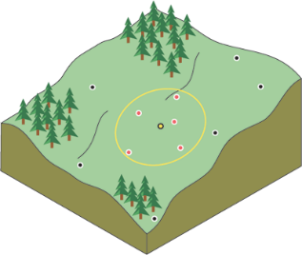
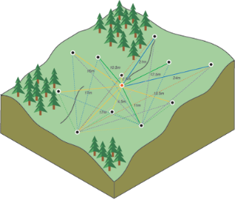

Methods: Spatial Interpolation
IDW
Interpolation predicts values to form a raster surface from existing points
Kriging vs. Inverse distance weighting (IDW)
  IDW: deterministic method based on surrounding measurements
  Kriging: similar to IDW but includes autocorrelation and measure of error
Kriging
ESRI, 2019, How IDW works—Help | ArcGIS Desktop:, https://pro.arcgis.com/en/pro-app/tool-reference/spatial-analyst/how-idw-works.htm (accessed March 2019).
ESRI, 2019, How Kriging works—Help | ArcGIS Desktop:, https://pro.arcgis.com/en/pro-app/tool-reference/spatial-analyst/how-kriging-works.htm (accessed March 2019).
Notes:
IDW
a linearly weighted combination of a set of sample points. The weight is a function of inverse distance. The surface being interpolated should be that of a locationally dependent variable. (Pro help)
Kriging
involves an interactive investigation of the spatial behavior of the phenomenon represented by the z-values before you select the best estimation method for generating the output surface.,
creates variogram
Formula
Z(s_{i}) = the measured value at the ith location
λ_{i} = an unknown weight for the measured value at the ith location
s₀ = the prediction location
N = the number of measured values
In IDW, the weight, λ_{i}, depends solely on the distance to the prediction location. However, with the kriging method, the weights are based not only on the distance between the measured points and the prediction location but also on the overall spatial arrangement of the measured points.

Slide 18
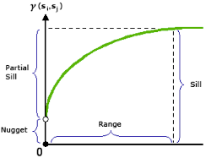
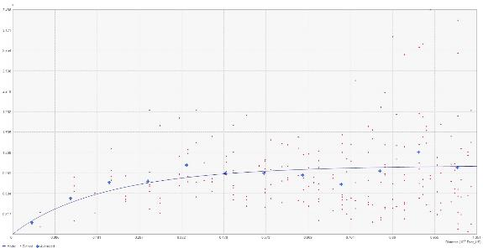
Results: Spatial Interpolation
Determined Kriging would not produce usable error surface
Variogram does not show expected data distribution for spatial autocorrelation
  No obvious range
Interpolation not included in final tool functions
Example
Test Mine D-2187
http://pro.arcgis.com/en/pro-app/help/analysis/geostatistical-analyst/fitting-a-model-to-the-empirical-semivariogram.htm
Notes:
Relationship displayed in curve, before points are too far away to show relationship – flatten outs
Range: indicated data that’s spatially autocorrelated
Sill: point that indicated end of range
Nugget: Y intercept
The steeper the curve near the origin, the more influence the closest neighbors will have on the prediction.
Top: example semivariogram from ArcGIS Pro Online
Bottom: D2187 semivariogram optimized, simple kriging, stable
http://pro.arcgis.com/en/pro-app/help/analysis/geostatistical-analyst/fitting-a-model-to-the-empirical-semivariogram.htm

Slide 19
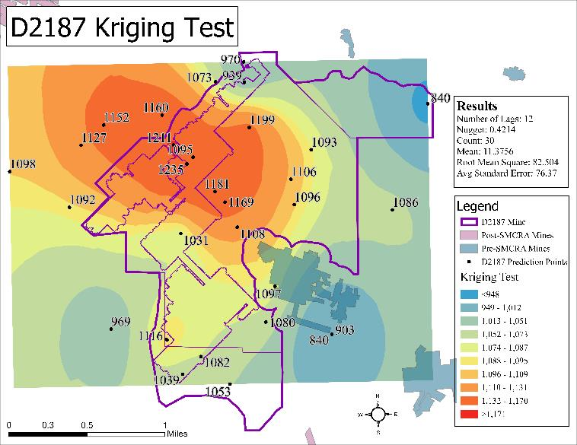
Results: Spatial Interpolation
Notes:
Look at distance between points, far
Fine scale variables change too much between points

Slide 20
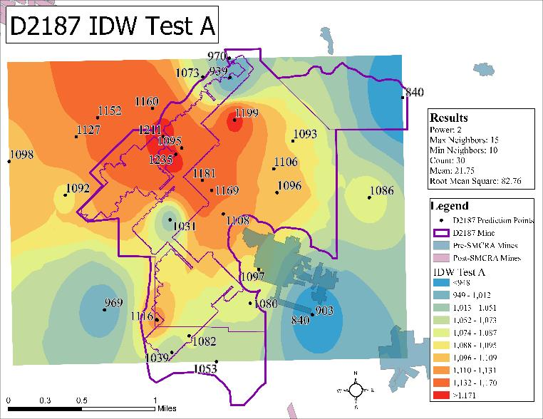
Results: Spatial Interpolation

Slide 21
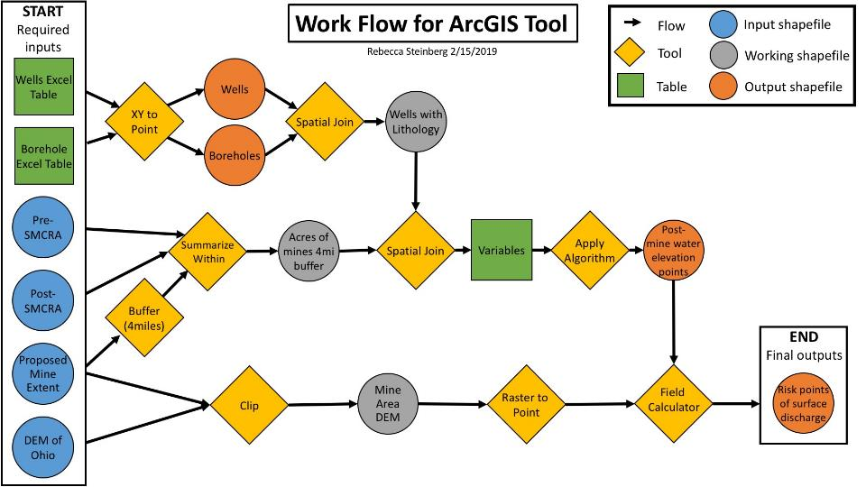
Methods: Tool Building

Slide 22
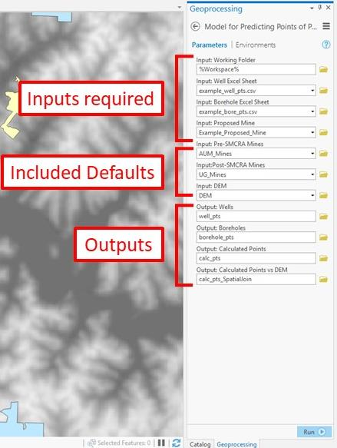
Results:
Tool Building
Required inputs:
  well & borehole data sheets
  shapefile of proposed mine
  folder location
Defaults in package:
  underground mine shapefiles
  DEM
Outputs of tool:
  well & borehole data points
  predicted post-mining water elevation points
  prediction points compared with DEM

Slide 23
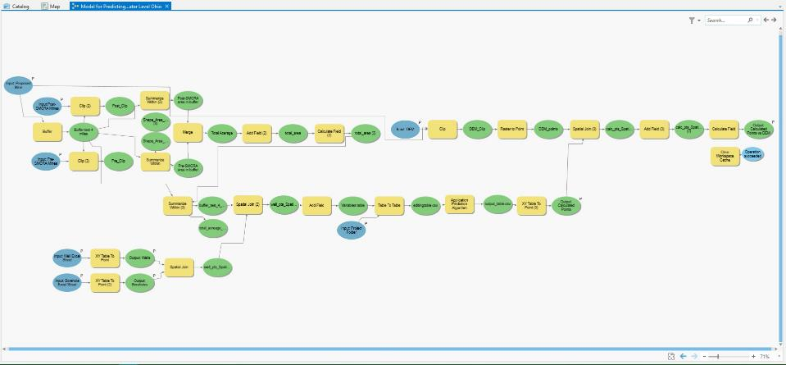
Results: Tool Building

Slide 24
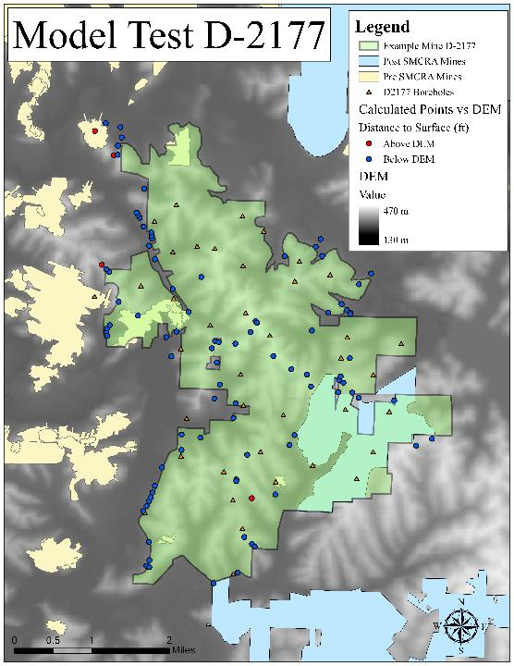
Results: Tool Building
Ran the ArcGIS model on test mine D-2177 data set
Selected test set based on data quantity and distribution

Slide 25
Discussion: Data Analysis
Results produced consistent variable relationships to previous analyses (Schafer 2018, Twumasi 2018)
Able to produce a prediction algorithm that can predict post-mining water level in the mined coal seam with in a reasonable error

Slide 26
Discussion: Spatial Interpolation
Able to produce a surface, but with a high level of uncertainty
Kriging not a possibility due to poor semivariogram structure
  Indicating poor spatial relationship in data distribution
  IDW thus poor as well
Continued work required
  Determine range of points per area needed to reduce error
  Will provide suggestions for regulator data collection

Slide 27

Discussion: Tool Building
Completed tool on Watersheddata.com, available for download and use by the public
  Includes User’s guide, project fact sheet, and formatted data Excel spreadsheets used in running the tool
Notes:
Hosted online for public download
Documents from running the tool including excels

Slide 28
Conclusions
Multivariate analysis has allowed for expanded knowledge of hydrologic/geologic systems influencing mine pool formation
Suggestions for regulation data collection consistency
  Consistency in recording, even distribution
  Continuous monitoring methods, piezometers (PA)
Notes:
Regulation for underground coal mining only requires 3 boreholes, per x acres
“a minimum of one test hole per one hundred sixty acres” and does not define a requirement for well monitoring density (Lawriter - OAC).

Slide 29
Conclusions
Continued work:
  With more quality data, multivariate analysis can be expanded and improved upon
  Study into possibility of using spatial interpolation with improved data, determine points per area needed
  Methods applicable outside the coal fields of Ohio
  Methods applicable to issues outside of underground mining

Slide 30



Questions?
Thank you to our project sponsors:
Office of Surface Mining and Reclamation (OSMRE)
Ohio Department of Natural Resources (ODNR)
American Society of Mining Reclamation (ASMR)

