Slide 1
Geocoding American Society of Mining and Reclamation Proceedings to Preserve and Easily Access Reclamation Research
Ashley Rovder, Staci Wolfe, Kari Lagan, Lily Currie, William Strosnider, Peter Smyntek

Slide 2
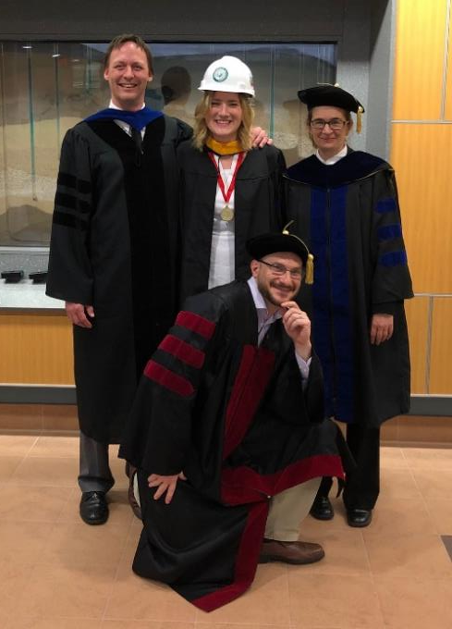
About Me
Recent environmental engineering graduate from SFU (May 2019)
Applied to become an EIT
Traveled to Bolivia, South Carolina, and France during my studies
First introduced to ASMR in the Fall of 2015

Slide 3
ASMR Request
“…much of the earlier technical work associated with specific mine sites or localities both in the USA and internationally is at risk of being lost or ignored by researchers and remediation practitioners because the paper/journal article titles or keywords of these papers may lack a geographic reference.”
Notes:
Reference REQUEST FOR PROPOSAL (RFP); Geolocation of Reclamation Research Sites Project
Include the project goals (both abstract and specific) as well as student development goals

Slide 4
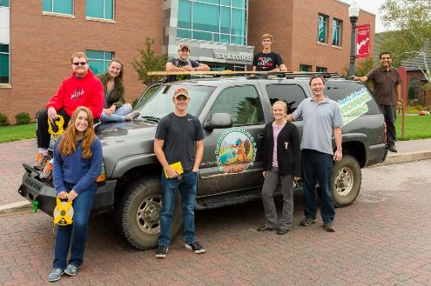
SFU CWRS Proposal
Products ASMR Requested:
Master excel sheet
.kmz files for Google Earth
Products submitted to ASMR past those requested:
ASMR abstract for poster presentation (2016, 2017, & 2019)
Oral presentation (2017 & 2019)
Reclamation Matters article (submitted for the fall publication)
Notes:
Reference: Undergraduate Research-Learning via the Geolocation of Mine Reclamation Research Sites: A Proposal for the ASMR Geolocation of Reclamation Research Sites Project
*Outside scope of work
Plug Dr. Tasker

Slide 5
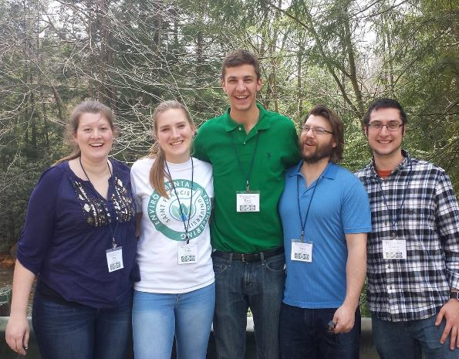
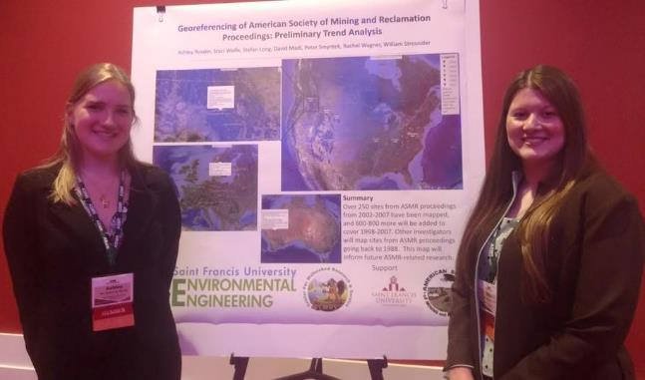
SFU CWRS
Research-Learning Model
Notes:
Reference: Undergraduate Research-Learning via the Geolocation of Mine Reclamation Research Sites: A Proposal for the ASMR Geolocation of Reclamation Research Sites Project
*Outside scope of work

Slide 6
Methods
Notes:
Necessary distinctions/Problems encountered
Include the various clarifications that were necessary when completing this process (for ex: identifying all of the sites in a single paper, form of latitude/longitude coordinates, etc.)

Slide 7
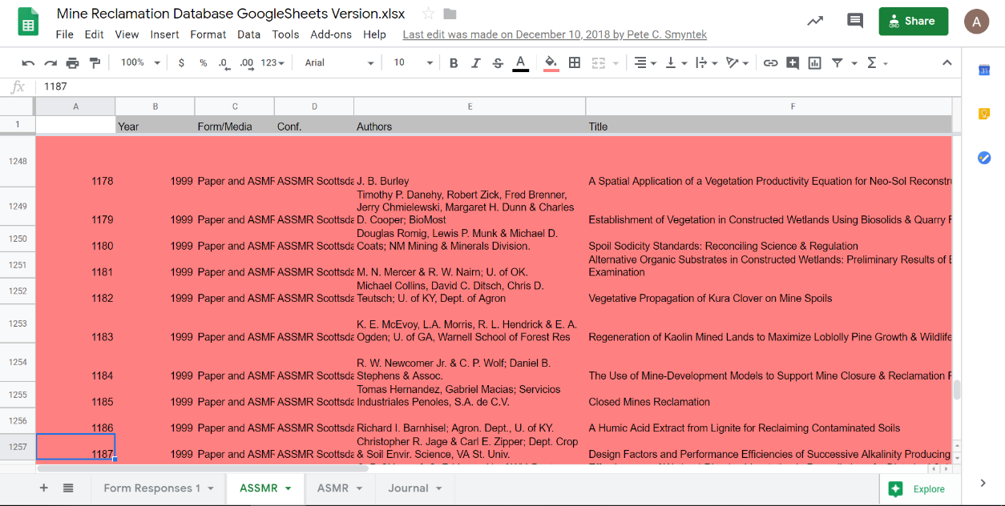

Slide 11
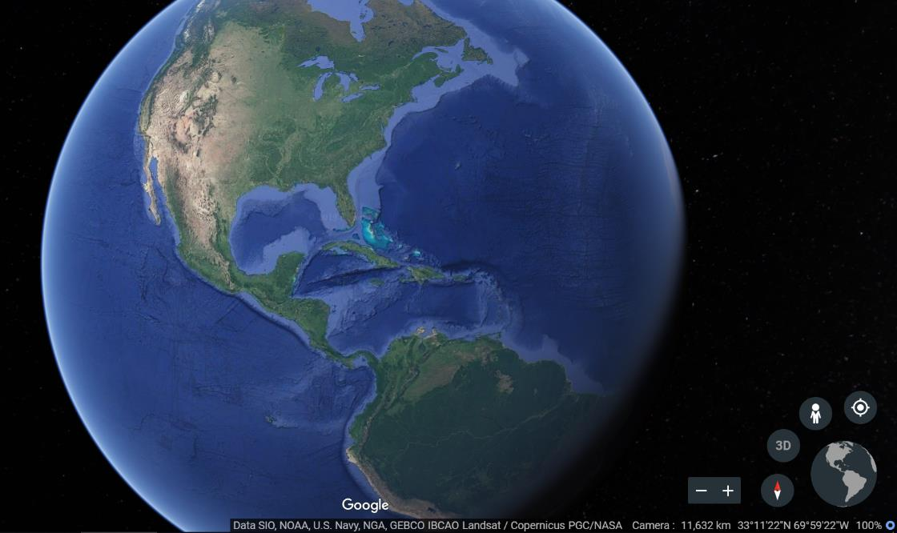

Slide 13
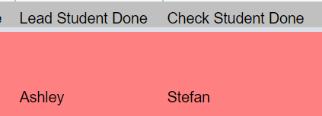

Slide 14
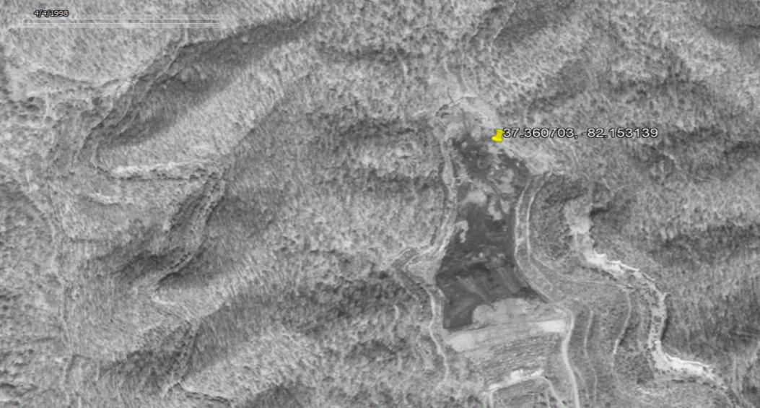
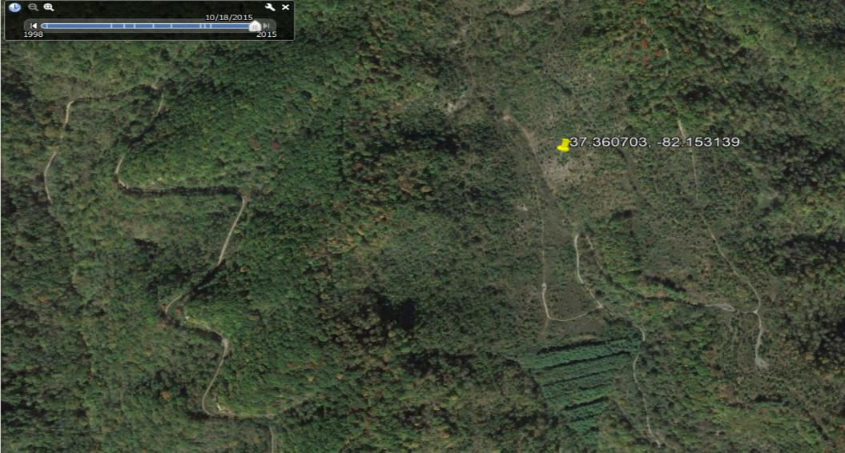
Historic Sites
Notes:
Figure 1. a. Google Earth imagery of a reclaimed surface coal mine site in Virginia in 2015 (top) b. Google Earth imagery of the same site in 1998 using historical imagery, where mining disturbance is more easily identifiable (bottom)
Title: Young Forest Composition and Growth on a reclaimed Appalachian Coal Surface Mine after Nine Years

Slide 15
Methods (cont’d)
Saint Vincent College
Dr. Peter Smyntek
Converted excel sheet into .kmz file
Obtained a free educational license from Earth Point (http://www.earthpoint.us)
Created information-laden placemarks
Notes:
Add the methods he used

Slide 16
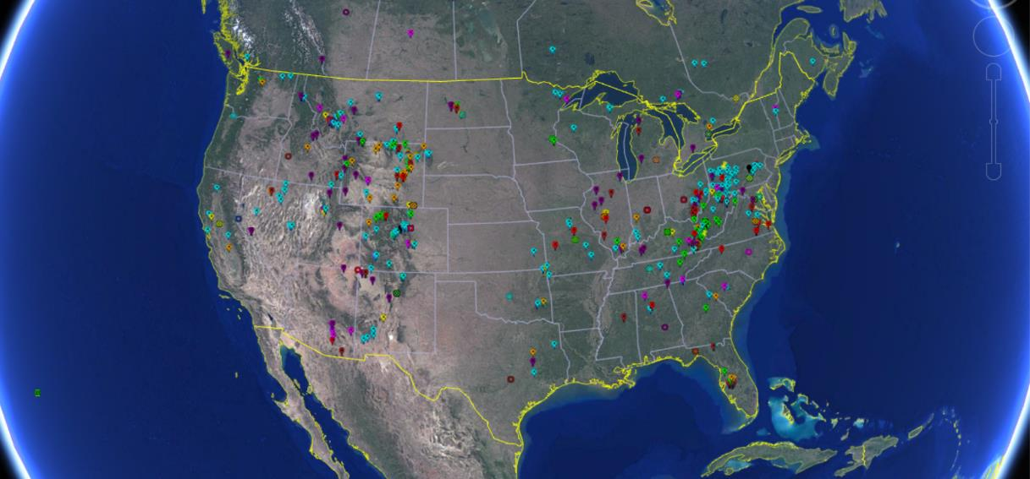

Slide 17
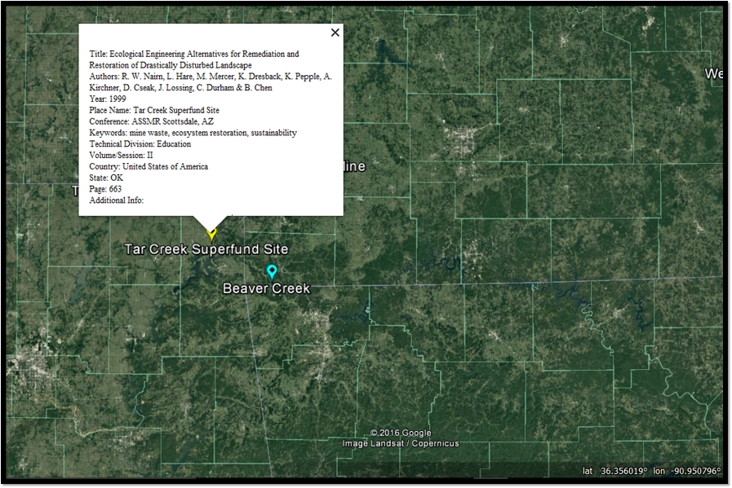

Slide 18
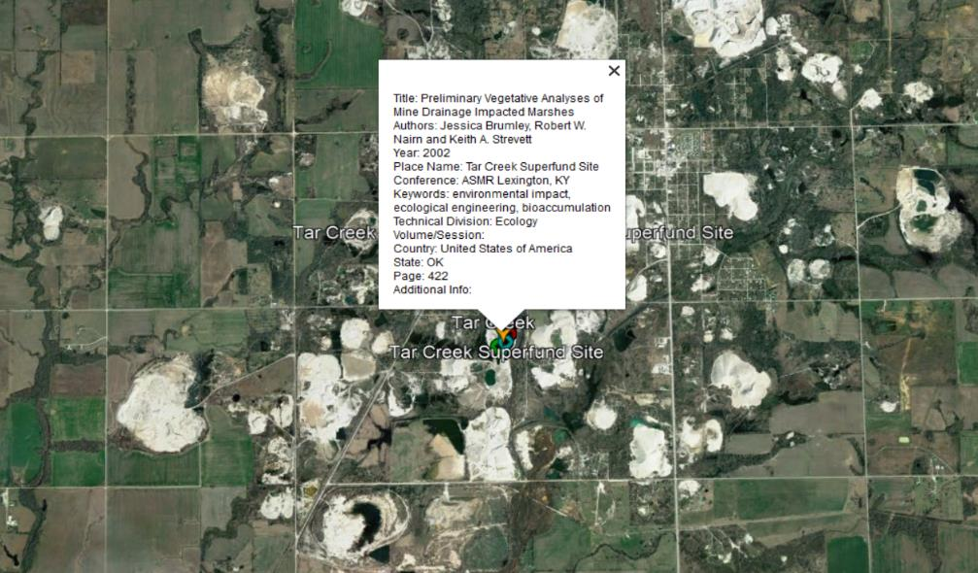

Slide 19
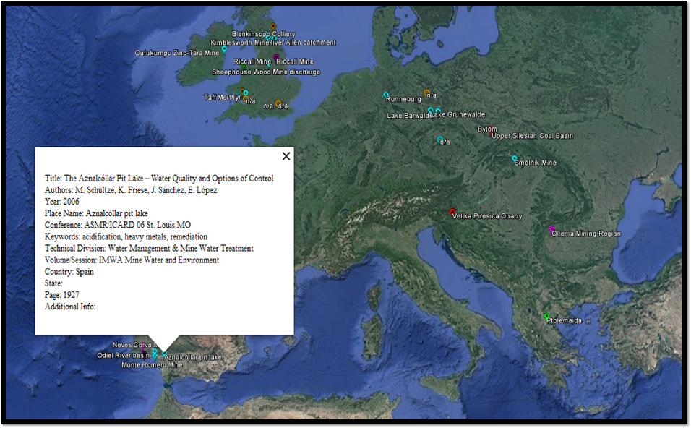

Slide 20
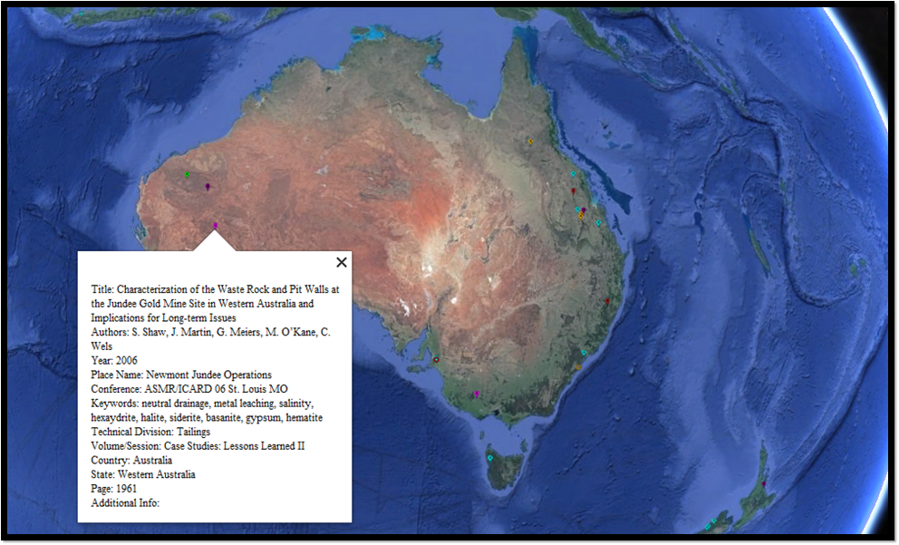

Slide 21
How Can I Use This Resource?
When ready, will share with ASMR members
Past authors—verify accuracy of placements
Corrections directed to team dedicated to updating & improving the database
Tool for future researchers
Past research at a particular site
Locations where research is lacking despite a need for reclamation
Connect with other ASMR members, past and present
Notes:
For example, one map version could highlight the spread of ASMR work over time, while another could accentuate the geographic distribution of technical topic areas.

Slide 22
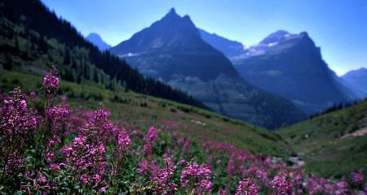
Moving Forward
As the field of mining and reclamation grows and more research is published, the database will be updated
Encourage authors to include the latitude and longitude coordinates of the location of the study in their paper
The geocoding method of preserving research may strike other professional organizations with inspiration
Desktopnexus.com

Slide 23
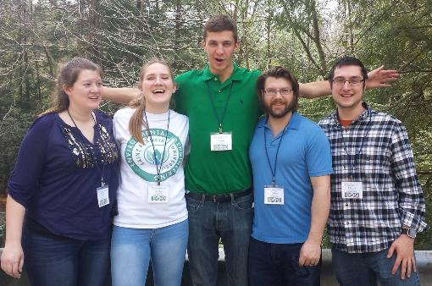
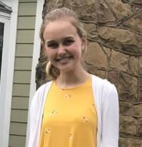
Acknowledgements
Dr. Strosnider
Teammates
ASMR

