Slide 1
Ecological Restoration Planning for Coal Mining Areas in China and Case Studies
中国煤矿区生态修复规划及其案例
Zhenqi Hu^{1,2} 胡振琪^{1,2}
Wu Xiao^{1,2} 肖武^{1,2}
1.Institute of Land Reclamation & Ecological Restoration
China University of Mining and Technology(Beijing)
1.中国矿业大学（北京），土地复垦与生态重建研究所
2. Engineering Research Center of Mining Environment & Ecological Safety, Ministry of Education
2.矿山生态安全教育部工程研究中心

Slide 2
Outline
1. Introduction
引言
2. Ecological Restoration Planning for Abandoned Coal Mines
废弃矿区的生态修复规划
3. Ecological Restoration Planning for Active Coal Mines
正在开采矿区的生态修复规划

Slide 3
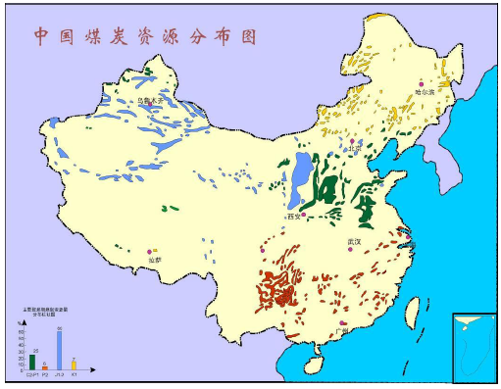
1. Introduction 引言
Coal is China’s most abundant, important, and widely distributed fossil fuel resource.
煤炭是中国最丰富、最重要，也是应用最广泛的化石能源。
Coal resources distribution in China
中国煤炭资源分布图

Slide 4
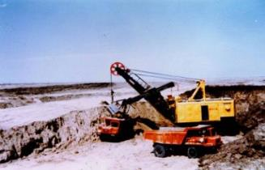
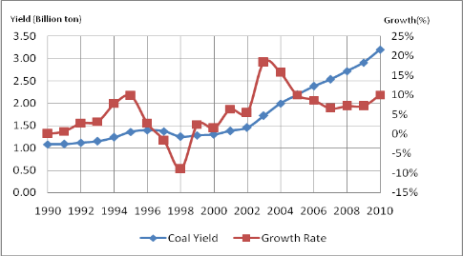
1. Introduction 引言
Coal yield and growth rate from 1990 to 2010 in China
1990-2010中国煤炭产量与增长率
China’s coal production was 3.8 billion tons in 2014. 90% from underground mining
2014年中国煤炭产量达到38亿吨，而90%的煤矿为井工矿

Slide 5
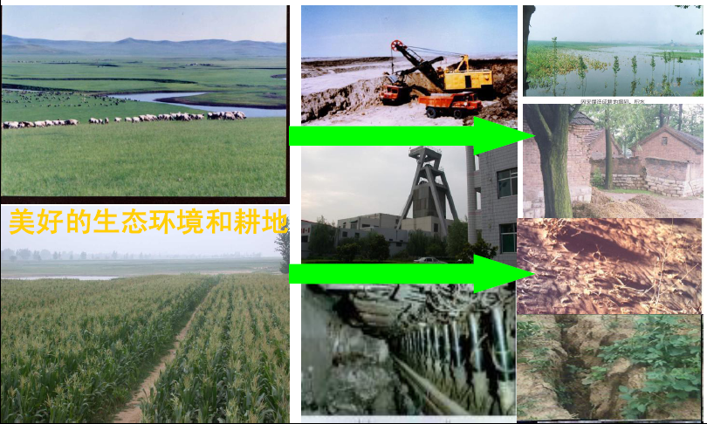
Impact of coal mining on environment in China
Coal mining has produced a lot of environmental problems while it makes great contribution to economic growth

Slide 6
Impacts of coal mining on eco-environment vary in different part of China
Northwest 西北地区：
Mining subsidence induced cracks and fissures;
开采沉陷引发的地表裂缝和裂纹；
Soil erosion; 水土流失；
Acid coal waste dumps spontaneous combustion;
酸性煤矸石山的自燃
Land occupation by surface mining露天开采的土地压占
东
Eastern东部地区：
Mining subsidence induced ponds area, 下沉积水
farmland lose, 耕地减少
Village movements 村庄搬迁
中
部
自
给
供
补
Southern南部地区：
mining subsidence induced landslide and mudslides, 开采沉陷引发的滑坡和泥石流
groundwater loses 地下水流失
带
带

Slide 7
In General,
Land Reclamation and ecological restoration
has become an urgent task in China
Restoration planning is very important for repairing the environment in mining areas.
it is a basis of restoration engineering.
it is a basis of regional environmental protection , economic development and ecological civilization construction.

Slide 8
Case studies
Hegang Subsidence land Reclamation Plan
鹤岗采煤塌陷地治理规划
东
Liaoyuan National Mining Museum
辽源国家矿山公园
中
部
自
供
Heze Subsidence land Reclamation Plan
菏泽采煤塌陷地治理规划
给
补
Huainan Datong Wetland Park
淮南大通湿地公园
带
带

Slide 9
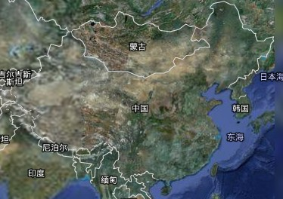
2. Ecological Restoration Planning for Abandoned Coal Mine 废弃矿区的生态修复规划
Case Study No.1 – Huainan 案例一： 淮南
The mining history of Datong coal mine was 67 years, from 1911 to 1978, with 27.465 million tons of coals produced in total. According to surveys and estimates, the subsidence area is 2.89 km², with a maximum subsidence of over 10 m.
淮南大通煤矿自1911年到1978年，有67年的开采历史，共开采3.7465亿吨煤炭。引发的沉陷土地约2.89km²，最大下沉深度达到10m。
Huainan city
淮南
The study area is located in Huainan City, Anhui Province
研究区位于安徽省淮南市

Slide 10
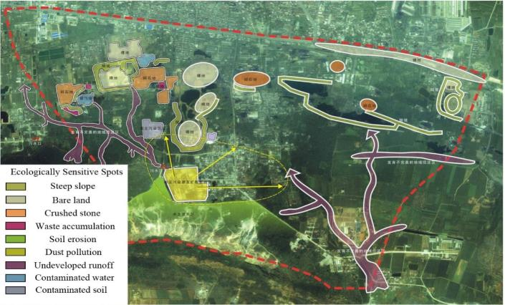
Case Study No.1 – Huainan 案例一： 淮南
The study area is 438 ha. The location of the study area is the transition section between the main city in the north and the new district in south and is the link between these two districts.
研究区面积438公顷，地处山北主城区和山南新区的过渡地段，是两城区之间相互联系的纽带，同时也是未来淮南城市生态环境的标志性区域之一。

Slide 11
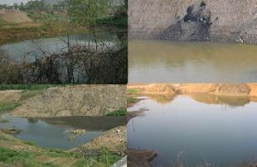
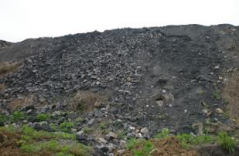
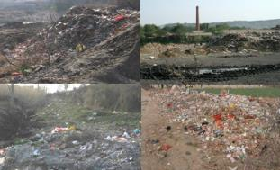
Case Study No.1 – Huainan 案例一： 淮南
Current situation 现状
Mining subsidence
地表沉陷
Coal waste dumps, 5 dumps
煤矸石山
3 waste yard; Garbage and water pollution
垃圾压占和水污染

Slide 12
Case Study No.1 – Huainan 案例一： 淮南
Technical roadmap 技术路线图
Field investigation
实地调查
Topography 地形
Investigation and Monitoring
调查与监测
Remote sensing
遥感
Soil contamination
土壤污染
GIS
Assessment 评价
Hydrological system水系
Biodiversity 生物多样性
Function division and Restoration Plan
功能分区域修复 规划
Land use 土地利用
Soil remediation
土壤修复
Hydrological system restoration
水系修复
Revegetation
植被恢复

Slide 13
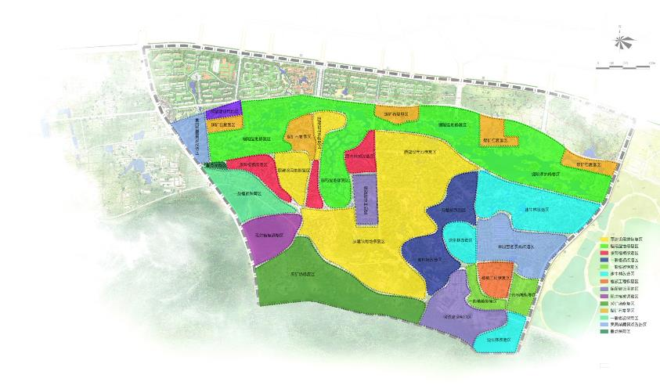
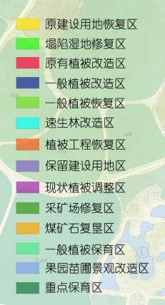
Function division
功能分区
Case Study No.1 – Huainan 案例一： 淮南

Slide 14
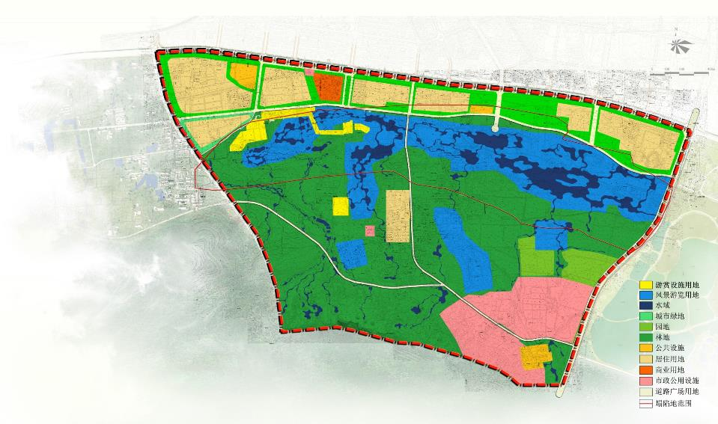
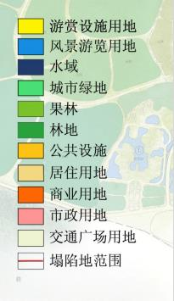
Landuse Planning
土地利用规划
Case Study No.1 – Huainan 案例一： 淮南
Land use planning

Slide 15
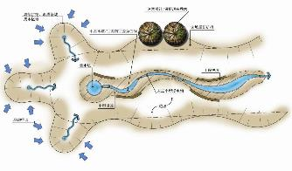
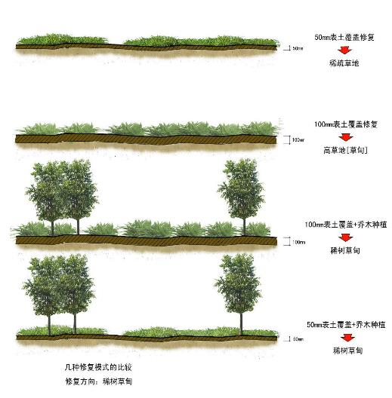
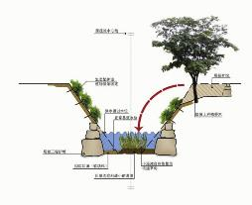
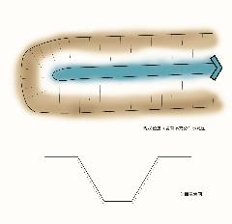
Some Restoration Treatments
修复措施
Case Study No.1 – Huainan 案例一： 淮南

Slide 16
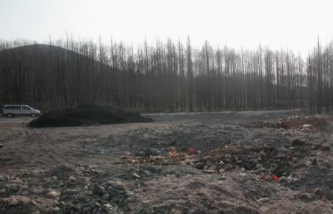
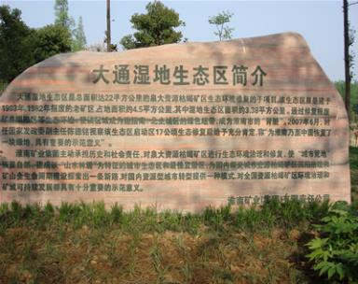
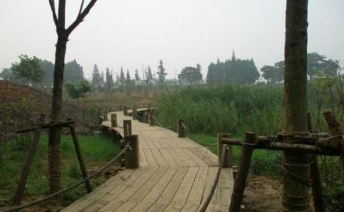
Case Study No.1 – Huainan 案例一： 淮南
Results of the AML reclamation project I
修复后的大通湿地生态区

Slide 17
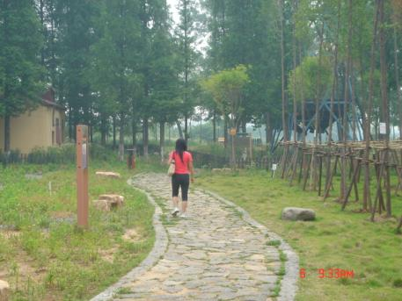
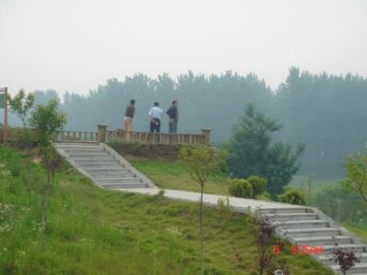
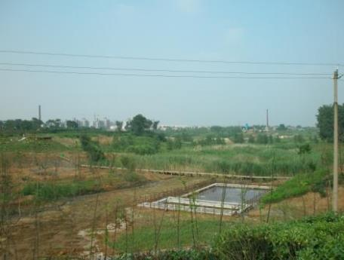
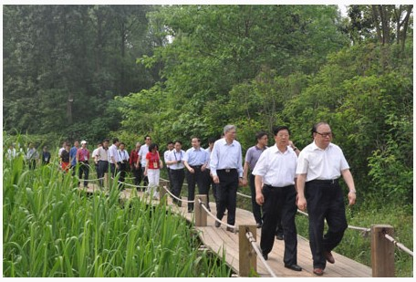
Industrial Square Restoration
工业广场修复
Shaft Restoration
原井口修复
Wetland Restoration
湿地修复
Wetland Restoration
湿地修复

Slide 18
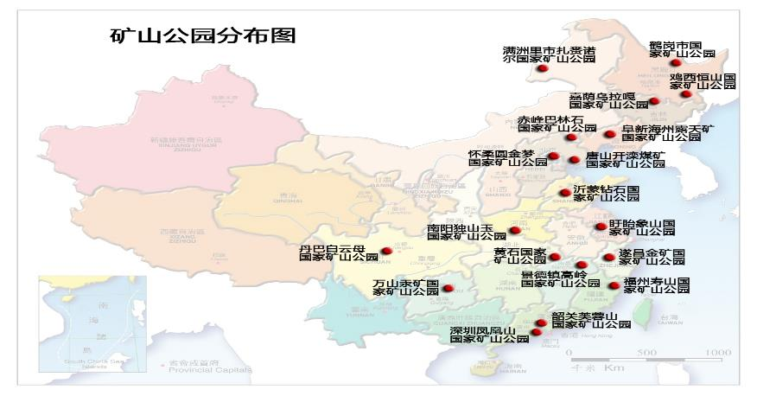
Case Study No.2 – Liaoyuan 案例二： 辽源
Mining Park Distribution in China
Liaoyuan National Mining Park
辽源国家矿山公园
The essence of Mining Park: restoration of mining area with the goal of park construction
矿山公园的实质——是以公园建设为目标的矿区生态修复
Only the region features can lead the plan of Liaoyuan National Mining Park to Success.
要占据国家矿山公园建设和发展的“一席之地”，只有突显地域特色。

Slide 19
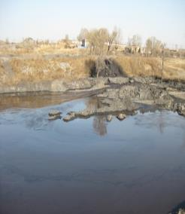
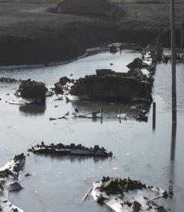
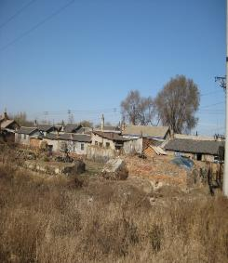
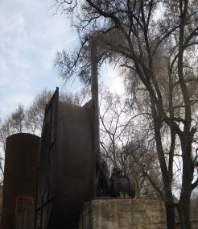
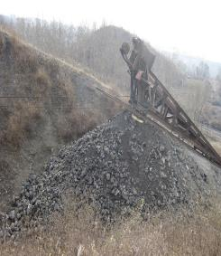
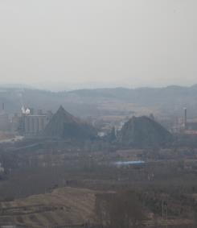
Case Study No.2 – Liaoyuan 案例二： 辽源
Investigation 调研

Slide 20
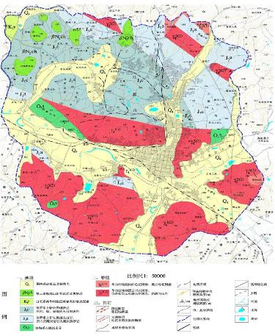
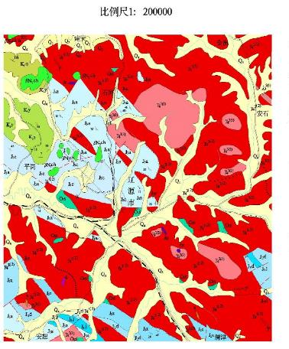
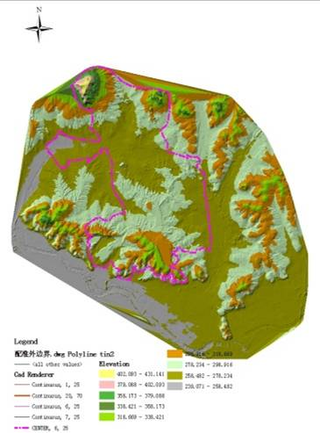
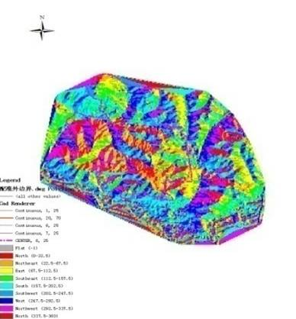
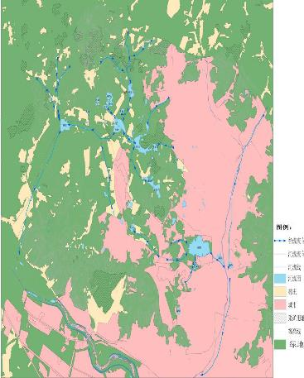
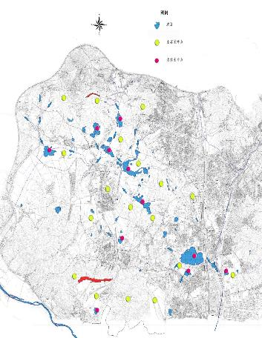
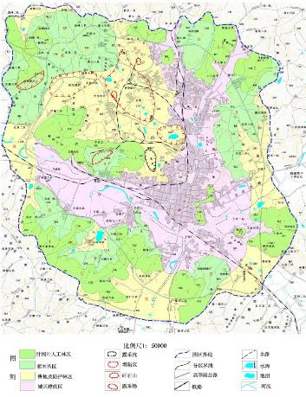
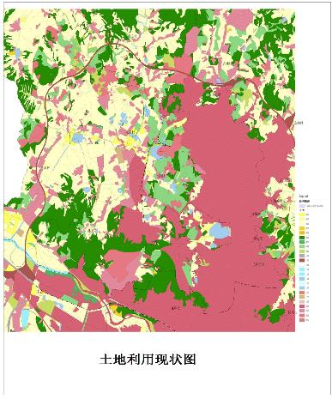
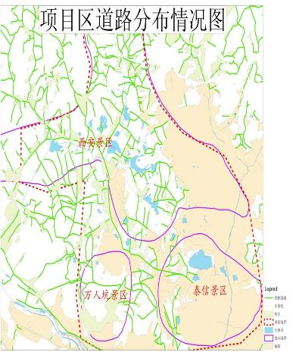
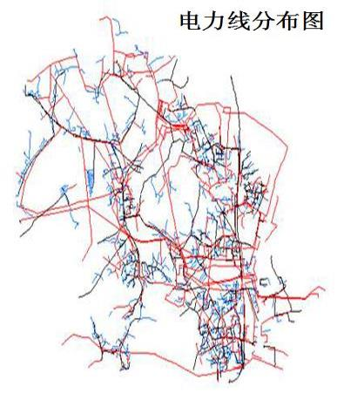
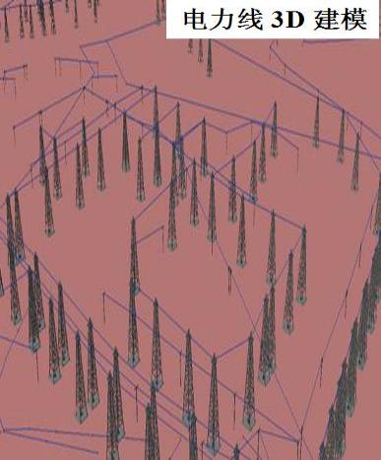
Case Study No.2 – Liaoyuan
Case Study No.2 – Liaoyuan 案例二： 辽源
Data Analysis 数据分析

Slide 21
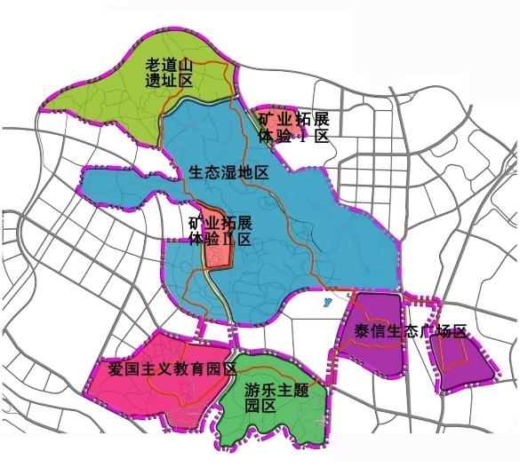
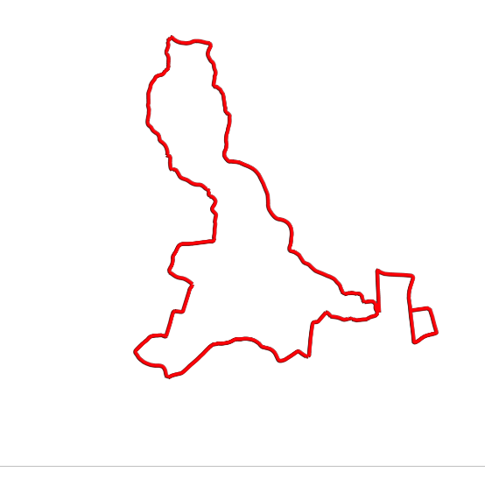
Case Study No.2 – Liaoyuan 案例二： 辽源
Function Division 功能分区
A Corridor 一廊：
About the Modern Mining History
中国近代矿业发展的历史回廊
Mining Relic Protection and Ecological Restoration Demonstration
矿业遗迹保护生态治理示范
Xi’an
西安
Two Cores 两核：
Mining produce exhibition and experience zone
矿业生产展示、拓展体验核心区
Patriotism Education and Mining History
爱国主义教育矿业情感诠释
Taixin泰信
Three Districts 三区：
Landscape districts which form the eco-isolation area.
景观集中区，形成绿色生态隔离带和生态保护屏障
Shengli
胜利
Amusement and Shopping
大众休闲娱乐
观赏游乐购物

Slide 22
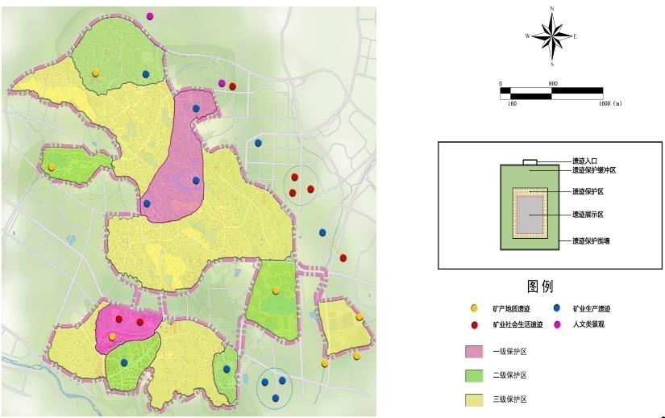
Case Study No.2 – Liaoyuan 案例二： 辽源
Special Plan - Mining Relic 专项规划—重要矿业遗迹保护规划

Slide 23
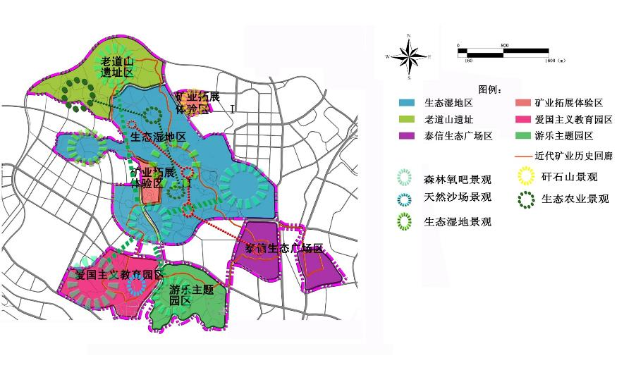
Case Study No.2 – Liaoyuan 案例二： 辽源
Special Plan – Natural Landscape 专项规划--典型自然景观规划

Slide 24
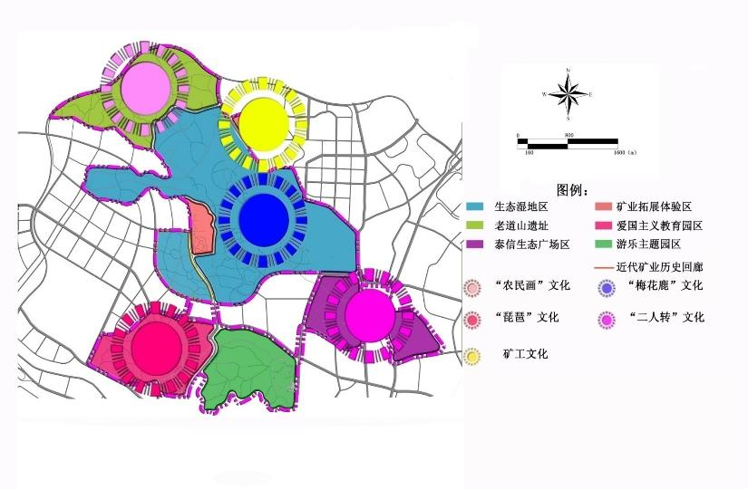
Case Study No.2 – Liaoyuan 案例二： 辽源
3、典型人文景观规划
Special Plan – Cultural Landscape 专项规划--典型人文景观规划
Folk Painting
“农民画”文化
Miner
矿工文化
Deer
“梅花鹿”文化
Folk Music
二人转
Chinese Lute
“琵琶”文化

Slide 25
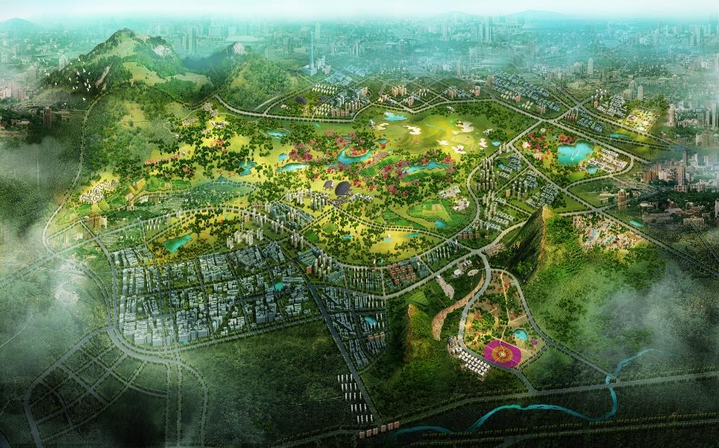
Case Study No.2 – Liaoyuan 案例二： 辽源
Aerial View of Design Sketch-鸟瞰效果图

Slide 26
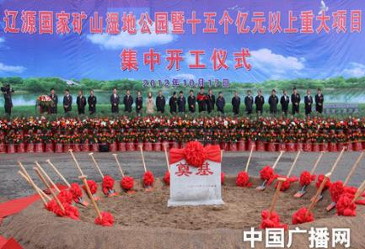
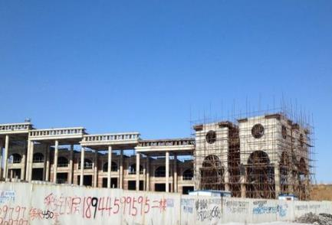
Case Study No.2 – Liaoyuan 案例二： 辽源

Slide 27
3. Ecological Restoration Planning for Active Coal Mine
在开采矿区的生态修复规划
Ecological Restoration Planning for Active Coal Mine with Long Mining History
Case Study No.3 – Hegang 案例三：鹤岗
Hegang city
鹤岗
Large areas of land subsidence , especially the subsidence in the urban area became an obstacle for the sustainable development.
大面积的土地塌陷，特别是很多沉陷区位于主城区内，严重影响了鹤岗的可持续发展。
Built because of coal mining, Hegang is a city with long mining history, the annual output achieve 18.47 million tons.
鹤岗是一座“因煤而兴，缘煤而建”的城市，煤炭开采历史悠久，年产量将达到1847万吨/年。

Slide 28
Technical roadmap 技术路线图
Data Collection 资料收集
Natural, Economic Condition
自然经济资源状况
Current Subsidence Situation
采煤沉陷地现状
Land subsidence prediction
采煤塌陷地预测
Impact of Subsidence to the Existing Plan
采煤沉陷地对现有规划的影响及建议
Restoration Plan for Subsidence areas
采煤沉陷地治理规划
Plan for Industrial Park
工业园区规划
Function Division
规划功能分区
Overall Urban Plan and Overall Landuse Plan
城市总体规划及土地利用总体规划
Shantytowns Reconstruction Plan
棚户区改造规划
Restoration Projects
治理项目
Transportation Plan
交通线路规划

Slide 29
Case Study No.3 – Hegang 案例三：鹤岗
Current Subsidence situation
沉陷现状
According to the statistics, the total area of subsidence land was 7932.12 hm² in 2013。
据统计，截止到2013年，鹤岗市境内采煤沉陷地共7932.12 hm²。

Slide 30
Case Study No.3 – Hegang 案例三：鹤岗
Subsidence Prediction
沉陷预测
2020
Mine Closure
闭矿
9400.31hm²
11993.25hm²
Probability Integral Method

Slide 31
Subsidence Prediction
沉陷预测
Case Study No.3 – Hegang 案例三：鹤岗
Maximum Depth
2014-2020
6.7m
2014-Mine Closure
39.4m
19.0m
7.4m
32.9m
7.1m
21.9m
10.8m

Slide 32
Subsidence Prediction
沉陷预测
Case Study No.3 – Hegang 案例三：鹤岗
Damage Degree Analysis
损毁程度分析
2014-2020
Seriously Damaged Vegetation severely impacted, cultivation and buildings destroyed.
重度损毁 地表沉陷严重，植被生长受到严重影响，农作物绝产，建筑物不能正常使用。
Medium Damaged Vegetation impacted, crop output decreases, buildings need maintenance.
中度损毁地表沉陷较严重，植被生长受到一定影响，农作物减产，建筑物需适当维修。
Slight Damaged No impact on vegetation, buildings could continue to be used.
轻度损毁地表出现轻微的变形，基本不影响植被生长，建筑物可正常使用。

Slide 33
Function Division
治理分区
Case Study No.3 – Hegang 案例三：鹤岗
优先永久治理区
Permanent Reclamation Areas
优先临时治理区
Temporary Reclamation Areas
动态治理
Dynamic Reclamation Areas
未来治理区
Future Reclamation Areas

Slide 34
Case Study No.3 – Hegang 案例三：鹤岗
Reclamation Projects
治理项目
31 reclamation projects of 3 category has been planned during 2014 to 2020.
结合以上治理分区，本规划在近期（2014-2020年）共安排了3类31个治理重点项目。
5 Alternative Industry Projects
替代产业用地治理项目（5个）
3 Temp Construction land Reclamation Projects
短期建设用地治理项目（3个）
23 Dynamic Cultivated land Reclamation Projects
动态农业用地治理项目（23个）

Slide 35
Study Area
研究区概况
Case Study No.4 – Heze 案例四：菏泽
巨野
矿区
Juye Mining area located in the southwest part of Shandong Province, with 80km from south to the north, and 12km from east to the west, the coal bearing area is about 729km²
巨野矿区位于山东省西南部，南北长80km，东西宽12km，含煤面积约729㎞²。

Slide 36
Study Area
研究区概况
Case Study No.4 – Heze 案例四：菏泽
Juye Mining area including 6 coal mines, till 2010, 4 of them started mining.
矿区由6对矿井组成，截止2010年底，已有4对投产。

Slide 37
Case Study No.4 – Heze 案例四：菏泽
Subsidence Prediction
采煤沉陷预测
Stage 1
近期(2013-2020)
Stage 2
中期(2021-2030)
Stage 3
远期(2031-2050)
Closure
闭矿(2051-2080)
The subsidence area is 63782hm² , account 87% of the coal mine boundary, and the water logging area is 39581hm², account for 62.1%.
塌陷面积为63782hm²，占矿区面积的87%，积水面积39581hm²，占塌陷面积的62.1%。

Slide 38
Plan Concept and Function Division
规划理念与功能分区
Case Study No.4 – Heze 案例四：菏泽
1 Belt, 1 Corridor, 4 Districts
“一带，一廊，四区”
Juyun Mining Ecology Economic Belt
巨郓矿业生态经济带
Tourism District of Water Margin
水浒文化旅游区
With the goal of joint development of coal mining and agriculture, economy and ecology, based on the mining development, with consideration of local feature, to restore the land subsidence area and create an area combined with agriculture, ecology and sightseeing.
以“煤粮兼得”、经济发展和生态优化为治理目标，依托矿业发展，结合当地文化特色，通过塌陷地治理打造菏泽东部一条集农业、生态、观光等为一体的生态经济廊道。
Sightseeing High Efficiency Agriculture
观光高效农业区
East Chemical Industry Corridor
巨东化工长廊
Eco-economic District
水域生态经济区
Agriculture and fishery District
绿色农渔示范区

Slide 39
Reclamation Goal and Projects
治理目标与治理工程
Case Study No.4 – Heze 案例四：菏泽
Planning Map 治理规划图
With consideration of the subsidence rate, reclamation ability and technology, divide three stages and set the goals for each stage.
综合考虑了巨野矿区采煤塌陷速度、治理能力、技术手段等，编制了巨野矿区的采煤塌陷地近期、中期和远期三期的治理规划、确定了各期的治理目标。

Slide 40
Reclamation Goal and Projects
治理目标与治理工程
Case Study No.4 – Heze 案例四：菏泽
Restoration Goal for each stage
各期治理目标
Subsidence area in this stage
本期塌陷面积
Subsidence area without restoration in last stage
上期未治理面积
Restored subsidence area
治理水域面积
Subsidence area reclaimed into farmland
恢复土地面积

Slide 41
First Stage
Second Stage
Last Stage
各阶段治理布局图

Slide 42
Subsidence area after restoration
治理目标与治理工程
Case Study No.4 – Heze 案例四：菏泽

Slide 43
Other Cases：Tangshan South Lake Park 其他案例：唐山南湖公园

Slide 44
Other Cases: Huaibei National Mining Park 其他案例：淮北国家矿山公园

Slide 45
Other Cases: Subsidence land Restoration Plan in Jining
其他案例：济宁市采煤塌陷地治理
Jining City locates in Shandong province, close to Yellow river.
济宁位于山东省，黄河沿岸。
Yellow river sediments reclaim district
黄河泥沙充填复垦区
It is the one of biggest coal-bases in China, Yanzhou coal company is in this city.
中国最大的产煤基地之一，兖矿集团所在地。
Ecological restoration district
生态修复区
Subsided land : 沉陷地面积24575.79hm² ( 2009)
Predict: 预测塌陷面积
2015: 47199.34 hm²
2020: 68100.53 hm²
Lake sediments reclaim district
湖泥充填复垦区

Slide 46
Other Cases: Subsidence land Restoration in Jining
其他案例：济宁市采煤塌陷地治理

Slide 47
Thank you!!
Welcome to Institute of Land Reclamation & Ecological Restoration, China University of Mining and Technology (Beijing), and Engineering Research Center of Mining Environment & Ecological Safety, Ministry of Education

