Slide 1
Subsurface Mine Void and Karst Imaging Using 3D Seismic Methods; Adapting Oil and Gas Seismic Advancements to Develop 3D Integrated Site Characterization Models
Jamey Turner, P.G., Lincoln Steele, Dan O’Connell PhD, Jeff Nuttall P.G.
2019 ASMR Annual Conference, Big Sky Montana

Slide 2
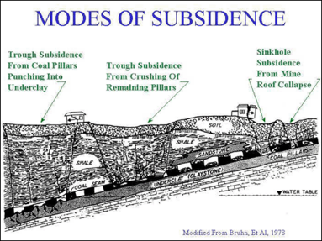
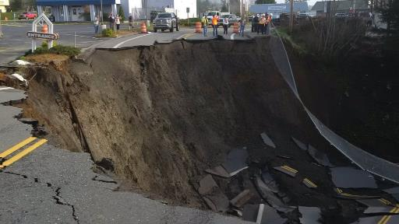
What causes subsidence?
The Three Main Causes:
Voids – underground mines and carbonate geology
Dewatering of Aquifers
Drainage of Organic soils
Types of Subsidence:
Sinkholes
Trough
Notes:
Soils issues and aquifer dewatering are generally lower magnitude subsidence over regions (for example, San Joaquin Valley, CA).
Subsidence associated with abandoned mines and karst geology tends to be greater in magnitude and more localized.
This presentation discusses integrated approaches to subsidence risk evaluations focused on AML and karst areas.

Slide 3
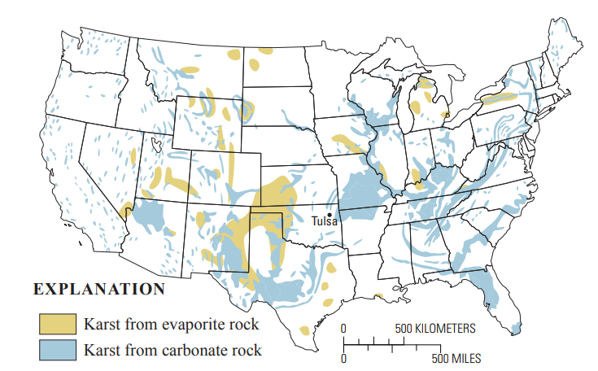
Increasing risk from Karst geology
Image Source: USGS - https://pubs.usgs.gov/of/2008/1164/pdf/OF08-1164_508.pdf
Notes:
How much of America’s infrastructure is at risk?
Karst regions are susceptible to changing groundwater conditions – drought in some regions – flooding in other areas.
The intensity and frequency of these changes are increasing. Think of a paperclip, you can only bend it so many times before it breaks.

Slide 4
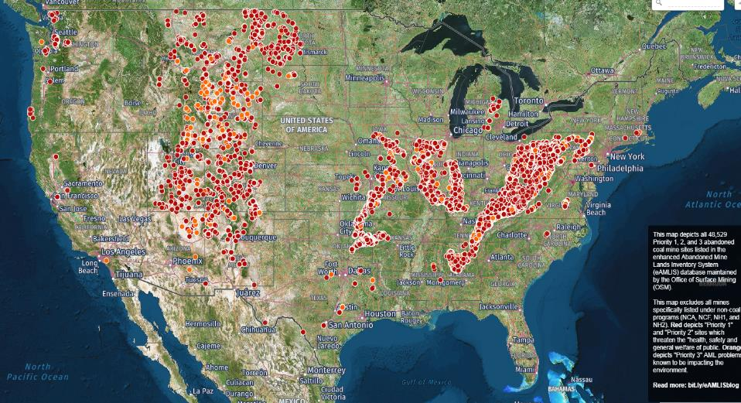
Abandoned coal mines across the country
https://www.osmre.gov/programs/AMLIS/description.shtm
Notes:
America’s mines are aging and more prone to collapse for some of the same reasons as the karst areas.
In some areas, economic growth is spurring development in areas previously uninhabited (e.g. real estate developments over mines in the Weld County, CO where oil and gas activity is high)

Slide 5
Historic mining assessment workflow
Determine what and where materials were mined
Compile mine maps and historic data
UAS survey (Imagery, DEM)
Geophysical survey
Downhole void scanning
3D integrated site modeling
Interpretation and analysis
Notes:
The more information gathered early in the site characterization process, the better (regional geology, borehole data, historic maps, understanding future use, etc.)
Understanding the characteristics of the potential mine voids is key in order to adjust and adapt your geophysical survey to capture the unknowns. Approximate depth/width/height, roof and floor materials, dip of mine layer, etc.

Slide 6
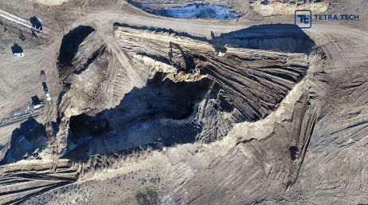
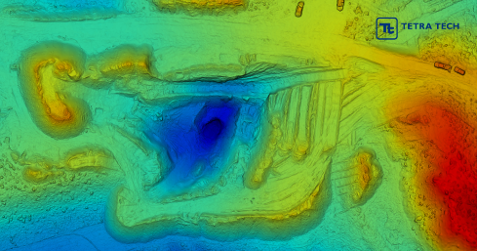
Mitigation strategies
Improve structural integrity
Isolate from mined area
Induce collapse or excavate if shallow
Grout remaining mine entries and open voids
Mitigation effectiveness (confirmation drilling, seismic survey)
Model potential subsidence strain and design for it
Notes:
Understanding what our end goals are for a given site, help us design and implement the appropriate survey and interpretation.

Slide 7
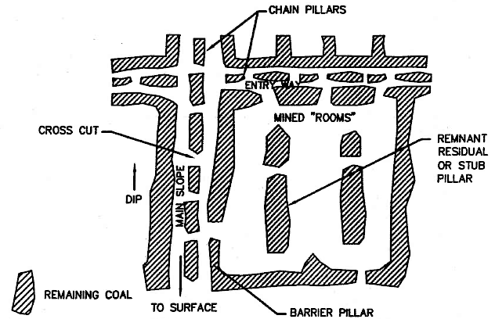
Traditional approach to finding mine voids
South Side Belt Route
Final Report
JFC March 2000
24 OF 25 BORINGS
ENCOUNTER VOIDS
5 OF 25 BORINGS
ENCOUNTER VOIDS
Notes:
Traditional investigation approach for mine subsidence investigations is a “blind swiss cheese” approach involving drilling on a predetermined grid. This approach can miss entire tunnels with no way of knowing.
This nominal spacing approach works at small sites where the constraints on potential voids are tight, but even at those type of sites it provides minimal information about the site and requires lots of interpolation between discrete samples.

Slide 8
Integrated high-resolution site characterizations for subsidence risk evaluations
Variables in subsidence risk evaluations
Composition and thickness of overburden material
Relative strength and thickness of overlying bedrock (if any)
Depth to voids
Groundwater Conditions
Historic land use and record keeping accuracy
Notes:
How to best address the variables in a subsidence risk evaluation?
In both proactive and reactive cases – an integrated approach to the site characterization provides the best understanding of the site and therefore the risk associated with it.
Integrated approaches are not a new a concept and have been utilized successfully for a long time. What changes the approach are the new technology and resulting tools available to us. We have spent the last 12 years completing over $30m in subsidence risk evaluations and have had the opportunity to try most technologies out there.
Advancements in shallow high resolution 3D seismic show that it is the next “new” tool for integrated subsidence risk.
Not a “One-Size-Fits-All” solution. More an adaptable tool that can help on a variety of sites.

Slide 9
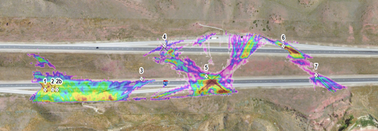
Traditional 2D geophysics vs. high-resolution 3D seismic
2D Cross Section
Map View
Notes:
So to highlight some of the advantages that the 3D seismic provides – we’ll discuss a few limitations of traditional employed 2D seismic
2D suffers from artifacts and low resolution of actual structure and does not provide a “map view” of structure
2D seismic only acquires linear raypaths, 3D methods provide complete azimuthal coverage to illuminate voids and slow zones.
Surface waves can work in ideal cases but usually have inadequate resolution for depths > 10-20 feet.
Advantages over 2D:
3D spatial resolution
Capable in all terrain, woods
Anomalies w/ extents and trends
Full Integration with 3D modeling
Geologic Fault and Fracture Mapping
Cost savings

Slide 10
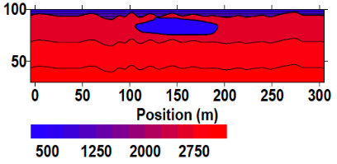
Why 3D seismic? Because 2D seismic does not work for void imaging!
Input
A synthetic example of a cavity (represented by low-velocity zone)
First-arriving energy does not pass through cavity.
No cavity (low-velocity zone) is imaged.
Ray Coverage
Output

Slide 11
The Banana-Doughnut kernel
“… the ‘doughnut’ hole, where the travel time is insensitive to variations in Vp.
Guust Nolet 2008
No sensitivity along the geometrical ray path!

Slide 12
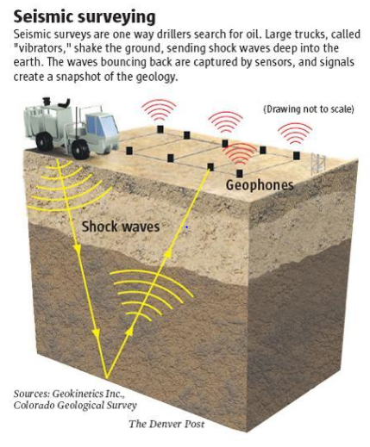
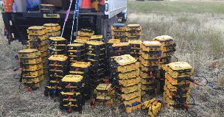
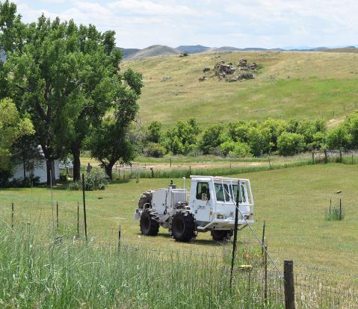
3D seismic surveys
3-component wireless nodes
Notes:
Adapted technologies from larger scale O&G surveys.
Combination of commercially available software with propriety algorithms for a 3D inversion methodology for seismic travel times and signal attenuation to map seismic reflectors, refractors, and in our cases, low velocity anomalies that correlate with mine voids
- 3D velocities alone rarely have sufficient resolution to delineate potential underground openings in 3D
3D P-wave attenuation tomography and 3D seismic reflection provide sufficient resolution to delineate potential openings to 200+ foot depths
3D P-wave attenuation tomography can map karst networks in 3D
Advances in seismic data acquisition technology have driven costs down and made 3D seismic very competitive with more traditional 2D approaches.

Slide 13
Customized site-specific 3D seismic acquisition geometry
Notes:
There are sites where 3D or any geophysics for that matter, won’t work – example: sites with extensive unconsolidated material ( e.g. glacial outwash) at the surface which prevents seismic energy generated at the surface from reaching meaningful depths.
For sites where the 3D imaging is to be conducted, customized acquisition arrays are developed which factor in: overburden and bedrock characteristics, target depth interval, and a void size.

Slide 14
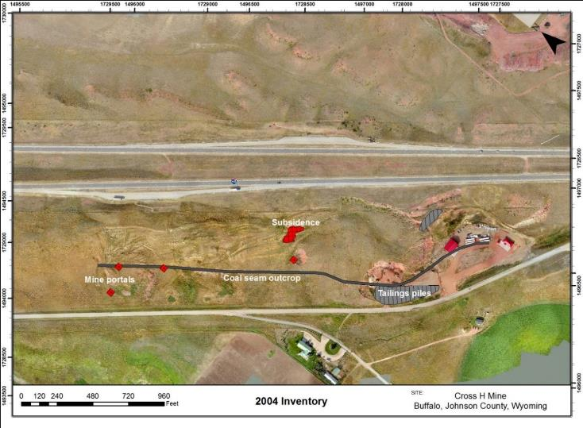
Undermined interstate – site features
~50 acres
Notes:
First example of 3D geophysics helping with a pro-active subsidence risk evaluation.
Known inventory – portals, outcrop, subsidence features
50 acre site – 400 ft wide ROW by 4,500 ft in length
Suspected direction of mining show by black arrows.

Slide 15
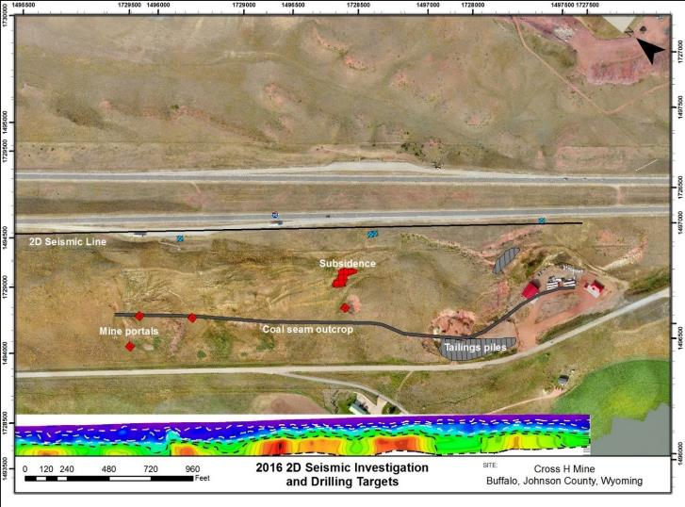
2D line along I-90
Notes:
Initial 2016 2D Seismic screening inconclusive for locating voids, limited coverage, but did identify a large mass wasting landslide complex. So 3D methods were necessary next step for site characterization.
At this particular site we were fortunate that 2D seismic data were available, which was useful for identifying seismic properties to design the subsequent 3D acquisition parameters (receiver and source spacing, vibroseis sweep).

Slide 16
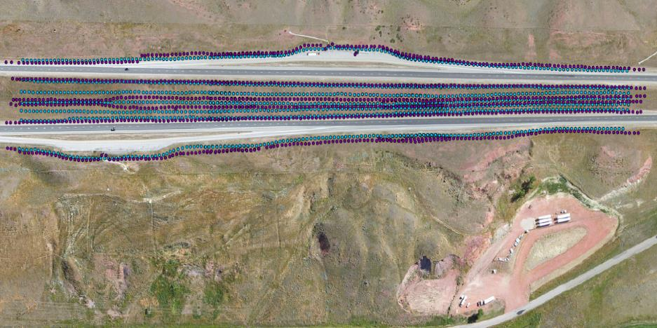
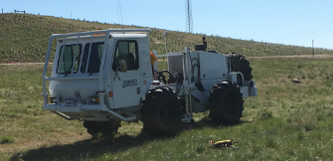
2017 3D seismic source/receiver acquisition geometry
Notes:
Acquired in 3 Patches over 3 days. ~ 1200 feet per day of linear / interstate acquisition per day. This was accomplished without impeding traffic. *Point out azimuthal raypaths from source to receivers*
Once the 3 component geophone nodes are deployed, a tuned swept-signal Vibroseis sweep is performed at each source point (open dots), and the seismic waves are recorded at every nodal receiver. This provides complete azimuthal coverage for 3D imaging within the receiver array. Mine workings are identified as low velocity, seismic attenuation, and reflection anomalies.

Slide 17
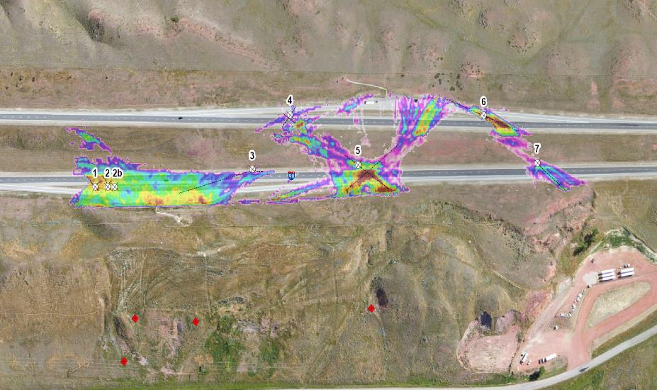
Initial attenuation map and drill targets
Notes:
2017 Tetra Tech 3D seismic delineated mine working extents, orientations, and the biggest anomalies were ranked as priority drilling targets which encountered voids under highway and in median.

Slide 18
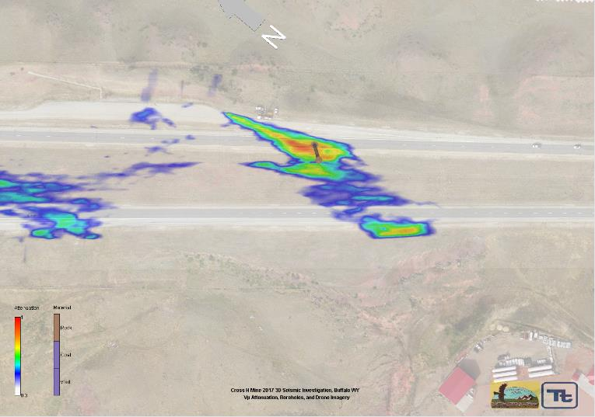
Cross H – Vp attenuation anomaly
Notes:
60 degree angle borehole from median extended under the middle westbound lanes of I90 and encountered a void that was imaged with a borehole camera.
Drill casing issues prevented 3D sonar scanning the void to quantify the dimensions.

Slide 19
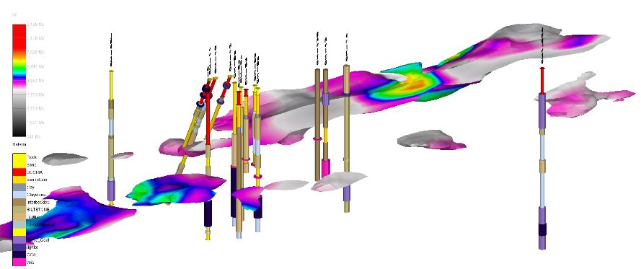
3D visualization of seismic data
Borehole Data – UAV Data – Geophysical Data
Notes:
The P-wave Attenuation and P-wave tomography seismic data, allow us to map collapsed/rubble zones and open voids which provide inputs for grout engineering and remediation design.
3D visualization is key for understanding complex datasets.

Slide 20
Integrated 3D site model

Slide 21
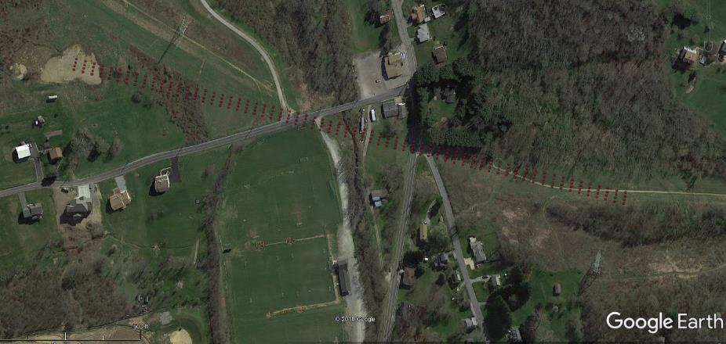
3D seismic imaging of proposed utility alignment and HDD boring
Notes:
This figure shows the preliminary subsidence risk evaluation for a section of pipeline along a proposed HDD.
Depth to mine workings is 100-300 ft bgs. Room and pillar mine. Extent of pillar robbing and auxiliary
Evaluation based on limited (2 boreholes), mine map, and assumptions about the conditions of the mine.

Slide 22
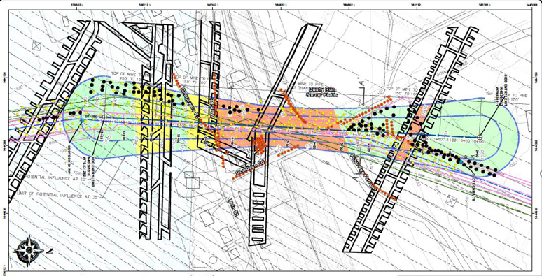
Preliminary subsidence risk
Notes:
This figure shows the preliminary subsidence risk evaluation for a section of pipeline.
- red indicates high subsidence risk – due to shallow workings and mining method
- yellow = moderate risk – likely partially collapsed areas
- green = low risk – areas are deep and likely already fully collapsed.
Major assumptions in this version of the risk evaluation include; configuration of mine rooms and entry at the completion of mining, condition of the mine workings, and extents of impacted zones above collapsed portions of the mine.

Slide 23
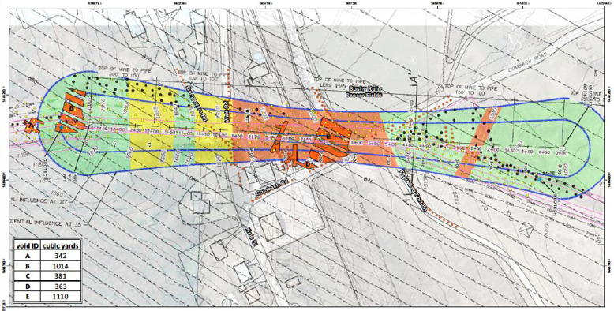
Revised subsidence risk
Notes:
This figure shows the revised subsidence risk evaluation for a section of pipeline.
3D seismic imaging identified open voids in the high risk zone as well as an uncollapsed area previously classified as low risk.

Slide 24
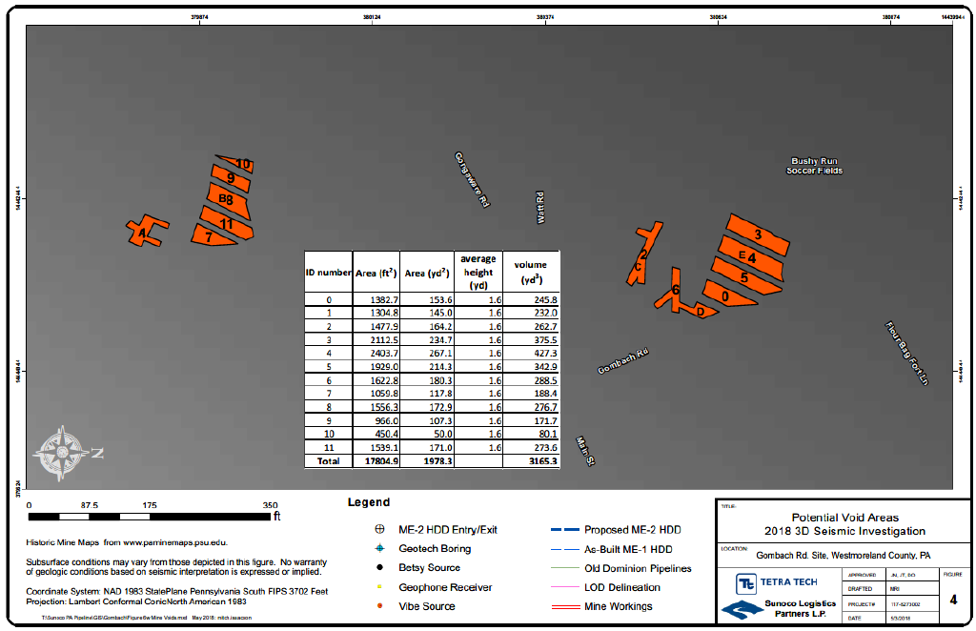
Void volume calculations
Notes:
Volume calculations for quantifying the open workings.
- Based on known mined thickness, room configurations based on mine maps, and locations of voids identified by the 3D seismic.

Slide 25
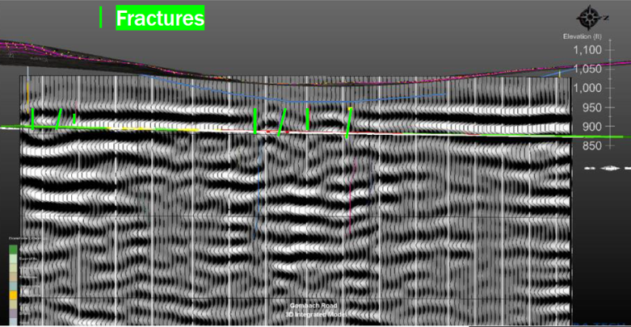
Fracture mapping above collapse zones
Notes:
In addition to void volumes, fractures associated with collapse boundaries were mapped offsetting seismic amplitude reflectors, providing HDD drillers, construction managers, and engineers valuable data for stress and strain analysis for the steel pipe, and understanding for potential fluid escape pathways for pressurized drilling fluids.

Slide 26
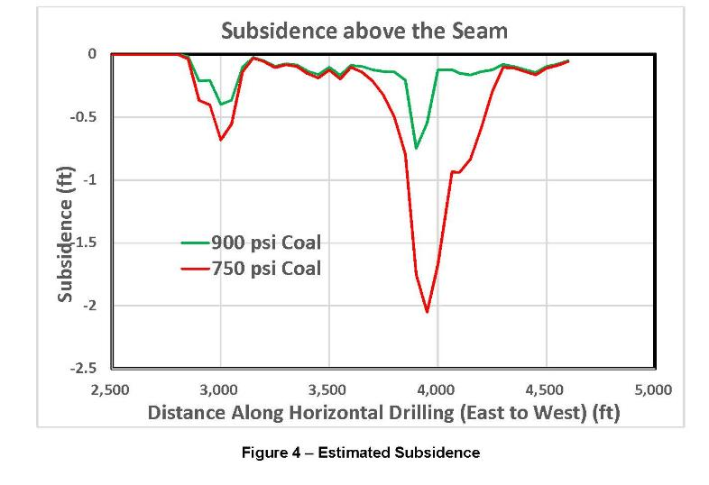
Modeling mine subsidence

Slide 27
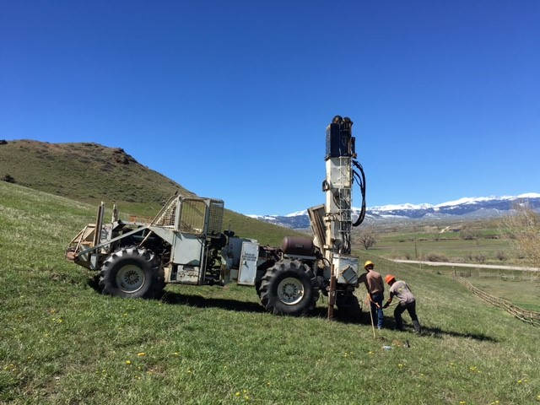
Drilling confirmation

Slide 28
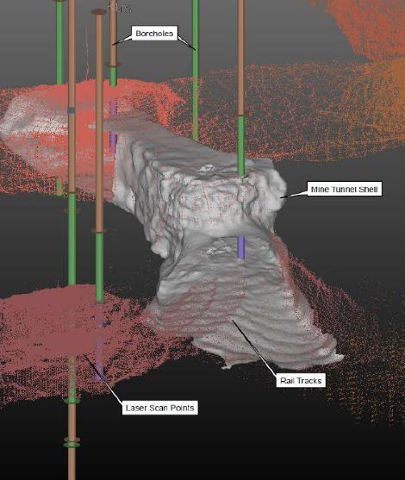
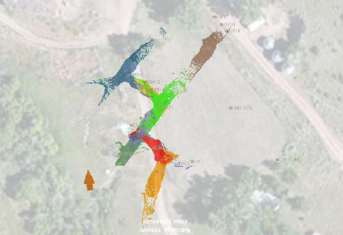
Borehole based void imaging
3D Void Scanning
1. Borehole Sonar (flooded)
Ring scans
2. Borehole Laser (dry)
3D scans
Notes:
When highly accurate characterization of voids is required, there’s the sonar and laser scanning tools.
They provide highly accurate scans of void spaces showing the depts., volumes, and orientations of voids.
Resolution is good enough to see old tracks and individual pieces of roof fall on the floor of the mine.

Slide 29
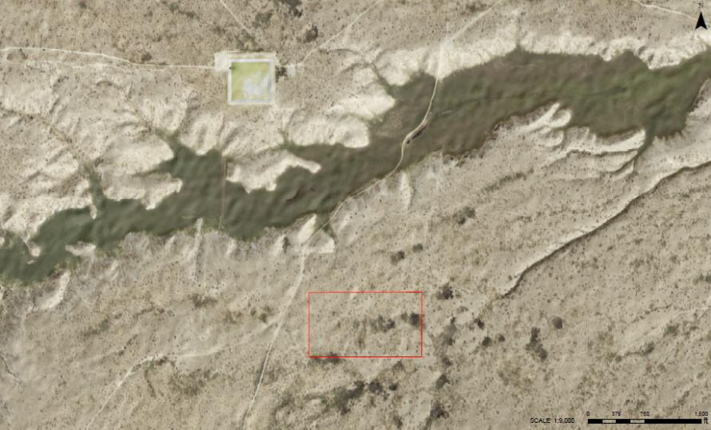
Site characterization – O&G facility in Karst
Notes:
Performed subsurface 3D imaging and confirmation drilling \ of potential karst features to inform placement of surface infrastructure for O&G operations.
20 acre site

Slide 30
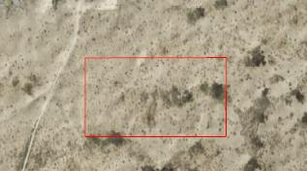
Preliminary tank locations
Notes:
The initial site layout had several tanks and other equipment located in the eastern portion of the site.
Several Geotech boreholes were drilled to 60 ft. Given the karst terrain features, concerns remained. Tetra Tech was hired to fill the in the data gaps on the initial evaluation.
3D seismic array deployed across the site.
Swept frequency source, real time monitoring of seismic data to ensure best possible data is acquired.

Slide 31
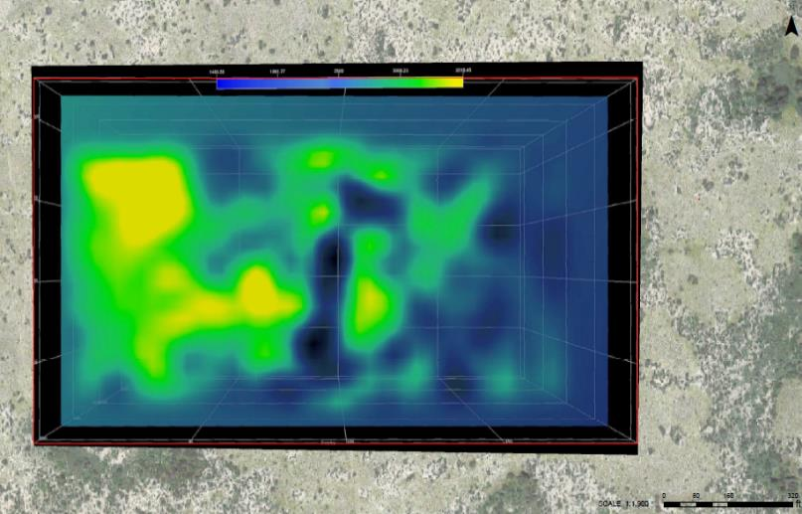
Site characterization – identification of Karst features
Notes:
Red areas represent karst features identified with the geophysics.
Confirmed by drilling.
3D P-wave attenuation tomography can map karst networks in 3D

Slide 32
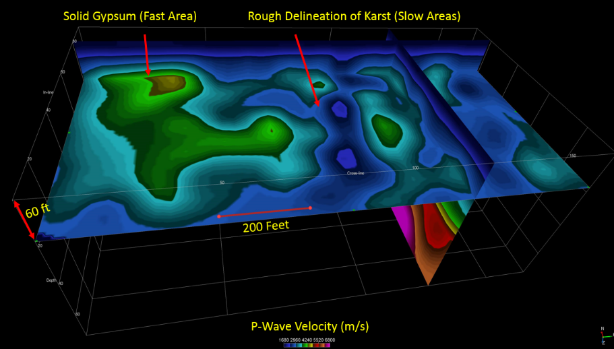
Site characterization – identification of Karst features – 3D P-wave velocity
Notes:
Red areas represent karst features identified with the geophysics.
Confirmed by drilling.
3D P-wave attenuation tomography can map karst networks in 3D

Slide 33
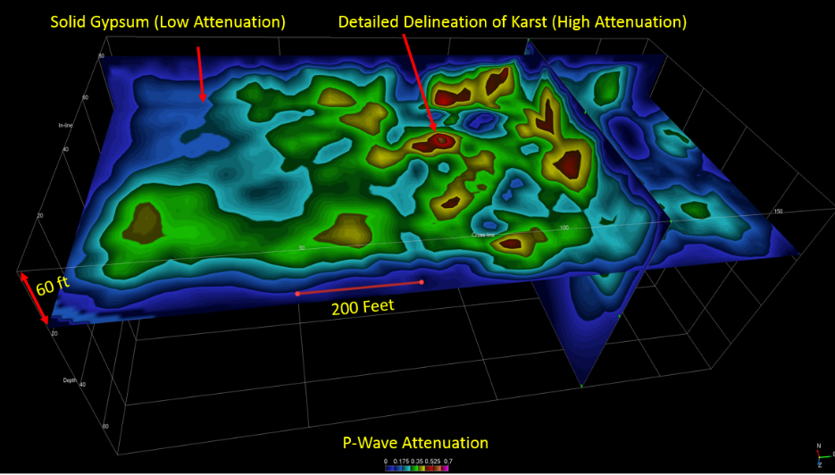
3D P-wave attenuation

Slide 34
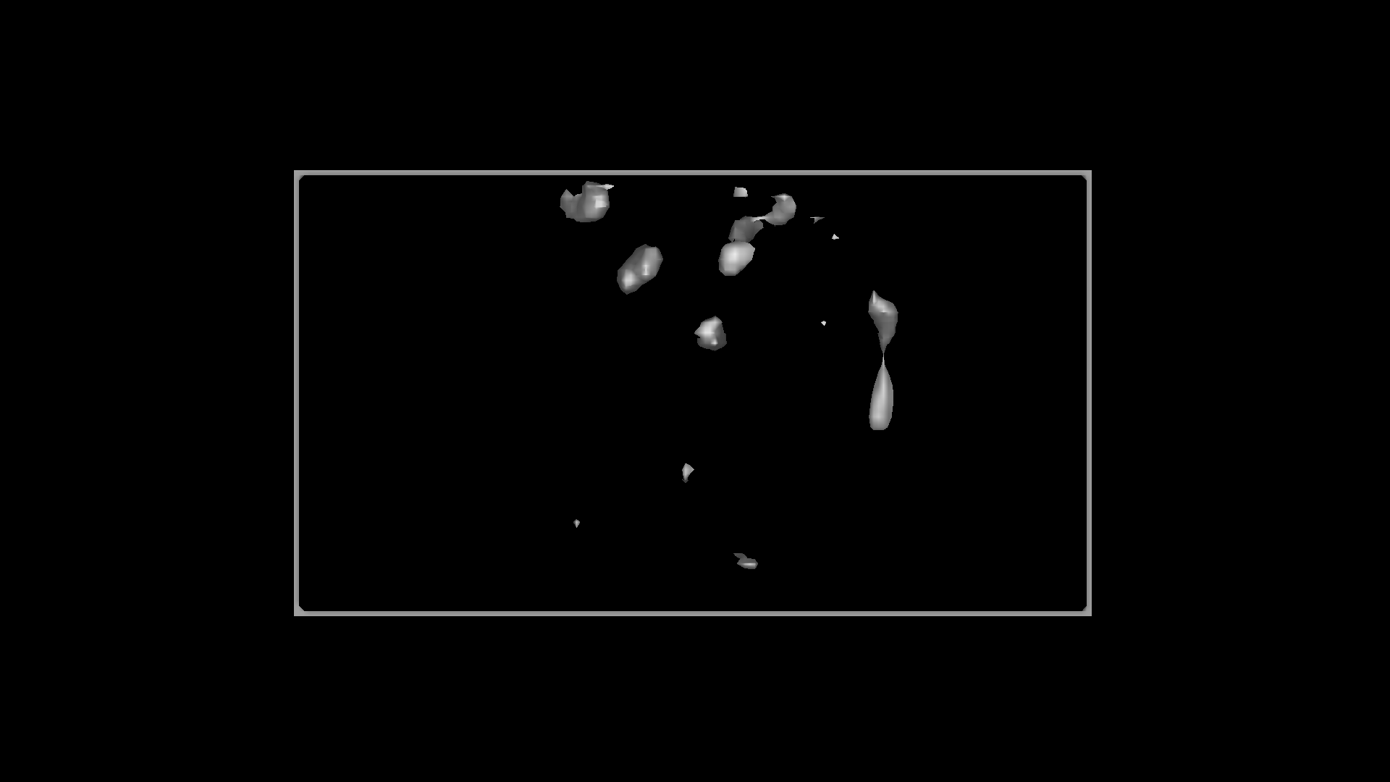
3D mapping of Karst extent using 3D attenuation: Caverns in 3D

Slide 35
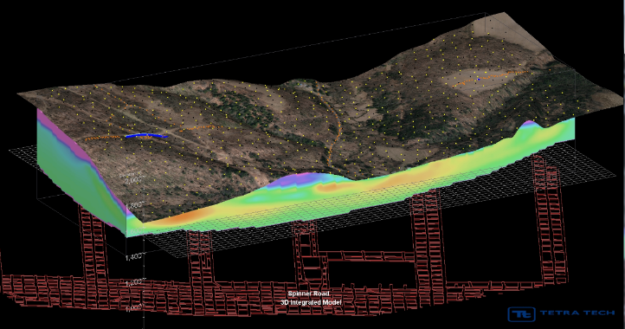
3D seismic advantages
1. Increased Resolution/Fewer Data Gaps
2. Accurate Site Characterization – Quantified Risk
3. Cost Savings – Project Level and From Mitigated Risk

Slide 36
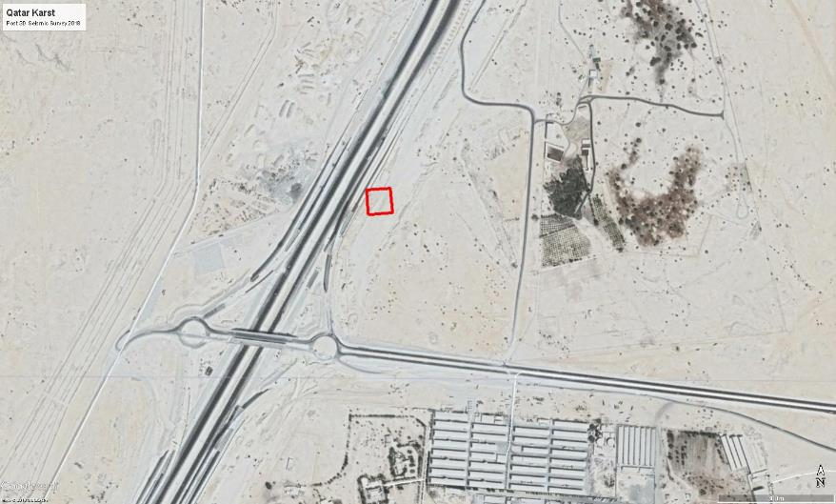
Qatar 3D fluid-filled Karst characterization for highway construction
3D Seismic
Survey Area
Notes:
Performed subsurface 3D imaging of potential karst features to inform placement of surface infrastructure for O&G operations.

Slide 37
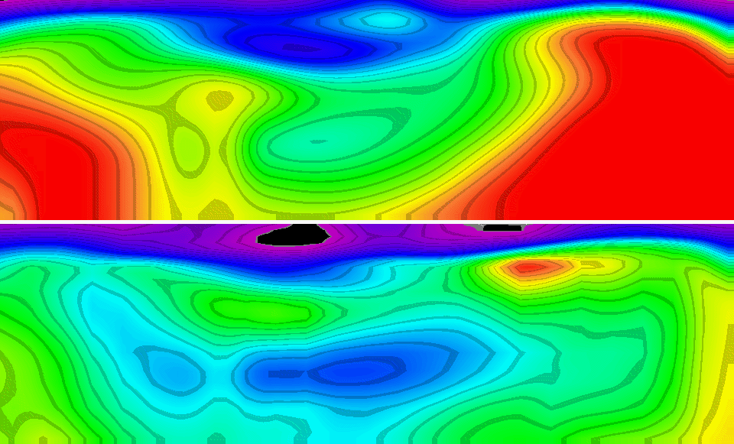
Qatar 3D waveform inversion: Sinkhole N-S cross section
Vp (ft/s)
North
55 ft
180 ft
<1 ft
Sag
5 ft
5 ft Roof
Collapse
33 ft
5 ft
Sinkhole
Vs (ft/s)
Notes:
Performed subsurface 3D imaging of potential karst features to inform placement of surface infrastructure for O&G operations.

Slide 38
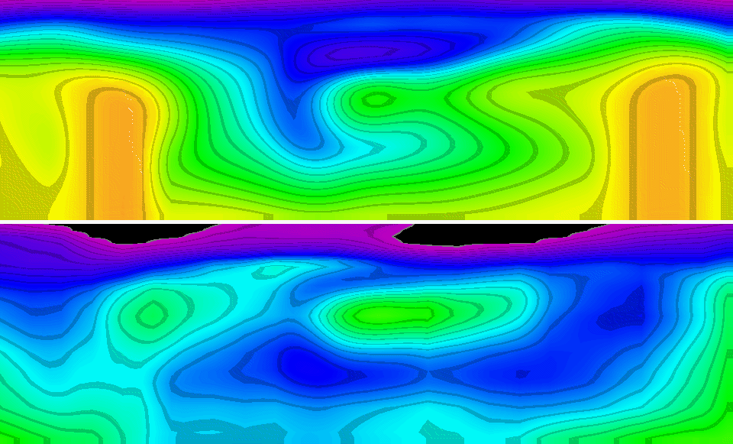
Qatar 3D waveform inversion: Sinkhole W-E cross section
Vp (ft/s)
East
55 ft
180 ft
Sinkhole
Vs (ft/s)
Notes:
Performed subsurface 3D imaging of potential karst features to inform placement of surface infrastructure for O&G operations.

Slide 39
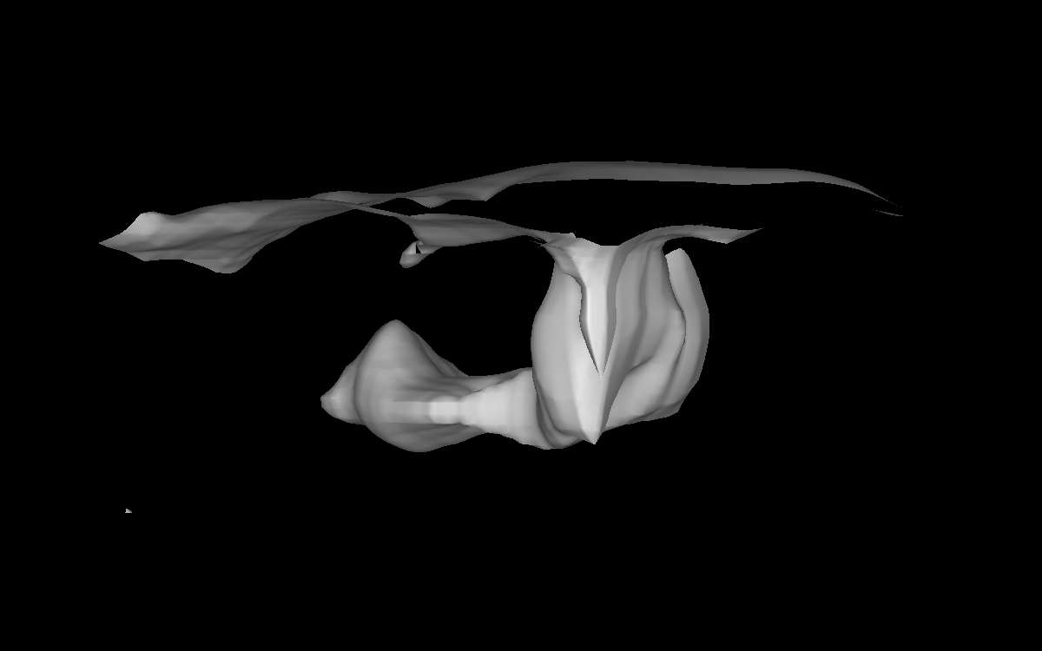
Qatar: Seismic mapping of fluid-filled Karst extent in 3D

Slide 40
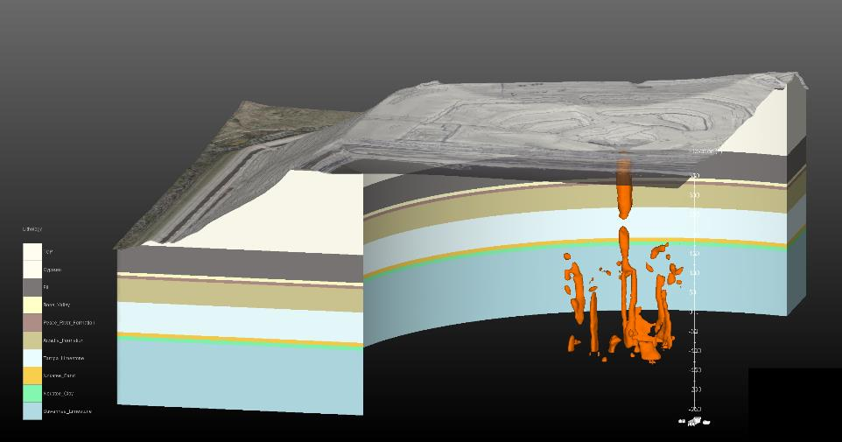
3D seismic modeling: Mine tailings mitigation/risk modeling
Notes:
Initial attempt to model the sinkhole/karst feature using attenuation was difficult. The survey area was large enough and the target small enough that energy was traveling around the void. This did give us an idea as to where the main sinkhole feature was located on site, but was not refined enough to image or model in 3D.
This lead us to a new method in seismic data processing that uses multiples as additional source points instead of filter them our of the data completely. Because of this we were able to image the entire sinkhole structure and observe detailed qualities of the network of sinkhole related feature in the area, including the bifurcated pipe system seen below the main sinkhole.

Slide 41
Multiple dataset integration: InSAR satellite monitoring
Notes:
Animation of satellite data from 2010 through 2016 highlighting downward trends near some utilities.

Slide 42
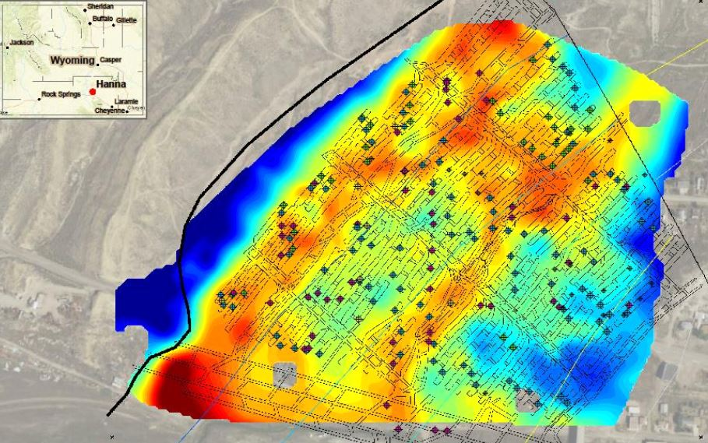
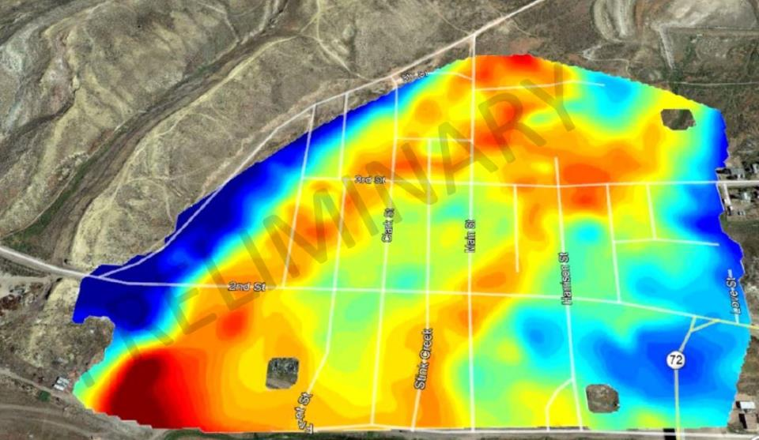
Multiple dataset integration: Gravity measurements/joint inversion
Notes:
Integrating gravity into the site characterization process allows us to compensate for one method’s weaknesses with another methods strengths. Gravity is an excellent tool for surveying the near surface but has limitation on imaging to depth. Seismic can image deeper when designed to do so, allowing for an integrated approach that provides the most useful data at the most efficient application for that method.
In this case in Hanna, WY we knew that gravity would get us from the surface down to about 100 feet below ground, we designed our seismic survey to capture from about 40 feet bgs down to about 500’. This saved us from having to deploy receivers at a fine nominal spacing which would have required shutting down roads, buildings, etc.

Slide 43
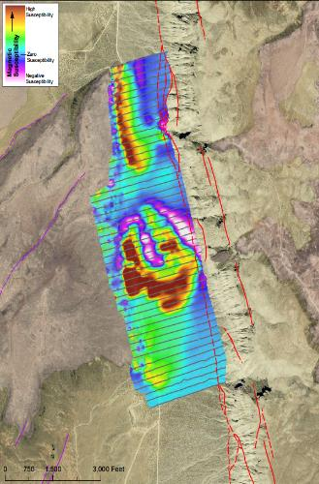
Multiple dataset integration: Magnetics and seismic (Vs) profiles
Dipping Basalt (Faulted)
Flat-Lying Basalt (Unfaulted)
Notes:
Like the gravity integration, we also use magnetic and EM data combine with our seismic imaging to better constrain anomalies in the data.

Slide 44
Conclusions
3D seismic is the only method that can successfully provide high-resolution imaging of subsurface features
Integrating data types allows for better constraints on the information captured
Don’t replace older methods, just provide a more detailed approach
Extracting as much information as we can from field surveys

Slide 45
Thank you!
Notes:
Thanks for having me.
Any questions at this time?

