Slide 1
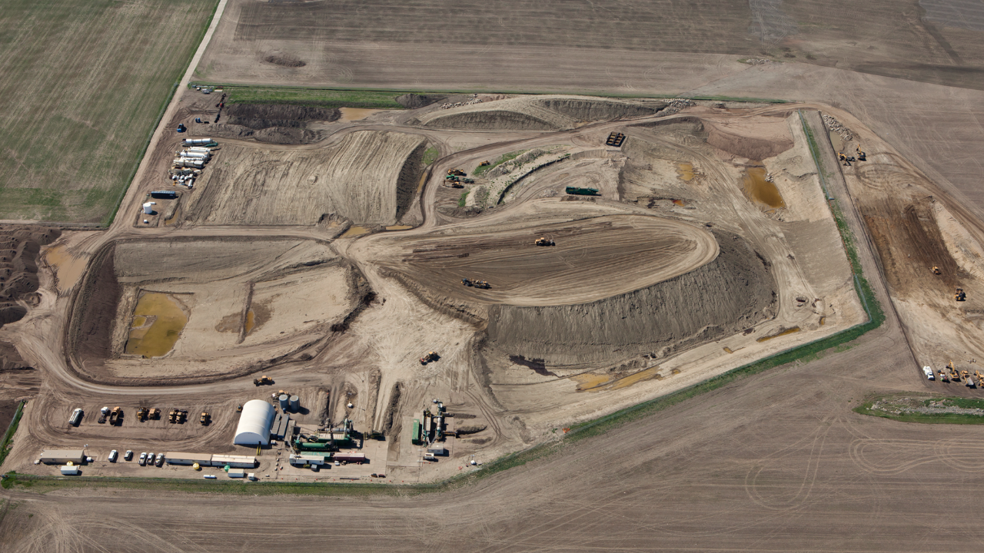

Soil Reclamation after a Bakken Crude
Pipeline Release:
A Summary of Research Results
Tom DeSutter
P. O’Brien, S. Croat, C. Gasch, F. Casey, and A. Wick
Department of Soil Science, School of Natural Resource Sciences Fargo, ND
5 June 2019
American Society of Mining and Reclamation
Big Sky, MT

Slide 2
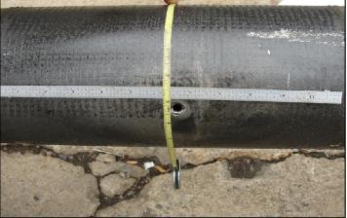
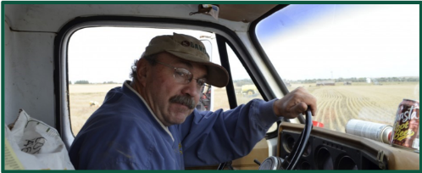
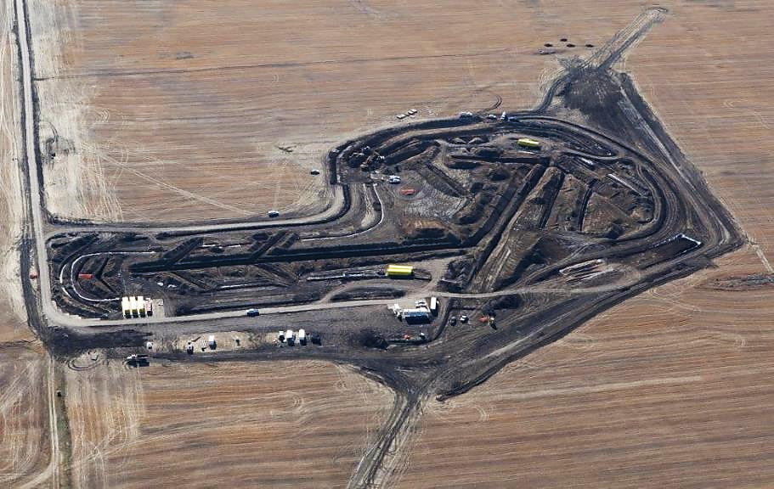

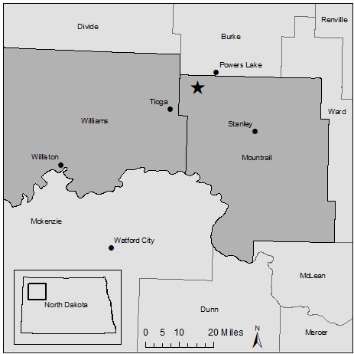
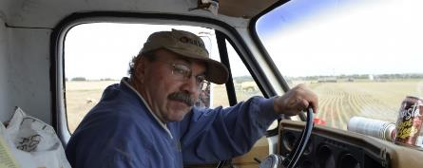
Problem
N
Goal: Bring soils back to agricultural production.
30 rail cars
Figure 2
Figure 2
Notes:
This heave oil activity, and the increase in activity seen in the past decade can create problems for farmers like Steve Jensen here. Steve discovered this spill on his land near Tioga ND in 2013.
-This spill was 21,000 barrels and if we do our math again, this is equivalent to 30 rail cars. It impacted approximately 6 hectares (or 15 acres) of agricultural land on the surface, but the oil moved more than 15 meters (or 50 feet) below the soil surface. So this is a large volume of soil that is taken out of crop production and needs to be cleaned up.
-So our overall goal is to bring these soils back to productivity.

Slide 3
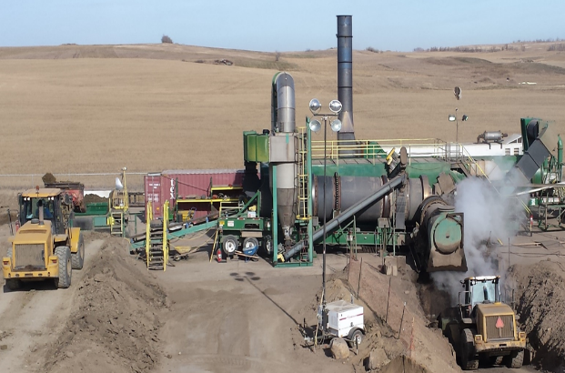
Solution: Thermal Desorption
…but some unknowns
Notes:
The way that this spill has been cleaned up is by a heating process known as thermal desorption. This involves placing contaminated soils into an oven like burner for 10-15 minutes at 350 degrees C. The hydrocarbons that crude oil is made up of are volatilized leaving the soil “clean” and available for reuse. However, there are some unknowns pertaining to certain soil properties when they are heated up to these high of temperatures, alterations in soil properties may prevent us from reaching our big picture goal of bringing these soils back to productivity.

Slide 4
Holistic Approach to the Remediation/Reclamation/Restoration of Soils
Soil Physical Properties
Soil Biological Properties
Soil Chemical Properties
- Available water
- Cone Penetrometer Resistance
or Bulk Density
- Organic Matter
- Nutrient Cycling
- Enzyme Production
- Microbial and Fungal Pools
- Carbon turnover
- Electrical Conductivity
- Sodium Content
- Nutrients
- pH
Soil Health/Quality
Yield or
Productivity
Can TD-treated soil be used for agricultural productivity?
Notes:
Successful remediation/reclamation requires a holistic approach which includes physical, chemical, and biological.
All three properties contribute to soil quality / health with soil health being the capacity of a soil to function within ecosystem boundaries to sustain biological productivity, maintain environmental quality, and promote plant, animal, and human health which
thus leads to the crops overall yield and productivity.
So, Can TD-treated soil be used for agricultural productivity? The overall objective is to determine if these thermally desorbed “soils”, coming from varying depths, would be an option for topsoil if needed. Because the topsoil in some regions of the world are very thin or non existent already.

Slide 5
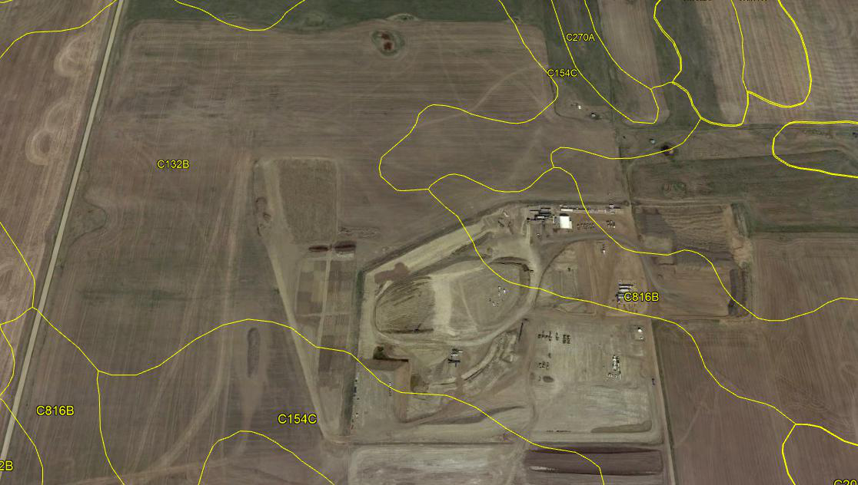



Williams-Zahl loams, 3 to 6 percent slopes, 2e and 3e
Lehr loam, 2 to 6 percent slopes, 3e
Notes:
Class 2 soils have moderate limitations that restrict the choice of plants or that require moderate conservation practices.
Class 3 soils have severe limitations that restrict the choice of plants or that require special conservation practices, or both.
The letter e shows that the main hazard is the risk of erosion unless close-growing plant cover is maintained;

Slide 6
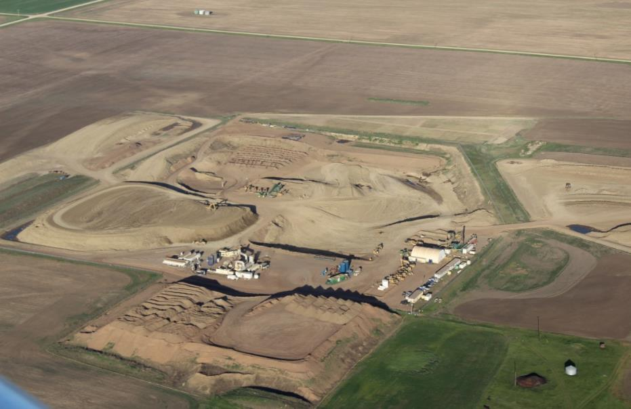
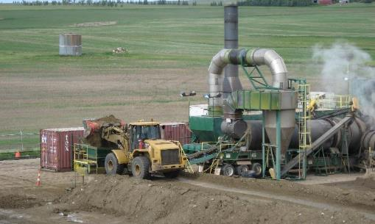
Soil Samples
Native Topsoil (TS)
Native Subsoil (SS)
Contaminated stockpile (SP)
Thermally Desorbed
Topsoil (TS-TD)
Subsoil (SS-TD)
Stockpile (SP-TD)
Notes:
We first addressed this objective by doing a number of laboratory analyses to figure out the fundamentals of these soils and how they were going to behave before just jumping into the reclamation field portion. Its important to understand what we are working with. So over multiple students and 3 years of data I’ve very briefly listed what we’ve found. This is an aerial photo of the remediation site where our soil samples were collected. Here we have our native non-contaminated topsoil or A horizon, and subsoil or B horizon, and this large stockpile is the crude contaminated soil which contains soils from depths up to 15 meters below the surface. These soils were excavated and are stockpiled so the amount of total hydrocarbons can be normalized to a certain level before being placed in the Thermal desorption unit.
Over here is the thermal desorption heating unit where each of these soils were sent through the process I described eariler to yield thermally desorbed TS, SS, and SP soils making a total of 6 soil samples.

Slide 7
Laboratory/Greenhouse analyses – Physical and Biological
Aggregate stability
Saturated hydraulic conductivity
Soil organic carbon
Microorganism populations
Microorganism activity
Wheat grain quality
Notes:
I mentioned that much of this work was conducted by other students and colleagues involved in this project. The physical parameters, aggregate stability and conductivity were done by Peter O’Brien while the biological parameters largely in regard to microbial dynamics were done by Samantha Struffert or Sam1 as I was then named Sam2. Each parameter is then explained with an increase, decrease, or neutral change in its respective property.
Emphasize that these “soils” are from varying depths. So in the case that these thermally desorbed soils needed to be used as topsoil, would they even be an option?
Starting with the physical properties.
Biologically

Slide 9
Laboratory analyses – Chemical
Cation exchange capacity
Cation selectivity
pH
Phosphorus sorption
Phosphorus desorption
Notes:
Moving onto chemical properties which were also largely evaluated by Sam1, you can see the respective changes.
I will be focusing on the Chemical properties with the objective being if TD impacts the cation exchange capacity, cation selectivity and Gibbs free energies
Now we are going to focus on the Biological properties with today which includes nutrient cycling accomplished by enzyme activity, microbial pools, and carbon turnorver, the objective being the effects of thermal desorption on the nitrogen cycle
Develop guidelines for TD processed soil

Slide 10
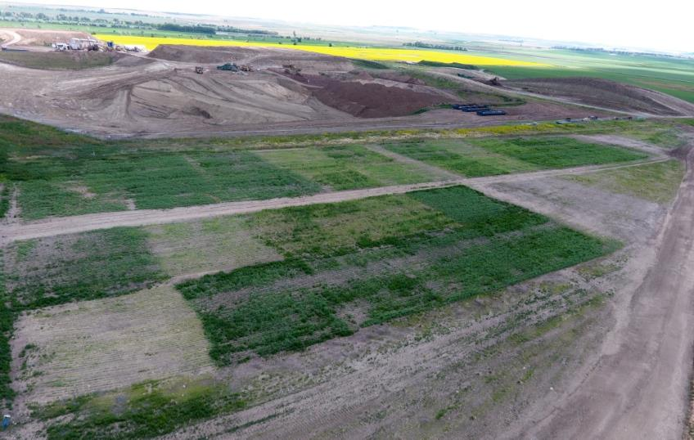
Field study
Notes:
So we looked at whether or not TD was changing soil properties and found out it was. Next, we were curious in finding out whether TD soils regardless of their original depth can be used as a replacement for topsoil. OR is mixing some native/non contaminated or TD-treated soils with TD treated soil going to increase overall soil quality and yields??
To compare the yields across three years and with different crops we compared the soil mixtures to that of the A horizon, our reference soil or what we want to return these disturbed soils back to, therefore all of the numbers are relative to the A horizon.
/The yields from any soil treatment that had A horizon mixed in was no different than the reference soil of the A.

Slide 11
Soil mixes
TDU: contaminated soil that has been treated by TDU
(TPH 229 mg kg⁻¹)
A: native, non-contaminated topsoil
(TPH < 5 mg kg⁻¹)
SP: contaminated soil that has been excavated and stockpiled, but not yet treated
(TPH 1475 mg kg⁻¹)
TDU + A
SP + A
(TPH 110 mg kg⁻¹)
(TPH 704 mg kg⁻¹)
Composted bedding (manure, m)
10 soil treatments
Notes:
The soils used in our plots include TDU soil or oil contaminated soil that has been sent through the TD process, A, native, non contaminated topsoil, and SP or contaminated soil that has been excavated and stockpiled but not yet treated by TD.
-by using those we have a 1:1 mixture of TD and A
-along with a 1:1 mixture of SP and A.
-each of these 5 are present in the plots with and without manure
-yielding a total of 10 soil treatments replicated 3 times.

Slide 12
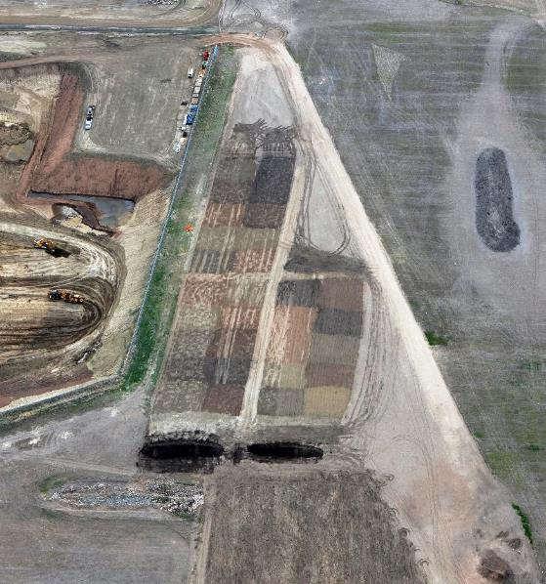
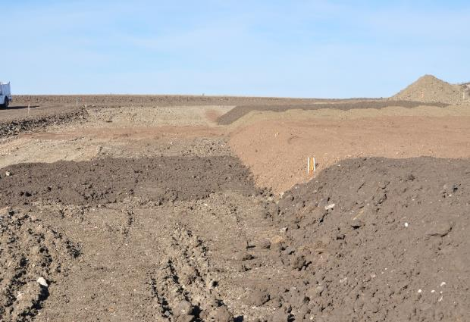
Soil mixes
A
SP
TDU
TDU + A
TDU
A
SP + A
SP
3 replications
Notes:
To better visualize the treatments, here they are labeled in the plots. The native A horizon topsoil is dark in color as you’d expect. While the TDU is more of a reddish and the SP is a gray/yellow color. And the mixes fall somewhere in-between those.
Plots were fertilized according to NDSU fertility recommendations.

Slide 13
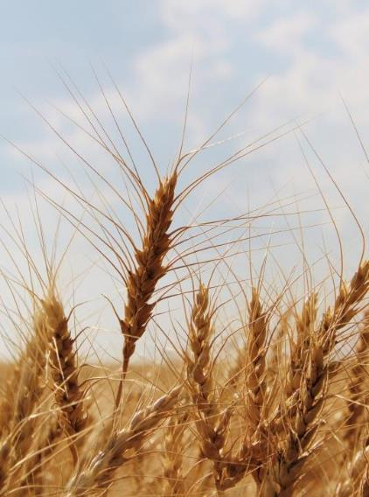
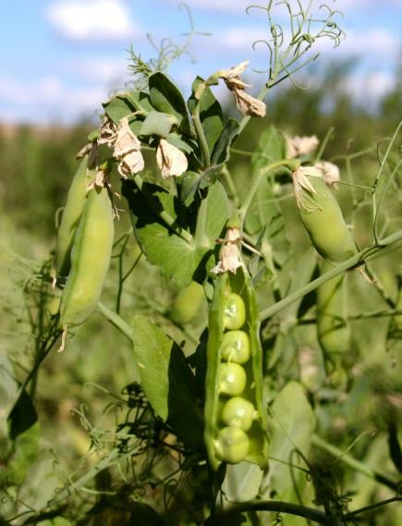
Cropping System
2016
2017
2018
Notes:
To further evaluate objective 1 of crop yield, our cropping system included hard red spring wheat was planted in 2016, followed by field peas in 2017, and HRSW again in 2018..

Slide 14
A = topsoil
TDA = 1:1 Thermally desorbed plus A
SPA = 1:1 Stockpile plus A
TD = Thermally desorbed
SP = Stockpile

Slide 15
Notes:
PHC concentrations were reduced between 46 and 53%

Slide 16
ppb)
Notes:
polycyclic aromatic hydrocarbons

Slide 17
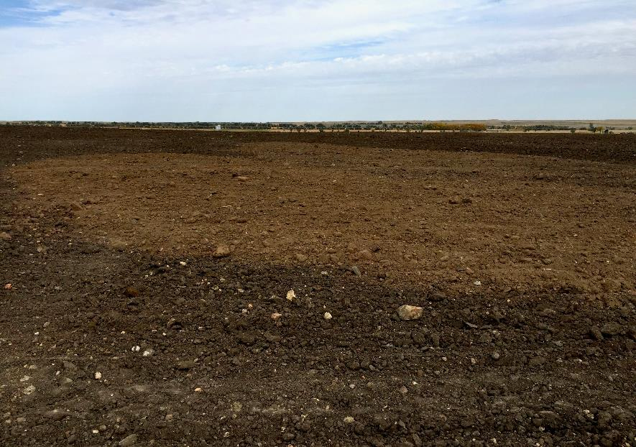
Fall 2018
Notes:
Because of what we learned in this project, we recommended that a blend of TDU + A horizon be placed back down as a replacement for the topsoil that was originally there. However, with minimal topsoil to begin with in the part of the state, the amount of topsoil needed was underestimated and they ran out of topsoil and as you can see in this photo, some TDU soil is exposed at the surface. So, by understanding the fundamentals and crop responses to all of our treatments, we can better manage these soils in regard to soil fertility and cropping sequences.
Yields in the first year were already meeting 90% of the county average.

Slide 18
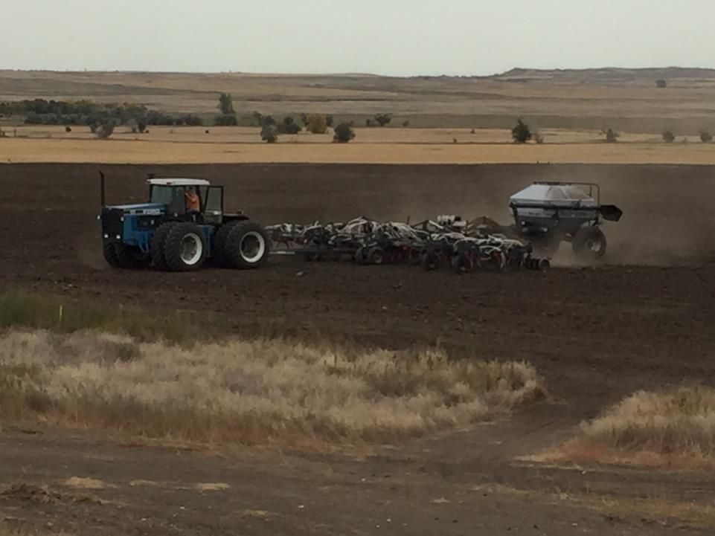
Fall 2018
lbs/a
Forage Oats: 20
Slender WG: 7
Forage WRye: 40
YB Clover: 3

Slide 19
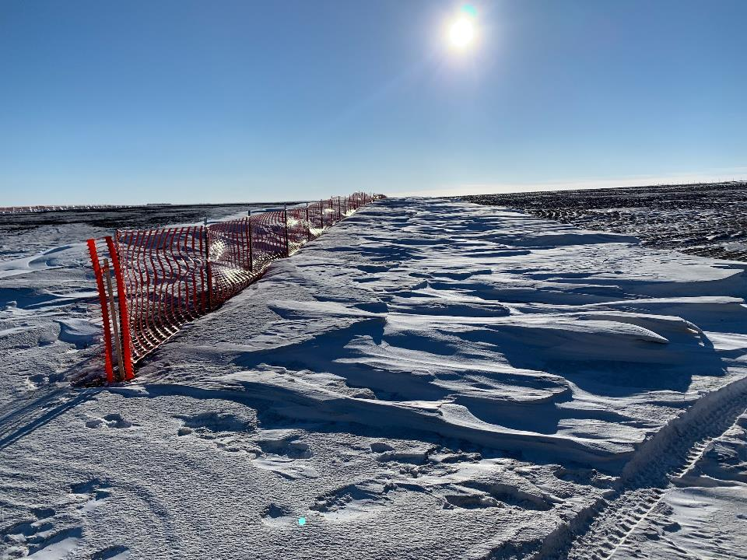
Winter 2018

Slide 20
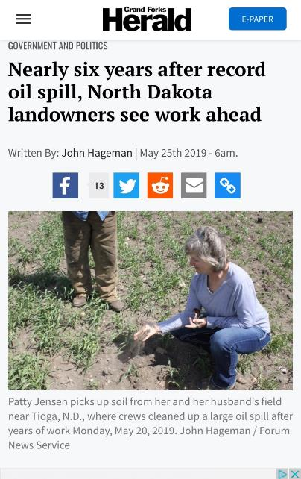
Spring 2019

Slide 21
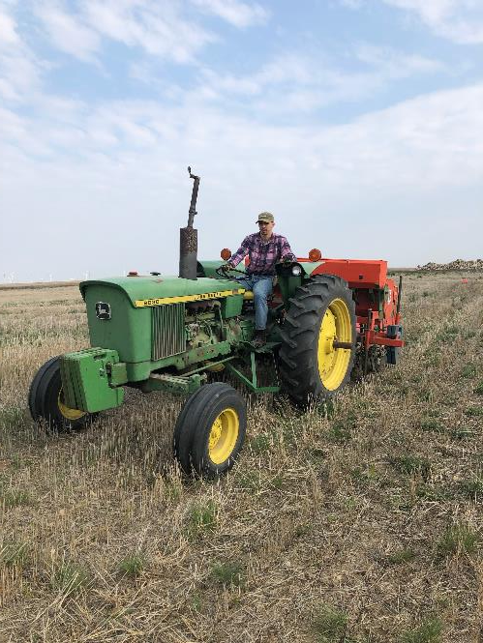
Spring 2019
Grain sorghum, 8 lbs/ac

Slide 22
Williams-Zahl loams, 3 to 6 percent slopes, 2e and 3e
Lehr loam, 2 to 6 percent slopes, 3e
Notes:
Class 2 soils have moderate limitations that restrict the choice of plants or that require moderate conservation practices.
Class 3 soils have severe limitations that restrict the choice of plants or that require special conservation practices, or both.
The letter e shows that the main hazard is the risk of erosion unless close-growing plant cover is maintained;

Slide 23
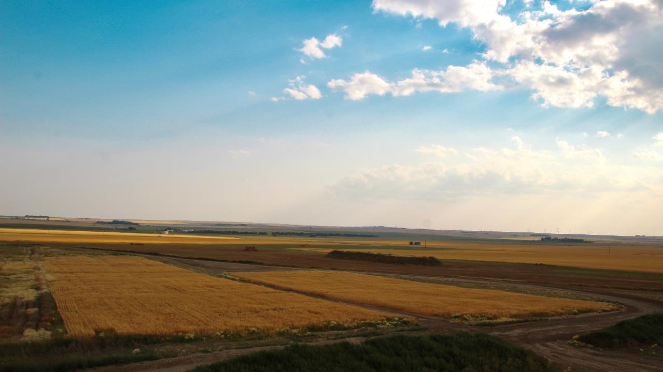
Publications
O’Brien, P. L. et al., 2018. Natural degradation of low-level petroleum hydrocarbon contamination under crop management. J Soils Sediments.
O’Brien, P. L., et al., 2018. Daytime Surface Energy Fluxes over Soil Material Remediated Using Thermal Desorption. Agrosystems, Geosciences & Environment.
O’Brien, P. L., et al., 2017. A large-scale soil-mixing process for reclamation of heavily disturbed soils. Ecol. Eng.
O’Brien, P. L., et al., 2017. Wheat growth in soils treated by ex situ thermal desorption. J Environ Qual. 46:897-905.
Ritter, S., et al, 2017. Binary exchanges of calcium, magnesium, and potassium on thermally desorbed soil. Soil Sci Soc Am J 88:1088-1095.
O’Brien, P. L., et al., 2016. Implications of using thermal desorption to remediate contaminated agricultural soil: physical characteristics and hydraulic processes. J Environ Qual 45:1430-1436.
O’Brien, P. L., et al., 2018. Thermal remediation alters soil properties – a review. J Environ Manage 206:826-835.
O’Brien, P.L., et al., 2017. Evaluation of soil function following remediation of petroleum hydrocarbons – a review of current remediation techniques. Curr Pollut Rep. 3:192-205.
In progress
Croat, S., et al. Effects of energy related disturbances on soil nutrient availability.
Croat, S., et al. Crop productivity and agronomic considerations in highly disturbed and thermally desorbed soils.
Notes:
In addition, this project has yielded a great amount of publications, in large part to Peter O’Brien. From the natural degradation of hydrocarbons in the soil to the surface energy fluxes of thermal desorbed soils to crop productivity we have covered a lot of ground and are appreciative for the opportunity brought to us from this tragic land event.

Slide 24
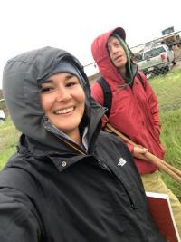
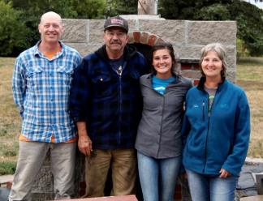
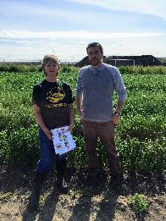
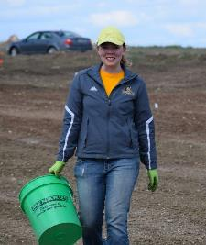
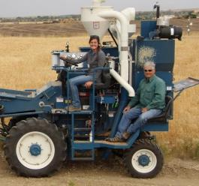
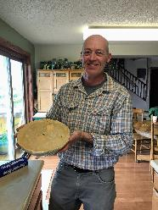
Acknowledgments
Kevin Horsager • Nate Derby • Aaron Green
Megan Ostrand • Becca Hebron • Zach Bartsch
Steve and Patty Jensen
Notes:
With that I would like to acknowledge all of those involved in the project especially Dr. DeSutter who could not make it to the meeting, Peter and Sam, the technicians, and the landowners for being so easy to work with and just as excited to learn all about soils during this journey.

