Slide 1
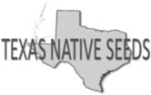
Restoration of Native Grasslands to Provide Monarch Habitat on the Enbridge Valley Crossing Pipeline in the South Texas Sand Sheet
Tony Falk*¹, Keith Pawelek², Forrest Smith³, and Devin Hoetzel⁴
*Presentor, Assistant Director South Texas Natives Project, Texas Native Seeds Program (TNS), Caesar Kleberg Wildlife Research Institute (CKWRI),
Associate Director, TNS, CKWRI,
Dan L Duncan, Endowed Director, TNS, CKWRI
Manager of Stakeholder Outreach, Enbridge.

Slide 2
Creation of a native pollinator corridor
Landowners in the county insisted on planting natives
In line with the pipeline company
Initial meeting
5 major landowners in the county
South Texas Natives
Pipeline operator
19 species seed mix made up of locally adapted commercially produced grasses and forbs
Collaborative effort with local experts and seed company

Slide 3
The last Great habitat
Fine sandy soils (MLRA83E)
Subtropical subhumid climate
Mean annual precipitation 28.00 in
Frost-free 343 days

Slide 4
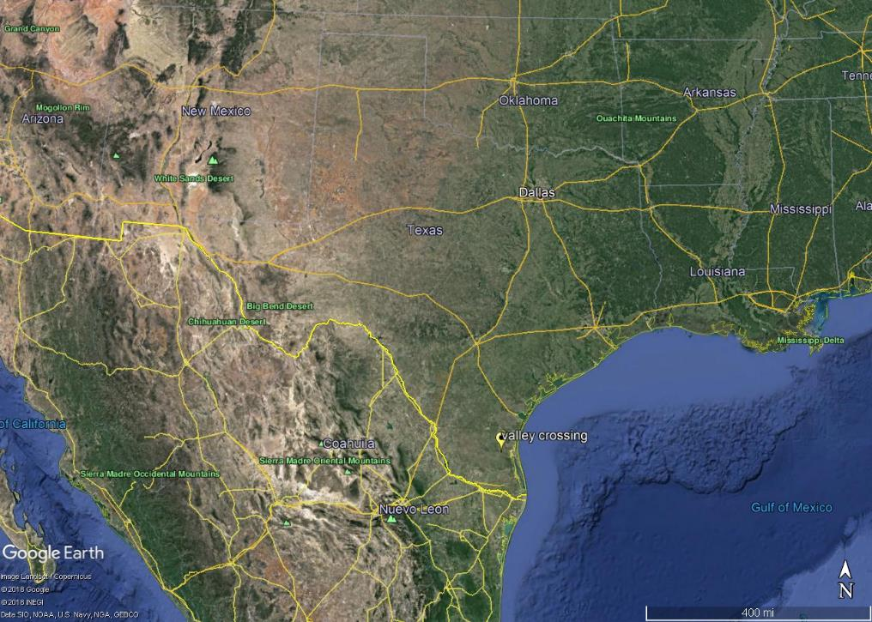

Slide 5
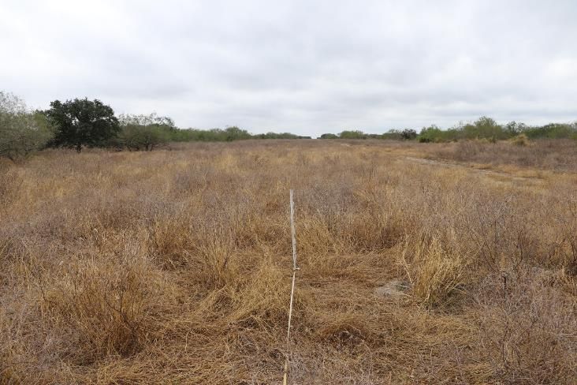
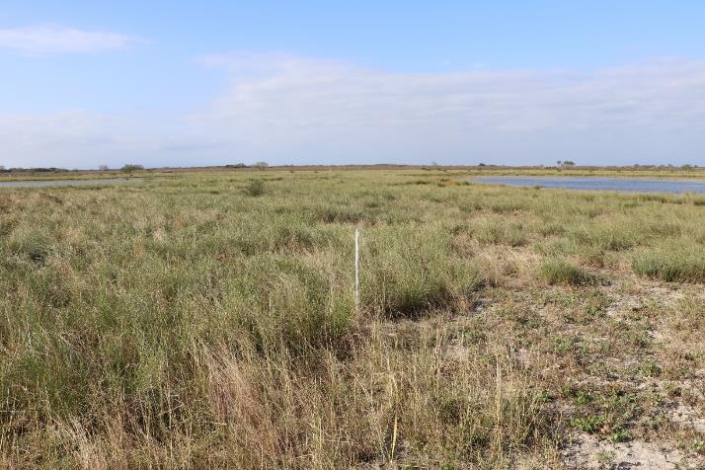
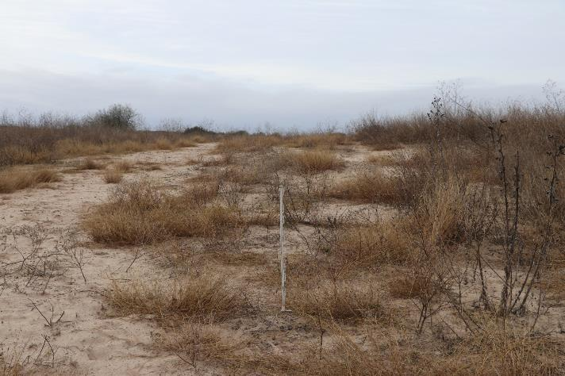

Slide 6
Variety | Species | Full rate PLS/ac | % of mix | Lbs PLS/ac
Carrizo Germplasm | Little bluestem | 4.0 | 5.0% | 0.2
Hidalgo Germplasm | Multi-flowered False Rhodesgrass | 1.0 | 5.0% | 0.05
Catarina Blend | Bristlegrass | 2.0 | 5.0% | 0.1
LaSalle Germplasm | Arizona cottontop | 2.0 | 5.0% | 0.1
Webb Germplasm | Whiplash pappusgrass | 3.0 | 5.0% | 0.15
Mariah Germplasm | Hooded windmillgrass | 1.0 | 13.0% | 0.13
Oso Germplasm | Hall’s panicum | 1.5 | 5.0% | 0.75
Welder Germplasm | Shortspike windmillgrass | 1.0 | 5.0% | 0.05
Diller Germplasm | Slender grama | 5.0 | 18.0% | 0.9
Duval Germplasm | Red lovegrass | 1.0 | 17.0% | 0.17
Nueces Germplasm | Sand dropseed | 1.0 | 17.0% | 0.17
Venado Germplasm | Awnless bush sunflower | 2.0 | 5.0% | 0.1
Balli Germplasm | Prostrate Bundleflower | 3.0 | 5.0% | 0.15
Rio Grande Germplasm | Prairie Acacia | 2.0 | 5.0% | 0.1
Goliad Germplasm | Orange zexmenia | 1.0 | 5.0% | 0.05
Zapata Germplasm | Rio Grande clammyweed | 5.0 | 5.0% | 0.25
Cuero Germplasm | Purple prairie clover | 8.0 | 5.0% | 0.4
South Texas Germplasm | Indian Blanket | 3.0 | 5.0% | 0.15
 |  |  |  | 3.97

Slide 7
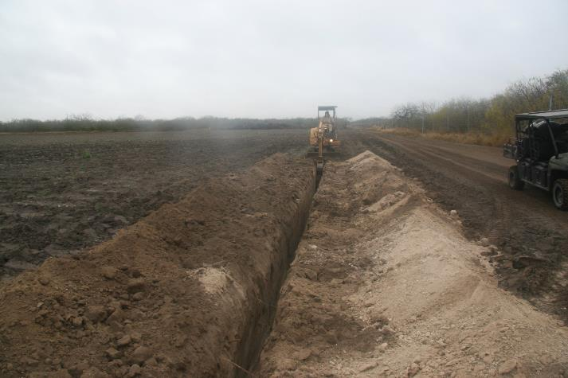
Methods
Pipeline was double ditched
Topsoil pushed off to one side
Subsoil trenched
Replaced in the same order
Planting completed by contractor between September and July 2018
Some of the earliest planted section were washed out and then replanted

Slide 11
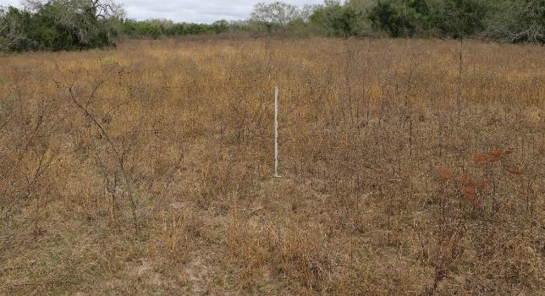
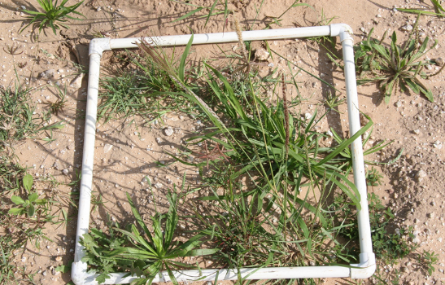
Sampled in November 2018: less than 6 months following planting
44 samples covering 56 miles ≈ 1 sample/10 ac
10, 0.25 m density counts, 100 pace step points, and photo points
Collected both on the pipeline right of way (ROW) and directly adjacent

Slide 13
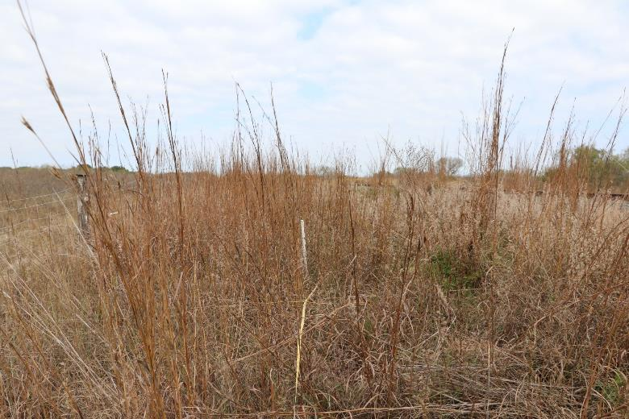

Slide 14
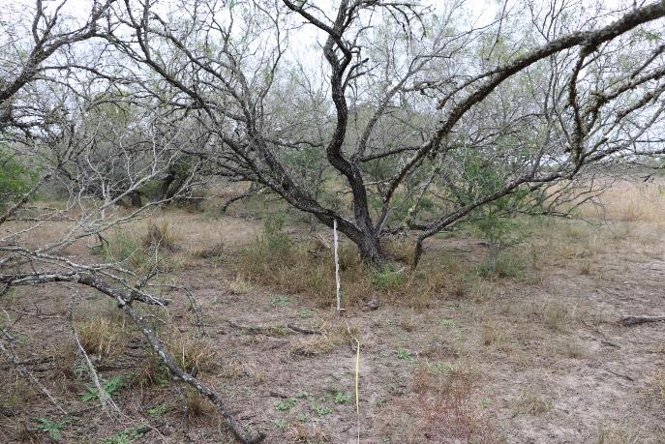

Slide 15
Basal Cover Results
Armstrong
Pipeline ROW | % basal cover | Adjacent area | % basal cover
Bare ground | 26 | Bare ground | 4
Non-native | 43 | Non-native | 9
Seeded native | 4 | Seeded native | 4
Native volunteer | 27 | Native volunteer | 84
Foundation
Pipeline ROW | % basal cover | Adjacent area | % basal cover
Bare ground | 32 | Bare ground | 5
Non-native | 23 | Non-native | 2
Seeded native | 3 | Seeded native | 7
Native volunteer | 43 | Native volunteer | 86
King Ranch
Pipeline ROW | % basal cover | Adjacent area | % basal cover
Bare ground | 43 | Bare ground | 1
Non-native | 35 | Non-native | 72
Seeded native | 13 | Seeded native | 1
Native volunteer | 9 | Native volunteer | 28
Trust
Pipeline ROW | % basal cover | Adjacent area | % basal cover
Bare ground | 35 | Bare ground | 12
Non-native | 20 | Non-native | 10
Seeded native | 6 | Seeded native | 9
Native volunteer | 39 | Native volunteer | 69
Overall
Pipeline ROW | % basal cover | Adjacent area | % basal cover
Bare ground | 34 | Bare ground | 5
Non-native | 30 | Non-native | 23
Seeded native | 6 | Seeded native | 5
Native volunteer | 29 | Native volunteer | 67

Slide 16
Density Count Results
Location | Pipeline ROW Density/ft² | Adjacent area Density/ft² | Pipeline ROW Species richness | Adjacent area Species richness
Armstrong | 0.354226 | 0.48508 | 12 | 19
Foundation | 2.723881 | 2.137527 | 16 | 28
King Ranch | 1.768083 | 1.360505 | 33 | 30
Trust | 1.457297 | 1.743367 | 24 | 45
Overall average | 1.575872 | 1.43162 | 21 | 30

Slide 17
Conclusions
There was no statistical difference in plant densities
At each location
Across the entire project
Percent bare ground is nearly 20% higher on the pipeline ROW
In general non-native species increased on the pipeline ROW
One exception
Seeded species contributed vary little to the percent cover in the pipeline ROW and on the adjacent sites

Slide 18
Acknowledgements
Embridge
King Ranch
Armstrong Ranch
Kenedy Trust
Kenedy Foundation
Other Generous donors to South Texas Natives

Slide 19
Questions?

