Slide 1
A PERMEABLE REACTIVE BARRIER (PRB) FOR THE IMMOBILiZATION OF SELENIUM IN Mine SEEP WATER AND GROUNDWATER
William J Walker, PhD
Seattle, WA
David Tooke, PhD Matthew Wright PE, Missoula, MT
Jeffrey Hamilton, JR Simplot
Notes:
Today I will present results of a study designed to assess the efficacy of PRB in reducing Se in mine water sources at a phosphate mine in se Idaho. While the results primarily discuss bench testing, some on-going work and a description of the full scale system will be presented.

Slide 2
Objective
Test the efficacy of a permeable reactive barrier (PRB) to remove Se from shallow mine seep water and groundwater,
Capable of reducing Se to below Idaho water quality standard (50 ug/L) without appreciably altering other water quality parameters
Constructed of materials easy to locate locally, and
The PRB would have a reasonable life time with low O&M costs.
Notes:
In general, our PRB testing involved a carbon based PRB through which water with enriched levels of Se would pass. In the process of flowing thru the media, the reucing conditions would create suffcinet reduction of Selenate and selenite to elemental Se, thereby meeting the water quality goal of 50 ppb. Also sought to use local materials and to ensure the PRB would have sufficient lifetime to prevent annual replacement of the media.

Slide 3
Contents
Site Description
Methods
  Characterization of water and media
  Batch leach test
  Column test
Results
  Se content of mine waters
  Media and seep water interaction
  Column – reduction of Se by pore volume (PV)
On-Going Lab Work
Full-Scale System Design and Performance

Slide 4
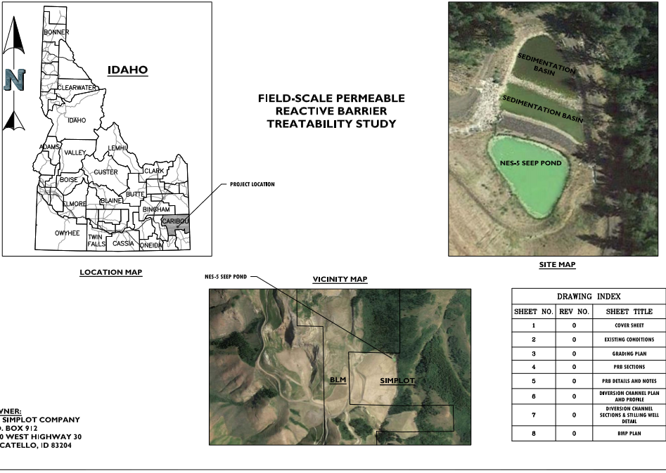
Project Location
Notes:
The site is located in se ID (Carbou county at the Conda Woodall mine). Mine water and gw collected from an overburden and waste rock storage area where a seep collection pond has been constructed

Slide 5
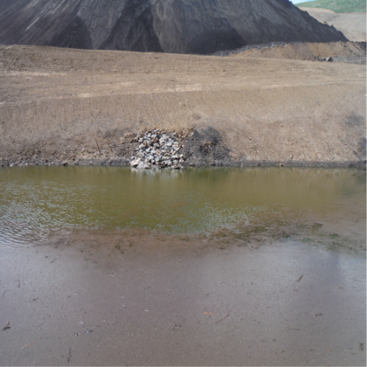
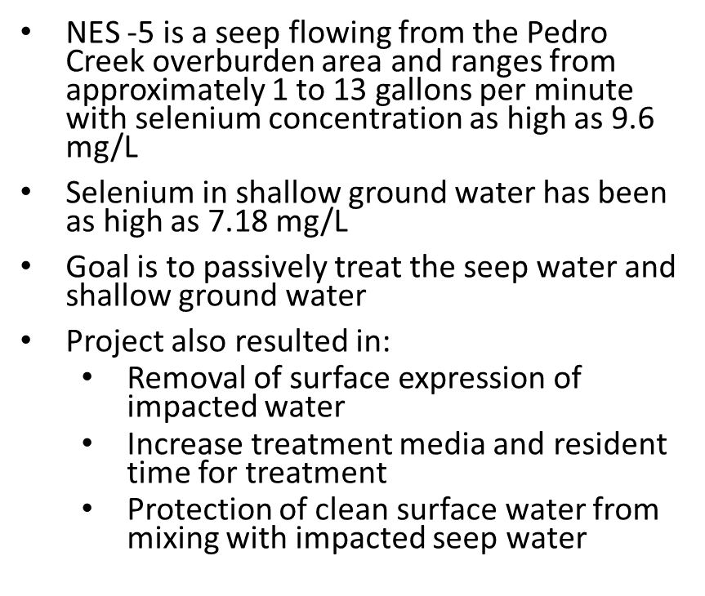
Mine Water Description

Slide 6
Methods- Materials
Mine water
200 L of each water (Seep and Groundwater) shipped to lab, no preservative, zero headspace, sampled before and after shipment
Media
PRB composed of sand, wood chips and alfalfa (from previous testing)
Sand – porosity
Wood chips – long term carbon source and porosity
Alfalfa – readily available soluble carbon

Slide 7
Methods- Testing
Batch leach testing
ASTM D-4646-02 (24-h Batch-Type Measurement of Contaminant Sorption by Soils and Sediments)
Seep water containing elevated Se added to each component separately and mixed for 24 hrs
Determine fate of Se and determine if other metal(oid)s possibly released by media components
Column
Columns of mixed media (50% sand, 37.5% wood chips and 12.5% alfalfa) and replicated (2 Seep water columns and 2 groundwater columns)

Slide 8
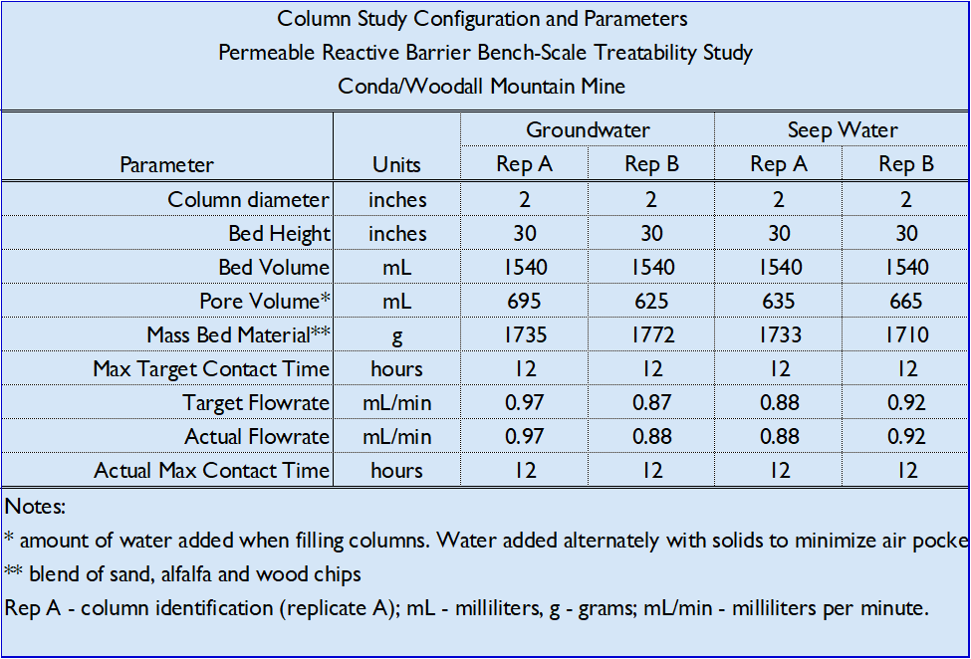
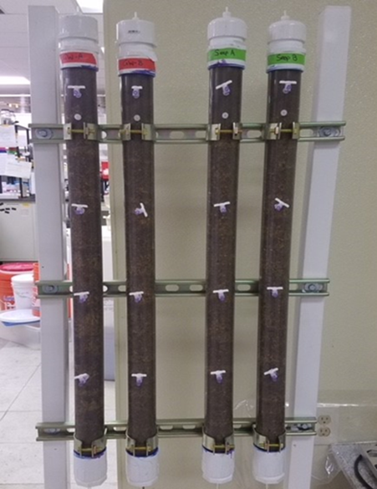
Methods - Column Setup
Column Specifications
Column Setup
Notes:
Column construction and details (2inch diameter, 2.5 ft tall, bed vol 1.5 L, HRT 12 hrs)
Note the inf and effl ports and 3 in between

Slide 9
Methods-Column Setup
Columns were leached with either Mine Seep water or Groundwater
At 25 PV and 50 PV, columns were sampled at 3 ports and effluent port
An additional 12 PV were added at an HRT of 24hr (twice original rate)
In total, about 50 L of water were run through the columns.
Notes:
Waited for 25 and 50 PV primarily to let column gain some maturity and stability.

Slide 10
Results:
Composition of Mine Seep Water and Groundwater
Notes:
Seep water Se initially at 4.54 mg/L, GW at 1 mg/L. Waters are Ca/MgSO4 type waters. Roughly circumneutral

Slide 11
Results:
Batch Testing Summary
Most elements unaffected by addition of seep water (Al, As, Cd, Sb, Be, Cr, Co, Mo, Pb, Hg, Ag, Th, V)
Se decreased in alfalfa leach, not affected in wood chips or sand
  Presumably raid carbon utilization, decreased O₂ (and ORP) in turn reducing Se to elemental Se.
Fe and Mn increased in alfalfa leach due to low ORP
Overall addition of mine seep water did not appear to add any constituents deemed problematic for effluent water quality

Slide 12
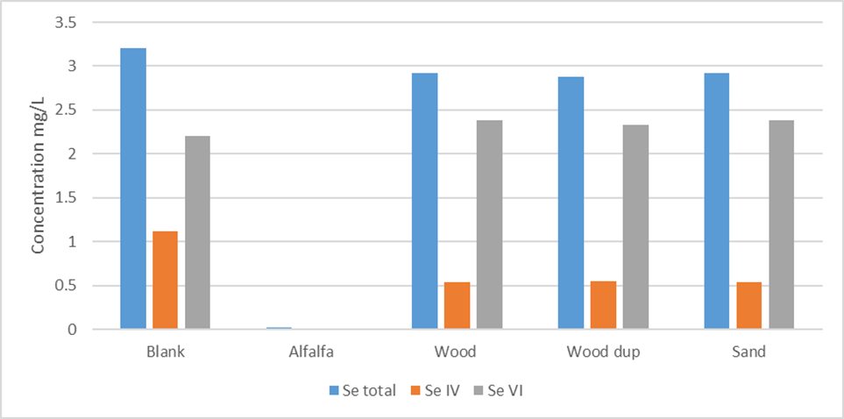
Batch Leach Results - Se
Notes:
Within 24 hrs, seep water added to alfalfa was reduced to elemental Se. Looks like Se (IV) may have been reduced to selenite then Seo

Slide 13
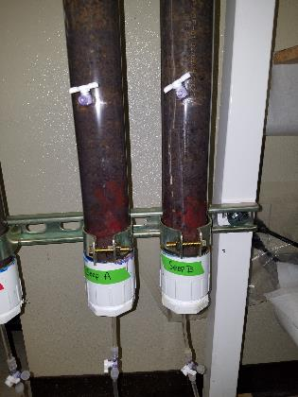
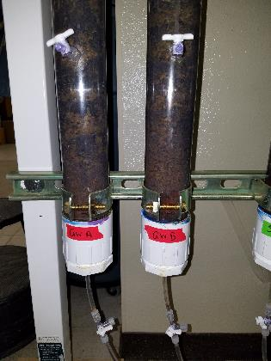
Results: Column Study

Slide 14
Column Study @25 PV
Mine Seep Water
Mine Groundwater
Notes:
First sample collection after 25 PVs, Se dropped to 200 ppb in the seep and only 18 in GW. Fe and Mn both mobilized by reducing conditions (-190 mv)

Slide 15
Column Study @50 PV
Mine Seep water
Mine Groundwater
Notes:
Se in seep water a little better down to 100 pbb and gw down to 13 ppb

Slide 16
Notes:
Just to illustrate what was going on in the column, the port samples reveal that Se was reduced pretty much as soon as it entered the PRB

Slide 17
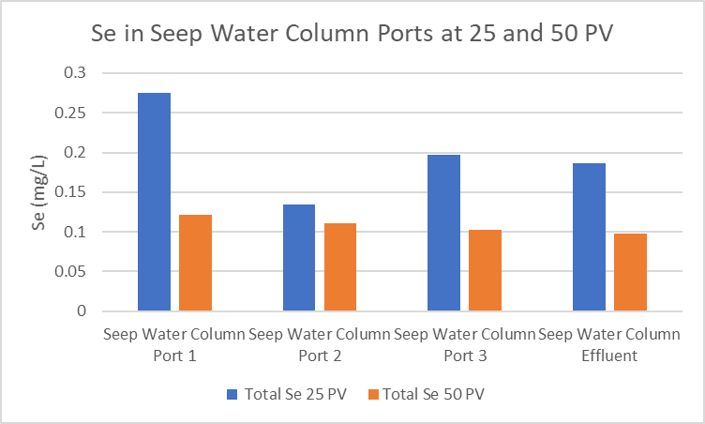
Column Study - Summary

Slide 18
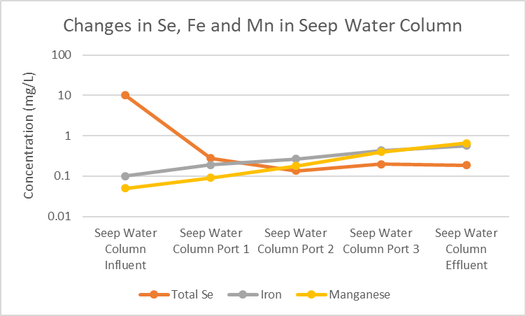
Column Study
Fe - Mn

Slide 19
Elemental Se in Columns

Slide 20
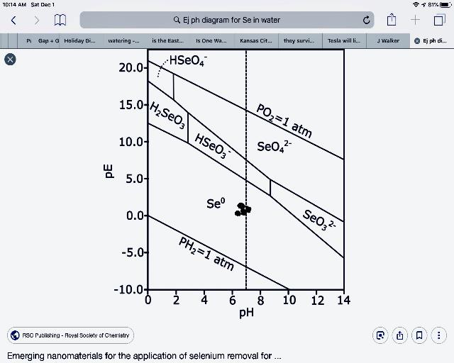
Eh pH Diagram

Slide 21
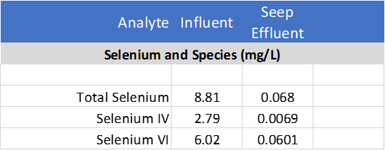
Additional 12 PVs
HRT = 24hrs
Notes:
In order to see if we could reach the 50 ppb WQS, we added an addition 12 PVs to the Seep columns and we got close, but still only achieved 68 ppb.

Slide 22
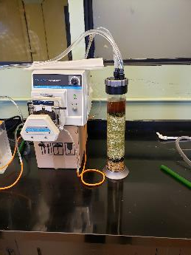
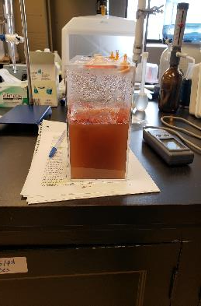
On-Going Work
New column, same media
Influent- seep water w/11.5 mg/L Se
Measuring:
  Eh, pH, DO
  Se in effluent
  DOC, DIC, TOC
Purpose – degradation rate of media

Slide 23
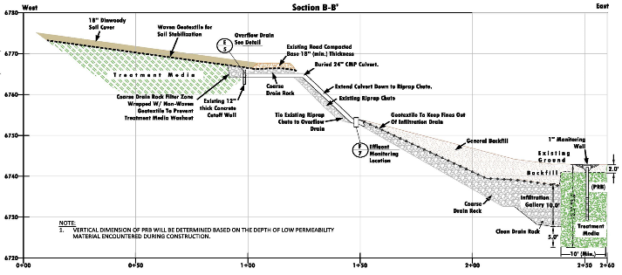
Field Design, Construction and Performance

Slide 24
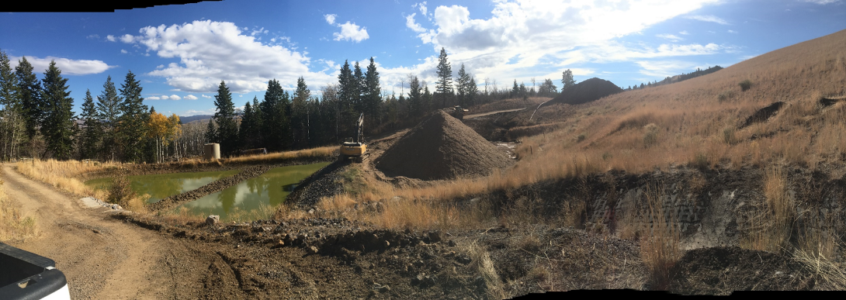
Media Placement

Slide 25
Summary (cont)
The column testing indicated Se was effectively removed from the influent solutions. The Se concentration in seep water was initially about 9 mg/L and was reduced to about 0.2 mg/L after 25 PV and 0.1 mg/L after 50 PV.
Increasing the HRT to 24 hr (a factor of 2) decreased the Se to just above (0.07 mg/L) the 0.05 mg/L water quality goal.
The groundwater Se, initially about 1 mg/L was reduced to less than 0.02 in the first 3 hours of column contact time, well below the 0.05 mg/L water quality goal.

Slide 26
Summary (continued)
On-going column work designed to determine media life and stability of elemental Se
Results of degradation work indicate organic media degradation is a two phase degradation process:
A fast reaction where DIC and DOC increase rapidly followed by a slower reaction.
The full-scale system is just beginning to produce effluent.
Monitoring includes Se (+speciation), pH, EC/TDS, SO4, PO4, other major cations and anions, Fe and Mn, TOC, DOC and DIC.
Lab column results will be compared to field system

Slide 27
NewFields
Mining and Energy Services
Hiring – Seattle WA and Missoula, MT
  Senior Geochemist
  Senior Environmental ngineer
  Laboratory Chemist
  bwalker@newfields.com
  425 785 1550

