Slide 1
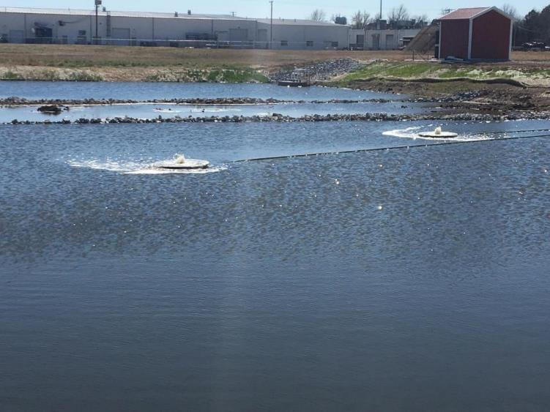



Removal of Excess Gaseous and Aqueous Sulfide from Vertical Flow Bioreactor Effluent Using Activated Carbon and Solar-Powered Blowers
Robert W. Nairn
David L. Boren Distinguished Professor
Viersen Presidential Professor
Taylor Wall
Graduate Research Assistant

Slide 2
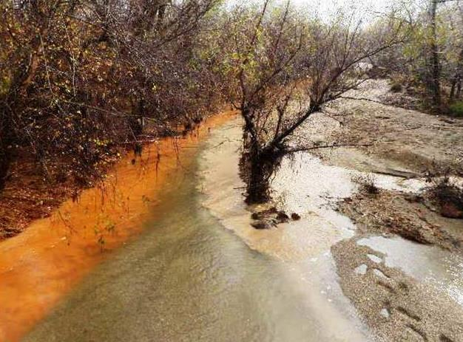
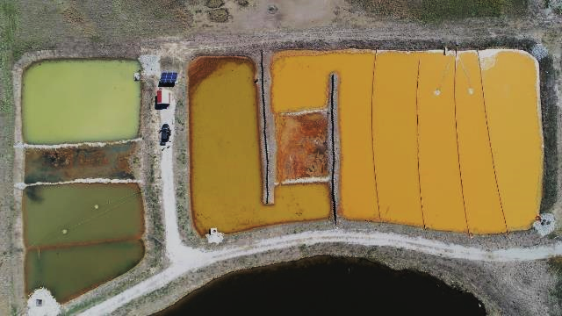
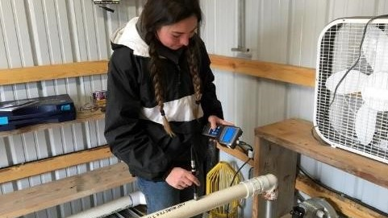
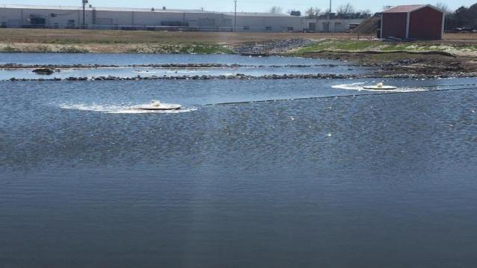
Problems/Challenges
System Design
System Performance
Conclusions

Slide 3
Problems/Challenges

Slide 4
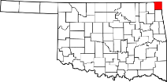
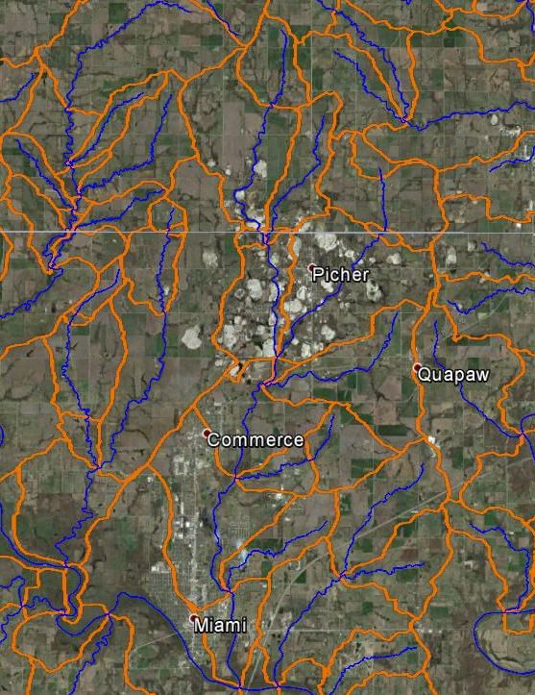

Tar Creek Superfund Site
National Priorities List (1983)
Elevated Fe, Zn, Cd, Pb, As in water, chat, soils and biota
Mining “mega-site”
Ten Native American Tribes
OU CREW comprehensive watershed monitoring
1997 - present
Streams, point (artesian discharges), nonpoint (waste pile runoff / leachate) sources
KS
OK

Slide 5

Tar Creek
Tar Creek Superfund Site
National Priorities List (1983)
Elevated Fe, Zn, Cd, Pb, As in water, chat, soils and biota
Mining “mega-site”
Ten Native American Tribes
OU CREW comprehensive watershed monitoring
1997 - present
Streams, point (artesian discharges), nonpoint (waste pile runoff / leachate) sources
KS
Lytle Creek
OK
Elm Creek
Beaver Creek
Unnamed Tributary

Slide 6
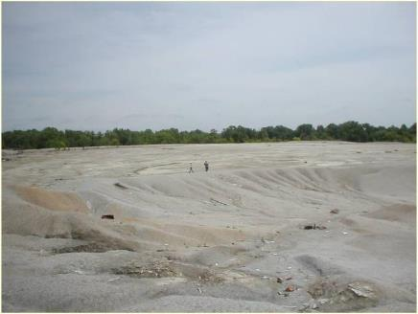
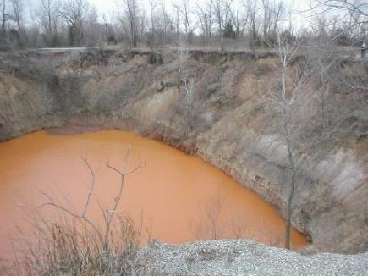
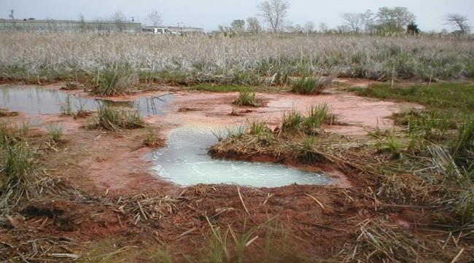

Slide 7
Tar Creek Operable Unit 1
Surface and Ground Water Decision
Initial artesian discharges (1979)
USEPA concluded that (1984):
“impacts to (surface waters) are due to irreversible man-made damages resulting from past mining operations at the site”
Fund-balancing waiver used
  Costs prohibitively high to address surface water contamination
Unabated flows for nearly 40 years

Slide 8

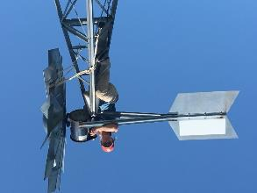
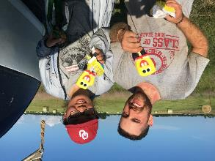
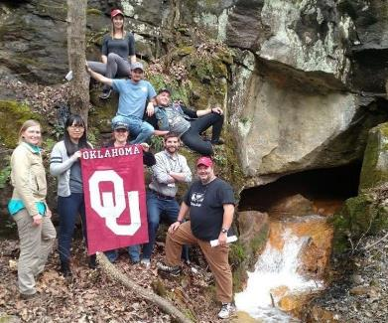
Center for Restoration of
Ecosystems and Watersheds
Watershed biogeochemistry
  Drainage-basin scale evaluations
  Materials and energy transport and fate
Ecological engineering
  Water and land reclamation
  Ecosystem remediation, restoration and creation
  Passive treatment systems
  Low impact development
  Water reuse

Slide 9
CREW builds ecosystems
Watershed biogeochemistry
  Drainage-basin scale evaluations
  Materials and energy transport and fate
Ecological engineering
  Water and land reclamation
  Ecosystem remediation, restoration and creation
  Passive treatment systems
  Low impact development
  Water reuse

Slide 10
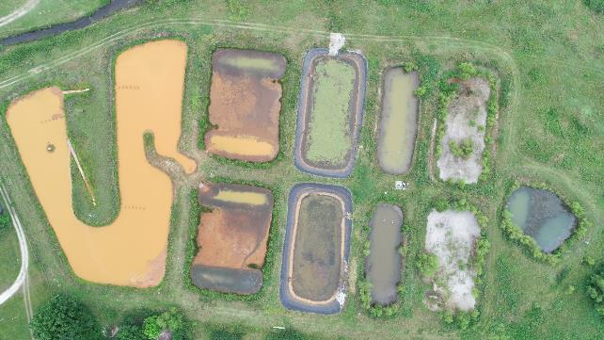
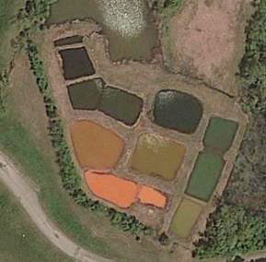

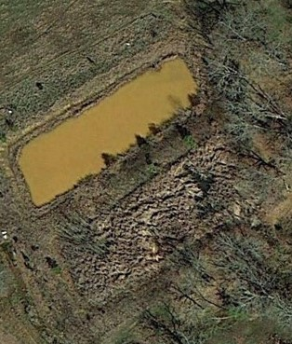
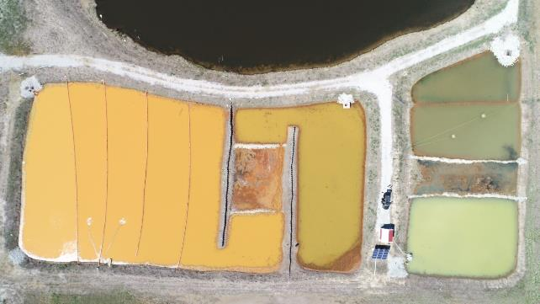
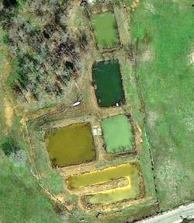
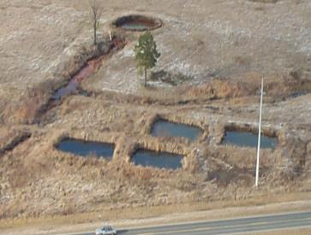
Mayer Ranch PTS
Hartshorne PTS
Leboskey PTS
Southeast Commerce PTS
Red Oak PTS
Gowen PTS

Slide 11
Mayer Ranch PTS
Hartshorne PTS
Leboskey PTS
Southeast Commerce PTS
Red Oak PTS
Gowen PTS

Slide 12
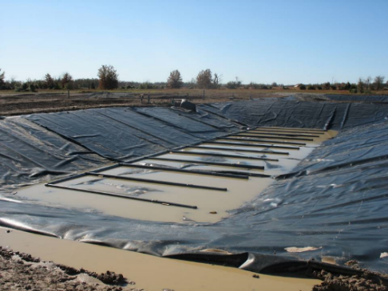
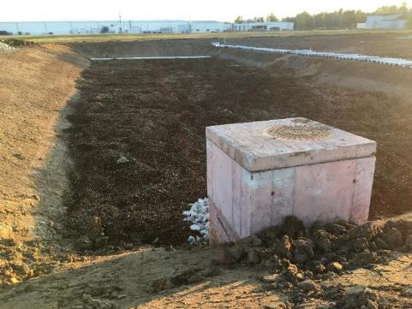
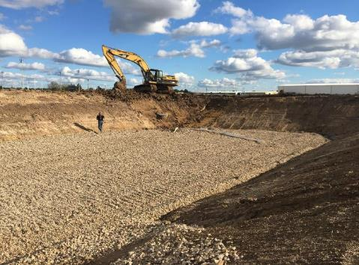
Bacterial sulfate reduction in
Vertical Flow Bioreactors (VFBRs)
Notes:
Organic matter oxidized, sulfate reduced to sulfide

Slide 13
Bacterial sulfate reduction in
Vertical Flow Bioreactors (VFBRs)
SO₄²⁻ + 2CH₂O → H₂S + 2HCO₃⁻
H₂S + Zn²⁺ + 2HCO₃⁻ → ZnS(s) + 2H₂O + 2CO₂
Notes:
Organic matter oxidized, sulfate reduced to sulfide

Slide 14
Bacterial sulfate reduction in
Vertical Flow Bioreactors (VFBRs)
SO₄²⁻ + 2CH₂O → H₂S + 2HCO₃⁻
H₂S + Zn²⁺ + 2HCO₃⁻ → ZnS(s) + 2H₂O + 2CO₂
Design for ~20 year lifetime
Potential excess sulfide production
Notes:
Organic matter oxidized, sulfate reduced to sulfide

Slide 15
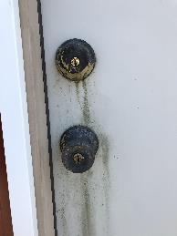
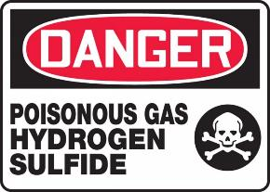
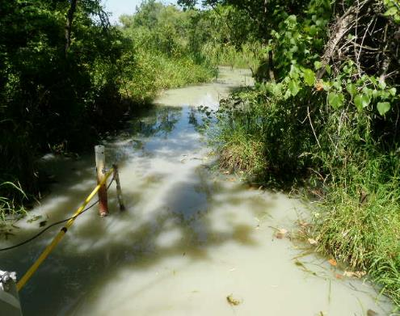
Excess Sulfide Concerns
Corrosive, poisonous and flammable
Aqueous sulfide
  Potential nuisance constituent
  Toxic to aquatic life > 0.002 mg/L (USEPA 1986)
Gaseous sulfide
  Nuisance odor problems
  Substantial human health effects

Slide 16
Excess Sulfide Concerns
Gaseous H₂S (ppmv) | Symptoms/Effects
0.00011-0.00033 | Typical background concentrations
0.01-1.5 | Odor threshold
2-5 | Nausea, headache, loss of sleep
20 | Fatigue, loss of appetite, headache, irritability, poor memory, dizziness
50-100 | Conjunctivitis, respiratory tract irritation, digestive upset, loss of appetite
100-150 | Olfactory fatigue and paralysis (loss of sense of smell)
200-300 | Pulmonary edema from prolonged exposure
500-700 | Staggering, collapse in 5 minutes, damage to eyes in 30 minutes
700-1000 | Rapid unconsciousness, "knockdown" or immediate collapse within 1 to 2 breaths, breathing stops, death within minutes
1000-2000 | Nearly instant death

Slide 17
Excess Sulfide Concerns
Gaseous H₂S (ppmv) | Symptoms/Effects
0.00011-0.00033 | Typical background concentrations
0.01-1.5 | Odor threshold
2-5 | Nausea, headache, loss of sleep
20 | Fatigue, loss of appetite, headache, irritability, poor memory, dizziness
50-100 | Conjunctivitis, respiratory tract irritation, digestive upset, loss of appetite
100-150 | Olfactory fatigue and paralysis (loss of sense of smell)
200-300 | Pulmonary edema from prolonged exposure
500-700 | Staggering, collapse in 5 minutes, damage to eyes in 30 minutes
700-1000 | Rapid unconsciousness, "knockdown" or immediate collapse within 1 to 2 breaths, breathing stops, death within minutes
1000-2000 | Nearly instant death
OSHA PELs
8-hour: 10 ppmv
Ceiling: 20 ppmv
NIOSH IDLH: 100 ppmv

Slide 18
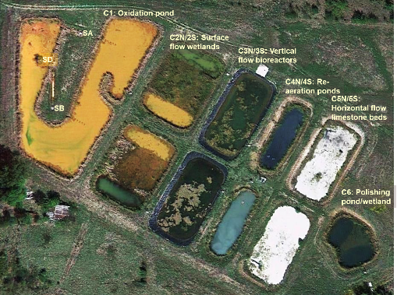
Excess Sulfide Production – Mayer Ranch PTS
Excess aqueous sulfide
Continuous operation since 2008
First PTS in TSMD

Slide 19

System Design

Slide 20
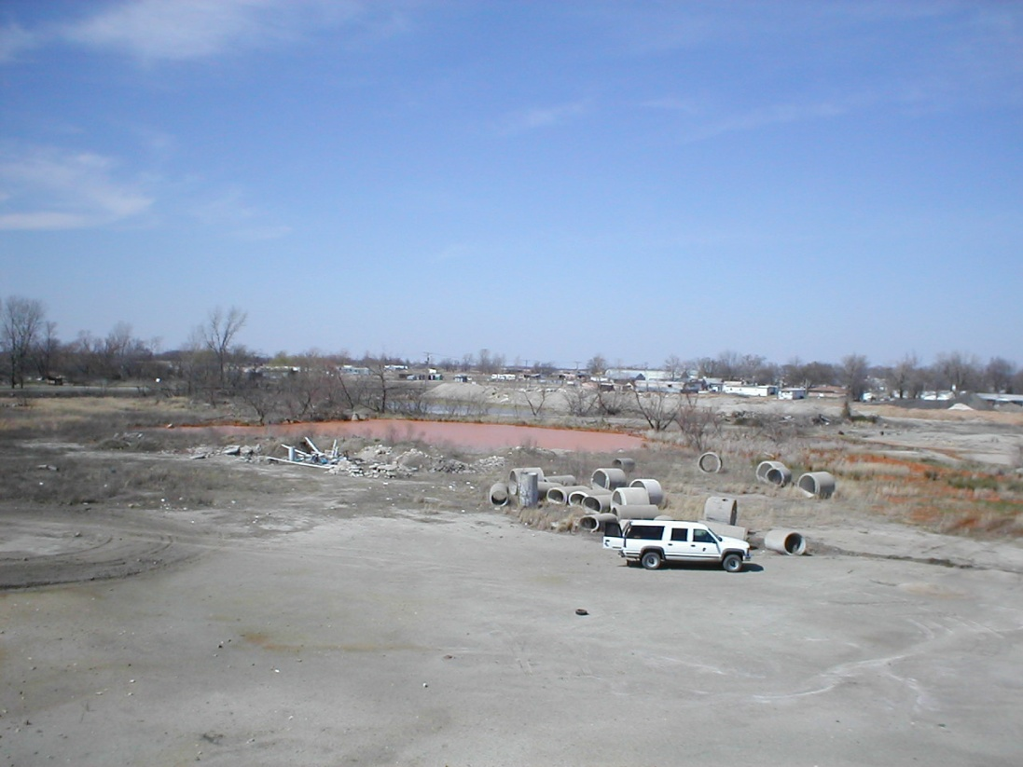
Southeast Commerce Site

Slide 21
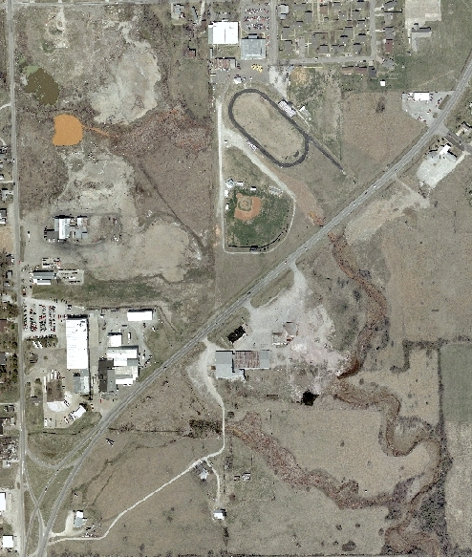
Southeast Commerce
Commerce, OK
“Red Hole” and “Green Hole” collapse features
Water discharges into Unnamed Tributary to Tar Creek
Collapses filled and surface reclaimed 2006
US66
Unnamed tributary

Slide 22
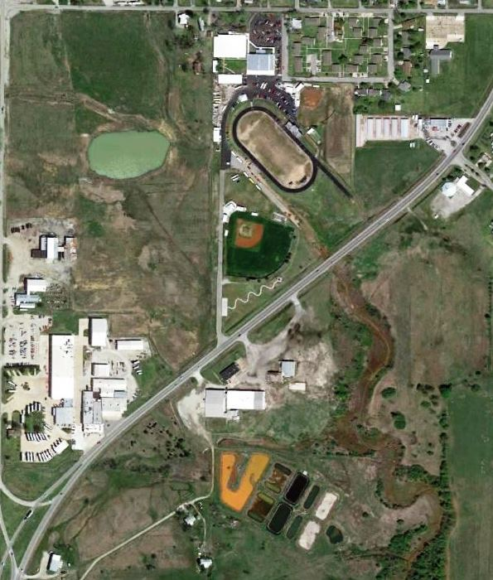
Southeast Commerce
Commerce, OK
Stormwater pond
Commerce High School and Sports Complex
“Red Hole” and “Green Hole” collapse features
Water discharges into Unnamed Tributary to Tar Creek
Collapses filled and surface reclaimed 2006
Mine water collected in French Drain and directed to UT
US66
Mickey Mantle Memorial
Unnamed tributary
Mayer Ranch Passive Treatment System

Slide 23
Southeast Commerce
Commerce, OK
Stormwater pond
Commerce High School and Sports Complex
Untreated SEC Waters
pH | 6.06
T. Alk. | 350 mg/L CaCO₃
Fe | 138 mg/L
Zn | 6.2 mg/L
Ni | 0.52 mg/L
Cd | 20 μg/L
Pb | 80 μg/L
As | 38 μg/L
SO₄²⁻ | 2100 mg/L
Q | 100 gpm
“Red Hole” and “Green Hole” collapse features
Water discharges into Unnamed Tributary to Tar Creek
Collapses filled and surface reclaimed 2006
Mine water collected in French Drain and directed to UT
US66
Mickey Mantle Memorial
Unnamed tributary
Mayer Ranch Passive Treatment System

Slide 24




Southeast Commerce Passive Treatment System
Ecological engineering field research site
Designed for 550 m³/d
Receives elevated Fe, Zn, Pb, Cd, As, SO₄
Four total process units
Shared water surfaces/baffles/z-piling
Solar-powered aeration/reaeration
Limited operation/maintenance
Discharge meets receiving stream criteria
Oklahoma DEQ funding 2015-present
4 process units
  - Directional baffle curtains and z-piling
  - Innovative solar-powered air-lift aerators
  - Unique GAC S²⁻capture system
Second PTS in Tri-State Mining District
Continuous operation since 02/2017
Stormwater Pond
N in
C1: Oxidation pond
C3: Vertical flow bioreactor
Up in
C4: Final polishing unit
C2: Surface flow wetland
S in
System start up 02/17

Slide 25
Southeast Commerce Passive Treatment System
Ecological engineering field research site
Designed for 550 m³/d
Receives elevated Fe, Zn, Pb, Cd, As, SO₄
Four total process units
Shared water surfaces/baffles/z-piling
Solar-powered aeration/reaeration
Limited operation/maintenance
Discharge meets receiving stream criteria
Oklahoma DEQ funding 2015-present
4 process units
  - Directional baffle curtains and z-piling
  - Innovative solar-powered air-lift aerators
  - Unique GAC S²⁻capture system
Second PTS in Tri-State Mining District
Continuous operation since 02/2017
Stormwater Pond
N in
C1: Oxidation pond
C3: Vertical flow bioreactor
Up in
C4: Final polishing unit
C2: Surface flow wetland
S in
System start up 02/17

Slide 26

VFBR Substrate
1,000 yd³ single- shredded wood chips
132 tons (~240 yd³) spent mushroom compost
~3.0 ft thickness
Underdrain 616 tons non-calcareous AASHTO #57 aggregate (~2.0 ft thickness)

Slide 27
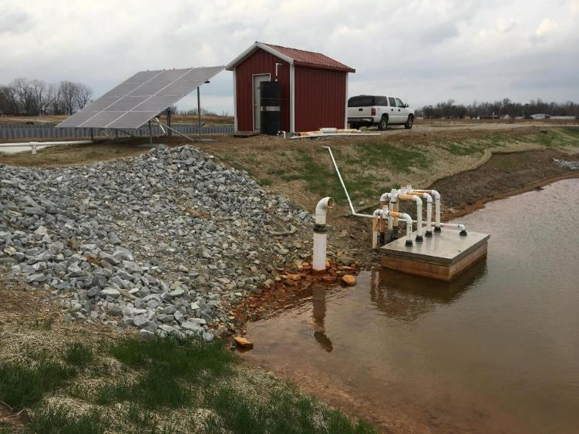
Custom-Designed Odor Control System
Solar-powered exhaust blower in shed
Solar Array
3200-W solar photovoltaic array
1 regenerative vacuum blower
Granular activated carbon (GAC) S²⁻ filter (ACF)
2 regenerative pressure blowers
Float-mix aerators
GACF
Four Cell VFBR Underdrain Effluent
VFBR
Airline
Odor Control System
Final Polishing Unit
Air
Water

Slide 28
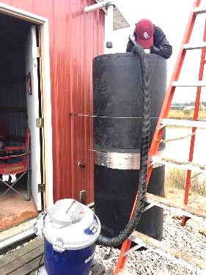
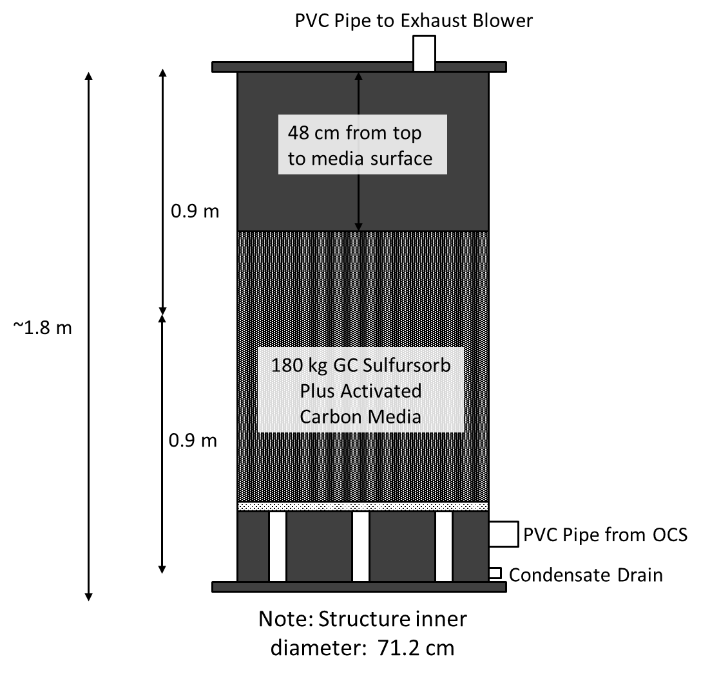

Slide 29
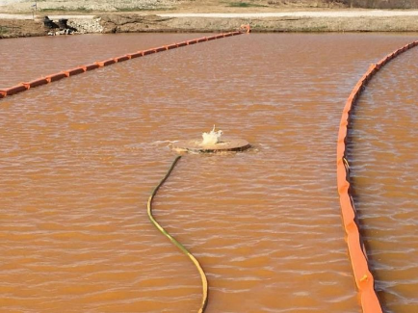
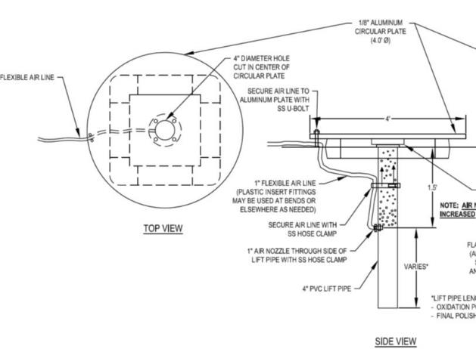
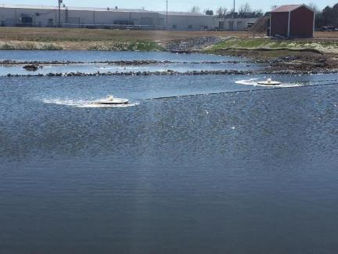
Float-Mix Aerators
Two each in Oxidation Pond and Final Polishing Unit

Slide 30
System Performance

Slide 31

Water Quality Changes
 | Southeast Commerce
 | In (n=80) | Out (n=22)
pH | 6.06 | 7.02
Alk_{T} (mg/L) | 350 | 117
Fe_{T} (mg/L) | 138 | 0.79
Zn_{T} (mg/L) | 6.15 | 0.69
Ni_{T} (mg/L) | 0.52 | 0.06
Cd_{T} (μg/L) | 20 | <PQL
Pb_{T} (μg/L) | 80 | 26
As_{T} (μg/L) | 38 | <PQL
SO₄⁻² (mg/L) | 2100 | 1956
Q (GPM) | --- | 125

Slide 32
Water Quality Changes
 | Southeast Commerce
 | In (n=80) | Out (n=22)
pH | 6.06 | 7.02
Alk_{T} (mg/L) | 350 | 117
Fe_{T} (mg/L) | 138 | 0.79
Zn_{T} (mg/L) | 6.15 | 0.69
Ni_{T} (mg/L) | 0.52 | 0.06
Cd_{T} (μg/L) | 20 | <PQL
Pb_{T} (μg/L) | 80 | 26
As_{T} (μg/L) | 38 | <PQL
SO₄⁻² (mg/L) | 2100 | 1956
Q (GPM) | --- | 125
OP
Fe and As ↓
27 g Fe m⁻² d⁻¹
WL
Fe ↓
VFBR
Zn, Ni, Cd, Pb ↓
0.6 mol SO₄⁻² m⁻³ d⁻¹
FPU
O₂↑

Slide 33
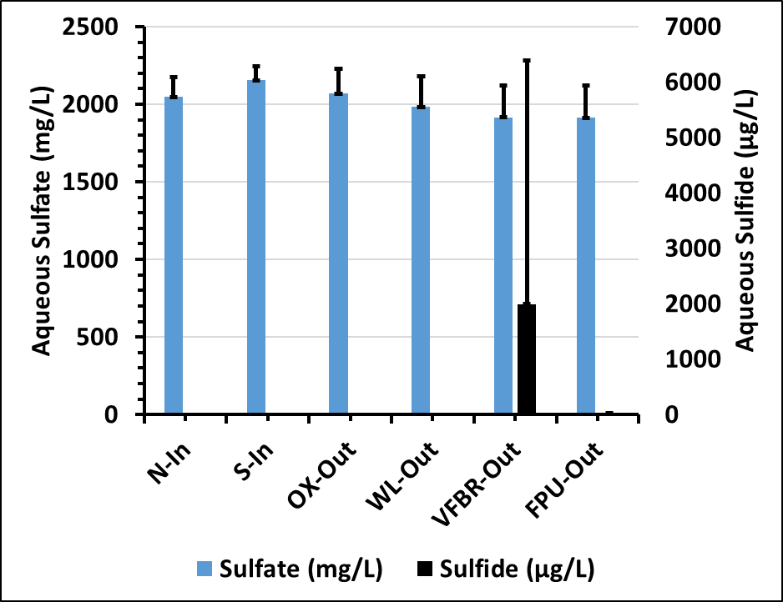

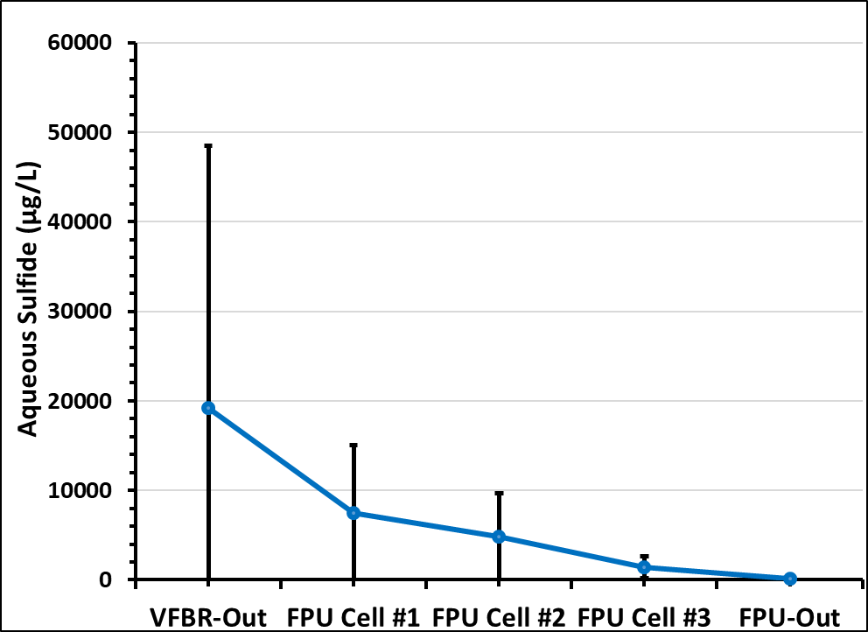
System Aqueous Sulfate and Sulfide

Slide 34
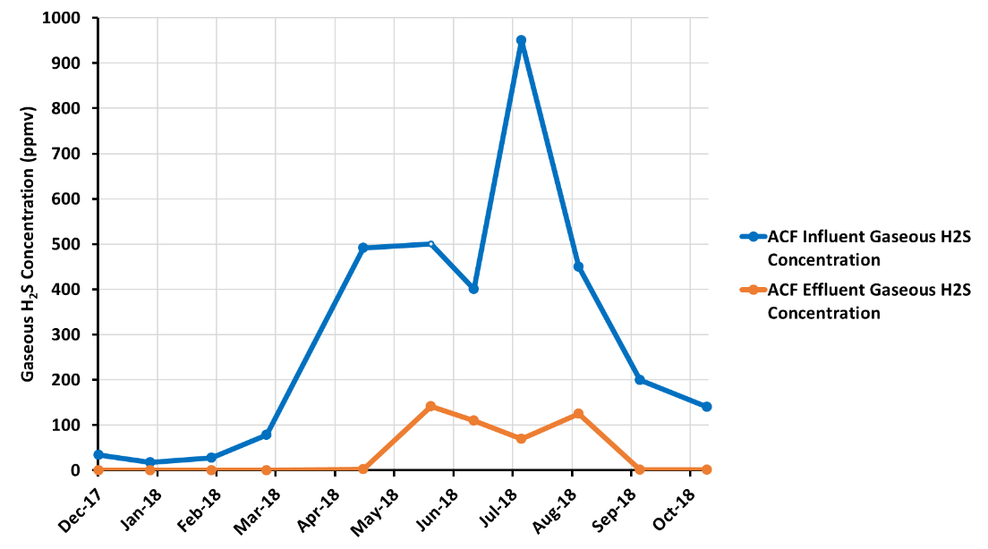
ACF Gaseous Sulfide

Slide 35
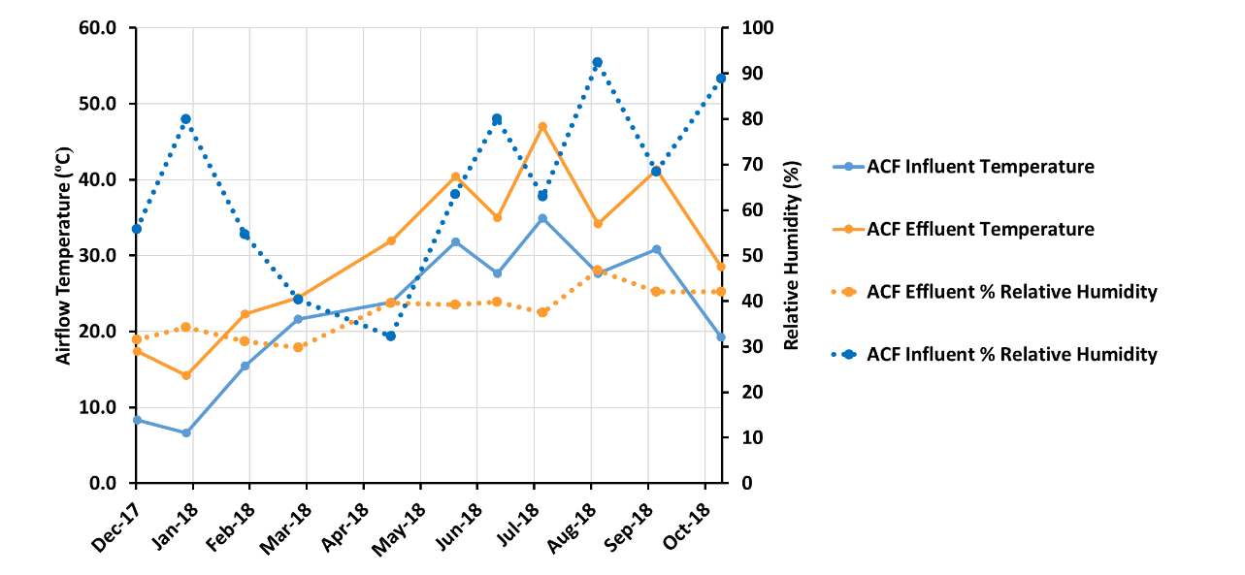
ACF Temperature and Relative Humidity

Slide 36
 | Air Flow (L/sec) | Temperature (°C) | Relative Humidity (%)
ACF Influent | 14±0.2 | 23±2.7 | 65±5.5
ACF Effluent | 15±0.1 | 31±9.1 | 38±1.5

Slide 37
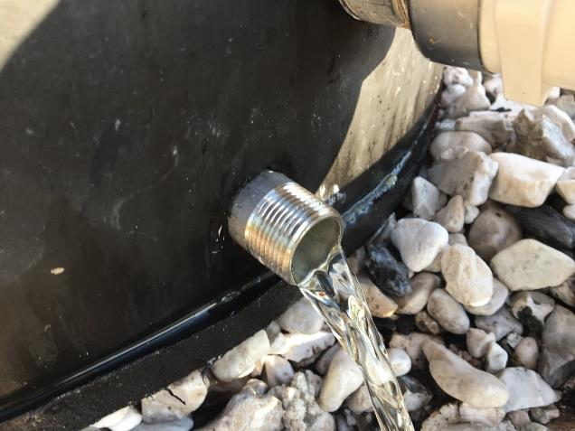
 | Air Flow (L/sec) | Temperature (°C) | Relative Humidity (%)
ACF Influent | 14±0.2 | 23±2.7 | 65±5.5
ACF Effluent | 15±0.1 | 31±9.1 | 38±1.5
2H₂S + 4O₂ → 2SO₂ + 2H₂O + O₂ → 2H₂SO₄
Elevated gaseous sulfide under moist aerobic conditions forms sulfuric acid

Slide 38
ACF media autopsy
PVC Pipe to Exhaust Blower
48 cm from top to media surface
October 2018
20 months operation
Core samples in lifts
0.9 m
129,000 mg S/kg
136,000 mg S/kg
138,000 mg S/kg
~1.8 m
132,000 mg S/kg
155,000 mg S/kg
0.9 m
Perforated HDPE Support Plate
248,000 mg S/kg
PVC Support Legs
PVC Pipe to OCS
Condensate Drain
Notes:
Delete metals and showS with depth on schematic

Slide 39
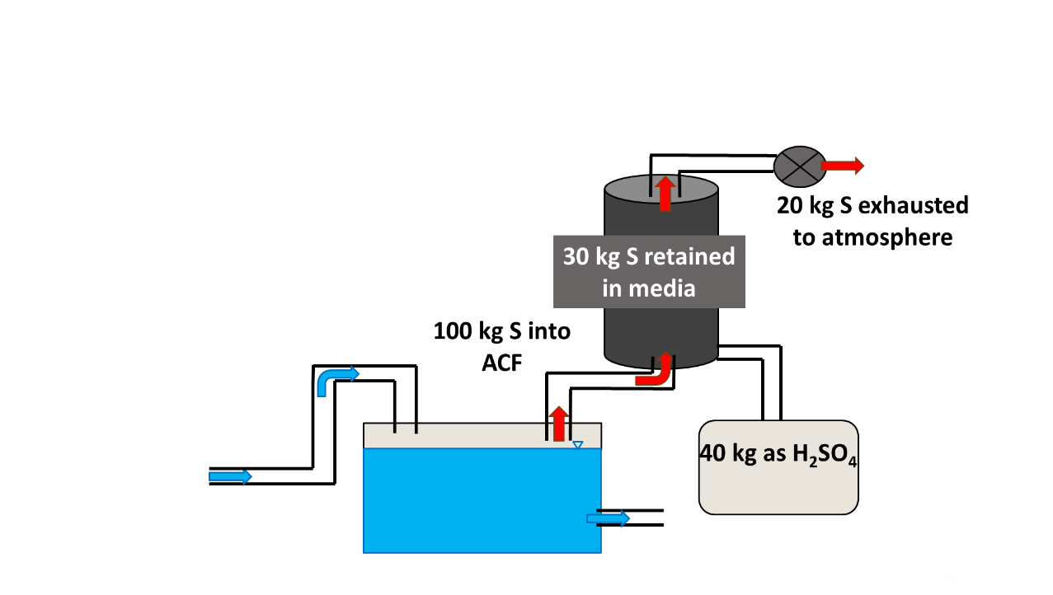
Sulfur mass balances
ACF S Mass Balance
Missing 10%

Slide 40
Sulfur mass balances
ACF S Mass Balance
VFBR S Mass Balance | kg S
Aqueous S retained - from water quality analyses | 1600
VFBR substrate S – from substrate analyses | 1100
S required for MeS precipitation | 640
Missing 10%

Slide 41
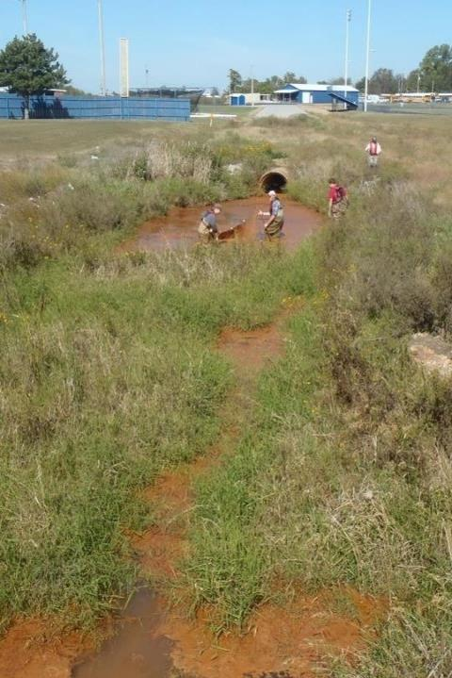
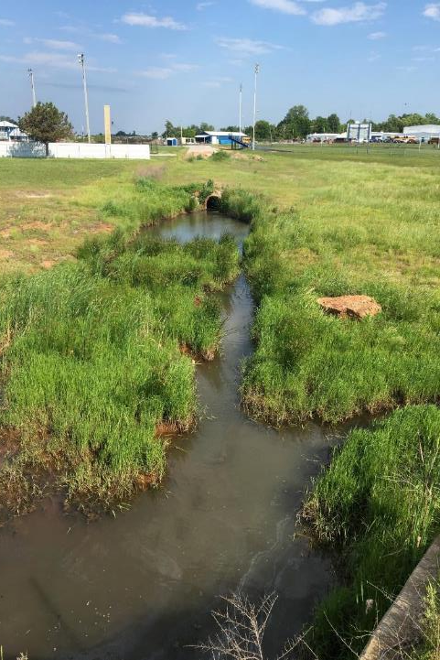
Pre-PTS
Post-PTS
Irreversibly Damaged?

Slide 42
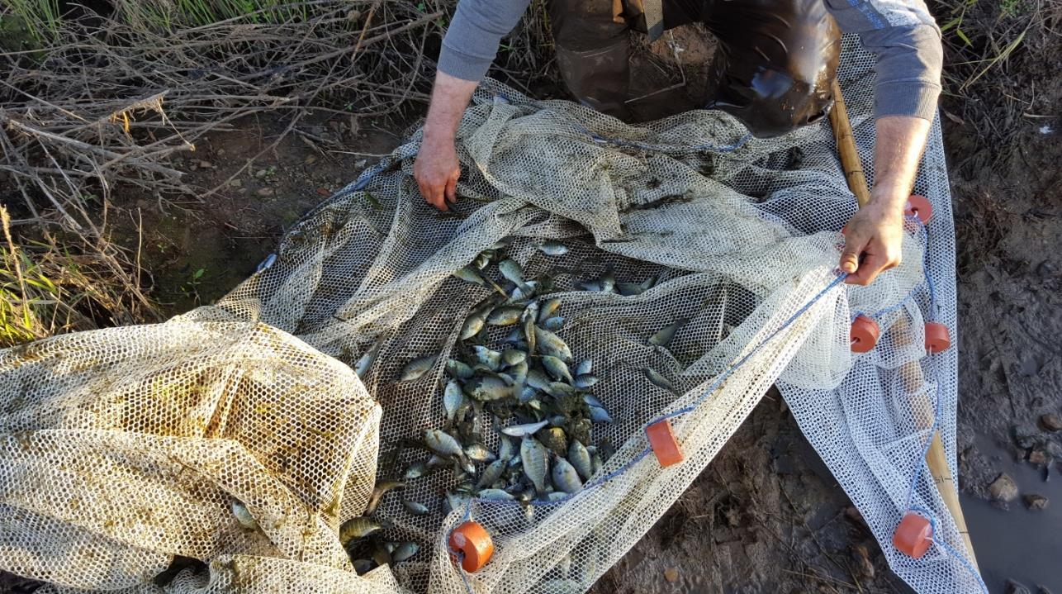
Receiving Stream Recovery

Slide 43
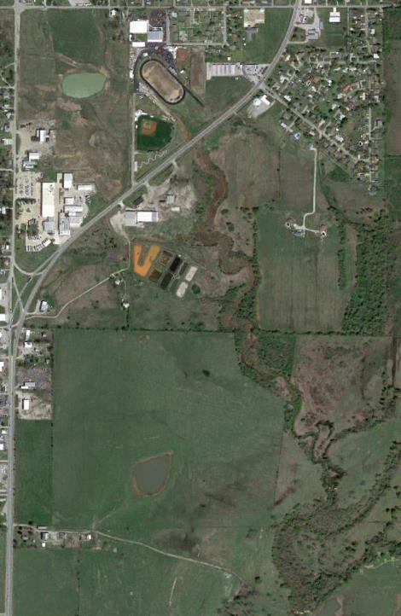
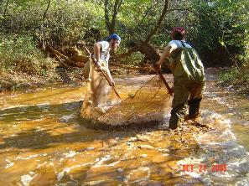

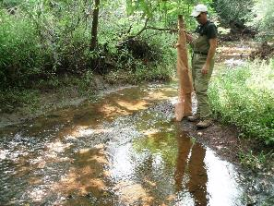
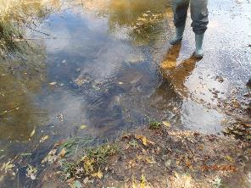
Receiving Stream Recovery
2005
UT-P
UT-HS
Long-term water quality data collection (15+ years)
Long-term fish community analysis (12+ years)
Documented changes in water quality and ecological community
2009
UT-U
Unnamed Tributary
UT-D
2012
UT-R
Tar Creek

Slide 44
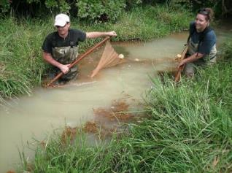
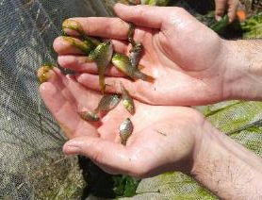

Unnamed Tributary fish data
Catch per unit effort (CPUE)
Scientific name | Common name | 2005-07 | 2009-16
Gambusia affinis | Western mosquitofish | 39.24 | 187.60
Lepomis cyanellus | Green sunfish | 0.81 | 16.80
Lepomis macrochirus | Bluegill | 1.00 | 3.00
Lepomis megalotis | Longear sunfish | 0.02 | 6.80
Notemigonus crysoleucas | Golden shiner | 0.17 | 0.60
Lepomis gulosus | Warmouth | 0.07 | 1.0
Lepomis microlophus | Redear sunfish | 0 | 18.00
Lepomis sp. | Sunfish hybrid | 0 | 2.5
Labidesthes sicculus | Brook silversides | 0 | 2.0
Etheostoma gracile | Slough darter | 0 | 0.80
Ameiurus melas | Black bullhead | 0 | 0.40
Fundulus notatus | Blackstriped topminnow | 0 | 0.40
Pomoxis annularis | White crappie | 0 | 0.30
Micropterus salmoides | Largemouth bass | 0 | 0.20
 | Species richness | 6 | 14

Slide 45
Conclusions

Slide 46
Study Conclusions
VFBR bacterial sulfate reduction produced excess sulfide beyond that needed for trace metal precipitation
Capture and removal of gaseous sulfide helped to decrease aqueous sulfide concentrations
Solar-driven vacuum blower and an activated carbon filter (ACF) effectively removed gaseous sulfide
Solar-driven float mix aerators (FMAs) effectively removed aqueous sulfide in the final polishing unit (FPU)
Estimates of sulfur species in aqueous, gaseous and solid phases accounted for reasonable mass balance of sulfur
Notes:
640 kg S needed for complete trace metal precipitation, and we’re producing almost double that

Slide 47
Big Picture Conclusions
Passive treatment is a demonstrated ecological engineering technology to improve mine water quality
Water quality improvement has direct influence on ecological metrics in stream and riparian areas
Widespread applicability requires revisiting and revising administrative and regulatory constraints

Slide 48




Special Thanks
Buck Neely
Tim Danehy
Russ Dutnell

Slide 49


















Acknowledgements
Our private landowner
  Corbus family
Our funding sources
  ODEQ Land Protection Division
  Grand River Dam Authority Ecosystems Management
Our partners
  OU CREW, CEES and Biology
  Quapaw Nation of Oklahoma
  City of Commerce
  Northeastern Oklahoma A&M College
  CH2M-Hill team and subcontractors
  BioMost Inc. and Riverman Engineering
  LEAD Agency
CREW past and present

Slide 50

The CREW
K Strevett, R Knox, W Matthews, J Basara, E Bergey, R Kolar, J LaBar, B Page, C Kellogg, A O’Sullivan, M Zhang, J Gu, J Halstead, F Walker, M Mercer, E Breetzke, C DuBois, R Garrett, V Arvidson, N Iverson, B Winter, D Athay, C Porter, J Coffey, T Traw, C Gause, R White, D Hensley, M Roberts, D Lutes, W Strosnider, A Garrido, C Neely, B Santamaria, A Brewer, W Andrews, J McAllister, A Smith, S Yepez, J Brumley, B Furneaux, M Rice, R Dutnell, J Arango, B Holzbauer-Schweitzer, L Oxenford, E Thornton, E Fielding, N Shepherd, A Sikora, D Nguyen, T Wall, N Berg-Mattson, M Dorman, Z Tang, J Ingendorf, H Stanfield, K Steele, A Marsh, T Verlander, G Huey, M Foster, M Bible, T Haviland, C Evenson, M Smith, A Spence, A Kirchner, E Trawinski, S Lipe, M Sprowls, C Cogburn, K Wahnee, E Spargo, D Miller, I Gray, K Swanson, W Katzenstein, E Solchick, M Brown, I Petterson, J Bennette, D Tepo, A Oberst, A Danielson, H Bragg, S Wong, A Donaldson, J Clifton, P Eger, B Winfrey, T Lenox, M McMahon, K Ryan, S McClenahan, W Runyon, L Mignogna, V Ferrufino, T Bisaner, Z Samson, V Nadeq, C Turley, S Guzman, S Zawrotny, J Fowler, D Herron, M Cousatte, Maguire, C Milligan, D Wright, C Iddings, D Bruer, K Markley, C Robb, T Pipher, S Hobson, E Wu, O Yancey, B Dittrich, D Morris, K Kauk, A Sutter, K Walker, D Ertugrul, C Cook, et al.

Slide 51

Questions?
http://CREW.ou.edu nairn@ou.edu

