Slide 1
Case Study: An Appraisal of Four Commonly Used Soil-Based Metrics for Evaluating the Establishment of Sustainable Upland Grassland on Completion of Five-Years of Aftercare at a Rehabilitated Mine Site in South Wales, United Kingdom¹
By
Neil Humphries (Natural Resources Manager) &
Robert Thompson (Operations Director)
Celtic Energy Ltd
Wales
United Kingdom

Slide 2
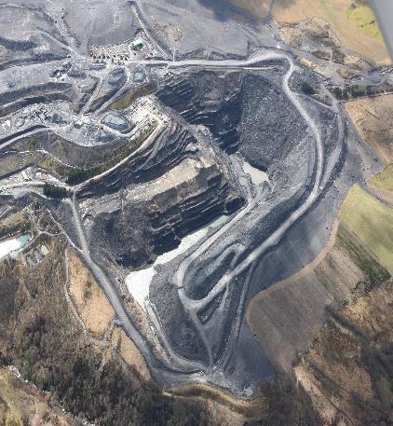
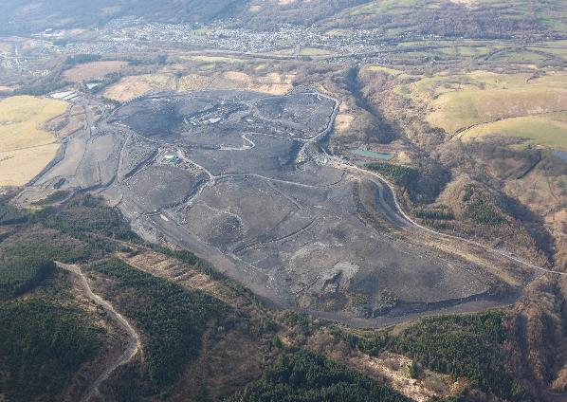
Selar Surface Coal Mine, Wales, UK

Slide 3
Context
Mine Closure
Establishment of land-use fit for beneficial and sustainable use
Rehabilitation to upland low-intensity grazed grassland ecosystem
5 years of statutory imposed management (aftercare) following backfill, placement soils, seeding/planting
Evaluation of achievement in absence of guidance or imposed methodology & standards
Release from obligations of mining permit
Re-payment from financial bond
Onus on the mining Company to prove its case

Slide 4
Progressive Rehabilitation - An Opportunity to Agree Metrics & Outcomes
350ha with 37ha rehabilitated 2011/2013, aftercare period completed 2018
Oceanic climate, >2000mm annual rainfall, north facing 170-300m AOD
Sown with upland acid grassland mixture with annual fertiliser application
Grazed/not grazed
Assessed in 2018 using 4 agricultural soil-based metrics
Established from experience at nearby mine site that plant performance-based metrics not reliable (see Humphries et al, 1999, DOI:10.21000/JASMR99010262 )

Slide 5
Four Soil-Based Metrics
Physical description of soil profile characteristics (Hodgson, 1974)
Visual evaluation of (top) soil structure “VESS” (Ball et al., 2017)
Fertiliser requirement of top-soil – laboratory tests (AHDB, 2019)
Soil-health condition of top-soil – laboratory tests (NRM Laboratories, 2016)

Slide 6
Field Evaluations
Visual Evaluation of Soil Structure (VESS)
Soil Profile Physical Characteristics

Slide 7
Summary: Comparison Soil Profile Physical Characteristics
 | Selar (5 years) | Local Soil | Reference Type | Rehabilitated Site (25 years)
Horizon Depth (cm) over mudstone | 3-17 | 12-100 | 20-50 | 3-59
Soil Texture | Clay | Clay | Clay loam | Clay loam
Soil Structure | Sub-angular/Blocky/ Apedal | Sub-angular/Blocky | Sub-angular/Blocky | Apedal
Target Land Use Grade (ALC) | 5 | 5 | 5 | 5

Slide 8
Summary: Selar Grassland Topsoil Structural Condition - VESS
VESS Index | 1 | 2 | 3 | 4 | 5
Target Grassland Condition | Good | Good | Adequate | Poor | Very Poor
Topsoil Structure | Small & rounded | Rounded | Large rounded / angular | Large angular | Very large angular
Sample frequency (n=12) | 0 | 0 | 1 | 5 | 6

Slide 9
Summary: Laboratory Analyses of Selar Soil Samples
Fertiliser Requirement Analyses
Soil Health Condition Analyses
 | Selar (5 years) | Rehabilitated Site (25 years) | Target Index (AHDB, 2019)
P Index | 1 | 1 | (+)2
K Index | 1 | 1 | (+)2
pH | 5.7 | 5.0 | 6.0
 | Selar (5 years) | Rehabilitated Site (25 years) | Target Index (NRM, 2016)
Organic matter % | 3.9 | 6.2 | >2.0
Microbial Activity Index | 4.7 (Good) | 5.1 (Very Good) | 4.0 (Good)

Slide 10
Credibility of Profile Characteristics Metric
 | Profile Characteristics | VESS | Fertiliser Requirement | Soil-Heath Condition
Reference Sites | + | - | + | -
Predictor of Land Use Potential | + | (+) | - | -
Rehabilitation Track Record | + | - | + | +

Slide 11
Expertise, Cost & Role
 | Profile Characteristics | VESS | Fertiliser Requirement | Soil-Health Condition
Professional Expertise Required | Yes | No (with training) | No | No
Relative Cost | High | Moderate | Very Low | Moderate (analyses)
Main/ Supplementary Metric | MAIN | Supplementary (Main if verified) | Supplementary | Supplementary

Slide 12
Outcome – Approval of Methodology & Metric
December 2018 Planning Authority approved release of the 37ha from the permit and monies from the bond
Soil profile physical characteristics accepted as the methodology and metric for the remaining 145ha upland grassland
Method and metric applicable to other similar sites

Slide 13
Significance of the Appraisal
Early agreement with planning authority & regulators gave surety for future permit compliance and bond repayment:
further 145ha restored at Selar Mine in 2018
Company has further 2 surface mines nearing closure with +250ha with the same land-use and grassland type
Gave early warning should alternative rehabilitation/aftercare or land-use be required to meet rehabiliatation expectations

Slide 14
Acknowledgements
The outstanding site rehabilitation achievements at the Selar Surface Mine are due to the commitment of the Mine Manger Mark Heames and his Site staff.
Dr R E Leverton of LLQS undertook the soil profile descriptions and VESS assessments, and NRM Laboratories the chemical analyses.

