Slide 1
36th Annual Meeting of
the American Society of Mining & Reclamation
Big Sky, Montana, June 3-7
Study on Soil Bulk Density of Reconstructed Soil in a Loess Open–pit Mining Area, China: Spatial Variations and Influencing Factors
Yingui Cao, Zhongke Bai, Wei Zhou, Shufei Wang, Yuhan Huang
Speaker: Dr. Yingui Cao
caoyingui1982@126.com
2019.06.04
Funded by the National Natural Science Foundation of China (41701607, 41571508)

Slide 2
CONTENT
I
Background
II
Research Process and Results
① Basic Statistical Analysis of Soil Bulk Density
② Analysis of Spatial Differentiation of Soil Bulk Density
③ Analysis on the Influencing Factors of Spatial Variability
III
Main Conclusion and Practical Guiding Significance

Slide 3
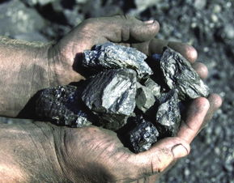
Background
Coal is known as black gold and industrial food, which is one of the main energy sources used by the human world since the 18th century, providing important mineral resources and raw materials for human progress and economic development.
China is one of the countries with the richest coal resources in the world. China has not only large reserves and wide distribution, but also complete varieties and excellent coal quality, which provides extremely favorable conditions for China's industrial modernization.

Slide 4
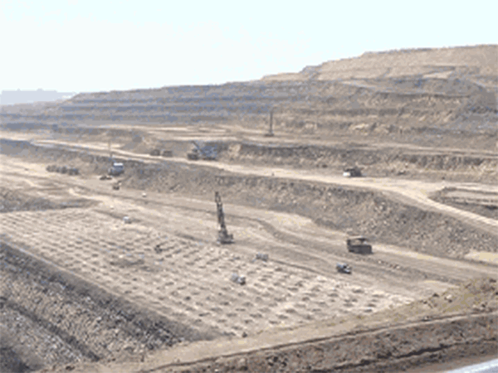
Background
High production capacity
High resource recovery rate
Safe production
Opencast mine
Since the beginning of the 20th century, the world's opencast coal mining has been increasing in the world's total coal production, and the impact of opencast coal mining has also increased.

Slide 5
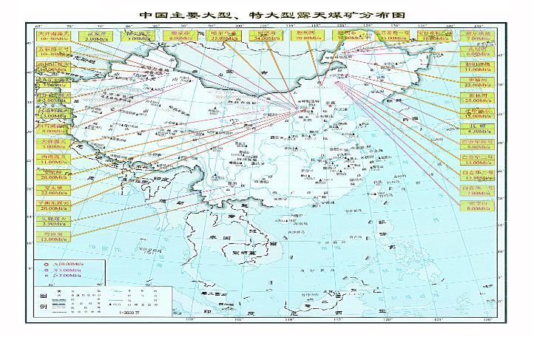
Distribution of Large-scale Opencast Coal Mines
Background
There are 14 opencast coal mining bases in China, and most of them distribute in Inner Mongolia, Shanxi, Shann’xi, etc, where are ecological vulnerable regions in China. Such as Heidaigou, Shengli, Baorixile, etc in Inner Mongolia, Antaibao, Anjialing, Donglutian in Shanxi. The coal production of each mine is more than 20 million tons per year.

Slide 6
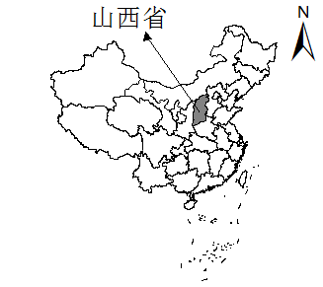
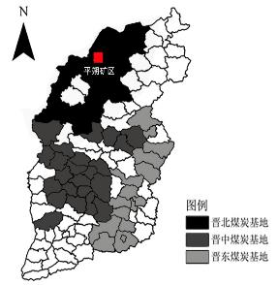
Background
Shanxi Province
According to China National Energy Administration's data on China's coal mine production capacity, by the end of December 2018, the state's new coal mine capacity was mainly concentrated in Shanxi, with an accumulated total of 180.02 million tons/year, of which opencast coal mine production is an important part.

Slide 7
The Important Role and Significance of Pingshuo Opencast Coal Mine
Background
Development of Pingshuo coal mining area from 1984 to 2016 (point-line-area-net)
Xiaoping Deng and Armand Hammer
Antaibao Opencast Coal Mine in Pingshuo, Shanxi Province, is the largest open-pit coal mine in China, which was constructed in 1984 by the cooperation between China and America. It is deeply imprinted with China's reform and opening, and is a milestone in the development history of China's coal industry.
Currently, Pingshuo coal mining area is the largest one that combined opencast mines with underground mines in China. The land and environment damage present the trend of point-line-area-net from 1984 to 2016.

Slide 8
The Important Role and Significance of Pingshuo Opencast Coal Mine
Background
The coal production of Pingshuo coal mining area was 10 million ton in 1990, 20 million ton in 2000 and more than 100 million ton in 2010. 160 million ton of raw coal had been produced. At present, one-sixth of the coal production in Shanxi has contributed by Pingshuo coal mining area.

Slide 9
New Era, New Requirements
Background
In the new era, opencast coal mining has many new features, such as intelligent, large-scale, and rapid, so the intensity of mining continue to increase, bringing convenience and benefits, but also bringing a series of severe environmental issue. With the concept of “lucid waters and lush mountains are invaluable assets” and “Green Mine” put forward, more emphasis is placed on land reclamation and ecological reconstruction in the opencast coal mining area, and soil reconstruction is the core of land reclamation.
Lucid waters and lush mountains are invaluable assets.

Slide 10
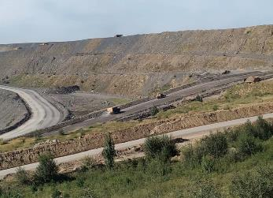
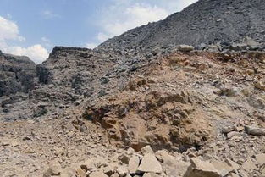
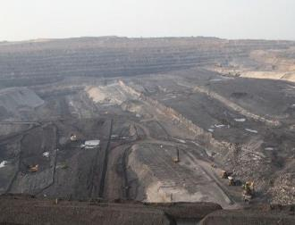
Unique Product of Opencast Coal Mine - Dump
Background
The dumping site is a huge structure in the opencast mine operation. It contains the geotechnical waste stripped from the opencast mine, ranging from a few million tons to hundreds of millions of tons, occupying a large amount of land resources and impacting the ecological environment of the mining area. In order to actively respond to the international call for “protecting the environment” and improve the ecological environment of the mining area, the research on the dumping site is of great significance.

Slide 11
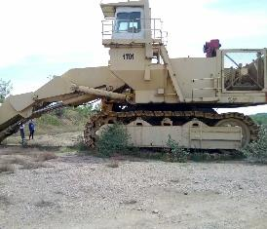
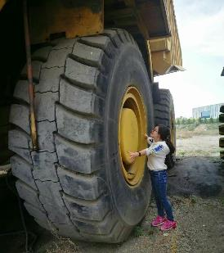
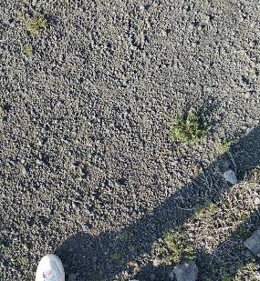
Unique Product of Opencast Coal Mine - Dump
Background
The artificially constructed soil profile is mechanically compacted during the dumping process, the soil bulk density（BD） is too large and difficult to change, affecting soil reconstructing and re-vegetation, hindering the development of reclamation process, and proposing integral protection, systematic restoration and comprehensive management. The challenge has made the concept of the community of life difficult to achieve. Therefore, it is urgent to study BD of dumping sites in opencast mines.

Slide 12
Current Process on Soil Bulk Density
Background
Soil physical properties are important indicators that reflect soil structure and hydrological conditions that influence soil quality (Gairola, 2010).
The BD of the surface layer (0-5 cm) of the small Zhifanggou watershed in Ansai County, Shaanxi Province was examined and its spatial heterogeneity was found to be mainly isotropic (Geng, 2014).
The surface BD is significantly lower than that of deep; the spatial variability of the former is affected by structural and stochastic factors, while that of the latter is mainly affected by structural factors (Li, 2019).
······
Based on traditional statistical methods, the study of variations of BD and its influencing factors has made some progress.

Slide 13
Current Process on Soil Bulk Density
Background
In recent years, with the development of geographic information systems (GIS) and its integration with spatial statistical methods, spatial pattern analysis and spatial variation in BD at regional scales have progressed.
Based on the data of the soil classification system, the BD transfer function is grouped to realize the spatial interpolation of BD, and the actual measurement and prediction value are tested according to the accuracy of the interpolation result (Vinícius, 2007; Chen, 2003).
Interpolation methods are widely used to describe continuous phenomena of spatial data and spatial surfaces (Achilleos , 2008).
Research at different sites has used spatial interpolation methods adapted to the characteristics of their respective regions (Zhu, 2012).
Based on the data of surface bulk density survey of 146 grassland plots in Yili area, Xinjiang, the correlation between various factors and BD was analyzed, a comprehensive model of variation in BD was constructed, and the spatial distribution pattern of grassland BD in Yili area was calculated by weighted overlay of the ArcGIS platform (Zhou, 2016).
······

Slide 14
Scientific Issues
Issue 1
What is the spatial variations feature of BD in the dumping site of the loess opencast mine?
Issue 2
How do vegetation allocation patterns, vegetation cover characteristics, site conditions, slopes, and slope directions affect the spatial variations of BD?
Issues
Issue 3
What is the significance of this study for practice?

Slide 15
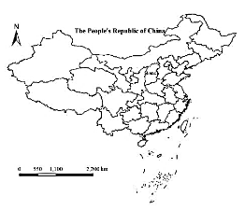
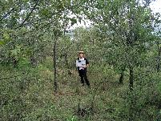
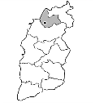
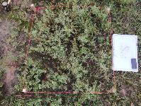
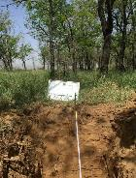
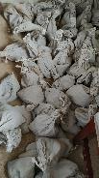
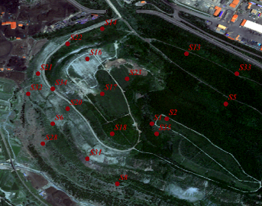
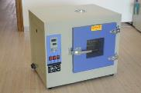
Main Data Source
Data of soil bulk density
Study area location and sample plot
Field sample collection
Determining the sample
Making a profile
Collecting samples
Fixed point
Shuozhou
Indoor analysis
wet weight
Dry
dry weight

Slide 16
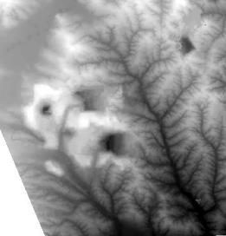
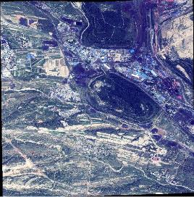
Main Data Source
Other data of sample plot
创新点一
Other data
High Definition Multispectral Images（www.gscloud.cn）
Quadrat number | Altitude /m | Site conditions | Slope aspects | Vegetation types | Vegetation cover characteristics
S1 | 1436 | Platform | Shady slope | Acacia | Pure forest
S2 | 1421 | Slope | Shady slope | Acacia | Pure forest
S5 | 1361 | Platform | Shady slope | Acacia | Pure forest
S6 | 1354 | Slope | Half sunny slope | Chinese pine | Pure forest
S8 | 1343 | Platform | Sunny slope | Acacia | Pure forest
S13 | 1343 | Platform | Shady slope | Chinese pine × Acacia | Mixed forest
S14 | 1332 | Platform | Shady slope | Acacia × Caragana | Mixed forest
S16 | 1404 | Platform | Shady slope | Chinese pine (dead) | Non -forest land
S17 | 1410 | Platform | Half sunny slope | Caragana × Acacia (dead) | Non -forest land
S18 | 1414 | Platform | Sunny slope | Acacia | Pure forest
S20 | 1380 | Platform | Half sunny slope | Chinese pine × Elm | Mixed forest
S21 | 1364 | Platform | Half sunny slope | Chinese pine × Elm | Mixed forest
S22 | 1348 | Platform | Shady slope | Grassland | Non -forest land
S23 | 1413 | Platform | Shady slope | Caragana × Acacia (dead) | Non -forest land
S28 | 1325 | Slope | Half sunny slope | Grassland | Non -forest land
S31 | 1371 | Slope | Sunny slope | Chinese pine (dead) | Non -forest land
S32 | 1332 | Slope | Half sunny slope | Chinese pine | Mixed forest
S33 | 1341 | Slope | Half shady slope | Acacia | Mixed forest
S34 | 1373 | Slope | Half sunny slope | Grassland | Non -forest land
S35 | 1439 | Platform | Sunny slope | Caragana × Acacia | Mixed forest
DEM（www.geodata.cn）
Visual interpretation of partitioned images

Slide 17
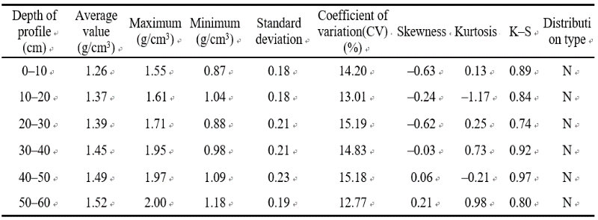
Research Process and Results
创新点一
Basic Statistical Analysis of Soil Bulk Density of Dumping Site
PART ONE
It can be seen that the sample data basically obeys the normal distribution and can be used directly for subsequent geostatistical analysis.
In general, the BD increases with the depth of the soil layer. The BD of each soil layer varies greatly. For all stratifications, the standard deviation is relatively small, indicating that the differences between the data are relatively small and the data is relatively neat. In the sample plots, the BD’s coefficient of variation (CV) in each layer is between 10% and 100%, which is moderate variability, indicating that the sample mean can represent the overall data well.

Slide 18
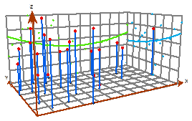
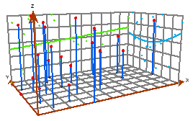
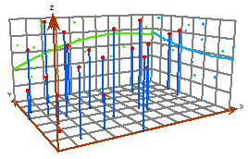
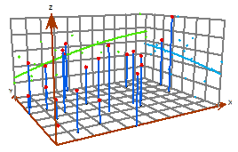
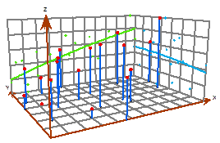
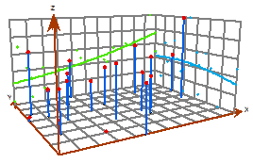
Research Process and Results
创新点一
2.1 Analysis of Spatial Differentiation Trend of Soil Bulk Density (Exploratory Spatial Data Analysis )
PART TWO
In general, the amplitude of BD in 0-20 cm two-layer was smaller in the east-west and north-south direction, and the north-south direction was larger than the east-west direction. In the 20-60 cm four-layer, the amplitude of variation in soil density in the east-west direction was much larger than the north-south direction, and even 4.4 times of the north-south direction.
From west to east, the BD of 0-10 cm soil layer decreased in a small stage, while the BD of other soil layers gradually increased with different linearity. From south to north, the BD of 0–20 cm soil decreased, while the BD of other soil layers gradually increase with different linearities.
a ) 0-10cm
b ) 10-20cm
c ) 20-30cm
d ) 30-40cm
e ) 40-50cm
f ) 50-60cm
we can clearly see the spatial variation trend of BD (east-west and south-north) in the study area.

Slide 19
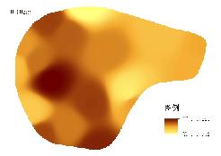
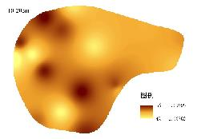
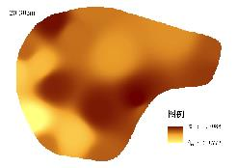
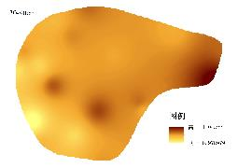
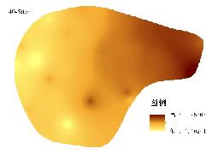
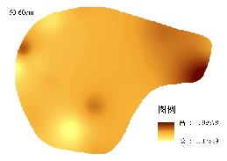
Research Process and Results
PART TWO
2.2 Analysis of Spatial Distribution Law of Soil Bulk Density (Inverse Distance Weighting)
The IDW is finally selected for spatial interpolation analysis.
The feature of BD’s distribution in the study area is obvious and block mosaic distribution is mostly.
In the 0-20cm soil layer, the BD in the western region is larger; in the 20-40cm soil layer, the BD in the central and eastern regions is larger; in the 40-60cm soil layer, the BD in the eastern region is larger, and the BD in the 50-60cm soil layer is more uniform.

Slide 20
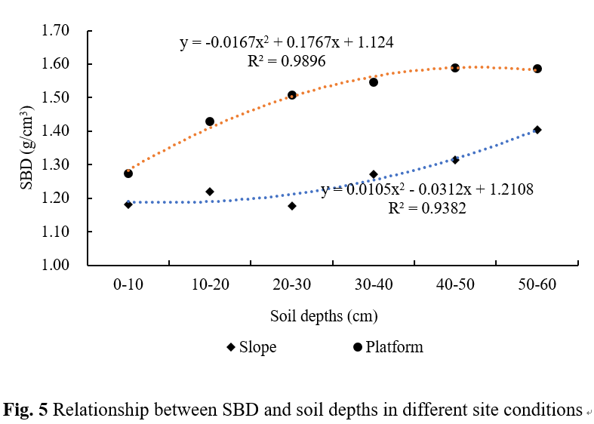
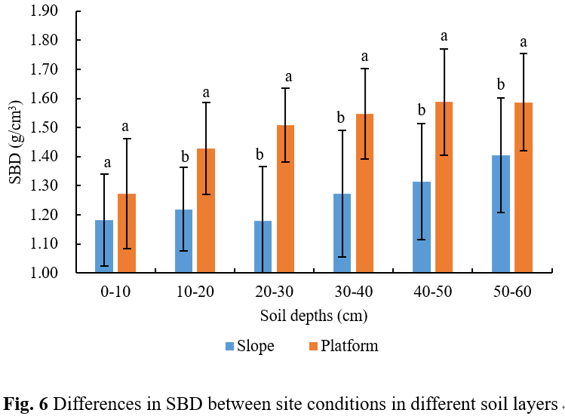
Research Process and Results
PART THREE
创新点一
3.1 Analysis of Spatial Variation in Soil Bulk Density - Site Conditions
The results show that with the increase of soil depth, the BD increases with slope or platform, and the change trend of BD at slope is “concave” parabola. The change of BD on platform is “convex” parabola. And the BD of the platform is always greater than the slope.
The results of analysis of variance showed that there was no significant difference in the BD of 0-10 cm soil between the slope and the platform, and other soil layers showed significant differences (P<0.05).

Slide 21
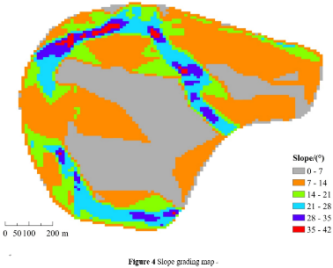
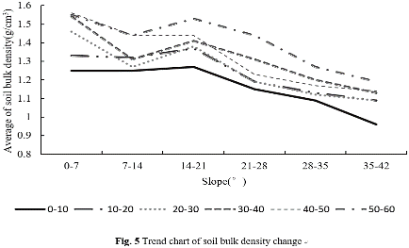
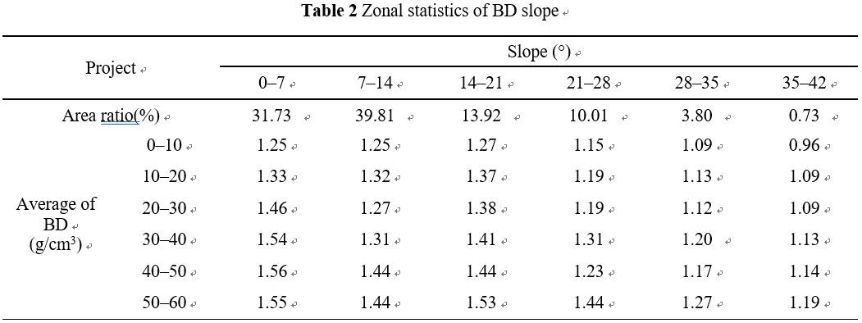
Research Process and Results
PART THREE
创新点一
3.2 Analysis of Spatial Variation in Soil Bulk Density - Slope
Combine the partition map and the statistical table: the proportion of the area occupied by each partition is (7-14°)>(0-7°)>(14-21°)>(21-28°)>(28-35°)> (35-42°).
As a whole, the BD of each layer in each zone decreases as the slope increases.
However, when the slope is between 10-20°, the BD of some layers increases with the slope. Combined with field vegetation species analysis, it was found to be mostly Locust.

Slide 22
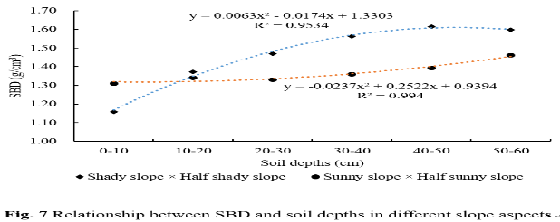
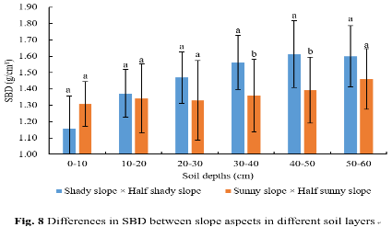
Research Process and Results
PART THREE
创新点一
3.3 Analysis of Spatial Variation in Soil Bulk Density - Slope Aspects
The results showed that with the increase of soil depth, the BD of different slopes increased, and the BD of shady slope + semi-shady slope showed a "convex" parabola. The change trend of BD of sunny slope and semi-sun slope was "Concave" parabola. The BD of the shady slope + semi-shady slope 0-10 cm is smaller than that of the sunny slope + semi-positive slope, and the depth below 10 cm is larger than that of the sunny slope + semi-sunny slope. The two are closest at 10-20 cm.
The BD of 30-40 cm and 40-50 cm was significantly different between the shady slope + semi-shade slope and the sunny slope + semi-sun slope (P<0.05).

Slide 23
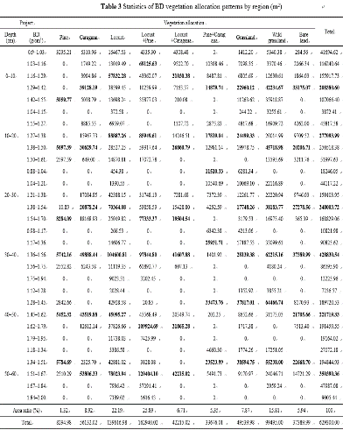
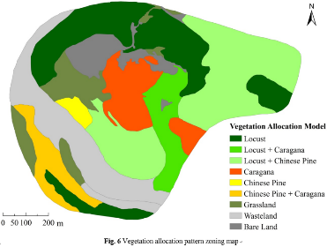
Research Process and Results
PART THREE
创新点一
3.4 Analysis of Spatial Variation in Soil Bulk Density - Vegetation Allocation Pattern
According to the results, the area of the Locust (Locust mixed forest) is the largest.
The BD of each layer was sorted according to the order from large to small: in the configuration mode of Pine + Caragana and grassland, the BD of each layer of 0-60 cm was relatively small, indicating that after the study area was retired for a certain period of time, the “grass-bush-tree” vegetation allocation pattern of Pine + Caragana + Grassland is relatively optimal.
According to the vegetation configuration pattern, the effect of reclamation in this area is very good—the vegetation is rich and the coverage is high.

Slide 24
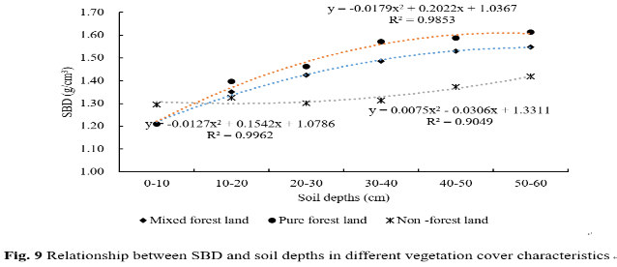
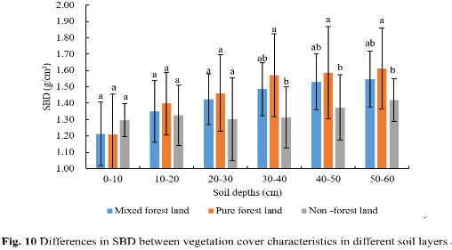
Research Process and Analysis Results
PART THREE
创新点一
3.5 Analysis of Spatial Variation in Soil Bulk Density - Vegetation Cover Characteristics
The results showed that with the increase of soil depth, the BD of different vegetation cover characteristics increased gradually, and the BD of mixed forest and pure forest land showed a "convex" parabola; the change of BD in non-forest land was "concave" parabola. The BD is 0-10 cm, non-forest land > pure forest > mixed forest; below 10 cm, pure forest > mixed forest > non-forest land.
The results of analysis of variance showed that the BD of 30-40 cm, 40-50 cm and 50-60 cm was significantly different between pure forest land and non-forest land (P<0.05), and other soil layers were different. There was no significant difference between the grounds (P>0.05).

Slide 25
Main Conclusion and Practical Significance
We have answered
No.1
The spatial variations feature of BD in the dumping site of the loess opencast mine.
No.2
The effects of vegetation allocation pattern, vegetation cover characteristics, site conditions, slope and aspect on the spatial differentiation of soil bulk density.
There is no strict increase or decrease of BD in the surface layer of 0-20cm, and the degree of spatial differentiation is small (the herb root system) .
The BD of 20-60cm soil layer decreases from east to west and from north to south with different linearities, and the east-west direction is more different than the north-south direction (difference between east-west vegetation types).
Issues
No.3
The significance of this study for practice.
Provide a basis for optimizing the land reclamation process (vegetation configuration, slope, aspect and topographical settings). (focusing on the combination of soil remediation and specific mining processes)
Provide guidance for improving soil conditions in the study area and reclamation work of similar or similar dumps.

Slide 26
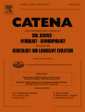
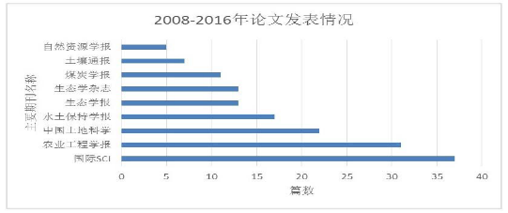
Land Reclamation Work from our Group
Publications and appraisal from international experts
Papers with important impact in land reclamation and ecological restoration
More than 200 papers were published on Ecological Engineering, CATENA, Transactions of the Chinese Society of Agricultural Engineering, etc, and there were 38 papers indexed by Science Index, 40 papers indexed by Engineering Index. These papers were referred more than 200 times by SCI/SSCI, and more than 2000 times by EI/CSCD/CSSCI.

Slide 27
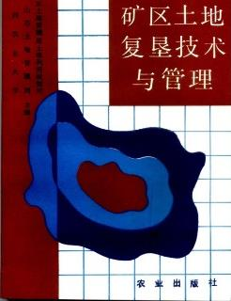
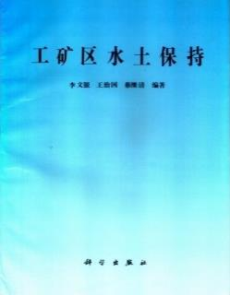
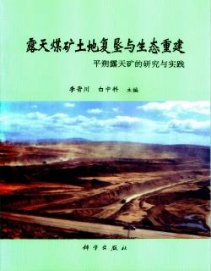
Land Reclamation Work from our Group
Publications and appraisal from international experts
Series books published with high academic impact

Slide 28
Land Reclamation Work from our Group
Applications and social-economic benefits
6 industry regulations and 1 enterprise regulation
TD/T 1031.1-2011
TD/T 1031.2-2011
TD/T 1031.3-2011
TD/T 1036-2013
TD/T 1044-2014
It is effective for pushing ecological restoration engineering in different mines, and it is the important guide for the integration of land reclamation planning and geological environment restoration planning in mines.

Slide 29
Land Reclamation Work from our Group
Applications and social-economic benefits
Become reference and supporting documents for related laws and regulations (i.e. Regulation on Land Reclamation)

Slide 30
Land Reclamation Work from our Group
Applications and social-economic benefits
Achievement on the news in on May 17th,2019 --- CCTV-4 Chinese International Channel
“Reconstructing the coal mountain into a fertile land in Shuozhou, Shanxi”
The Loess Plateau should be vertical and horizontal, with drought and water shortage, and the land is barren. However, through the reclamation work, there are a large flat land and green forest now.
The mining area in Pingshuo from black to green is the effort of so many people.
Practice is true. - The research we do must be done from practice and then tested by practice.

Slide 31
36th Annual Meeting of
the American Society of Mining & Reclamation
Big Sky, Montana, June 3-7
Study on Soil Bulk Density of Reconstructed Soil in a Loess Open–pit Mining Area, China: Spatial Variations and Influencing Factors
Shufei Wang, Yuhan Huang, Yingui Cao, Zhongke Bai, Wei Zhou
Speaker: Dr. Yingui Cao
caoyingui1982@126.com
2019.06.04
Funded by the National Natural Science Foundation of China (41701607, 41571508)

