Slide 1
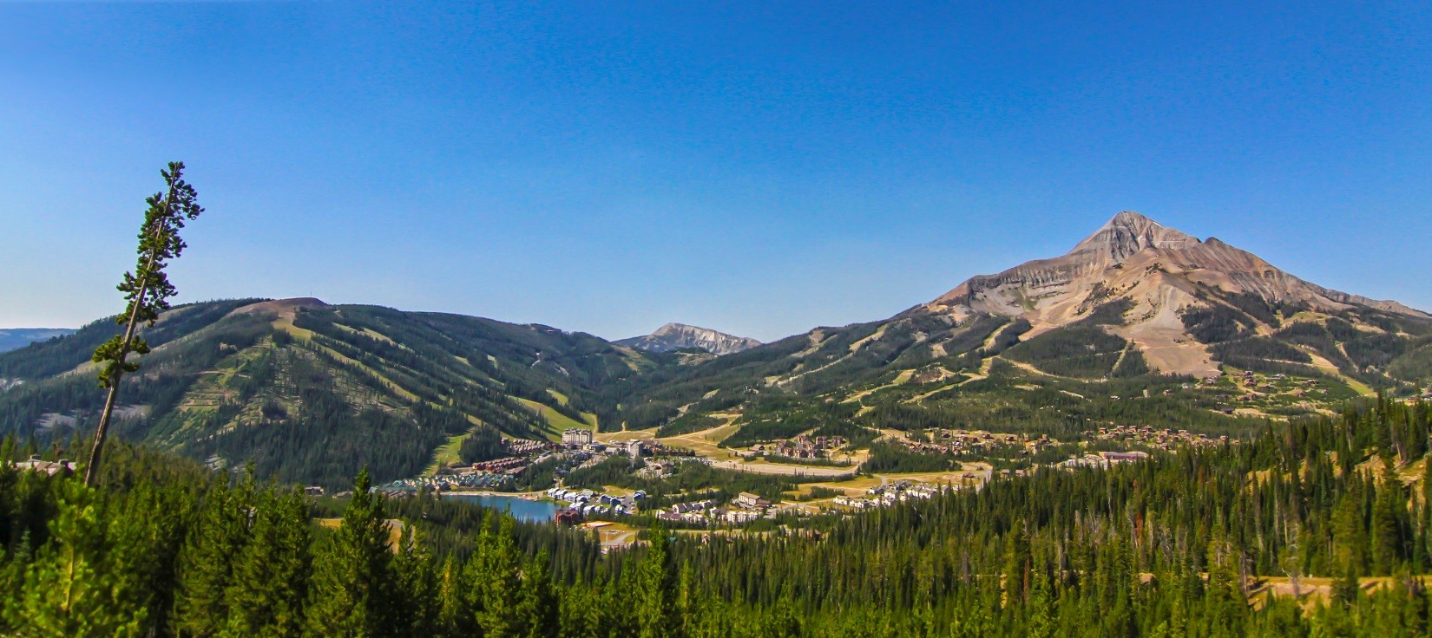
36th Annual Meeting of the
American Society of Mining and Reclamation
June 3 to 7, 2019 Big Sky, Montana
Welcome Back to Montana: The Land of Reclamation Pioneers

Slide 2
PLATINUM SPONSOR

Slide 3
GOLD SPONSORS

Slide 4
SILVER SPONSORS

Slide 5
Bronze Sponsors
BKS Environmental Associates, Inc.
Herrera Environmental Consultants
GeoEngineers
Foam Concepts LLC
Rocky Mountain Reclamation
Energy Laboratories Inc
Pacific Inter-Mountain Distribution
MT Abandoned Mine Lands

Slide 6
Event Sponsors
Early Career Professional Event
Anonymous Donor
Inter-Mountain Labs
Virginia Tech
Break and Meal Sponsors
Arkansas Valley Seed
Barr Engineering
Cedar Creek Assoc. Inc.
Crowley Fleck PLLP
Granite Seed and Erosion Control Co.
Hecla Mining Company
Tetra Tech, Inc
Westmoreland/Rosebud
Field Tour Sponsor
High Altitude Revegetation Committee

Slide 7
Exhibitors
ACF West
ACZ Laboratories
Arkansas Valley Seed
BioLynceus
ERTEC Environmental Systems
Fiber Marketing International, Inc.
Granite Seed and Erosion Control Co.
Pioneer Technical Services
RESPEC
Rocky Mountain Bio Products
Sitesee-Ramboll
Stevenson Intermountain Seed, Inc.
Trihydro Corporation
Truax Co. Inc.
Voss Signs, LLC
Water & Environmental Technologies

Slide 8
Conference Mobile App Manager
Trihydro Corporation
Check our conference app at: https://yapp.us/JFFTRM

Slide 9
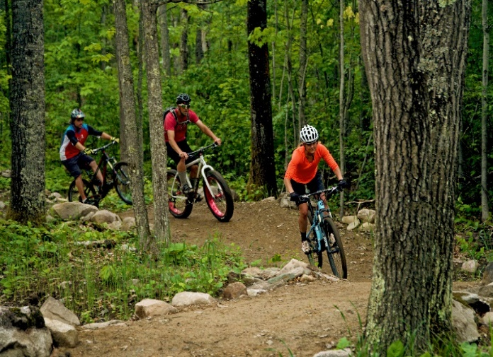
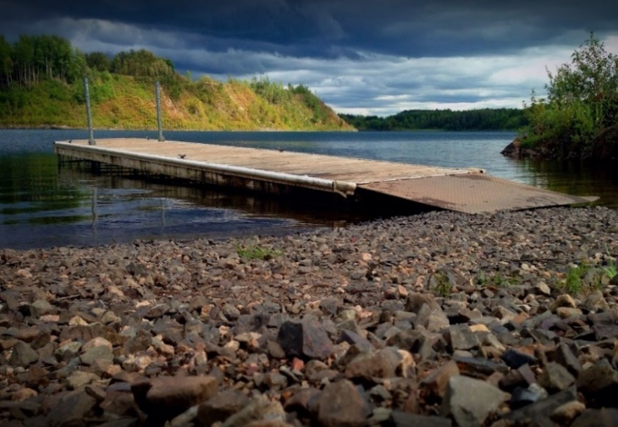
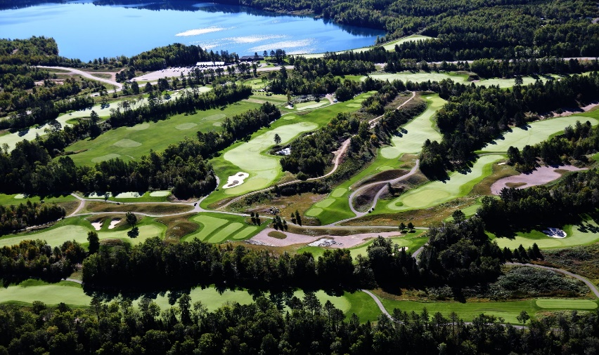
Next Year Plan to Attend the
37th Annual American Society of Mining and Reclamation Meeting
In Beautiful Duluth Minnesota
June 7-11, 2020
Transforming Pits and Piles into Lakes and Landscapes
Conference field trips will involve reclamation efforts unique to the Duluth region

