Slide 1
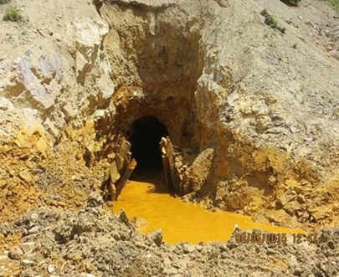
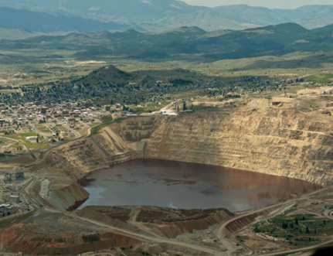
Abandoned Mine Lands: Cleanup Challenges and Technology Opportunities
American Society of Mining and Reclamation
June 4, 2019

Slide 2
The Site Universe
No comprehensive national inventory of abandoned mine lands (AML) in the U.S., estimates range from 100,000 to 500,000 sites
Superfund Enterprise Management System (SEMS) contains less than 0.1 percent of this large AML universe
There are more than 50,000 abandoned coal mines, which fall under the jurisdiction of the Office of Surface Mining Reclamation and Enforcement as well as authorized states

Slide 3
Superfund Mine / Mineral Processing Sites
140 Superfund sites (Superfund National Priorities List [NPL] or Superfund Alternative Approach) are mining and mineral processing sites:
More than half are greater than 500 acres in size; Bunker Hill Mining and Metallurgical Complex site (a.k.a., Coeur d’Alene Basin; Idaho and Washington), which covers 1,500 sq miles, is largest
Mine-influenced waters will need to be addressed at more than 30 percent of these sites
EPA Superfund program has estimated expenditures of more than $4B to address mining and mineral processing sites to date (does not capture all costs PRPs have spent to date)

Slide 4
National Priorities List Mining Sites Remedy Components

Slide 5
A Continued Need for Innovation
Drivers include:
Mining site universe: large number of sites, common problems
Timelines and long-term costs
Interest in innovation: “demand pull”
Public and private problem-holders
Leadership attention
Communities, economic development
Big problem/larger window of opportunity
Research programs/results: “supply push” (?)

Slide 6
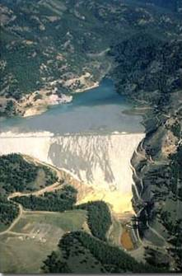
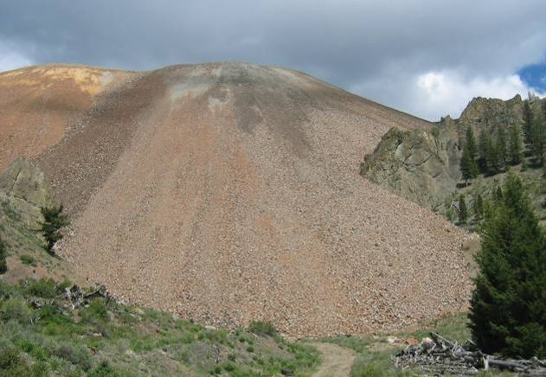
Target Areas of Innovation
Treatment of mine-influenced waters (MIW)
Source treatment/tailings/waste rock/underground workings
Site revitalization and reuse
Mineral resource recovery
Characterization and monitoring tools
Involve
Chemistry, biology
Geology, hydrogeology
Engineering

Slide 7
Key Considerations for Innovation
Legal issues
Liability
Complex ownership (Mixed Ownership)
Intellectual property
Funding and human resources
Health and safety
Transferring experience, lessons
Documenting results
Quality assurance

Slide 8
Key Considerations for Innovation
Scalability: from the bench to field to full-scale use
Harsh, cold realities
Time: not always a short process
Site differences
Documentation, communication, and “urban legend”
Project level: present-oriented, technologies ready now
Available site information, characterization
Researcher to entrepreneur
Inertia: “this is the way we’ve always done it”

Slide 9
Technology Development
Idea/Proof of Concept
Bench scale testing
Pilot scale technology
Field testing
Scaling
Investment/funding
Information transfer
Familiarity/early adopters
Procurement
Full scale technology
Commercial availability
Acceptance
This Photo by Unknown Author is licensed under CC BY-SA

Slide 10
Collaboration is Essential
Many information needs
Many decisions/decisionmakers
Many perspectives
Research is spread out
Agencies/Federal funding
Private sector research
Funding, technology incubation
Leveraging vs. duplicating

Slide 11
Technology Acceptance: Multiple Decisionmakers, Diverse Decision Needs
Responsible Party/Owner Operator
State/Federal Project Manager
Technology Vendors, Researchers, Investors
Consulting Engineer
Local officials
Developers
Lenders
Community

Slide 12
Innovation is Not a Linear Process
Feedback: experience, issues, needs
Basic Research
Bench scale develop-ment
Pilot testing
Field testing/ demo
Full-scale field use
Response: modify, optimize, new solutions
This Photo by Unknown Author is licensed under CC BY-NC-ND

Slide 13
Innovation Happens
Innovation is happening
Case examples
Research and development
But…
It’s a tough crowd: “If there were other options, we’d use them” or “Nothing else is ready to go now.”
Innovation requires patience
Innovation is both technology and approach based
No single path to acceptance; process is adaptive

Slide 14
Existing Avenues of Innovation
Biological/Biochemical Treatment
Ecological restoration
Passive and semi-passive treatment
Engineering controls
Greener remediation
Site characterization, data use/management
Upcoming (2020) mining technology update, Handbook of Capabilities of Remedial Technologies for Use at Mining Waste Sites

Slide 15
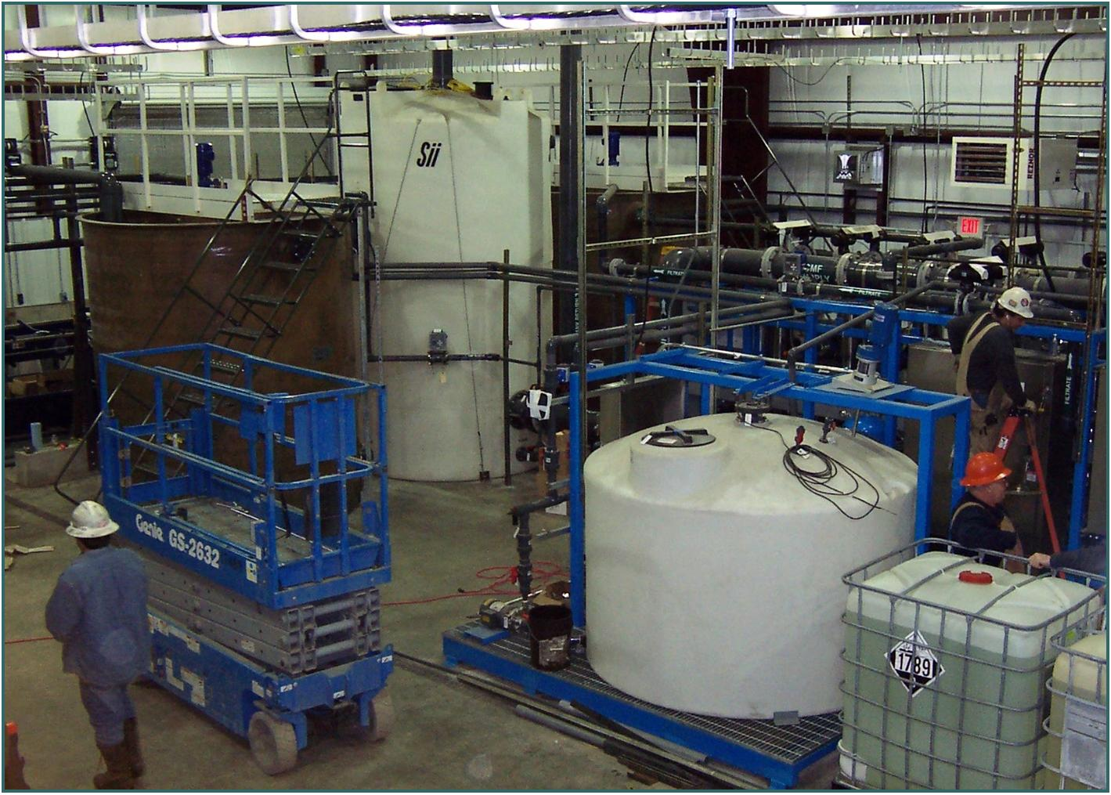
Technologies
Anoxic limestone drains
Successive alkalinity producing systems
Aluminator
Constructed wetlands
Biochemical reactors

Slide 16
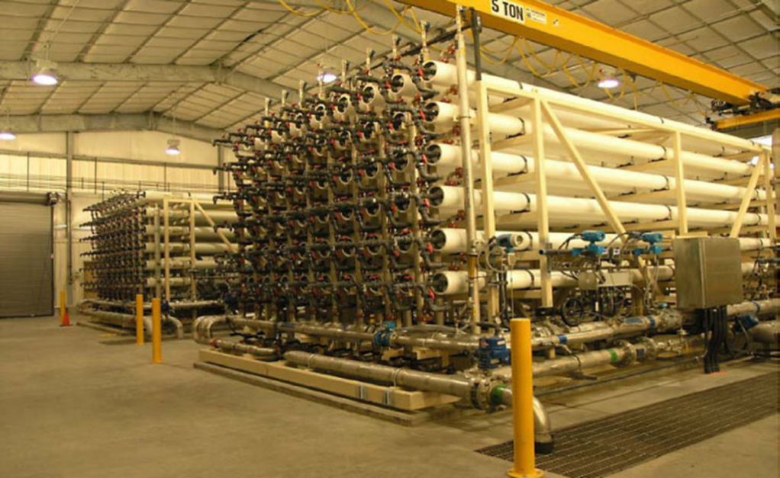
Technologies
Phytotechnologies ( http://cluin.org/products/phyto/ )
Permeable reactive barriers
Fluidized bed reactors
Reverse osmosis
Zero valent iron

Slide 17
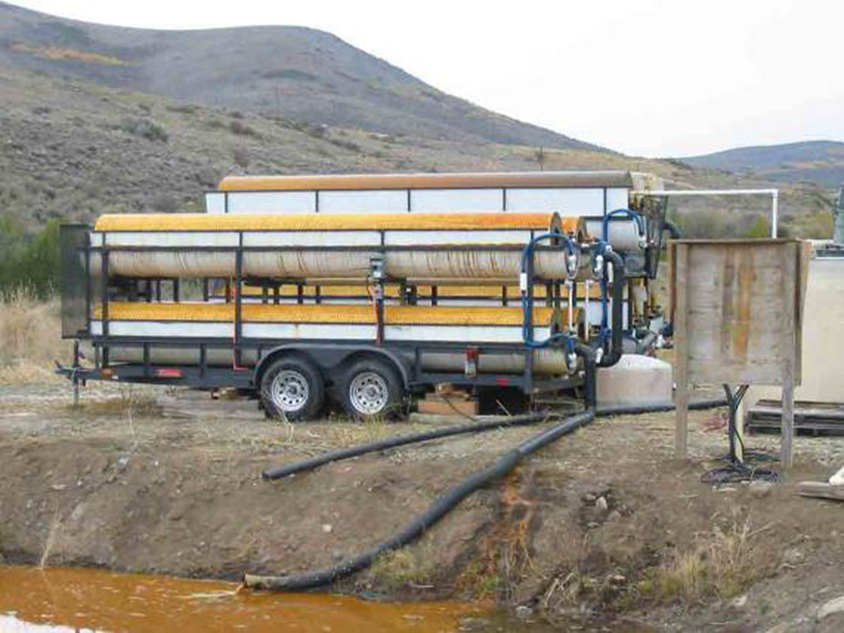
Technologies
Rotating cylinder treatment systems
Ferrihydrite adsorption
Electrocoagulation
Ion exchange
Biological reduction
Ceramic microfiltration

Slide 18
Selection of P&T Continues to Decline and Selection of In Situ Treatment Is Steady (FY 1985-2017)

Slide 19
Recently Selected Groundwater Remedies (FY 2015–17) Groundwater Decision Documents = 111
Remedy | Total (FY15-17) | Percent Groundwater Decision Documents
Ex Situ Treatment (P&T) | 22 | 20%
In Situ Treatment | 57 | 51%
Bioremediation | 30 | 27%
Bioremediation (anaerobic, insitu) | 20 | 18%
Bioremediation (bioaugmentation, insitu) | 11 | 10%
Bioremediation (aerobic, insitu) | 5 | 5%
Bioremediation (other, NOS, insitu) | 4 | 4%
Chemical Treatment | 26 | 24%
Chemical Oxidation (insitu) | 19 | 17%
Chemical Reduction (insitu) | 8 | 7%
Neutralization (insitu) | 1 | 1%
Thermal treatment | 6 | 5%
Permeable Reactive Barrier | 6 | 5%
Multi-phase Extraction | 4 | 4%
Air Sparging | 3 | 3%
Unspecified in situ treatment | 3 | 3%
Vapor Extraction | 3 | 3%
Electrokinetics | 1 | 1%
Flushing | 1 | 1%
Phytoremediation | 1 | 1%
Solidification/Stabilization | 2 | 2%

Slide 20
P&T Remedies Almost Always Combined with Other Remedies, Especially Source Control (FY 1982-2017)
MNA = monitored natural attenuation
P&T = pump and treat (selected at 834 sites)

Slide 21
We can leverage existing infrastructure, opportunities
EPA Waste Programs and Technology Innovation, 25+ years of experience
Information exchange
Training
Communication, distance learning
Research capabilities and demonstration experience
Other Federal programs, academic, private sector
Owners
Research
Collaboration and relationships/existing work groups, associations, etc.

Slide 22
Examples of Resources
Hazardous Waste Cleanup Information (CLUIN) Web Site
Information
Online Training
https://cluin.org
Best Practice Guides and Case Studies
Training
CERCLA Education Center
ERT Training Program
https://trainex.org
EPA Office of Research and Development
Federal Research, e.g., Superfund Research Program-National Institute of Environmental Health Sciences (NIEHS)
www.niehs.nih.gov
ETV and ISO Standards, Guidance
Interstate Technology Regulatory Council (ITRC)
Technical Guidance
Training
https://www.itrcweb.org
Federal Collaboration (e.g., FRTR and FMD)

Slide 23
Charting a Course to Innovation
Demonstrating/evaluating technologies
Technology identification: intersection of priorities and technologies ready for evaluation at field level
Site identification
Evaluation framework: based on existing ISO ETV, EPA ETV and SITE procedures, tools
Increasing acceptance by supporting decisionmakers
Build collaboration among decisionmakers/leverage work
Information dissemination and educational resources
Leadership commitment/encouragement

Slide 24
Charting a Course to Innovation
Individual demonstrations will not lead to technology use, acceptance. Requires sharing and building on information, use at multiple sites. Not solely a function of formal demonstration or verification programs
Technology demonstration has multiple levels
Field access to support research
Field demonstration to support transition to field-scale, commercial scale technology availability
Pilot or treatability testing to support selection at sites, raise comfort of regulators, site owners, and contractors

Slide 25
Charting a Course to Innovation
Information exists, projects underway. Need to build comprehensive understanding, access to information
Link between technical support and research is essential
We can’t do it alone
Where do we go from here?

Slide 26
Contact Information
Shahid Mahmud, Team Leader, EPA National Mining Team
Office of Superfund Remediation and Technology Innovations
U.S. Environmental Protection Agency
Phone: 703-603-8789
Email: mahmud.shahid@epa.gov
Ed Gilbert, Chief, Technology Assessment Branch
Office of Superfund Remediation and Technology Innovations
U.S. Environmental Protection Agency
Phone: 703-603-8883
Email: gilbert.edward@epa.gov
Michele Mahoney, Team Leader, Mining Technologies
Office of Superfund Remediation and Technology Innovations
U.S. Environmental Protection Agency
Phone: 703-603-9057
Email: mahoney.michele@epa.gov
Daniel Powell, Chief, Technology Integration and Information Branch
Office of Superfund Remediation and Technology Innovations
U.S. Environmental Protection Agency
Phone: 703-603-7196
Email: powell.dan@epa.gov

