Slide 1

American Society of Mining & Reclamation
36th Annual Meeting
Welcome Back to Montana,
the Land of Reclamation Pioneers!
Welcome to ALL and a Special thanks our SPONSORS and especially our:
Platinum Sponsor –
US Office of Surface Mining, Reclamation and Enforcement
Gold Sponsors
Peabody
KC Harvey Environmental, LLC
Silver Sponsors
Pace Analytical, Midas Gold, Brierley Associates
Our Bronze sponsors and Exhibitors. THANK YOU!
Notes:
Welcome to Big Sky and to our 36th annual meeting. Kevin Harvey and Rachel Schmidt have put together an outstanding conference and we hope you will make new connections, hear insightful and interesting presentations, and reconnect with colleagues. We started off with Pre-conference field trip: exceptional introduction to Yellowstone and the reclamation efforts around Cooke City. Mary Beth Marks, Autumn Coleman, and others gave excellent overviews of their reclamation efforts and Helen with KCHarvey provided impromptu road side geology.

Slide 2


American Society of Mining & Reclamation
36th Annual Meeting
Energy, Reclamation and the Next Chapter
Gwen Geidel, PhD, JD
ASMR President
University of South Carolina
June 4, 2019
Notes:
As a society dedicated to the promotion of advancement of basic and applied reclamation science through research and technology transfer, we can be proud of the efforts and research that have involved scientists, practitioners, private industry, educators, planners and government regulators. Our collective knowledge and accomplishments since the mid 1970’s when ASMR was founded, have led to tremendous outcomes in land and water reclamation, from restoring resilient plant communities to re-establishing functioning hydrologic systems. The efforts began with a concern for improving and re-establishing the ecosystems which were interrupted by mining activities; primarily coal. Between regulation, research and brilliant ideas, the successes that the society has promoted through technology transfer have truly transformed restoration, rehabilitation and ecological engineering outcomes in many sectors. However, reclamation in the energy sector continues to be important whether related to coal, oil and gas, conventional or renewable energy production.

Slide 3


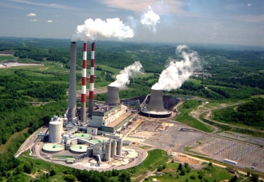
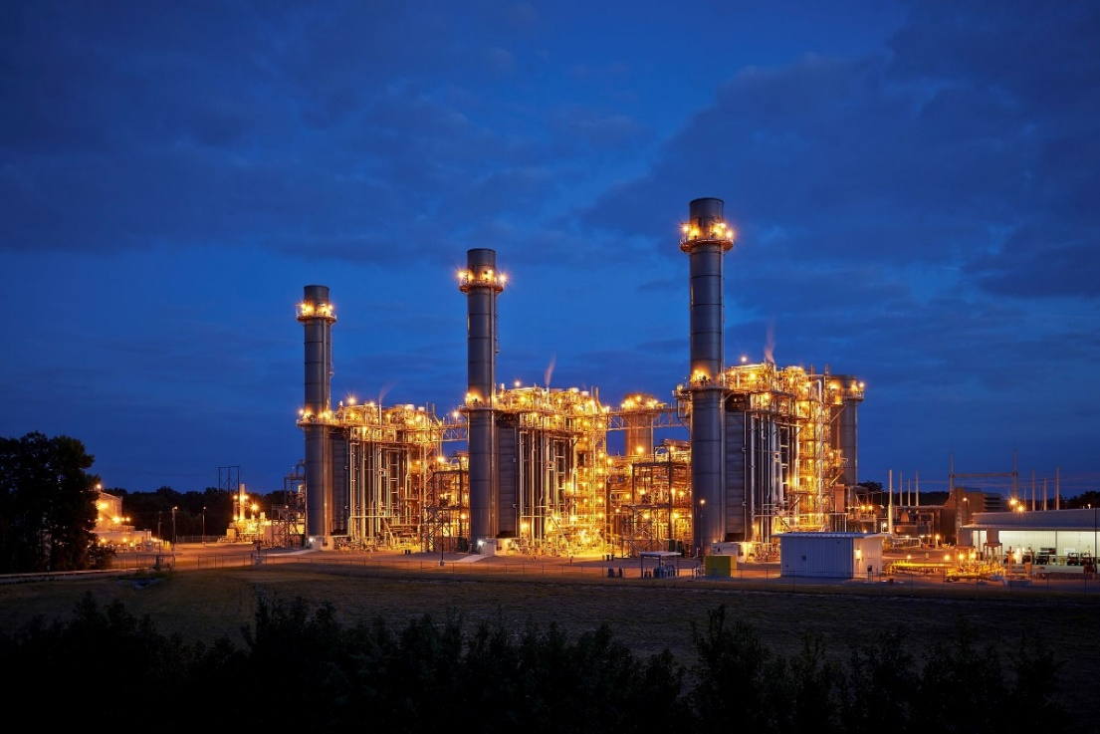
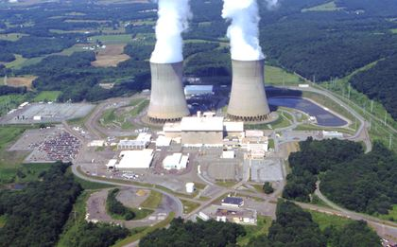
ASMR - Energy and Reclamation
renewables
coal
Electric Grid
natural gas
nuclear
Notes:
Energy is the backbone of our society and grid security is critical. For the grid to be secure, reliable and resilient , and to meet the sustainability goals, many sources of energy must included. Each plays a role in the base load &/or peak operations to supply energy to grid. Pictures:
https://wattsupwiththat.com/2015/05/02/tesla-announces-low-cost-batteries-for-off-grid-homes/ (solar & wind & hydro)
http://www.crainsnewyork.com/article/20170925/OPINION/170929939/letter-to-the-editor-odd-time-to-call-for-gas-fired-power-plants (natural gas)
http://www.power-eng.com/articles/2015/04/nrc-approves-nuclear-power-plant-ownership-transfer.html (Susquehanna nuclear power plant)
http://www.power-eng.com/articles/2013/08/firstenergy-units-agree-on-coal-fired-power-plant-share-rate-reduction.html (Harrison Coal plant WV)

Slide 4
ASMR: beginning - Reclamation of Coal mines;
now Reclamation of all disturbed sites;
But coal continues to be mined as part of the US Electric Power Generation mix. In 2018
Natural gas = 31.7%
Coal = 27.4% (~92% of coal mined)
Nuclear = 19.3%
Renewables (total) = 17.1%
Hydropower = 7.50%
  Wind = 6.6%
  Biomass = 1.5%
  Solar = 1.6%
  Geothermal = 0.4%
Other = 0.3%
Notes:
ASMR beginning 1973 (Neil says first meeting to form in 1978)
SMCRA – 1977
https://www.eia.gov/tools/faqs/faq.php?id=427&t=3 (for 2018)

Slide 5
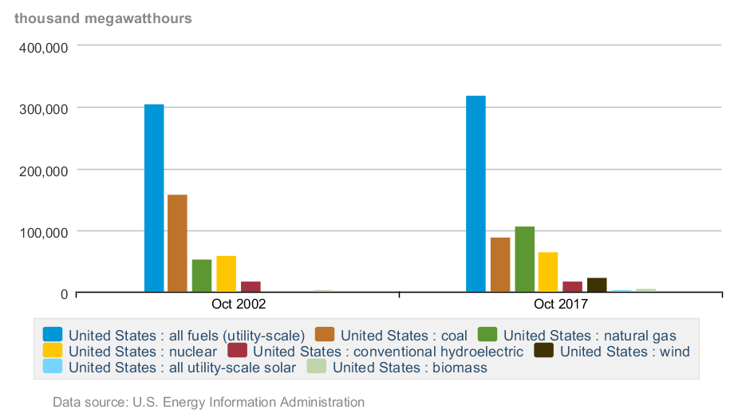
Coal as source of US Electricity has declined
in last 15 years: March 2004 & 2019
323
309
320
308
Coal
159 = 52%
Coal
154=50%
90 = 28%
78=24%
Notes:
VRE – Variable Renewable Energy
Gas doubled from 16% to 35% with hydraulic fracking and VRE sources increased.
https://www.eia.gov/electricity/data/browser/#/topic/0?agg=2,0,1&fuel=vvg&geo=g&sec=g&linechart=ELEC.GEN.ALL-US-99.M~ELEC.GEN.COW-US-99.M~ELEC.GEN.NG-US-99.M~ELEC.GEN.NUC-US-99.M~ELEC.GEN.HYC-US-99.M&columnchart=~ELEC.GEN.COW-US-99.M~ELEC.GEN.NG-US-99.M~ELEC.GEN.NUC-US-99.M~ELEC.GEN.HYC-US-99.M~ELEC.GEN.AOR-US-99.M~ELEC.GEN.OTH-US-99.M&map=ELEC.GEN.ALL-US-99.M&freq=M&start=200403&end=201903&ctype=columnchart&ltype=sourcekey&rtype=s&maptype=0&rse=0&pin=

Slide 6
When ASMR began, the US was mining approximately the same amount of coal as mined today, however, the overall energy consumption has increased.
Notes:
https://www.eia.gov/totalenergy/data/browser/index.php?tbl=T06.01#/?f=M&start=197408&end=201904&charted=0-5-8
coal per month from August 1974 to April 2019
ASMR began as ASSMR in 1973.

Slide 7
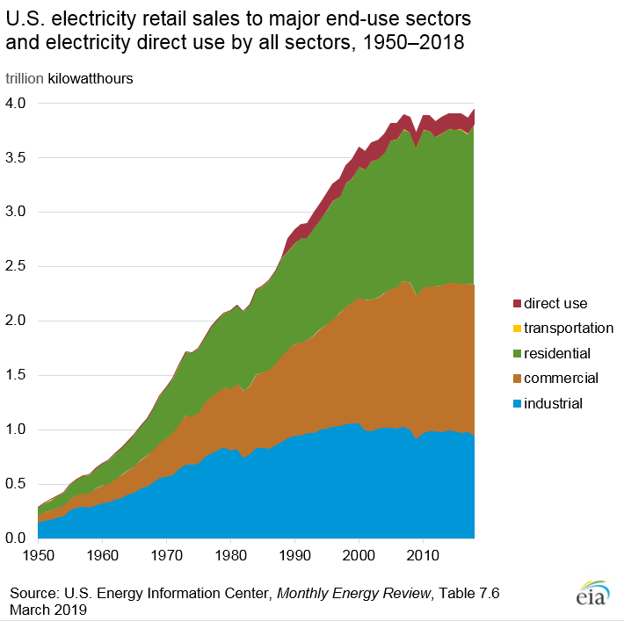
Sales of electricity in 2018 were:
Residential - 1.46 trillion kWh: 38.5%
Commercial - 1.38 trillion kWh: 36.2%
Industrial - 0.95 trillion kWh: 25.1%
Transportation - 0.01 trillion kWh:0.2% (mostly to public transit systems)
Cooling accounts for the largest share of annual U.S. residential sector electricity consumption in 2018
-fans and A/C for cooling homes - largest use of residential electricity.
The major uses of residential electricity :
Cooling/air conditioning—14.7%
Space heating—14.2%
In late 1970s, about ½ the energy consumed today.
Notes:
https://www.eia.gov/energyexplained/index.php?page=electricity_use

Slide 8
- Coal’s decline and NG and VRE’s expansion, altered ways grid operators have handled routine days and emergencies for decades; planning and operating responses are essential.
- Report notes primary task is correct mix of generation and grid support systems to meet projected threats and challenges. Coal will continue be part of mix, albeit smaller.
Notes:
In order to maintain reliable and resilient energy sources for the grid, DOE reported on Electricity Markets and Reliability.
The report identified threats and challenges to the grid, which included extreme weather conditions (prolonged cold periods or heat) and storms (causing grid disruptions and power outages).
FERC – Federal Energy Regulatory Commission; NG – natural gas, VRE – Variable Renewable Energy
(90 Day Rule) which would impact costs for maintaining a 90 day supply
DOE proposed new 90 Day Rule for grid, but FERC did not find that potential retirements of coal and nuclear plants would jeopardize grid resilience or reliability issues.
“We find that these assertions do not demonstrate the unjustness or unreasonableness of the existing RTO/ISO tariffs. In addition, the extensive comments submitted by the RTOs/ISOs do not point to any past or planned generator retirements that may be a threat to grid resilience,” (FERC order). (Jan 8, 2018)
http://www.powermag.com/ferc-rejects-does-proposed-controversial-grid-resiliency-rule/

Slide 9
Retirement of Coal units may be largely a cost issue but also an environmental issue as plants strive to meet:
- Affordable Clean Energy Plan (Proposed 2018-19) (re-write of CPP by EPA)
ds.
T. Hewson, Energy Ventures Analysis, June 2016 in DOE Staff report, Aug 2017.
Notes:
Becomes a smaller percentage through retirement of coal fired power plants.
See page 60 of DOE Staff report, Aug 2017 and
From: T. Hewson, Energy Ventures Analysis, June 2016. Assessing Coal Unit Retirement Risk.
https://www.eia.gov/outlooks/aeo/workinggroup/coal/pdf/Hewson_Coal%20Retirement%20Workshop%20%206-14-16.pdf

Slide 10
Coal will continue to be mined:
- Minimized % in the electricity generation mix;
(Approximately 14 gigawatts of coal fired electric generation capacity retired in 2018 and about 4 GW to retire in 2019.)
- Coal required for steel production (coke), industry use;
(2.5% of consumption for coke and 5.1% for other industrial uses)
- “metalliferous coal” becoming a recognized source of Rare Earth Elements (REE) and elements such as: Ge, U, Ga, V, Se, Y, Sc, Nb, Au, Ag and Re
Notes:
https://www.eia.gov/coal/production/quarterly/pdf/t32p01p1.pdf
Total US Coal production 2017 (million tons)= 774 produced, 717 consumed.
- may be economically feasible from “metalliferous coal” (up to 10x higher than average world coal) in
Ge, Ga, V, Se, Y, Sc, Nb, Au, Ag and Re
75 Re Rhenium
41Nb Niobium
21 Sc Scandium

Slide 11
But Energy Growth and Mining Will Continue:
Fueled in part by Electric Vehicles (EV)
Electric Vehicle Revolution
  January 2019 about 1.1 million units (mu) (not including hybrids)
  2030 projected to increase to 20 mu¹
  2035 projected increase to between 140² and 150³ mu
The energy required to supply these vehicles is compared to the energy surge of the 1950’s with the rise in air conditioning.¹
Navigant forecasts 93 terawatt hours (TWh)/year by 2030 to meet EV need.¹
Notes:
Smart Electric Power Alliance (SEPA), A Comprehensive Guide to Electric Vehicle Managed Charging . SEPA 2019 Report (Ericka Myers). https://sepapower.org/resource/a-comprehensive-guide-to-electric-vehicle-managed-charging/
BHP Billiton
IEA

Slide 12
Energy: Managed Charging (MC)
MC - When and how EVs will be charged is current policy debate.
  If primary recharge in evening, the surge required will exceed current capacity. Policies implemented now may manage recharging when wind and solar peak, allowing the surge to be managed. In addition, managed charging includes vehicles adding excess battery power back to the grid.
Notes:
Many utilities have turned first to instituting EV specific time-of-use (TOU) rates to influence drivers to shift their EV loads to off-peak times of day. This approach allows customers to reduce their energy bill and encourages EV charging when it is least-disruptive to the grid, such as night-time hours.
But to more effectively take advantage of peak solar and peak wind, the timing would be different.

Slide 13
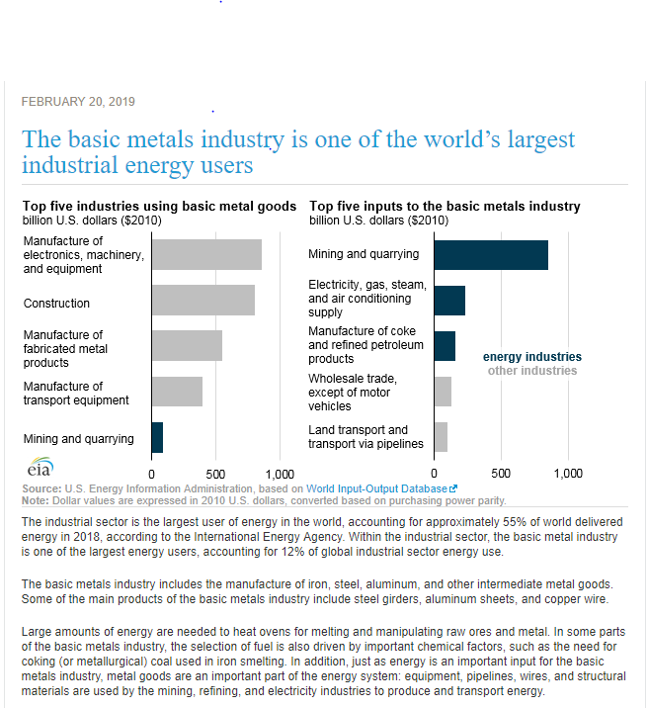
Energy for EV – renewable but
Construction of EV will also require Energy
Notes:
https://www.eia.gov/todayinenergy/detail.php?id=38392#

Slide 14
Electric Vehicle – Metals and Mining
The metal requirements - vary depending on the design and manufacturing process.
Tesla models use:
lithium, graphite, cobalt, copper, titanium, aluminum and nickel.
Nissan Leaf battery uses quantities of manganese.
Other cars use “rare earth elements” in electronics and steel to reinforce the chassis at critical points.
Example: Copper
An average gasoline-powered car uses some 20 kg of copper, mainly as wiring. A hybrid uses 40 kg. A fully electric car uses 80 kg of copper (176 pounds) per car. ⁴
Electric vehicles and batteries are expected to create huge demand for copper and cobalt. ^{5, 6}
Notes:
4. https://www.geologyforinvestors.com/metals-electric-cars-revolution-making/ (accessed 5/31/19)
5. https://www.economist.com/business/2017/03/11/mining-companies-have-dug-themselves-out-of-a-hole ( accessed 5/31/19)
6. https://www.thedrive.com/tech/26675/cobalts-perfect-storm-rattles-electric-car-supply-chain (accessed 5/31/19)

Slide 15
Mining and Energy bring us back to Reclamation
ASMR began with concerns for reclamation of mining disturbed lands.
Huge strides – via research conducted, presented and published by you and your predecessors.
The Lessons Learned have allowed this early and continuing knowledge to meet our Society’s purpose:
To encourage and assist any agency, institution, organization, or individual in efforts to reestablish, enhance, or protect our natural resources disturbed by mining or other human activities, or by disturbance through natural events.

Slide 16
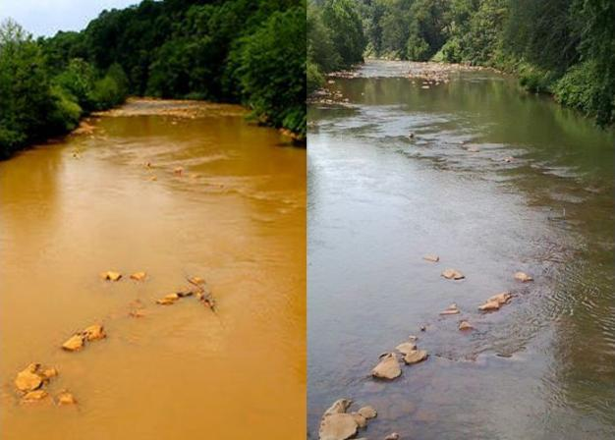
Reclamation technologies have minimized acidic weathering products from reaching the surface or ground water & prevented water degradation. Significant strides have also been made in improving waters previously degraded by acidic or alkaline waters.
Conemaugh River, PA before and after treatment
Notes:
http://archive.alleghenyfront.org/story/mining-company-invests-big-treat-acid-mine-drainage.html
Conemaugh River (fed by Topper Run), PA

Slide 17
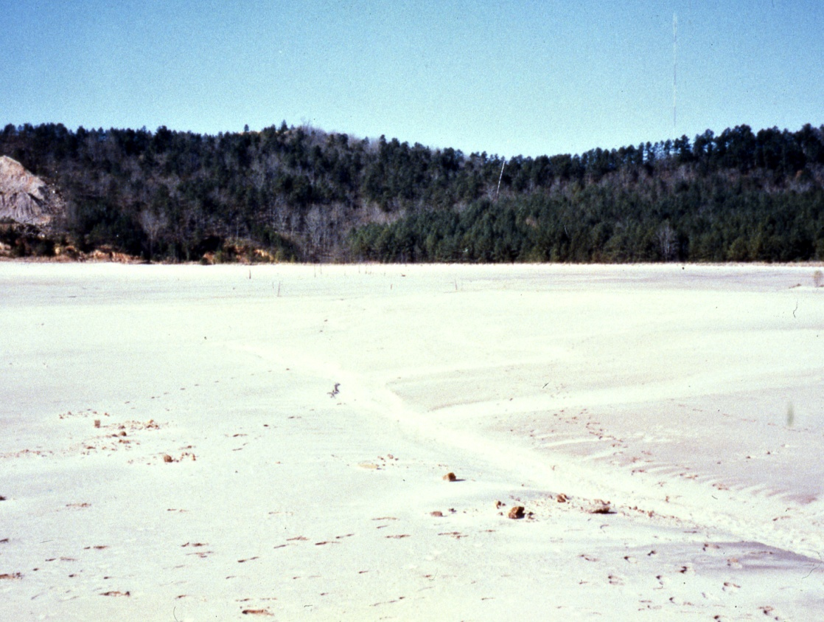
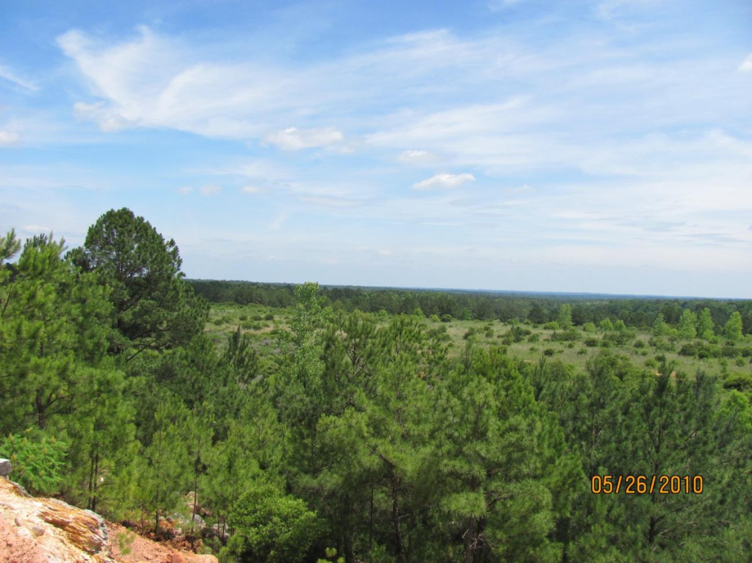
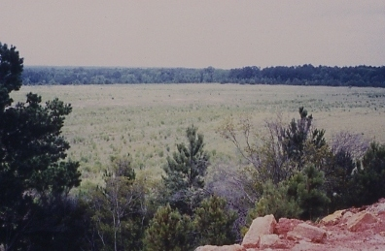
Graves Mountain site, GA
Dec. 1994
May 2010
Notes:
Jim Burger – FRA (Forestry Reclamation Approach) not all shrubs, but now yellow poplar and pines as well as murkle

Slide 18
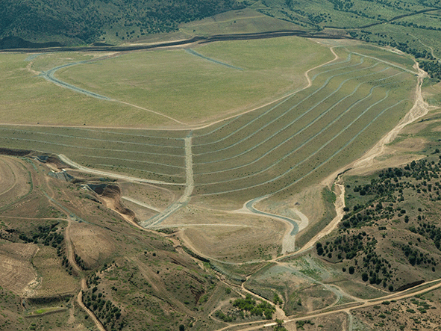
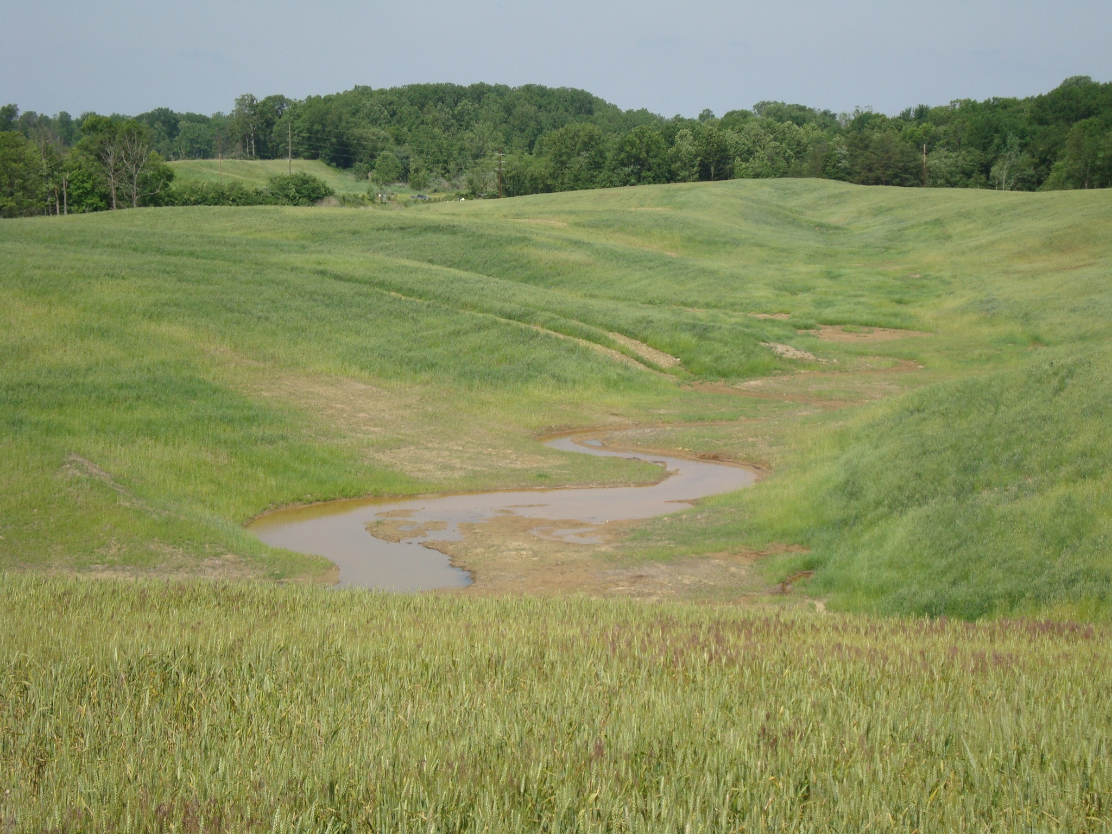
Reclamation: An Integral Component of Land Disturbance
Pipeline or frac pad or coal
Copper mine Reclamation
Tyrone Mine, NM
https://www.osmre.gov/programs/awards/AMLAwards.shtm

Slide 19
Land Reclamation is key to Environmental Preservation:
Minimizes soil erosion
Increases soils fertility
Increased levels of CO₂ in soils minimizes acid production and improves water quality
Improving soils and growth of vegetation, provides for carbon sequestration in the soils.
And ASMR is an organization dedicated to educating and assisting with these efforts
Notes:
Improved land-use practices may increase the amount of carbon stored in the top layer of soils worldwide by between 0.9 and 1.85 billion metric tons each year and that North America has the highest potential for total C storage.
(Zomer, et al. 2017).

Slide 20
But Reclamation includes other Rs!
The Many R’s of Sustainable Land Use and Environmental Stewardship :
  Reclamation
  Restoration
  Reforestation
  Revegetation
  Revitalization
  Rehabilitation
  Remediation

Slide 21
ASMR Strategic Plan
In Dec. 2018, NEC adopted a Strategic Plan based on
Strengths – 14 identified including:
Diverse membership, extensive database of research, financial stability.
2) Weaknesses –
small membership, extent of efforts not captured in our name, our electronic footprint.
3) Threats and Opportunities:
Opportunities to promote, enhance and expand current diversity of membership, though recognizing that other organizations have some overlap with our interests and expertise.
.
Notes:
Given our history of reclamation tied to mining, great strides have been made in the last 45 years and, as envisioned, the gains learned here are now applied to many sectors of “R.”

Slide 22
Goals identified to address SWOT
Transition the society’s identity –
from an industry focus to a discipline focus : such as reclamation science
including land and water reclamation science.
This transition would increase the scope and breath of the association.

Slide 23
Goals identified to address SWOT
During transition, re-branding would:
1) create the opportunity for other industries, regulatory agencies, and individuals to see increased value in membership, conference participation and journal contributions.
2) improve our web presence
3) ensure sustainability and relevance of society into the future.

Slide 24
The Society would Continue to Seek and Encourage our Four Prongs of Support
Governmental: Federal and State Agencies
Energy and Mining: such as Peabody and Midas Gold
Professional Organizations: such as KC Harvey Environmental, LLC; Pace Analytical; Brierley Assoc. and many others who are sponsors and exhibitors
Academia:

Slide 25
In Summary:
Energy and grid security are essential and mining will continue with reclamation as a critical component;
2) Effective reclamation maintains water quality and ensures that existing land and new soils will retain value;
3) Our society can continue to play an important role in promoting and providing technology transfer for effective reclamation.
Notes:
Coal will continue to be mined even as it is retired from the electric grid and reclamation essential and reclamation of past and present mines is critical
2) Effective reclamation maintains water quality and ensures that existing and new soils will retain value.
Global Sequestration Potential of Increased Organic Carbon in Cropland Soils
Robert J. Zomer,
Deborah A. Bossio,
Rolf Sommer &
Louis V. Verchot
Scientific Reports 7, Article number: 15554(2017)
doi:10.1038/s41598-017-15794-8

Slide 27
References
Smart Electric Power Alliance (SEPA), A Comprehensive Guide to Electric Vehicle Managed Charging . SEPA 2019 Report (Ericka Myers). https://sepapower.org/resource/a-comprehensive-guide-to-electric-vehicle-managed-charging/
BHP Billiton
https://www.eia.gov

