Slide 1
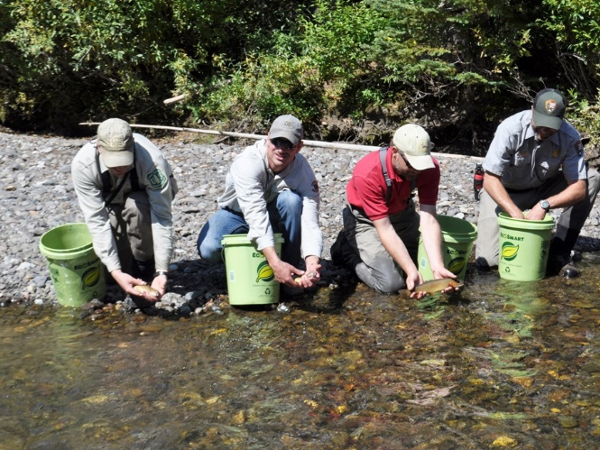


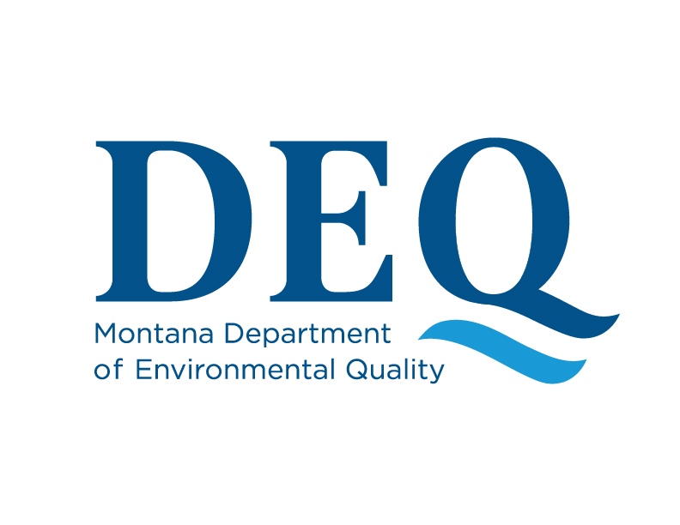
Collaborative Science Supports Recovery of Yellowstone’s Soda Butte Creek
Andrew Ray, Autumn Coleman, and Tom Henderson
4 June 2019
ASMR Conference
Big Sky, Montana
Notes:
Wow, pulling off a project like this in a place where the average annual snowfall accumulates to 20 feet and where the work window is about 4 months does in indeed REQUIRE ruthless persistence, ingenuity, real technical skills, STRONG partnerships, and a collaboration champion.
We had all of these, particularly the collaboration champion in Tom Henderson.

Slide 2
Collaborative Science Supports Recovery of Yellowstone’s Soda Butte Creek
Boundary-spanning opportunities
Involves sharing resources and information
  Historical data sets: mining data!
Promotes innovation, mutual learning, and expanded possibilities
Improves scientific understanding to inform decision-making
Notes:
Why is collaboration crucial to Reclamation and Water Resources Science?
Tom Henderson knew that it facilitated our ability to work across borders and at ecologically and hydrologically relevant scales.
Collaboration also means consolidating resources and the regular sharing of information and knowledge.
In places like Soda Butte Creek where old datasets are plentiful, sharing of information also means ‘mining‘ existing datasets and leveraging historic data sets in your current work –
What do I mean, ask yourself how you can use it for establishing baseline conditions or for understanding temporal change or for looking at pre and post-reclamation conditions.
Collaboration also promotes innovation, facilitates mutual learning and expands what is possible in all your project and post project work
Finally, collaboration facilitates interactions that improve understanding among partners and supports decision making

Slide 3
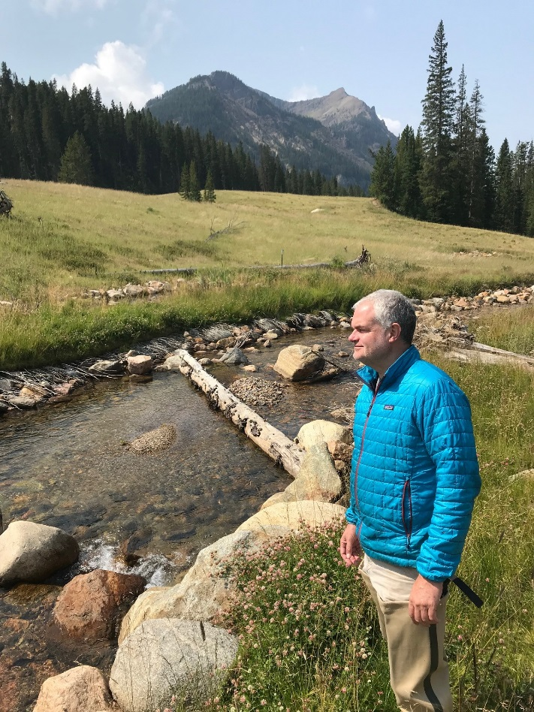



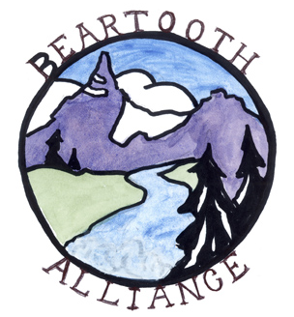


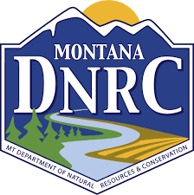
Collaborative Science Supports Recovery of Yellowstone’s Soda Butte Creek
Collaborations Key to the Recovery of Soda Butte Creek
Reclamation
  MT DEQ, MT DNRC, NPS WRD, YELL, USFS, Beartooth Alliance
Water Quality Response and Delisting
  NPS GRYN, MT DEQ AML and WQM&A, YELL, NPS WRD, USGS, MSU
Restoration of Native Fishery
  NPS, USFS, MT FWP, WGFD, Beartooth Alliance

Slide 4
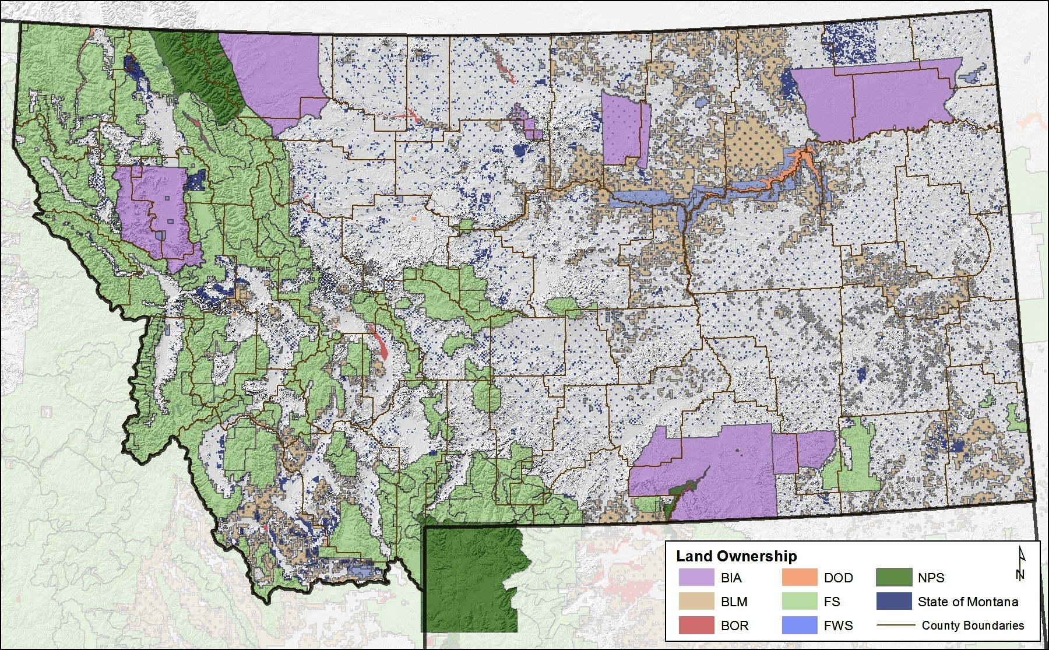
Collaboration is Crucial
Notes:
Collaboration IS crucial to land and water management everywhere.
Our MODERN landscapes require it.
Montana is a good example of this where ownership is divided among tribes, private landowners, and multiple land management agencies.
For those of you that aren’t familiar with Soda Butte Creek it begins just outside the NE boundary of Yellowstone National Park near the town of Cooke City.

Slide 5
Collaboration on Soda Butte Creek
Boundary-spanning work
McLaren Mill and
Tailings Site
Yellowstone National Park
Notes:
Even in this 5 mile segment of stream bounded by the McLaren Mill to the east and YNP to west…... federal, state, and private lands demand collaboration among stakeholders.

Slide 6
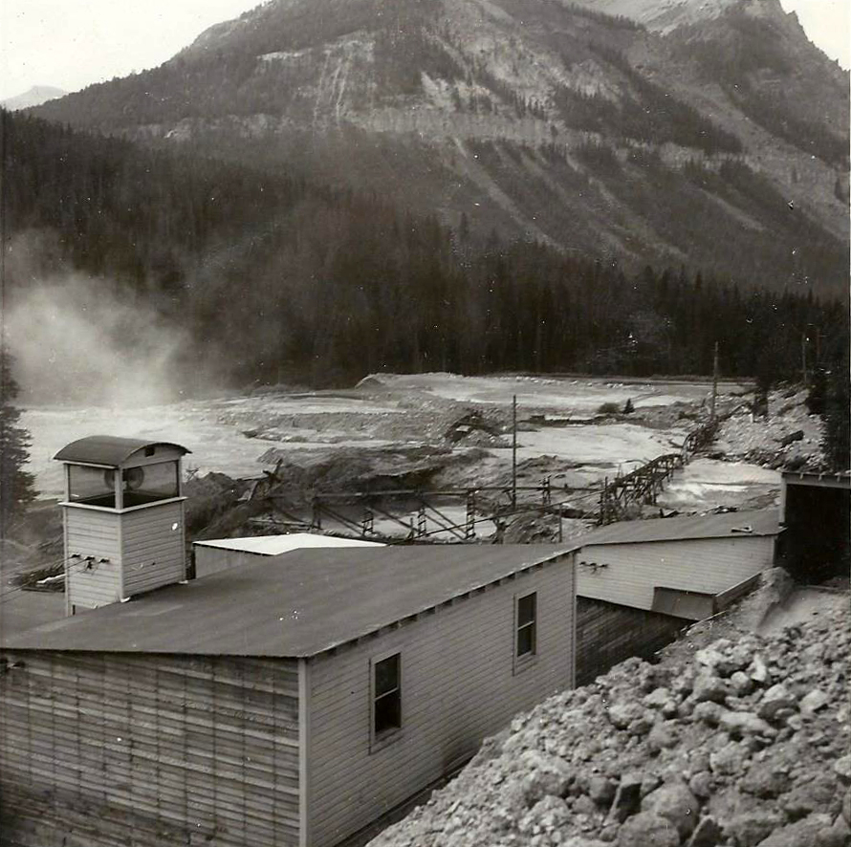
McLaren Gold Mines
1933 to 1953
Overall Productivity:
Gold: 60,000 oz
(≈ $72 million in 2018 dollars)
Copper 2,000 tons
(≈ $10.7 million in 2018)
Environmental Legacy:
Deposited 250,000 yd³ of mine tailings in floodplain
McLaren Gold Mine Mill, 1946. Courtesy of Cooke City Montana Museum.
Notes:
The McLaren Mining Company began after neighbors E.B. Turner and Water McLaren detected particles of gold in Gros Vente formation on Henderson Mountain.
The McLaren Mill, primarily a Gold and Copper mill, produced 60,000 troy oz of gold and 2,000 short tons of copper during is 20 years of operation.
The environmental legacy of this 20 year operation however persisted. Concerns about the downstream impacts of the mill were voiced as early as 1937 in an internal company memo:
‘The present milling plant is situated one mile east of Cooke City on Soda Butte Creek, which drains into YNP….this drainage in entering the Park introduces serious complications’. Cited in Glidden 2001.
In the end, the McLaren Gold Mine Mill deposited 250,000 cubic yards of waste in the Soda Butte Creek floodplain and covered up the stream itself.

Slide 7
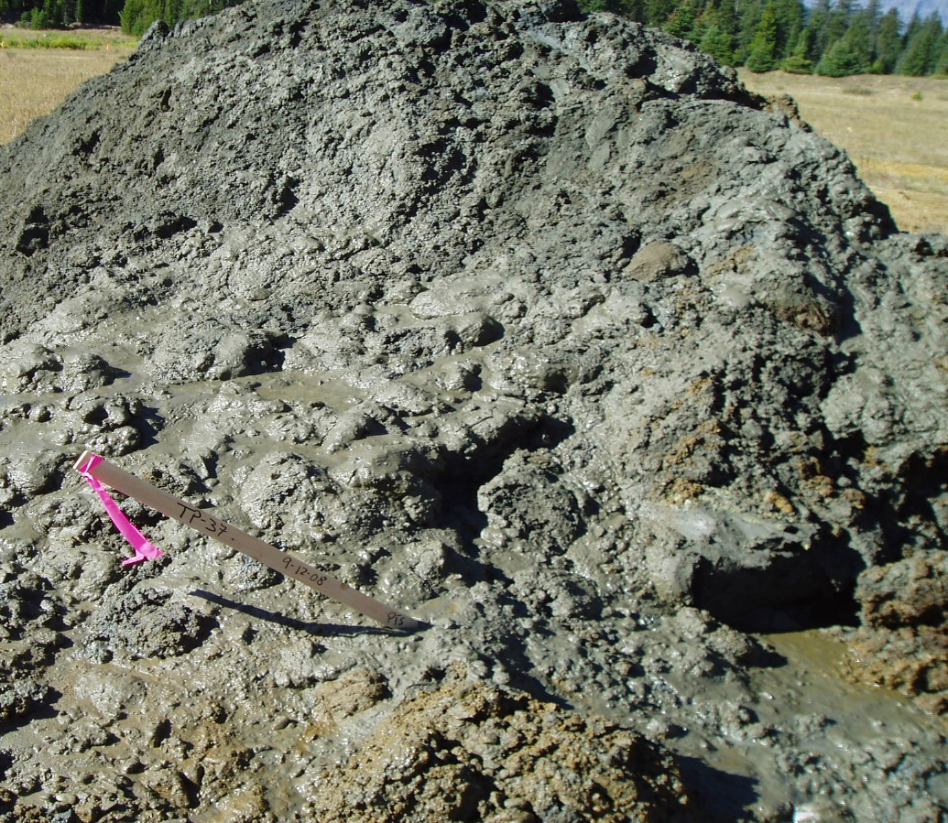
McLaren Mill and Tailings and NPS Concerns
1800’s ‘fast fishing and large trout’
1930’s fishery degraded
1950’s Chief Ranger memos highlight concerns
Tailings contained 20% pyrite
Water in tailings :
  Cu and Fe > 1000x MT standards
  Pb > 100x above
  Cd, Ag, As, Zn > 10x above
Notes:
In the 1800’s Soda Butte Creek was described as having ‘fast-fishing and large-trout’.
As early as the 1930’s mining impacts had already degraded the quality of the fishery. McLaren Mill and Tailings site further degraded the fishery of Soda Butte Creek for decades creating a pollution barrier that was toxic to fish.
Copies of official memos to the Chief Ranger in 1949 and 1950 during active operation indicate that Mill site infrastructure had annual failures.
Efforts in 1969 were carried out to ‘eliminate pollution from the offending tailing area’. These included rechanneling of stream around tailings and amendment of 2 feet of soil with grass seed added.
Despite these efforts, groundwater seeping from the tailings impoundment contained high concentrations of dissolved metals. The stream reach immediately down-stream of the acidic inflows was coated with orange to red-colored deposits typical of streams receiving acid mine drainage.

Slide 8
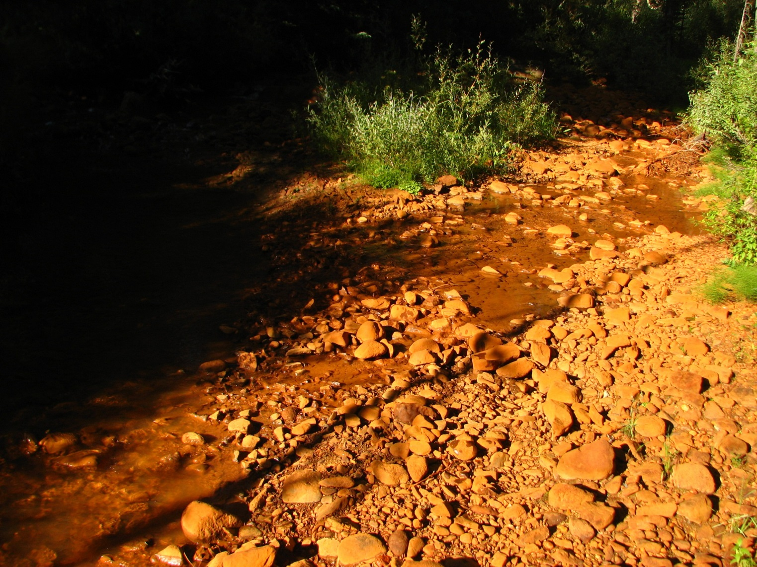
Collaboration on Soda Butte Creek
Data-mining and Information Discovery
Soda Butte Creek
Fall 2008
Tailings Discharges (USGS):
Fe 418 mg/L
Al 122 mg/L
Cu 6 mg/L
Pb 0.6 mg/L
Cd 0.06 mg/L
Notes:
8
In the Fall of 2008 and prior to reclamation the USGS characterized some of the concentrations of metals leaving seeps in the tailings.

Slide 9
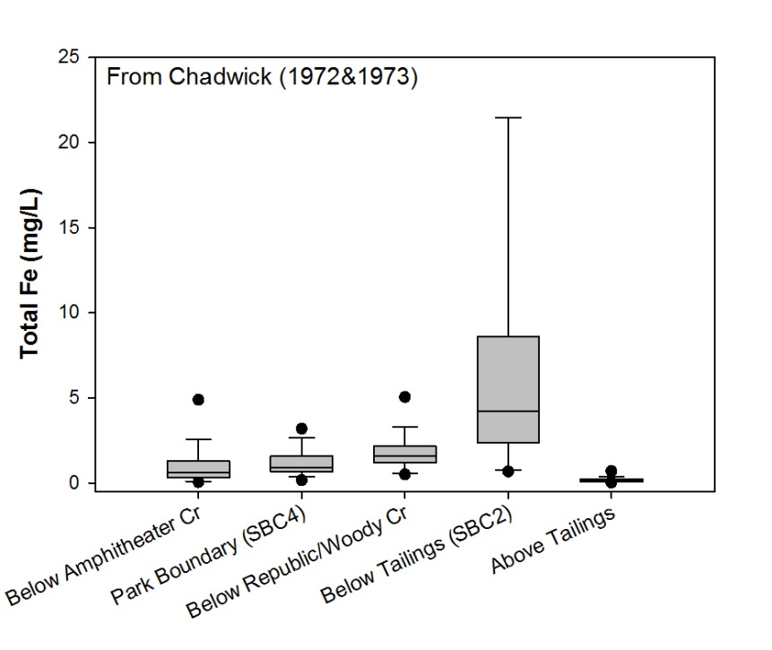
Data-mining and Information Discovery
Direction of Flow
Direction of Flow
0.6
1.6
0.9
4.2
0.1
Map from Chadwick (1974)
Notes:
Graduate students from MSU began longitudinal studies of the WQ, diatom, macroinvertebrate, and fish assemblages in Soda Butte Creek.
From their 13 month study in 1972 and 1973, they found that water quality below the former Mill and Tailings site had high concentrations of iron and sulfate.
Median Fe concentrations were 0.12 mg/L above the tailings site and 35X higher below. Concentrations >20 mg/L were documented. Water quality improved with increasing distance d/s of tailings.

Slide 10

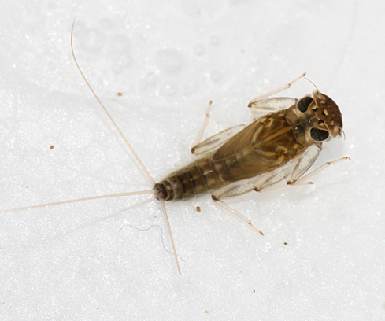
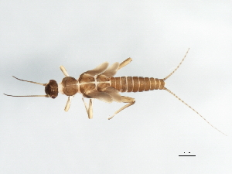
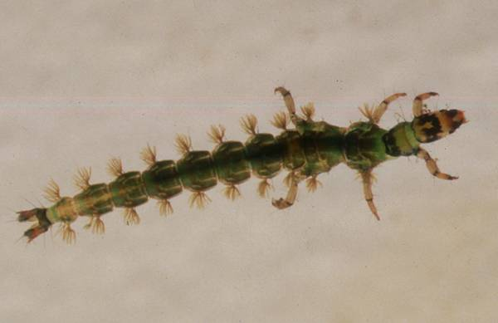
Biological Impacts
Mayfly
Cinygmula
Direction of Flow
Stonefly
Nemoura
Caddis
Rhyacophila
Site | 1 SBC-1 | 2 SBC-2 | 3 SBC-RC | 4 SBC-4 | 5 SBC-IBC
Total Count | 174 | 0 | 392 | 800 | 381
Richness | 13 | 0 | 11 | 13 | 15
Diversity | 1.66 | 0 | 1.35 | 1.63 | 2.06
Map from Chadwick (1974)
Notes:
Importantly, diatom and macroinvertebrate communities indicated biological effects of waters seeping from the former tailings site.
Downstream of the tailings, diatom growth was absent, but productivity and diatom richness increased in a downstream manner.
Similarly, macroinvertebrate richness and abundance was lowest below the former mill and tailings site.

Slide 11
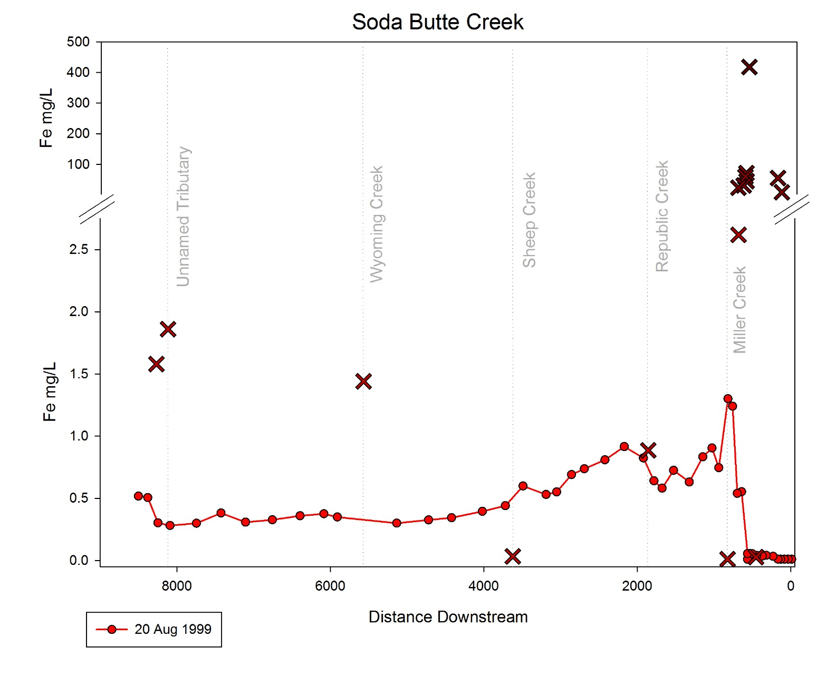
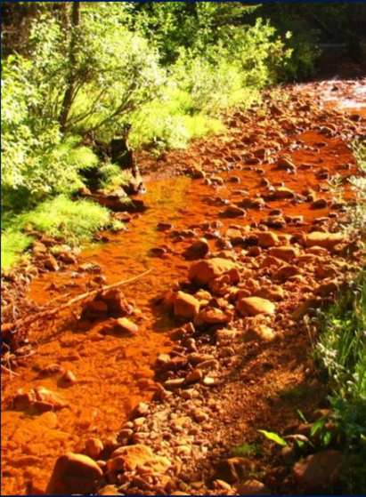
Water Quality Impacts
Soda Butte Creek, below former tailings site. 2008.
DEQ Chronic Aquatic Life Standard for Fe = 1.0 mg/L
Data from Boughton, G.K. 2001.
Notes:
Longitudinal studies

Slide 12

Improves Scientific Understanding and Supports Decision Making
Mining disturbances are primary source of increased metals loading in SBC… McLaren Tailings…is the most significant. Treatment and removal would reduce metal loading - Boughton 2001 and MT DEQ 2002
Yashan et al. 2002. Water Quality Restoration Plan for the Cooke City TMDL Planning Area. Montana Department of Environmental Quality. Helena, Montana. 208 pp. Published September 23, 2002.
Boughton, G.K. 2001. Metal loading in Soda Butte Creek upstream of Yellowstone National Park, Montana and Wyoming: a retrospective analysis of previous research and quantification of metal loading, August 1999. USGS Water Resources Investigations Report 01-4170. Cheyenne, Wyoming.
Notes:
Pulling together existing data sets led to the conclusion that mining impacts were the most significant source of metal loading in Soda Butte Creek and state water managers concluded that a 99% reduction in metal loading would be needed to improve water quality in Soda Butte Creek and restore ecological characters.

Slide 13

Leveraging Existing Datasets
Pre- and Post Reclamation
2008
2013
Notes:
Now, I want to begin sharing some examples of how we leveraged former datasets to maximize their value.

Slide 14
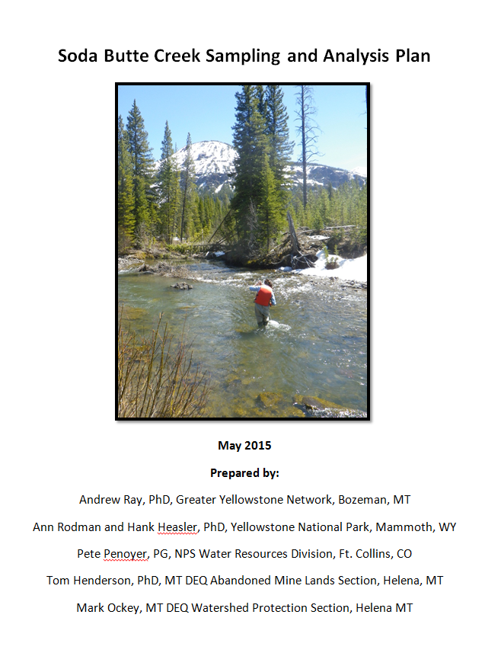
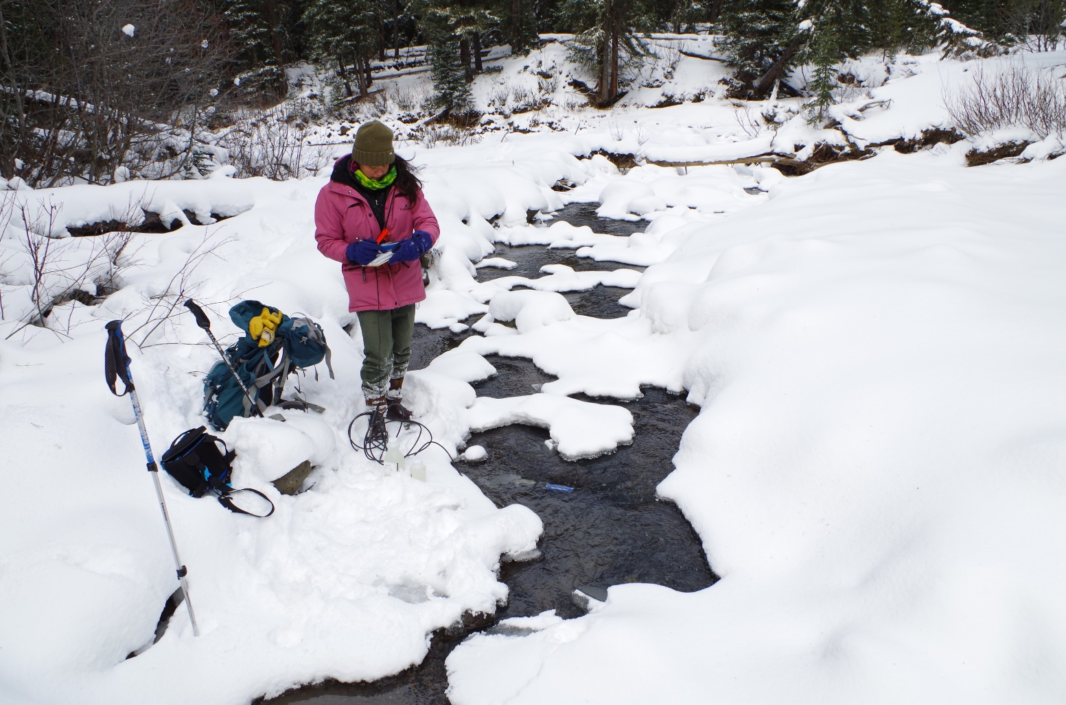
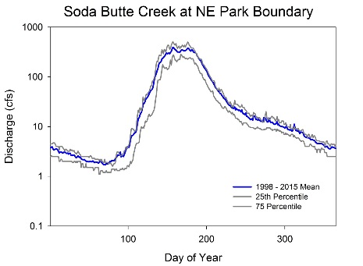
Post-Reclamation WQ Study of Soda Butte Creek 2015 & 2016
Notes:
Its also important to note that state and federal scientists worked collaboratively to co-produce a Sampling and Analysis Plan that met multiple needs and built off prior work in the basin.

Slide 15
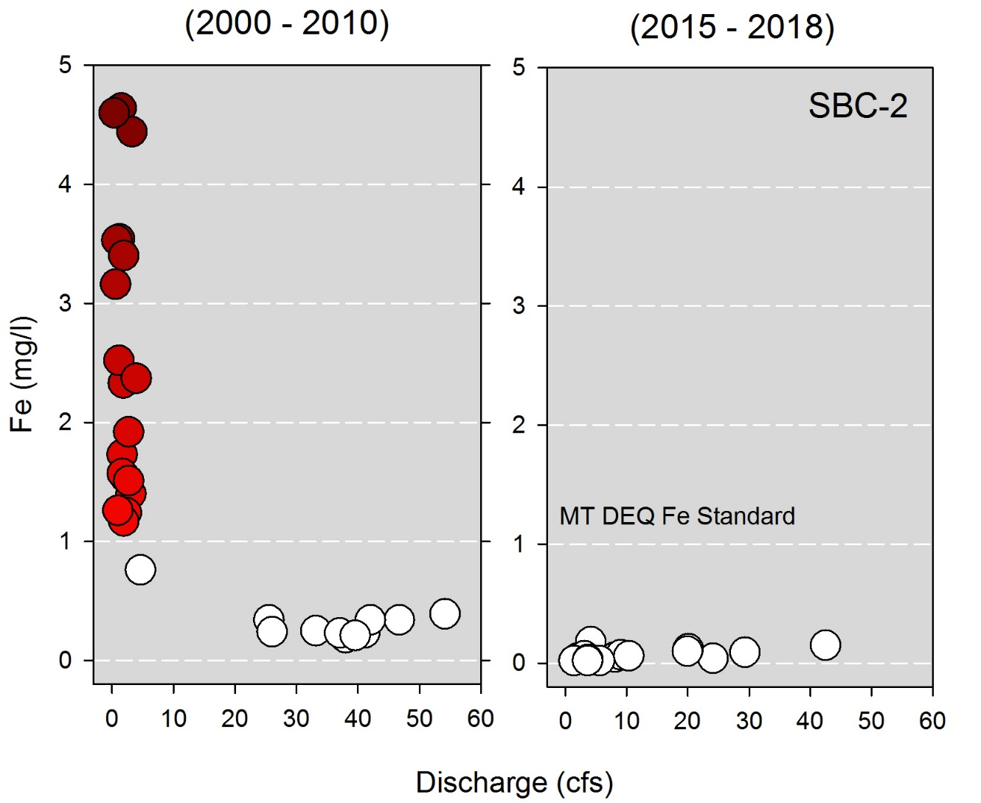
Co-location of monitoring sites supported pre- and post- reclamation comparisons
USFS Data
Notes:
Co-locating monitoring sites, for example, supported comparisons between current and historic, pre-reclamation datasets.

Slide 16
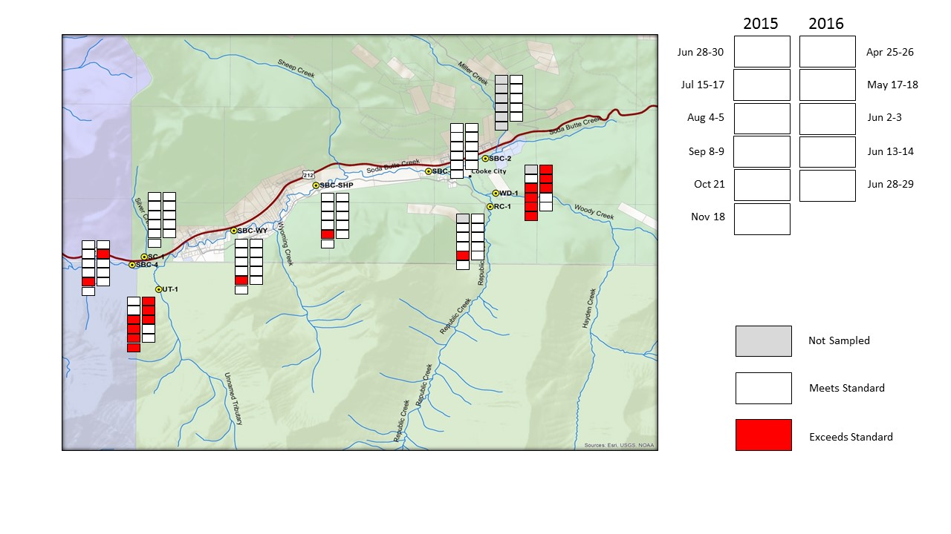
Current WQ Exceedances
Iron
Notes:
Our collaborative monitoring work described in our Sampling and Analysis Plan not only quantified metals concentrations throughout the watershed they identified when and where exceedance happened

Slide 17
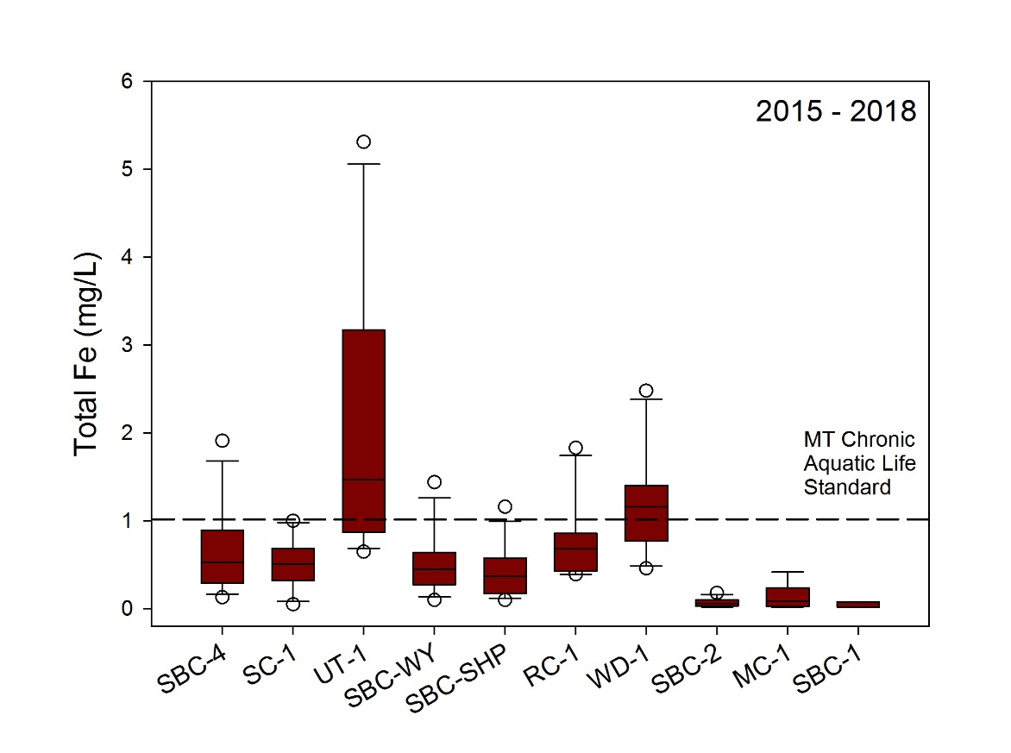
SBC WQ Study 2015 - 2018
Sample Results
Fe levels lowest above and below former tailings site
Highest [Fe] from 2 tributaries
At YNP boundary generally below MT DEQ chronic aquatic life criterion
Direction of Flow
Notes:
Our collaborative monitoring work, led to an improved understanding of current metal concentrations throughout the watershed. Here we learned that Fe….

Slide 18
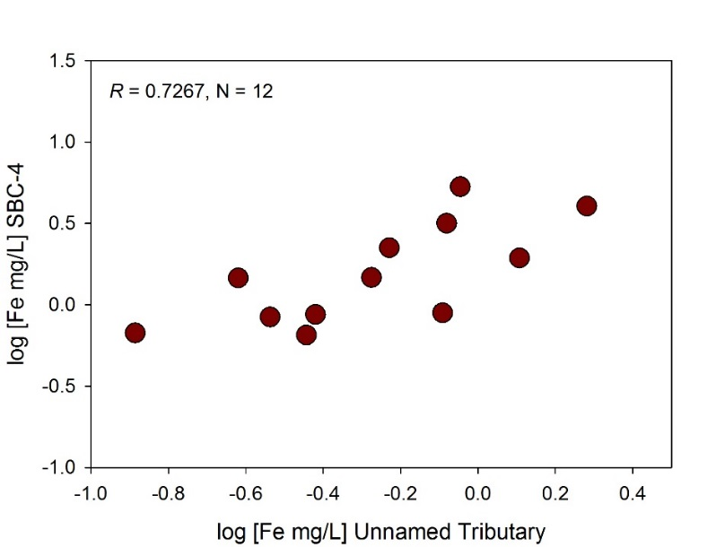
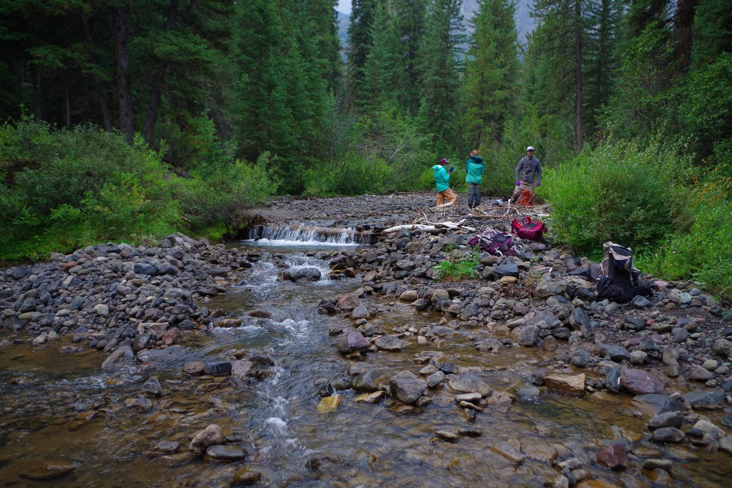
Unnamed Tributary Influence
Notes:
This improved understanding showed NPS managers that Fe measured at the YNP boundary TODAY is not the result of the former mill site, but instead a tributary just outside the YNP boundary.

Slide 19
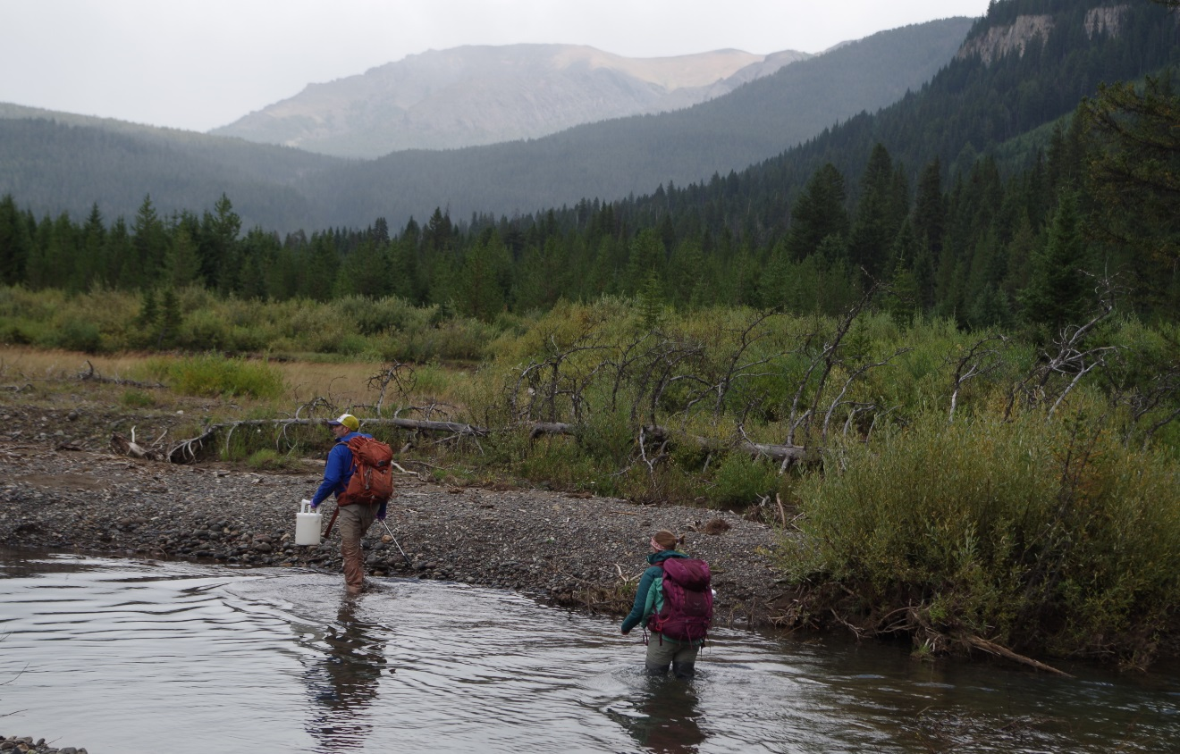
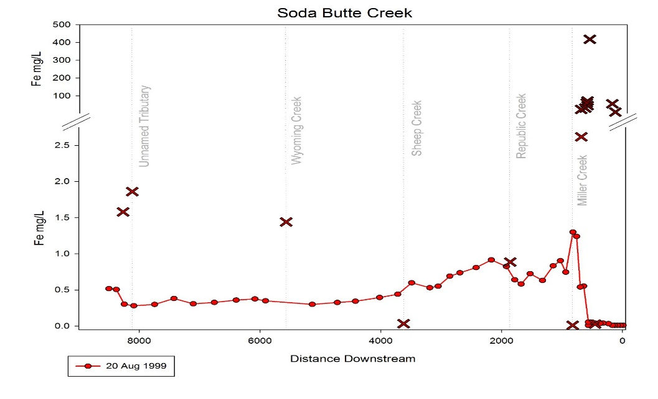
Leveraging Existing Datasets
Pre- and Post Reclamation
Notes:
We continue to leverage historic datasets for maximum value. Just last year we began repeating previous studies by Greg Boughton and other scientists.

Slide 20
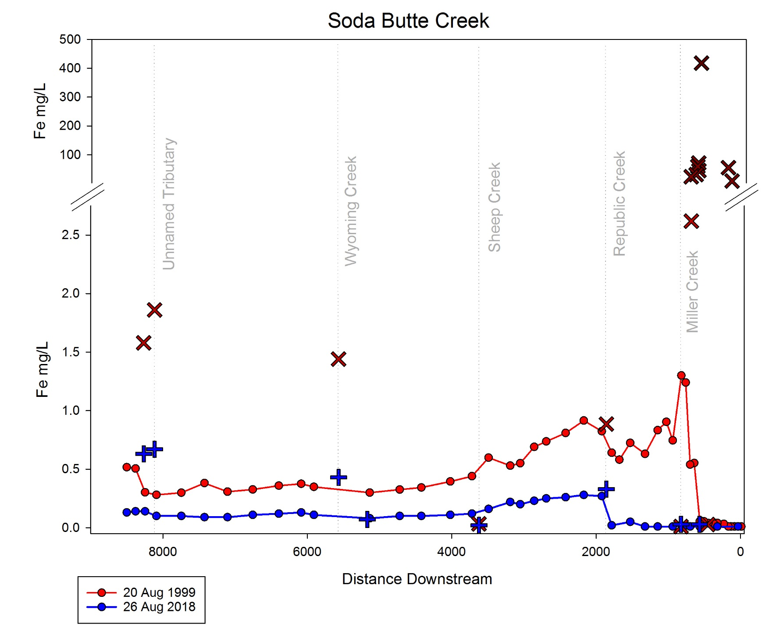
DEQ Chronic Aquatic Life Standard for Fe = 1.0 mg/L
Notes:
These repeats of previous monitoring efforts help reveal the dramatic and more nuanced changes in water quality.

Slide 21
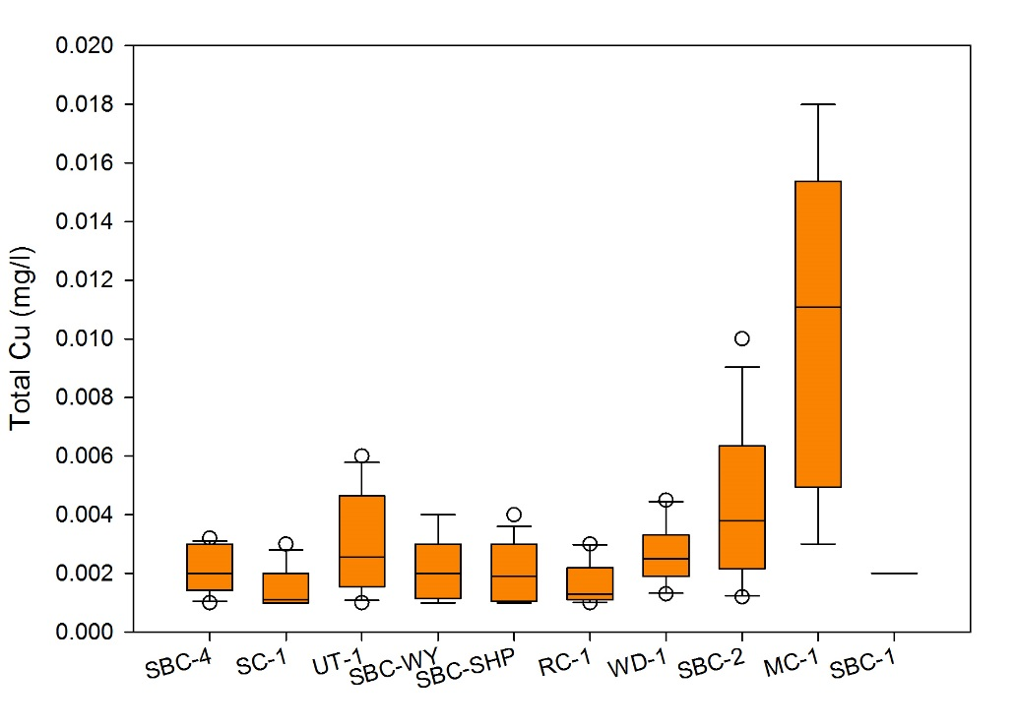
SBC WQ Study 2015 – 2018 Sample Results
Cu levels in SBC variable but mostly below DEQ criterion
Exception is Miller Creek where [Cu] are 3 to 4X higher
At YNP boundary Cu below DEQ criterion
Direction of Flow
Notes:
Our work with Iron represents just one example of our findings. We also have documented trends in copper at these same monitoring locations and this work reveals that the current source of copper is a tributary, Miller Creek, that also has a history of mining.

Slide 22
Leveraging Existing Datasets
Pre- and Post Reclamation
Direction of Flow
Site | 1 SBC-1 | 2 SBC-2 | 3 SBC-RC | 4 SBC-4 | 5 SBC-IBC
Total Count | 174 | 0 | 392 | 800 | 381
Richness | 13 | 0 | 11 | 13 | 15
Diversity | 1.66 | 0 | 1.35 | 1.63 | 2.06
Map from Chadwick (1974)
Notes:
This past September we repeated another historic dataset by graduate student James Chadwick at MSU. Recall, Chadwick found no macroinvertebrates downstream of the former mill and tailings site.

Slide 23

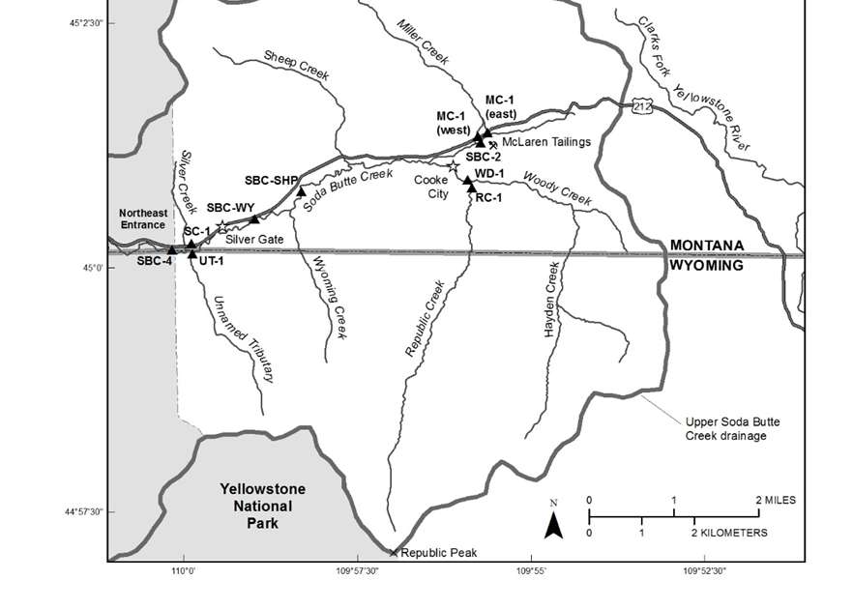
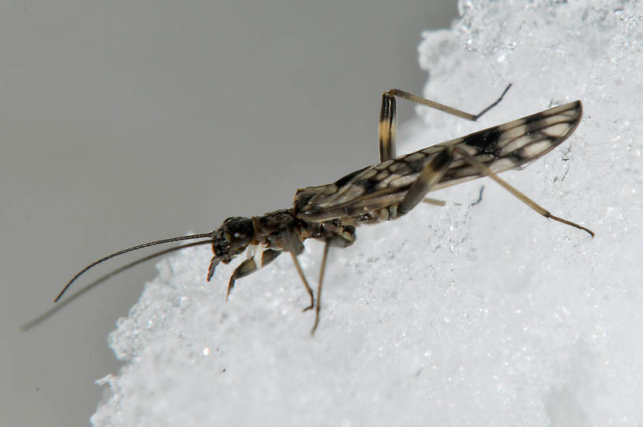
Cinygmula sp.
Zapada columbiana
Site | SBC-1 | SBC-2 | SBC-RC | SBC-4 | MC-1 | UT-1
Total Count | 550 | 538 | 536 | 543 | 468 | 550
Richness | 48 | 41 | 35 | 40 | 34 | 40
Diversity | 3.15 | 3.02 | 2.81 | 2.68 | 2.80 | 2.74
Notes:
Today, the story with macroinvertebrates is much different. Sensitive coldwater dependent stoneflies such as Zapada columbiana and mayflies Cinygmula were abundant ABOVE and BELOW the project site.

Slide 24
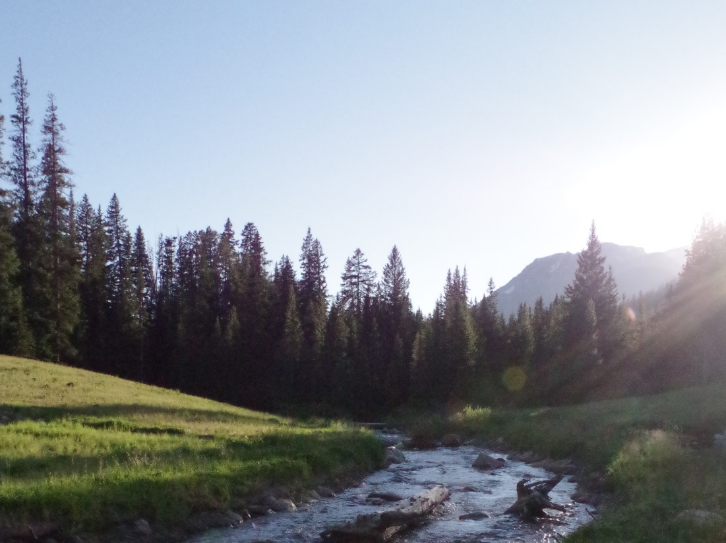
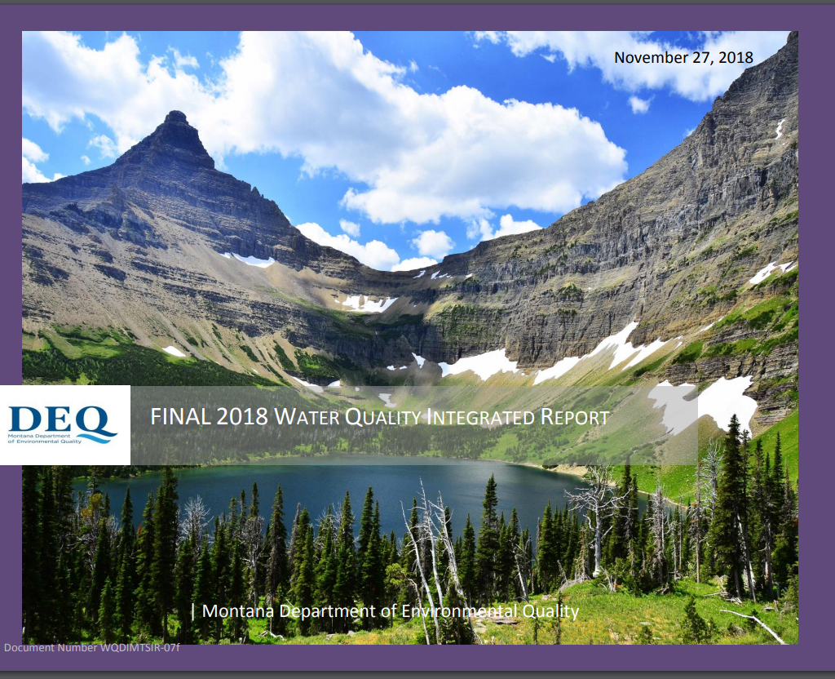
Collaborative Science Supports Recovery of Soda Butte Creek
Boundary-spanning work
  Cooke City to YNP
Sharing resources and information
  Reclamation to WQ to Fisheries
  Relied heavily on historic data sets
Improved scientific understanding to inform decision-making
MT DEQ delisting of Soda Butte Creek
First Abandoned Mine clean-up to result in CWA delisting of all metals
Notes:
I hope I’ve conveyed how this work at the McLaren Mill site was boundary spanning: it wasn’t limited to project site but stretched from the headwaters of SBC to the YNP boundary and beyond.
Key to the success was sharing resources and information….
…from the reclamation successes to WQ improvements and biological responses.
Sharing information included leveraging all available data for maximum impact
Collectively this work strengthened our understanding of WQ improvements below the reclamation site and baseline conditions watershed-wide.
Importantly the work supported management decisions….

Slide 25
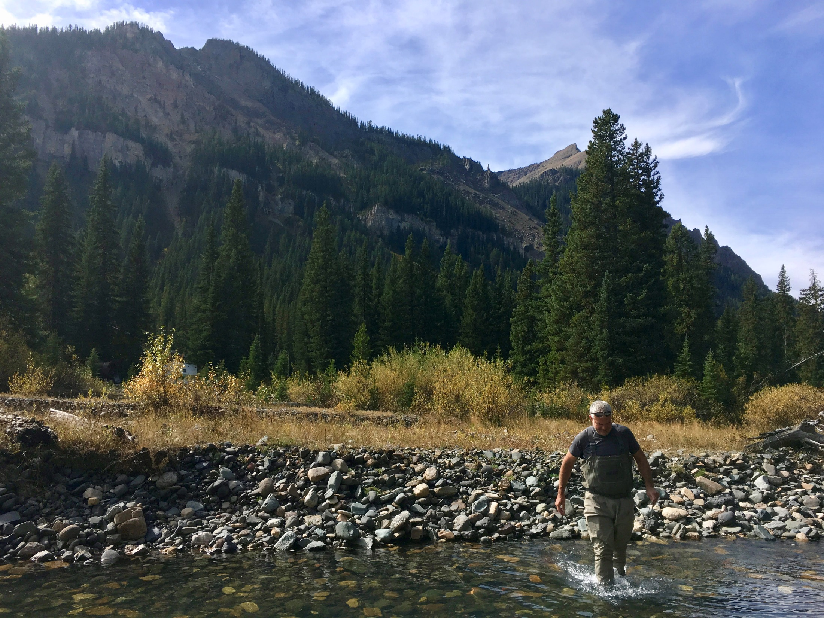
Collaborative Science Supports Recovery of Soda Butte Creek
Notes:
These are some summaries of the post-reclamation work that Tom Henderson championed and I’d be happy to share those with people that are interested….he was proud of this story and we are excited to share it.

Slide 26
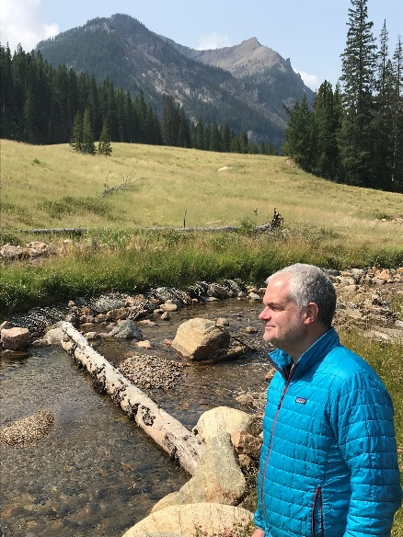
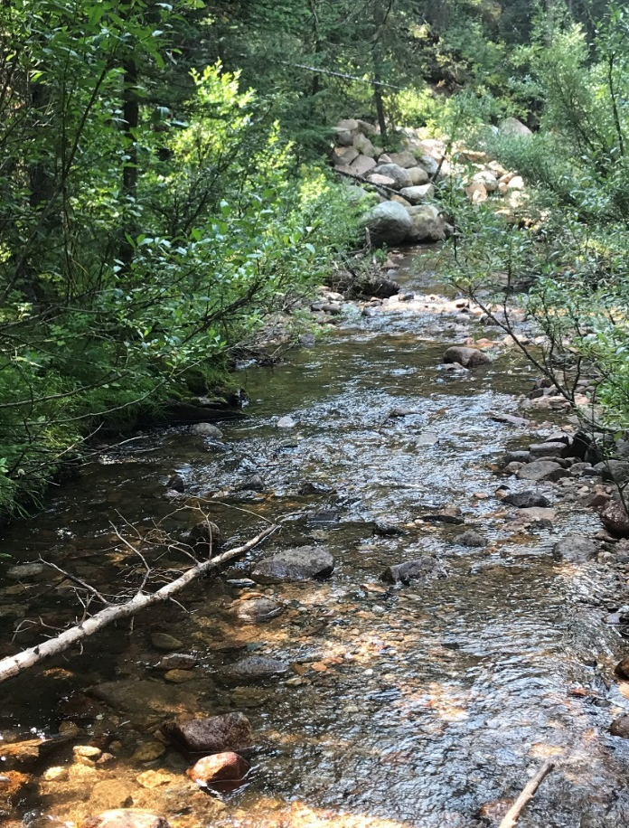
McLaren Mill and Tailings Reclamation
2008
2013
2018
Notes:
But, by far the most visible reminder of Tom’s great work on the McLaren Mill and Tailings site sits 5 miles east of Yellowstone NP and just outside Cooke City. Please consider taking a visit and seeing first hand how efforts championed by Tom Henderson single handedly made Yellowstone NP a better place for all of us.

