Slide 1
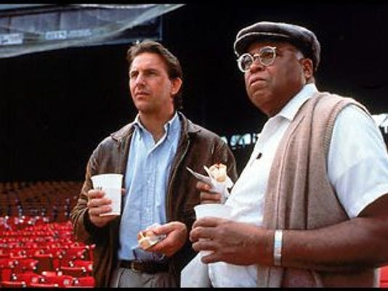
ASMR 2020: Duluth, MN
“We’re Going to Minnesota Now.”
“I don’t Believe This. What’s in Minnesota?”

Slide 2

What’s in Minnesota?
- Fargo

Slide 3
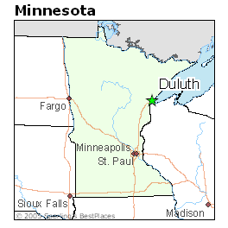
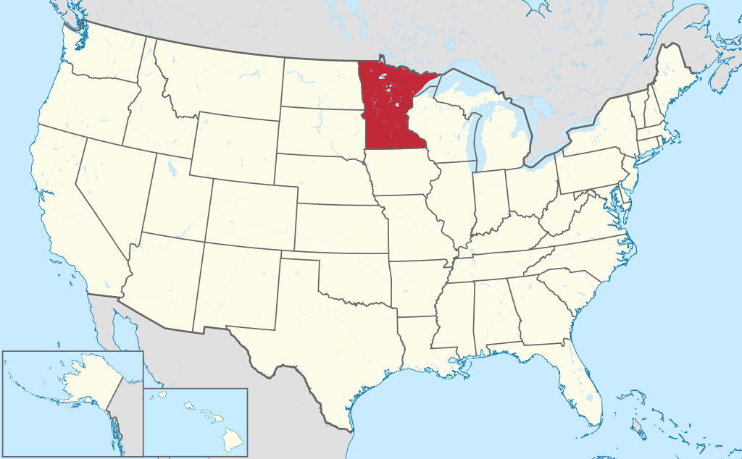
What’s in Minnesota?
- Fargo

Slide 4
What’s in Minnesota?
- Fargo
- Polar Bears

Slide 5
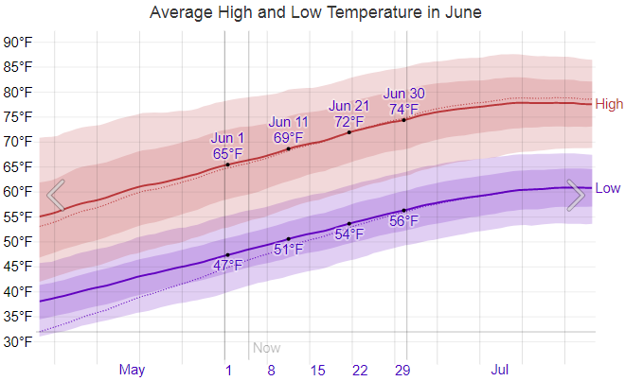
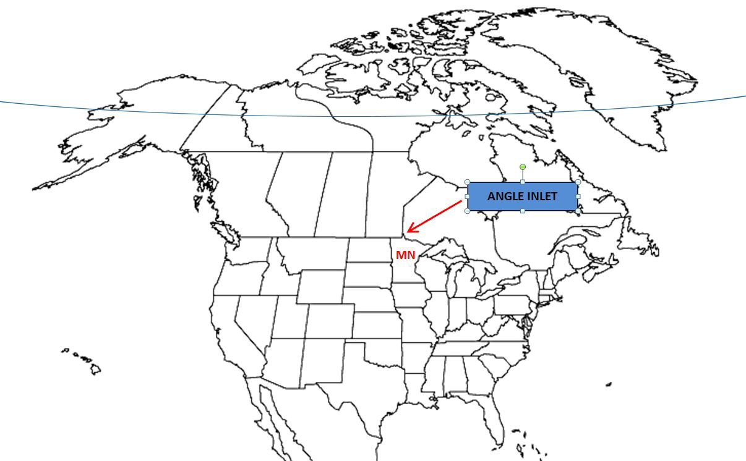
What’s in Minnesota?
- Fargo
- Polar Bears
Arctic Circle is really WAY above Duluth somewhere.

Slide 6
What’s in Minnesota?
- Fargo
- Polar Bears
- Lutefisk

Slide 7
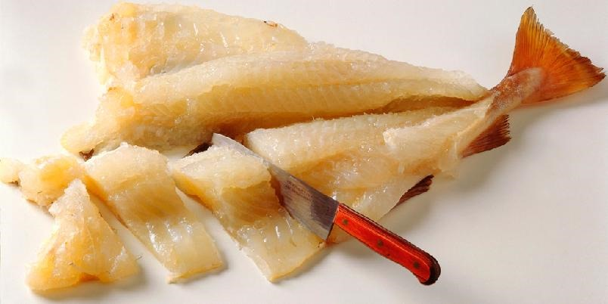
What’s in Minnesota?
- Fargo
- Polar Bears
- Lutefisk*
Codfish, rehydrated in lye.
It’s a thing. Don’t worry about it.
* Except, in some houses, at Christmas. (Your results may vary.)

Slide 8
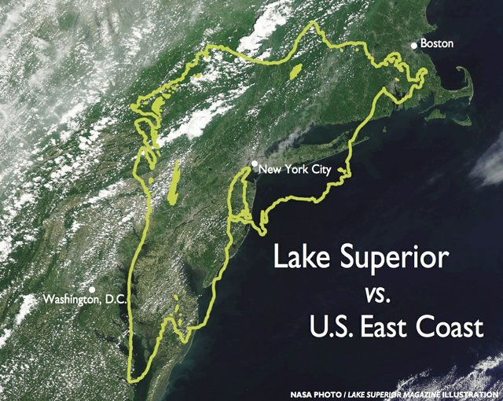
What’s in Minnesota?
- 10% of Earth’s fresh water
Yup. 3 quadrillion gallons.

Slide 9
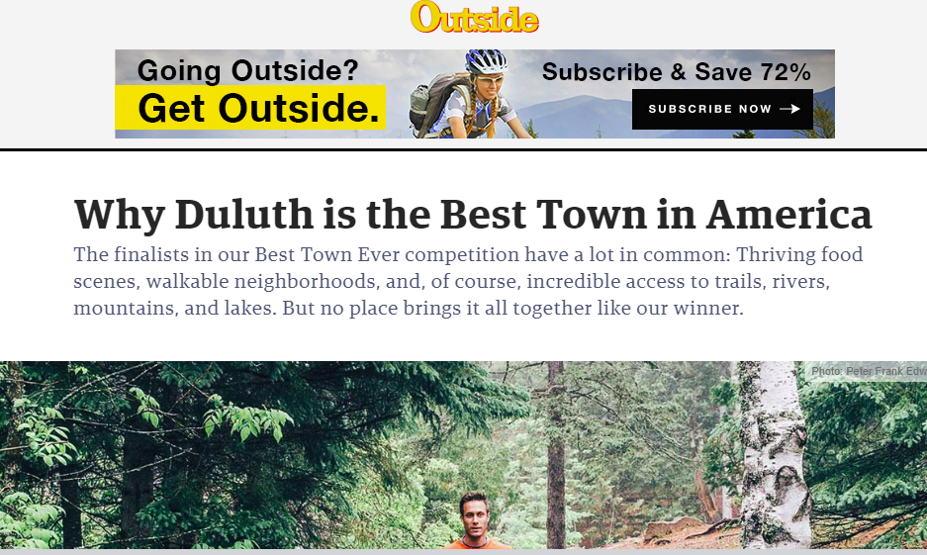
What’s in Minnesota?
- 10% of the Earth’s fresh water
- Outside Magazine’s Best Town Ever
Yup. Duluth.

Slide 10
What’s in Minnesota?
- 10% of the Earth’s fresh water
- Outside Magazine’s Best Town Ever: Duluth
- Mining

Slide 11
What’s in Minnesota?
Mining
- 5th largest in the US
- Duluth is the #1 tonnage port on the Great Lakes
- Taconite, peat, Cu/Ni +/-PGE, manganese, dimension stone, crushed rock, sand and gravel

Slide 12
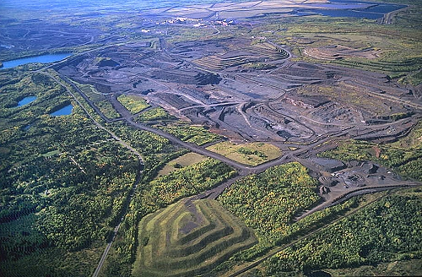
What’s in Minnesota?
Regional, landscape-scale mining & reclamation
Adaptive re-use of mining landscapes
www.visitduluth.com

