Slide 1
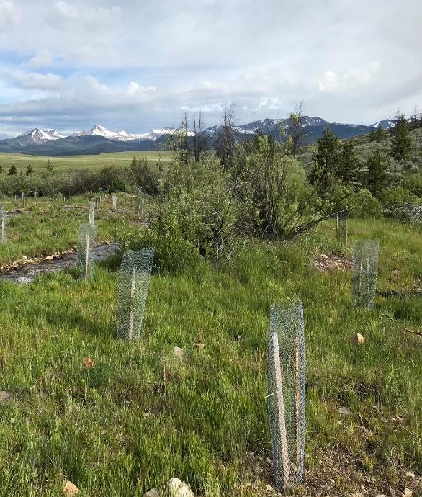
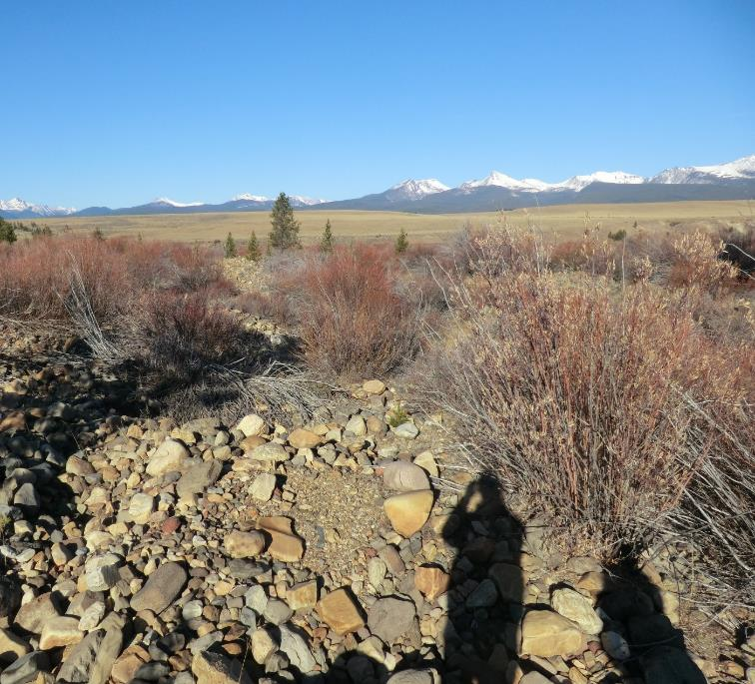
Restoration
French Gulch & Moose Creek
We create solutions that build better communities
Notes:
Quick intro and background

Slide 2
Outline
Project Planning
Survey and Design
Construction Process
Monitoring Post Construction
Enhancements
Future Monitoring
Take Home Lessons
French Gulch & Moose Creek Restoration
Notes:
Quick outline of presentation topics

Slide 3
Others:
Montana Civil Contractors
Watershed Consulting
R & S Johnson Construction
Pioneer Technical
Montana Conservation Corps
Notes:
Project owners, agency, design team, contractors

Slide 4
Project Location
Anaconda Smelter Impacts
Project Location
Notes:
Describe location, SW of Butte. Private individual mines from 1800s

Slide 5
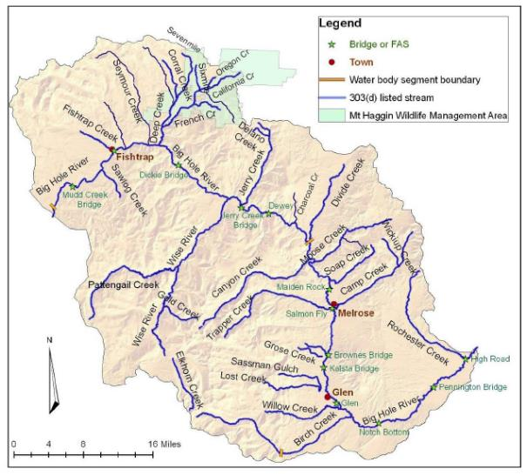
Project Location
Notes:
Public lands, watershed restoration

Slide 6
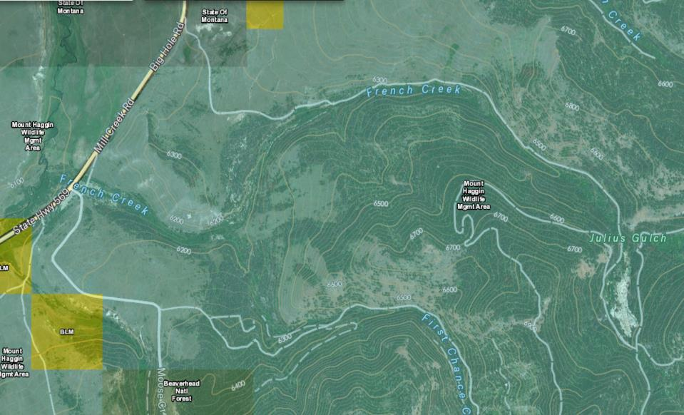
Project Location
Notes:
Public lands, watershed restoration

Slide 7
History of Mining
Upstream project limit
French Gulch & Moose Creek Restoration
Notes:
Past impacts from dredge mining and Anaconda smelter 1913

Slide 8
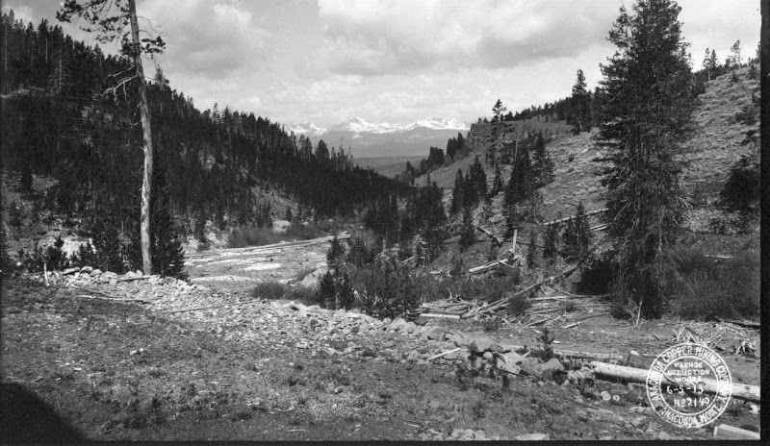
Notes:
Past impacts from dredge mining and Anaconda smelter 1913

Slide 9
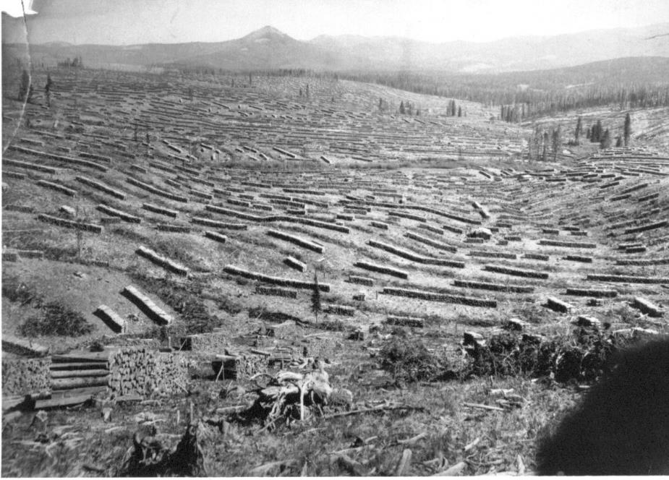
Notes:
Past impacts from dredge mining and Anaconda smelter 1913

Slide 10
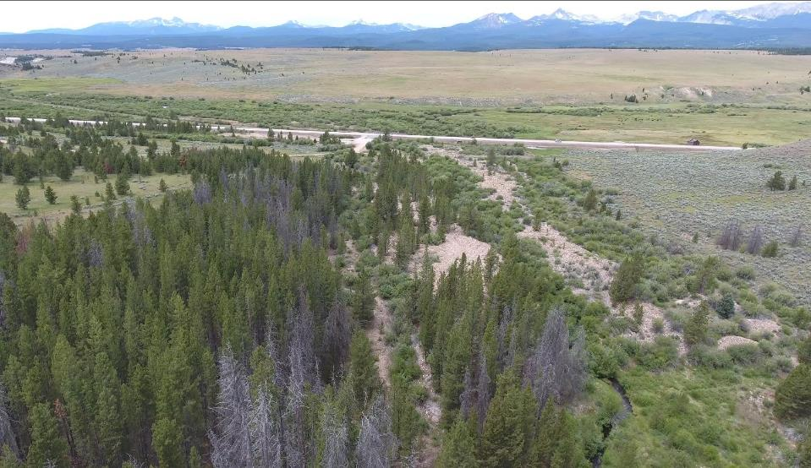
In 2016
New Hwy 569
Old French Creek
Dredge Mine Piles
New French Creek
Notes:
Pre-project site and other work on HWY

Slide 11
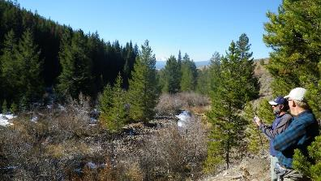
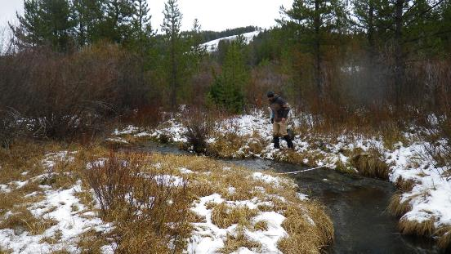
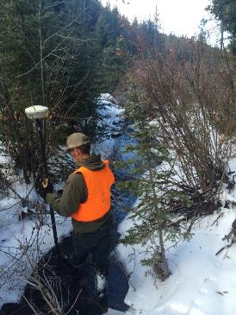
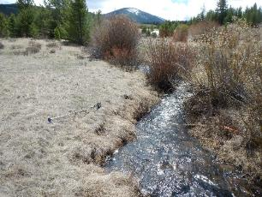
Field Investigations
Notes:
Field work to survey topo, characterize impacts, find functioning sections.

Slide 12
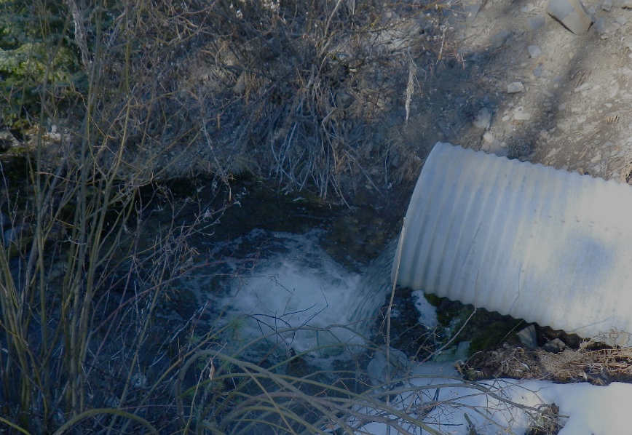
Project Objectives
Restore spawning habitat for native trout species.
Increase sediment retention.
Reduce conifer encroachment on riparian areas.
Remove mine dredge piles to restore stream/floodplain.
Remove fish passage barrier.
Relocate existing road from floodplain.
Notes:
Project objectives to restore stream and fish habitat, restore sediment retention

Slide 13
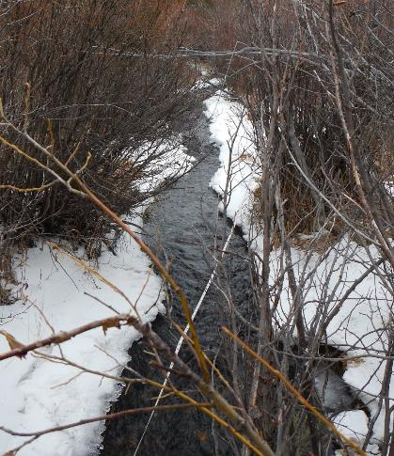
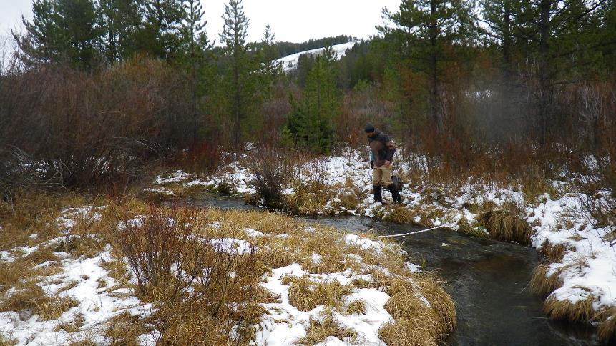
Prioritized Restoration
Geomorphic Comparison
 | Impact | Reference |  | Difference
Bankfull Width: | 7.9 | 5.9 | ft | 32%
Floodprone Width: | 22 | 53 | ft | 59%
% Pools: | 12.0 | 50.5 | % | 76%
Meander Length: | 224 | 49 | ft | 356%
Notes:
Quantify impacts and degree of need

Slide 14
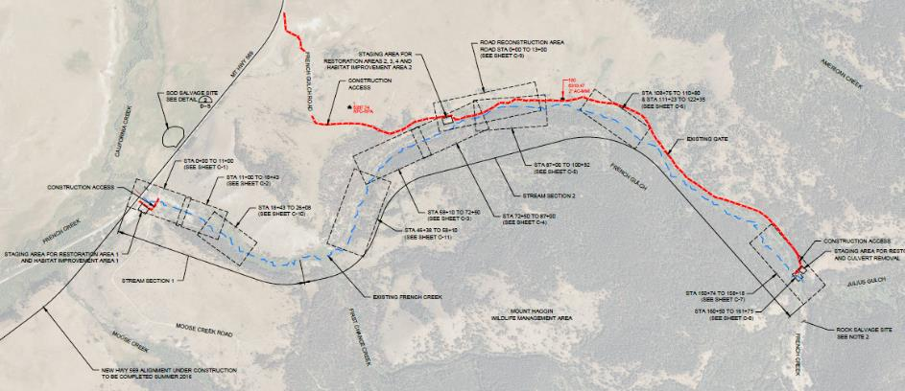
Prioritized Restoration
French Gulch & Moose Creek Restoration
Notes:
Design segments of re-construction

Slide 15
Project Funding
Notes:
Many agency and NGOs part of funding project

Slide 16
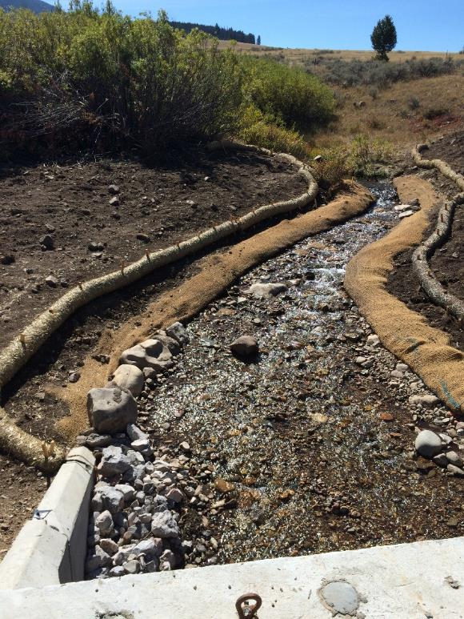
Hwy 569
Notes:
Highway reconstruction required coordination

Slide 17
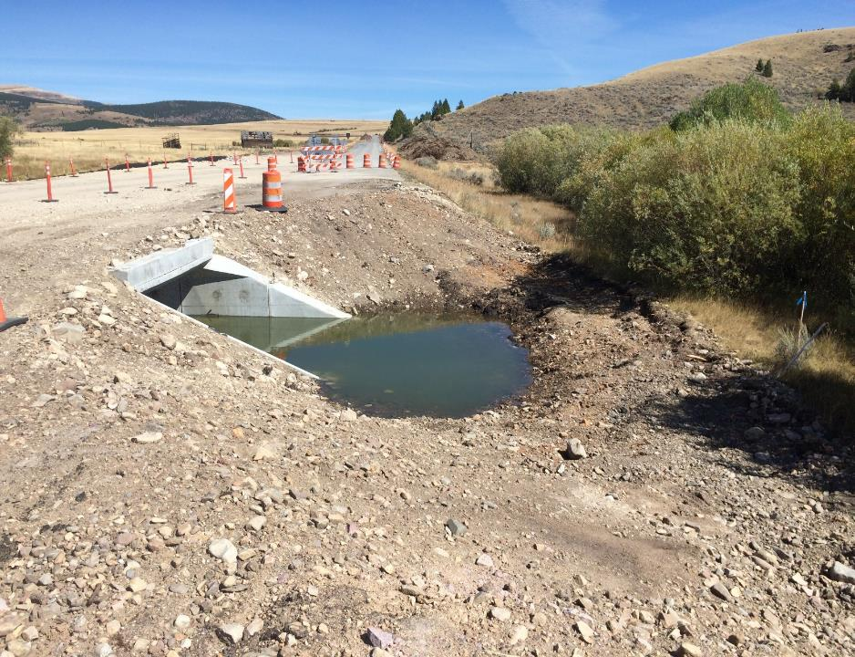
Hwy 569
Notes:
Highway reconstruction required coordination

Slide 18
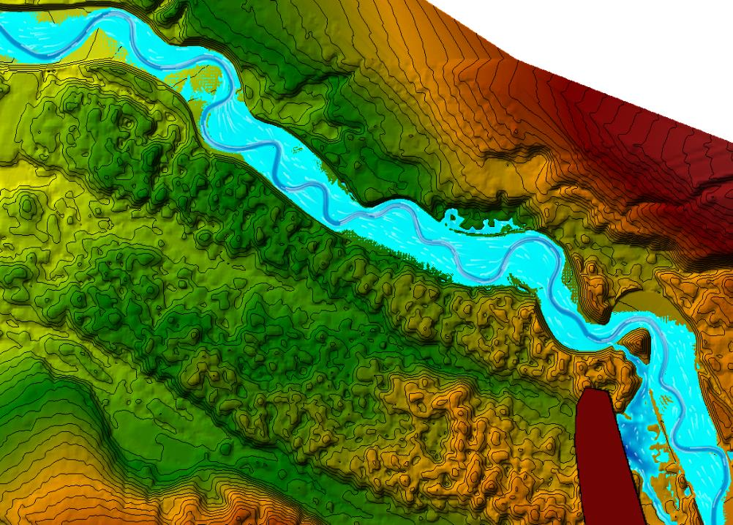
Design
Design
Notes:
Detailed analysis for final design

Slide 19
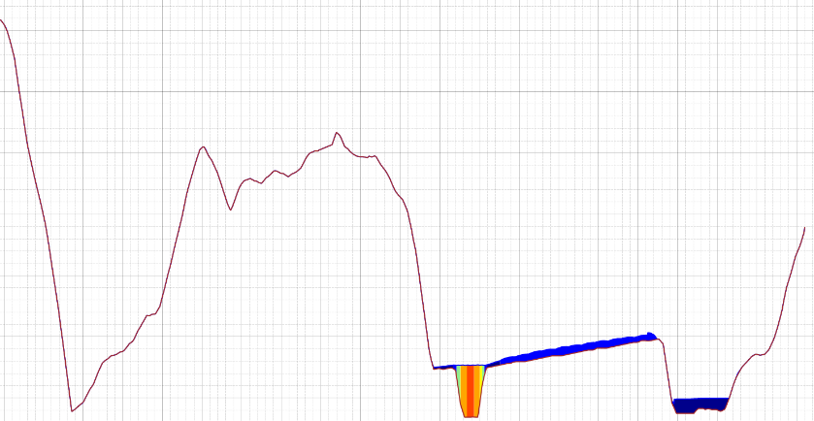
Design
French Gulch & Moose Creek Restoration
Notes:
Detailed analysis for final design

Slide 20
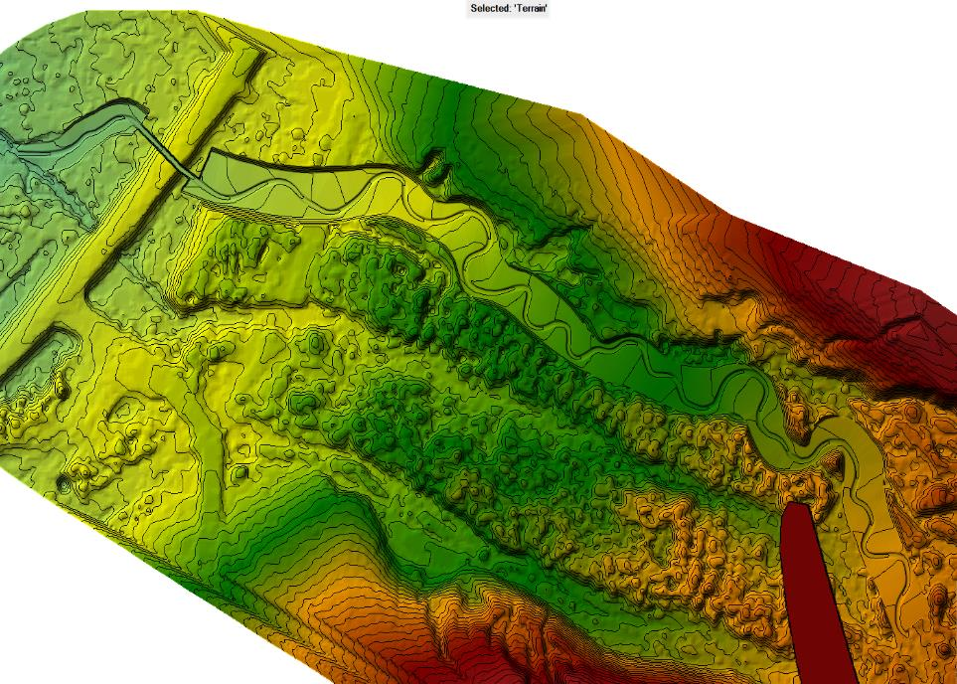
Design
Notes:
Multiple restoration approaches in one project, value engineering

Slide 21
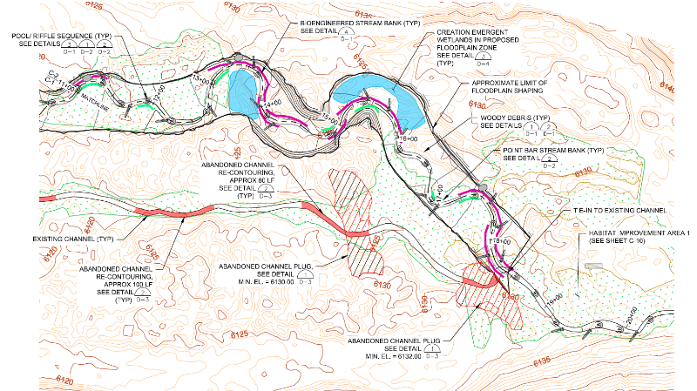
Design
French Gulch & Moose Creek Restoration
Notes:
Multiple restoration approaches in one project, value engineering

Slide 22
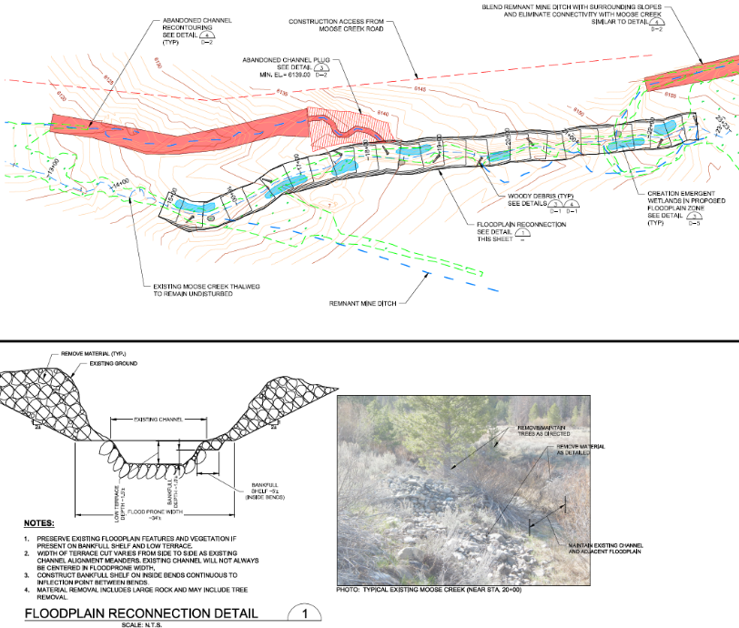
Notes:
Multiple restoration approaches in one project, value engineering

Slide 23
Construction
Notes:
Dirt work and salvage efforts

Slide 24
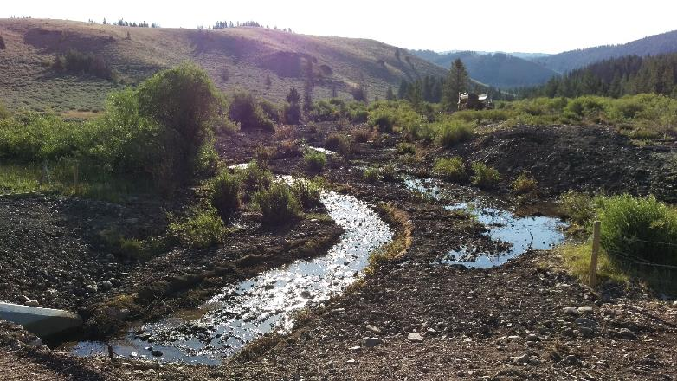
Construction
French Gulch & Moose Creek Restoration
Notes:
Dirt work and salvage efforts

Slide 25
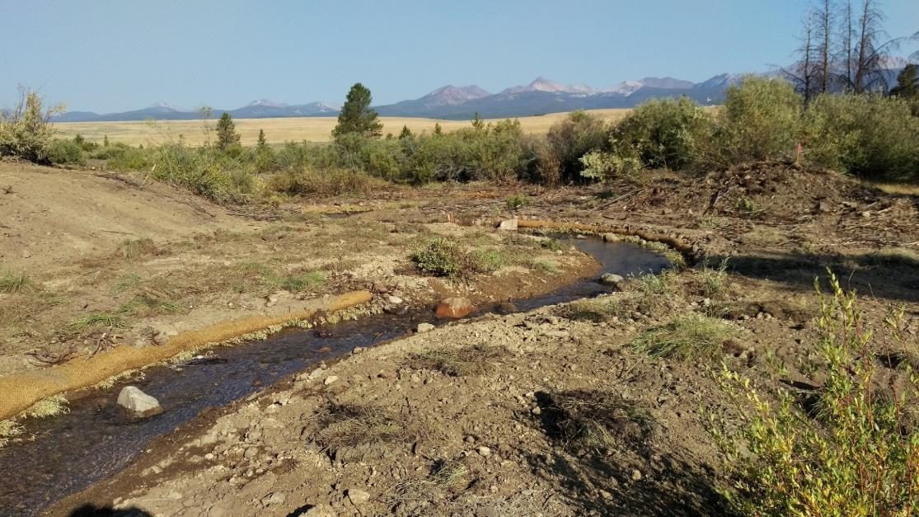
Construction
Notes:
Dirt work and salvage efforts

Slide 26
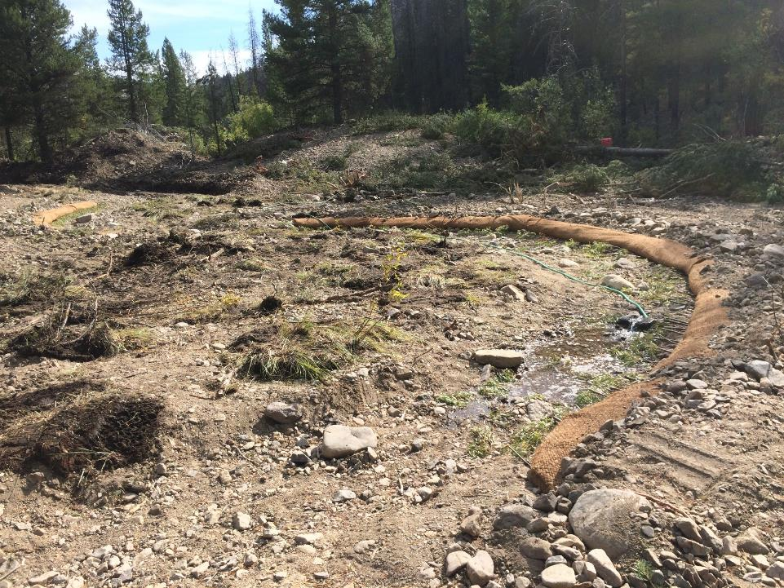
Notes:
Design flexibility to suit site conditions, construction survey

Slide 27
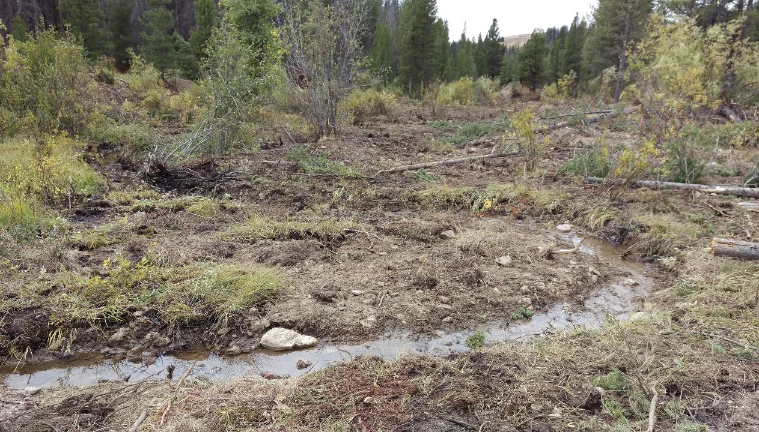
Notes:
Design flexibility to suit site conditions, construction survey

Slide 28
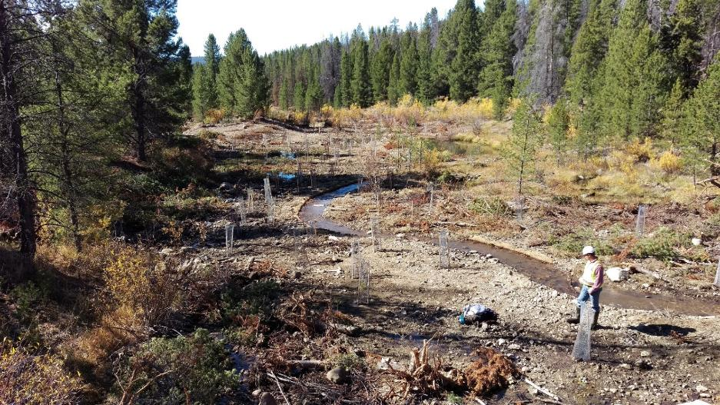
Construction
French Gulch & Moose Creek Restoration
Notes:
Design flexibility to suit site conditions, construction survey

Slide 29
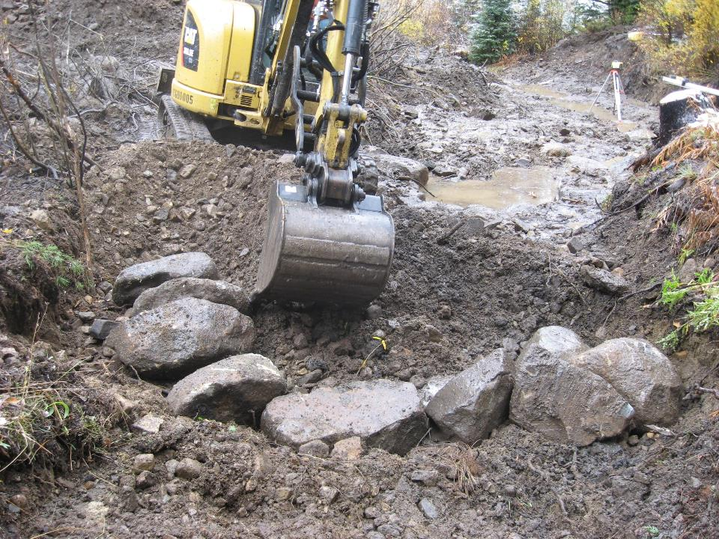
Notes:
Design flexibility to suit site conditions, construction survey

Slide 30
Construction
French Gulch & Moose Creek Restoration
Notes:
Moose Creek, floodplain re-connection

Slide 31
Construction
French Gulch & Moose Creek Restoration
Notes:
Additional dredge impact removals, FP roughness with onsite materials

Slide 32
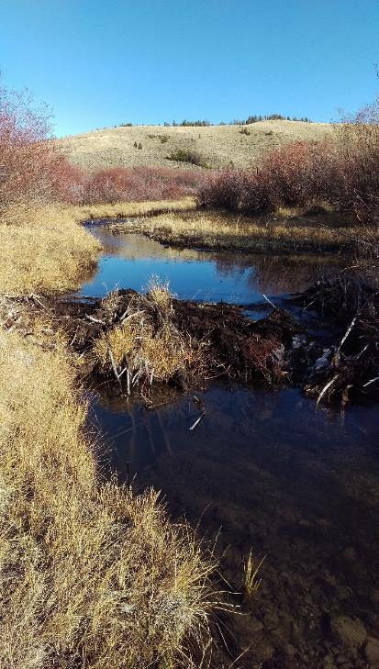
Construction
8 acres new floodplain/wetlands
30,000+ cubic yards of mine tailings removed from floodplain
7,400 feet new stream channel with complex habitat
1 fish passage barrier removed
2,200+ riparian container plants
Notes:
Recap of 2016 field season

Slide 33
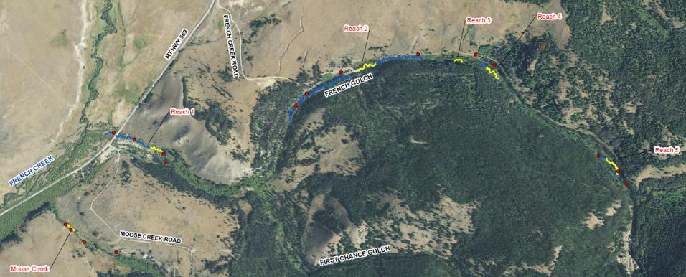
Monitoring
Notes:
2017 re-survey and monitoring of stream reach

Slide 34
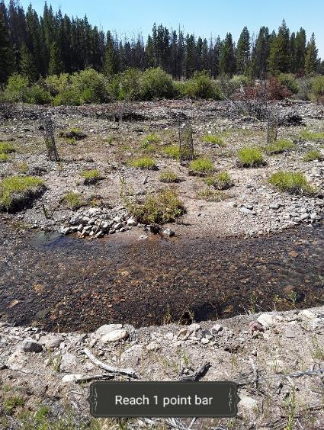
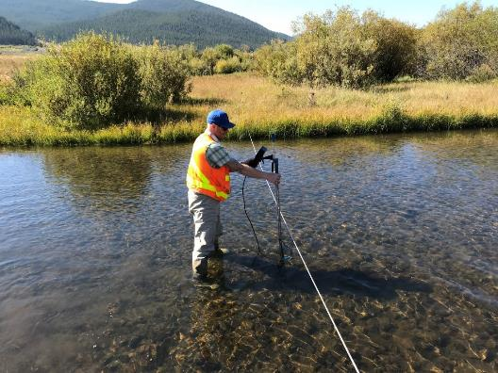
Monitoring
Notes:
2017 re-survey and monitoring of stream reach

Slide 35
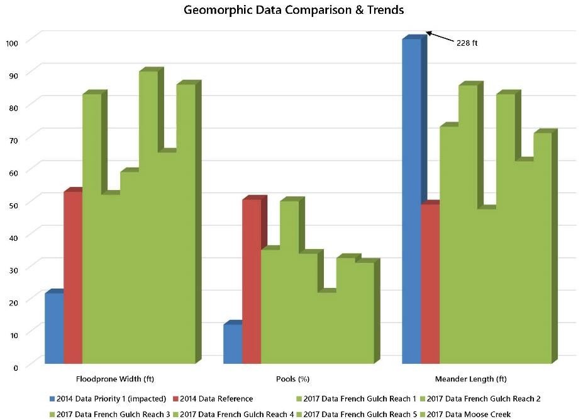
Notes:
Sediment load TMDL allocations, monitoring data by reach

Slide 36
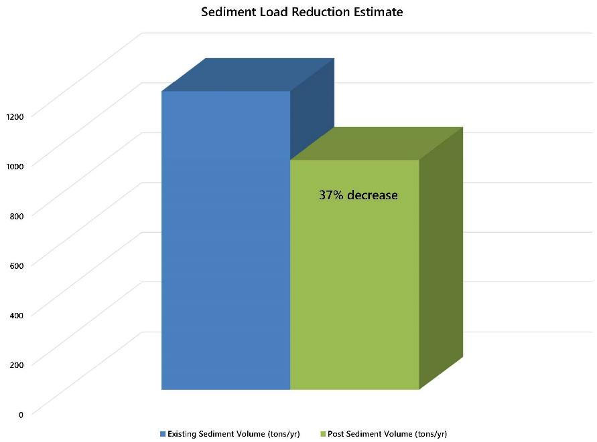
Notes:
Sediment load TMDL allocations, monitoring data by reach

Slide 37
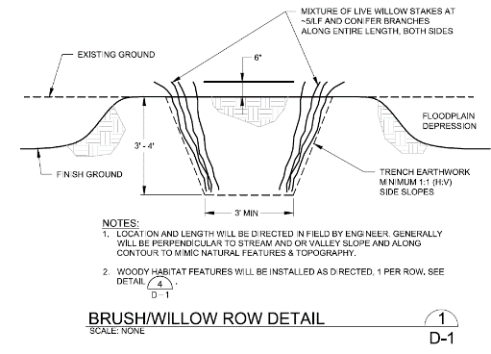
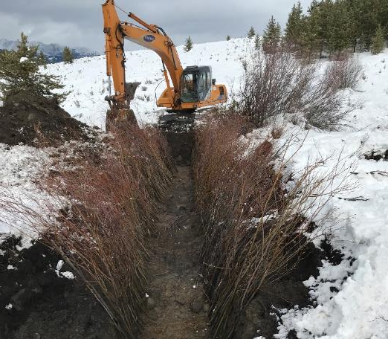
2017 Enhancements
Notes:
Remaining funds to construction off-stream floodplain, riparian and wetlands expansions

Slide 38
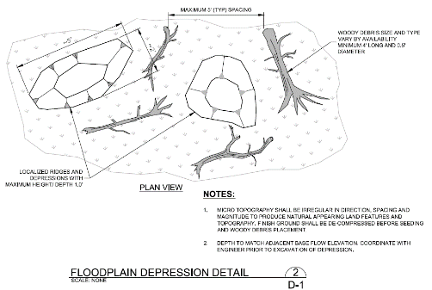
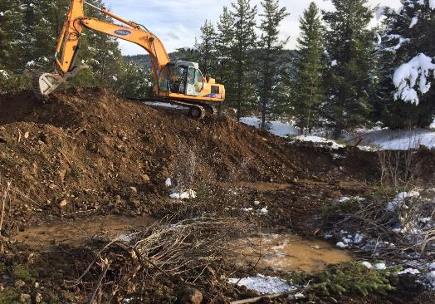
2017 Enhancements
Notes:
Remaining funds to construction off-stream floodplain, riparian and wetlands expansions

Slide 39
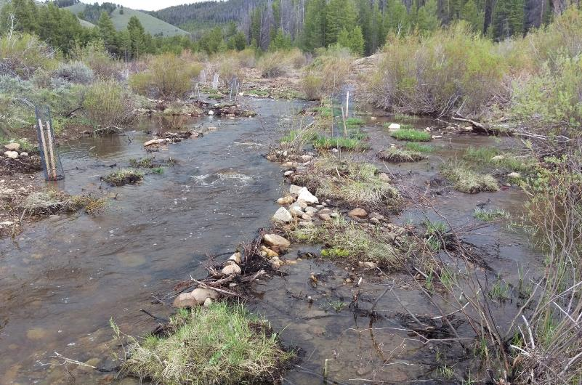
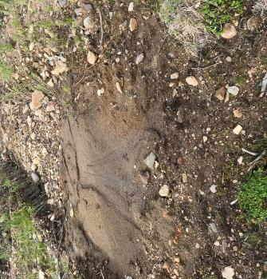
Notes:
2018 site photos

Slide 40
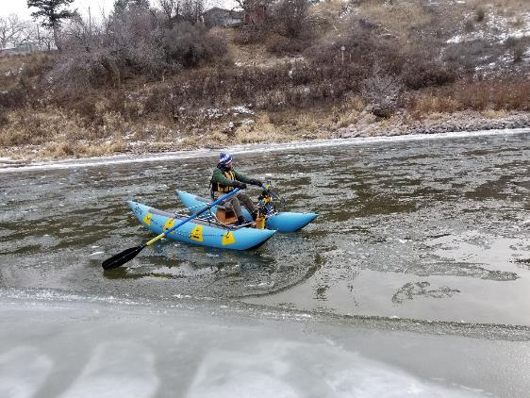
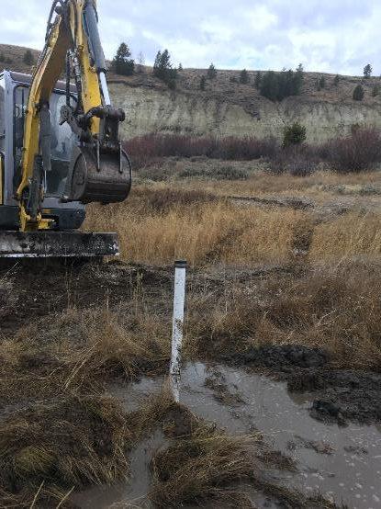
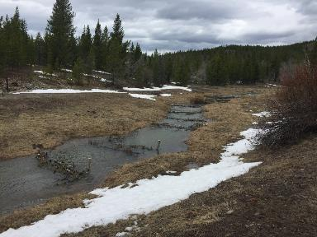
Moving Forward
Notes:
Thoughts and lessons

Slide 41
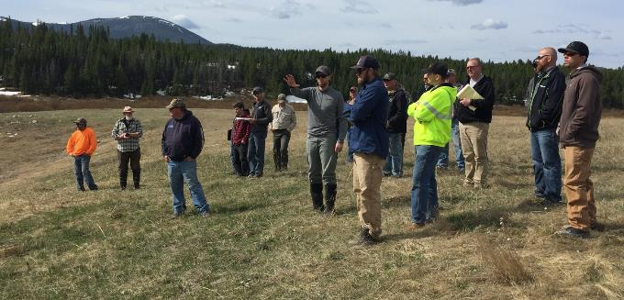
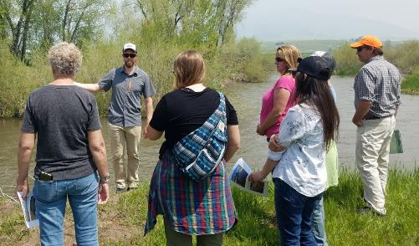
Moving Forward
Notes:
Thoughts and lessons

Slide 42
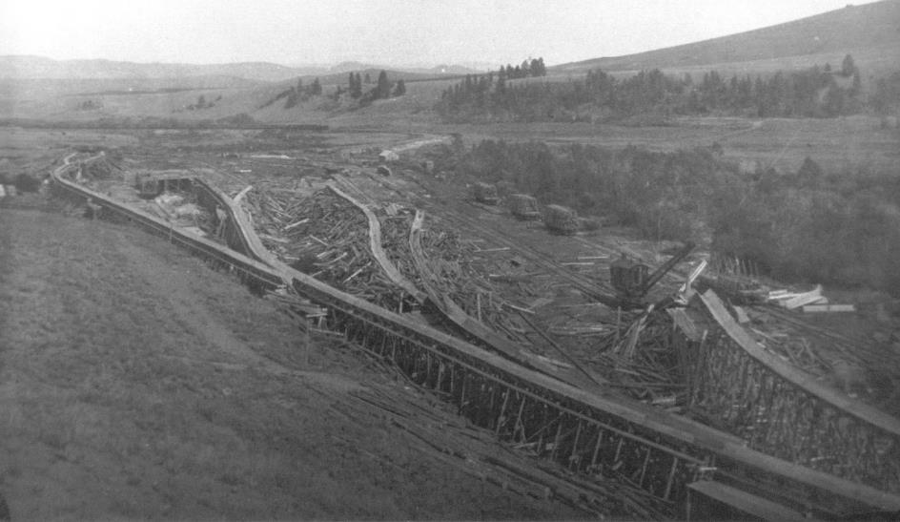
Lower French Creek
Notes:
Current project, improved information use, address fine sediment delivery

Slide 43
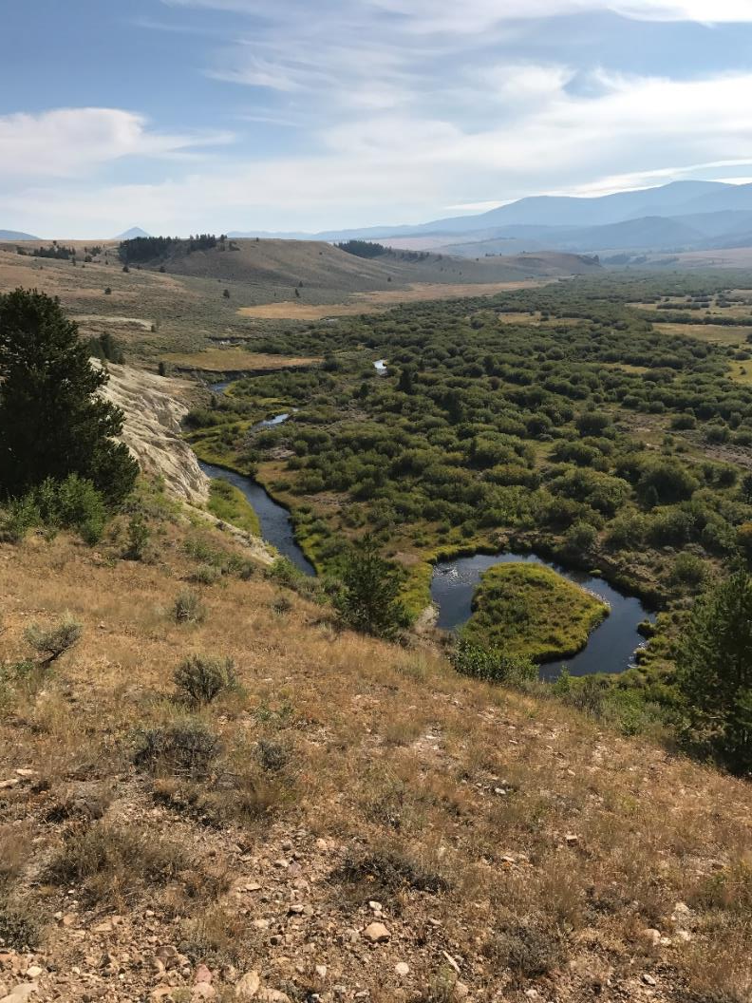
Notes:
Current project, improved information use, address fine sediment delivery

Slide 44
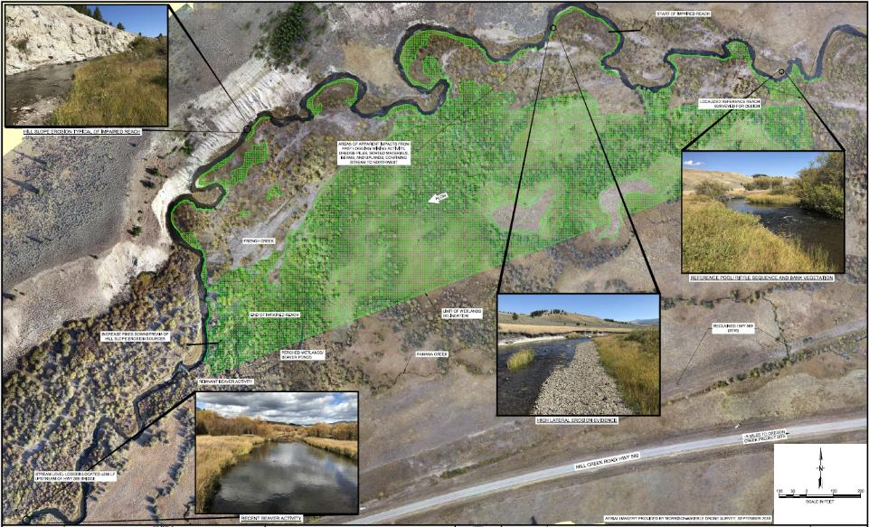
Lower French Creek
Notes:
Current project, improved information use, address fine sediment delivery

Slide 45
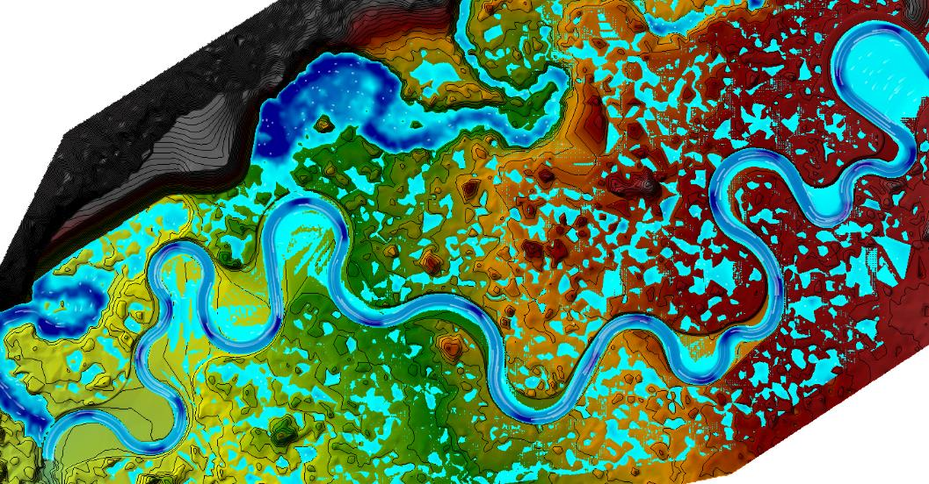
Lower French Creek
Notes:
Improved clarity

Slide 46
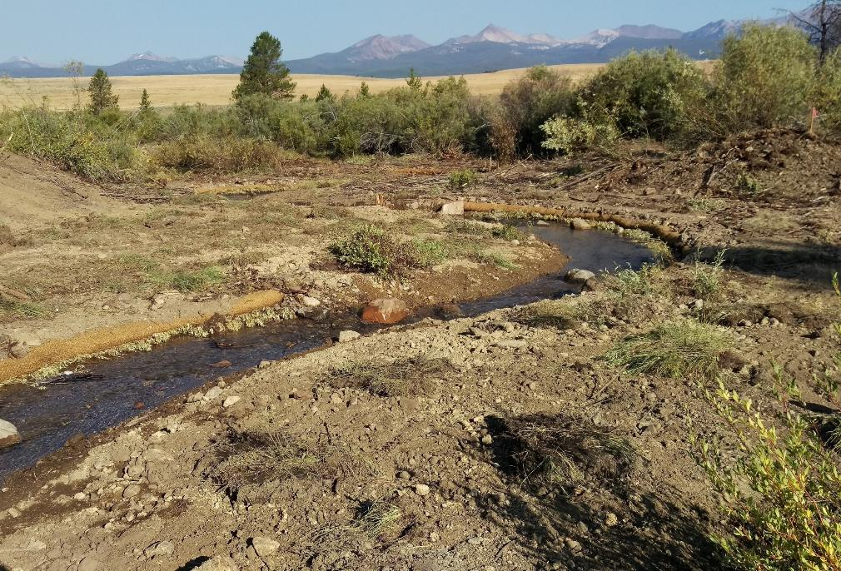

Slide 47
Lower French Creek
Notes:
Improved clarity

Slide 48
Questions?
Matt Barnes, PE, CFM
406-495-3482 | mbarnes@m-m.net
Notes:
Thank you!

