Slide 1
Application of coupled surface and subsurface hydrological modeling in hydrology-based reclamation of mine lands
Chang Liao
Teklu K. Tesfa
Z Fred Zhang
Notes:
About the Image: PNNL Aerial Photo
Aerial photo of the Pacific Northwest National Laboratory campus from the west.
https://www.flickr.com/photos/pnnl/42712951642/in/album-72157670058514908/

Slide 2
Motivation
Both surface and subsurface flow provide seepage pathways for contaminant transport from mine lands.
Effective reclamation of mine lands must incorporate detailed understanding of both surface and subsurface hydrological processes including their interaction.
Coupled surface (SW) and groundwater (GW) hydrological modeling is needed to simulate the surface and subsurface water flow considering their interactions.

Slide 3
Objectives
Use the coupled USDA Soil & Water Assessment Tool (SWAT) and USGS modular finite-difference flow model (MODFLOW) to simulate the GW-SW flow in the Tin Pan watershed.
Model simulation results are used
as inputs to a site-scale (SS) simulation of water balance and contaminant transport
to support the design of reclamation technique of mine lands.

Slide 4
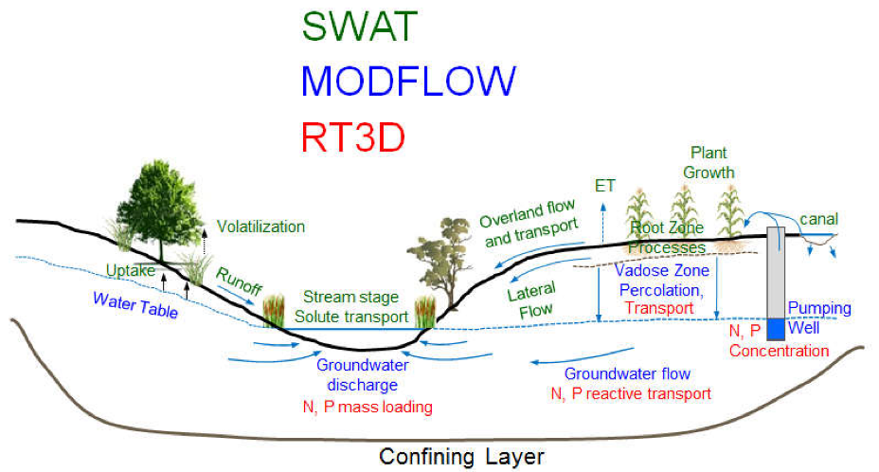
Coupled surface water and groundwater flow model
surface water
groundwater
The SWAT-MODFLOW (2017) is a coupled hydrologic model that combines the SWAT and MODFLOW to provide a comprehensive coupled hydrologic model for watershed systems.

Slide 5
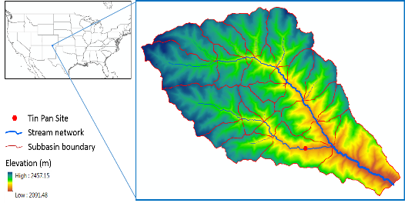
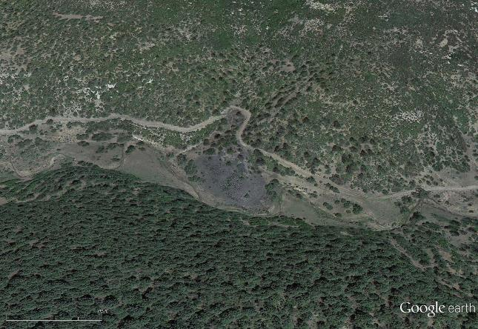
Study area
Tin Pan watershed
about 9 km from west to east
area of 42.0 km²
Small Gob Pile
Valley Road
Valley road
Tributary channel
Tin Pan Mine Gob
Large Gob Pile
Mining waste site
Tin Pan Canyon Stream

Slide 6
Data list
 | Source | Usage
Digital elevation model (DEM) | USGS National Elevation Dataset (NED) 10.0m | SWAT, MODFLOW
Geological setting | USGS National Geologic Map Database | MODFLOW
Land use and land cover change (LUCC) | USGS National Land Cover Database (NLCD) | SWAT
Precipitation | USGS | SWAT
Temperature | USGS | SWAT
Soil | Soil Survey Geographic Database (SSURGO) | SWAT, MODFLOW
Stream network | USGS National Hydrography Dataset (NHD) | SWAT, MODFLOW

Slide 7
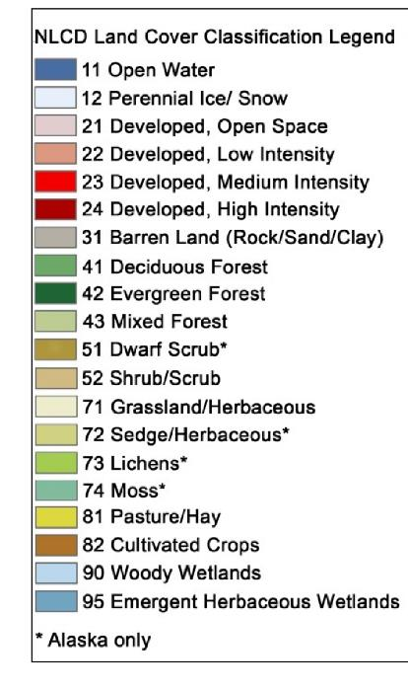
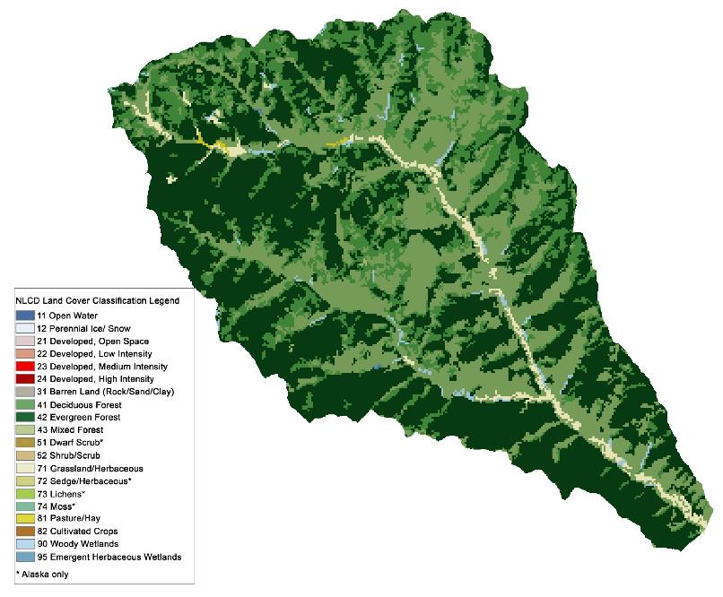
Land use and land cover
(NLCD 2001)

Slide 8
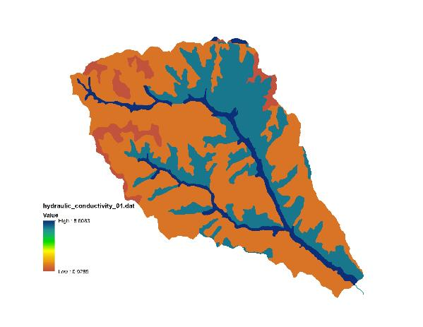
Soil properties
Soil thickness: 0.3 and 2 m
Soil saturated hydraulic conductivity: 0.9 to 5.6 m/d

Slide 9
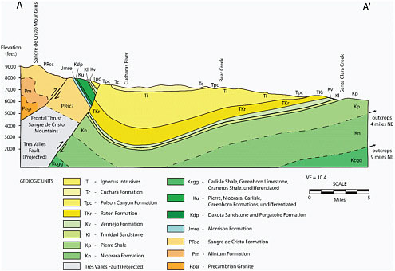
Groundwater aquifer
Groundwater aquifers were defined using soil and geological data.
 |  | Thickness
Top layer | Soil, Alluvial fan | ~2m
Middle layer | Alluvial fan, coal | ~150m
Bottom | Fractured rock | ~300m
(Council, N. R. 2010.)

Slide 10
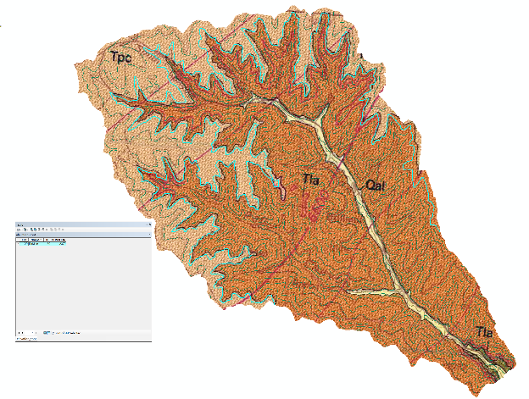
Spatial discretization
The groundwater divide was used as the horizontal spatial extent.
The horizontal spatial resolution is 10 m x 10 m.
A domain of ~2.3 million grid cells (939 x 833 x 3) was defined.
Tpc:
Tla:
Oal:
(USGS open report map I-2266)

Slide 11
Coupling
The SWAT model and MODFLOW model have the same horizontal spatial resolution (10.0m) and extent (watershed boundary).
Both models have the same temporal resolution (daily time step).
Several linking files were prepared to map SWAT hydrological response units (HRUs) with MODFLOW grids.
SWAT and MODFLOW interact at the interface of the two domains.
The three-dimensional, multi-species, reactive transport (RT3D) component was not activated in our simulation.

Slide 12
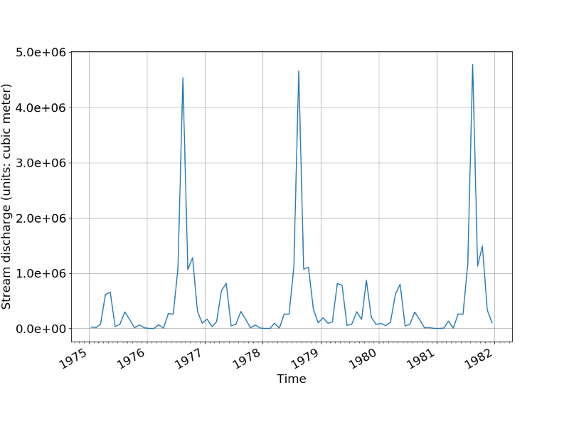
Results: Stream discharge (m³/month)
At the outlet
At the outlet: between about 0 and >4x10⁶ m³/month
Near the Tin Pan site:
similar time series pattern
on average, it is about 30% of the total discharge

Slide 13
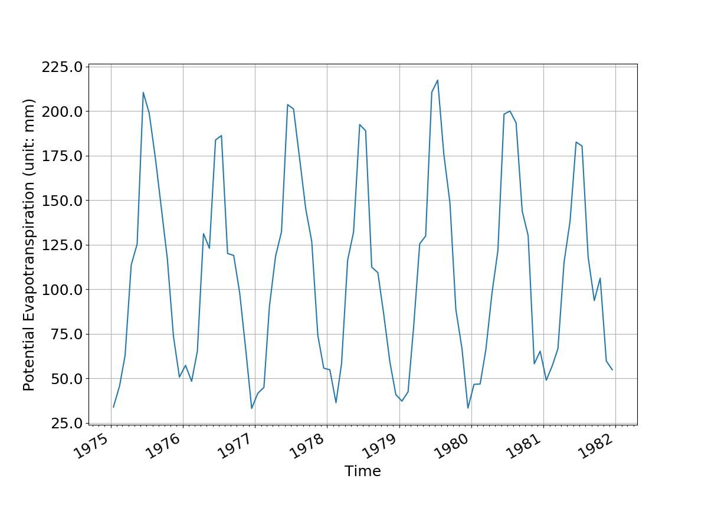
Potential Evapotranspiration (PET, mm/month)
Summer: ~200 mm/month
Winter: ~50 mm/month

Slide 14
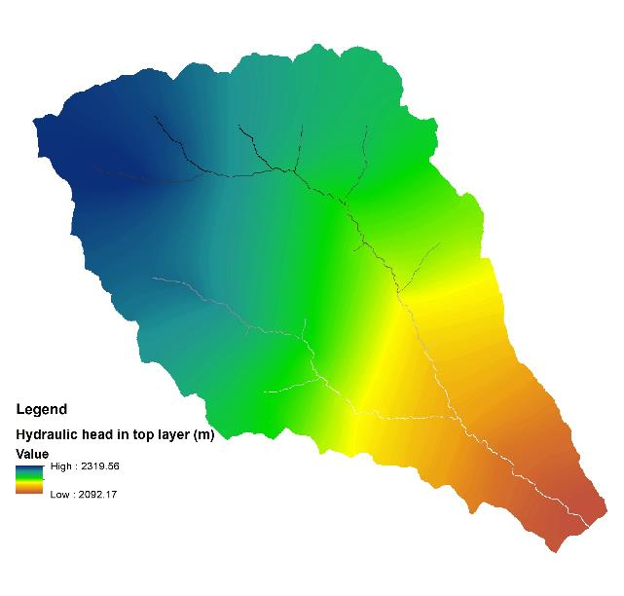
Water Table Elevation (m)
Water table follows the surface topography and ranges between 2092 and 2320 m asl.
Stream networks influence the water table due to GW-SW interactions.

Slide 15
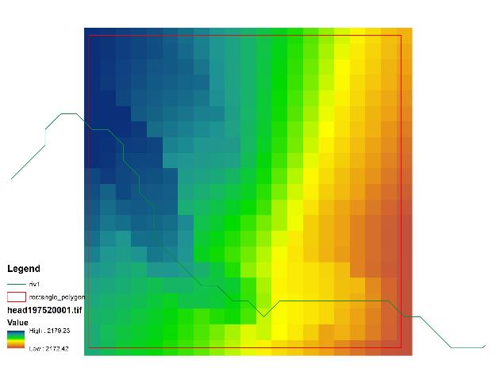
Water table near Tin Pan Site
Water table near the Tin Pan site is 2~30 m below land surface.
The closer to stream channel, the smaller the water table depth is (< 5 meter).
200 m

Slide 16
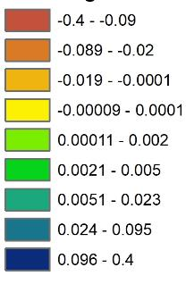
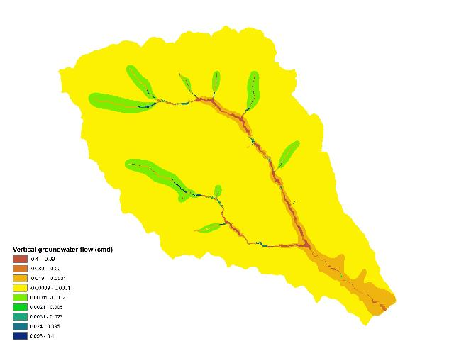
Vertical groundwater flow (m³/day) (positive downward)
On the spatial domain, vertical groundwater flow mainly occurs near stream networks.
Surface water recharges groundwater in high elevation near headwater.
Groundwater recharges stream water in the lower elevation.
Jan. 2, 1975

Slide 17
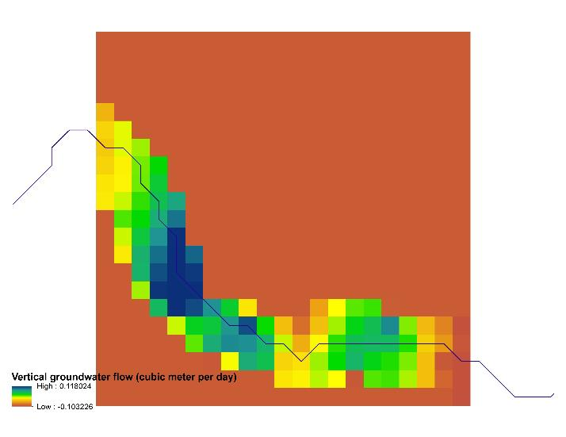
Vertical groundwater flow near Tin Pan site
The GW vertical flow is much faster (~0.1 m³/d) near stream channel than away from the stream.
Stream water recharges groundwater slowly (~0.1 m³/d).
Jan. 2, 1975
Stream channel

Slide 18
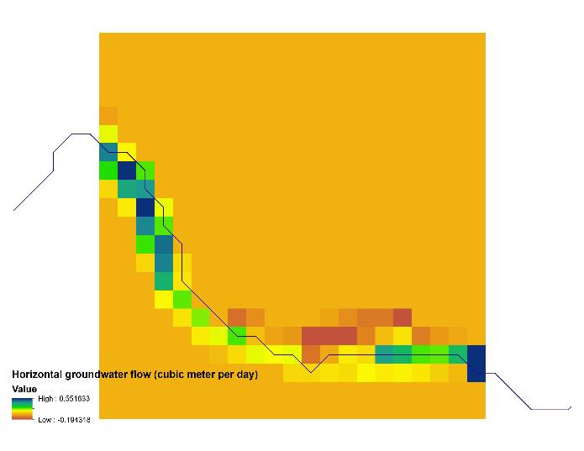
Horizontal groundwater flow near Tin Pan site
Much faster (~0.55 m³/d) near stream channel.
Horizontal flow rate ~ 10X the vertical flow rate.
Consider flow in both X and Y directions, ~1.5 m³/m²/yr groundwater flows
Stream channel

Slide 19
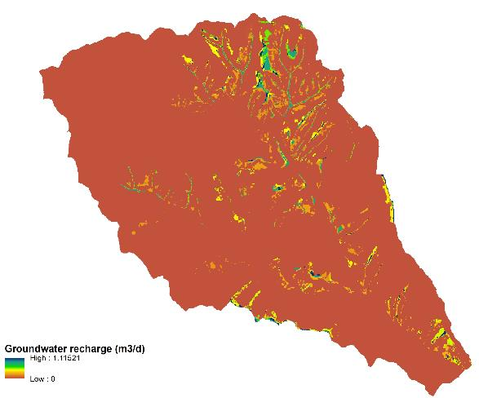
Recharge from soil to groundwater
The recharge rate ranges between 0 and 1.1 m³/d (over an area 100 m²)
Recharge rate is generally <0.1 m³/d.
A site-scale simulation of flow is conducted separately to better predict recharge rate under different conditions of grading, vegetation, and precipatation.

Slide 20
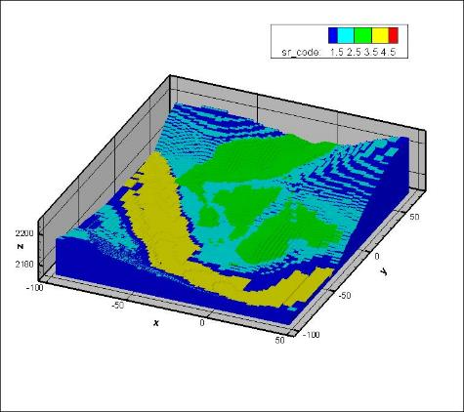
Integrated Watershed (WS) and Site-Scale (SS) Models
The WS model provides for the SS the boundary conditions
GW level
PET
The SS model can provide for the WS model flux rates of water and contaminants if the impacts of different reclamation on the GW/SW will be investigated

Slide 21
Summary
Both horizonal and vertical groundwater flow pass through Tin Pan site.
Contaminants from the mine piles may enter the groundwater and surface water systems and be carried away and hence poses a risk to the environment.
The flux of water and hence the dissolved contaminants can be reduced by proper reclamation that promotes evapotranspiration.

Slide 22
Acknowledgement
This work was supported by interagency agreement S17PG00002 between Department of the Interior, Office of Surface Mining Reclamation and Enforcement and Department of Energy, Pacific Northwest National Laboratory.

Slide 23
Reference
Liao C, TK Tesfa, ZF Zhang and R Leung. 2019. A Python package for parallel model calibration. MODFLOW and More 2019 June 2 – 5, 2019 in Golden, Colorado.
Neitsch, S., Arnold, J., Kiniry, J., Williams, J. R., & King, K. W. (2005). SWAT2009 Theoretical Documentation. Texas Water Ressources Institute Technical Report, (406).
Niswonger, R. G., Panday, S., & Ibaraki, M. (2011). MODFLOW-NWT, a Newton formulation for MODFLOW-2005. US Geological Survey Techniques and Methods, 6, A37.
Geologic and structure-contour map of the Raton 30' X 60' quadrangle, Colfax and Union Counties, New Mexico, and Las Animas County, Colorado.
Bailey, R. T., Wible, T. C., Arabi, M., Records, R. M., and Ditty, J. ( 2016) Assessing regional‐scale spatio‐temporal patterns of groundwater–surface water interactions using a coupled SWAT‐MODFLOW model. Hydrol. Process., 30: 4420– 4433. doi: 10.1002/hyp.10933.
Council, N. R. (2010). Management and effects of coalbed methane produced water in the Western United States. National Academies Press.

Slide 25
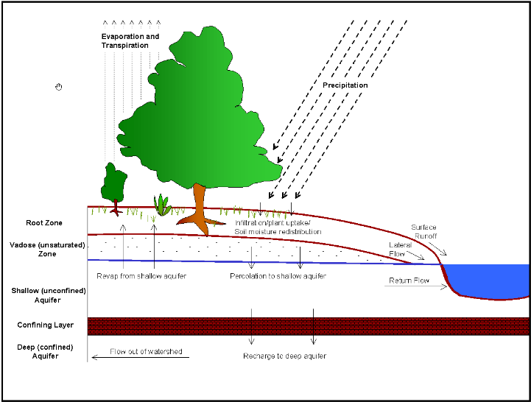
SWAT model
SWAT is a watershed to river basin-scale model used to simulate the quality and quantity of surface and ground water and predict the environmental impact of land use, land management practices, and climate change.
(SWAT 2009 Theoretical Documentation)

Slide 26
SWAT model
DEM at 10m resolution and NHD data were used to delineate the watershed boundary and stream networks.
LUCC, Soil type and surface slope were used to define a total of 417 Hydrologic Response Unit (HRUs).
Gap filling was used to prepare daily temperature and precipitation data from 1975 to 1981.

Slide 27
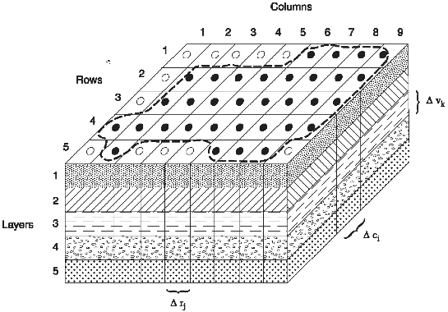
MODFLOW model
MODFLOW is the USGS's modular hydrologic model. MODFLOW is considered an international standard for simulating and predicting groundwater conditions and groundwater/surface-water interactions.
(Harbaugh, Arlen W, MODFLOW 2005)

Slide 28
Model calibration
MODFLOW simulation is computationally expensive.
MODFLOW simulation in mountainous area is very sensitive to boundary conditions. Model convergence is a challenge.
We selected several parameter groups to calibrate the model. For example, spatial-explicit runoff curve numbers (CN2) were calibrated to improve groundwater recharge from SWAT to MODFLOW.

Slide 29
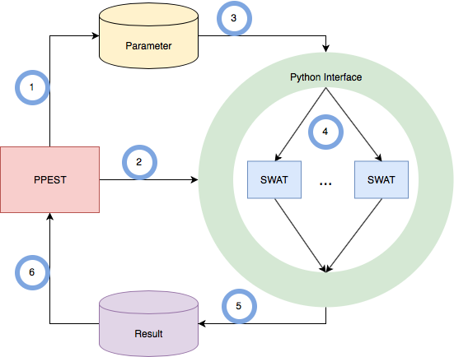
Model calibration using Python PEST
Automatic
Model independent
Parallel computing
(Liao, MODFLOW and more, 2019)

