Slide 1
Coal mining subsidence and its effects on agricultural land-A UAV based investigation in eastern China
Wu Xiao^{1,2}, Zhenqi Hu², Jiale Chen²
1. Department of Land Management, Zhejiang University, Hangzhou, 310058, PR China
2.Institute of Land Reclamation & Ecological Restoration, China University of Mining and Technology(Beijing), 100083, PR China
E-mail: xiaowuwx@126.com

Slide 2
Introduction
Outlines
01
02
Study Area and Method
03
Result and Analysis
Conclusions and Future work
04

Slide 3
Introduction
01

Slide 4
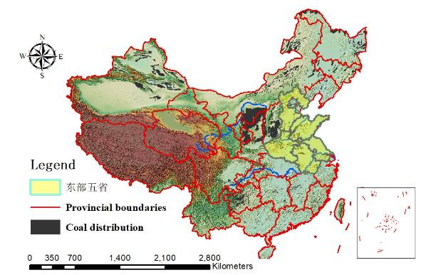
Coal production in China
China’s coal production was 3.45 billion tons in 2017, 45.6% of global coal production
85%-90% comes from underground mining, coal mining induced land subsidence increased 45,000 hectares/Year
Coal yield and growth rate from 2003 to 2016 in China

Slide 5
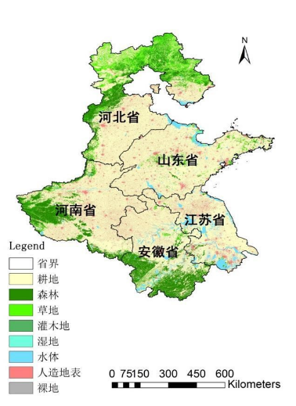
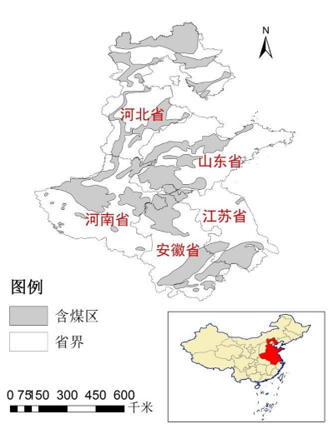
Coal mining in China
Hebei
Hebei
Shandong
Shandong
Henan
Henan
Jiangsu
Jiangsu
Anhui
Anhui
The five eastern provinces are not only important grain bases in China, but also occupy an important role in China's coal mining and utilization.

Slide 6
Coal mining in China
Land-social-economic parameters of the 5 province in eastern China
ZONE | Land |  | Population |  | Farmland |  | Crop production
 | Area/10⁴km² | Proportion/% | Quantity / 10⁴ | Proportion/% | Area /10⁴km² | Proportion/% | Production /10⁴t | Proportion/%
China | 960.00 14.01 | 100.00 1.46 | 136782 6083 | 100.00 4.45 | 135.38 5.91 | 100.00 4.37 | 60702.61 3415.83 | 100.00 5.63
Anhui
Henan | 16.70 | 1.74 | 9436 | 6.90 | 8.19 | 6.05 | 5772.3 | 9.51
Hebei | 18.85 | 1.96 | 7384 | 5.40 | 6.56 | 4.85 | 3360.17 | 5.54
Shandong | 15.79 | 1.64 | 9789 | 7.16 | 7.67 | 5.67 | 4596.6 | 7.57
Jiangsu | 10.72 | 1.12 | 7960 | 5.82 | 4.62 | 3.41 | 3490.62 | 5.75
Total | 76.08 | 7.92 | 40652 | 29.72 | 32.95 | 24.34 | 20635.52 | 33.99
Coal production of Jiang, Anhui, Shandong, Henan, and Hebei occupied 0.52%、3.43%、3.82%、3.48% and 2.25% of the nation’s coal production, respectively.
Total 13.50% of China’s coal production

Slide 7
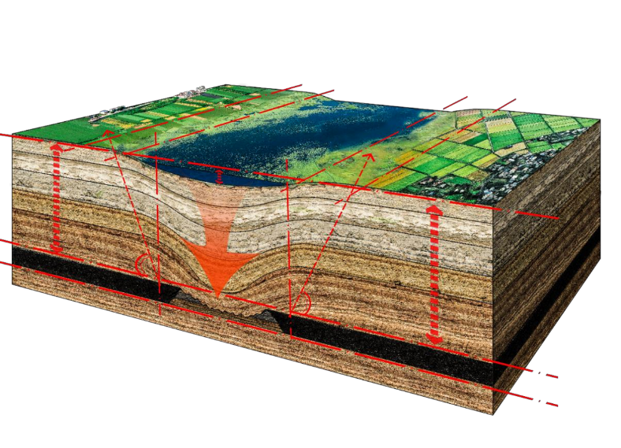
Multi-coal mining, superimposed settlement, large subsidence area
Ecosystem transition
Soil erosion, deterioration of water quality, surface water system disorder
Prominent conflict between man and land

Slide 8
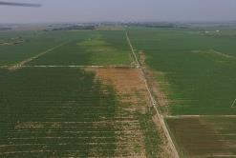
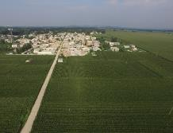
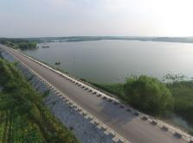
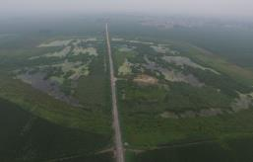
Coal mining in China
The mining areas in the five eastern provinces of China (Henan, Hebei, Shandong, Anhui, Jiangsu) are mostly high ground-water level mining areas. Due to the high ground-water level, the damage of cultivated land caused by coal mining subsidence is particularly serious.
Cultivated land damage
Building damage
Ponding area
Road damage

Slide 9
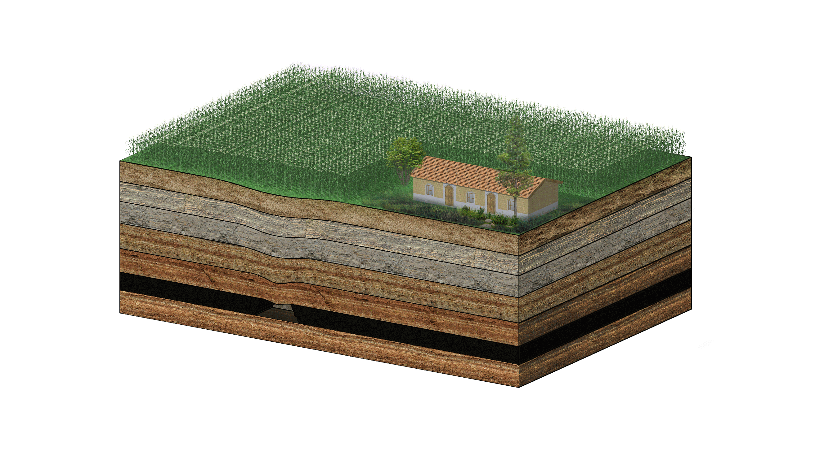
Underground coal mining and its effect on agricultural land system

Slide 10
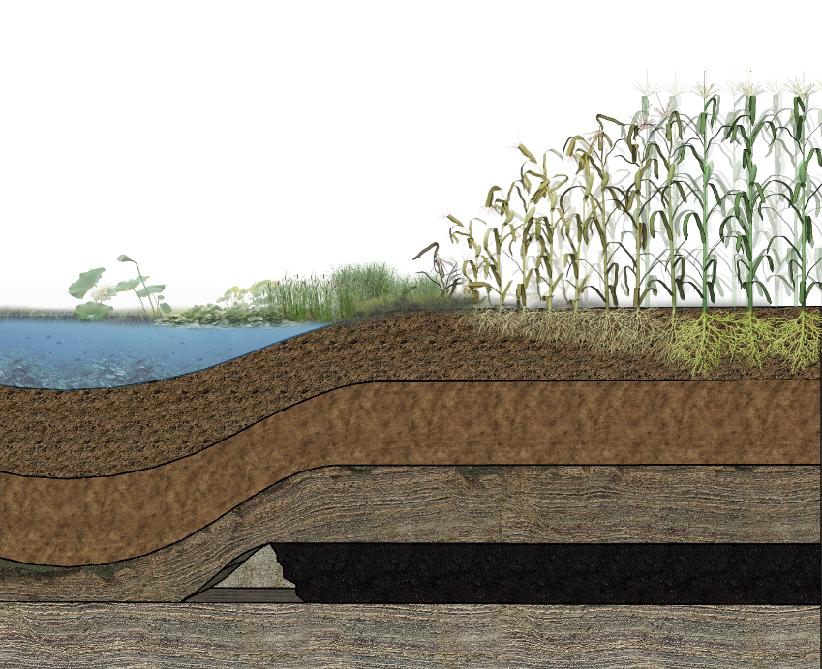

Slide 11
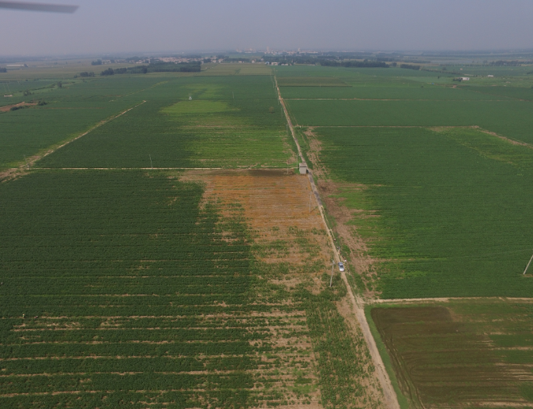

Slide 12
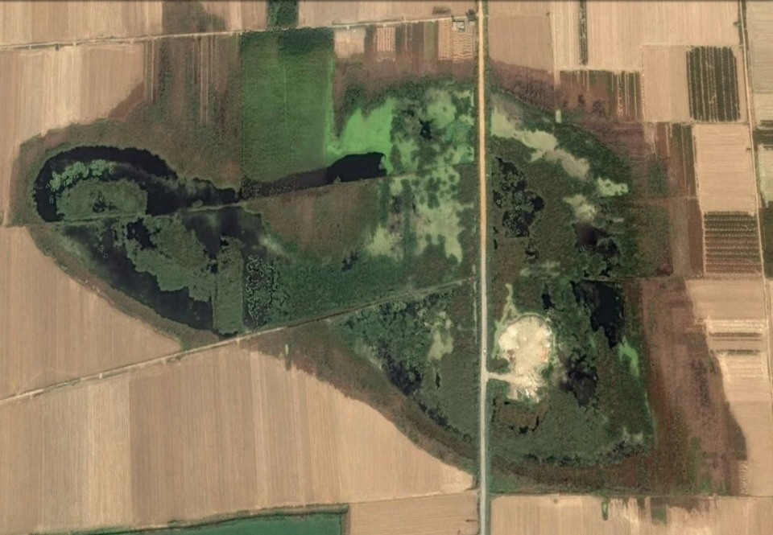
1、Ecological environment monitoring
2、Identify the extent of damage to cultivated land

Slide 13
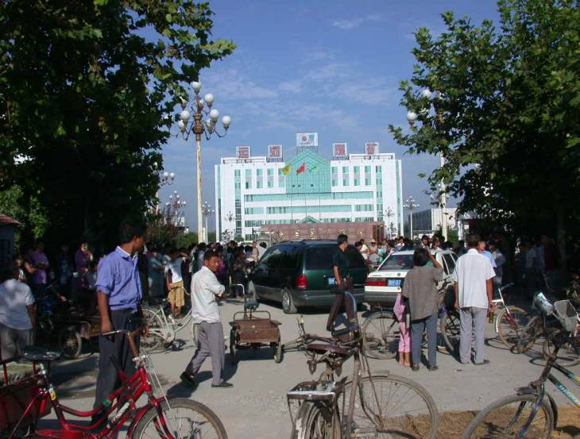

Slide 14
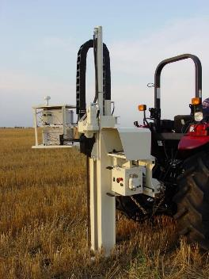
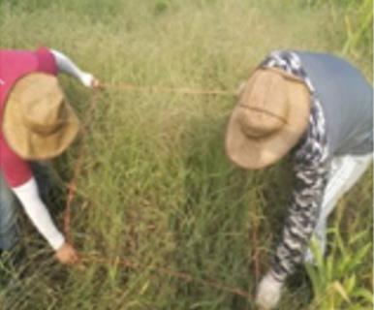
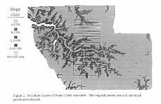
Traditional technology
Yield investigation
Darmody, 1995,2008

Slide 15
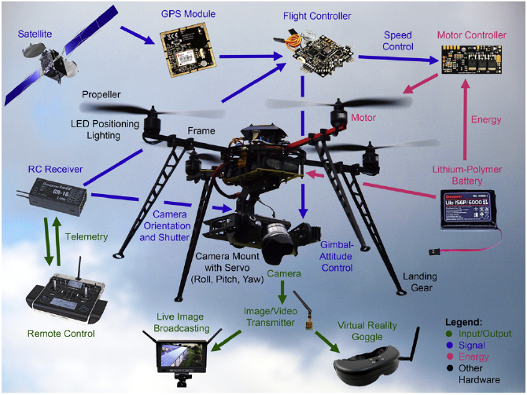

Slide 16
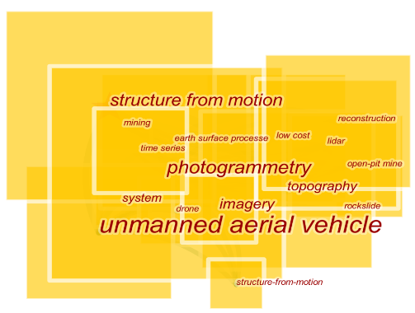
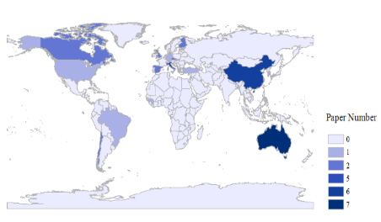
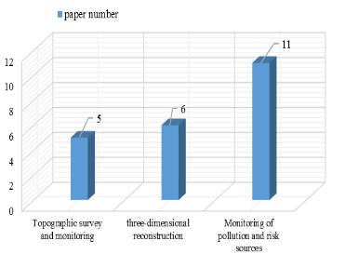
Literature Review
A total of 40 studies (except for conference articles) have been published from 2015 to 2018 related to the field of “unmanned aerial vehicle (UAV)”, “unmanned aerial system (UAS)”, “drone”, “mine(s)”, “mineral” and “mining” in the Web of ScienceTM Core Collection Database. Unfortunately, no articles were searched from earlier than 2014. Our analysis shows that the studies were mainly from Australia (7 articles), China (6 articles), Italy (5 articles), Finland (2 articles) and other countries
The articles mainly focused on topographic surveying and monitoring, three-dimensional (3D) reconstruction and pollution monitoring .

Slide 17
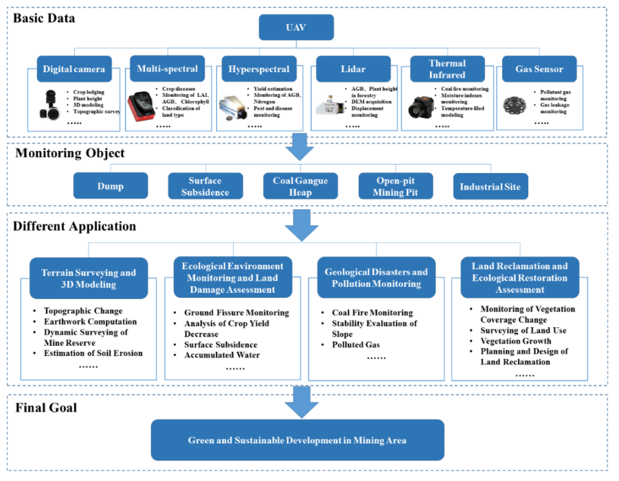

Slide 18
Study area and method
2

Slide 19
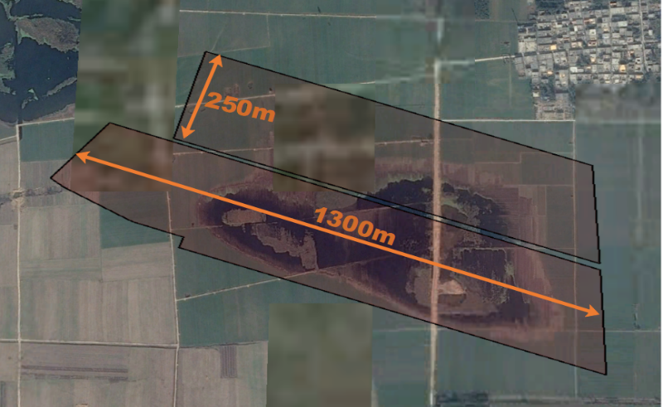
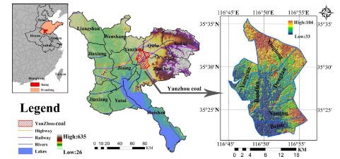
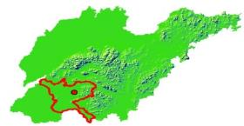
Study area
Ground Elevation :+50.72m Average mining elevation :-497.8m
Average Coal seam thickness :8.30m Ground horizontal Movement coefficient :0.25
Maximum crack width :42cm Coal seam dip angle : 4°
Maximum subsidence angle θ=86°41′ subsidence coefficient: 0.9
Maximum subsidence v : 4.234 m Mining duration : 2014.8-2016.1

Slide 20
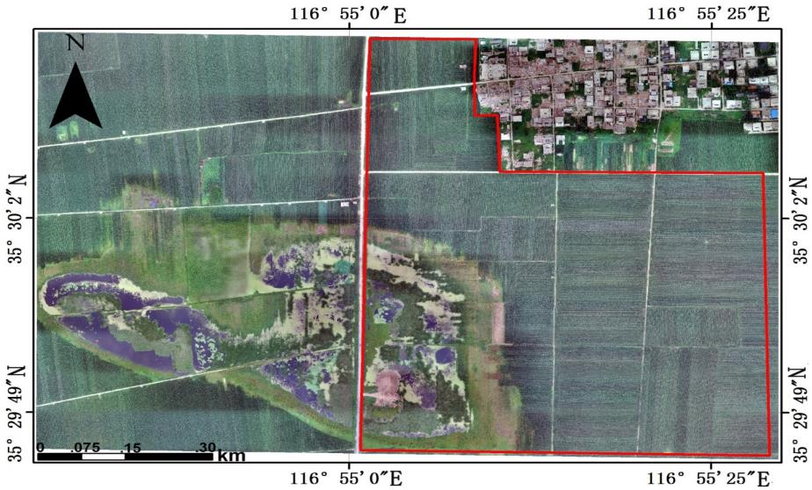
Forming a typical subsidence basin in the mining area.
Vegetation that are distributed in the order of reeds, swamps, tidal flats, and flooded crops.

Slide 21
March, 2013
March, 2014
September, 2016
February, 2017
September, 2017

Slide 22
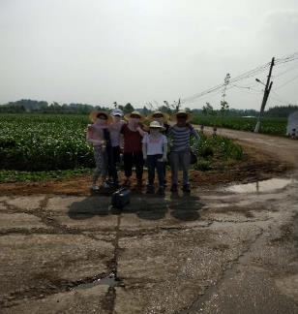
Purpose of this research
UAV MONITORING
Terrain monitoring
01
02
Vegetation classification
03
Maize biomass estimation
04
Maize SPAD(Chlorophyll) estimation

Slide 23
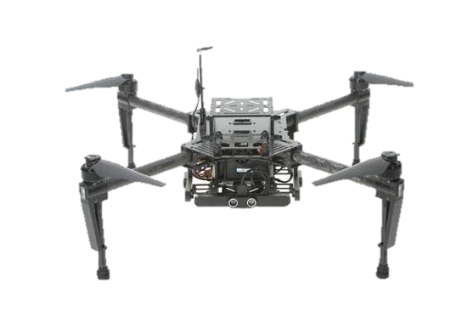
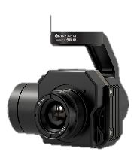
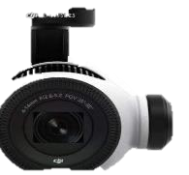
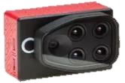
Instrument
DJI M100 无人机
有效像素:1200万
传感器尺寸：1/2.3英寸
光学变焦倍数：3.5倍光学变焦
传感器: COMOS传感器
Green: 530-570
Red: 640-680
Near-infrared:770-810
Red-edge:730-740
有效像素: 120万
波长:7.5 – 13.5 μm
全帧频: 640 × 512
PARROT SEQUOIA
多光谱相机
ZENMUSE XT
热成像相机
ZENMUSE Z3
可见光相机
Terrain
SPAD/ Biomass/Vegetation classification
Temperature/Soil moisture

Slide 24
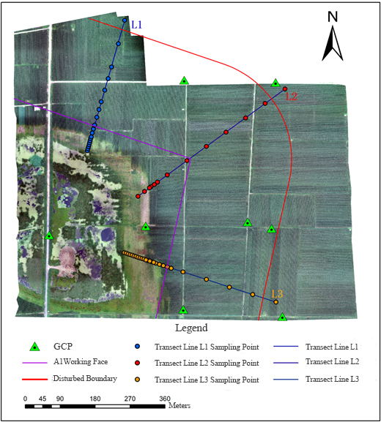
Field sampling
1、The L1、L2、L3 lie in the direction、inclination and angle bisector along the working face. The sampling distance is 5, 10,20,30,60 meters in order from inside and outside.
2、Field data ,including Biochemical parameters of crops and physical and chemical properties of soil.
3、Remote sensing data ,including Vegetation canopy reflectance data an Precision terrain data.

Slide 25
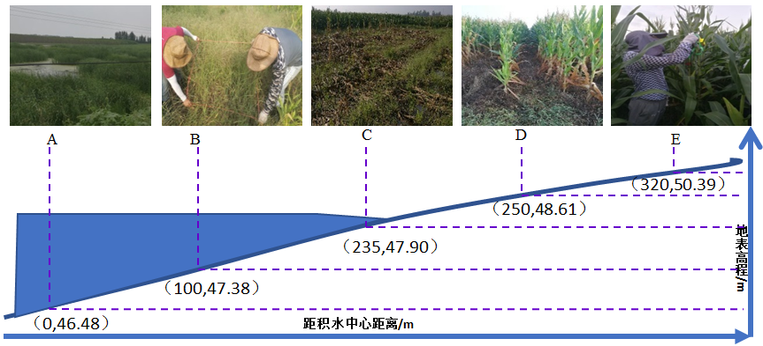
Profile of mining subsidence basin
The study conducted ground data collection in the study area from August 12 to 24, 2017. The indicators collected in this experiment were: leaf area index, chlorophyll content, soil samples, and plant samples. A total of 3 sampling lines, 54 sample squares, 35 corn samples, 19 other plant samples, and 37 soil samples were collected, we also investigated the vegetation types for the mining subsided wetland.

Slide 26
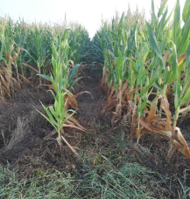
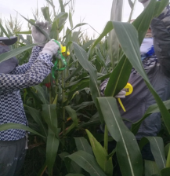
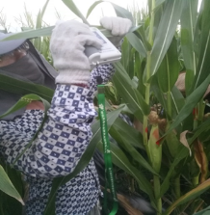
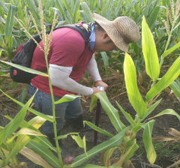
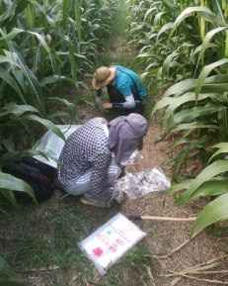
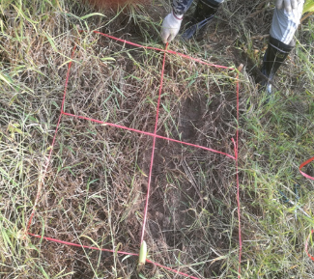
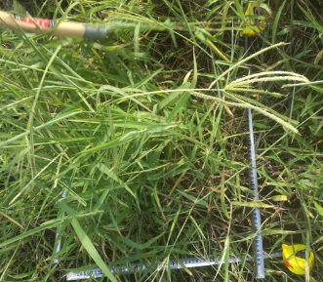
Field data
Maize growth near the water
LAI measurement
Chlorophyll measurement
Measuring soil moisture with TDR
Collecting maize samples
Sample making
Collecting vegetation samples

Slide 27
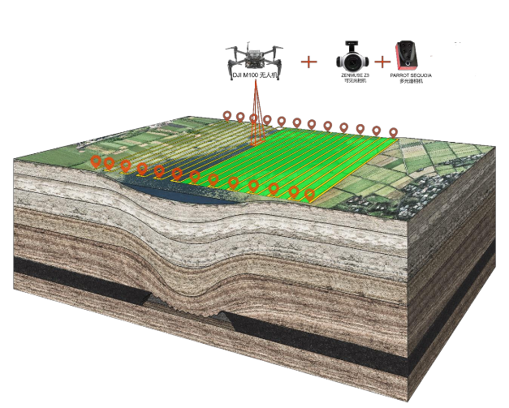
Remote sensing data
At the same time, as the field data collection, the aerial survey mission was carried out on August 13 with good weather conditions, and 5352 multi-spectral and 811 RGB images were obtained in the study area. RTK measured 4,535 points in the field, covering a area of about 1 km² in the study area with a grid of 10m × 10m.

Slide 28
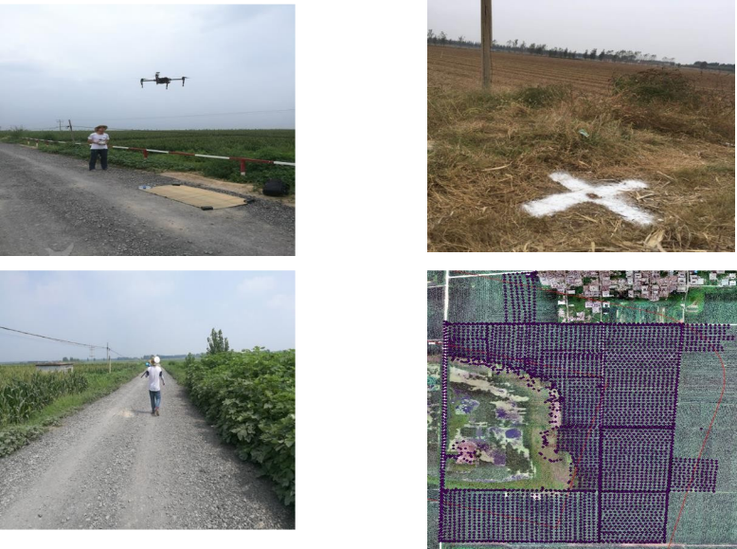
Aerial survey site

Slide 29
Data analysis
1、Field data analysis
Classical statistical spatial variation analysis (SPSS 22.0)
Geostatistical analysis and semivariogram (GS+ 9.0)
Correlation analysis(SPSS 22.0)
Kriging interpolation (Arcgis 10.3)

Slide 30
Data analysis
2、Vegetation biochemical parameter inversion (Estimation)
PIX4D SOFTWARE
Correlation analysis(SPSS 22.0)
Back propagation neural networks， 、Random forest (R Core Team and Matlab statistical packages)
Unary linear regression model(SPSS22.0)
Stepwise regression model based on least squares(SPSS22.0)
Cross-validation (Matlab statistical packages )
Coefficient of determination( Ｒ² ) 、 Root mean square error( ＲMSE) , Estimation accuracy( EA) were used to determine the best inversion model

Slide 31
Result and analysis
3

Slide 32
Maize biomass distribution for L1-L2-L3
积水区

Slide 33
Maize SPAD(Chlorophyll) distribution for L1-L2-L3
积水区

Slide 34
Field data analysis
Descriptive statistical feature values of soil physical and chemical properties and Crop biochemical parameters（n=35）
Element | Minimum | Maximum | Median | Mean | S.D. | CV | Skewness | Kurtosis | K–S test
Terrain | 46.192 | 51.437 | 47.69 | 48.15 | 1.467 | 0.03 | 0.780 | -0.495 | 0.944
Biomass | 311.920 | 46.610 | 220.25 | 200.84 | 69.219 | 0.345 | -0.885 | 0.288 | 0.900
LAI | 0.874 | 8.745 | 5.62 | 5.17 | 1.839 | 0.356 | -0.708 | 0.044 | 1.004
Chlorophyll | 22.080 | 71.300 | 57.02 | 55.07 | 10.513 | 0.191 | -1.388 | 2.383 | 0.868
AP | 5.640 | 64.747 | 31.16 | 33.38 | 13.792 | 0.413 | 0.076 | -0.013 | 0.577
AN | 91.624 | 171.563 | 132.13 | 132.07 | 16.544 | 0.125 | 0.038 | 0.589 | 0.484
AK | 121.149 | 683.949 | 208.15 | 231.90 | 95.719 | 0.413 | 3.746 | 17.180 | 1.359
SOM(g/kg) | 17.05 | 29.34 | 23.073 | 23.296 | 2.929 | 0.126 | 0.128 | -0.063 | 0.467
BD | 1.227 | 1.673 | 1.480 | 1.487 | 0.096 | 0.065 | -0.252 | 0.798 | 0.861
SMC | 15.310 | 47.380 | 30.38 | 30.545 | 7.589 | 0.248 | 0.033 | 0.480 | 0.594

Slide 35
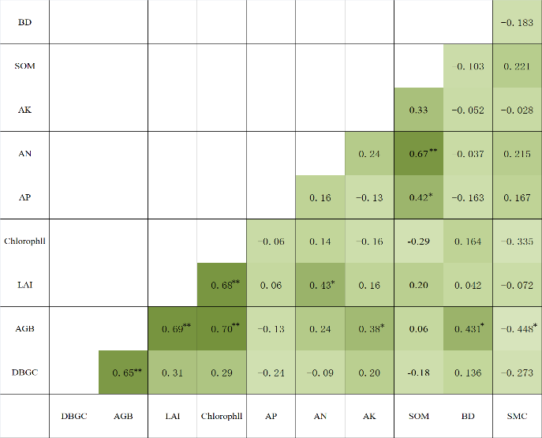
Field data analysis
Correlation coefficient between soil properties and vegetation growth parameters(n=35)

Slide 36
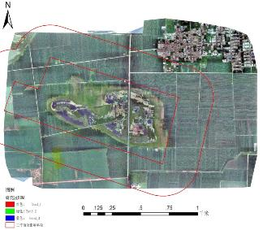
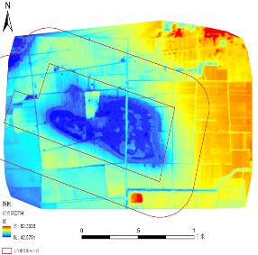
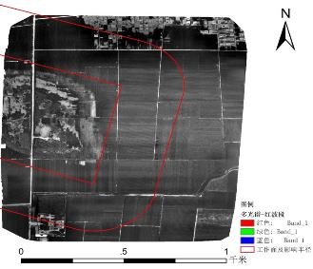
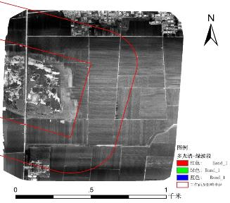
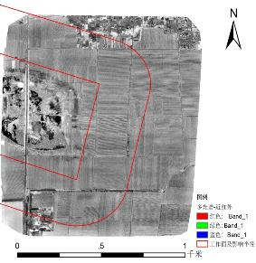
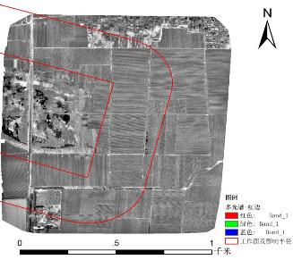
Image data analysis
RGB-DOM
RGB-DSM
Multispectral (RED)
Multispectral (Green)
Multispectral (Near infrared)
Multispectral (Red edge)

Slide 37
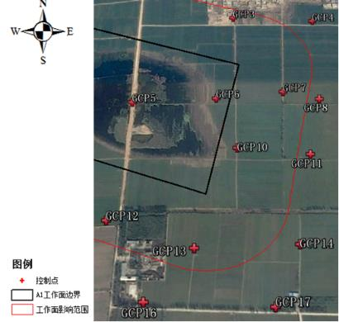
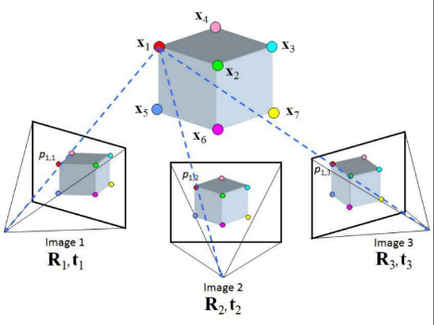
Mapping terrain with UAS
Structure from Motion

Slide 38
Mapping terrain with UAS
Mining subsidence DEM
DEM ERROR

Slide 39
Mapping terrain with UAS
1:1000

Slide 40
Vegetation classification

Slide 41
Vegetation classification
Based on the optimized object-oriented scale segmentation parameters, the object-oriented classification model was constructed after the classification rules were determined. The wetland vegetation was classified and the vegetation distribution map was generated.
322 sampling points are used to verify the accuracy. The results show that the overall accuracy of the object-oriented classification method is 83%.

Slide 42
Above ground biomass estimation
Vegetation index | Formula | Reference
SR | ρNIR/ρR | PearsonRL等.1972
EVI2 | (ρNIR-ρR)/(1+ρNIR+2.4*ρR) | Jiang等.2008
NDVI | (ρNIR-ρR)/(ρNIR+ρR) | RouseJW等.1974
WDRVI | (aρNIR-ρR)/(aρNIR+ρR)(0.1≤a≤0.2) | GitelsonAA等.2004
MSR | (ρNIR/ρR-1)/(ρNIR/ρR+1)½ | Chen等.1996
TVI | 0.5×[120×(ρNIR-ρG)]-200×(ρR-ρG) | BrogeNH等.2001
MVI | [(ρNIR-ρR)/(ρNIR+ρR)+0.5]½ | McDanielKC等.1982
MSAVI | {2NIR+1-[(2ρNIR+1)²-8(ρNIR+ρR)]½}/2 | QiJ等.1994
CIredge | (ρNIR/ρRed-edge)-1 | GitelsonAA等.2005
CIgreen | (ρNIR/ρG)-1 | GitelsonAA等.2005
GNDVI | (ρNIR-ρG)/(ρNIR+ρG) | GitelsonAA等.1996
MTCI | (ρNIR-ρRed-edge)/(ρRed-dedge-ρR) | Dash等.2004
MSRredge | (ρNIR/ρRed-edge-1)/(ρNIR/ρRed-edge+1)½ | Wu等.2008
SRredge | ρNIR/ρRed-edge | Sims等.2002
MTVI2 | 1.5*[1.2*(ρNIR-ρG)-2.5*(ρR-ρG)]/sqrt((2ρR+1)²-(6NIR-5ρR½)-0.5) | Haboudane等.2004
NLI | (ρNIR²-ρR)/(ρNIR²+ρR) | Gong.2003
NDGI | (ρG-ρR)/(ρG+ρR) | GeorgeE.2008
NDVIred-edge | (ρNIR-ρRededge)/(ρNIR+ρRed-edge) | GitelsonAA等.1997

Slide 43
Above ground biomass estimation

Slide 44
Above ground biomass estimation

Slide 45
Above ground biomass estimation
The correlation between the improved red edge index and biomass was the highest among the single variables.
However, there is serious collinearity between the red-edge band indices. Therefore, besides the combination of red-edge band and near-red band, the combination index between green band, red band and near-red band should be considered to further improve the accuracy of the model.

Slide 46
Above ground biomass estimation
MVIre- Power model
MVIre、GNDVI、NDVI- Multivariate stepwise regression model
MTVI2re、GNDVI-BPNN
a:样本建模; b:样本验证 c:交叉验证

Slide 47
AGB (Above Ground Biomass) estimation

Slide 48
SPAD estimation

Slide 49
LAI (Leaf Area Index) estimation

Slide 50
 | R² | Expression
L1 | 0.62 | y=0.551x²+4.489x+838.17
L2 | 0.63 | y=-2.448x²+45.884x+792.25
L3 | 0.44 | y=-1.383x²+38.360x+753.26
L4 | 0.54 | y=-0.148x²+16.229x+797.07
L5 | 0.70 | y=-2.189x²+53.793x+746.70
L6 | 0.66 | y=-1.548x²+37.382x+828.94
L7 | 0.76 | y=-17.362x²+206.77x+461.39
L8 | 0.84 | y=0.025x²+20.551x+894.45

Slide 52
Conclusion and Future work
4

Slide 53
Conclusion:
Coal mining subsidence induced basin has a typical impact on agricultural land from center to edge
UAV deployed multi-sensor has proven to be a sophisticated tool for monitoring and assessment.
Notes:
The three crop growth indices in the study area increased gradually from the disturbance boundary to the center of the basin along the three splines, and reached the lowest value in the near-water area. Most of the maize growth in the distal part of the K1 line and the K3 coverage area within the disturbance boundary were not affected, showing significant spatial differences and regularity.

Slide 54
Spatial heterogeneity
Ownership
Planting time
Field management

Slide 55
Discussions and future work：
Because of the difference of farmer's field management, there are significant differences in the growth of maize among different measuring lines in space. Therefore, it is impossible to divide the damage degree by a certain threshold and interval.
How to combine or synthesis several indicator to a single one still needed to study.
3. The dynamic monitoring of mining subsidence needs further research and improvement. (DSM-DEM? Deformation monitoring?)

Slide 56
That’s all, Thanks！

