Slide 1
Applying UAV Imagery to Minimize Impacts to Surface Water from Oil and Gas Development
Michael Strager
Professor of Spatial Analysis
School of Natural Resources, Davis College
Notes:
UAV for landscape analysis
More than just pictures
Real estate sites use drones for property, etc
Imagery and processing for a terrain model
Adv of drone: better temporal and spatial resolution of imagery, software is better, price of drones

Slide 2
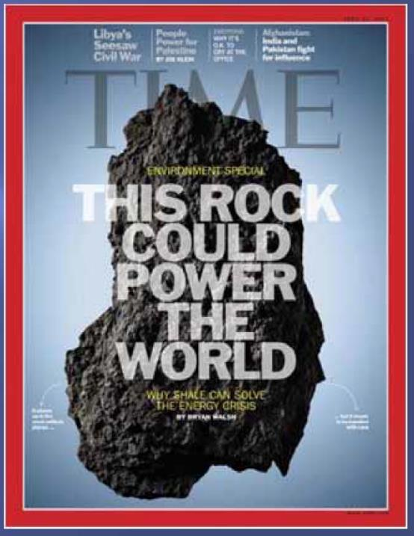
Notes:
So this is the cover from Time magazine in April of 2011 of how shale can solve the energy crisis and power the world.
Dr. Gwen Giedel noted this morning about nat gas use for electric generation.
However, the natural gas from shale for electric generation presents some potential challenges. Unlike coal which can be stored on-site at power plants, natural gas must be delivered as it is used.
Even with this need, worldwide consumption is expected to increase by 70% to 2025 especially in emerging economies. (United States Energy Information Administration (EIA))

Slide 3
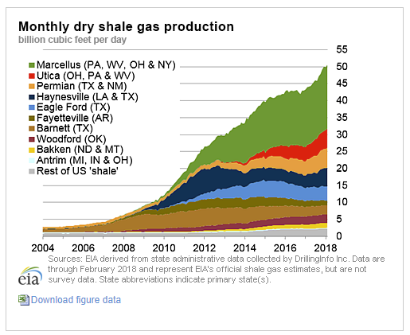
Notes:
In terms of gas production, this graphic highlights the Marcellus shale in our region and how it has been exponentially increasing since 2010.

Slide 4
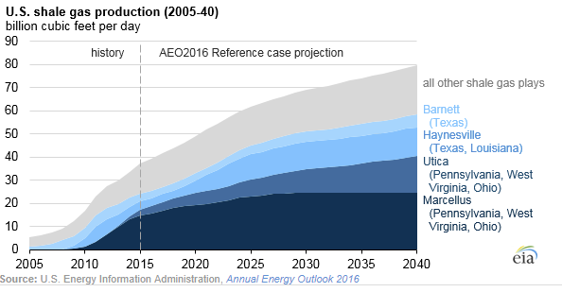
Notes:
And into the future, the shale gas production is expected to continue as this graph shows especially in the Marcellus shale gas play.

Slide 5
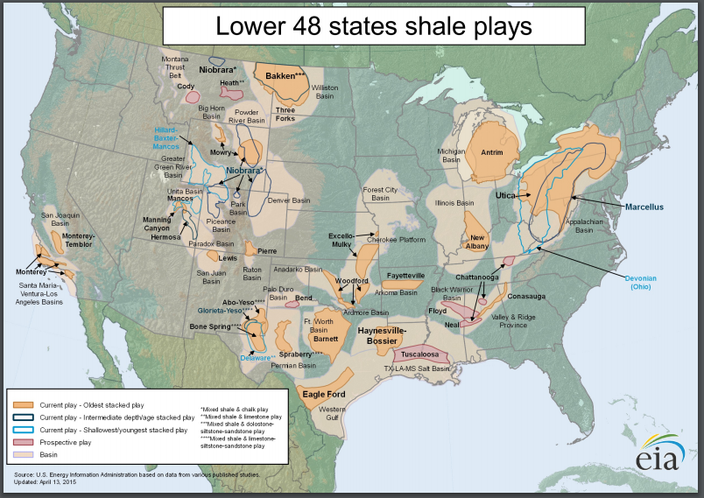
Notes:
This shows the widely distributed nat gas well drilling regions that is quite widespread across the US.

Slide 6
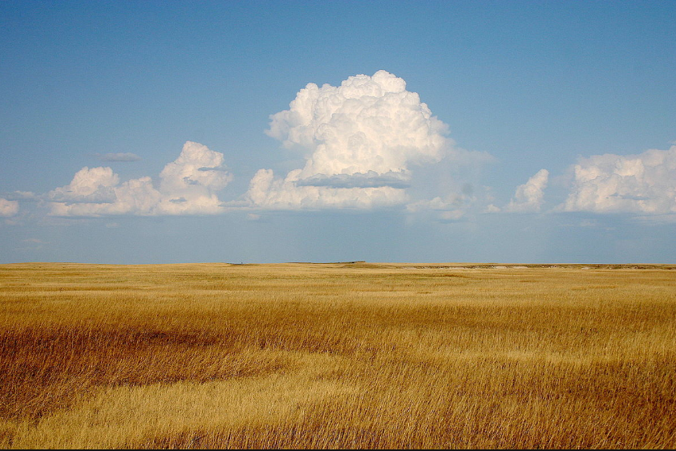
Notes:
Now looking at the landscape in the country, there is a big difference between gas well drilling activity in the central part of the country such as Oklahoma tall grass prairie.

Slide 7
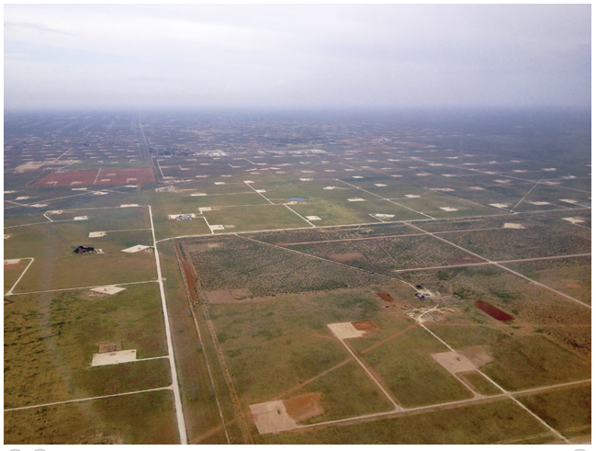
Notes:
Midland texas gas well pads.

Slide 8
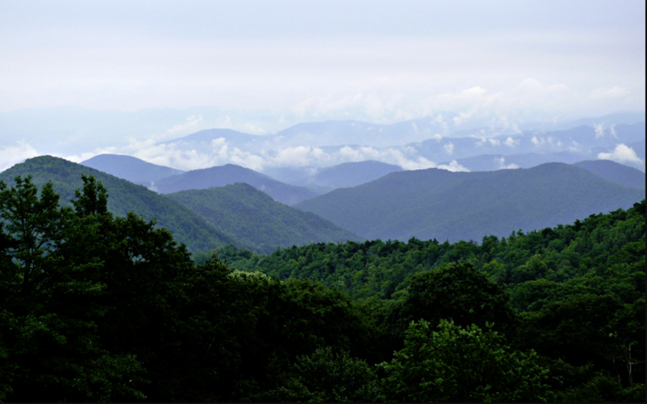
Notes:
Contrast those landscapes to what we have in Appalachia which has mature diverse mesophytic deciduous forests.

Slide 9
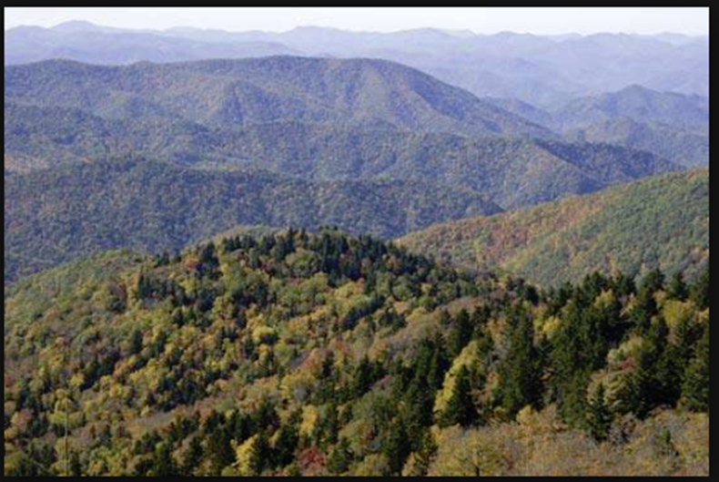
Notes:
Rugged terrain.

Slide 10
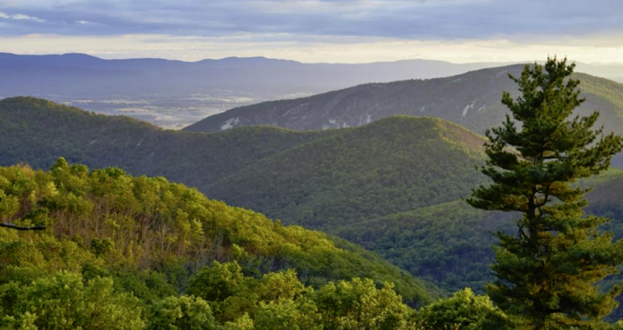
Notes:
Just finding some flat land is difficulty sometimes.

Slide 11
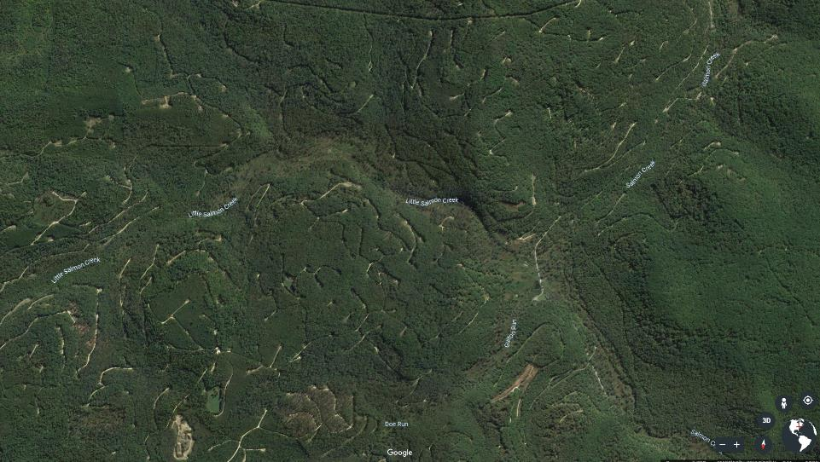
Notes:
Our region and mature diverse mesophytic trees

Slide 12
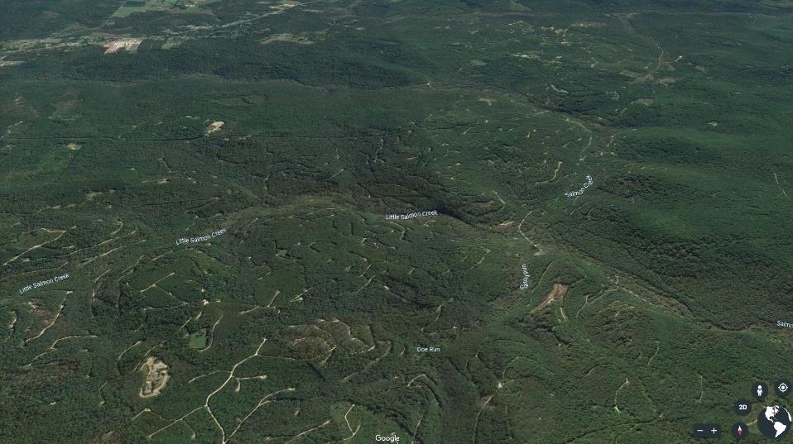
Notes:
Google earth imagery showing the terrain and the ridges, valleys. And in our region we have a lot of water.

Slide 13
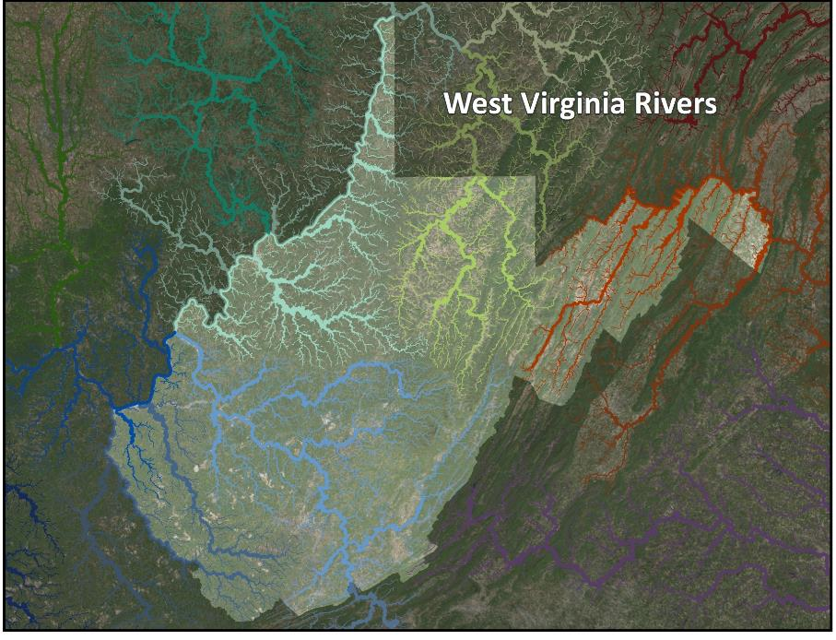
Notes:
We are a water rich state
A headwater state, goes to DC for 60% of their drinking water supply
To Pittsburgh as the Monongahela River as one of the cities three main rivers
Direct drains to the Ohio and downstream communities such as Cincinatti

Slide 14
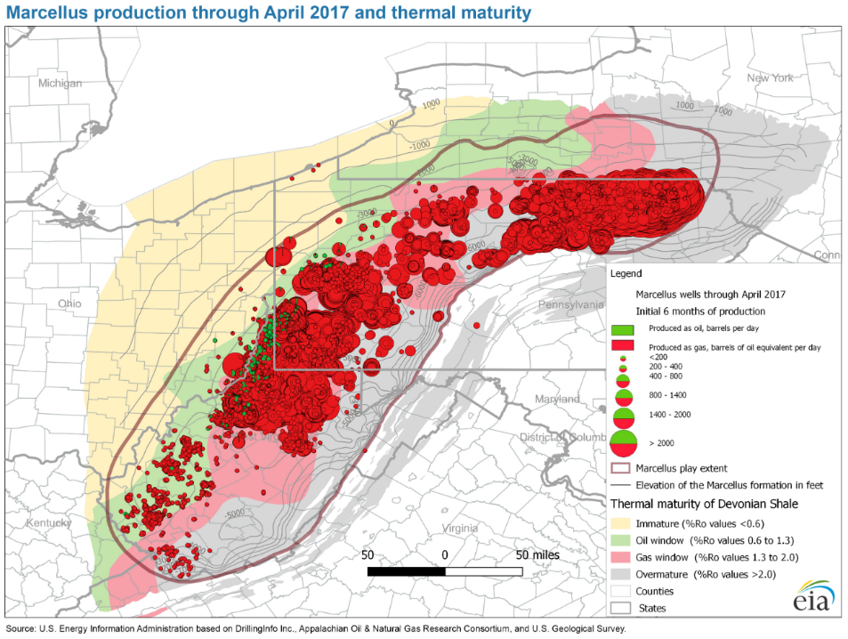
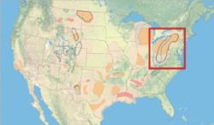
Notes:
Map focuses on the Marcellus nat gas production.

Slide 15
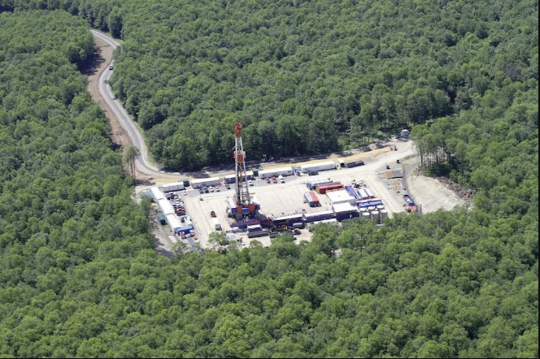
Notes:
And their landscape disturbance in a forested area like this.

Slide 16
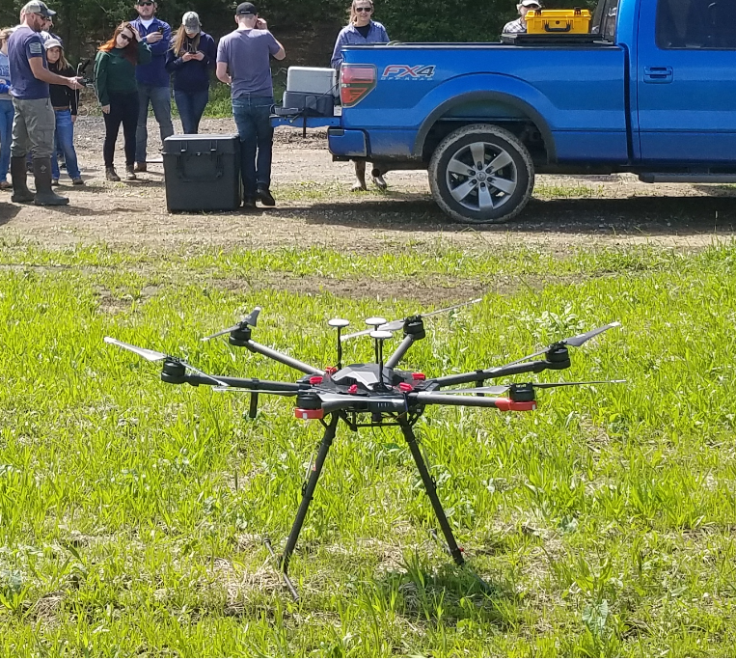
Notes:
Our UAV is a DJI Matrice 600 UAV.
This flies our lidar unit which is a Geo-MMS LiDAR, which is equipped witha Velodyne VLP-26 LiDAR sensor.
The VLP-26 has 16 laser beams, a range of 100 m and generates up to ~600,000 points/second, across a 360° horizontal field of view and a 30° vertical field of view.

Slide 17
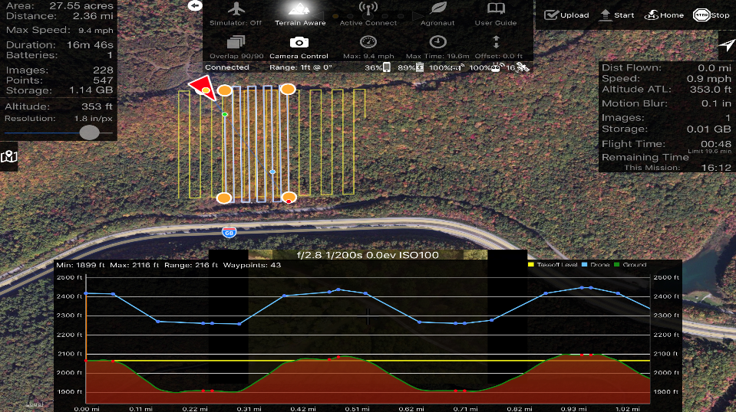
Notes:
Flight planning software which allows UAV to follow the terrain at a set elevation to make sure images are same scale.
When the AOI is on steep terrain the photo overlap will not be consistent as the surface comes closer or falls away from camera.
Terrain awareness actually follows topography and changes aircraft altitude in order to maintain a consistent altitude above ground level (AGL)
Higher accuracy and ground resolution is the result

Slide 18
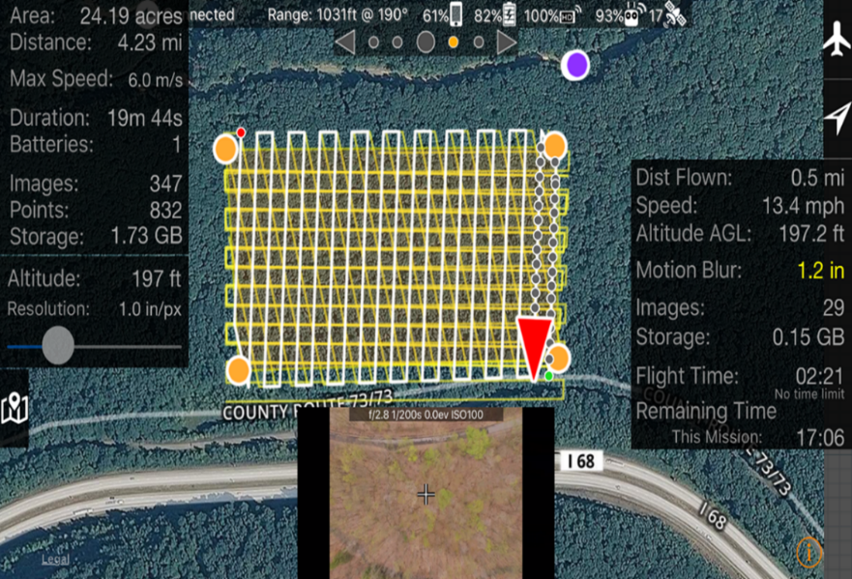
Notes:
Target overlap and endlap is 60-80% to get 8-10 photos of the same feature on the ground.

Slide 19
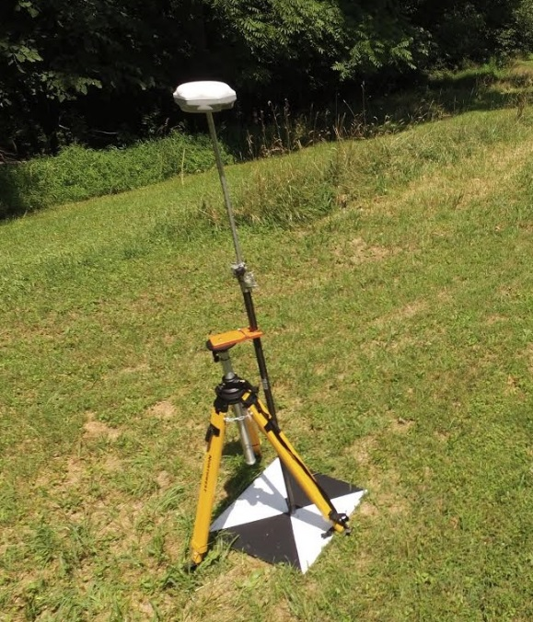
Notes:
GNSS Survey equipment is utilized for precise location of aerial targets. 6-9 targets for a10 acre site. This is for photogrammetry.

Slide 20
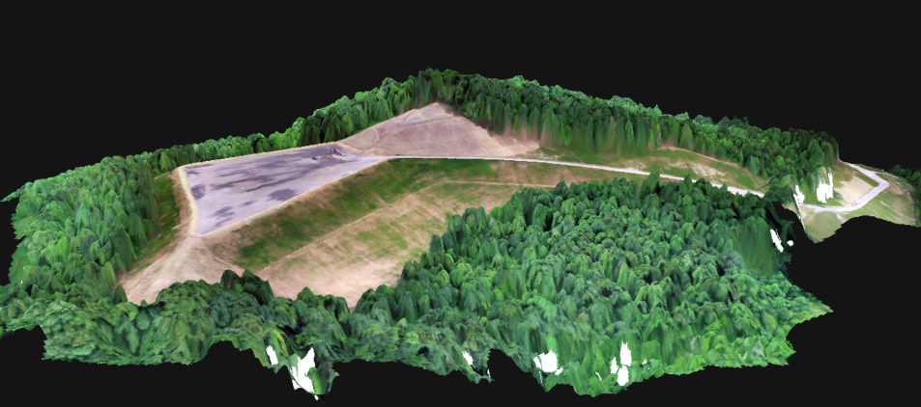
Notes:
Orthophoto imagery draped over the digital terrain model.

Slide 21
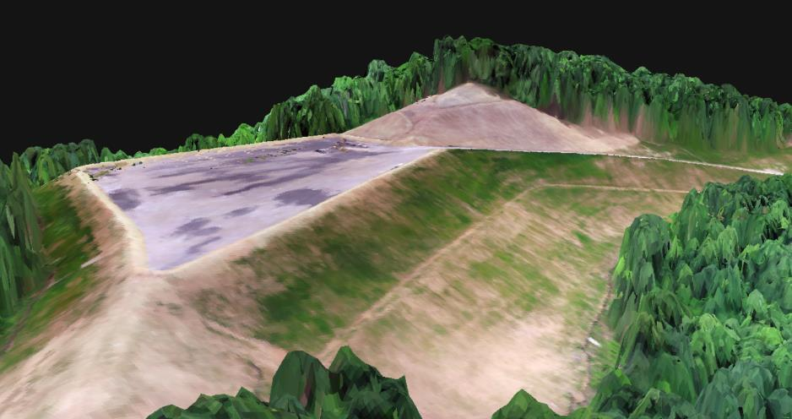
Notes:
Zoom in display showing the runoff extent

Slide 22
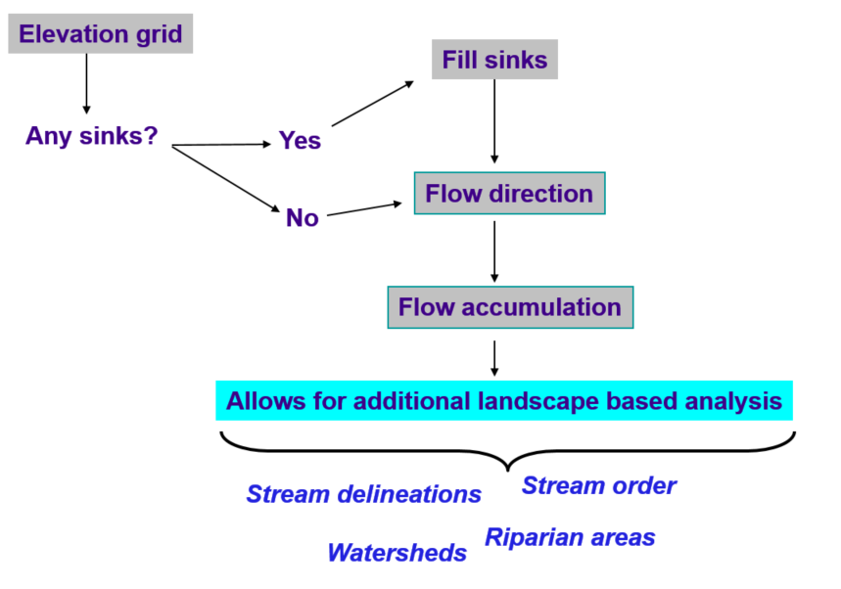
Notes:
Typical surface hydro modeling approach using Dr. Maidment approach for GIS.
The drainage path derivation is the main goal as well as the path from a source to the ending point.

Slide 23
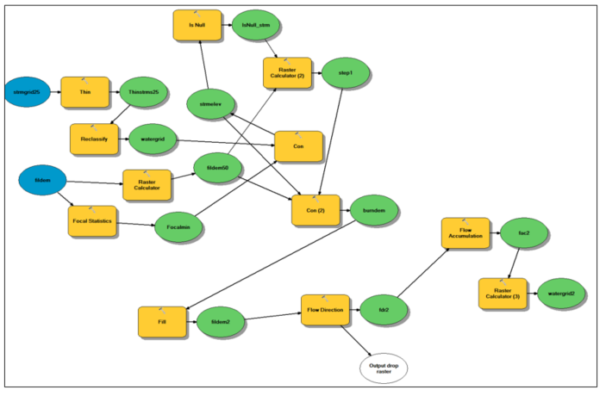
ESRI ArcGIS ArcMap Model Builder Steps

Slide 24
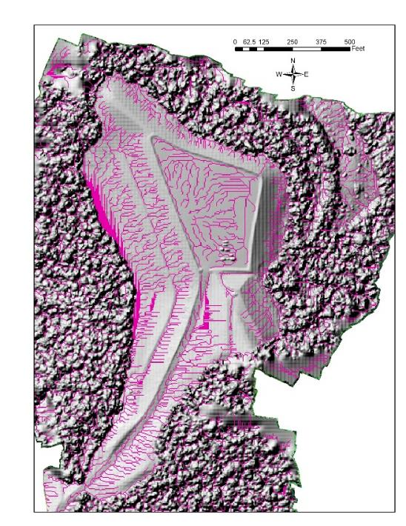

Slide 25
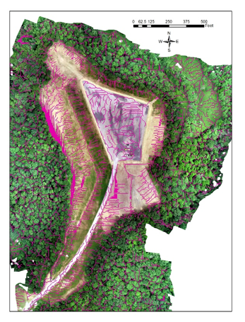

Slide 26
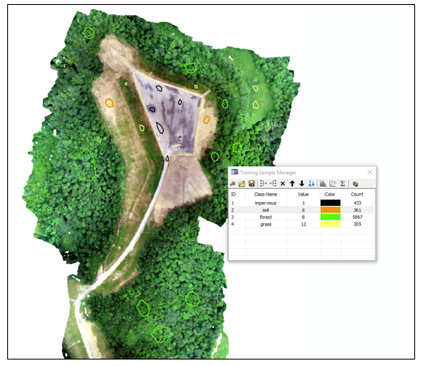
Notes:
Remote sensing application of the orthophoto using the true color imagery. If after these general classes, you can get by without color infrared or other bands of imagery.
Training data sites

Slide 27
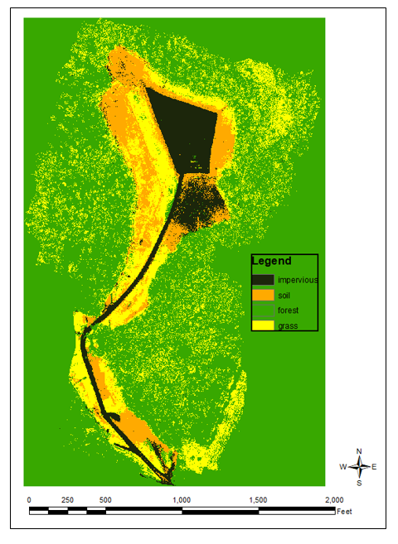
Notes:
This land cover becomes the input for our water runoff modeling.

Slide 28
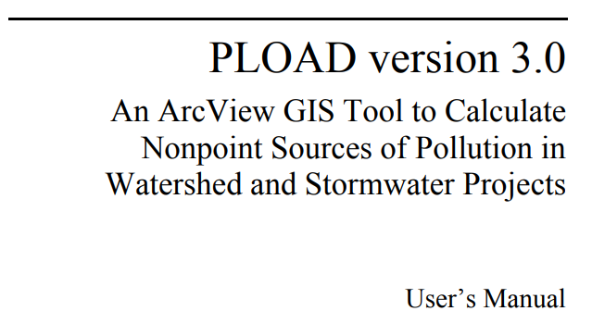
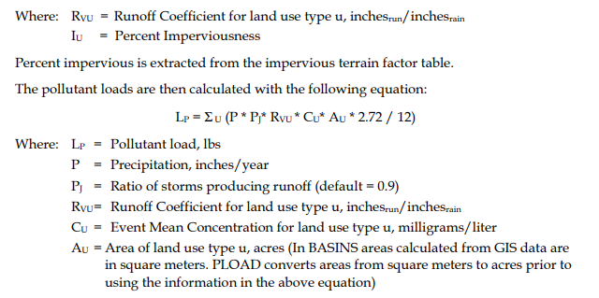
Notes:
Landscape based model. Potential impact model of what possible impacts could be.
GWLF developed by Barry Evans at Penn State is similar. EPA Basins, Qual2E, HSPF approaches are similar.

Slide 29
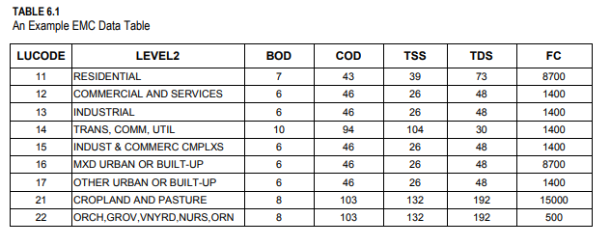
Notes:
Loading values from regional studies of watershed studies.

Slide 30
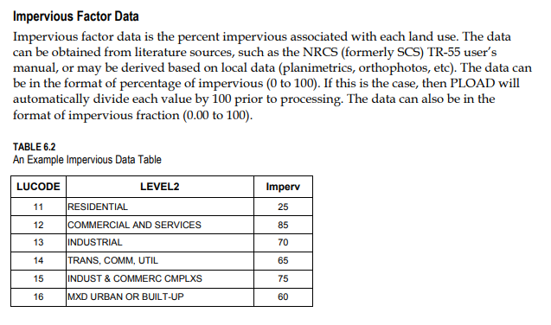

Slide 31
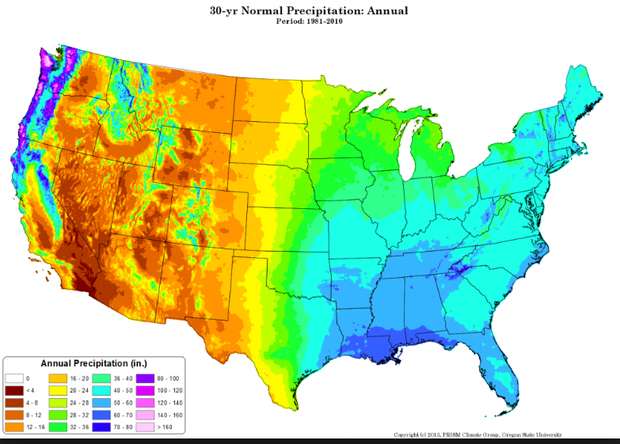
Notes:
A runoff grid is needed to estimate precip input on an annual basis to match the EMC values which are annual.

Slide 32
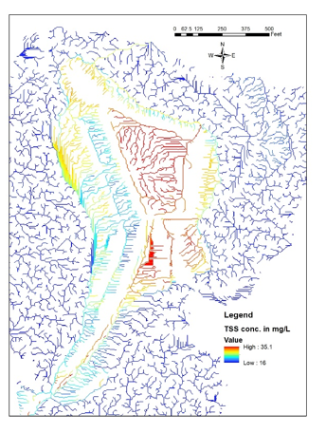
Notes:
Streams have uniform width, depth, roughness
Same ecological rate constants (reareation rates, pollution decay rates and sediment oxygen demand rate)
Transport of pollutants is considered to be conservative (values get averaged over changing flow conditions only) -> no loss or decay of pollutants is considered
Does not consider infiltration, interflow, or ground water flow additions
Does not include atmospheric conditions such as temperature or evapotranspiration
Uses mean annual runoff and flow measures with one time water quality sampling data (must match sampling to normal flow conditions or calibrate flow to time of sampling)
Includes surface runoff from non-point sources
It is a landscape (watershed) model as compared to a receiving water model
Easy to analyze visual output and query capability from results
A deterministic simulation model type
This is a landscape based water quality modeling approach as compared to an instream water quality modeling approach
Difficult to find and have EMC studies done in study area
Soils, temperature, rainfall, etc are all different
It is best used as a proxy of possible conditions to compare one area vs another based on land cover distribution

Slide 33
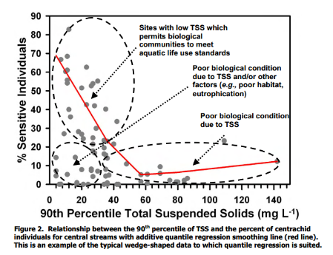
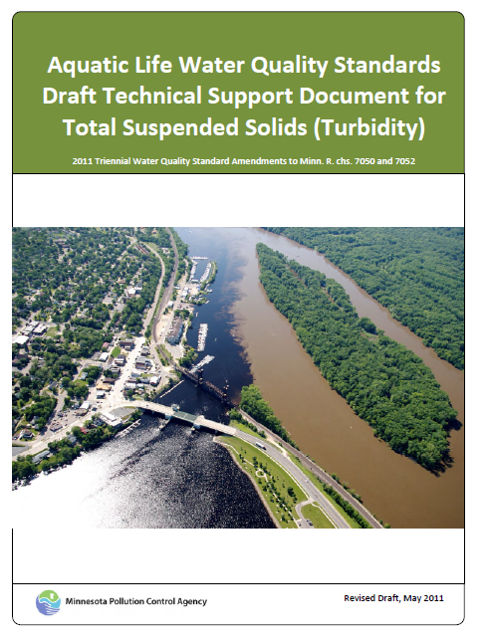
Notes:
Thresholds are important to note what a particular TSS means or where the impact can be.
This study is one example of where a threshold can be of concern.

Slide 34
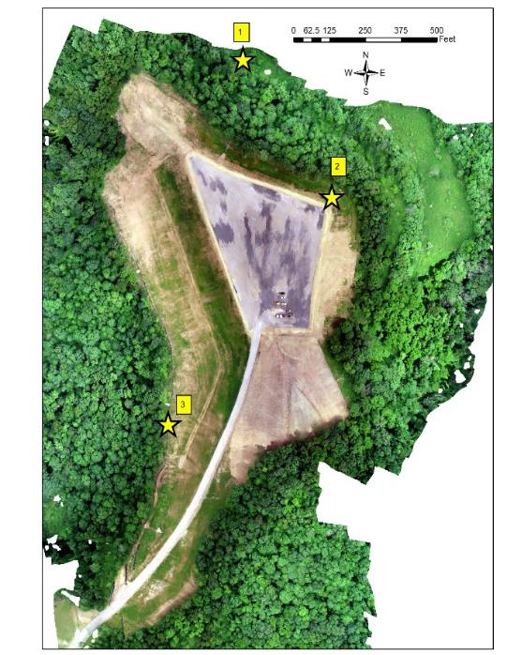
Notes:
We found this technology provided very site-specific high-resolution information in a timely manner to effectively identify runoff sources, extent, and water quality from the well pad. The predicted TSS estimates indicated a potential risk to downstream biological conditions highlighting the importance and utility of this approach to monitoring such pad sites for this industry.

Slide 35
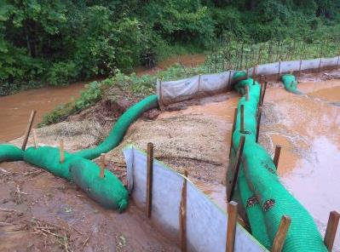
Notes:
Failed sediment controls during gas well pad construction.

Slide 36
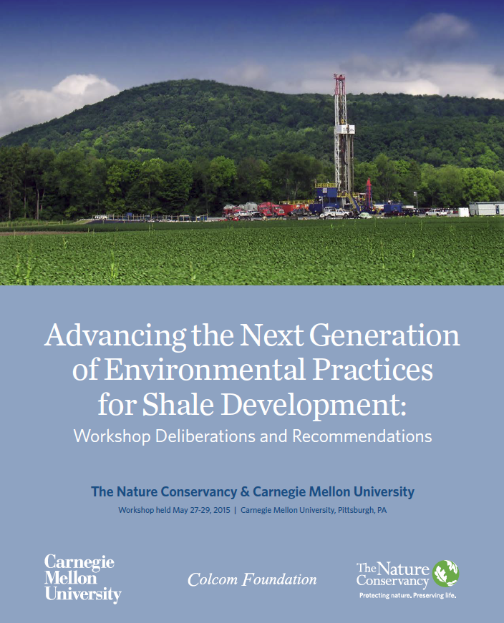
Notes:
Other work was done during a workshop at Carnegie Mellon with TNC. In this workshop, the focused on the potential impacts to land, water, and air associated with shale development in the Appalachian region.
Recommendations:
In the context of shale infrastructure development, the goal of landscape-scale planning can be characterized as avoiding and minimizing impacts to landscape-scale ecological values — wildlife habitat, water resources, and ecosystem functions — while increasing regulatory predictability and improving Operational efficiencies (including potential cost savings).
The goal of co-locating infrastructure is to reduce this footprint by utilizing areas that have already been developed, which can also potentially be economical by lowering construction costs. Operators often seek to co-locate their pipelines near other pipelines, electric power lines, roads, or other existing rights-of-way.
WATER SOURCING AND CONSUMPTIVE USE
In the Marcellus shale play, an estimated 4.4 million gallons of water is required to hydraulically fracture a gas well. Over the next 50 years, it is estimated that cumulative demand could reach 264 billion gallons for the region. Water is generally sourced from streams and rivers, transported to gas well pads and stored onsite, and then used for drilling and high-volume hydraulic fracturing. The use is considered “consumptive,” meaning it is unavailable for future freshwater uses.

Slide 37
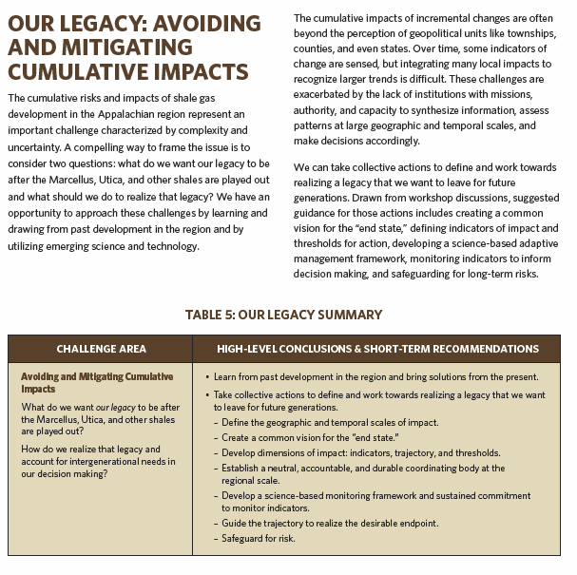
Notes:
The big take away from this workshop was the need to focus on avoiding cumulative impacts and envisioning the end state.
Drawn from workshop discussions, suggested guidance for those actions includes creating a common vision for the “end state,” defining indicators of impact and thresholds for action, developing a science-based adaptive management framework, monitoring indicators to inform decision making, and safeguarding for long-term risks.

Slide 38
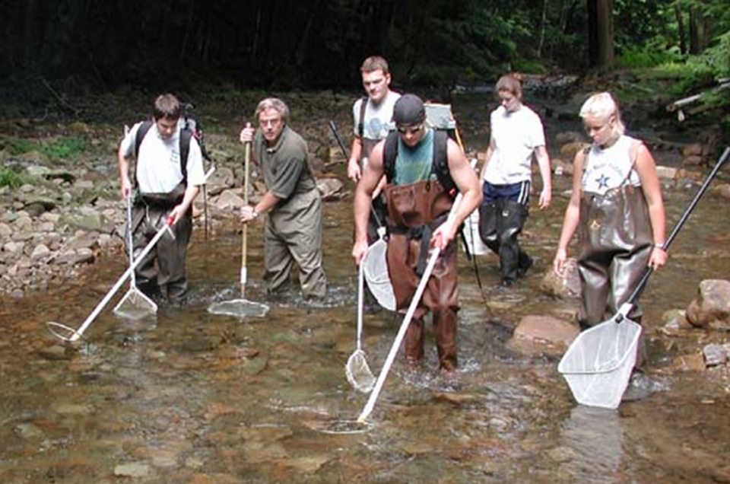
Notes:
We build relationships of the landscape disturbance to receiving stream condition with water quality or aquatic sampling for fish and macroinvertebrates. We are doing this for not just local but cumulative impacts.

Slide 39
