Slide 1


Role of Optical Depth on Spectral Reflectance Data from sUAS-Mounted Multispectral Sensors and Handheld Hyperspectral Radiometers with Relation to Development of Water Quality Models in Mine Drainage Systems
B. K. Holzbauer-Schweitzer and R. W. Nairn
36th Annual ASMR Meeting
Tuesday June 4th, 2019
Notes:
Good afternoon, everyone my name is Brandon Holzbauer-Schweitzer and today I will be presenting a portion of my doctoral research, titled, “The Role of Optical Depth on Spectral Reflectance Data from sUAS-Mounted Multispectral Sensors and Handheld Hyperspectral Radiometers with Relation to Development of Water Quality Models in Mine Drainage Systems.”

Slide 2


Acknowledgements
Center for Restoration of Ecosystems and Watersheds (CREW) especially:
  Harper Stanfield
  Juan Arango
  Nicholas Shepherd
  JD Ingendorf
  Dillon Bruer
  Taylor Wall
  Maggie Tang
  Duncan Wright
Earth Observation and Modeling Facility (EOMF) especially:
  Dr. Xiangming Xiao
  Dr. Rajen Bajgain
Grand River Dam Authority
Notes:
So to begin I just wanted to thank some individuals and organizations who have helped me a great deal and without this project would not be possible

Slide 3
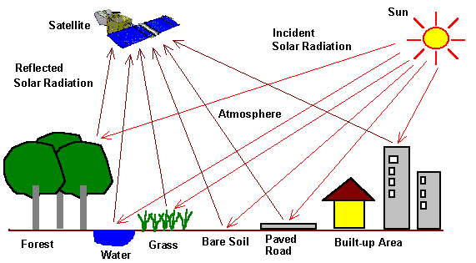
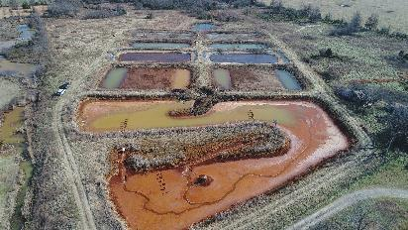
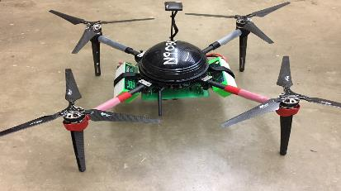
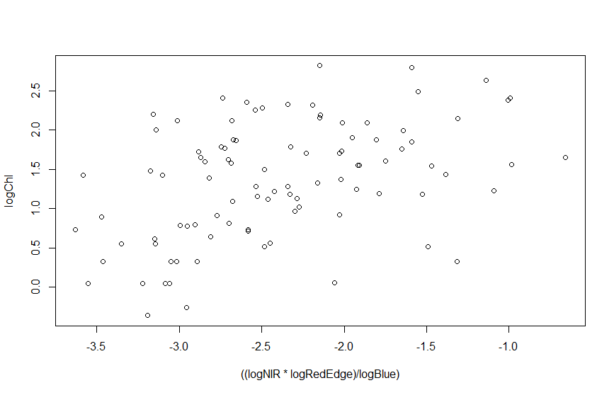
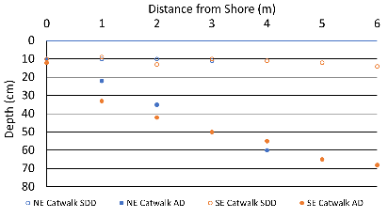
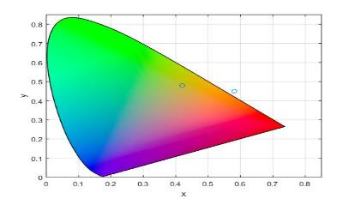

Background/Introduction
Study Sites
Methodologies
Challenges with sUAS Models
Optical Depth Sensing
Conclusions/Future Work
3

Slide 4
Background/Introduction

Slide 5
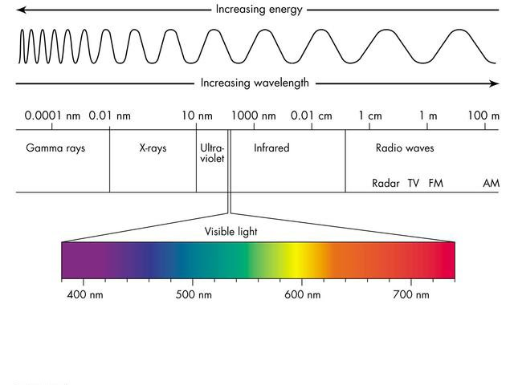
Introduction to Remote Sensing
Commonly described as, the science and art of identifying, observing, and measuring an object without coming into direct contact with it
Humans and other species remotely sense but are limited by:
  The ability to only sense electromagnetic (EM) energy within the visible range of the EM spectrum
  Viewing perspective
  Inability to store data
NIR-840nm
400nm
700nm
Blue-475nm
Green-560nm
Red-668nm
RedEdge-717nm
5
Notes:
Remote sensing is commonly described as the science-and art- of identifying, observing, and measuring an object without coming into direct contact with it. This process typically involves detecting and measuring radiation that is reflected, or emitted at different wavelengths from distant objects or materials.
So if you think about it humans and other species are using remote sensing techniques to visualize their surroundings. However we are limited by our ability to only sense electromagnetic energy within the visible range of the EM spectrum. The viewing perspective, meaning the location of our bodies, and our inability to store a last record of data
These five bands represent the multispectral sensor I will be discussing today, while the hyperspectral sensor measured every nm from 250 to 2500

Slide 6

Typical Spectral Signature of Common Earth Materials
6
Notes:
This figure represents the typical spectral signatures of common earth surface materials. The y-axis is percent reflectance and the x-axis is wavelength in nanometers. Notice the color band on the bottom, this is to indicate the visible portion of the EM spectrum, which is the portion of the spectrum that humans can sense. The NIR region here can provide insight into the structure of the object, where higher reflectance indicates more structure, and finally the SWIR region where low reflectance values indicate high water content.
Holly has a waxy stiff leaf, and more internal structure than grass, therefore it has a higher peak reflectance in the NIR portion of EM spectrum

Slide 7
When light interacts with water, what happens?
Radiative Transfer Theory
  Physical phenomenon of energy transfer as EM radiation
Inherent Optical Properties (IOPs)
  Properties depending only on the medium
Apparent Optical Properties (AOPs)
  Properties depending on the medium (IOPs) and the directional light structure
ɸ_{i} (λ)
ɸ_{s} (λ)
0
∆r
ɸ_{a} (λ)
ɸ_{r} (λ)
R
ɸ_{t} (λ)
Optically Deep Waters
7
Notes:
So, when light interacts with optically deep waters what happens? Well the radiative transfer theory can help describe this. Which is a physical phenomenon of energy transfer in the form of electromagnetic radiation through a medium. Water also has inherent and apparent optical properties. Inherent optical properties are properties that only depend upon the medium, and therefore are independent of the ambient light field within the medium. While apparent optical properties are properties that depend on both the medium (IOPS) and the directional light structure of the light field.
Inherent optical property – beam attenuation coefficient – radiant power lost through a medium
Apparent optical property – the remote sensing reflectance I am going to talk about today
So, looking at the figure on the right which represents optically deep waters, we can see that as incident radiant energy comes from the sun, it can be scattered off the surface of the water body, it can be absorbed by the water body, reflected from the bulk of the water body, and transmitted through the volume until all EM energy has depleted.

Slide 8
When light interacts with water, what happens?
Radiative Transfer Theory
  Physical phenomenon of energy transfer as EM radiation
Inherent Optical Properties (IOPs)
  Properties depending only on the medium
Apparent Optical Properties (AOPs)
  Properties depending on the medium (IOPs) and the directional light structure
ɸ_{i} (λ)
ɸ_{s} (λ)
0
∆r
ɸ_{a} (λ)
ɸ_{r} (λ)
R
Optically Shallow Waters
8
Notes:
Now, changing the case to optically shallow waters, which happen to be the types of bodies of water that I am working in. Instead of EM being transmitted through the waterbody, in this case when the substrate in a system is visible to the human eye, the reflected radiant energy interacts with it and impacts the spectral signature retrieved. Which can be detrimental to developing relationships between the reflected energy and the in-situ water quality

Slide 9
Why this study? What is missing from the literature?
Little to no research has been completed on developing statistical spectral reflectance models capable of predicting surface water quality in mine drainage systems
Chlorophyll and trace metal concentrations in optically shallow waters present challenges
Models relating sUAS-derived multispectral imagery and in-situ water quality data may help in mine drainage watershed reclamation
9
Notes:
So, why is this study being completed and what is missing from the literature:
Little to no research has been completed on developing statistical spectral reflectance models capable of predicting surface water quality in mine drainage systems.
Estimating chlorophyll and trace metal concentrations in optically shallow waters presents challenges
And finally the developed models relating sUAS-derived multispectral imagery and in-situ water quality data may help in mine drainage watershed reclamation

Slide 10

Study Sites

Slide 11

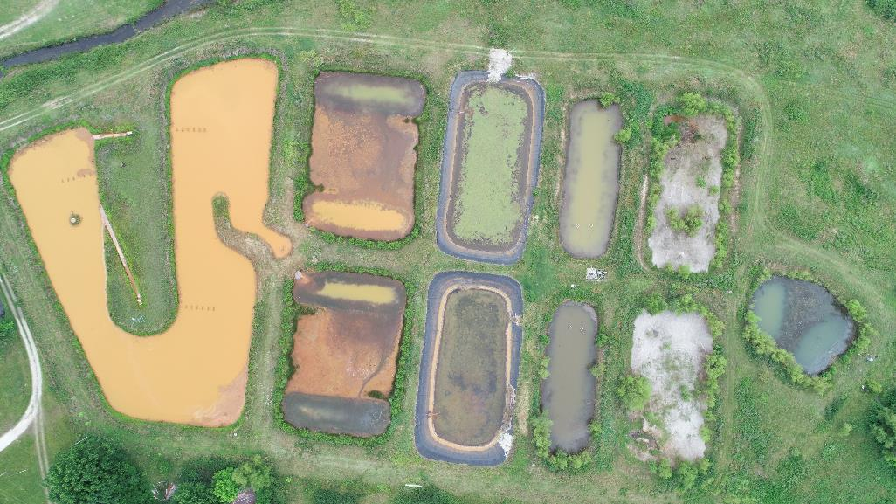
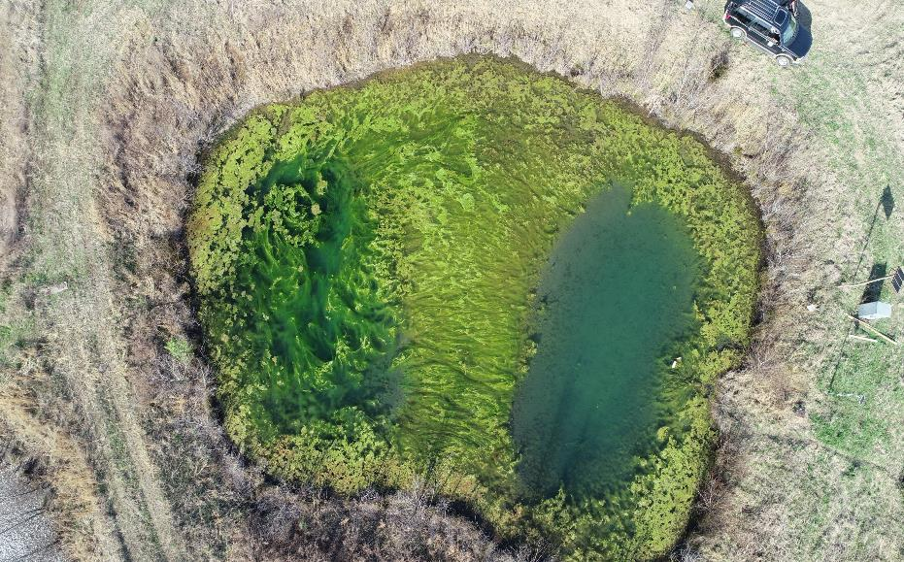

Study Sites
Cell Six
11
Notes:
I am going to present today on two study sites. Briefly, I collected ten missions worth of sUAS and water quality data in cell six (or the final polishing unit) of the Mayer Ranch Passive Treatment Systems in an attempt to relate surface reflectance to in-situ water quality at the time of the mission. One thing I would like to note here, is looking at this close up picture of the pond, you can see the bottom substrate.

Slide 12
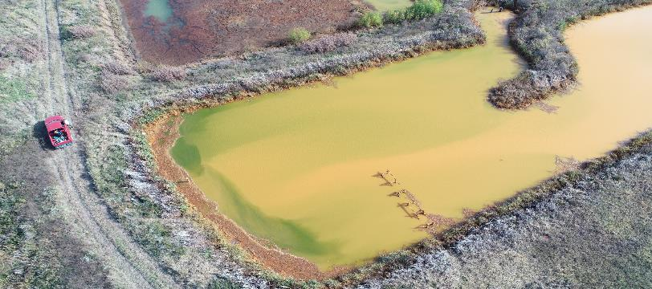
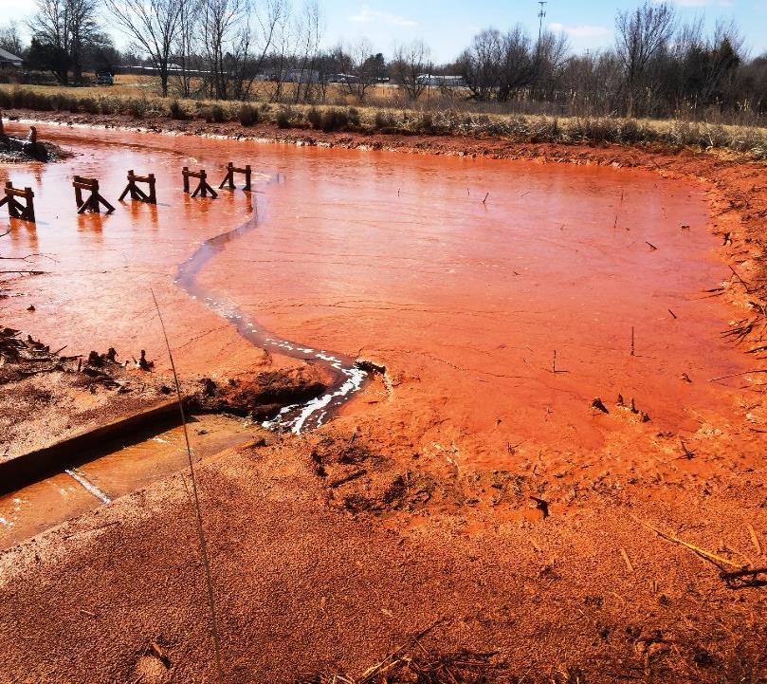
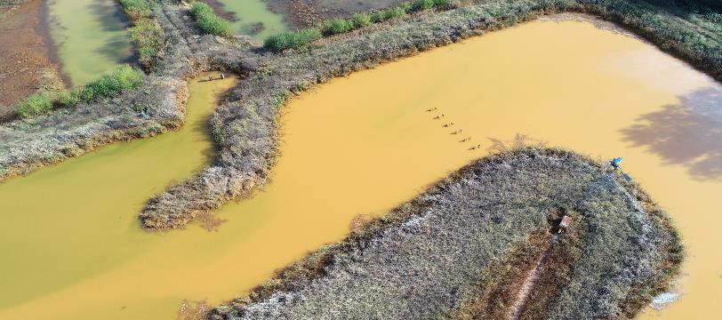
Study Sites
NE Catwalk
NE Catwalk
SE Catwalk
SE Catwalk
12
Notes:
The second site I want to discuss is also at the Mayer Ranch Passive Treatment System and it is Cell one or the oxidation pond. I chose this unit because of its optical properties and because it would allow me test my hypothesis of if you can visibly see the bottom substrate in a water body, the substrates physical, chemical, and optical properties will alter the reflectance measured at the sensor.

Slide 13

Methodologies
Notes:
Alright, so how did I do all this?

Slide 14

Multispectral Data Collection: Chl-a Models
Use a sUAS to collect multispectral imagery of surface water
Collect in-situ data via YSI 6920V2s and surface water grab samples
Correlate in-situ water quality with band ratio transformations to determine what relationships exist and the strength
Develop models capable of predicting surface water quality utilizing only reflectance from the target object
14
Notes:
This methodology addresses the prediction of chlorophyll concentrations. I have used the sUAS to collect multispectral imagery of surface water, collecting in-situ water quality data using field-deployable YSI 6920V2s and grab samples. I have analyzed those samples, and attempted to correlate the water quality with various band ratio transformations to determine what relationships exist and their strength. From there I attempted to develop pixel by pixel linear regression models to allow for prediction of surface water quality using only MS imagery. Reasoning for this type of analysis to address remote sensing problems such as mixed pixels (e.g., land and water), specular reflectance (e.g., glare from sunlight) and water fluidity.

Slide 15

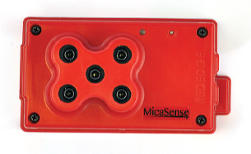
Methodology: AgBot and RedEdge
  Aerial Technologies International (ATI)
  MicaSense RedEdge Multispectral Sensor
15
Notes:
I have collected high-resolution multispectral imagery using CREWs ATI AgBot. The AgBot is a 5 kg, tri-prop dual battery sUAS. Capable of flying with a payload and full charge for over 26 minutes, 4 miles away, at maximum speeds of approximately 40 mph. Furthermore, the sUAS has the capability of flying autonomously, which is how data will be collected for most of this project. The autonomy removes the human aspect of flight and allows for the same mission to be repeated at different time periods.
-------
The AgBot is equipped with a MiceSense RedEdge multispectral sensor which captures 5 discrete bands in the blue, green, red, rededge, and NIR regions of the EM spectrum. With an altitude of 60 m AGL the spatial resolution of the sensor is approximately 5.4 cm/ pixel

Slide 16

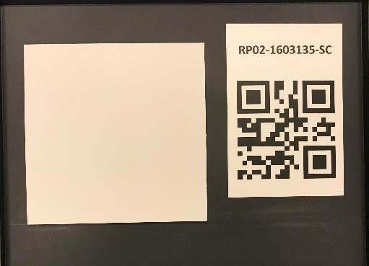
Hyperspectral Data Collection: Optical Depth
ASD FieldSpec 3 calibrated to make the spectral radiant power (ɸ_{i} (λ)) equal to 1
Measurements collected approximately 30 cm from the surface of the water at nadir (directly down)
Ten samples were collected at every λ
Each profile was collected five times
16
Notes:
In order to collect hyperspectral data with the ASD FieldSpec it had to first be calibrated. This instrument is calibrated with a calibration panel, which is supposed to represent a completely white object that reflects 100 percent of the light. Something quick I wanted to show you all deals with how humans perceive color. This first image of the calibration panel was taken indoors under incandescent lighting, making us perceive the color of the panel as a lightish yellow. I then took the same panel outside, and took another picture of it. Notice how much whiter the panel is. Reasoning for this is because the sun emits a full spectrum of EM energy while the lighting indoors only emits energy at certain wavelengths.
However, all of these measurements were collected outside, +/- one hour around solar noon (when the sun is highest in the sky, providing the lowest zenith angles). I collected measurements approximately 30 cm from the surface of the water, at nadir (or directly down). At every wavelength ten samples were collected, and the entire profile was collected five times for averaging in the laboratory.

Slide 17
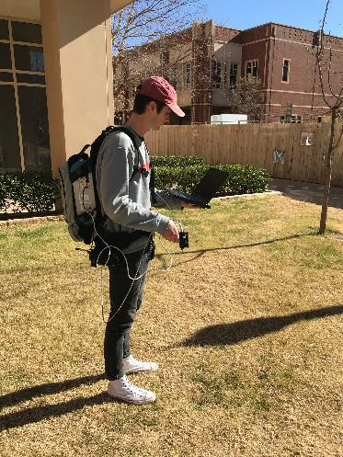
Methodology: Analytical Spectral Devices (ASD) FieldSpec 3
  Field-portable UV/VIS/NIR/SWIR spectroradiometer
  Capable of capturing reflected light energy measurements every nanometer (nm) from 350 – 2500 nm
17
Notes:
The ASD FieldSpec 3 is a field-portable UV/Vis/NIR/SWIR spectroradiometer covering the full solar reflected spectrum. Which is capable of capturing reflected light energy measurements every nanometer from 350-2500 nm. The image on the right shows the entire setup. The back pack is actually the spectroradiometer (which is a device designed to measure the spectral power emitted from a source. There are two batteries beneath the spectroradiometer which power the device. A fiber optic cable runs from the spec to the gun which holds the fiber optic capable in position and allows the user to “point and shoot”. The final piece of the system is the computer where all the data is stored and processed.

Slide 18
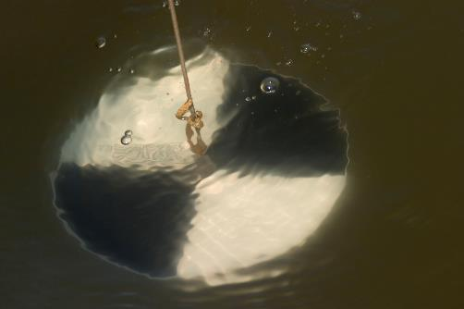
Methodology: Measuring Optical Depth
  Secchi disk depth = visible optical depth
    If visible light cannot penetrate to show the Secchi disk, the sensor used will not measure properties below Secchi disk depth
  If optical depth exceeds actual depth substrate will impact measured signature
18
Notes:
In order to measure the optical depth of these water bodies I used a secchi disk. My idea here is that the secchi disk depth = the visible optical depth. If visible light cannot penetrate to show the Secchi disk, the sensor being used will not be able to measure the properties below that depth. If optical depth exceeds actual depth the substrate will impact the measured signature. However, if the actual depth exceeds the optical depth, the reflectance will come from the bulk (somewhere in the middle) of the water body.

Slide 19
Challenges with sUAS Models
Notes:
I would like to move to some of the challenges I faced trying to develop these models.

Slide 20
sUAS Model Development Results and Challenges
# of Variables | Strongest Positive (R) | Models Evaluated
1 | 0.4512 | 75
2 | 0.5352 | 100
3 | 0.5442 | 23
20
Notes:
Okay. Now to get into some of the results of my attempts to predict chlorophyll concentrations in optically shallow waters. The table here is a very brief summary of my current results, which are grim to say the least. I attempted to develop a series of models, 1, 2, or 3 variable, with very limited success. I believe the ineffectiveness of these chlorophyll models was due to the interaction with the substrate in optically shallow ponds, thus altering the true reflectance from the bulk of the water body not allowing for development of desired models.

Slide 21
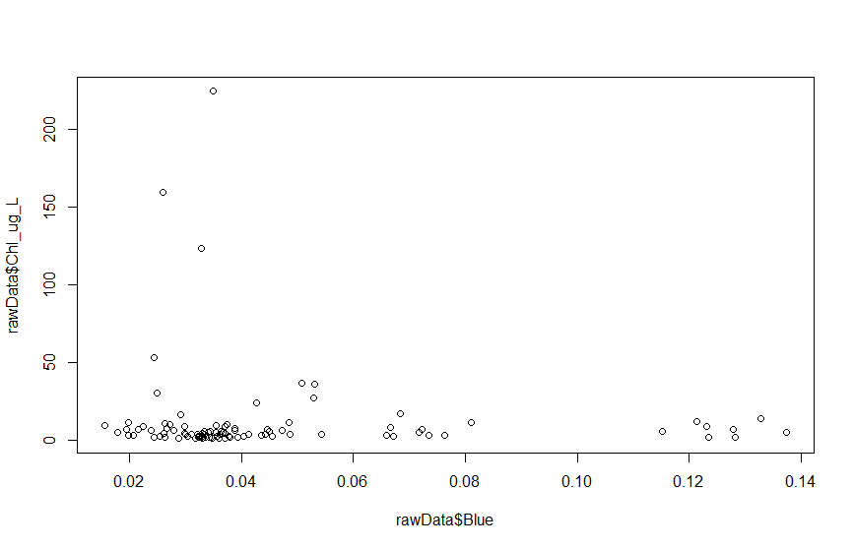

Preliminary Results: The Dataset – C6
n = 96
21
18
Notes:
Now I would like to present some of the data I collected during my attempt to develop the chlorophyll models.
Here we have the chlorophyll concentration in micrograms per liter versus the reflectance in the blue band. I believe the figure speaks for it self in that weak to no relationships exist between the two raw datasets. Even further there appears to be really not prominent distribution in the dataset.

Slide 22
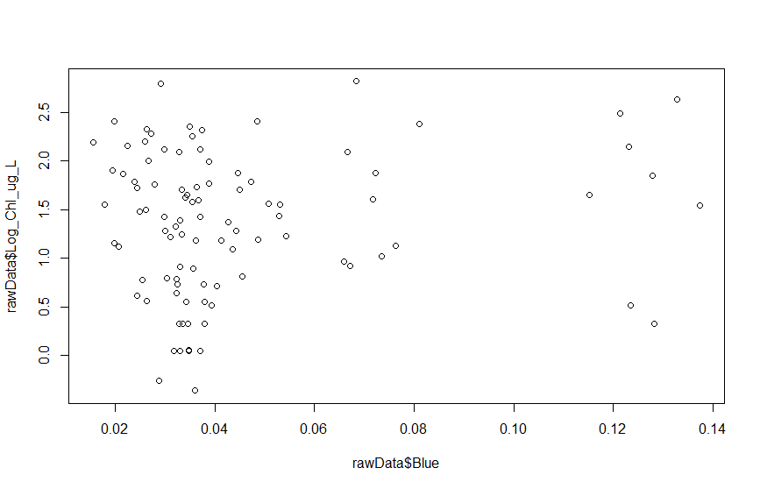
Preliminary Results: The Dataset – C6
n = 96
22
18
Notes:
So, lets try and transform the data. Here I present a log transformed chlorophyll concentration versus the reflectance in the blue band again. Somewhat of a logarithmic relationship, but still that is reaching

Slide 23
n = 96
R= 0.54
23
Notes:
SO lets go one step further and transform the reflectance values. Wow, starting to look better but still only an R value of 0.54 using three variables. I attempted many different transformations, I tried to use turbidity, TSS, or alkalinity as descriptor variables, again to no prevail. So after, attempting all of the data processing/analysis I just mentioned, I decided to take a step back and look closer at what interactions are occurring and how.

Slide 24
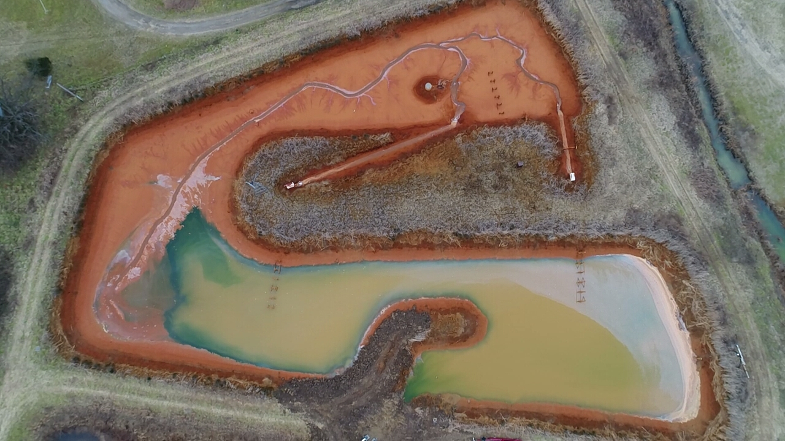


Optical Depth Sensing
20
Notes:
Which takes from the end of the passive treatment systems (Cell six) to the start of the passive treatment system (cell one) transitioning from sUAS chlorophyll models to an ongoing optical depth study in this oxidation unit. This study along with a mesocosm study I am planning this summer should allow me to test the hypothesis of substrate sensing when it is visible to the human eye (thus also visible to the sensor in the visible portions of the EM spectrum).

Slide 25
25
Notes:
This figure shows some data from a recent investigation into optical depth. On the y-axis we have depth in (cm) and on the x-axis we have distance from shore in (m). The blue unfilled circles represent SDD at the NE catwalk while the filled blue circles represent the actual depth. While, the orange unfilled circles represent SDD at the SE catwalk while the filled orange circles represent the actual depth. As we can see moving away from shore, depth increases, which makes sense as we designed the pond this way. However, what is important to note is that the SDD remains relatively constant moving across the pond.

Slide 26
26
Notes:
Looking at this figure we have the ratio between SDD and AD on the y-axis and distance from shore again on the x-axis. NE catwalk is blue and SE catwalk is orange. What is important to note here is the ratio between SDD and AD. When the ratio between the two is equal to one, the substrate has a significant impact on the spectral signature retrieved. However, when it is below one, it appears that the substrate does not have an impact on the morphology of the signatures. This will become apparent in the next slide.

Slide 27
Visible
NIR
SWIR
Distance from Shore
27
Notes:
This figure is similar to one of the first figures I showed it. It is a spectral reflectance plot with percent reflectance on the y-axis and wavelength in nm on the x-axis. The black line is the percent reflectance from the point closest to shore, that had a SDD/AD ratio equal to one. In other words, I lowered the secchi disk down and while it sat on the bottom of the pond I was still able to clearly see it. Which means that so could my sensor, which is apparent here. What is important to note here is even though the curves have different magnitudes their peaks and valleys occur at essentially the same wavelength. Several things could cause the changes in percent reflectance, cloud cover or lack of, specular reflectance caused by wind action, or imperfect positioning at NADIR. Regardless, the fact that the curves remain relatively consistent with ratios below one, leads me to believe that if I can visibly see the bottom it will impact the data measured.

Slide 28

Conclusions
EM energy reflected from the benthic surface impacts the water leaving radiance in optically shallow waters
  Biological in origin (chlorophyll)
  Physicochemical (iron oxide turbidity)
ɸ_{i} (λ)
ɸ_{s} (λ)
0
∆r
ɸ_{a} (λ)
ɸ_{r} (λ)
R
28
Notes:
So, what does this mean? In optically shallow water the light reflected from the benthic surface affects the remotely sensed water leaving radiance (electromagnetic energy) from that expected in optically deep water. Whether that benthic surface be of biological origin or physiochemical, the same principles should hold true
ɸ - phi

Slide 29
Conclusions
To model optically shallow waters, the contribution to the sensed signal from the surface must be separated from that of the bottom
  Three diffuse attenuation coefficients required
    Diver operated spectroradiometer
    Radiative transfer numerical model
ɸ_{i} (λ)
ɸ_{s} (λ)
0
∆r
ɸ_{a} (λ)
ɸ_{r} (λ)
R
29
Notes:
In order to model optically shallow waters, the contribution to the sensed reflectance signal from the surface must be separated from that of the bottom. This requires three diffuse attenuation coefficients, which are the down dwelling irradiance (energy coming to earth from the sun), reflectance from the surface, and the bottom upwelling reflectance. The first two are not difficult to acquire, however, in order to determine the third, one either needs to have a diver operated spectroradiometer, or perform optical modeling using a radiative transfer numerical model.
Which will require me to bridge the gap between the heavy optical science, the biogeochemistry occurring in the ponds, and the development of the surface water quality model.

Slide 30
Future work
Mesocosm studies this summer to get more detailed information on optical depth
Model bottom upwelling radiance
Apply lessons learned to development of water quality models in oxidation ponds
Continue to collect multi/hyperspectral data
30
Notes:
So, I have a lot left to do. Some of the currently planned and proposed future work is to first complete this mesocosm study to get a more detailed look at optical depth and the role is plays in development of these surface water quality models.
I plan to explore the option of modeling bottom upwelling radiance. Although this extra step to model another parameter is somewhat out of the scope of my larger dissertation, I believe it to be a necessary step in understanding why my chlorophyll models were not as successful as expected.
Take any lessons learned and apply those to the development of models capable of predicting metal (specifically iron) concentrations in oxidation units.
Finally, continue to collect the multi and hyperspectral data so I can graduate.

Slide 31

Thank you for your time.
Are there any questions?
Notes:
With that I thank you all for your time and look forward to addressing any comments, questions, or concerns you may have.

Slide 32
Hyperspectral Data Processing
Raw digital numbers (DN) were post-processed to spectral reflectance
Averaged using ViewSpec Pro producing a single spectral reflectance profile
Atmospheric interference due to aerosols were removed for clarity
32
Notes:
This figure represents the raw data that is retrieved from the instrument. Tells a great story right? No, like I said, at each site I measured the profile five times and then used the processing software (ViewSpec Pro) to average and produce a single spectral reflectance profile. Note the extremely large peaks and valleys around 1900 nm and past 2400, those data were removed because there is interference with atmospheric water vapor and allows for more clarity when viewing the data.

