Slide 1
PREDICTION OF OPTICAL AND NON-OPTICAL WATER QUALITY PARAMETERS IN OLIGOTROPHIC AND EUTROPHIC SYSTEMS USING A SMALL UNMANNED AERIAL SYSTEM
Juan G. Arango and Robert W. Nairn
University of Oklahoma
36th Annual Meeting of the American
Society of Mining & Reclamation
Notes:
First of all, I want to thank you all for being part of my committee, as I have mentioned several times in my emails it is an honor for me to have you guys as contributing members in this project. Today I will be presenting to you my PhD research prospectus, that I have tile (READ TITLE).

Slide 2
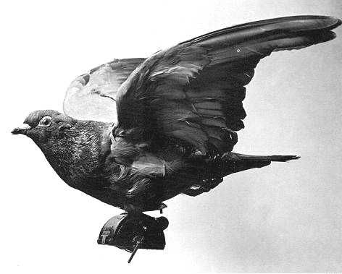
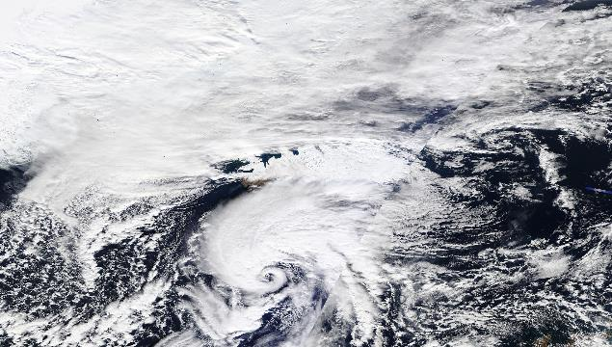
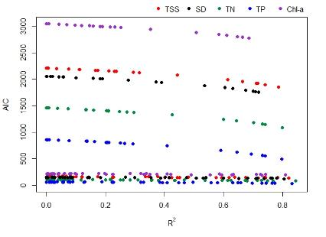
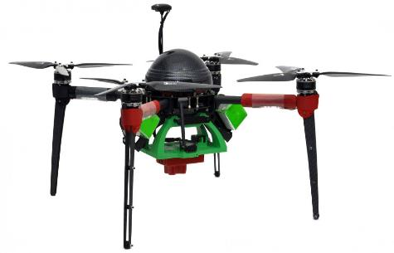
Hypothesis and Objectives
Introduction
Methodology
Results

Slide 3
REMOTE SENSING
Notes:
An energy source, in this case the sun emits energy. That incident energy hits a target (paved roads, bare soil, water, grass, a forest or a built-up area) and the reflected energy from each target gets sense and recorded by a sensor onboard a satellite.

Slide 4
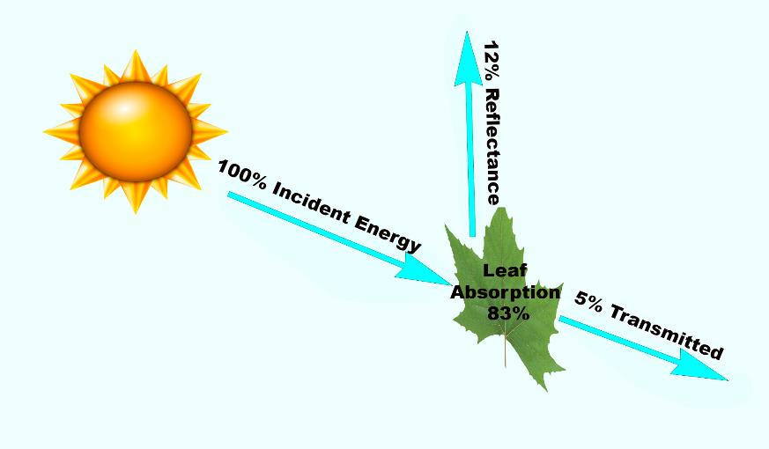
ENERGY INTERACTIONS WITH TARGETS
Notes:
An energy source, in this case the sun emits energy. That incident energy hits a target (paved roads, bare soil, water, grass, a forest or a built-up area) and the reflected energy from each target gets sense and recorded by a sensor onboard a satellite.

Slide 5
SPECTRAL SIGNATURES
Notes:
An energy source, in this case the sun emits energy. That incident energy hits a target (paved roads, bare soil, water, grass, a forest or a built-up area) and the reflected energy from each target gets sense and recorded by a sensor onboard a satellite.

Slide 6
EARTH OBSERVATION SATELLITES
Satellite | Launched Year | Spatial Resolution | Temporal Resolution (Day) | Spectral Resolution | Radiometric Resolution
Landsat-5 | 1984 | 30 m. multispectral 120 m. TIR | 16 | Blue, Green, Red, NIR, SWIR-1, SWIR-2, TIR | 8-bit
OrbView–2 | 1997 | 1130 m. | 1 | 8 bands (0.402 to 0.885 μm) | 12-bit
IKONOS | 1999 | 1 m. panchromatic 4 m. multispectral | 3 | Panchromatic, Blue, Green, Red, NIR | 11-bit
Landsat-7 | 1999 | 15 m. panchromatic 30 m. multispectral 60 m. TIR | 16 | Panchromatic, Blue, Green, Red, NIR, SWIR-1, SWIR-2, TIR | 12-bit
Terra - MODIS | 1999 | 250 m. B1 – B2 500 m. B3 – B7 1000 m. B8 – B36 | 1-2 | 36 bands (0.620 – 14.385 μm) | 12-bit
EO-1 ALI | 2001 | 10 m. panchromatic 30 m. multispectral | 16 | 10 bands (0.450 – 2.350 μm) | 12-bit
QuickBird-2 | 2001 | 3 m. panchromatic 15 m. multispectral | 1-3 | Panchromatic, Blue, Green, Red, NIR | 8-bit
OrbView-3 | 2003 | 1 m. panchromatic 4 m. multispectral | 3 | Panchromatic, Blue, Green, Red, NIR | 11-bit
GeoEye-1 | 2008 | 0.41 m. panchromatic 1.64 m. multispectral | 3 | Panchromatic, Blue, Green, Red, NIR | 11-bit
Landsat-8 | 2013 | 15 m. panchromatic 30 m. multispectral 60 m. TIR | 16 | Panchromatic, Coastal, Blue, Green, Red, NIR, SWIR-2, SWIR-4, TIR | 12-bit
Gaofen-1 | 2013 | 2.0 m. panchromatic 8 m. multispectral | 4 | Panchromatic, Blue, Green, Red, NIR | 14 -bit
Sentinel-2 | 2015 | 10 m. multispectral 20 m. 60 m. | 5 | 13 bands (0.43 – 2.28 μm) | 12-bit
GeoEye-2 | 2016 | 0.31 m. panchromatic 1.24 m. multispectral | 3 days | Panchromatic, Blue, Green, Red, NIR | 11-bit
Notes:
An energy source, in this case the sun emits energy. That incident energy hits a target (paved roads, bare soil, water, grass, a forest or a built-up area) and the reflected energy from each target gets sense and recorded by a sensor onboard a satellite.

Slide 7
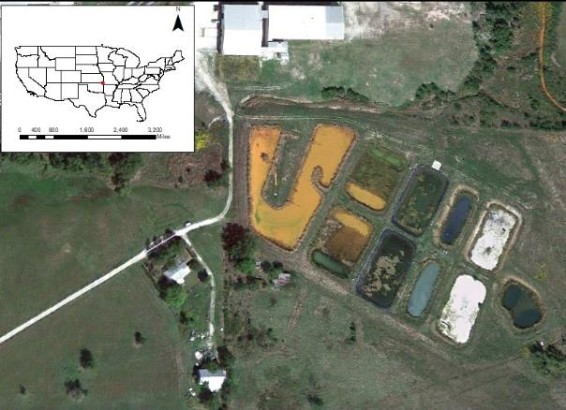
EOS – MINING WATER BODIES
Mayer Ranch - True Color Image 04/23/2013 – Quickbird
Collapse Feature - True Color Image 09/27/2011 – Landsat
Notes:
An energy source, in this case the sun emits energy. That incident energy hits a target (paved roads, bare soil, water, grass, a forest or a built-up area) and the reflected energy from each target gets sense and recorded by a sensor onboard a satellite.

Slide 8
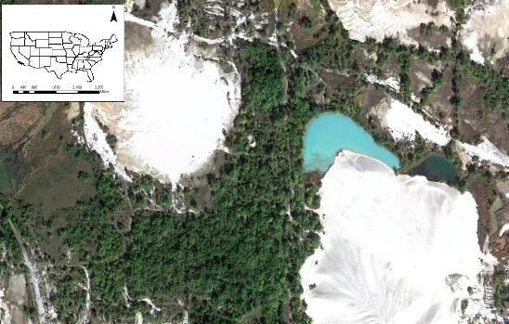
EOS – MINING WATER BODIES
Tailings Pond - True Color Image 09/27/2011 – Landsat
Collapse Feature - True Color Image 06/15/2009 – Quickbird
Notes:
An energy source, in this case the sun emits energy. That incident energy hits a target (paved roads, bare soil, water, grass, a forest or a built-up area) and the reflected energy from each target gets sense and recorded by a sensor onboard a satellite.

Slide 9
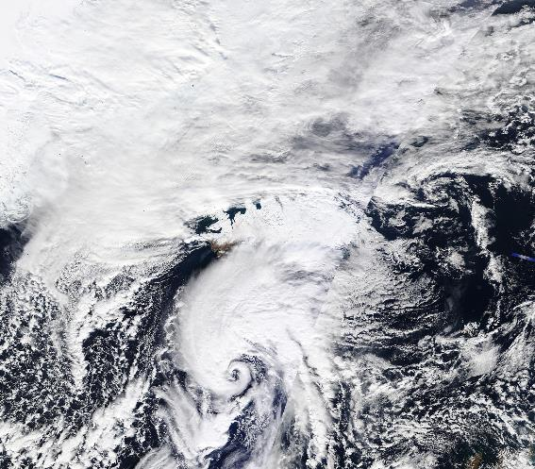
EOS SATELLITE LIMITATIONS
Data lost due to cloud coverage
Only optical variables:
Chl-a
Turbidity
SDD
TSS
Notes:
An energy source, in this case the sun emits energy. That incident energy hits a target (paved roads, bare soil, water, grass, a forest or a built-up area) and the reflected energy from each target gets sense and recorded by a sensor onboard a satellite.

Slide 10
HYPOTHESIS AND OBJECTIVES
Notes:
An energy source, in this case the sun emits energy. That incident energy hits a target (paved roads, bare soil, water, grass, a forest or a built-up area) and the reflected energy from each target gets sense and recorded by a sensor onboard a satellite.

Slide 11
HYPOTHESIS
A combination of bands from images captured by a multispectral sensor attached to an sUAS can predict optical (TSS, Chl-a, SDD) and non-optical (TP, TN) water quality parameters in reservoirs with different trophic states
By having the ability to capture free cloud images at a finer spatial resolution, sUAS models that predict optical and non-optical water quality parameters have the ability to generate more accurate data, than the models that rely on satellite data
Notes:
An energy source, in this case the sun emits energy. That incident energy hits a target (paved roads, bare soil, water, grass, a forest or a built-up area) and the reflected energy from each target gets sense and recorded by a sensor onboard a satellite.

Slide 12
OBJECTIVES
To develop statistical models capable of predicting optical (TSS, Chl-a, SDD) and non-optical (TP, TN) water quality parameters in reservoirs with different trophic states
To statistically compare and evaluate the accuracy of the data generated by water quality models that rely on satellite imagery and sUAS imagery
Notes:
An energy source, in this case the sun emits energy. That incident energy hits a target (paved roads, bare soil, water, grass, a forest or a built-up area) and the reflected energy from each target gets sense and recorded by a sensor onboard a satellite.

Slide 13
METHODOLOGY
Notes:
An energy source, in this case the sun emits energy. That incident energy hits a target (paved roads, bare soil, water, grass, a forest or a built-up area) and the reflected energy from each target gets sense and recorded by a sensor onboard a satellite.

Slide 14
METHODOLOGY
Phase 1
Phase 2
Phase 3

Slide 15
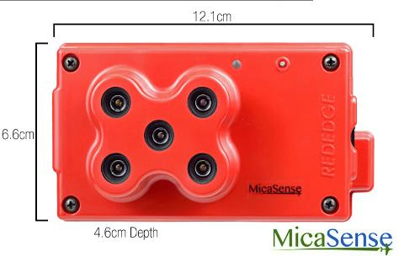
DATA COLLECTION AND ANALYSIS
MULTISPECTRAL DATA COLLECTION
LABORATORY ANALYSIS
Analyte | Method
Chlorophyll α | EPA 445.0
Total Phosphorus | EPA 365.3
Total Nitrogen | Multi N/C 2100S
Nitrate-Nitrogen | EPA 352.1
Ammonia-nitrogen | HACH 10031
Total Suspended Solids | EPA 160.2
Secchi Disk | -
Notes:
An energy source, in this case the sun emits energy. That incident energy hits a target (paved roads, bare soil, water, grass, a forest or a built-up area) and the reflected energy from each target gets sense and recorded by a sensor onboard a satellite.

Slide 16
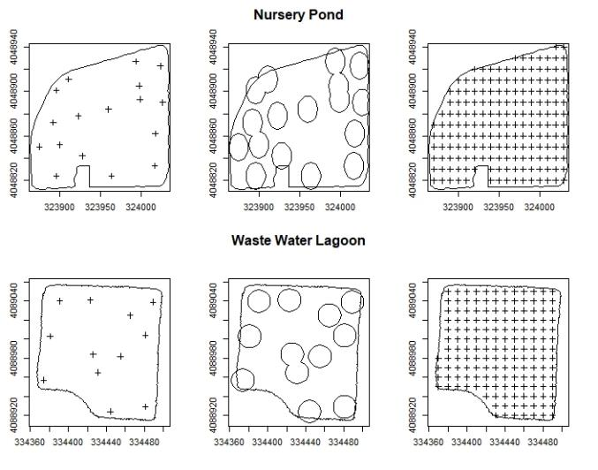
SCENARIO EVALUATION

Slide 17
MODEL DEVELOPMENT
Model Development (50% Data)
Regression analyses
Water quality parameter (dependent variable)
Refraction data from multispectral image (independent variable)
Best Fit Determination
Coefficient of determination (R²)
Akaike Information Criterion (AIC)
Model Validation (50% Data)
Statistically comparison between in-situ water quality parameter measurements and predicted measurements

Slide 18
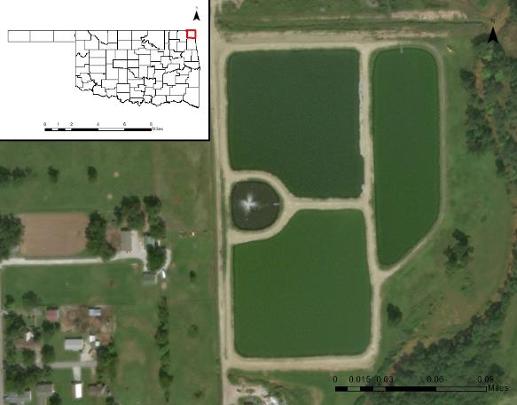
STUDY AREA
Notes:
Oligotrophic = Nursery Ponds
Eutrophic = WWL

Slide 19
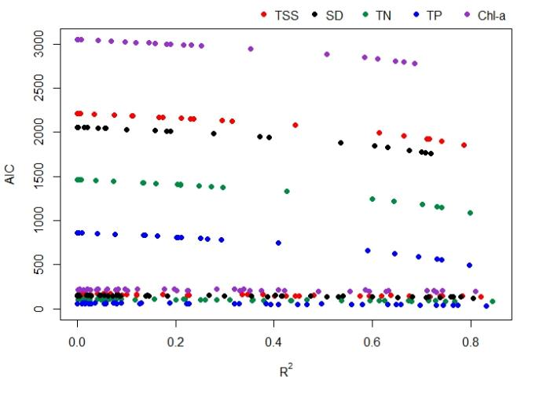
RESULTS
Notes:
An energy source, in this case the sun emits energy. That incident energy hits a target (paved roads, bare soil, water, grass, a forest or a built-up area) and the reflected energy from each target gets sense and recorded by a sensor onboard a satellite.

Slide 20
SINGLE VARIABLE RESULTS
Total of 315 (single variable) linear models
Point Extraction = 105
Buffer Extraction =105
Kriging Extraction = 105
$$Y_{i}=β_{1}x+β$$
Notes:
Oligotrophic = Nursery Ponds
Eutrophic = WWL

Slide 21
MODEL DEVELOPMENT
Model Development (50% Data)
Regression analyses
Water quality parameter (dependent variable)
Refraction data from multispectral image (independent variable)
Best Fit Determination
Coefficient of determination (R²)
Akaike Information Criterion (AIC)
Model Validation (50% Data)
Statistically comparison between in-situ water quality parameter measurements and predicted measurements

Slide 22
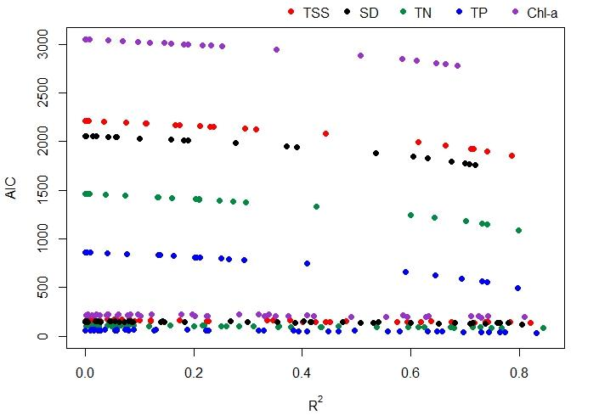
LINEAR MODELS - EVALUATION
Notes:
An energy source, in this case the sun emits energy. That incident energy hits a target (paved roads, bare soil, water, grass, a forest or a built-up area) and the reflected energy from each target gets sense and recorded by a sensor onboard a satellite.

Slide 23
POINT EXTRACTION RESULTS
TSS = 37.317*(Green/Red) - 47.273 (R²= 0.821 p= 5.87e-7)R²R
²
SD = -786.440*(Green) + 72.929 (R²= 0.780 p= 2.56e-6)
Chl-a = 202.84*(Green/Red) - 262.58 (R²= 0.810 p= 8.52e-7)
TN = 7.0435*(Green/Red) - 8.5676 (R²= 0.844 p= 1.885e-7)
TP = 1.8392 *(Green/Red) - 2.4117 (R²= 0.831 p= 3.46e-7)
Notes:
An energy source, in this case the sun emits energy. That incident energy hits a target (paved roads, bare soil, water, grass, a forest or a built-up area) and the reflected energy from each target gets sense and recorded by a sensor onboard a satellite.

Slide 24
BUFFER EXTRACTION RESULTS
TSS = 37.361*(Green/Red) - 51.626 (R²= 0.759 p= 1.09e-5)R²R
²
SD = -875.989*(Green) + 77.687 (R²=0.605 p= 2.469 e-6)
Chl-a = 199.75*(Green/Red) - 280.56 (R²= 0.730 p= 2.47e-7)
TN = 6.991*(Green/Red) - 9.273 (R²= 0.768 p= 8.39e-6)
TP = 1.8464*(Green/Red) - 2.6307 (R²= 0.764 p= 9.56e-6)
Notes:
An energy source, in this case the sun emits energy. That incident energy hits a target (paved roads, bare soil, water, grass, a forest or a built-up area) and the reflected energy from each target gets sense and recorded by a sensor onboard a satellite.

Slide 25
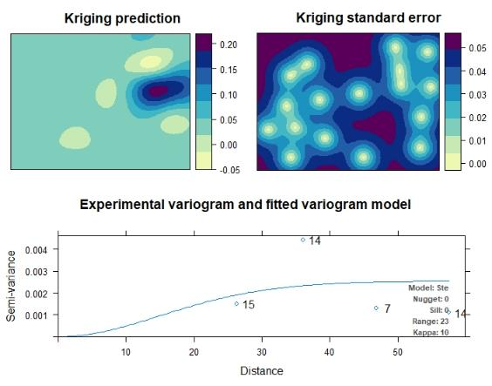
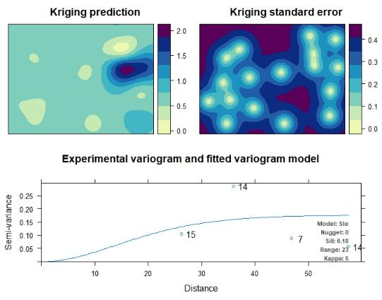
ORDINARY KRIGING – NURSERY POND -A
TP
TN
Notes:
An energy source, in this case the sun emits energy. That incident energy hits a target (paved roads, bare soil, water, grass, a forest or a built-up area) and the reflected energy from each target gets sense and recorded by a sensor onboard a satellite.

Slide 26
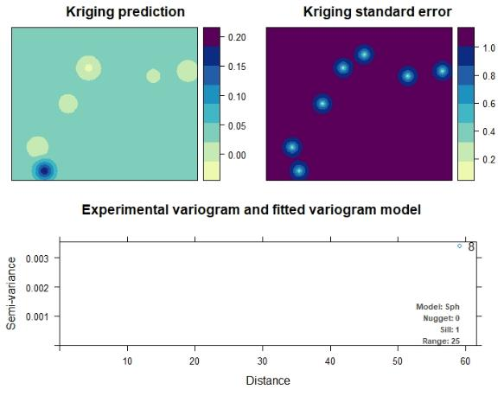
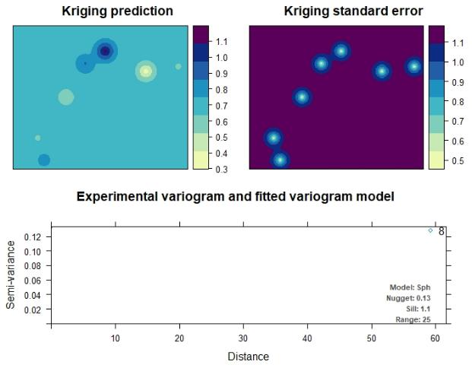
ORDINARY KRIGING – NURSERY POND - B
TP
TN
Notes:
An energy source, in this case the sun emits energy. That incident energy hits a target (paved roads, bare soil, water, grass, a forest or a built-up area) and the reflected energy from each target gets sense and recorded by a sensor onboard a satellite.

Slide 27
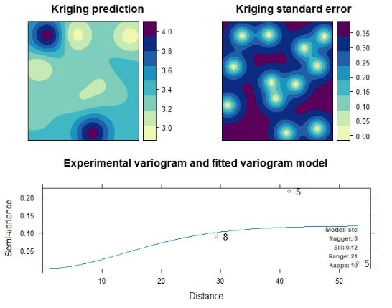
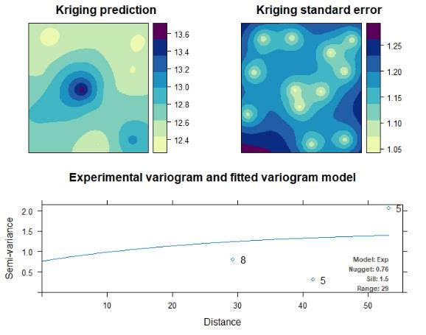
ORDINARY KRIGING – WASTEWATER LAGOON
TP
TN
Notes:
An energy source, in this case the sun emits energy. That incident energy hits a target (paved roads, bare soil, water, grass, a forest or a built-up area) and the reflected energy from each target gets sense and recorded by a sensor onboard a satellite.

Slide 28
KRIGING EXTRACTION RESULTS
TSS = 31.694*(Green/Red) - 35.248 (R²= 0.787 p= 1.19e-78)R²R
²
SD = -875.989*(Green) + 77.687 (R²=0.699 p= 7.75e-58)
Chl-a = 199.75*(Green/Red) - 280.56 (R²= 0.687 p= 1.34e-59)
TN = 6.2312*(Green/Red) - 6.8654 (R²= 0.799 p= 6.39e-82)
TP = 1.71343*(Green/Red) - 2.04546 (R²= 0.798 p= 1.71e-81)
Notes:
An energy source, in this case the sun emits energy. That incident energy hits a target (paved roads, bare soil, water, grass, a forest or a built-up area) and the reflected energy from each target gets sense and recorded by a sensor onboard a satellite.

Slide 29
MODEL DEVELOPMENT
Model Development (50% Data)
Regression analyses
Water quality parameter (dependent variable)
Refraction data from multispectral image (independent variable)
Best Fit Determination
Coefficient of determination (R²)
Akaike Information Criterion (AIC)
Model Validation (50% Data)
Statistically comparison between in-situ water quality parameter measurements and predicted measurements

Slide 30
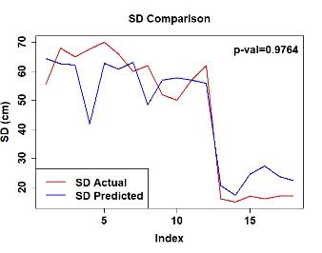
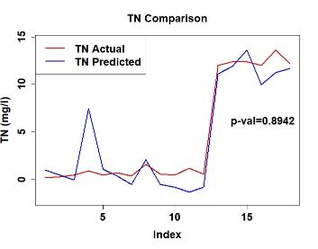
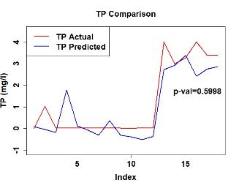
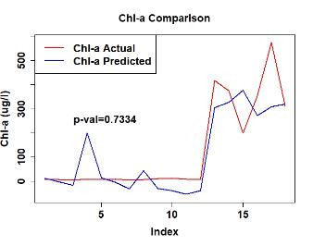
POINT EXTRACTION VALIDATION

Slide 31
MULTIPLE VARIABLE RESULTS
Total of 15 (multiple variable) linear models
Point Extraction
Model Evaluation
Analysis of Variance (ANOVA)
$$Y_{1}=β+β_{1}x_{1}+β_{2}x_{2}+β_{3}x_{3}+…+β_{n}x_{n}$$
Notes:
Oligotrophic = Nursery Ponds
Eutrophic = WWL

Slide 32
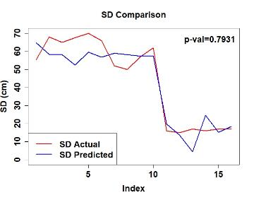
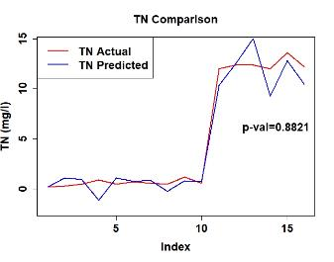
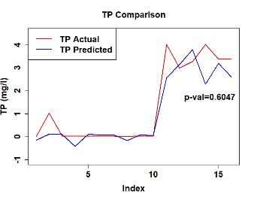
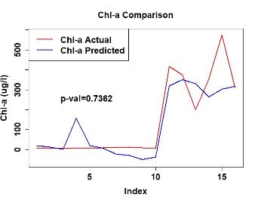
MULTIPLE VARIABLE VALIDATION

Slide 33
SINGLE VS. MULTIPLE VARIABLE
Parameter | Single Variable Model | R² | Multi Variable Model | R²
SD | lm(formula = SD.sub$SD ~ SD.sub$PointGreen) | 0.7809 | lm(formula = SD.Mod.Data$SD ~ SD.Mod.Data$B.R + SD.Mod.Data$G.R + SD.Mod.Data$G.B) | 0.8883
TSS | lm(formula = TSS.sub$TSS ~ TSS.sub$G.R) | 0.8211 | lm(formula = TSS.Mod.Data$TSS ~ TSS.Mod.Data$B.R + TSS.Mod.Data$G.B + TSS.Mod.Data$G.R) | 0.9869
TN | lm(formula = TN.sub$TN ~ TN.sub$G.R) | 0.8446 | lm(formula = TN.Mod.Data$TN ~ TN.Mod.Data$B.R + TN.Mod.Data$G.B + TN.Mod.Data$G.R) | 0.9793
TP | lm(formula = TP.sub$TP ~ TP.sub$G.R) | 0.8316 | lm(formula = TP.Mod.Data$TP ~ TP.Mod.Data$B.R + TP.Mod.Data$G.B + TP.Mod.Data$G.R) | 0.9835
Chl-a | lm(formula = Chloro.a.sub$Chloro.a ~ Chloro.a.sub$G.R) | 0.8104 | lm(formula = CHL.A.Mod.Data$Chloro.a ~ CHL.A.Mod.Data$PointGreen + CHL.A.Mod.Data$PointRed) | 0.846

Slide 34
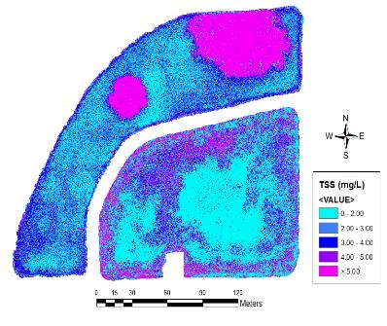
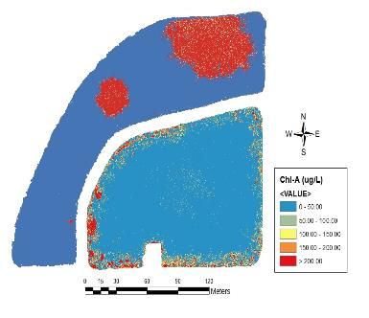
NURSERY POND – WATER QUALITY OPTICAL PARAMETERS
Secchi Disk
Total Suspended Solids
Chlorophyll – A

Slide 35
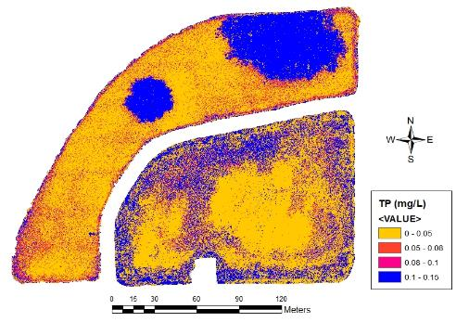
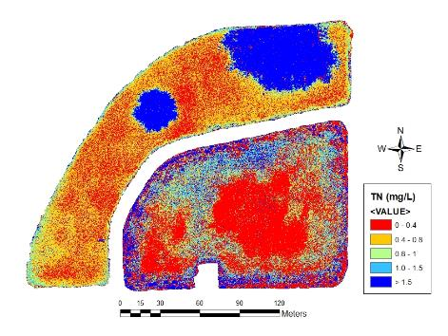
NURSERY POND – WATER QUALITY NON- OPTICAL PARAMETERS
Total Phosphorus
Total Nitrogen

Slide 36
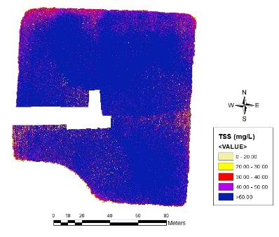
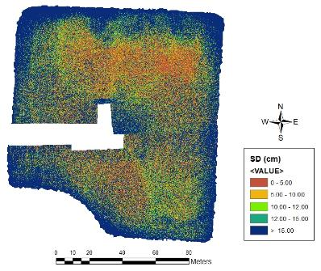
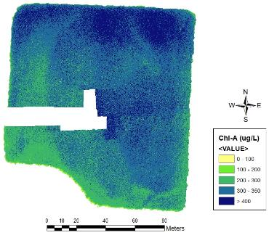
WASTEWATER LAGOONS – WATER QUALITY OPTICAL PARAMETERS
Total Suspended Solids
Secchi Disk
Chlorophyll – A

Slide 37
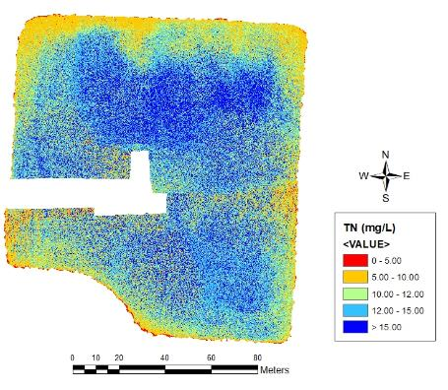
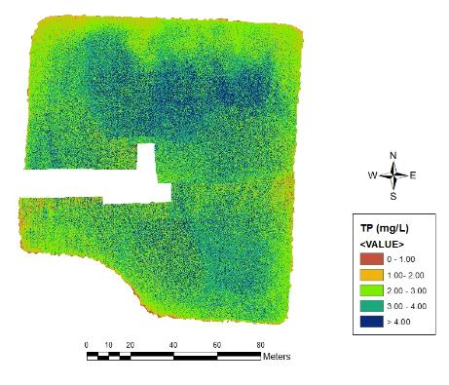
WASTEWATER LAGOONS – WATER QUALITY NON- OPTICAL PARAMETERS
Total Nitrogen
Total Phosphorus

Slide 38
FINAL CONCLUSIONS
Optical and non-optical water quality parameters can be predicted using sUAS
Statistical interpolation (ordinary kriging) does not improve the relationship between the different water quality parameters and the reflectance values. More doesn’t mean better!
Single linear models have the capability to predict different water quality parameters; however, multiple linear models can explain these relationships in a better way (higher R²)

Slide 39
ACKNOWLEDGMENTS
City of Commerce, OK
Brandon Holzbauer Schweitzer (CREW)
Maggie Tang (CREW)

Slide 40
THANK YOU QUESTIONS?
In memory of Gonzalo E. Arango
Gracias papá! Te extraño

