Slide 1
Golden Sunlight’s Outside Ore Program
“Cleaning Up Montana One Dump At A Time”
Steve Lloyd

Slide 2
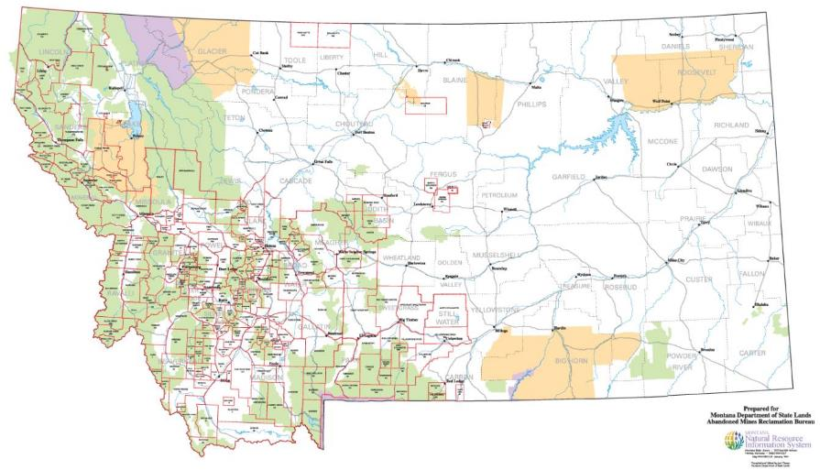
Historic Mining
Mining was one of the first well developed industries in Montana
In some cases, early methods left gold behind that are now economically recoverable
Benefits are both environmental and economical
Put general map and brief description here

Slide 3
Implementing GSM Outside Ore Program
Former Mine Manager Tim Dimock initiated the program in 2007. Program execution occurred from 2007-2009 and terminated during GSM’s mill shutdown
However, in May 2011 Mr. Dimock and John Childs / Childs Geoscience Inc. relaunched the program
Expansion of the program has continued successfully throughout present day

Slide 4
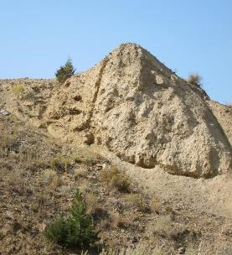
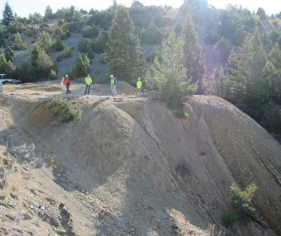
Mine Dumps & Tailings
Vary in size and shape
Grades vary between and within dumps
Typically Located downslope of portals/shafts, some occurring in drainages
Access to dump sites can be difficult and restricted by topography

Slide 5
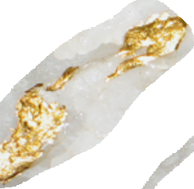
Conceptual Dump Genesis
Heterogeneous nature of dumped material, variable placement and grade in the dump

Slide 6
Benefits of Processing Mine Dumps Economic & Environmental
Removal of historic waste from landscape
Waste deposited in modern tailings facility
Land reclaimed to nearly pre-mining state
Positive economic impact
Employment of multiple mine industry positions, i.e. local contractors, geologists, etc.
Local influx of revenue via jobs, expenditures and taxes
Sites are targeted as abandoned mine clean up projects
saves taxpayer money by privately clearing the sites of dumps and tailings

Slide 7
Mining a Dump – General Process
Exploration
Permitting
Production
Reclamation
Recon
Land & Mineral Status
Agreements
Phased Sampling
Assay & Lab Tests
Preliminary Economics
DEQ
BLM
SHPO
Bonding
Contractor Bids
MSHA Compliance
Final Economics
Purchase Agreements
Screen, Crush, Haul
Re-contour
Topsoil Cover
Mulch Debris
Seed

Slide 8
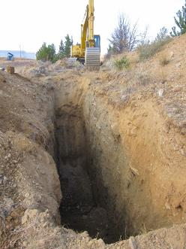
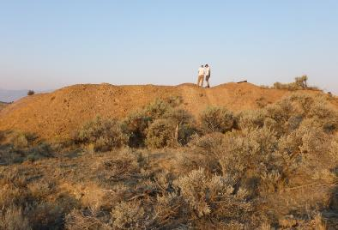
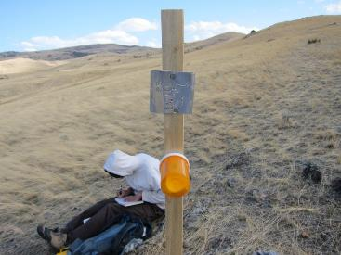
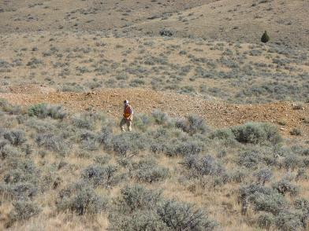
Exploration
Phase I – preliminary research, mapping of targets, tonnage/volume estimates, access agreements, field grab samples and lab assays
Phase II – Data reconciliation, refining targets, trench sampling and lab assays

Slide 9
Data Analysis and Reconciliation
Detailed analysis of collected data is undertaken following exploration results
Bottle Rolls and multi-element analysis conducted at accredited laboratories
GSM replicates the tests before accepting an ore purchase agreement
Multi-element analysis results are given to DEQ for approval of the material being shipped

Slide 10
Permitting
Various phases of permitting
SMES or exploration permit
Land owner agreements
Agencies involved varies by claim type
Patented, Unpatented Claims
Land surface & mineral owners
DEQ, BLM, USFS, SHPO

Slide 11
Production
Fractions of the dump include oversized coarse, coarse to crush and fine material
Construct necessary temporary roads
Remove debris from dump
Crush/screen material then stockpile to ship
Conduct check assays
Ship to Golden Sunlight

Slide 12
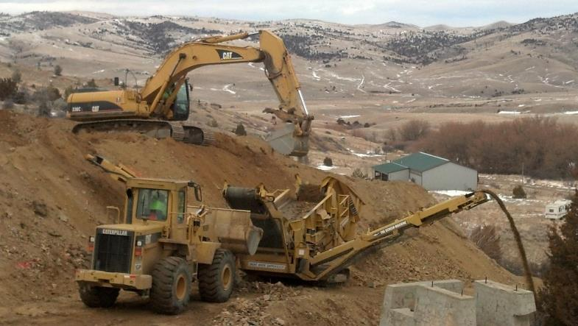
Production
Processing and screening at Boaz

Slide 13
Production
Load out at Iron Age

Slide 14
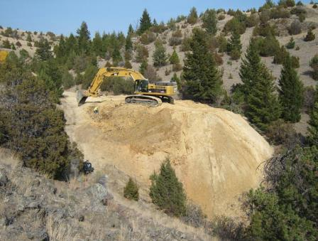
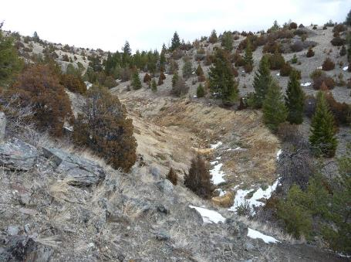
Reclamation
Reclamation improves the landscape by removing historic legacy material, some of which have potential for ARD
Mitigates safety hazards on historic sites

Slide 15
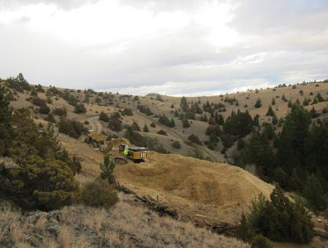
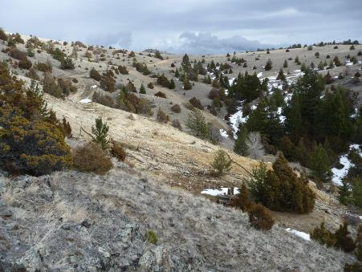
Reclamation
Hard Cash mining area before and after
Project on BLM ground that saved tax dollars slated for mine legacy material clean up

Slide 16
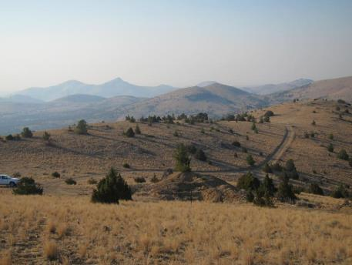
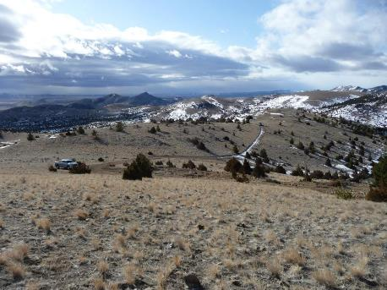
Reclamation
Dump in photo was completely removed and topography re-contoured and seeded

Slide 17
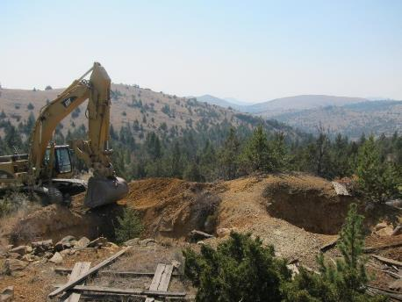
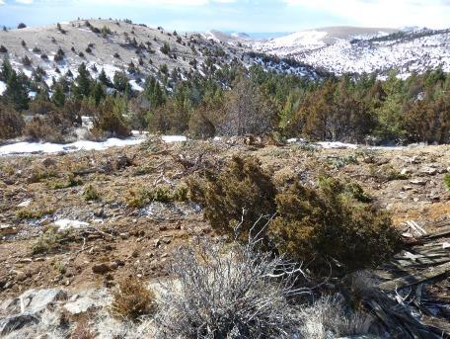
Reclamation
Debris is cleared off the site, disturbed vegetation is shredded and used as mulch then spread back into the landscape

Slide 18
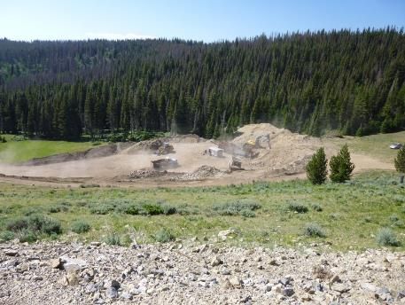
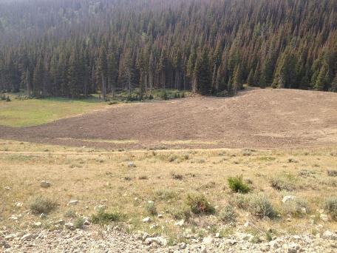
Reclamation
Caretaker- nice job!

Slide 19
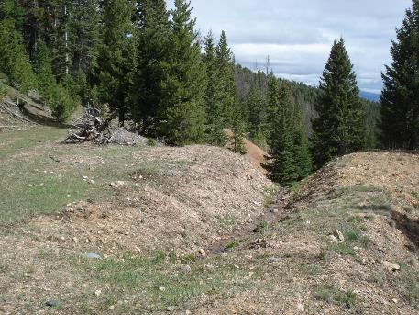
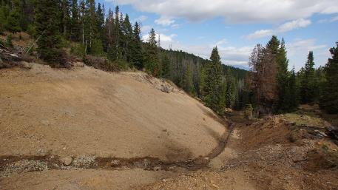
Reclamation
High Up -Whoa!

Slide 20
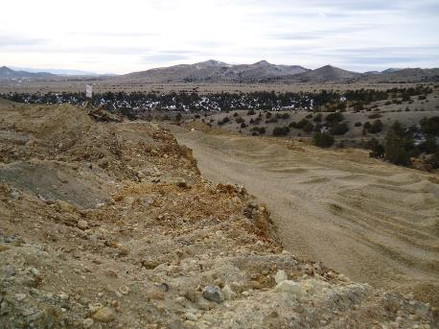
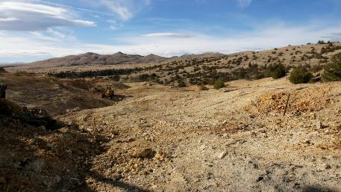
Reclamation
Keating- what a change

Slide 21
Interest In Accepting Outside Ore
Reclamation of legacy dumps and tailings
Reclamation of landscape
Overall benefit to the region and Montana
Builds a positive relationship and helps to support Montana communities

Slide 22
Barrick’s Requirements for Ore Purchase
From the supplier:
Barrick’s testing:
Proof of ownership
Verification that it is not open pit ore
Assay, recovery, and a multi-element analysis of a representative sample
The representative sample is assayed to verify grade
A bottle roll that mimics our mill process is performed
A 600 gram sample is sent out for ICP analysis

Slide 23
Barricks Constituents of Concern
Due to Barrick’s safety concerns with transporting material with higher constituent values, GSM will only accept elements up to maximum levels

Slide 24
Customer Evaluation Matrix
Safety | Does the operator have a worker safety plan?
 | Does the site have the potential to impact residents?
Environmental | Does the site have the potential to impact surface water?
 | Does the site have the potential to impact air quality?
 | Reclamation
 | Project duration
 | Legacy material
Community | Employment Opportunity
 | County
 | Publically funded clean up
 | Community Impact
Production | Grade
 | Recovery
 | Hazardous constituents
GSM evaluates each customer’s ore site for these criteria
The sites are then scored and prioritized based on this criteria

Slide 25
Chain of Events
Once the ore is approved, contracts are signed and material must be crushed small enough to pass through a two inch screen
Hauling then commences and the material is deposited on GSM’s toll ore pad for holding until it can be processed
The material must be free of organics and metal debris

Slide 26
Receiving Trucks
At GSM
Receiving Trucks:
A trucks gross weight is recorded when the trucks arrive on site loaded with toll ore materials
The tare (empty) weight of the truck is subtracted from the gross weight to calculate the total net ore received for that truck

Slide 27
Example of an End-dump truck delivering Ore.
At GSM
Busy morning on the Ore Pad- 2017.

Slide 28
Ore Sampling
At GSM
With the shovel, the outer material is scraped away before taking a sample
A total of six or more scoops make up the sample
This is completed on each side of the pile
A 20-30 pound sample is taken by using small scoops from high, middle, and low points of the ore pile

Slide 29
At GSM
Example of an empty haul truck, recording the Tare weight of the truck as they leave the site

Slide 30
Truck Sample Processing
Samples are crushed and pulverized to 75% passing a 200 mesh screen and placed into sample cups to be “fired”
These samples are then weighed at 1 assay ton (29.17g) in triplicate and are individually fluxed and “fired” in a 2000 degree oven, to melt the silica and metals

Slide 31
Truck Sample Processing
After an hour in the furnace, the samples are poured (shown on the right); producing a lead button and slag
The slag and the lead button are poured into molds and the slag is knocked off, and the lead buttons are cupelled

Slide 32
Truck Sample Processing
The cupellation process yields a ~1 mg Pd/Au/Ag bead that is digested in aqua regia and diluted to read on the AA (Atomic Absorption) Spectrometer
These samples are then read on the AA and the average of each truck sample is reported to the customers, along with tonnage, oz contained, and % moisture of each truck received

Slide 33
End of Month Testing
All of the months truck samples are compiled into a composite (weighted average) for bottle roll testing
The bottle rolls are a 48 hour leach with a CN solution that mimics the Golden Sunlight Mine mill process that provides the recovery % for that material.

Slide 34
End Of Month Testing
The solutions and the solids are tested for gold and silver content to calculate the recovery of the ore
This % recovery will determine the recovered ounces that defines the customers pay for the month

Slide 35
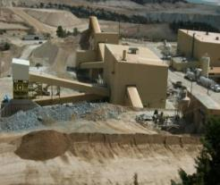
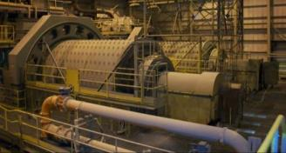
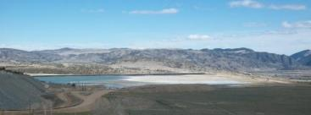
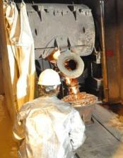
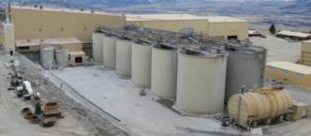
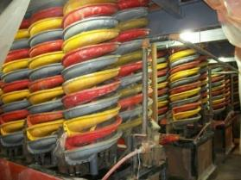
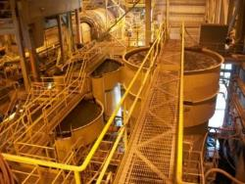
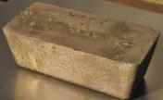
Processing
INTERNATIONAL CYANIDE MANAGEMENT INSTITUTE
1.Crush
8.Tails
2.Grind
7.CN
Destruct
3.Leach
6.Strip &
Refine
5.Carbon
Absorption
4.Gravity
Circuit

Slide 36
Mill Operation
7600 tons/day capacity
Three stages of crushing
Rod mill – ball mill - cyanide and lime added to slurry
Vat leach (44-hour retention time)
Cycloned (wash circuit)
Sands (cyclone underflow) to sand tailing retreat (STR)
Spirals to separate pyrite
Regrind pyrite and leach
Slimes (cyclone overflow) to thickener
Thickener overflow to carbon columns
Thickener underflow to carbon in pulp (CIP)
Gold stripped from carbon in pressure vessels
Steel wool cathode electrowinning
Refinery - Doré – 70% gold; 10% silver
Mill tailings - Inco cyanide destruction

Slide 37
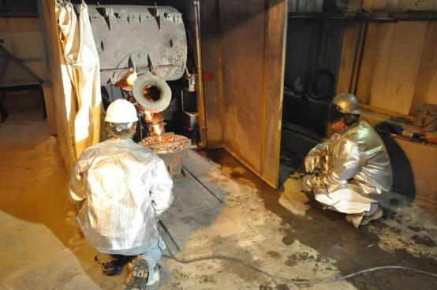
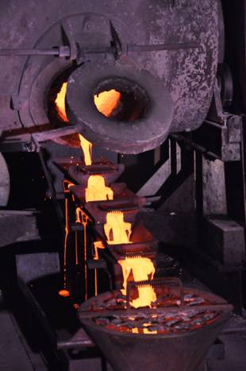
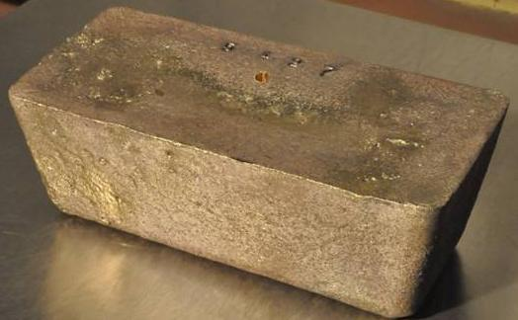
Refining

Slide 38
Toll Ore Program Totals 2011-Present
Golden Sunlight ‘s outside ore program runs from May to October every year with typically four to five suppliers delivering four days per week
The Toll Ore Program has paid out a total of $45 million in the past six years that has gone back into the community
This program has also removed 690,000 tons of legacy material from existing dump sites and relocated this material into GSM’s modern tailings facility

Slide 39
Summary
Identification of historic mine dumps
Land use agreements, sampling, assay & lab work
Process and ship to Golden Sunlight Mine
Safe operations that leave a reclaimed landscape for safer use
Positive environmental and economic impact for Montanan communities

