Slide 1
Reclamation of the McLaren Tailings
The Rest of the Story
Presented to:
2019 ASMR National Meeting of the American Society of Mining and Reclamation
Presented:
June 3-6, 2019 Big Sky, Montana
Presented by:
Pioneer Technical Services, Inc.

Slide 2
Presentation Outline
Project Settings
History
Challenges
Construction
Post Reclamation

Slide 3
McLaren – Cooke City Montana
McLaren Tailings Site

Slide 4
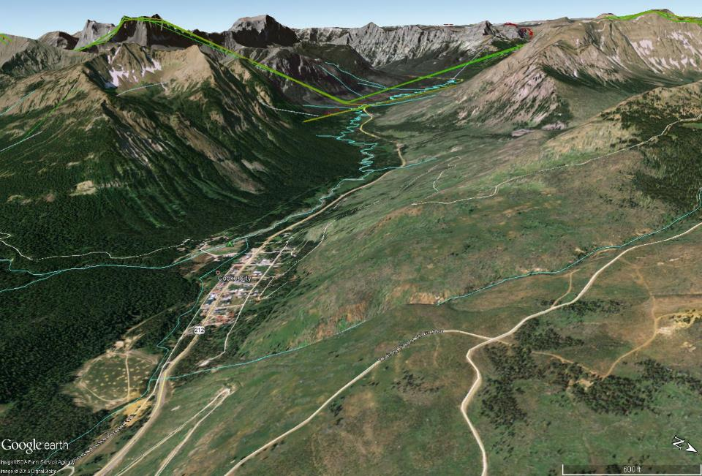
Project Setting
Yellowstone National Park
Cooke City
McLaren Tailings
Notes:
4

Slide 5
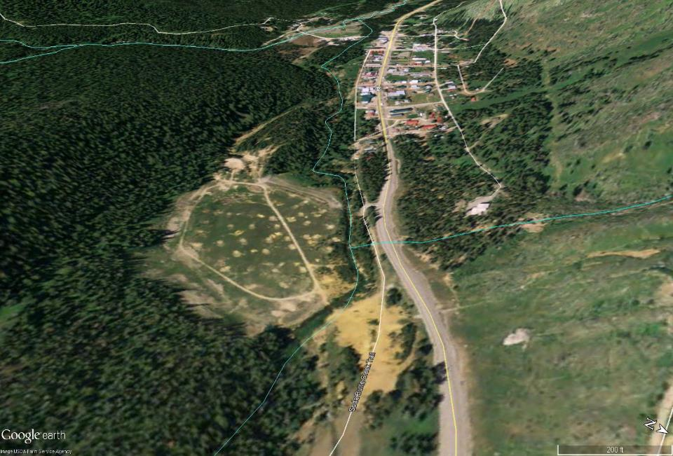
McLaren Mill and Tailings
Soda Butte Creek
McLaren Tailings
Miller Creek
McLaren Mill Site
Notes:
5

Slide 6
Approximate Pre-Mining Creek Locations
Pre-mining Miller Creek
(approximate)
Pre-mining Soda Butte Creek (approximate)
Notes:
6

Slide 7
HISTORY
New World Mining District
Near Cooke City and Northwest Entrance to Yellowstone National Park
Site of Crown Butte $65M Buyout in 1997 and USFS $30M Cleanup
McLaren Mill
Processed Gold and Copper ore from 1933 – 1953
Produces 60,000 troy oz of gold, 2,000 short tons of copper
Tailings Impoundment grew over Soda Butte Creek and Miller Creek
1950 tailings release mapped to the Lamar River
Notes:
Walter McLaren invented the ice cream cone

Slide 8
WHY

Slide 9
Seep from Toe of Dam

Slide 10
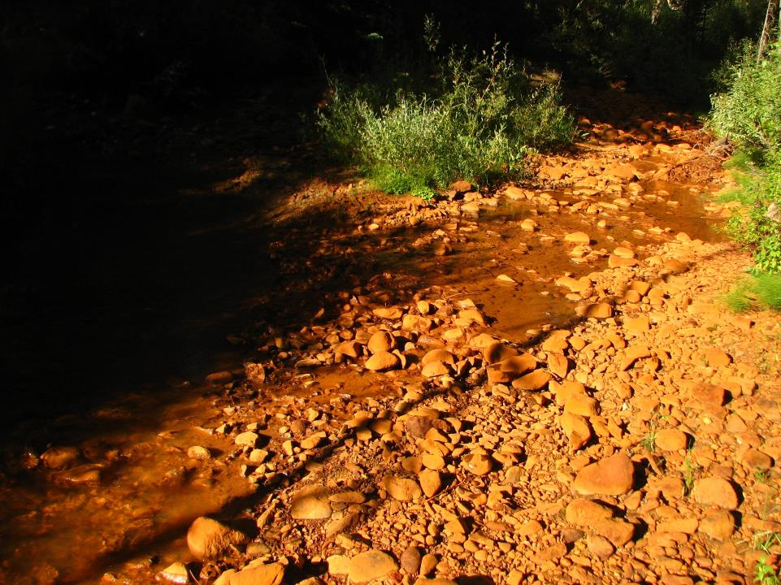
Soda Butte Creek Below Tailings
No Color Enhancement
Tailings Discharges (USGS):
Fe 418 mg/L
Al 122 mg/L
Cu 6 mg/L
Pb 0.6 mg/L
Cd 0.06 mg/L
Approximate Annual Loads:
40,000 lb Fe
12,000 lb Al
590 lb Cu
58 lb Pb
6 lb Cd
Notes:
10

Slide 11
Soda Butte Creek Below Tailings No Color Enhancement

Slide 12
McLaren Reclamation Challenges
Dewater the tailings by pumping the underlying aquifer
Intercept clean water
Treat contaminated water to DEQ water quality standards

Slide 13
McLaren Reclamation Challenges
Saturated tailings up to 50% moisture
Stabilize tailings using quick Lime (3 to 5%)
Reduce metal mobility

Slide 14
Sometimes Just Getting There

Slide 15
GROUNDWATER
Groundwater fluctuation 12-15 feet
To effectively dewater the site would require 17 wells
Pumping up to 500 gallons per minute
Groundwater from 8 of the wells would require treatment (primarily pH, Cu, Fe, Mg and Al)

Slide 16
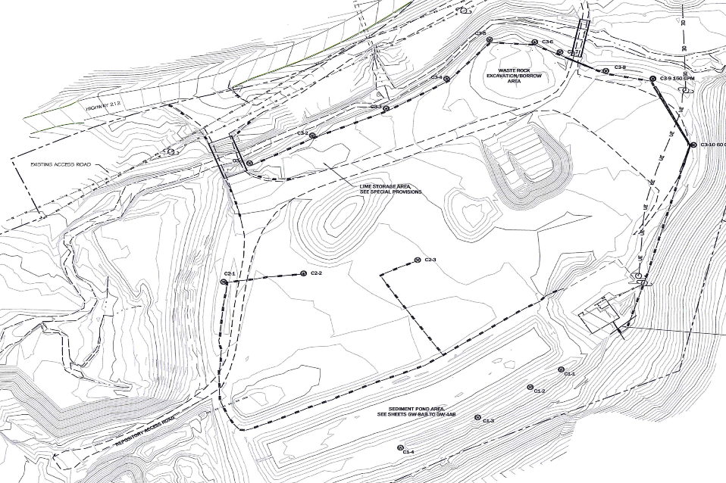
Final Pumping Well Design Locations
Capture of Clean Groundwater Using Perimeter Wells
Capture of Impacted Groundwater Using Interior Wells

Slide 17
Start of Construction 2010
Knife River – Yellowstone Division, Billings, Montana. Mobilized to the Site June 2, 2010
Install BMPs
Install west and east bridges
Construct Water Treatment Building (WTB)
Clear, Grub and partial excavation of repository area
Stabilization of 10,990 cubic yards of tailings
Notes:
Out of 50 contractors at pre-bid 10/28/2009 only 3 bid on project KR, Ofteldal and Shumaker

Slide 18
Construction 2010

Slide 19
Construction 2010

Slide 20
Construction 2011
KR started summer construction June 13, 2011
Completed WTB (electrical, plumbing, wiring of wells)
Complete excavation of Repository 24,000 cy
Salvaged 13,000 cy of cover soil
DEWATER, DEWATER, and DEWATER
Stabilized and placed 55,900 cy of tailings
Constructed sediment detention pond

Slide 21
Construction 2011

Slide 22
Construction 2011

Slide 23
Construction 2011
Cu and Fe > 1000x DEQ-7
Pb > 100x DEQ-7
Cd, Ag, As, Zn > 10x DEQ-7
1-5 million gallons water
30 feet of tailings

Slide 24
Construction 2011

Slide 25
Construction 2011

Slide 26
RCTS

Slide 27
Construction 2011
Summer construction shut down October 20, 2011

Slide 28
Construction 2012
Summer Construction started on May 17, 2012
Stabilized 169,000 cy tailings
Excavated, stockpiled 46,700 cy cover soils
Installed 25,475 sq yd of temporary liner over compacted tailings in the repository
Used 8,930 tons of quick lime
Used 5 drums of anionic flocculant

Slide 29
Construction 2012

Slide 30
Construction 2012

Slide 31
Construction 2012

Slide 32
Construction 2012

Slide 33
Construction 2012

Slide 34
Construction 2012

Slide 35
Construction 2012

Slide 36
Construction 2012

Slide 37
Construction 2013 Highlights
Stabilized 29,100 cy of tailings
Excavated and stockpiled 12,000 cy of cover soil
Removed 17 pumping wells
Removed the WTB
Constructed 1,315 feet of Soda Butte Creek
Constructed 465 feet of Miller Creek
Installed 25,595 sq yds of geocushion and HDPE liner at repository

Slide 38
Construction 2013

Slide 39
Construction 2013

Slide 40
Construction 2013

Slide 41
Construction 2013

Slide 42
Construction 2013
Notes:
Turned Soda Butte Creek into new on August 30th

Slide 43
Construction 2013
Notes:
Geocushion and 60 mil HDPE

Slide 44
Construction 2013
October 2nd

Slide 45
Construction 2013
October 3rd ~8” of snow

Slide 46
Construction 2013
October 13th

Slide 47
Construction 2014 Highlights
Started June 5
Mixed 4,360 dry tons of compost with cover soil for a target of 3% organic matter (volume basis)
Backfilled 35,400 cy of amended cover soil
Installed 23800 sq yds of geonet on repository
Placed 28,200 cy of amended soil on repository
Constructed 2,000 feet of runoff/run-on channels
Fertilized and seeded 26 acres
Planted 820 tubelings (Douglas fir, Aspen and Thimbleberry)

Slide 48
Construction 2014

Slide 49
UPLAND SEED MIX
Species | Common Name | Lbs PLS/acre
Upland Grasses
Elymus lanceolatus | Streambank Wheatgrass | 5.0
Pseudoroegneria spicata (ssp) | Bluebunch Wheatgrass | 5.0
Poa alpinum | Alpine Bluegrass | 7.0
Bromus marginatus | Mountain Brome | 7.0
Phleum alpinum | Alpine Timothy | 7.0
Festuca ovine | Sheep Fescue | 5.0
Forbs |  | 36.0
Aquilegia flavescens | Yellow Columbine | 0.5
Linum lewisii | Lewis Blue Flax | 0.5
Non-Native Annuals |  | 1.0
Regreen | Sterile wheat | 15
 |  | 52.0 PLS/ac

Slide 50
RIPARIAN SEED MIX
Species | Common Name | Lbs PLS/acre
Grasses
Dechampsia caespitosa | Tufted Hairgrass | 6.0
Phleum alpinum | Alpine Timothy | 6.0
Calamagrostis canadensis | Bluejoint Reedgrass | 5.0
Poa alpina | Alpine Bluegrass | 5.0
Grass-like |  | 22.0
Carex nebrascensis | Nebraska Sedge | 1.0
Juncus articus (ssp) littoralis | Baltic Rush | 1.0
Forbs |  | 2.0
Erigeron speciosus | Aspen Daisy | 3.0
 |  | 25.0 PLS

Slide 51
Construction 2014

Slide 52
Construction 2014
Summer Erosion Control

Slide 53
Construction 2014

Slide 54
Construction 2014

Slide 55
Construction 2014

Slide 56
Construction 2014
September 18th

Slide 57
Construction 2014
September 19th

Slide 58
Final Project Quantities
Repository contains 245,000 cubic yards of compacted lime stabilized tailings and waste rock
13,512 tons of quick lime used for tailings stabilization
4,840 dry tons of compost
Soda Butte and Miller Creek - 1,797 feet
Constructed 4,000 feet of storm water channels
Re-Vegetated 26 acres
The McLaren Reclamation project was completed 1 year ahead of schedule and $2.5 million under budget

Slide 59
Soda Butte Creek
2008 2013

Slide 60
June 2015

Slide 61
June 2015

Slide 62
June 2015

Slide 63
July 2015

Slide 64
July 2015

Slide 65
October 2015

Slide 66
2016

Slide 67
2016

Slide 68
2017

Slide 69
2017

Slide 70
STAKE HOLDERS:
Montana Department of Environmental Quality/Mine Waste Cleanup Bureau
John Koerth
Autumn Coleman
Tom Henderson
Cooke City Residents
Beartooth Alliance,
Gallatin National Forest, and
Yellowstone National Park
2014 American Council of Engineering Companies (ACEC) awarded the State and National Engineering Excellence Award in the Environmental category to Montana DEQ and Pioneer.

Slide 71
Costs Funding
COSTS
Total Construction Cost $21,897,248.55
Total Engineering Costs $2,027,851.85
FUNDING
U.S. Department of Interior Office of Surface Mining (OSM) $23,000,000
Department of Natural Resources Conservation $300,000

Slide 72
2015 to Present
September 2015 and 2016 FWP and NPS removed all non-native species from Soda Butte for Cutthroat
Soda Butte Creek 303(d) Listing
Soda Butte Creek Water Quality Study 2015
Montana Institute of Ecosystems, MT DEQ and YNP
Conclusion – Soda Butte Creek below the former tailings site now contributes marginally to total loads
2018 Soda Butte Creek Removed from 303(d) List

Slide 73
Questions

